Slide 1
HIPAA and Cloud Applications
The Basics of Handling PHI for Developers
“HIPAA is probably the most ironic acronym in healthcare. It stands for the Health Insurance Portability and Accountability Act. Although HIPAA has succeeded largely in making health information more “accountable,” it is usually the first excuse for not making it portable.”
Fred Trotter, Hacking Healthcare

Slide 2

Disclaimer
This presentation was inspired by the fact that there are few resources available for cloud developers who want to build a healthcare app that falls under HIPAA.
Which means that I had few resources when putting this presentation together.
Please speak up if I am missing something… the primary goal of this talk is to encourage conversation.
This is NOT legal advice
Notes:
Most of the resources are sitting in this room.

Slide 3
A little about you…
How many developers?
How many cloud developers?
How many people don’t know much about HIPAA and it’s implication on software design?
How many people here want to build healthcare apps in the cloud?

Slide 4
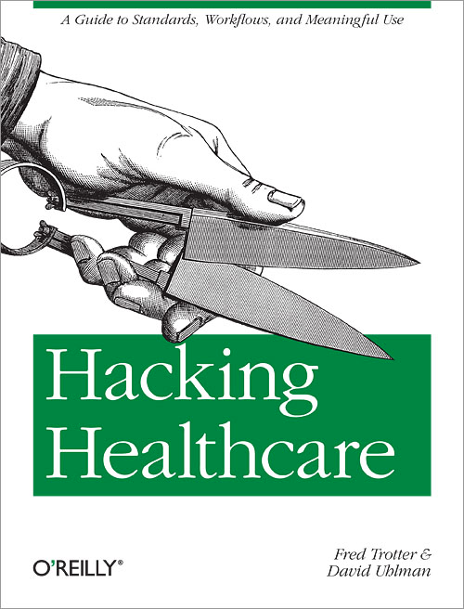
Hacking Healthcare
Lifesaving book
Aimed at internal Health IT or Doctors who want to learn about Health IT
Short on
  materials for app devs
  Cloud specific advice
Notes:
I tried to cite areas where I leaned on Fred’s content, but just in case I want to give a shout out up front to this amazing book

Slide 5
I’m @numbersnelson
Notes:
A little about me…

Slide 6
I’m a Solutions Engineer @ Janrain

Slide 7
I’m really an accounting nerd
Notes:
My dirty little secret is that I’m actually a CPA….
My love of running out crazy figures and spreadsheets is what got me my nickname
I pose sometimes as a software guy, or someone who knows a thing or two about healthcare
Every day I pretend I know how to use this MacBook, but let’s be honest… Macs and Accountants don’t mix.

Slide 8
I’m just trying to build healthcare apps…

Slide 9
… in the cloud.

Slide 10
… in the cloud.
Wait, WHAT?!?

Slide 11
Cloud App + HIPAA == ????
Notes:
When I began work to launch a simple web-based healthcare app, I was shocked to find it difficult to impossible to find guidance on how to meet HIPAA guidelines when providing a SaaS offering from the cloud.
The goal of this session is to share my experiences and what I have learned in the past year in launching a healthcare app in the cloud, and to present a framework that others can use to bring their ideas to life and help change our failing healthcare system.

Slide 12
Here’s what I found:
We need to cut costs while improving the level of service
Cloud technologies can help
The open source movement is making the healthcare industry’s problems more accessible to developers
Most of the resources available for handling ePHI are aimed at IT staff charged with securing healthcare data inside the firewall
Notes:
44% percent of physicians are burned out
Patients rate quality of care at an all time low
While at the same time we are spending 1/3 of our healthcare dollars on admin expenses
While new technology allows developers to bootstrap applications that transcend firewalls and organizational boundaries, there are very few publicly available resources that address the question of how to adhere to HIPAA that are designed specifically for application developers attempting to revolutionize the healthcare industry with open source cloud technologies.

Slide 13
Adhering to HIPAA is difficult enough for healthcare practitioners, but it can be seemingly impossible for a passionate developer new to healthcare and hoping to make a difference.

Slide 14
What we should be covering today:
What is HIPAA?
Does HIPAA cover me?
Responsibilities of covered entities
Innovation and HIPAA
Framework for HIPAA compliance for cloud application developers
Additional resources

Slide 15
Between the questions brought on by HIPAA Final Rule, and what I’ve learned here at StrataRx, I have a new agenda

Slide 16
What we are going to cover instead:
Why enabling cloud development in healthcare enables innovation

Slide 17
HIPAA in the Cloud in 1 slide
All entities (all the way down the stack) who have the ability to come into contact with PHI are either a CE or BA
In order to utilize services from partners who won’t sign a BA, you have three options for the PHI that passes through their hands:
  Purge the data
  De-identify the data
  Encrypt the data before passing it
This information is all still a question, rather than a fact
Notes:
I’m going to deliver

Slide 18
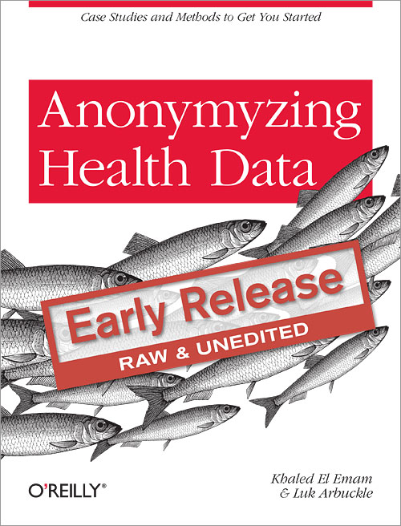
De-identification Book
PHI is either identifiable or easily reidentifiable
You should assume that you have not done so successfully until you are absolutely certain that you have
If you are guessing about whether you have truly deidentified a set of patient data, you are playing a very dangerous game
Notes:
Written by a very smart man who is one of the few resources that know this area well
You NEED an expert to help you with this, this is not something you can guess at
Truly separating PHI from the identity of the patient is called deidentification and is much harder than it seems

Slide 19
Why are we here today?
To build “Good software that can sustain frequent nimble changes to improve the quality of care”
Text Credit: Hacking Healthcare

Slide 20
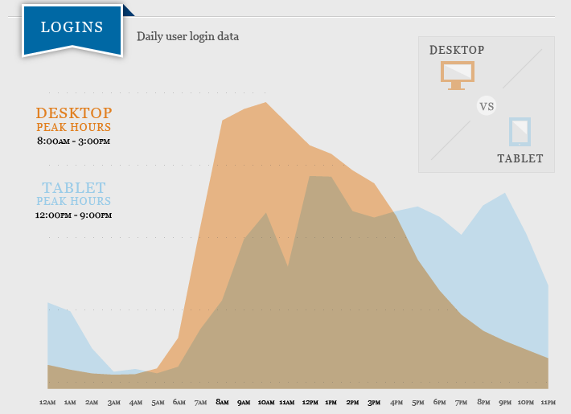
Is this “Improved Quality of Care?”
Maybe just improved Quality of Life for Physicians?
Image Credit: Practice Fusion Blog Text Credit: Hacking Healthcare
Notes:
Image Credit: http://www.practicefusion.com/ehrbloggers/2012/12/practice-fusion-reaches-record-growth-in-2012.html
I think this graph demonstrates the ability that innovations have to improve the quality of a lot of things in our healthcare system

Slide 21
Good Software vs. Good Data
Assuming that data comes from software:
Good Software == Good Data
Notes:
Since we’re at a data conference,
I should probably address why I am talking about software and not talking about data
Well, I am talking about data… indirectly

Slide 22
But what is our reality?
We are a long ways from good software…
And even further from good data

Slide 23
49% of U.S. Patients will be on Epic’s records when all the company’s contracted customers have their systems operating
Text Credit: host.madison.com
Notes:
Source credit: http://host.madison.com/business/epic-diss-verona-health-records-company-left-out-of-new/article_7343b176-8792-11e2-a4ba-0019bb2963f4.html
If this doesn’t scare you, I’m not sure why you are listening to this presentation

Slide 24
Why should we store our healthcare data in the cloud?
More secure
Encourages interoperability by nature
Innovators/developers want to build here
Availability
Flexibility
Mobility
Scalability
Notes:
--More secure
Encourages interoperability by nature
Innovators/developers want to build there
--Availability
--Flexibility
--Mobility
Scalability

Slide 25
Security

Slide 26
Is On-Premise really more secure?
… and why did they put “hack” at the top of the list???
Notes:
http://www.hitrustalliance.net/breachreport/HITRUST%20Report%20-%20U.S.%20Healthcare%20Data%20Breach%20Trends.pdf
Improper disposal 5, 2
Loss 12, 45
Theft 54, 37
Total 71, 84

Slide 27
It looks like storing data On-Premise is a huge security risk
If we can eliminate the physical security vector by entrusting our disks to secure, certified hosts
And if we can eliminate loss by eliminating the need to store data locally
Also, loss will be further reduced by eliminating most needs to export data
Does that really mean we can reduce breached record count by 84%?
(loss + theft + improper disposal)
Notes:
#2 – secure connection from anywhere
#3 – our systems are more agile now

Slide 28
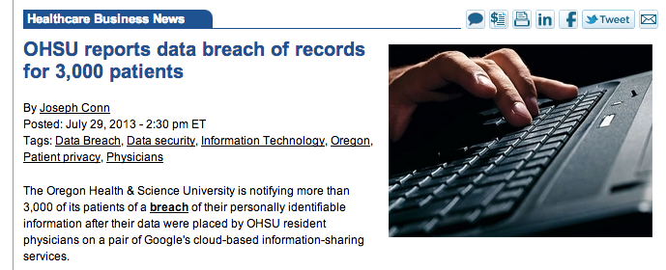
According to the university's statement, the intent of the resident physicians at the division of plastic and reconstructive surgery who used the services was “to maintain a spreadsheet of patients” to:
“provide each other up-to-date information about who was admitted to the hospital under the care of their division.”
Notes:
http://www.modernhealthcare.com/article/20130729/NEWS/307299953

Slide 29
What is so wrong with our On-Premise software (Epic in this case) that providers don’t have up-to-date information about who was admitted to the hospital under the care of their division?
Yes, we may need cloud software to solve this problem.
At least the residents seems to think so.
Notes:
The residents are obviously stupid and should know HIPAA…
But might this represent something? Maybe there are more important priorities than obsessing over potential privacy breaches.

Slide 30
Are the residents as “stupid” as they seem?
Or are we missing the feedback

Slide 31
Developers

Slide 32
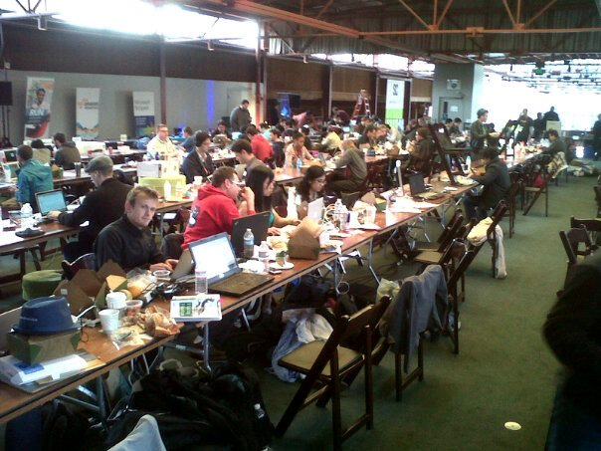
After 47 hours of this…

Slide 33
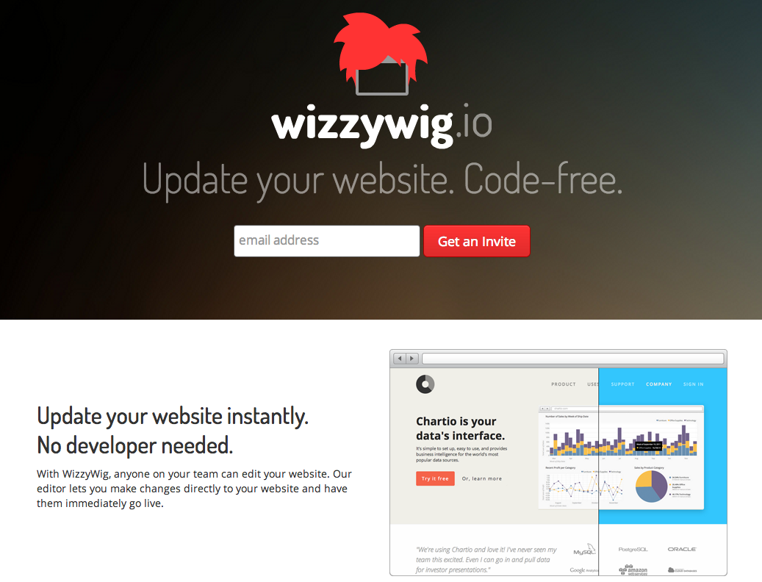
A team of 3 built this…
And received $125k+ in funding

Slide 34
Developers want to build in the cloud
Without the cloud, this type of innovation becomes much more difficult

Slide 35
Availability

Slide 36
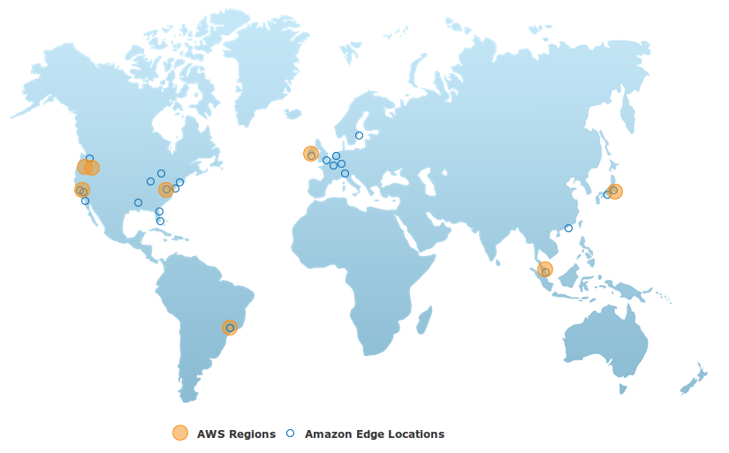
Does your On-Premise network have this level of geographic distribution?

Slide 37
Flexibility

Slide 38
“The big advantage is the ability to quickly align with changing requirements, an area where traditional approaches to IT have failed for the last 20 years. In fact, they’re getting worse at it.”
David Linthicum - Cloud providers aren’t selling the real value of the cloud
Notes:
Business is changing now faster than it ever has in the past, and speed of change is only going to keep increasing

Slide 39
Mobility

Slide 40
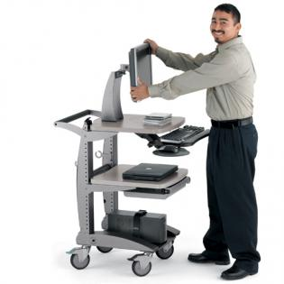
Welcome to the Future
Otherwise known as 1990 on wheels, with a car battery attached
Image Credit: UpTime4u.com
Notes:
http://www.uptime4u.com/v-web/gallery/main.php?g2_view=core.DownloadItem&g2_itemId=4286&g2_serialNumber=8
I would like to extend my most heartfelt welcome to the future of Health IT
Story about taking fiancé to ER…

Slide 41
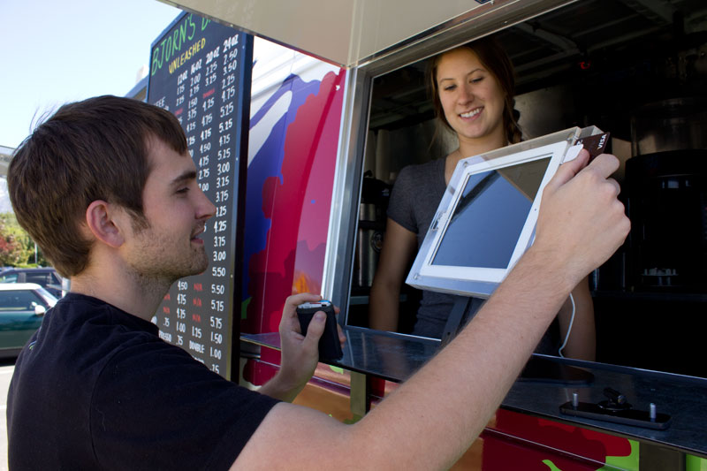
Welcome to your neighborhood food cart
Image Credit: ipadenclosures.com
Notes:
http://www.ipadenclosures.com/php-oak/themes/global/admin_images/industries/food-truck-ipad-pos.jpg

Slide 42
A few ideas

Slide 43
Does your consumer facing login solution offer all of these security features?
Remote Logout - see which sessions are active and have the ability to end sessions (more relevant when working with multiple devices)
Login Approvals - you are asked to enter a special login code each time you try to access your account from a new device
Login Notifications - get an alert each time a login happens from a new location or device
One-Time Passwords - use a one-time password to log into your account anytime you feel uncomfortable entering your real password
Trusted Contacts - you can reach out to other users you have previously identified if you ever need help getting into your account (multiple accounts compromised)
Social authentication - upon a suspicious login attempt, you are shown pictures of your contacts and asked to verify their name, even after you entered the correct username and password combination.
Full-time HTTPS
Malicious Software Protection - account frozen if malicious activity detected, and unfrozen once it is scanned and cleaned
Clickjacking Scam Removal - service scans a trillion links a day and block 230 million malicious actions per day, on top of all the other security features
Notes:
http://allfacebook.com/facebook-privacy-security_b63132
https://www.facebook.com/help/www/413023562082171/

Slide 44
Facebook does.
And you can leverage it

Slide 45
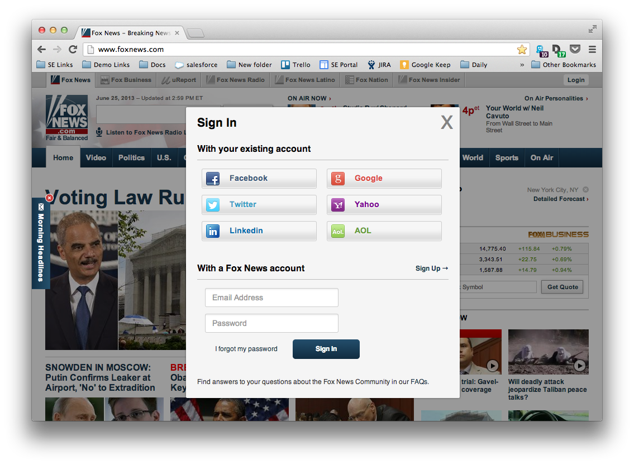
Social login + registration
Notes:
This is the 1 second explanation of what janrain does…
We offer user management platform transforms how you engage with site visitors

Slide 46
3rd Party Authentication
Using OpenID, OAuth, or other protocols to allow users to autheniticate using a 3rd party (Facebook, Google, etc)
Major Benefits:
Reduce friction for using services
Reduce security overhead
Increase data quality
Increase data scope
Increase development agility
Can offer additional security advantages
Notes:
3rd part authentication is a concept that I have leveraged heavily in all my apps
and something that I think will be a game-changer in healthcare IT:
This is an industry that Janrain essentially created and continues to dominate.

Slide 47
OMG… Social Data?!? ;-)
{
"profile": {
"providerName": "Facebook",
"identifier": "http://www.facebook.com/profile.php?id=10710324",
"verifiedEmail": "exxxxxxxxxx@gmail.com",
"preferredUsername": "EricNelson",
"displayName": "Eric Nelson",
"name": {
"formatted": "Eric Nelson",
"givenName": "Eric",
"familyName": "Nelson"
},
"url": "https://www.facebook.com/profile.php?id=10710324",
"photo": "https://graph.facebook.com/10710324/picture?type=large",
"utcOffset": "-04:00",
"address": {
"formatted": "Vancouver, Washington",
"type": "currentLocation"
},
"gender": "male",
"providerSpecifier": "facebook"
},
"merged_poco": {
"id": "http://www.facebook.com/profile.php?id=10710324",
"displayName": "Eric Nelson",
"preferredUsername": "EricNelson",
"gender": "male",
"profileUrl": "https://www.facebook.com/profile.php?id=10710324",
"currentLocation": {
"formatted": "Vancouver, Washington",
"type": "currentLocation"
},
"updated": "2013-09-12T17:07:28.000Z",
"utcOffset": "-04:00",
"urls": [
{
"value": "https://www.facebook.com/profile.php?id=10710324",
"type": "profile"
}
],
"addresses": [
{
"formatted": "Vancouver, Washington",
"type": "currentLocation"
},
{
"formatted": "Hood River, Oregon",
"type": "hometown"
}
],
"movies": [
"Modern Collective",
"The Last Boy Scout"
],
"music": [
"Rage Against The Machine",
"Jack White",
"Rage Against the Machine",
"Collin McLoughlin",
"Avril Lavigne",
"The Black Keys",
"Son House",
"Jay Z",
"Robert Pete Williams",
"Jack White"
],
"quotes": [
"\"... no exceptional brain power is needed to construct a new science or to expand on an existing one. What is needed is just the courage to face inconsistencies and to avoid running away from them just because 'that's the way it was always done'.\"\r\n\r\n\"Of the other major resources, money is actually quite plentiful. We long ago should have learned that it is the demand for capital, rather than the supply thereof, which set the limit to economic growth and activity. People one can hire. But one cannot rent, hire, buy, or otherwise obtain more time. The supply of time is totally inelastic. No matter how high the demand, the supply will never go up. There is no price for it and no marginal utility curve for it. Moreover, time is totally perishable and cannot be stored. Yesterday’s time is gone forever and will never come back. Time is, therefore, always in exceedingly short supply. Time is totally irreplaceable. Within limits we can substitute one resource for another, copper for aluminum, for instance. We can substitute capital for human labor. We can use more knowledge or more brawn. But there is no substitute for time.\"\r\n\r\n\"It's not smiling because it wants its picture taken...\"\r\n\r\n\"Giving up the illusion that you can predict the future is a very liberating moment.\"\r\n\r\n\"Ultimately, man should not ask what the meaning of his life is, but rather he must recognize that it is he who is asked. In a word, each man is questioned by life; and he can only answer to life by answering for his own life\""
],
"interests": [
"Dirt Jumps",
"Data",
"Hollow Lefts",
"40's"
],
"photos": [
{
"value": "https://graph.facebook.com/10710324/picture?type=small",
"type": "other"
},
{
"value": "https://graph.facebook.com/10710324/picture?type=large",
"type": "other",
"primary": true
},
{
"value": "https://graph.facebook.com/10710324/picture?type=square",
"type": "other"
},
{
"value": "https://graph.facebook.com/10710324/picture?type=normal",
"type": "other"
}
],
"organizations": [
{
"name": "Janrain",
"title": "Solutions Engineer",
"type": "job",
"startDate": "2013-04-08"
},
{
"name": "Executive Technology Solutions",
"title": "Sandwich Artist",
"type": "job",
"startDate": "2010-07-01",
"endDate": "2013-04-05",
"description": "this is me"
},
{
"name": "REAL Watersports",
"title": "Numbers Nelson",
"type": "job",
"startDate": "2007-09-01",
"endDate": "2010-07-01"
},
{
"name": "REAL Kiteboarding",
"title": "Kiteboarding Coach",
"type": "job",
"startDate": "2007-06-01",
"endDate": "2007-08-01"
},
{
"name": "REAL Kiteboarding",
"type": "job"
},
{
"name": "Hood River Valley High School",
"type": "High School"
},
{
"name": "University of Washington",
"department": "Accounting/Engineering",
"type": "College"
}
]
},
"friends": [
"http://www.facebook.com/profile.php?id=203936",
"http://www.facebook.com/profile.php?id=405682",
"http://www.facebook.com/profile.php?id=506691",
"http://www.facebook.com/profile.php?id=610411",
"http://www.facebook.com/profile.php?id=1010327",
"http://www.facebook.com/profile.php?id=1304541",
"http://www.facebook.com/profile.php?id=1530276",
"http://www.facebook.com/profile.php?id=2308380",

Slide 48
Benefits of Data from Social Networks
It’s remarkably accurate due to social pressure
Why make the users enter it again?
You get data you won’t get anywhere else
Millennials actually WANT to share this data with you

Slide 49
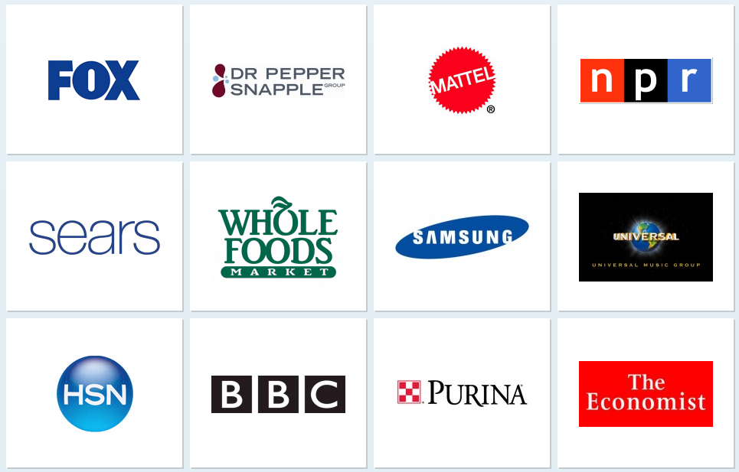
The obvious use case for this consumer facing brands and media
Less obvious are the traditional systems in other areas that we are starting to supplant

Slide 50
Use Case: Pharmaceuticals
Janrain helping major pharmaceutical companies to wrap HCP verification services to meet marketing regulations
Standard HCP ID Providers could increase cross-app integration security

Slide 51
Use Case: Patient Portals
DoctorBase offers patients the ability to connect to their patient portal using Facebook
  Helps doctors meet meaningful use standard (5% of your patient population has to be registered for and communicating with your office electronically) by reducing friction for users
  Other benefits like doctors getting to view picture of patient to further ensure identity
Notes:
http://www.health2con.com/news/2013/06/18/lessons-from-a-founder-whos-been-there-and-now-doing-that/?utm_source=Health+2.0+Newsletter&utm_campaign=ab12b2c9ce-Editorial+%231+%283%2F27%29&utm_medium=email&utm_term=0_ff5fa802a7-ab12b2c9ce-11354857
http://blog.doctorbase.com/hipaa-compliance-guide/

Slide 52
Engagement == Compliance
A major component of Meaningful Use Stage II is “patient engagement.” That means 5% of your patient population has to be registered for and communicating with your office electronically.
Technology previously only used by the marketing department is now helping us meet compliance mandates
Notes:
http://blog.doctorbase.com/hipaa-compliance-guide/

Slide 53
Encryption at rest
Use of secure cloud hosting providers can virtually eliminate physical security risks
With negligible physical security risks, encryption at rest does not add to the security of the data
Benefits:
  Lower overall solution complexity = more secure
  Better performance now that we can index
  Eliminating one false sense of security = more secure
Notes:
Encryption at rest in a system that requires an internet exposed application to have continuous query access to the plaintext doesn't make for good security. The keys MUST live in memory in this scenario in order to decrypt and encrypt data as it's accessed. This means that if the application is breached the key is also exposed and all the data with it.
What encryption at rest does secure against is the scenario where ninjas break into your datacenter and rip the hard drives from your unsuspecting servers; escaping into the night. Only later to discover that your data was encrypted at REST! Dun Dun Dun!
But that is silly. Amazon is a very secure facility with perfect audit reports.
In all reality there are arguments that could be made for secure key escrow services and other such fun, however there's always an impact on response times and availability. The truth is that no one really does this and it's expensive.

Slide 54
Benefits of encryption at rest
Benefits:
  Protects you against untrusted host
Downsides:
  Perceived (vs real) security benefit
  Performance hit (up to 20%)
  Search
  Reporting

Slide 55
BAA vs EULA
When serving Covered Entities (B2B), EULAs should include the business associate agreement, if possible

Slide 56
Alpha testing phase security measures
Minimize record count
  During preliminary production runs, company admins must sync records to other app and purge before 500 record limit is reached
  Limit login providers and users
  Unique application instance per CE

Slide 57
ACO vs API
Is the main driver for this effort that the data is all under one roof?
Why not just build connectable apps instead?

Slide 58
Why aren’t API’s addressed by meaningful use?

Slide 59
So you really want innovation to happen?

Slide 60
Eric’s Rough Draft of a
Framework for innovation
Boilerplate legal paperwork for common use cases
Allow cloud hosting, specifically full-service application hosting
Reduce risk for innovators
Mandate RESTful API access to data
Encourage loosely coupled systems
Make room for failure

Slide 61
Additional resources
HIPAA compliance outline
Hacking Healthcare, Anonymizing Health Data
AWS HIPAA Whitepaper (not updated for final rule)
HIPAA in the Cloud Whitepaper
Health 2.0 conference and blog
Open hardware speech from OSCON 2012:
  http://www.oscon.com/oscon2012/public/schedule/proceedings#topic-809
Notes:
http://www.us.sogeti.com/what-we-do/PDF/HIPAA-in-the-Cloud-Whitepaper-Sogeti-v1.2.pdf
http://d36cz9buwru1tt.cloudfront.net/AWS_HIPAA_Whitepaper_Final.pdf

