Slide 1
Turing’s Curse
July 26, 2013
John Graham-Cumming

Slide 2
A Long, Long TIME AGO...

Slide 3
The Mother of All Demos - 1968

Slide 4
What’s New?

Slide 5
I’ve got a bad feeling about this

Slide 6
Cloud Computing

Slide 7
Cloud Computing - 1966
1966 - 1968

Slide 8
Big Data

Slide 9
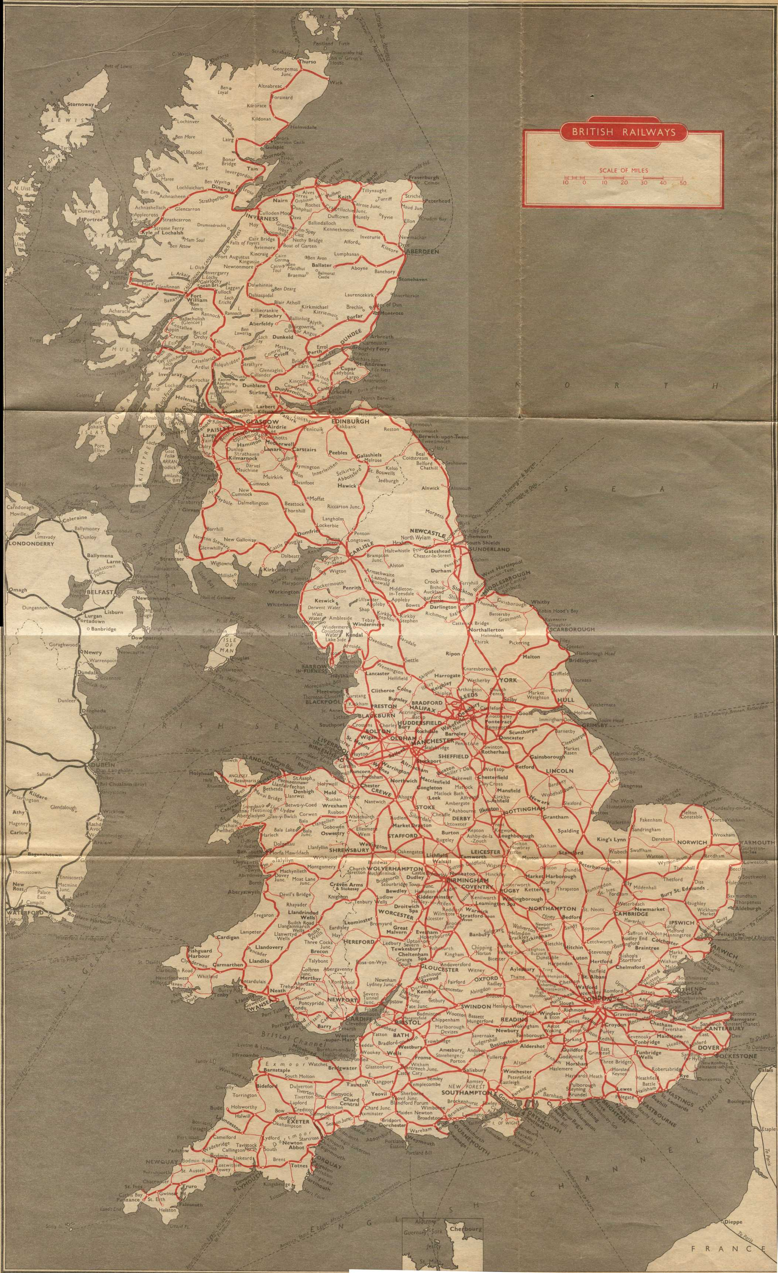
Big Data in 1955
1955 - 1968

Slide 10
Virtual Machine Hypervisor

Slide 11
Virtual Machine Hypervisor - 1967
1955 - 1968

Slide 12
Hypertext

Slide 13
Hypertext - 1945
1945 - 1968

Slide 14
Hypertext with clickable links

Slide 15
Hypertext with clickable links - 1967
1945 - 1968

Slide 16
Markup Languages

Slide 17
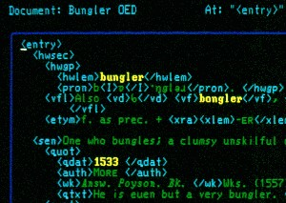
Markup Languages
1945 - 1968
IBM Generalized Markup Language – 1960s

Slide 18
Fibre Optic Networking

Slide 19
Fibre Optic Networking - 1966
1945 - 1968

Slide 20
Wireless Networking

Slide 21
Wireless Networking – 1971
1945 - 1971

Slide 22
Ethernet

Slide 23
Ethernet - 1973
1945 - 1973

Slide 24
Solid state disks

Slide 25
SSDs – 4MB in 1976
1945 - 1976

Slide 26
ProcessOR Architecture

Slide 27
Processor Architecture
1945 - 1976
RISC (1960s Cray; 1980s)
CISC (1960s IBM mainframes)
Instruction and Data Caching (1960s; IBM System/360)
Instruction Pipelining and Prefetch (1961 IBM Stretch; 1979 8086)
Branch Prediction (1961 IBM Stretch)
Vector processor (1974 STAR-100)

Slide 28
INTERNETWORKING

Slide 29
Internetworking
1945 - 1976
Chat – 1967 (NLS later Unix Talk)
File Transfer – 1971 (FTP)
Email – 1971 (host to host)
Remote Procedure Calls – 1975 (RFC 707)

Slide 30
Graphical User Interface

Slide 31
GUI – Xerox 8010 (1981)
1945 - 1981

Slide 32
GUI – Apple Lisa (1983)
1945 - 1983

Slide 33
Internet
1945 - 1983
TCP/IP – 1983

Slide 34
Functional Programming
1945 - 1983
LISP – 1958
APL - 1964
ML – 1973

Slide 35
Object Oriented Programming
1945 - 1983
Simula 1 – 1967
C++ - 1979
Smalltalk - 1980

Slide 36
Concurrent Programming
1945 - 1983
CSP – 1978
Ada - 1979
Occam – 1983

Slide 37
Event Driven Programming
1945 - 1983
PL/1 - 1966

Slide 38
Declarative Languages
1945 - 1983
SQL – 1979
Regular Expressions – 1970s

Slide 39
HIGH WATER MARK is (ROUGHLY) 1983

Slide 40
IMPLICATIONS

Slide 41
The thing you are DOING HAS BEEN DONE BEFORE
There’s great value in computer science education

Slide 42
WE ARE IN THE AGE OF GREAT PRODUCTIVITY
Be thankful all that stuff’s been invented already

Slide 43
we have YET to conquer unreliability

Slide 44
Ada Lovelace (1840s)

Slide 45
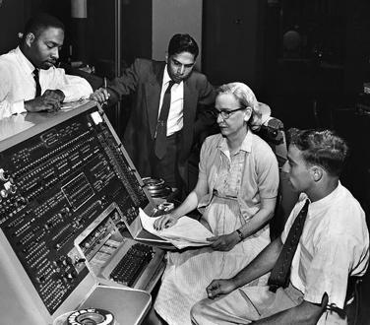
Grace Hopper (1947)

Slide 46
Maurice Wilkes (1950s)
As soon as we started programming, we found to our surprise that it wasn't as easy to get programs right as we had thought. Debugging had to be discovered. I can remember the exact instant when I realized that a large part of my life from then on was going to be spent in finding mistakes in my own programs.

Slide 47
Donald Knuth (1990s)
Question from audience: “Which programming language do you prefer Java or C++?”
Knuth: “Which has the better debugger?”

Slide 48
Turing’s Curse
1936: There is no program that, given a description of an arbitrary computer program, can decide whether the program finishes running or continues to run forever.

Slide 49
Work on RELIABILITY
Help programmers make fewer mistakes
Help programmers find their mistakes

