Slide 1
SDN: Adding Network Agility to the Cloud
Sebastien Goasguen,
July 24th 2013
#OSCON @sebgoa

Slide 2
Outline
Introduction to SDN
Controllers and Switches
Quick start demo of OpenDaylight
SDN in Cloud Platforms

Slide 3
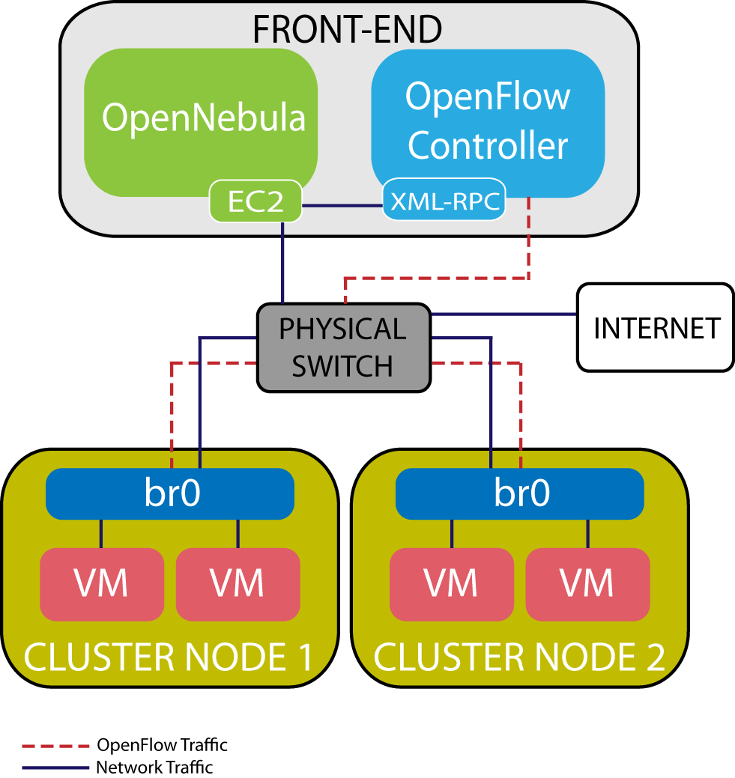
My SDN experience
~March 2012
Elastic IP and Security Group in Opennebula
Using NOX Open flow controller
http://blog.opennebula.org/?p=2695
http://code.google.com/p/onenox/

Slide 4
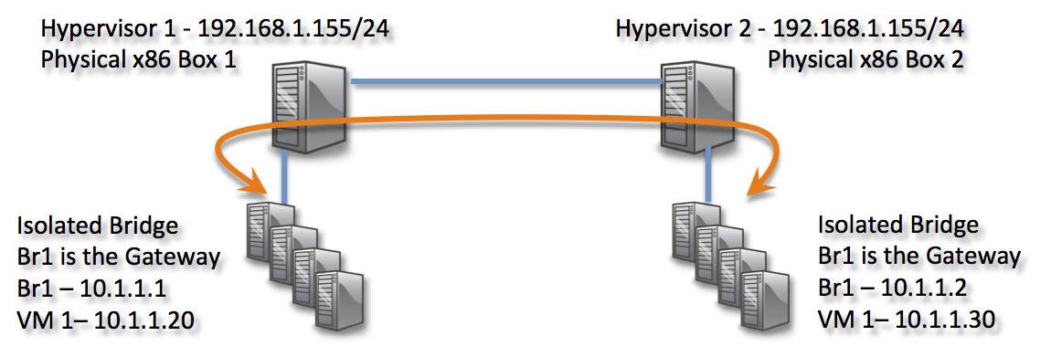
My SDN experience
~Summer 2013
Google Summer of Code project
Xen/XCP support for native GRE controller in Apache CloudStack
http://ngtuna.blogspot.com

Slide 5
Software Defined Networking

Slide 6
What is SDN ?

Slide 7
What is SDN ?

Slide 8
SDN:
A new network architecture that abstracts the physical network to provide:
Automation
Dynamic provisioning
In order to enable business innovation

Slide 9
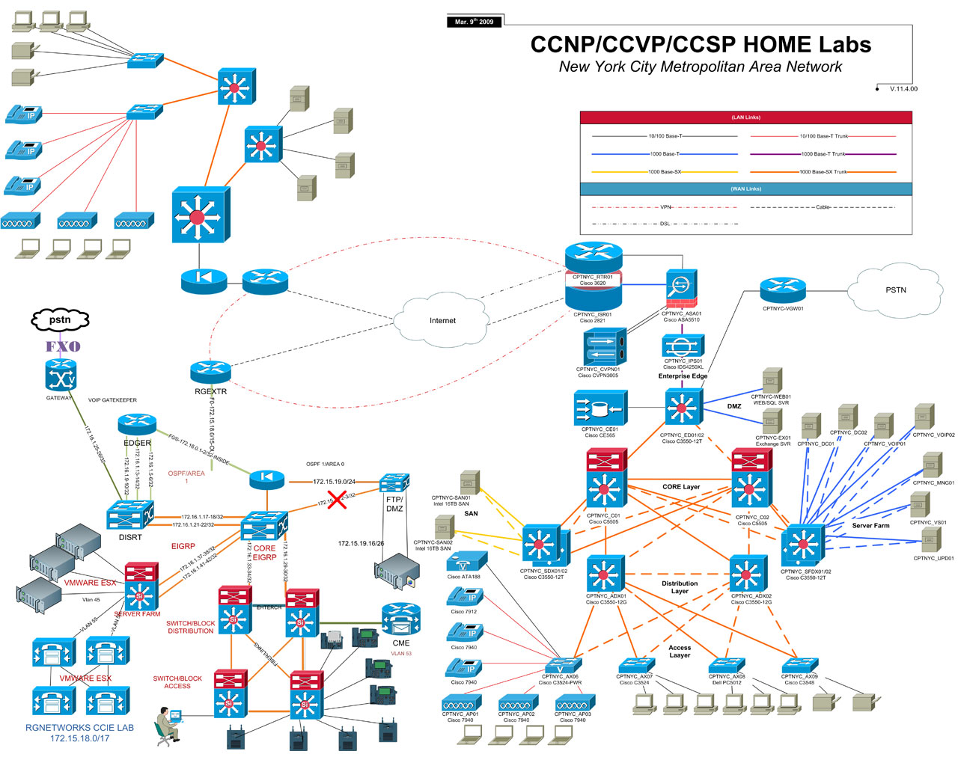
Why ?

Slide 10
Because

Slide 11
Architecture

Slide 12
Software Defined Networking
Enable innovation, experimentation, optimization and customization of networks
Move control of the network to software. i.e Programmable network
Virtualize the network
Beyond traditional network virtualization ala VPN and VLAN
Enables overlays with control at the edges
Existing Vendor-agnostic, standard protocol for control: OpenFlow

Slide 13
OpenFlow
Leading SDN protocol
Decouples control and data plane by giving a controller the ability to install flow rules on switches.
Hardware or software switches can use OpenFlow
Spec driven by ONF
Google achieved 95% utilization of WAN backbone by using SDN

Slide 14
OpenFlow Protocol
OpenFlow rules can drop, rewrite, forward packets
Rule
Action
Stats
Packet + byte counters
Forward packet to port(s)
Encapsulate and forward to controller
Drop packet
Send to normal processing pipeline
Switch
Port
MAC
src
MAC
dst
Eth
type
VLAN
ID
IP
Src
IP
Dst
IP
Prot
TCP
sport
TCP
dport

Slide 15
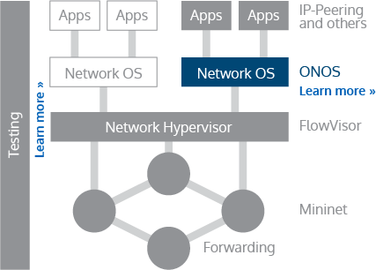
OF scalability ?
Central Logical controller not a single point of failure
ONOS to be Open Sourced in the ~fall
Scale-out design, availability
Cassandra + message bus

Slide 16
“SDN” Timeline
Feb 2012: Floodlight project
Feb 2011: OF v 1.1
July 2012: Vmware acquires Nicira
April 2012: ONF talk by Google
April 2013: OpenDayLight
Dec 2011: OF v 1.2

Slide 17
GENI
“GENI is a virtual laboratory at the frontiers of network science and engineering for exploring future internets at scale. GENI creates major opportunities to understand, innovate and transform global networks and their interactions with society.”
Dec 2008: VM Mobility
June 2010: Aster*x Load Balancing
2009: FlowVisor
~ 2011: GENI Racks

Slide 18
Controllers and Switches

Slide 19
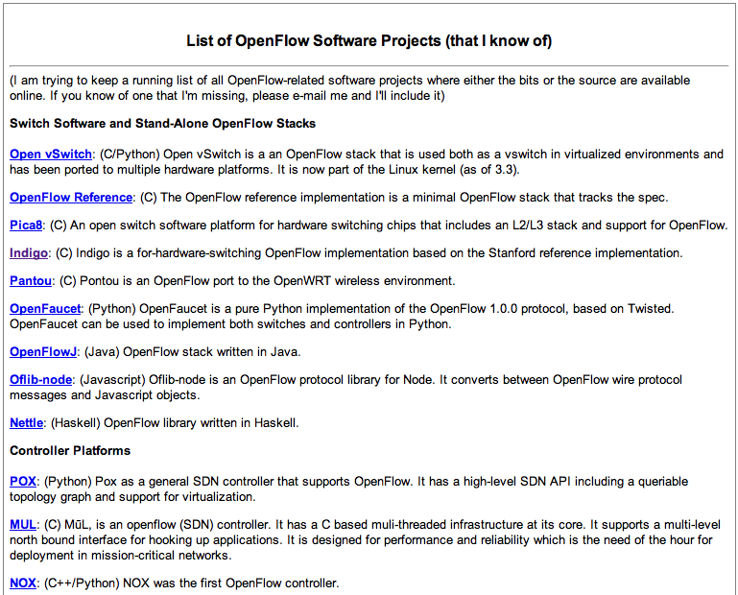
OF Controllers and more …
Several controllers out there (NOX, POX,Trema, Beacon…)

Slide 20
OpenVSwitch
“Open vSwitch is a production quality, multilayer virtual switch licensed under the open source Apache 2.0 license. It is designed to enable the massive network automation through programmatic extension…”

Slide 21
e.g OVS rate limiting
Can enforce QoS with rate limiting controls
ovs-vsctl set Interface tap0 ingress_policing_rate=1000
ovs-vsctl set Interface tap0 ingress_policing_burst=100

Slide 22
e.g OVS VLAN tagging
ovs-vsctl add-br br0
ovs-vsctl add-port br0 eth0
ovs-vsctl add-port br0 tap0 tag=1
ovs-vsctl add-port br0 tap1 tag=2
Complement on host2…

Slide 23
e.g OVS and GRE tunnels
No Cookbook on OVS page
ovs-vsctl add-port br1 gre1 -- set interface gre1 type=gre options:remote_ip=192.168.1.152

Slide 24
OVS and Openflow
Point OVS switches to an OF controller:
$ovs_vsctl set-controller br0 tcp 192.168.1.33:6633
Install rules on switch
Proactively (before any packet flows)
Reactively (unknown packets forwarded to controller, who pushes flow mod on switch, then operates at line rate)

Slide 25
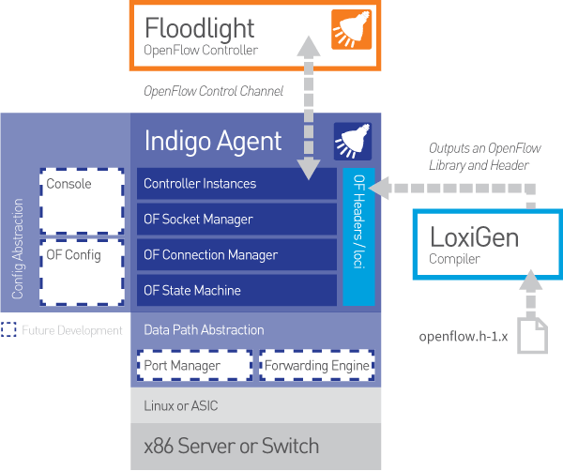
Switch Light, Indigo (IVS)

Slide 26
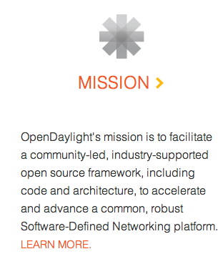
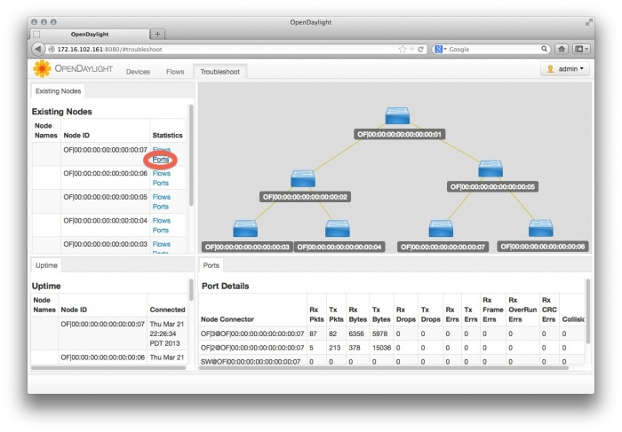
OpenDaylight

Slide 27
OpenDaylight Demo ?

Slide 28
SDN in Cloud Platforms

Slide 29
OpenNebula
Supports VLAN tagging and rate limiting through “hooks” that call ovs_vsctl
Scripts executed on an hypervisor before a VM is launched
Potentially also executed after VM shutdown for cleanup
Also supports OpenFlow

Slide 30
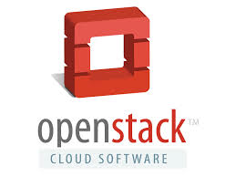
Quantum == Neutron

Slide 31
Quantum == Neutron

Slide 32
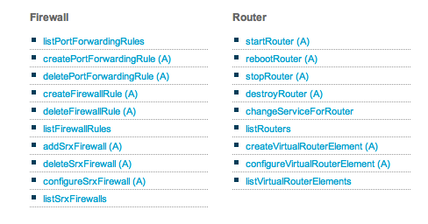
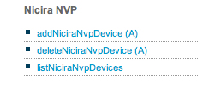
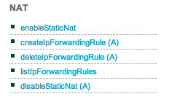
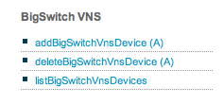
CloudStack Network API

Slide 33
CloudStack Nicira NVP Support
By Hugo Trippaers @Spark404, Schuberg Philis
Isolated Networks in advanced Zone 4.0+
L3 functionalities in 4.2

Slide 34
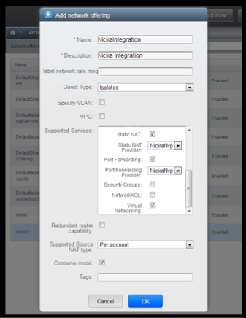
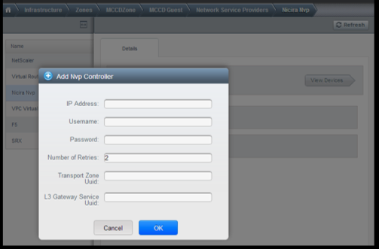
CloudStack + Nicira NVP

Slide 35
CloudStack SDN Plugins

Slide 36
Conclusions
Network abstractions to decouple from the physical network is the last leg of Cloud
SDN provides an architecture to abstract the network
OpenFlow is a standard that can be used to create SDN implementations
SDN is key to innovation in networking
The Open Cloud Platforms are embracing SDN solutions as network providers for multi-tenancy

Slide 37
Get Involved with Apache CloudStack
Web: http://cloudstack.apache.org/
Mailing Lists: cloudstack.apache.org/mailing-lists.html
IRC: irc.freenode.net: 6667 #cloudstack
Twitter: @cloudstack
LinkedIn: www.linkedin.com/groups/CloudStack-Users-Group-3144859
If it didn’t happen on the mailing list, it didn’t happen.

