Slide 1
Your OSS Project Is Now Served
Launching and sharing OSS projects
Uri Cohen
Head of Product @ GigaSpaces
@uri1803
github.com/uric
#oscon 2013

Slide 2
So You’ve Built This Kickass New Database / Framework / Project
http://blog.enfocussolutions.com/Powering_Requirements_Success/?Tag=Developers
Notes:
Ask how many built oss project / app / demo

Slide 3
Here Are the Roadblocks That Stand in The Way of Your Users…
http://ronmoore.org/wp-content/uploads/2012/11/1157986_21931439.jpg

Slide 4
Hear about Your Masterpiece
http://bobbleheaddad.com/wp-content/uploads/2011/12/hearcall1.jpg
Notes:
Github has literally millions of repos (more than 4m is the last I heard)

Slide 5
Download
http://ridiculousfish.com/hexfiend/images/download_square.png

Slide 6
Install & Configure
Notes:
That’s where you lose most users. If things need to be configured out of the box (and very few times they don’t)

Slide 7
Realize It Gives Them Value
http://www.usagold.com/images/usagoldcoins.jpg
Notes:
Value vs effort. It’s not just about whether it’s good, it’s whether they have time to test it. Most users would give it 10-15 minutes to make up their mind

Slide 8
Many Things Can Break along the Way…
http://commons.wikimedia.org/wiki/File:Broken_glass.jpg

Slide 9
Wouldn’t It Be Awesome If You Could Replace This With a Button?

Slide 10
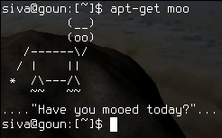
Solution #1: Package Managers / Installers
http://commons.wikimedia.org/wiki/File:Apt-get_moo(2).png
Notes:
Good progress but still has a lot of the previous problems plus requires configuration, OS specific, and messes up your local env
Updates are done in pull not push

Slide 11
Solution #2: Boxes! Vagrant Boxes!
Notes:
Doesn’t mess up your local env
You can use boxes but it’s not the right medium, hard to update, large
And wha if you’re using multi-node? Riak, ZK, etc

Slide 12
Solution #3: Cloud Images
Notes:
Doesn’t require download, introduces a new set of problems:
Cloud account in place
Hard to share
Market place is also nice but there’s an inherent conflict with cloud providers as well
Clustering and multi machine setup is complicated

Slide 13
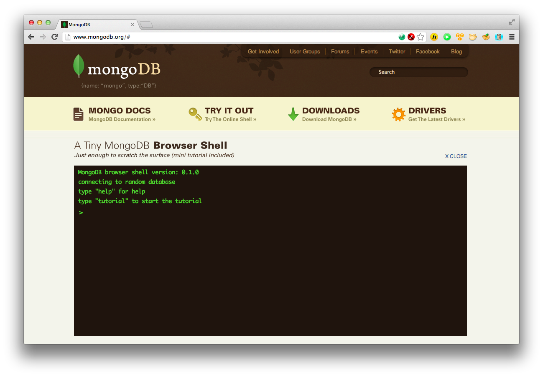
Solution #4: Roll Your Own Demo-as-a-Service
Notes:
Case in point: 10geb, great mongodb online tutorial. But it takes a lot of effort which most people can’t really do

Slide 14
Some Background

Slide 15
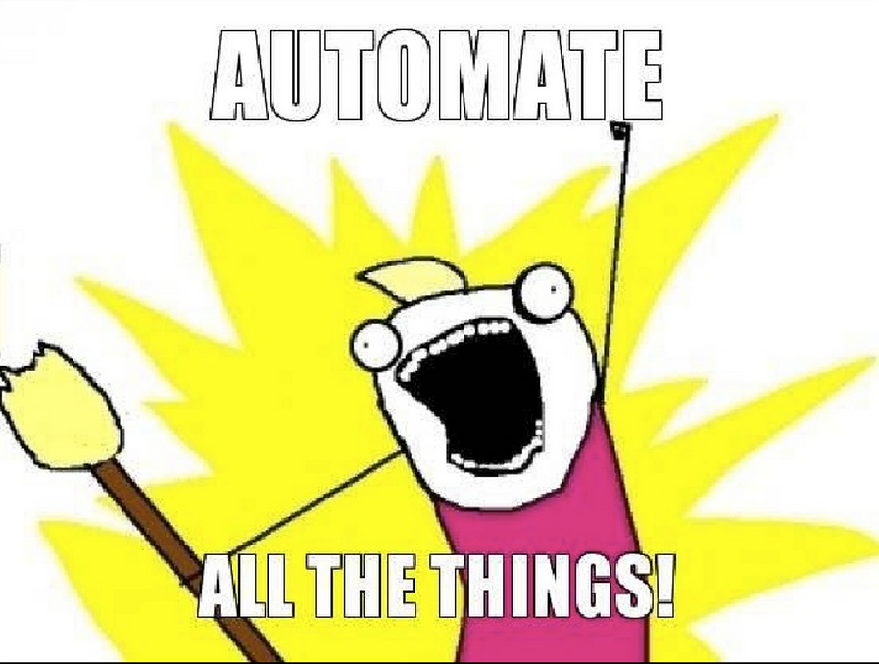
Environment Creation
SW Infra. Setup & Config
Code Push
Monitoring & Alarming
Repairing
Scaling

Slide 16
- Open Source (Apache2) - Supports all major Clouds - Proven

Slide 17
Application & Stack Recipes

Slide 18
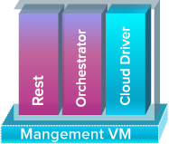
How It Works

Slide 19
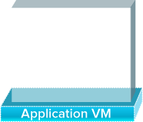
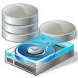
Install Application

Slide 20
Post Deployment

Slide 21
Self Healing

Slide 22
We Asked Ourselves How We Can Promote Adoption…

Slide 23
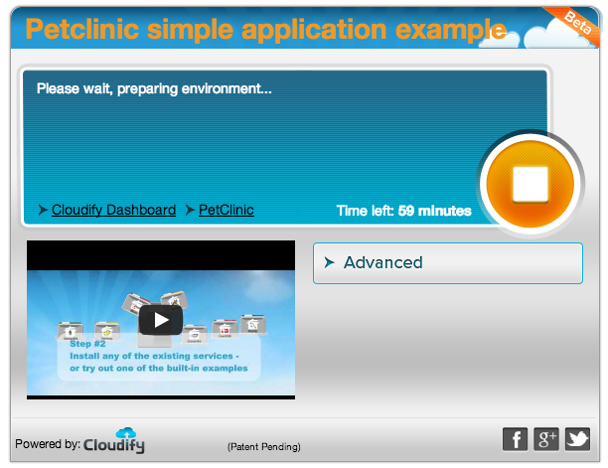
So We’ve Built This Embeddable, Web Based Recipe Player

Slide 24
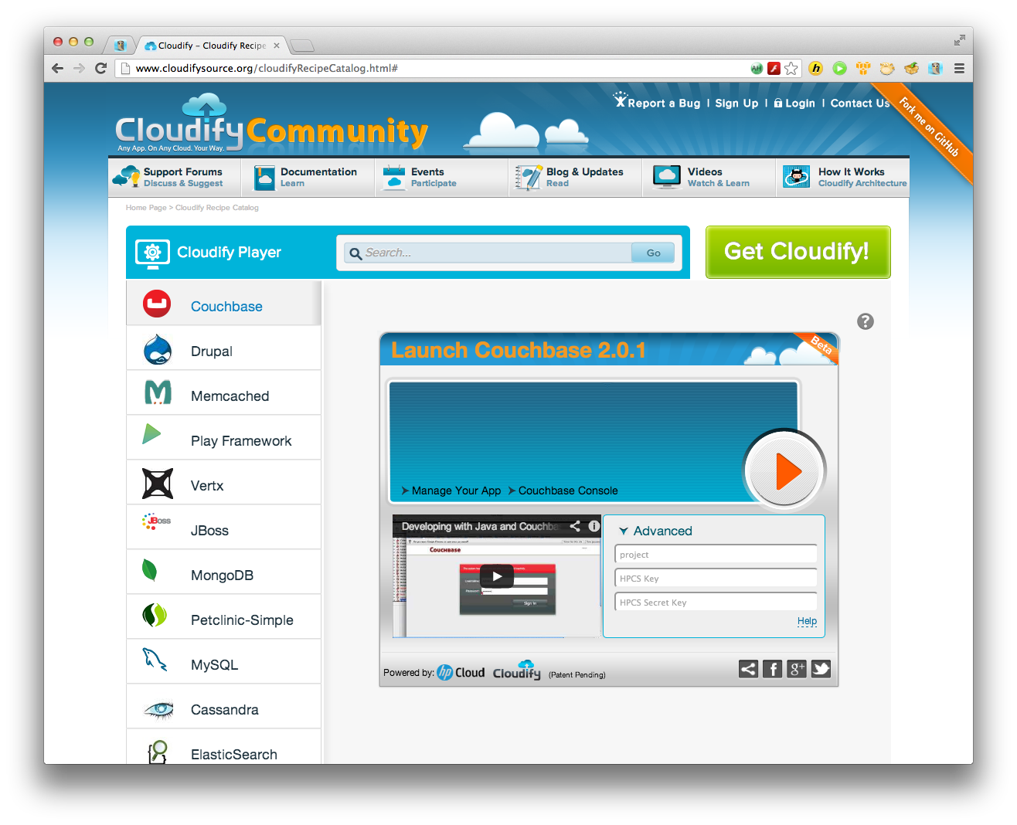
How It Works
GIT
Player Server
Zip, Tarball
VM
VM
VM
VM
VM
VM

Slide 25
How It Works
GIT
Player Server
Zip, Tarball
VM
VM
VM
VM
VM
VM

Slide 26
How It Works
GIT
Player Server
Zip, Tarball
VM
VM
VM
VM
VM
VM

Slide 27
How It Works
VM
GIT
Player Server
Zip, Tarball
VM
VM
VM
VM
VM

Slide 28
How It Works
VM
GIT
Player Server
Zip, Tarball
VM
VM
VM
VM
VM

Slide 29
Resources
Sample git repo https://github.com/uric/oscon-mongo-demo
CloudifySource demo page http://www.cloudifysource.org/cloudifyRecipeCatalog.html
Cloudify docs http://www.cloudifysource.org/guide/2.6/qsg/quick_start_guide_helloworld
Player admin dashboard (beta) http://launch.cloudifysource.org/
Cloudify on Github
Cloudify Player Github repo https://github.com/cloudifysource/cloudify-widget
The framework
https://github.com/cloudifysource/cloudify

Slide 30
Thank You!

