Slide 1
Internal Open Source
Running Internal Projects with Open-Source Practices
Camille Fournier
Rent the Runway
@skamille
Notes:
Part 1: Benefits gained from OS-style community development, in general
Benefits to companies, in specific
How to identify projects that could benefit from these
Lessons learned: Big Company
Lessons learned: Small company

Slide 2
Motivation
Notes:
ORGANIZATIONAL CHALLENGE

Slide 3
Friction
Communication overhead

Slide 4
Notes:
You will be assimilated

Slide 5
Friction
Communication overhead
Meetings meetings meetings
Increases with more people
Amplified by distance
Notes:
Startup: everyone sit in a room
OSS: Built-in tolerance to friction because distributed dev is fundamental

Slide 6
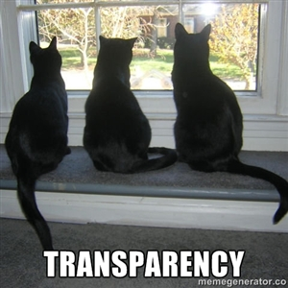
Notes:
Eases friction esp in large org
More than just shared source
Especially in distributed org
Of process
Of decision making
Leads to higher Quality

Slide 7
More than just available source

Slide 8
Notes:
Especially in distributed org
Of process
Of decision making
Leads to higher Quality

Slide 9
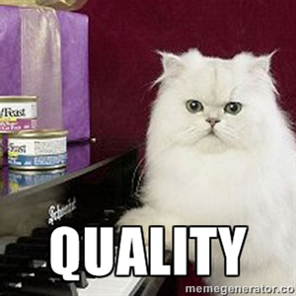
Notes:
Quality comes from transparency
Quality via process
Allow developers to learn and level-up from each other

Slide 10
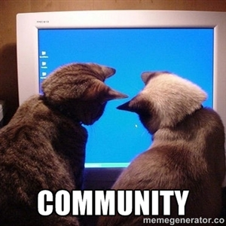
Notes:
Learn from each other
Meetups, Conferences
*Identify quality and maturity
Engagement beyond immediate team, to others in the company
Ability to switch teams with lower overhead, helps internal mobility

Slide 11
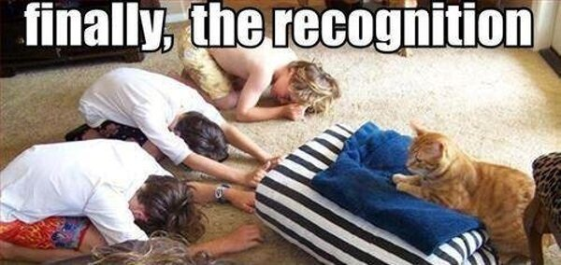
Notes:
retention

Slide 12
Benefits
Reduce Friction
Enable Internal Mobility
Improve Quality
Strengthen Community and Culture
Improve Retention

Slide 13
Where to find Internal OSS?

Slide 14
Shared Needs

Slide 15
Shared Needs
OSS exists and thrives in places of shared need
>1 developer + >1 project = shared needs
Start simple!
Notes:
Logging standards, alerting, often evolves into libraries to enable standards

Slide 16
How do we deal with shared needs?
We don’t; each team implements exactly what they need
Shared software is collectively owned by the whole team
“Collective Code Ownership”
We create a “core” team that owns all centralized code
Notes:
Collective code ownership:
Principle of Agile
Requires quality discipline (testing, mentoring, pairing)
Doesn’t scale
How do you focus responsibility?
When all code is written this way, it can slow down development

Slide 17
The “Core” Team
Benefits: Dedicated resources working on shared software
Downside: Team is not using the shared software
Can make for sane software but can also lead to feature bloat
Great starter material for internal open source

Slide 18
Case Study: Big Company

Slide 19
Case Study: Big Company
Some centralized libraries not even released with source
Federated organizations developing their own code
Disparity of ways of doing development across the company
A desire to centralize and share functionality
A desire to code cross-team

Slide 20
Needs
Shared Repos that are visible to the whole engineering staff
Shared ticketing system
Mailing lists
Code Review system
Support for builds and artifacts

Slide 21
Barriers to Entry
Expected: Management buy-in
Actual: Platform and tools for running shared projects

Slide 22
Adoption
Within a matter of months, over 40 projects moved to open platform
Entire teams moved all of their development onto shared platform
Created a shared platform that everyone could use for SDLC management
Opened the whole company to more involvement with external Open Source Community

Slide 23
Case Study: Small Startup
Notes:
Small co of 15 devs
Collective code ownership
Storefront and infra teams

Slide 24
Case Study: Small Startup
All source code is viewable by all tech employees
Infrastructure team writes and owns core services
Need to move fast
Time constraints and heavy business pressure

Slide 25
New Structure
Business-focused Pods
No more core infrastructure team
Shared infrastructure services across Pods
No dedicated resources for shared code

Slide 26
Developer Poll
Does visibility into the code bases of other teams make a difference in your experience here at Rent the Runway?
1 – It is something that provides a lot of job satisfaction for me
5 – I never look and don’t care

Slide 27
Developer Poll
Does being able to modify all code make your job easier?
1 – Much easier, I would quit if I could not do this
5 – I never do this and never want to

Slide 28
What Should We Be Doing?

Slide 29
Lessons
Hard to find the time to maintain cohesion between all projects when 100% “volunteer”
May want a core infrastructure team that acts as a gatekeeper group
When you don’t adopt all OSS best practices (such as formal code reviews) quality is perceived to suffer

Slide 30
Final thoughts
OSS practices bring a great deal of developer joy
Can help identify weaknesses in your systems
Need to follow ALL of the best practices of OSS to make it work best
Start the way you want to grow

Slide 31
Contact me!
Tweet me @skamille
Email me camille@apache.org
Read me http://whilefalse.blogspot.com/

