Slide 1
How to get (more) kids to code

Slide 2
Intro
Questions
Who are we
Tools
Events

Slide 3

Who are we
Kim Spiritus
Java Developer
Speaker
Duchess member

Slide 4


Régina ten Bruggencate
  Java developer
  JUG leader
  Java champion
  Teacher / Student
  Speaker

Slide 5


Duchess
Women in Java
International Java User Group (JUG)

Slide 6
Tools

Slide 7

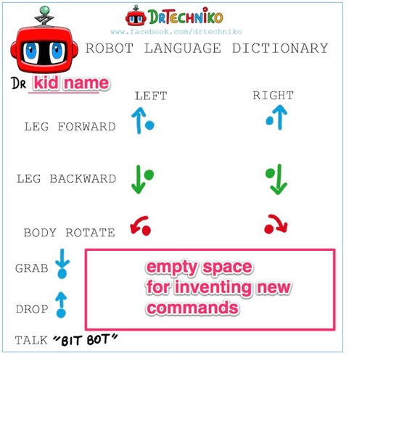
http://drtechniko.com/

Slide 8

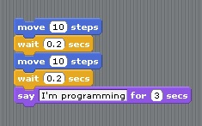
http://scratch.mit.edu/

Slide 9

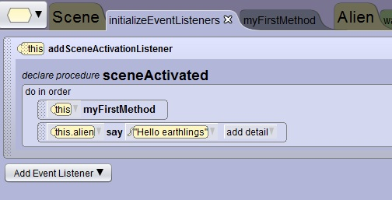
Alice
http://www.alice.org

Slide 10

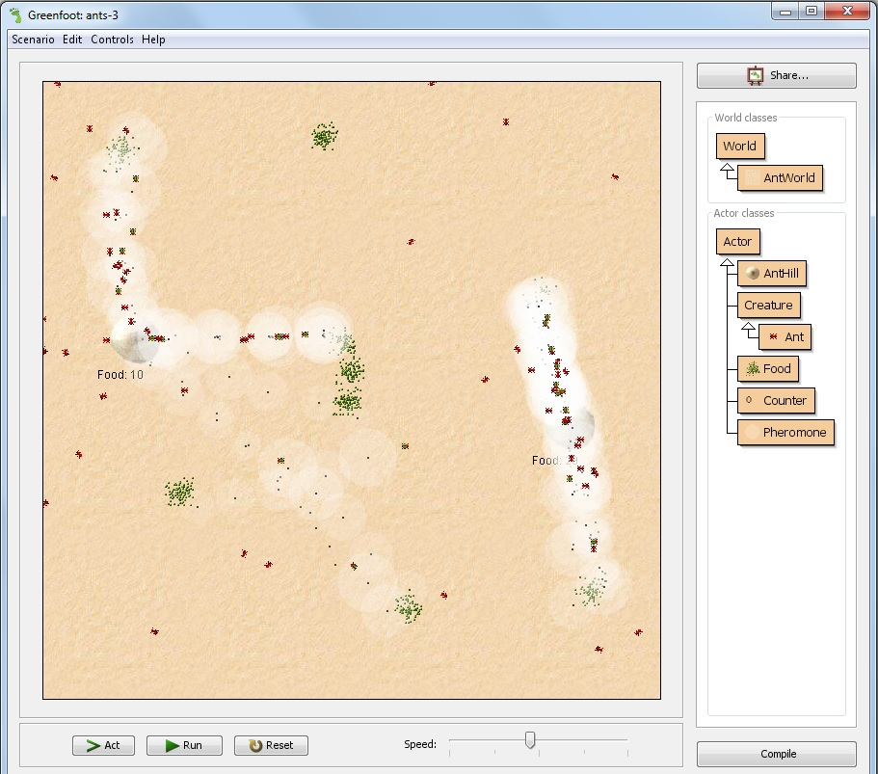
Greenfoot
http://www.greenfoot.org

Slide 11

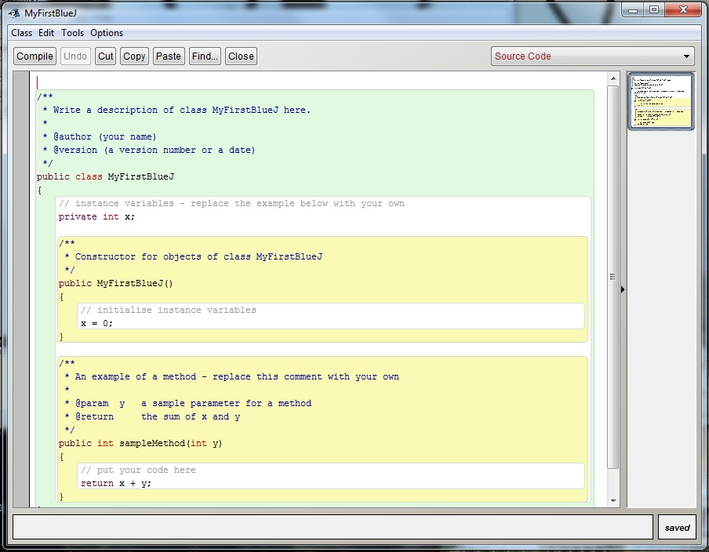
BlueJ
http://bluej.org

Slide 12
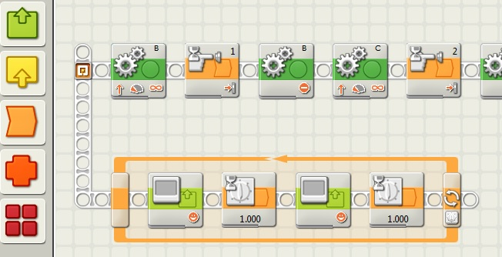
http://mindstorms.lego.com

Slide 13

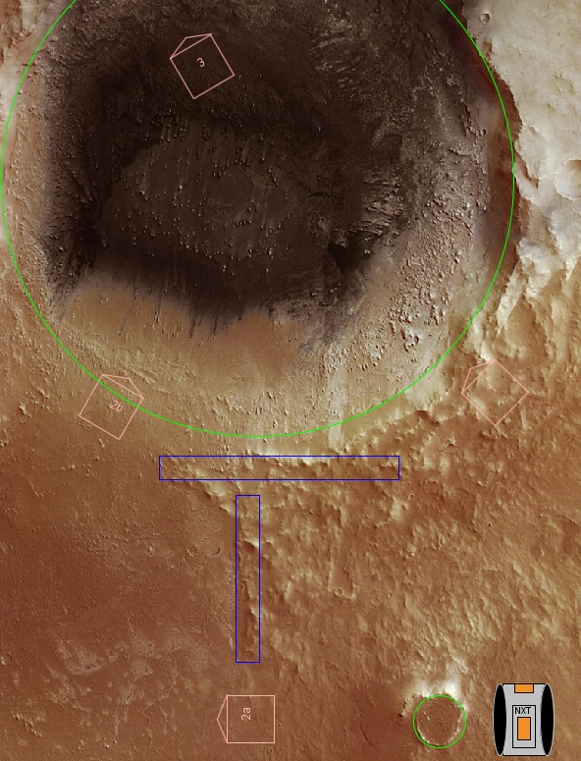
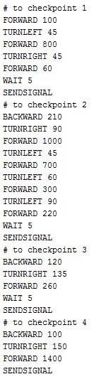
Sagan
http://sagan.be/

Slide 14
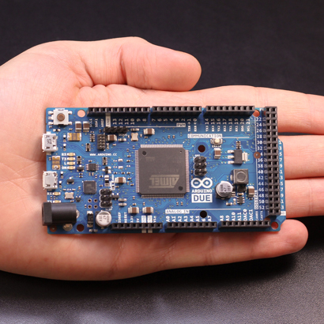
Arduino
http://www.arduino.cc/

Slide 15

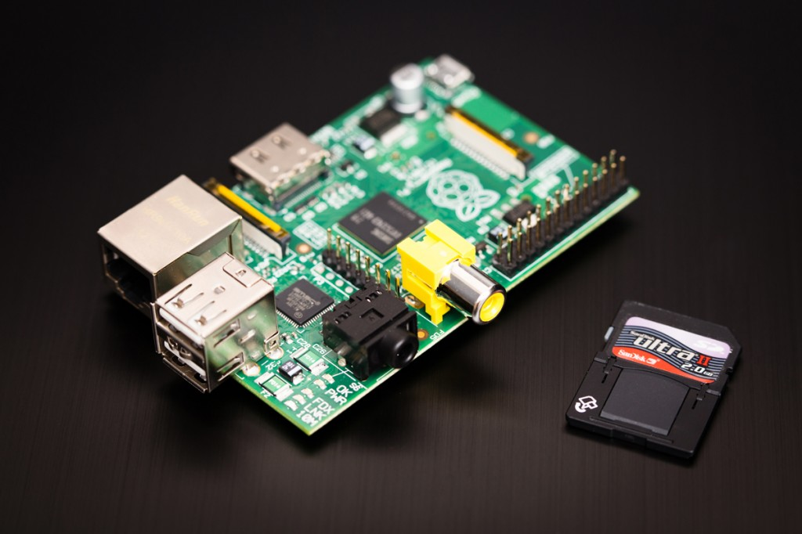
Raspberry Pi®
http://www.raspberrypi.org/

Slide 16
Events for kids

Slide 17
http://www.devoxx.com/display/4KIDS/Home

Slide 18


FIRST LEGO League
http://firstlegoleague.org/
The Robot Game and Project are what teams do. The FLL Core Values are how they do it.

Slide 19


http://makerfaire.com/
Make magazine
Maker faire
Make projects
Make kits

Slide 20

VHTO
Talent watcher
Mirror image
Speeddating
Class
Girlsday
http://vhto.nl/

Slide 21
Office Hour
Thursday 10:40 AM
Expo Hall (Table 1)
Come chat with us about:
  teaching kids to code
  kids programs
  kids events

Slide 22
Devoxx 4 kids video
http://vimeo.com/51393678

