Slide 1
wabi-sabi 侘寂
the beauty of imperfection
rachelnabors.com @RachelNabors

Slide 2
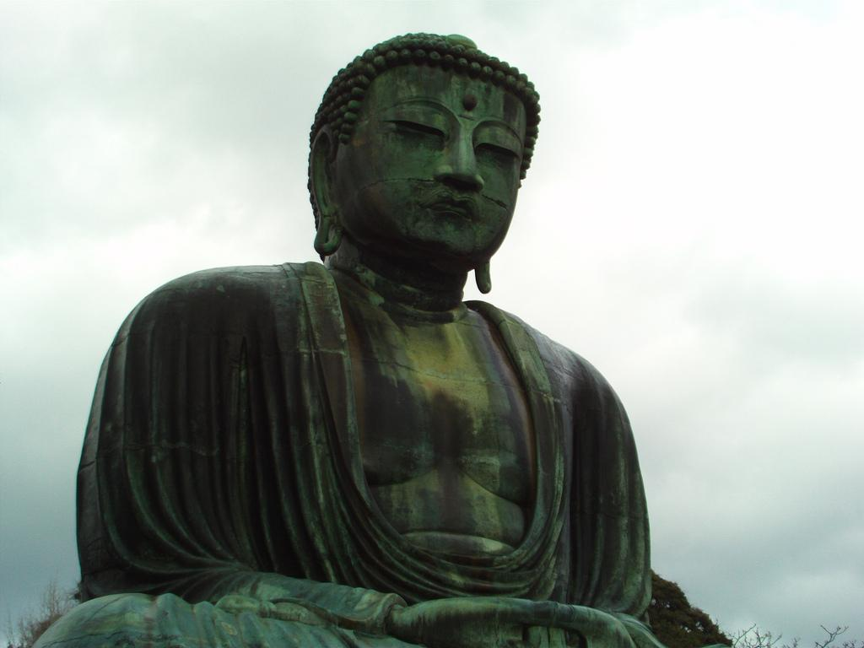
everything is imperfect incomplete impermanent
Jennifer Feuchter http://www.flickr.com/photos/jennerosity/

Slide 3
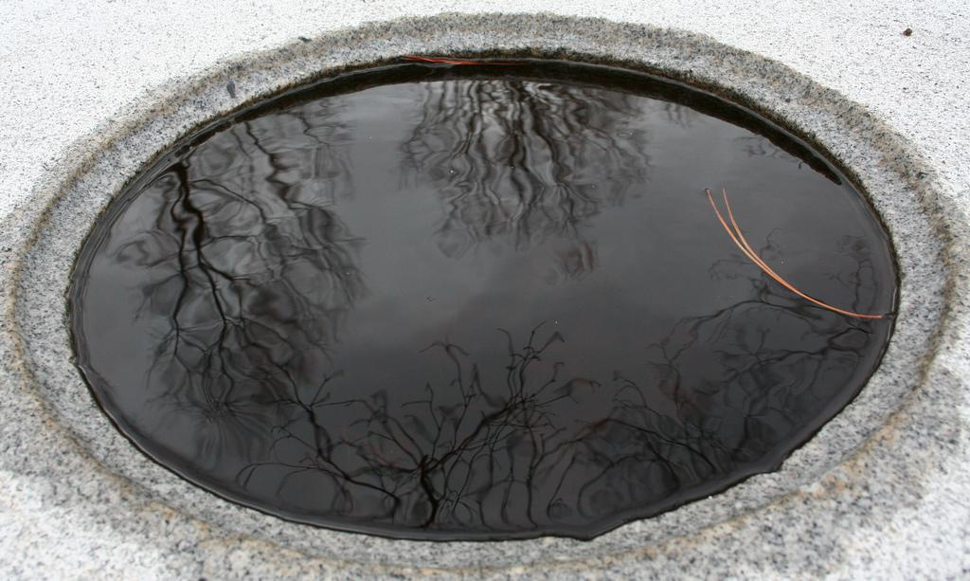
the beauty of...
character
age
weathering
utility
...ugliness
Kelly Teague http://www.flickr.com/photos/span112/

Slide 4
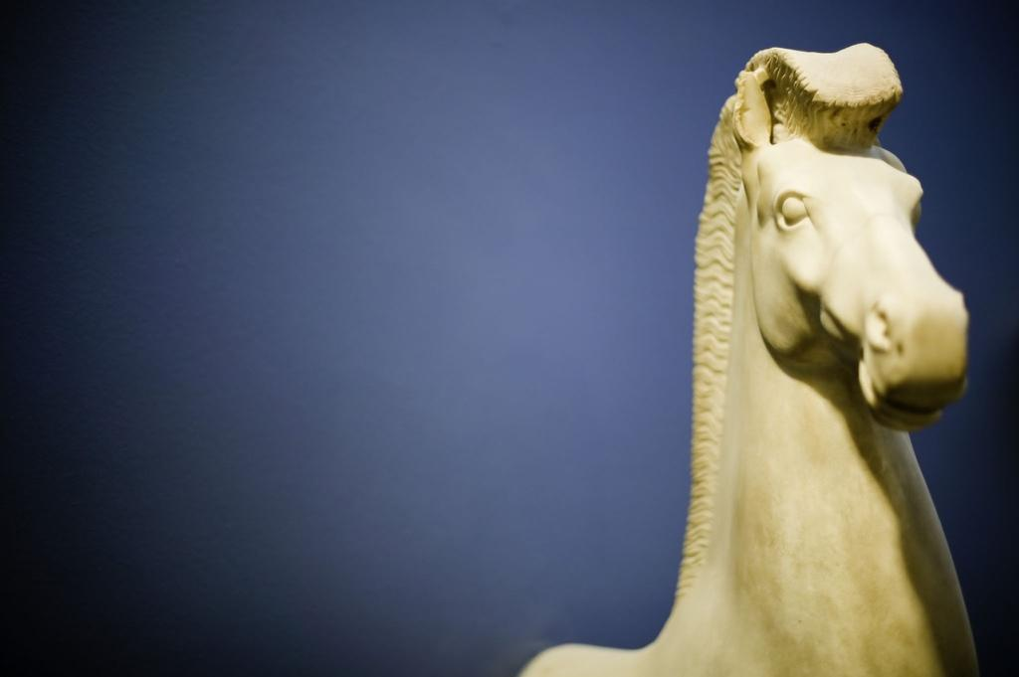
(im)perfect
Jared Zimmerman http://www.flickr.com/photos/spoinknet/

Slide 5
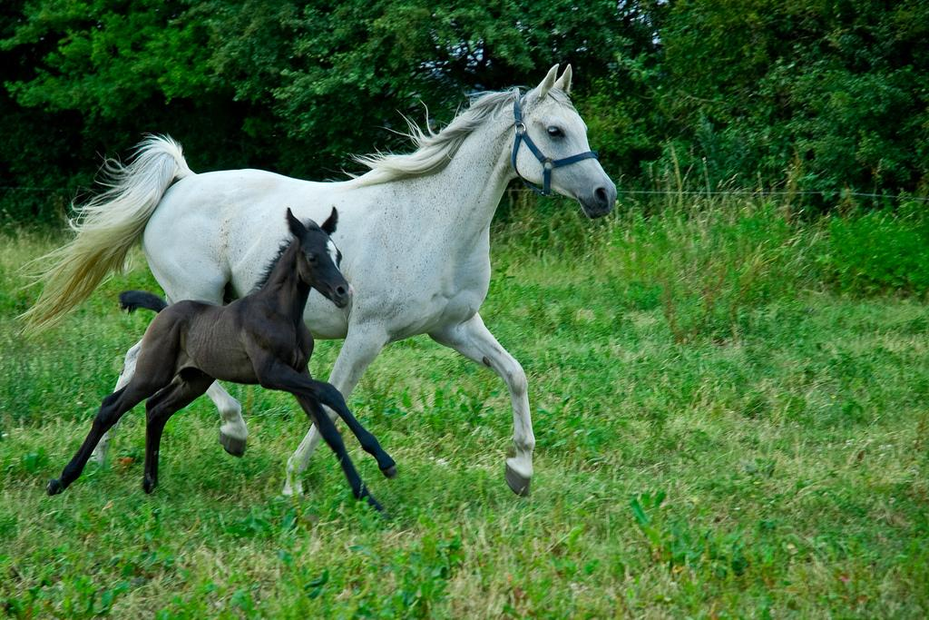
Jan Ingemansen http://www.flickr.com/photos/nomanson/

Slide 6
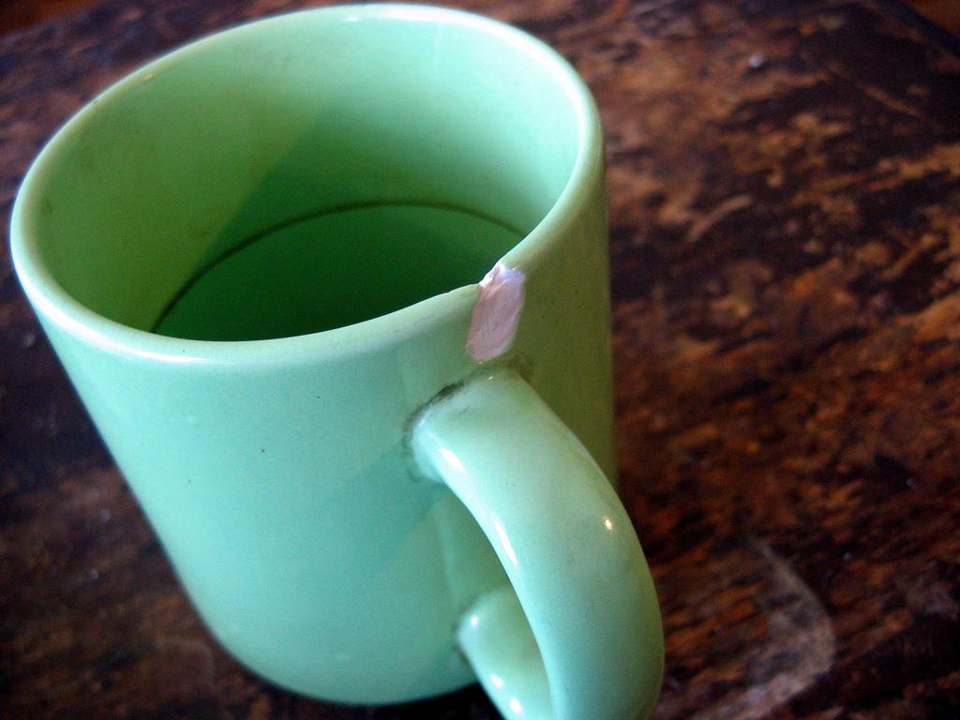
With time, imperfections only become more pronounced.
Jürgen Fauth http://www.flickr.com/photos/muckster/

Slide 7
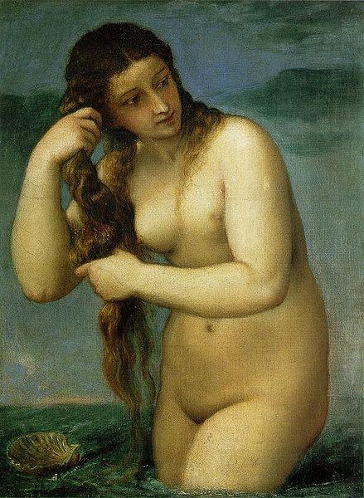

Perfection then and perfection now
Guillermo http://www.flickr.com/photos/memoflores/

Slide 8
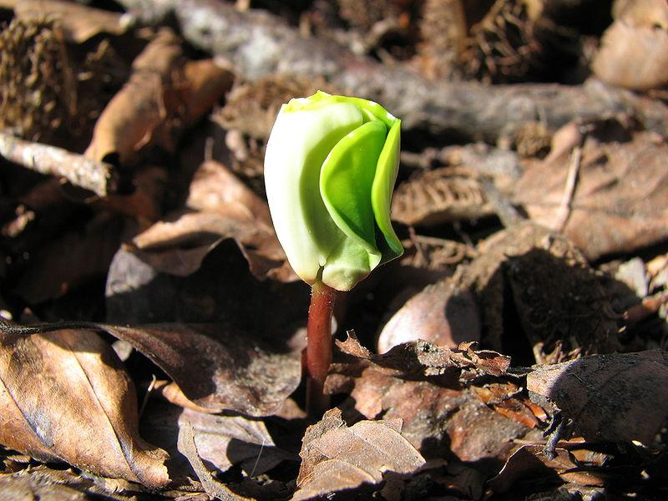
(in)complete

Slide 9

Projects are never truly complete.

Slide 10
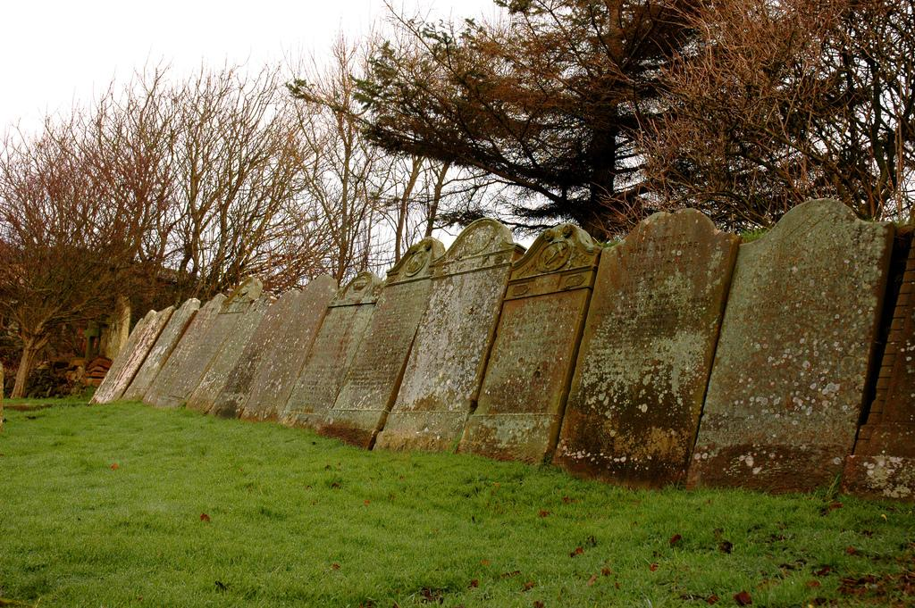
(im)permanent
Tim Duckett http://www.flickr.com/photos/tim_d/

Slide 11
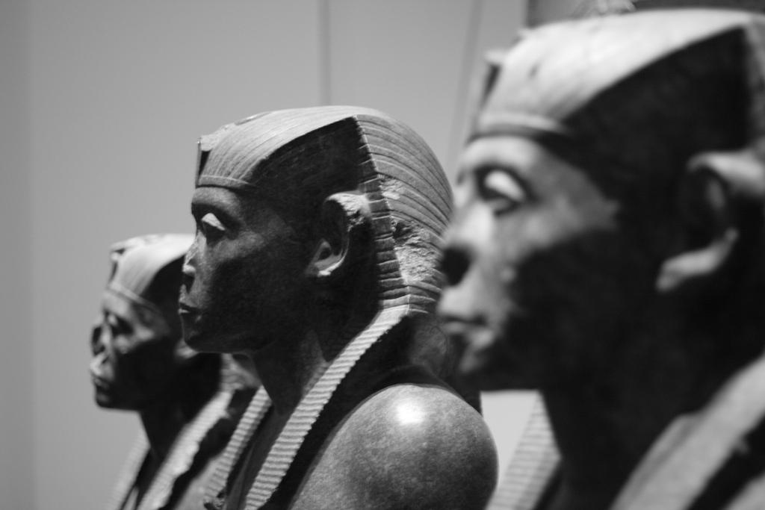
We like to think that we can leave some lasting mark in the Universe.
Jamie Carter http://www.flickr.com/photos/letsbook/

Slide 12
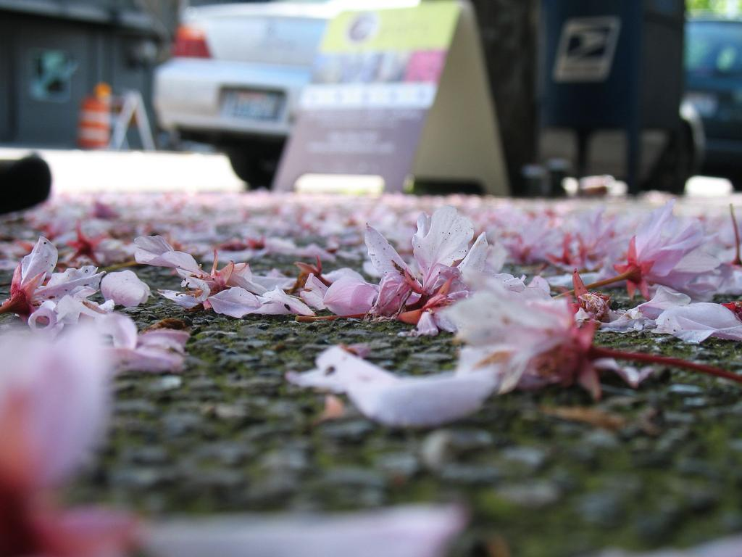
The Universe trudges ever onwards.
rakka http://www.flickr.com/photos/rakka/

Slide 13
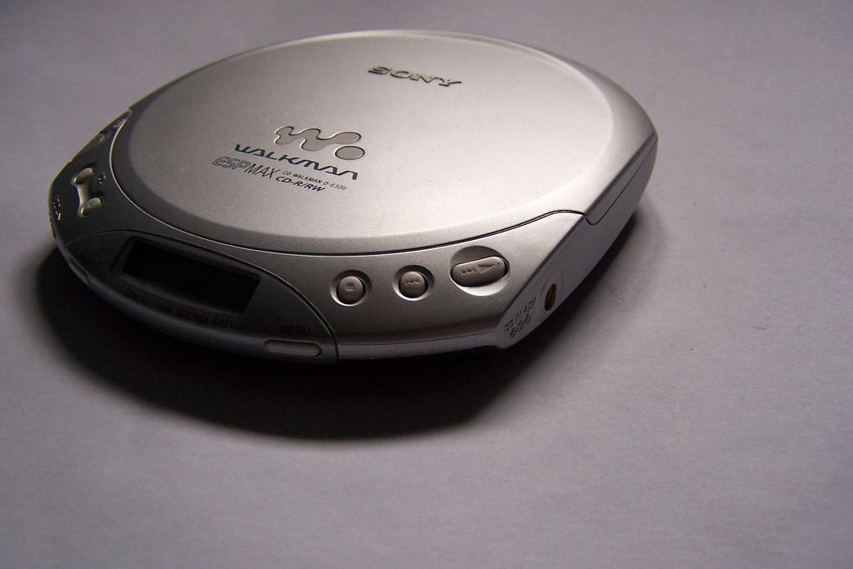
Don’t expect the solutions of today to work on the problems of tomorrow.
http://www.flickr.com/photos/roberthl/

Slide 14
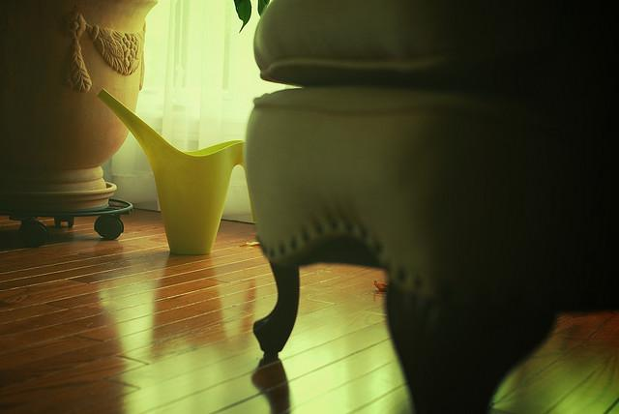
Utility
Steve Mishos http://www.flickr.com/photos/flyzipper/

Slide 15
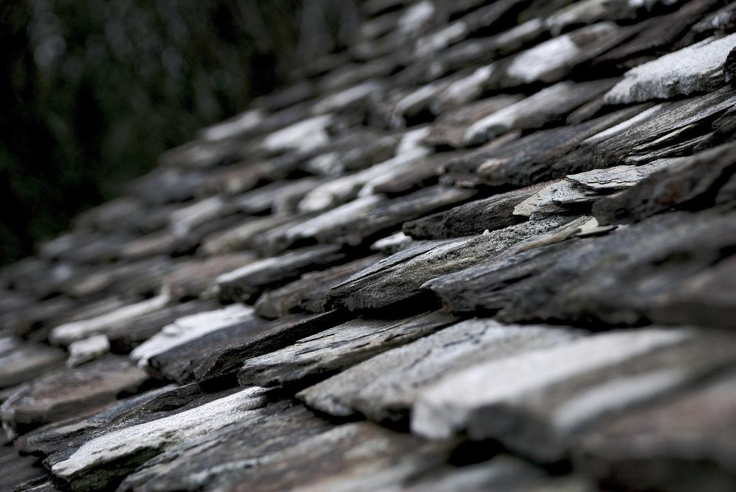
“Don't make something unless it is both necessary and useful;
but ...don't hesitate to
make it beautiful.”
—Shaker saying
Chris Jackson http://www.flickr.com/photos/abundanceguy/

Slide 16
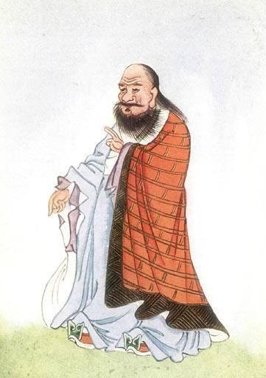
The “reality”
of a room exists in the empty space within
the room.

Slide 17
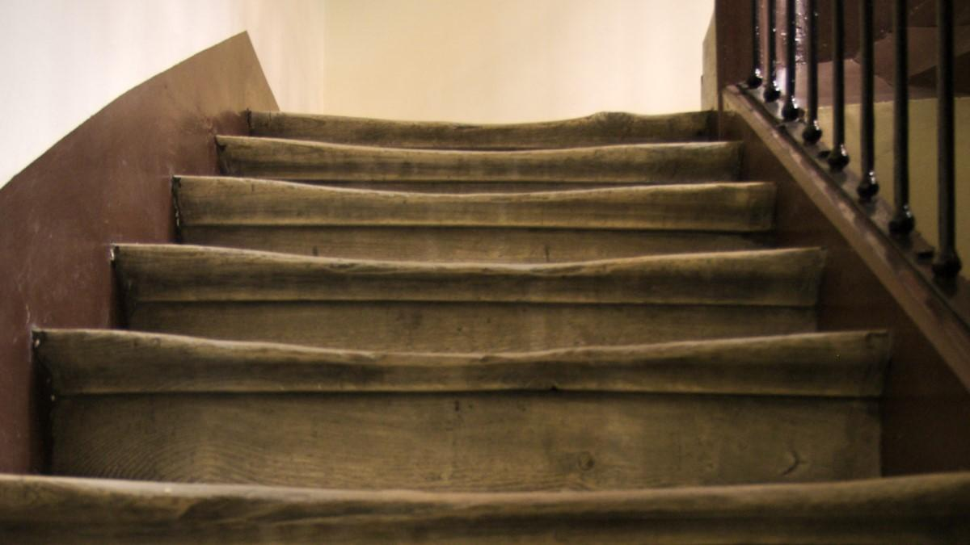
True beauty only becomes apparent with use.
van Ort http://www.flickr.com/photos/vanort/

Slide 18
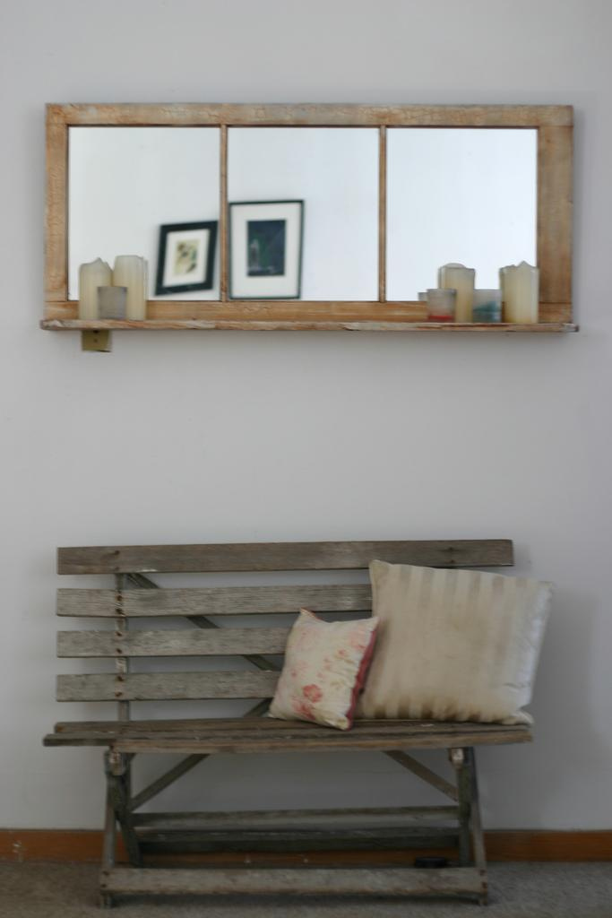
You can’t
buy wabi-sabi at Pottery Barn.
http://www.flickr.com/photos/fling93/

Slide 19
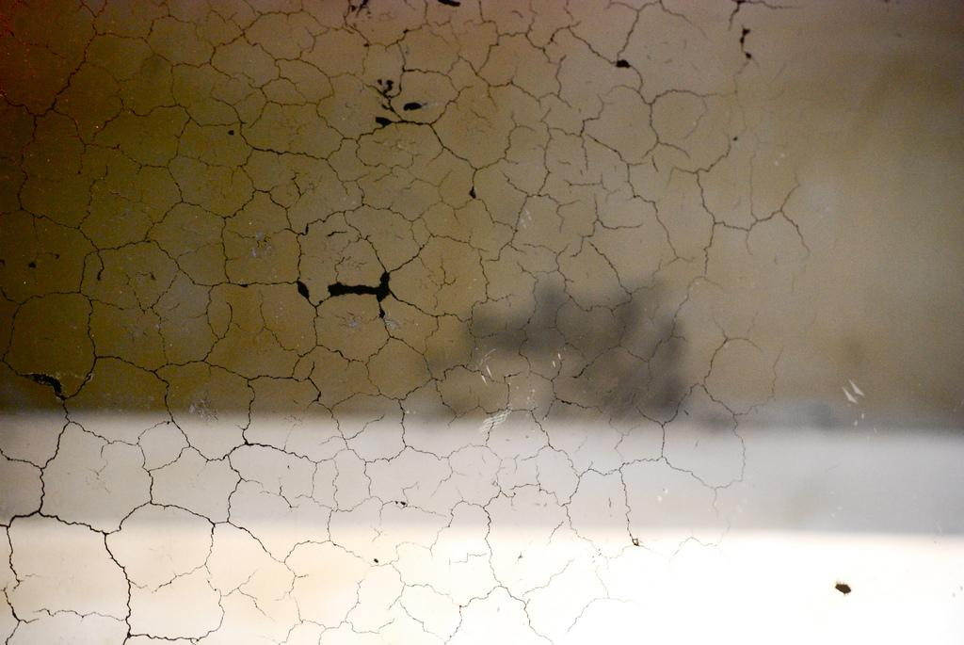
an acceptance of the
natural order of things
Sean Ganann http://www.flickr.com/photos/essgee/

Slide 20

find me on Twitter @rachelnabors

