Slide 1

Design Principles of
Miško Hevery
Father of AngularJS
Notes:
\

Slide 2
The Principles
Boilerplate
D.R.Y.
Structure
Testability

Slide 3
2009: GetAngular
<angular/>

Slide 4

Project
Results
17,000 LOC
1,500 LOC
Before
with Angular

Slide 5

<div>
<span>
<ul>
RAM
Database
<li>
<li>
<li>

Slide 6
Data Binding
Eureka: DOM
<html ng-app>
<body>
<input ng-model='user.name'>
<p ng-show='user.name'>Hi {{user.name}}</p>
<script src='angular.js'></script>
</body>
</html>

Slide 7
{{ databinding }}
<div>
Logic
RAM
<span>
<ul>
<li>
<li>
<li>

Slide 8
MVC
<html ng-app>
<body ng-controller='UserCtrl as uCtrl'>
Hi <input ng-model='uCtrl.user.first'>
<button ng-click='uCtrl.bye()'>bye</button>
<script src='angular.js'></script>
<script src='UserControllers.js'></script>
</body>
</html>
function UserCtrl() {
this.user = {
first:'Larry',
last:'Page'
};
this.bye = function() {
alert('bye:' + this.user.first);
};
}
index.html
UserController.js

Slide 9
Structure
<div>
UI / View
(DOM)
Observes
Data / Model
(JS Objects)
<span>
<ul>
RAM
<li>
Notifies
Manages
Logic / Controller
(JS Classes)
Notes:
Look at the arrows
Logic can be instantiated without view
View is declarative

Slide 10
Dependency Injection
function UserController(voiceSynth) {
this.user = { first:'Larry', last: 'Page' };
this.bye = function() { voiceSynth.say('bye') };
}
function VoiceSynth(webAudio) {
this.say = function(text) {// do Web Audio stuff};
};
var myApp = angular.module('myApp', []);
myApp.controller('UserController', UserController);
myApp.service('voiceSynth', VoiceSynth);
Module: myApp
View (DOM)
UserController
VoiceSynth
WebAudio

Slide 11
Dependency Injection: Mocking
function VoiceSynthMock() {
this.say = function(text) {
this.said.push(text);
};
this.said = [];
};
var myMocks = angular.module('myMocks', ['myApp']);
myApp.service('voiceSynth', VoiceSynthMock);
Module: myMocks -> myApp
View (DOM)
UserController
VoiceSynth
VoiceSynthMock
WebAudio

Slide 12
Imperative
Declarative
{{ databinding }}
ng-hide
ng-controller
ng-model
Eureka!!!
my-tab
my-pane
my-map
Notes:
Imperative for logic
Declarative for templates and configuration

Slide 13
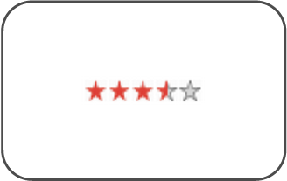
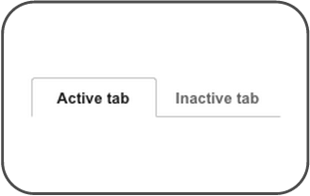
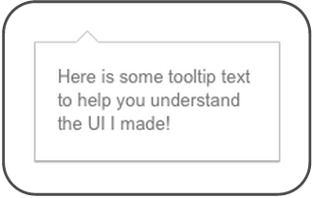
Directives as Components
<rating max="5" model="stars.average">
</rating>
<tabs>
<tab title="Active tab">...</tab>
<tab title="Inactive tab">...</tab>
</tabs>
<span tooltip="{{messages.tip1}}">

Slide 14
Live Coding

Slide 15
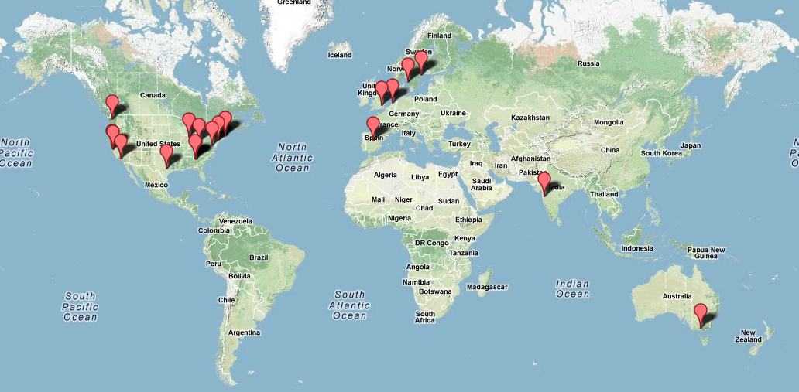
Community

Slide 16




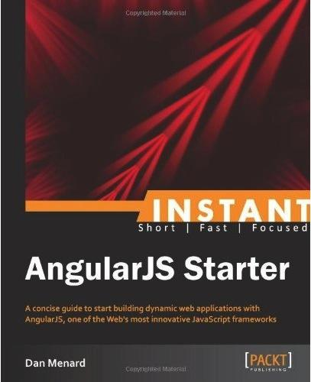





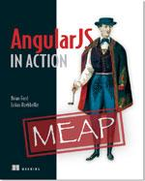



Ecosystem
Tools
UI Components
Libraries
Books
Batarang
AngularUI

Slide 17
Thank You!
angularjs.org
+angularjs
@angularjs
@mhevery
Code samples: http://goo.gl/N1sCd
Notes:
https://github.com/mhevery/ng-google-io/commits/master

