Slide 1
Unleashing the Power of Medicare Data to Accelerate Health System Change
Niall Brennan, Director
Office of Information Products & Data Analysis, CMS
October 16, 2012

Slide 2
Introduction
CMS is the largest single payer for health care services in the US
1.3 billion claims submitted annually
Significant additional data sources on the way
EHRs
Medicare Advantage plan encounter data
Health Insurance Exchange/Medicaid expansion data
Receive billions of other “non-claim” data points
Transition from a passive payer to active purchaser
Expected to drive new innovation in health care
Trusted to protect beneficiary privacy

Slide 3
CMS is Transforming Its Approach to Data Analytics and Dissemination
June 2012: Established standalone office dedicated to data analytics
Employ advanced analytics to create actionable information products for internal and external use
Explore new policies to support more flexible use and reuse of CMS data
Expand pool of CMS data users while maintaining appropriate beneficiary protections
E.g., establish data enclave/portal to expand secure access to different levels of CMS data for a wider range of users

Slide 4
Monthly Data Feeds for ACOs
CMS is sending near real-time data to Accountable Care Organizations (ACOs) for patients enrolled in ACO
Include beneficiaries entire claims history, including all service types, procedures and supplies.
Opportunity for private sector to help ACOs transform the data to actionable clinical information

Slide 5
Medicare Data Sharing for Performance Measurement
NOW
FUTURE
INSURANCE COMPANIES
MEDICARE?
INSURANCE COMPANIES
MEDICARE?
Qualified Entity
COMPREHENSIVE
CONSISTENT
FAIR ACTIONABLE

Slide 6
Blue Button Data
VA, DoD and CMS effort to give patients access to their own data (FEHB plans beginning to also offer blue button)
300,000 CMS beneficiaries have downloaded their data to date
2012 enhancements:
Moving from 1 year of data to 3 years of data
Moving from Parts A and B data to Parts A, B and D data
Need private sector innovation and engagement to maximize utility of Blue Button Data

Slide 7
Medicare Data Availability
Medicare Geographic Variation data available publicly
Includes demographics, utilization, cost and quality indicators
Data from 2007-2010…..2011 coming soon!
Permits any user to immediately assess their regions health system performance relative to other areas / national averages.
Institute of Medicine http://iom.edu/Activities/HealthServices/GeographicVariation/Data-Resources.aspx
CMS website Public Use Files
www.cms.gov/Research-Statistics-Data-and-Systems/Statistics-Trends-and-Reports/Medicare-Geographic-Variation/index.html

Slide 8
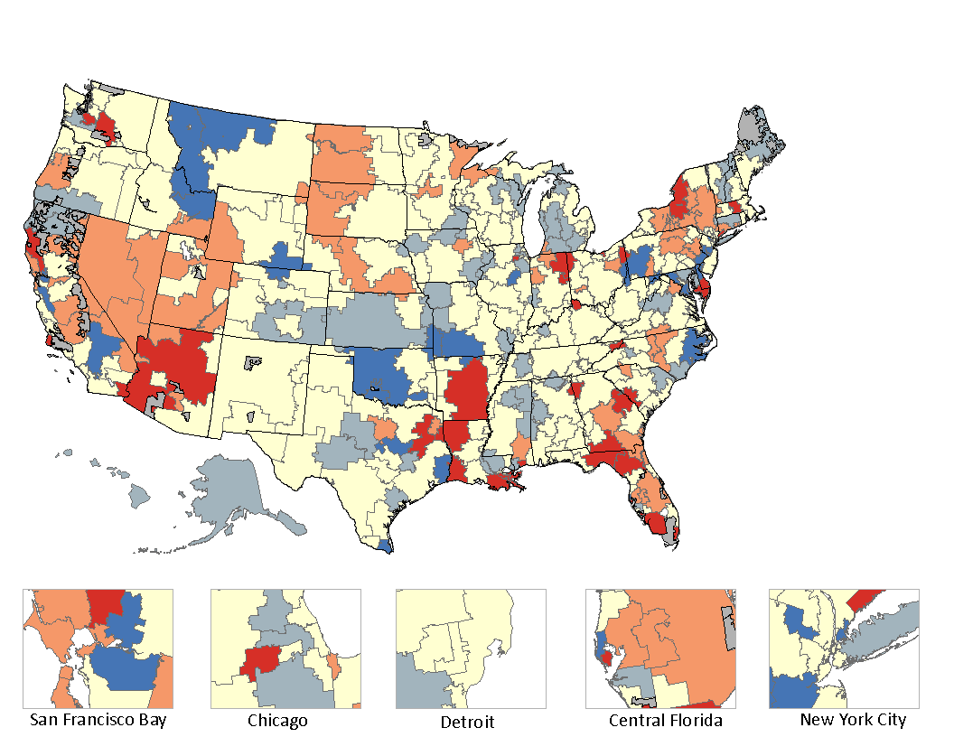
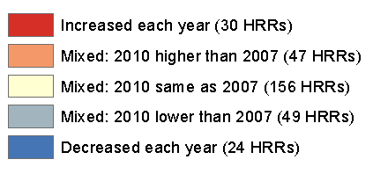
Change in Readmission Rates (2007-2010) by HRR
Readmission rate dropped from 21.7% to 20.2% in Harlingen, TX
Notes:
Note here that Harlingen was one of the areas where the QIO worked on care transitions under the 9th SOW

Slide 9
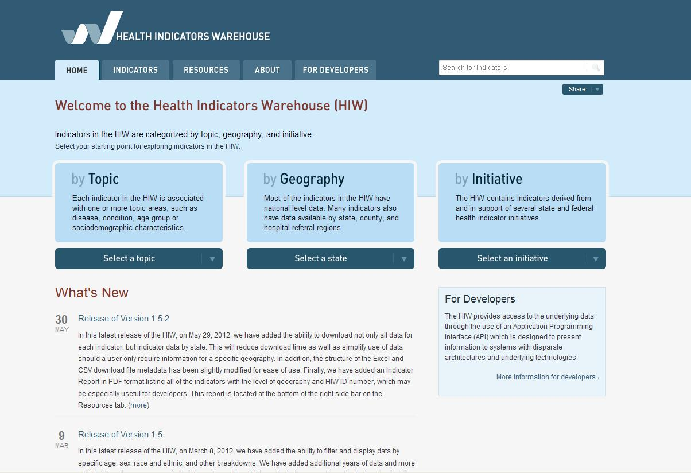
Health Indicators Warehouse www.healthindicators.gov/
Single, user-friendly, source for national, state, and community health indicators
Facilitate harmonization of indicators across initiatives
More than 1,000 indicators; 172 are at the hospital referral region level and 81 have county level data
Indicators used for:
Healthy People 2020
County Health Rankings
Community Health Status Indicators (CHSI)
Medicare quality and utilization indicators initiative

Slide 10
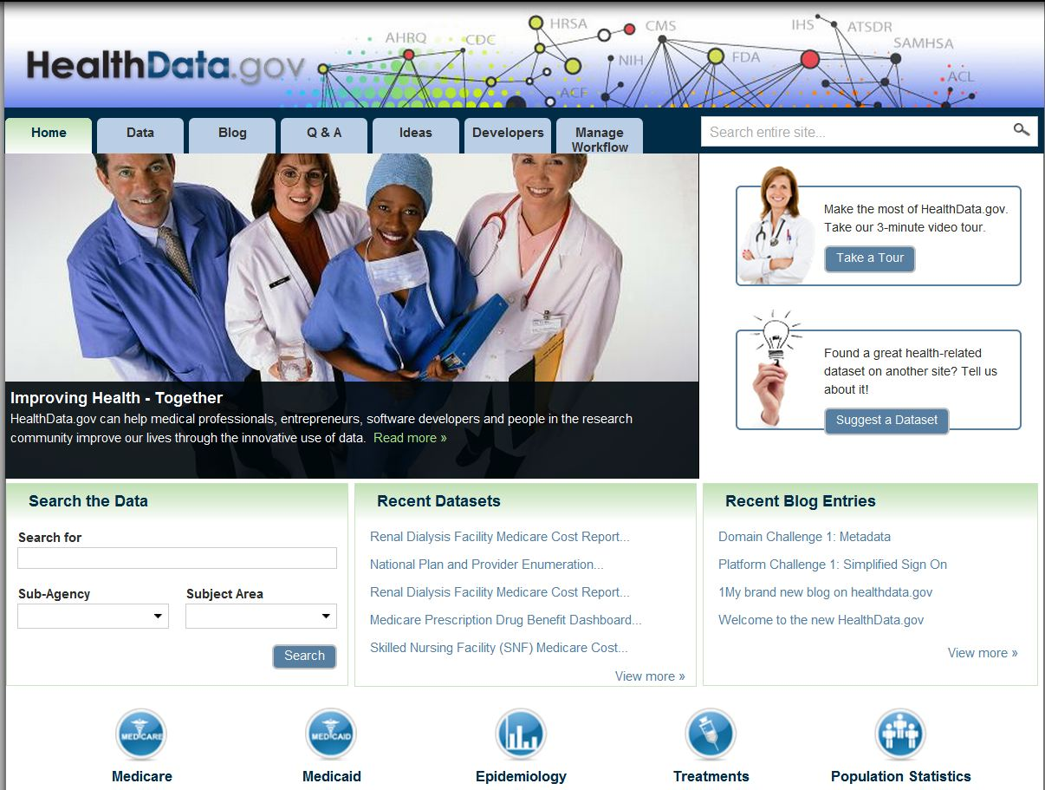
Health Data.gov
One-stop shop for health data
Increasing access to open health data
Over 300 data sets available
32 Data sets with APIs – and more are coming

Slide 11
Health Data Initiative Forum III
Washington, DC June 2012
1,600 Attendees
Industries included: business, health care, venture capital, government, academia
Data owners and users in one place
Over 250 Applications using open health data featured
5 Health Data Affiliates Launched
More information at www.hdiforum.org

Slide 12
Health Data Initiative Forum IV June 3 – 4, 2013 Washington, DC @ Omni Shoreham
Washington, DC
Omni Shoreham
June 3 – 4, 2013
More information at www.hdiforum.org

