Slide 1
Convergence of Genomic and Phenomic Data
What Does this Mean for the Future of Personalized Medicine?
StrataRx
October 16th, 2012
Alexis Borisy

Slide 2
Disclosure of Financial Interests:
Foundation Medicine, Co-Founder and Chairman
Blueprint Medicines, Co-Founder and Board Member
Warp Drive Bio, Interim CEO and Board Member
Forma Therapeutics, Co-Founder and Chairman
Third Rock Ventures, Partner

Slide 3
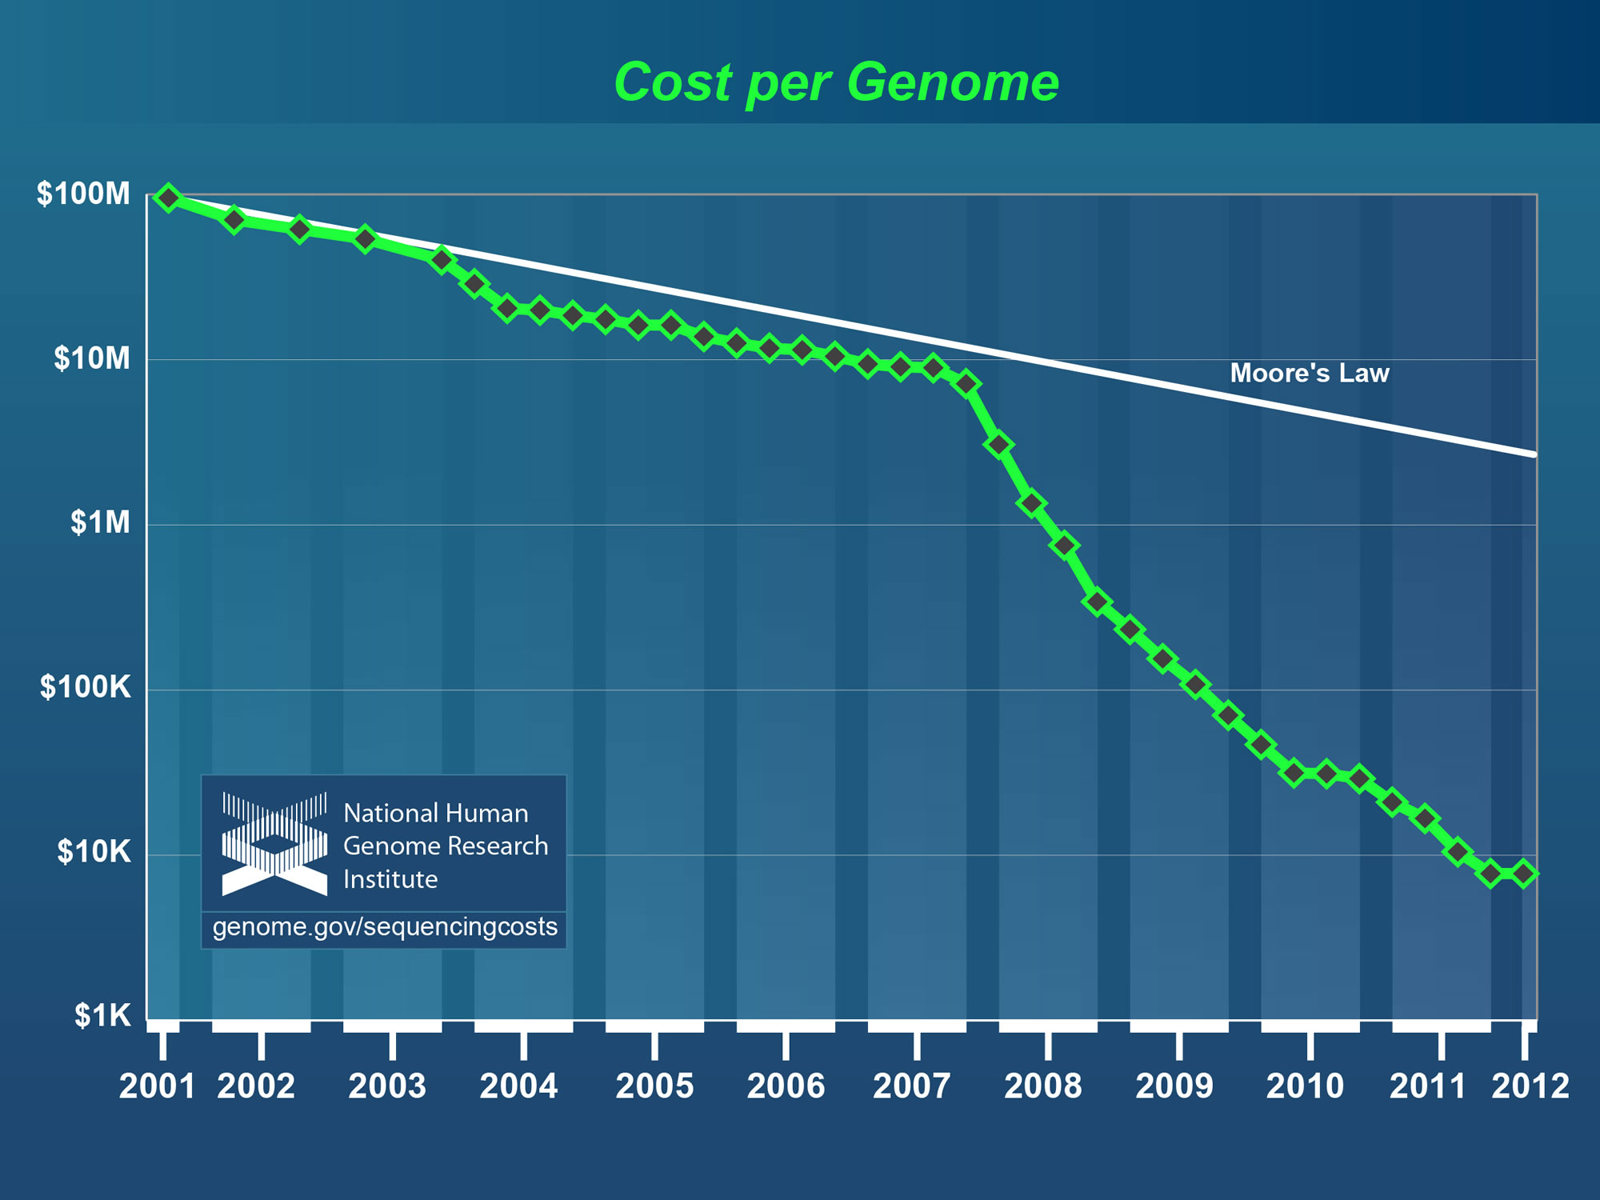

Slide 4
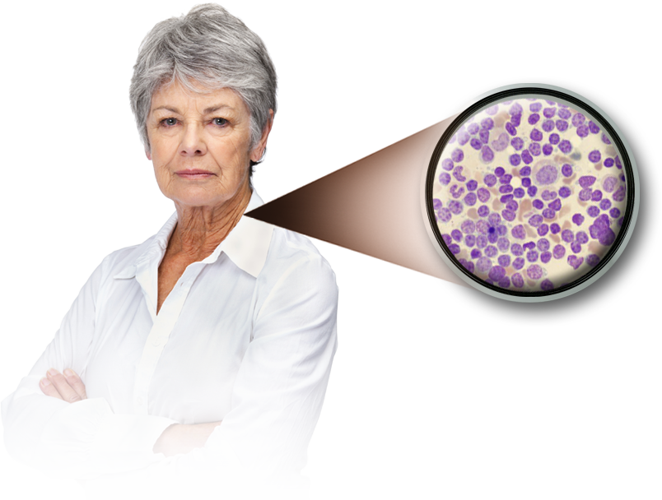
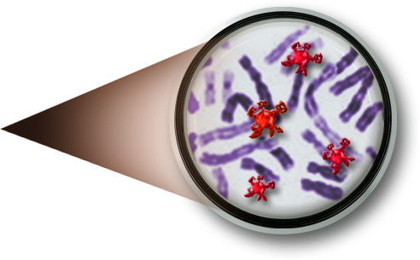

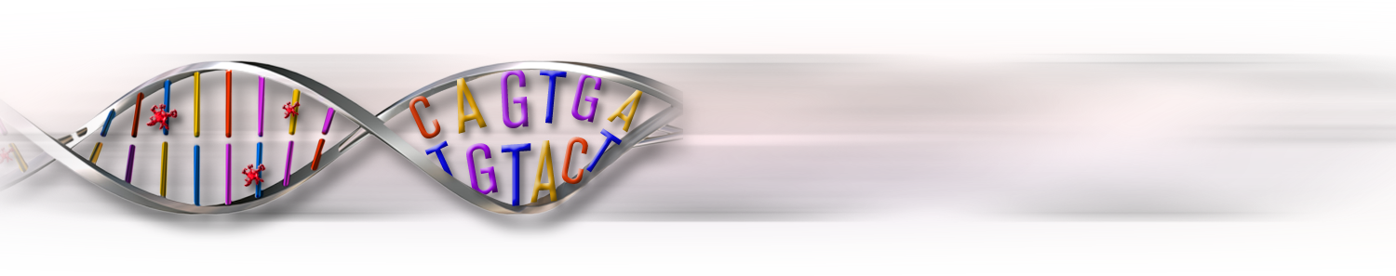
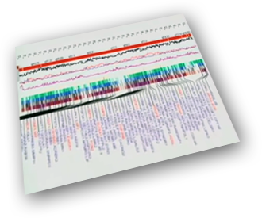
‘Translating’ each Cancer’s Genome
Cancer Cells
Cancer Genes
Gene Alterations
4
CONFIDENTIAL

Slide 5




Personalized Medicine of the future
Preventative, predictive, personalized
KNOWLEDGE
Drug + Diagnostic + Device + Healthcare
In Vivo
Pathology
PERSONAL IMAGING
PERSONAL GENOMIC DATABASES
PUBLIC GENOMIC DATABASES
HEALTH CARE DATA BASES
RIGHT PATHOLOGY
RIGHT PERSON
RIGHT PHARMACOLOGY
RIGHT
TIME
RIGHT
DRUGS
Biosensors
Personal Algorithm
Focal
Delivery
Wireless
Implantable
Devices
Information Technology

Slide 6
Ineffective therapies: One size Does Not Fit All
Average percent of patient population for whom a particular drug in a class is ineffective
Asthma Drugs
Arthritis Drugs
Cancer Drugs
Antidepressants
Diabetes Drugs
Alzheimer’s Drugs
Source: Personalized Medicine Coalition

Slide 7
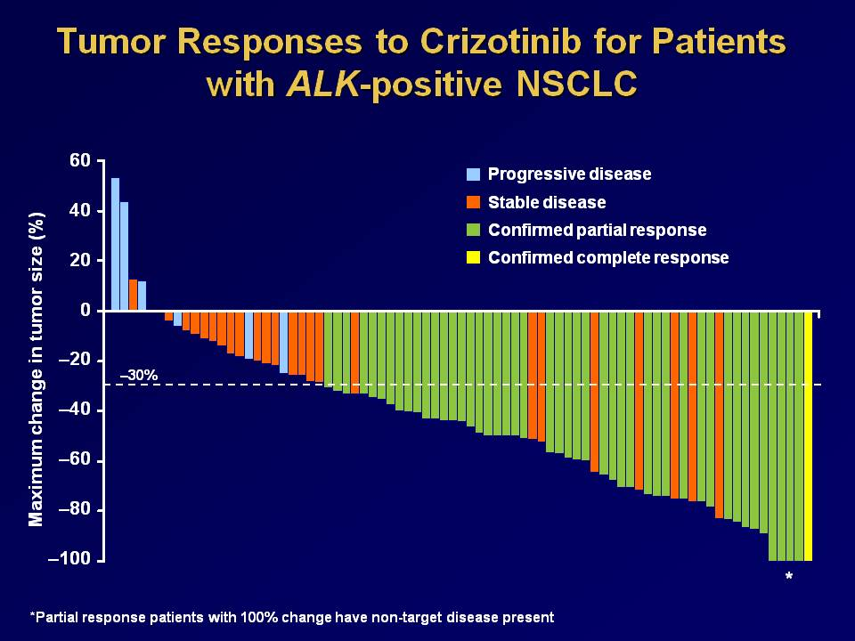
Source: Pfizer

Slide 8
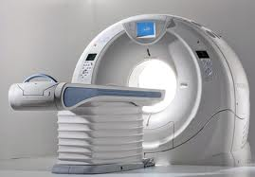

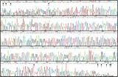
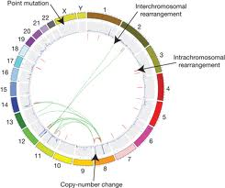
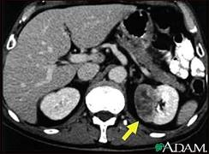
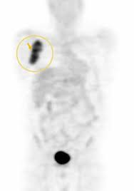
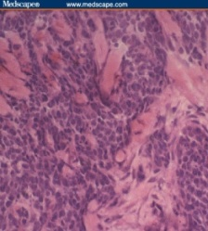
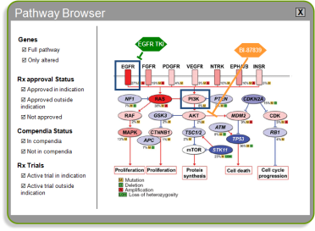
Provides a Molecular “Portrait”
Comprehensive imaging and pathology review of cancer is standard medical practice before treatment
Comprehensive description of the genomic and other molecular aberrations will become standard of care
8

Slide 9


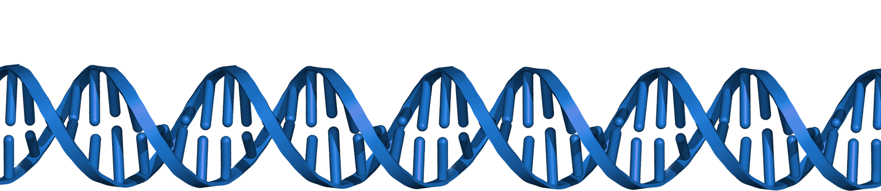
the diagnostic test – IT/Data/personalized medicine
THE TESTS
Mutational Status of Genome
Epigenetic Analysis
Genome-Wide Expression Profiling
Genome Wide Proteomics
Imaging
Systems Analysis
Data
Analysis
Design
Data
Generation
Interpretation

Slide 10

Phenotype
Genotype

Slide 11
Healthware with network effects
Information Identification
Plausible action
Mutations – SNPs
Biomarkers
Pharmacogenomics
CNVs
Potential interventions
Phenotypic traits
Others…
Diagnosis
Therapeutic
Other intervention
Tools/Algorithms
Network effects
Outcomes
genomic
proteomic
epigenetic
phenotypic
outcomes
Molecular datasets
Clinical datasets

Slide 12
Staged learning
Network Effect Learning System
time
PaTIENTS
and/or caregivers
Clinical analysis
Genomic analysis
Behavioral analysis
Clinical analysis
Genomic analysis
Patient Reported Data
Physicians
time
Longitudinal datasets
Track outcomes
Improve algorithm
Potential predictive power

Slide 13
POSSIBLE DATASETS
Cancer
Other
MDACC
MOFFIT and M2GEN
MSKCC, MGH
GCI
FOUNDATION MEDICINE
GOVERNMENT?
EMERGING NON-PROFITS?
DECODE
SAGE
VA
KAISER P
GEISINGER
DENMARK +

Slide 14
Data, operating system, and aPS
App
App
App
App
Operating System
Data

Slide 15
Personalized Medicine
RRIGHT INTERVENTION, RIGHT PATIENT, RIGHT TIME
COMMERCIAL
Genomically Matched Patients
Patient Social Media
Medical Social Media
Physician Decision Support
DTC
Wireless
Nutrigenomics
Therapeutics
Diagnostics
Imaging
Drug Development in Specific Populations
PRODUCT DEVELOPMENT
RGD
Cancer
Met/CV/other
Predictive
Algorithms
Comprehensive
Companion Dx
Molecular Dx
In vivo in genetic models
Genomic, epi, met, proteomic, microbial
Target ID & Validation
HCIT
Storage
Appliances
Data Pipeline
Analysis
Public Genomic Datasets
Private Genomic Datasets
Phenomic Datasets
Registries
Healthcare Datasets
HUMAN DATA

Slide 16
Right Intervention
Right Patient
Right Time

