Slide 1
Why Page speed isn’t enough
Betfair’s Performance Journey
Tim Morrow
Velocity Europe 2012
Notes:
My name is Tim Morrow I work at Betfair
I’ve spoken in the past about Betfair’s focus on performance as we built our new website platform to support our Sports betting website.
We defined a customer commitment, documented our target page load and put in place the measurements we needed to assert that we were meeting those commitments. Our average page load times dropped to 3 seconds or less.
However, when we spoke to our customers, they kept telling us our site was slow. They chose to remain on our old site.
Today I’m going to talk about what we learned from our customers and why measuring page speed isn’t enough.

Slide 2
Notes:
Betfair is a betting company; but we’re different to most other betting companies.
Our primary betting product is our betting exchange.
It’s a market for matching customer bets that works like a financial exchange.
Prices are constantly moving; customers can trade their positions before and during events
We have a broad customer base consisting of over 4m customers across 100s of countries and territories
They bet on a diverse range of events such as Horse Racing, Greyhounds, Soccer, Tennis, Golf, Cricket, Darts
And they exhibit different behaviours. Our customers range from grandmothers placing a £5 bet on the Grand National to professional trading businesses

Slide 3
Traded volumes
£63m
traded 2012 US Open Tennis
£1bn
traded Euro 2012
Notes:
Just to provide the scale: as money flows through our exchange, prices are changing 10 times per second
Automated trading tools and human customers take positions for and against outcomes
As events progress in-play, scores change and prices move as customers trade their positions
>>> For example, during the US Open tennis final, £63m pounds was traded during the 5 hour match on our exchange
>>> This summer during the Euro 2012 football competition £1bn pounds was traded
References: http://bit.ly/V1NQpq http://bit.ly/VeE3Ld

Slide 4
Notes:
Last year we published our customer commitment.
>>> We said “Our products will meet the needs of our customers by delivering a quick and responsive experience”
From a website perspective, we defined our promise in terms of full page load times
We added Keynote measures from 11 geographic locations with alerting in place and daily reports
We use our private webpagetest.org instance to continuously measure full page load times in our test lab
We instrumented our pages with Javascript to capture real user measures beaconed back to our analytics system

Slide 5
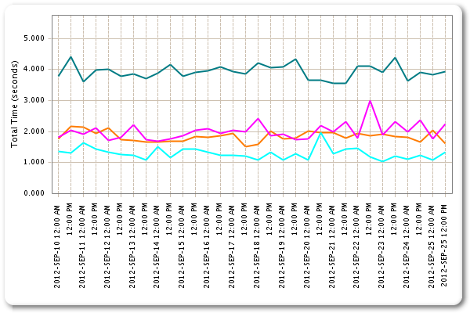
Notes:
And by those measures we made good progress.
Take a look at a 2 week front-end full page load measurement via a DSL Keynote agent
Each line represents a different page in a 4-page user journey. They vary based on the complexity of the page.
So in the first page, also our most complicated, we aren’t hitting our target 3 seconds, but other pages are significantly faster.
We saw similar improvements from our RUM measurements too

Slide 6
Customer feedback
“Its slower and harder to place bets in EVERY way”
“I am finding the new site very slow to place bets”
“I can complete this much quicker on the old site with fewer key strokes”
Notes:
We get feedback from customers via a number of mediums: They call us, respond to our on-line feedback form, they post in our forums
What did they have to say? There were many positive comments but there were equally as many comments complaining about it being slower.
>>> Slower and harder to place bets
>>> Same again
>>> Old site faster to complete tasks
But we had empirical proof it was faster; where was the gap in our understanding?

Slide 7
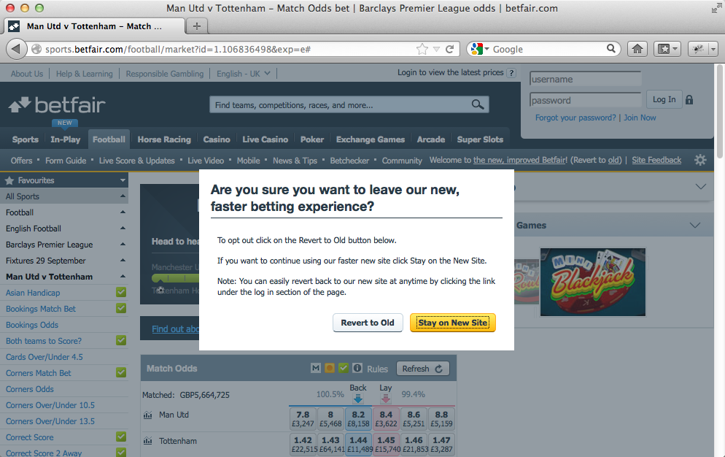
Notes:
So let me talk about the cost of this poor perceived performance
As we built the site, we provided the ability for customers to revert to use our legacy site; there was an option to click a link and select Revert To Old
>>> Click <<<
Initially our opt-out rate was low; we started with Football as the only available sport, then rolled out other sports in waves, increasing the breadth of our product offering and encompassing a greater proportion of our customer base
But, as we added those sports the number of customers choosing to opt-out increased; and those same customers chose to stay away even as we attempted to entice them back.
We had delivered lots of improvements and new features on our new site. It was a (functionally) better product.
So aside from the cost of maintaining two website products, there was a significant opportunity costs to have those customers continue to use our old site; it was imperative for us to understand the root issues and rectify them

Slide 8
Understanding our customers
Notes:
So we wanted to understand our customers and what their behaviours are
Betfair has a large and varied customer base; importantly our customers exhibit very different characteristics;
we analyse our customer activity via our web analytics and data warehouse and segment them based on their value within our ecosystem
We found our higher value customers were opting out and a significantly greater rate than other customers
So we took a look at our highest value customers

Slide 9
Customer segments
Visitors
Transactions
Notes:
So this first chart is showing the proportion of High Value customers (gold) to low value customers (blue).
Our highest value segments make up 23% of visitors
>>> Click <<<
However, they place 58% of bets
Again high value customers are gold, low value customers in blue
By focusing on the high value customers we could make the most impactful improvements

Slide 10
Task completion
Notes:
We examined the behaviours of our highest value customers and identified four key tasks that they perform most often.
Many of these tasks involve complex bet placements with dozens or hundreds of selections and a high degree of interaction with our site
We developed automated measurement of these tasks using Selenium in a test lab
Comparing them on our new site to the old site, we found the experience to be significantly worse.
Let me illustrate that

Slide 11
Example task
Notes:
Here’s a chart showing the timing of a complex task – typical of a high value customers.
The Y-AXIS is task completion time in seconds when executed via a Selenium script
Blue is our old site; Gold is our new site; clearly there was a massive gap.
>>> Click to see steps <<<
So we broke the task down into the individual steps that customers would take to complete this task
The data provides a stark illustration of the problem; there was something fundamentally wrong on our new experience
But because we hadn’t been measuring it we were oblivious – aside from the vocal customers who had taken the time to tell us our site was slow

Slide 12
Improvements
Notes:
We put together a team to review each journey and recommend improvements.
They quickly iterated and measured the performance at each iteration; we quickly achieved parity between new & old
This graph simply shows the improvement to the overall task completion time measured using our automated scripts as we iterated
This wasn’t some fundamental architectural problem – its what happens when you don’t focus on key areas; you layer feature upon feature; when you pace and don’t measure
Simply put, we took our eye off the ball

Slide 13
real customer journeys
Notes:
Next, we looked beyond our simplistic 4-page journeys that we’d worked so hard to optimize.
Again, we focused on our high value customer segments and examined their sessions and click patterns.

Slide 14
Customer behaviour
+80%
time on site
+30%
pages
Notes:
Our highest value customers spend a significant amount of time on site; 80% more than lower value customer segments
>>> They also visit 30% more pages, on average
So we knew fast navigation was important;
These customers navigate quickly between markets and place numerous bets per market while in-play
In this scenario, even 3 second full page loads would feel slow

Slide 15
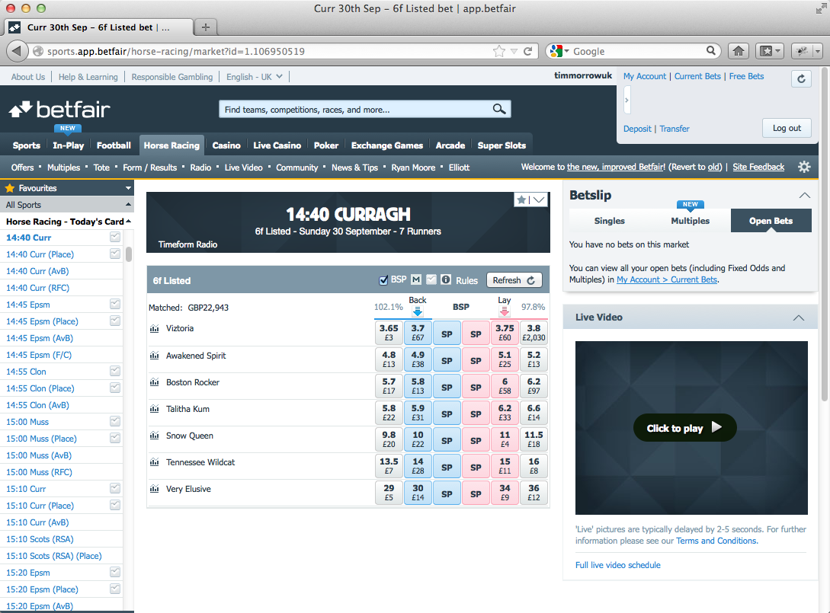
Notes:
We built our site in a loosely coupled modular fashion but launched only with server-side rendering of complete pages.
Our architecture consists of individual modules that render themselves when the data they need is available.
>>> Click 6 times to show modules <<<
Each of these is a module that requests its own data and can be rendered in isolation on the server-side
We exploited our architecture to add a navigation feature that only updates the bits of the page that change via Ajax; we still server-side render the page modules, but insert them into the page
>>> Click <<<
So if these modules are the only ones that need to change, that’s all that changes
The calls are lightweight and load pretty quickly
The rest of the page furniture remains static

Slide 16
Notes:
Let me illustrate this Ajax Architecture improvement
I’m going to play a 25 second video in which I’llto navigate through 21 horse racing markets.
The section in the middle – that provides the event header, runners, live prices – is different for each market.
Keep your eye on the page furniture – the header, the left-hand menu, the right-hand video module
>>> Click to Play <<<
The slowest part is the human clicking through the menu. That’d be me.
With 3 seconds page loads, this would have taken significantly longer
We’ve still got some work to do; currently at around 200ms, we’d like to get it down to 100ms – so they load in the blink of an eye

Slide 17
So what have learned?

Slide 18
Know your customers
Understand how your most valuable customers interact with your site
Notes:
Know your customers
Understand how your most valuable customers interact with your site
Speak to them; watch them use your product; ask their opinion; listen to their feedback
Use your analytics data to understand customer behaviours

Slide 19
Page Speed isn’t enough
Measure what matters for the customers that matter
Notes:
Page speed isn’t enough
Measure what matters for the customers that matter
Customers don’t come to your site to load the pages; they come to browse, to discover, to discuss, to build, to buy, to… bet
Identify key areas of concern and optimise transactional flows
Look to optimize the entire experience; consider implementation approaches such as Ajax architecture

Slide 20
You truly do get what you measure
Notes:
Always remember; you truly do get what you measure

Slide 21
Thank you
@timmorrow
http://betfair.jobs/

