Slide 1
Combining the Power of Hadoop with Object-Based Dispersed Storage

Slide 2
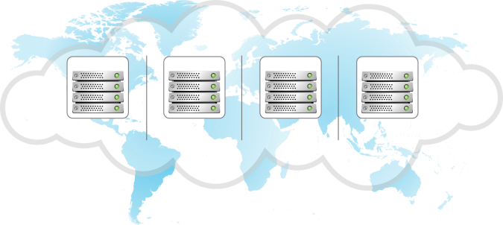
How Cleversafe’s Dispersed Storage Works
DATA
Cleversafe IDA
1
Data is expanded, virtualized, transformed, sliced and dispersed using Information Dispersal Algorithms.
[ Total slices = ‘width’ = N ]
2
Slices are distributed to separate disks, storage nodes and geographic locations.
SITE 1
SITE 2
SITE 3
SITE 4
[ Subset required to read = ‘threshold’ = K ]
3
Real- time bit perfect data is retrieved from a subset of slices.
Cleversafe IDA
DATA
Cleversafe Confidential Information

Slide 3
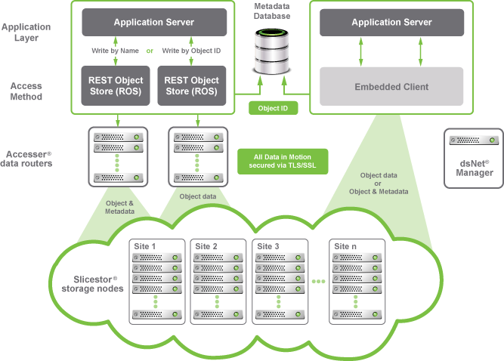
Object-based Access Methods

Slide 4
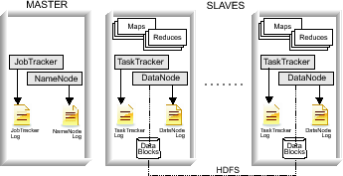
How Hadoop Works
Popular open-source MapReduce implementation, commercialized by Cloudera and others
Take the computation to the data, not the data to the computation
Compute
Storage
Cleversafe Confidential Information

Slide 5
Hadoop MapReduce Challenges
Enables computations where data exists but has limitations
HDFS utilizes a single server for metadata operations – if this server fails – data could be inaccessible or result in permanent loss of data. Federation helps but is passive/active with manual management
Maintains 3 copies of data for protection – not a big deal in terabyte range – but scale up to petabyte and Exabyte levels and management/overhead costs are unmanageable
Cleversafe Confidential Information

Slide 6
Combining computation and dispersed storage
Hadoop MapReduce computation runs directly on dsNet Slicestors
Jobs are assigned to stores for completely local data access
Replace underlying HDFS with Dispersed Storage® while maintaining HDFS interface to MapReduce process
dsNet Slicestor
dsNet Storage
Hadoop MapReduce
dsNet API
Local data access
Cleversafe Confidential Information

Slide 7
System Architecture
ACCESSERS
MASTER
SLAVES
Job Tracker
Maps
Maps
Reduces
Reduces
Task Tracker
Task Tracker
Job Tracker
Log
Object
Vaults
Metadata
Vaults
Analytic
Vaults
Cleversafe Confidential Information

Slide 8
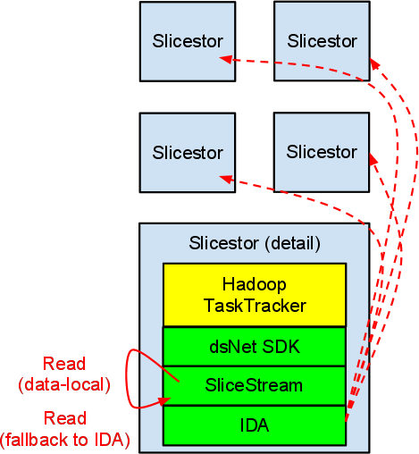
New SliceStream™ Protocol
Concept:
Manipulate input so that, after dispersal, raw data falls in contiguous chunks
Read directly from raw slices bypassing IDA reconstruction
Fall back to full IDA reconstruction if an error occurs
Result:
Full reliability/availability of dispersal
On a healthy dsNet, most reads for a MapReduce task can be satisfied locally
Cleversafe Confidential Information

Slide 9
Key Features and Benefits
Cost-effective scalability
Infinite scalability in a single system
Increased performance and productivity
Computation brought to the data
dsNet Slicestors provides both computation and storage
Geographic distribution enabled
Lower storage costs
Information dispersal calls for one instance of the data vs. 3x with replication
Significantly higher reliability and availability
Information dispersal eliminates single points of failure
Continuous data availability with multiple simultaneous device or site failures
Drop in replacement for existing MapReduce jobs via standard Hadoop File System interfaces
Cleversafe Confidential Information

