Slide 1

Hadoop, HBase, and Healthcare
Ryan Brush

Slide 2
Topics
The Why
The What
Complementing MapReduce with streams
HBase and indexes
The future

Slide 3
Health data is fragmented

Slide 4
Pieces of a person’s health
spread across many systems

Slide 5
How many times have you
filled out a clipboard?

Slide 6
Better-informed decisions
Application of best available evidence
We need to put the pieces
together again
Health recommendations
Systemic improvement of care

Slide 7
Some ways Hadoop is
helping solve this

Slide 8
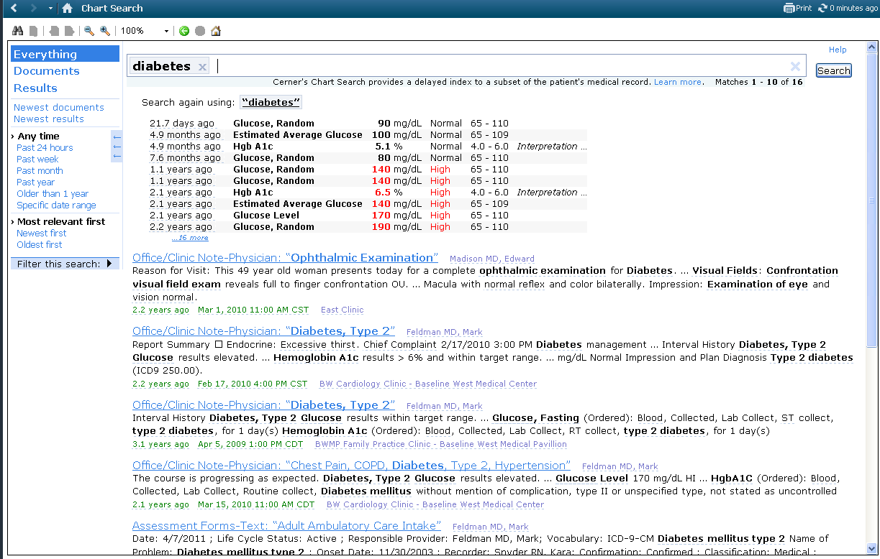
Chart Search

Slide 9
Chart Search
Information extraction
Semantic markup of documents
Related concepts in search results
Processing latency: tens of minutes

Slide 10
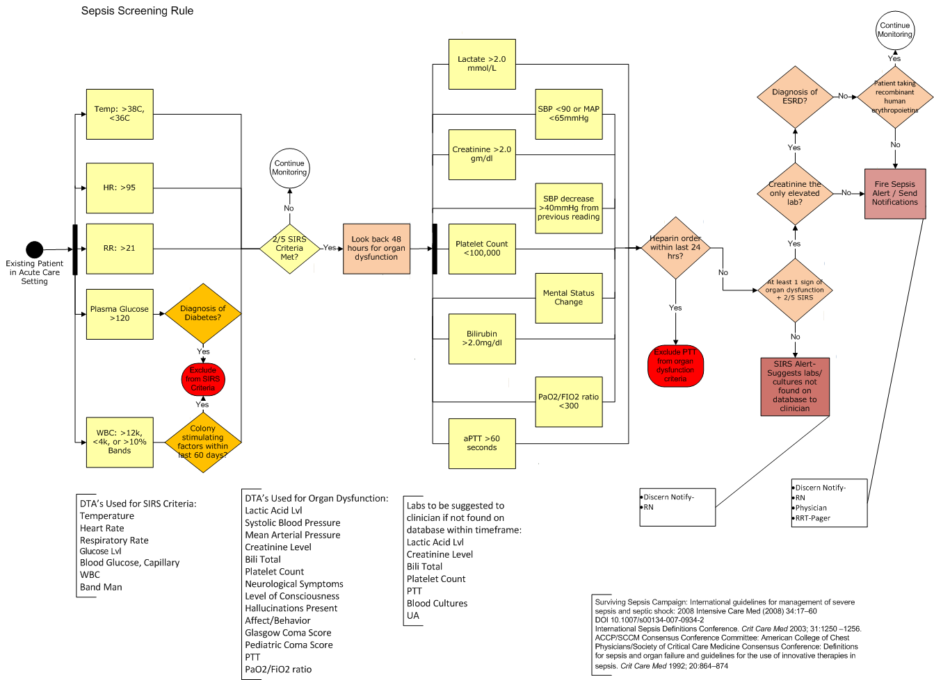
Medical Alerts

Slide 11
Medical Alerts
Detect health risks in incoming data
Notify clinicians to address those risks
Quickly include new knowledge
Processing latency: single-digit minutes
Notes:
This has actually saved lives!
Algorithms may be arbitrary complex

Slide 12
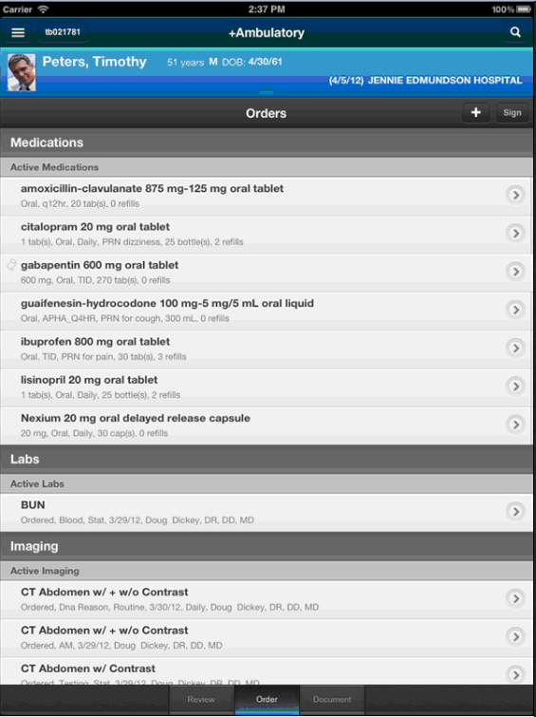
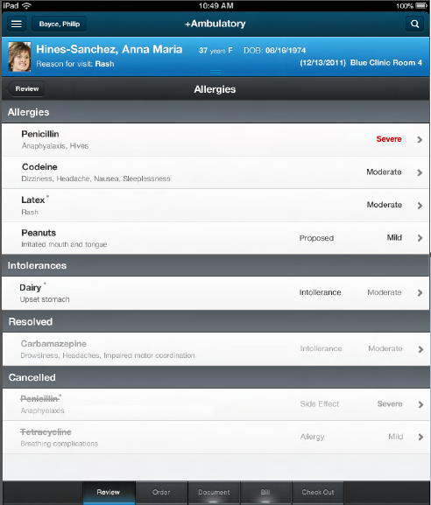
Exploring live data

Slide 13
Exploring live data
Novel ways of exploring records
Pre-computed models matching users’ access patterns
Very fast load times
Processing latency: seconds or faster

Slide 14
Care coordination
Personalized health plans
Population analytics
And many others
Data sets growing at hundreds of GBs per day
> 500 TB total storage
Rate is increasing; expecting multi-petabyte data sets
Notes:
Multi-petabyte data sets are in our future

Slide 15
A trend towards competing needs
Analyze all data holistically
Quickly apply incremental updates

Slide 16
A trend towards competing needs
MapReduce
Stream
(re-)Process all data
Move computation to data
Output is a pure function of the input
Assumes set of static input
Incremental updates
Move data to computation
Needs to clean up outdated state
Input may be incomplete or out of order
Both processing models are necessary
and the underlying logic must be the same

Slide 17
A trend towards competing needs
Speed Layer
Batch Layer
http://www.slideshare.net/nathanmarz/the-secrets-of-building-realtime-big-data-systems

Slide 18
A trend towards competing needs
Speed Layer
Move data to computation
Hours of data
Incremental updates
Low Latency (seconds to process)
Batch Layer
Years of data
Move computation to data
Bulk loads
High Latency (minutes or hours to process)

Slide 19



A trend towards competing needs
Speed Layer
Stream-based
Storm
Batch Layer
Hadoop
MapReduce

Slide 20
Into the rabbit hole
A ride through the system
Techniques and lessons learned along the way

Slide 21
Data ingestion
Stream data into HTTPS service
Content stored as Protocol Buffers
Mirror the raw data as simply as possible
Notes:
Mirror raw data is important – shift complexity to the cloud so it can be re-processed at any time
It does make cloud processing more complicated – see below

Slide 22
Process incoming data
Scan for updates
Initially modeled after Google Percolator
“Notification” records indicate changes
Scan for notifications
Data Table
source:1/document:123
source:2/allergy:345
source:2/document:456
. . .
source:150/order:71
Notification Table
source:1/document:123
source:150/order:71
Notes:
BigTable and HBase divide regions differently – BigTable need not deal with the scans of thousands of regions for a small amount of data.
Consumers scan notification table, batch get data

Slide 23
But there’s a catch…
Percolator-style notification records require external coordination
More infrastructure to build, maintain
…so let’s use HBase’s primitives

Slide 24
Process incoming data
Row Key | Qualifiers (lease record and keys of updated items)
split:0 | 0000_LEASE, source:2/allergy:345, source:150/order:71, …
split:1 | 0000_LEASE, source:4/problem:78, source:205/document:52, …
. . .
Consumers scan for items to process
Atomically claim lease records (CheckAndPut)
Clear the record and notifications when done
~3000 notifications per second per node
Notes:
Writers write notifications, must retry in case of failure
Scanners use a filter to limit what they get
Split rows to scale – haven’t had to do much of thisyet.

Slide 25
Advantages
No additional infrastructure
Leverages HBase guarantees
  No lost data
  No stranded data due to machine failure
Robust to volume spikes of tens of millions of records
Notes:
Most queuing systems would struggle with such large volume spikes

Slide 26
Downsides
Weak ordering guarantees
Must be robust to duplicate processing
Lots of garbage from deleted cells
  Schedule major compactions!
Simpler alternatives if latency isn’t an issue
Notes:
If latency isn’t an issue, just scan the data itself or run MapReduce jobs against it.

Slide 27
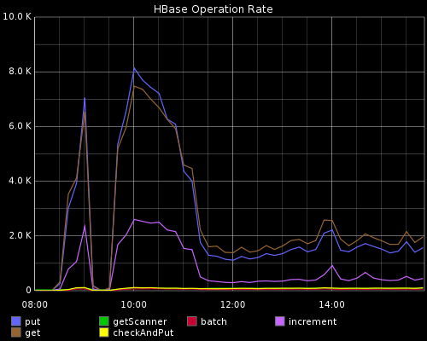
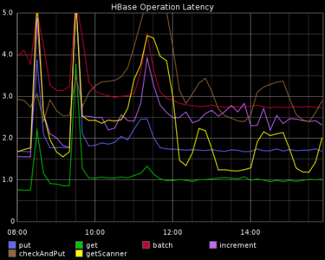
Measure Everything
Instrumented HBase client to see effective performance
We use Coda Hale’s Metrics API and Graphite Reporter
Revealed impact of hot HBase regions on clients
Notes:
Need hard data to understand and improve any sophisticated system – applies even more greatly for something at this scale
Bad assumption: no single data source would saturate a region
We saw big per-source volume spikes
Switching to a single-byte salt (ala HBaseWD) to spread load
Better locality than random keys, still has data distribution
Using a MultiScanInputFormat

Slide 28
The story so far
Notes:
So, how do we do the processing?

Slide 29
Into the Storm
Storm: scalable processing of data in motion
Complements HBase and Hadoop
Guaranteed message processing in a distributed environment
Notifications scanned by a Storm Spout
Notes:
Processing guaranteed as long as you can replay failures
Better guarantees than others

Slide 30
Processing with Storm

Slide 31
Challenges of incremental updates
Incomplete data
Outdated previous state
Difficult to reason about changing state and timing conditions
Notes:
Incomplete data: (Only have page 1 and page 3 of the document – page 2 is in flight)
Outdate previous state: If a name changed from Able to Smith, we need to remove an entry from the “A” index
Not enough time to go into all of these, but touch on a few.

Slide 32
Handling Incomplete Data
Incoming data
Row Key | Summary Family | Staging Family
document:1 |  | page:1
Process (map) components into a staging family

Slide 33
Handling Incomplete Data
Incoming data
Row Key | Summary Family | Staging Family
document:1 |  | page:1 page:3
Process (map) components into a staging family

Slide 34
Handling Incomplete Data
Incoming data
Row Key | Summary Family | Staging Family
document:1 |  | page:1 page:2 page:3
Process (map) components into a staging family

Slide 35
Handling Incomplete Data
Incoming data
Row Key | Summary Family | Staging Family
document:1 | document_summary | page:1 page:2 page:3
Process (map) components into a staging family
Merge (reduce) components when everything is available
Many cases need no merge phase – consuming apps simply read all of the components
Notes:
Like a rolling MapReduce
Can leverage same logic in MapReduce and low-latency processing!

Slide 36
Different models, same logic
Incremental updates like a rolling MapReduce
Write logic as pure functions
Coordinate with higher libraries
  Storm
  Apache Crunch
Beware of external state
  Difficult to reason about and scale
Notes:
External state example: an innocuous call in our logic to look up external reference data slowed processing by an order of magnitude

Slide 37
Getting complicated?
Incremental logic is complex and error prone
Use MapReduce as a failsafe
Notes:
See Nathan Marz talks on “Beating the Cap Theorem”

Slide 38
Reprocess during uptime
Real time incremental update
Row Key | Document Family
document:1 | {doc, ts=50}
document:2 | {doc, ts=100}
, {doc, ts=300}
, {doc ts=200}
, {doc, ts=200}
MapReduce outputs
Deploy new incremental processing logic
“Older” timestamps produced by MapReduce
The most recently written cell in HBase need not be the logical newest
Notes:
Ensure the timestamp of your MapReduce outputs are are less than your realtime updates
Could simply using the start time of the job for all output timestamps

Slide 39
Completing the Picture

Slide 40
Completing the Picture

Slide 41
Building indexes with MapReduce
A shard per task
Build index in Hadoop
Copy to index hosts

Slide 42
Pushing incremental updates
POST new records
Bursts can overwhelm target hosts
Consumers must deal with transient failures
Notes:
In an extended failure manual steps might be necessary

Slide 43
Pulling indexes from HBase
Custom Solr plugin scans a range of HBase rows
Time-based scan to get only updates
Pulls items to index from HBase
Cleanly recovers from volume spikes and transient failures

Slide 44
A note on schema: simplify it!
Heterogeneous row keys great for hardware but hard on wetware
Must inspect row key to know what it is
Mismatches tools like Pig or Hive
Row Key | Qualifiers
person:1/name | <content>
person:1/address | <content>
person:1/friend:1 | <content>
person:1/friend:2 | <content>
person:2/name | <content>
…
person:n/name | <content>
person:n/friend:m | <content>
Notes:
Tall-table designs are fine as implementation details, but not as a mental model for the system

Slide 45
Logical parent per row
Row Key | Qualifiers
person:1 | name<…> address:<…> friend:1:<…> friend:2:<…>
person:2 | name<…> address:<…> friend:1:<…>
. . .
person:n | name<…> address:<…> friend:1:<…>
The row is the unit of locality
Tabular layout is easy to understand
No lost efficiency for most cases
HBase Schema Design -- Ian Varley at HBaseCon
Notes:
Intra-row scanning is efficient!

Slide 46
The path forward
Notes:
Existing libraries are at too low of a level

Slide 47
This pattern has been successful
…but complexity is our biggest enemy

Slide 48
We may be in the assembly
language era of big data
Notes:
All things are possible, but requires a deep skillset and low-level understanding of these systems

Slide 49
Higher-level abstractions for these patterns will emerge
It’s going to be fun
Notes:
Existing libraries are at too low of a level

Slide 50
Questions?
@ryanbrush

