Slide 1

Big Data, Small(er) Company
Camille Fournier @skamille
Head of Engineering

Slide 2
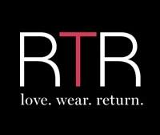
The Business
Short-term rental of designer dresses and accessories
Don't buy it, rent it!
Get the items the day before or the day of your event
Ship them back a couple of days later

Slide 3
The Challenge
Changing consumer behavior
Getting comfortable with the rental model
What if the dress doesn't fit?
What size do I need, anyway?
Designer dresses all fit differently
A size 4 fits like an 8 or a 2

Slide 4
The Data
Unlike traditional retail, many data points on users experiencing the same items
Hundreds of different women rent the same style
Site average of ~300 orders/style, up to over 1000
1/6th of our customers have written at least 1 review
Women are willing to provide information to help others make decisions
50% of reviewers share their weight
60% share their bust size
Seeing a photo review increases likelihood of renting by 200%

Slide 5
Introducing
"Our Runway"
The first-ever online social shopping platform
Allow women to shop by pictures of other women wearing styles
Allow women to filter and sort styles based on those worn and reviewed by women with similar attributes

Slide 6
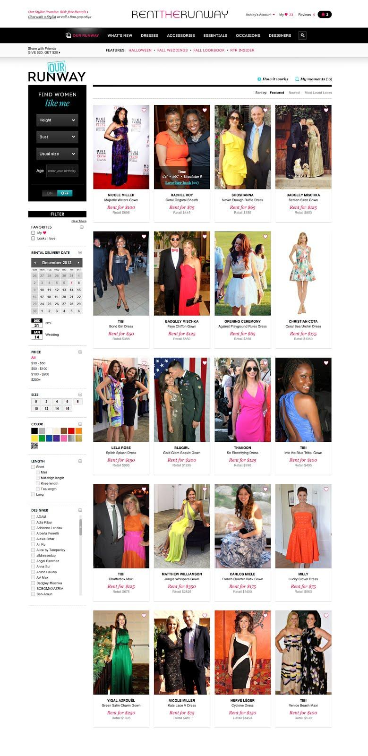
Images

Slide 7
Data Sources
"Small"
Customer-provided size, height, age
Dress metadata
Rental history
"Big"
Customer clickstream
Review text
Sources range from SQL database tables to log files to MongoDB collections

Slide 8
Women Like Me
How many data points do we need to accurately find other women in our user base like you?
Start basic: Same size, demographics
Expand: Similar taste
Evaluate: Clickstream updating

Slide 9
Calculating Sameness
Even with only 4 points of comparison (size, age, height, bust) over 100,000 possible combinations
Too much detail narrows the result set too far
Slow to compute, large to store
Simplify: create buckets per characteristic
Height: Petite, Short, Average, Tall
Bust: small, med, large
Age: Demographic group
Result: 864 vectors that accurately capture the range of women on our site

Slide 10
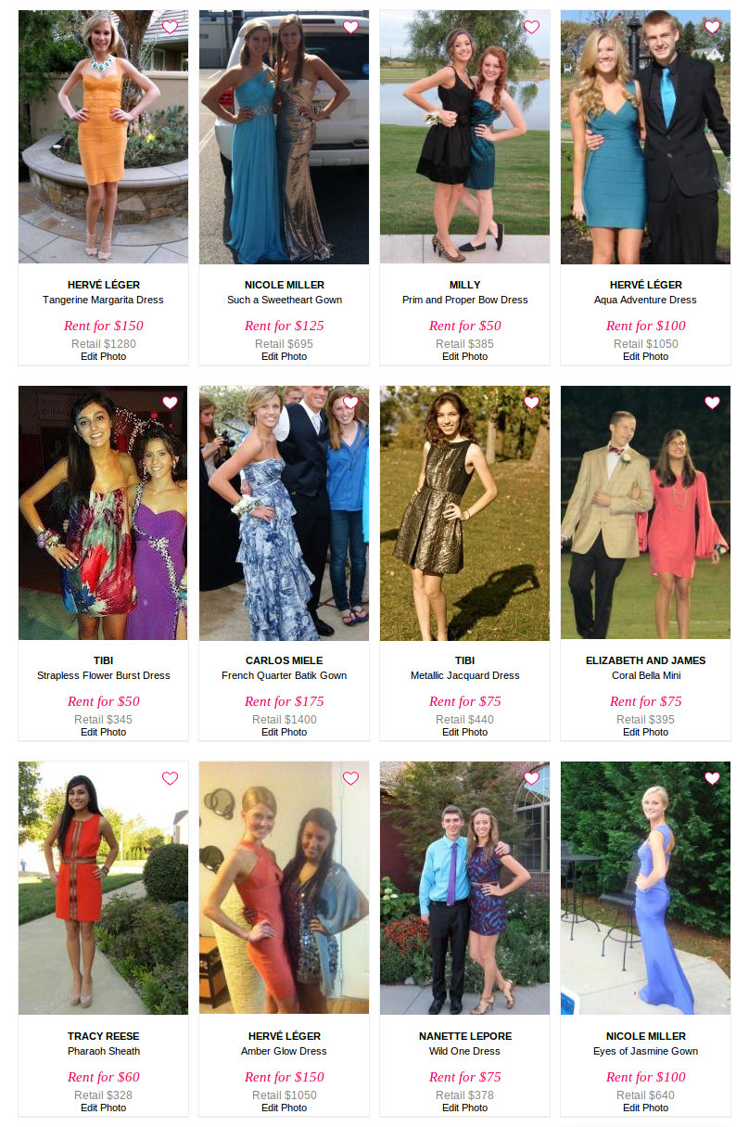
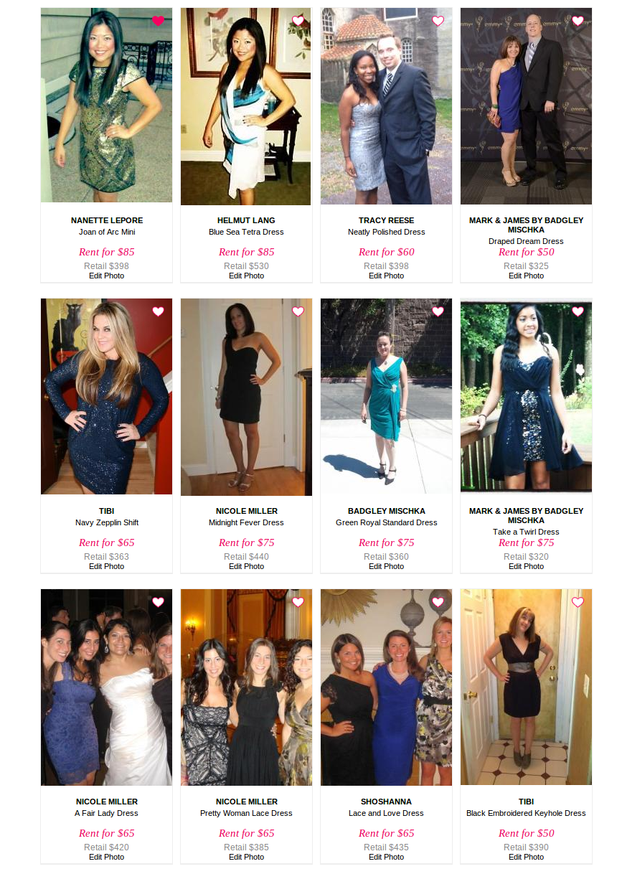

Slide 11
The Future of Fashion is Data-Driven
Crowdsourcing of fit and style matches
Continuous updating of information based on user-generated content
Building confidence in the rental behavior by showing real successful experiences

