Slide 2
The Insight Crisis In A Data-Soaked World Sharmila Shahani-Mulligan CEO & Founder ClearStory Data

Slide 3
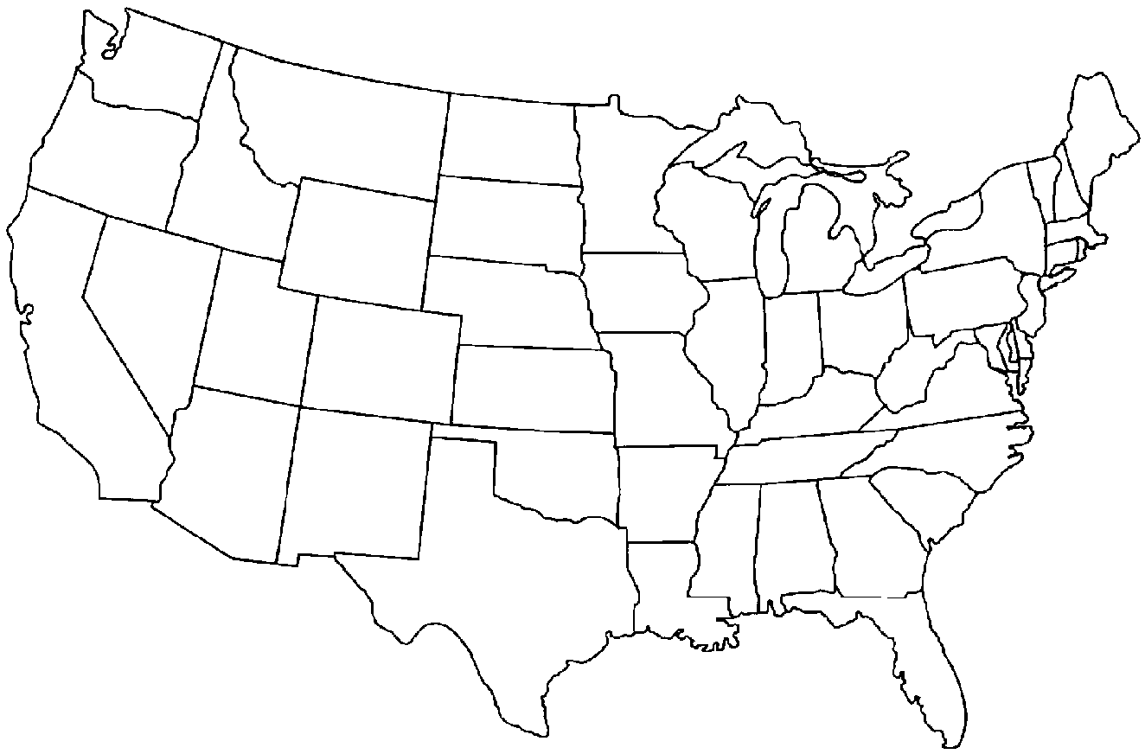
The Data Dilemma
The average U.S. company is doubling its data annually.
The bigger challenge is educating 1.5M managers to harness big data.
1. New York City
3. Chicago
5. Data Science, USA
Population: 1.5M
2. Los Angeles
4. Houston
Source: “Big Data: The next frontier for innovation,
competition and productivity”
McKinsey Global Institute, June 2011.

Slide 4
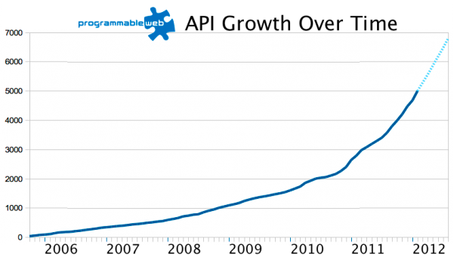
Ever-Increasing Complexity of Sources
Private Data Sources
Public Data Sources
Data created & replicated in 2011 surpassed 1,800 Exabytes
Today – 7000+ open data APIs and growing
Source: “Extracting Value from Chaos” IDC, June 2011.
Source: Programmable Web
August 2012.

Slide 5
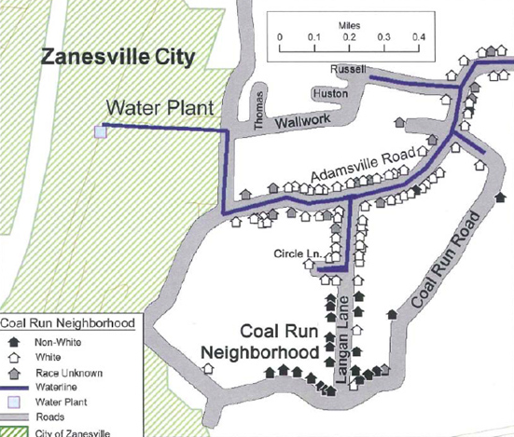
Merging Private and Public Data
Public data
Water lines
Household census
Immediate insight to the tune of $10.9 million
Private data
Race survey
Source: “Denied Water Service Because of Race” Journal of Poverty Law and Policy, Nov/Dec 2009.

Slide 6
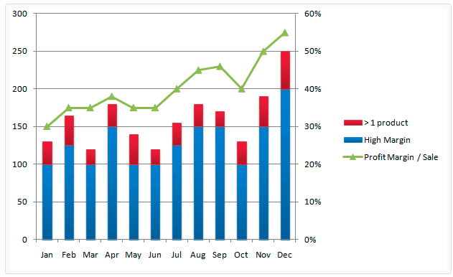
Fusing Data from Private Sources
Private data
Clickstream data
Immediate market basket optimization to maximize profit margins
Private data
Online sales
Product SKU’s
Source: “Segmenting Data with a KPI Overlay” Matt Smedley Blog, Feb 2, 2010.

Slide 7
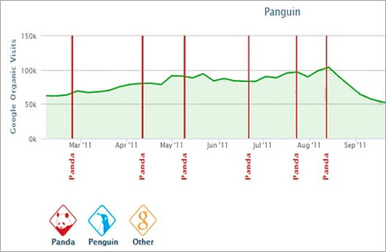
Harnessing Web Data Sources
Private data
Website visitors
Immediate insight and action on web/SEO trends
Public data
Google algorithm changes
Source: Barracuda Digital
http://www.panguintool.com.

Slide 8
And Everything that Brought us Here is Accelerating
v
Vast farms of diverse data storage
Cheaper memory
Blazing computation speeds
Advanced algorithms
Machine learning

Slide 9
But the Most Valuable Thing is Human Insight
v
37% of analysts still rely on ‘gut feeling’ to make decisions
44% have no transparency into how decisions are made from insights
52% of managers feel they need new training
Source: “Evolution of Decision Making”
Harvard Business Review. 2012

Slide 10
This Gets us to the Biggest Challenge
The last 30 years created a $35 billion industry* for ‘databases’ and ‘data containers.’
The new era is about making it easy to analyze big data and balance it with judgment & experience
*Source: “Worldwide Semiannual Database and Data Integration Software Tracker”
IDC Survey, December 2011.

Slide 11
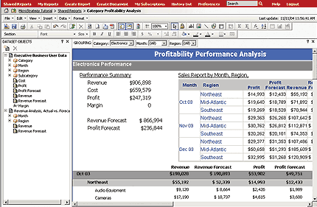
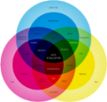
New Solutions Must Aid Human Insight Big Data + Amplified Human Intelligence
Last Decade
Next 5 Years
Structured data
Any data, from anywhere
Conclusive dashboards
Intuitive exploration
Small scale / sampling
Making sense of it at scale
A data architect built a view to reach a specific conclusion.
Business users easily find, explore, visualize and navigate insights.

Slide 12
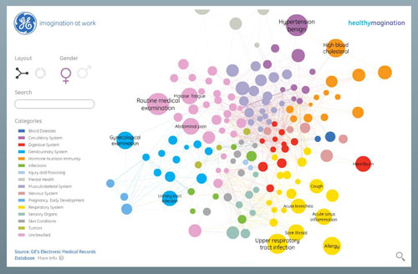
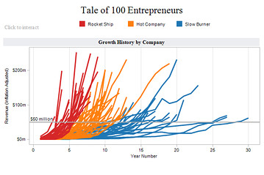
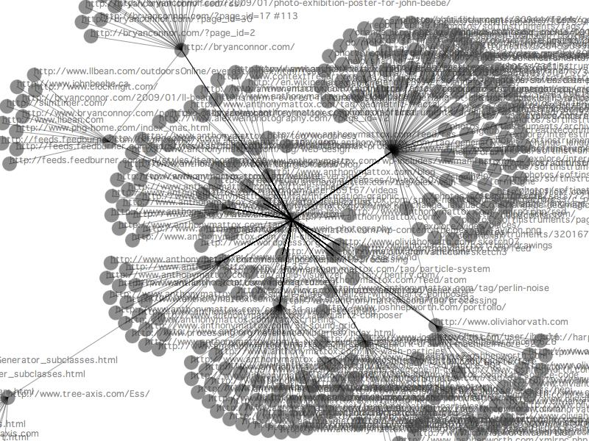
Is This the Right Answer? Next Gen Visualizations – Only One Part of the Answer

Slide 13
Big Data’s Next Opportunity
Knowing how to get to diverse data
Simplicity and progressive insights
Re-defining human judgment of insights

Slide 14
www.clearstorydata.com

