Slide 1
How Do You Reverse Geocode Indoors?
Getting Started with an Indoor Map API
Dave Sutter
sutter@micello.com
1

Slide 2
Overview
Placing an Object on a Street Map
Translating to Indoors
Overview of Micello Indoor Map API
Examples
Dave Sutter
sutter@micello.com
2

Slide 3
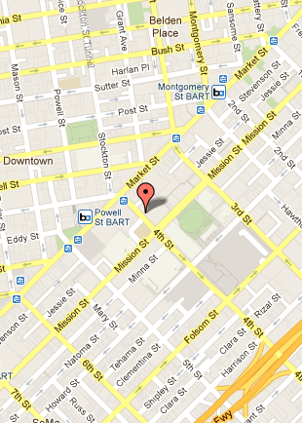
Placing an Object on a Street Map
Get a Map
Get a Location: Marriot Marquis
55 4th St, San Francisco, CA
Convert to Map Format
Lat=37.785094, Lon=-122.404687
Place Marker on Map
Dave Sutter
sutter@micello.com
Source: Google Maps

Slide 4
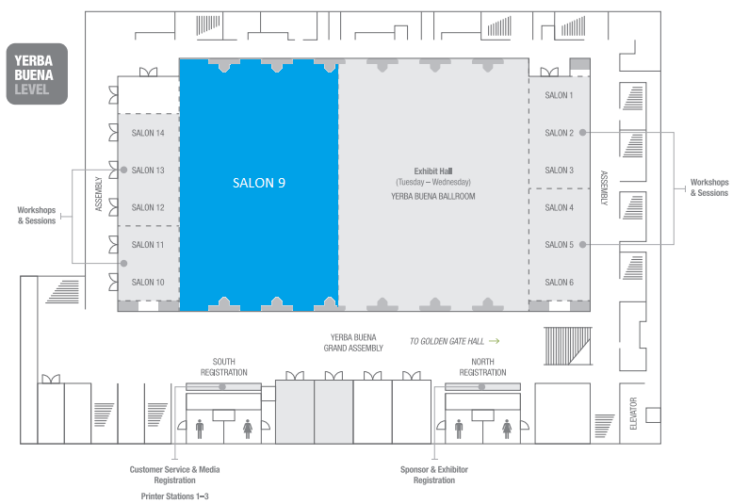
Translating to Indoors
Get a Map
Get Location: "How Do You Reverse Geocode Indoors?"
No Global Address Standard for Indoors
Local Address: Yerba Buena Salon 9
Convert to Map Format
Lat, Lon + Level
Room Object
Annotate Map
Source: Where Conference
Dave Sutter
sutter@micello.com
4

Slide 5
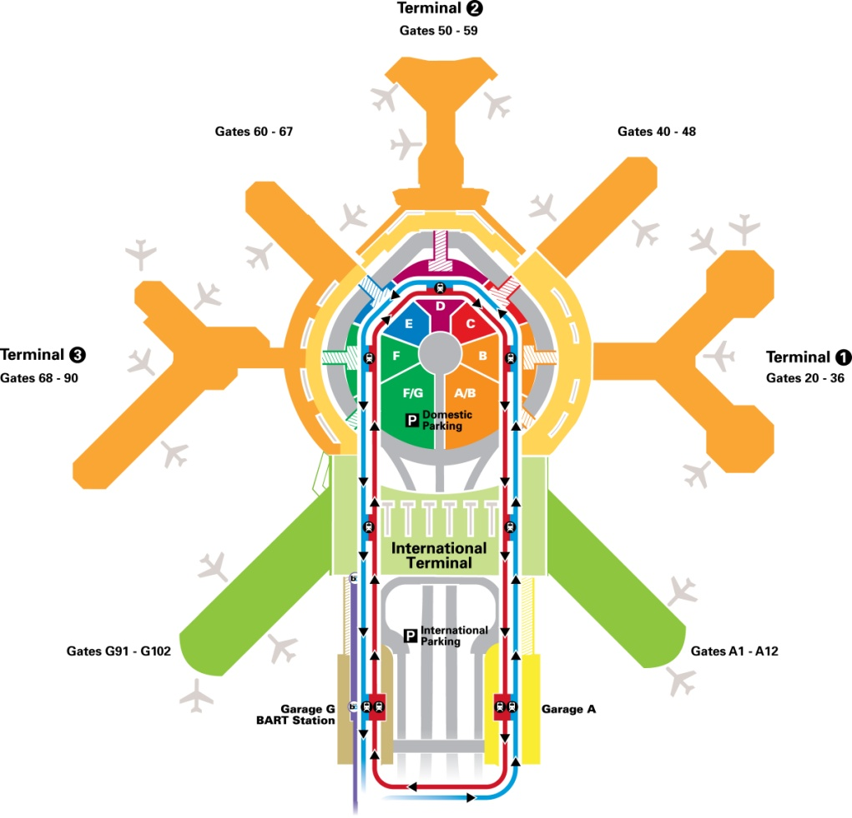
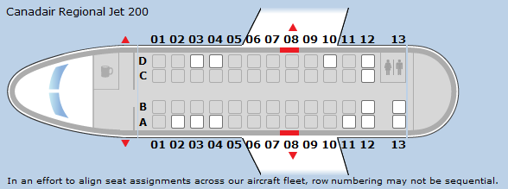
Address and Map Examples
Coming to the Where Conference:
Flight UA5484 out of Boise, departs Gate C4
Sat in Seat 12D
Arrived SFO Gate 72
Picked up baggage at Carousel 17
Hertz rental car, Space 22-F
Marriott Hotel, Room 759
Source: United Airlines
Source: SFO
Dave Sutter
sutter@micello.com
5

Slide 6
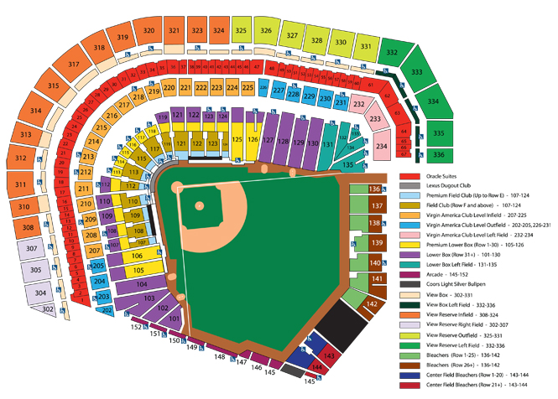
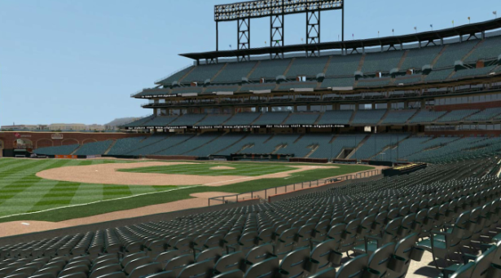
More Examples…
AT&T Park Section 129 Row 25 Seat H
Plug N Play Tech Center Mount Diablo Conference Room
Stanford Phil-11N "Skepticism” McCullough 126
Whole Foods Organic Ice Cream Sandwiches
Aisle 4B Freezer 3
CVS Colgate Total Plus Whitening Toothpaste in 5.8 Ounce Self Standing Tube
Aisle 8 Bin E Shelf 4
Carnival Cruise Lines "Fantasy" Stateroom E126
Source: SF Giants
Dave Sutter
sutter@micello.com
Source: Carnival Cruise Lines

Slide 7
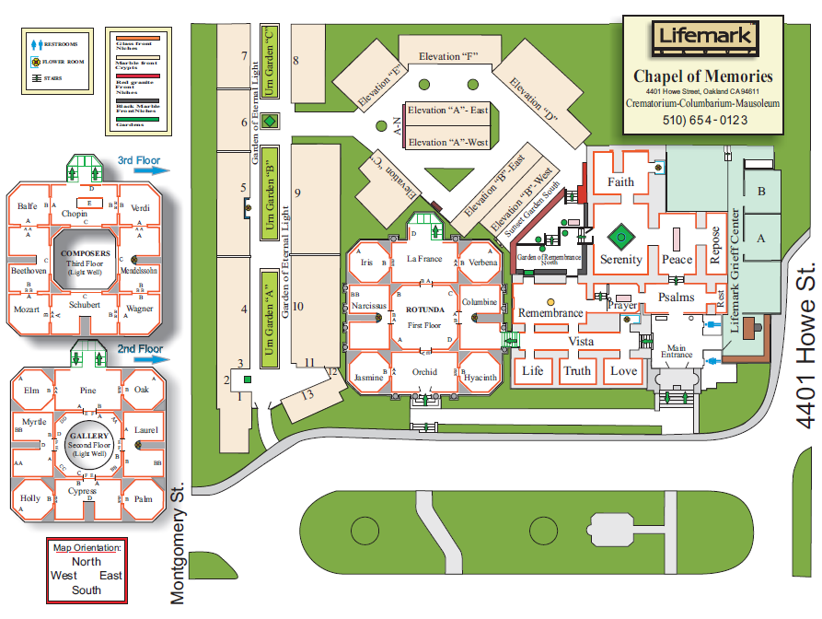
One More Example
Chapel Of Chimes Columbarium
Serenity Room, ???
Source: Chapel of Chimes
Source: Yelp
Dave Sutter
sutter@micello.com
7

Slide 8
Standardizing Indoor Maps
No Shortage of Maps
No Shortage of Local Addresses
Challenge: Standardize Maps and Addressing
so developers can access lots of maps the same way
Dave Sutter
sutter@micello.com
8

Slide 9
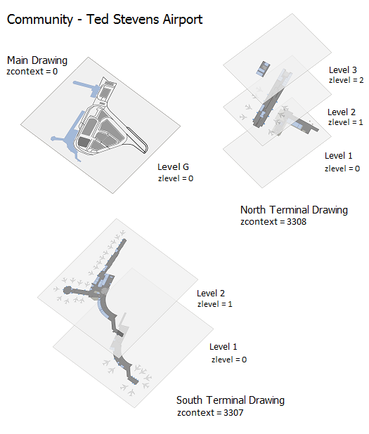
Micello Map Structure
Community
Drawing
Drawing Level
Geometry
Dave Sutter
sutter@micello.com
9

Slide 10
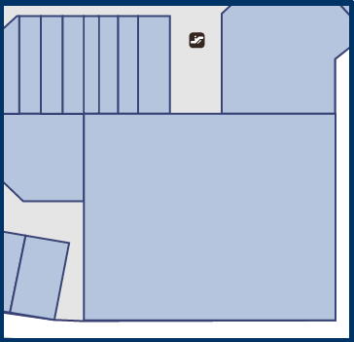
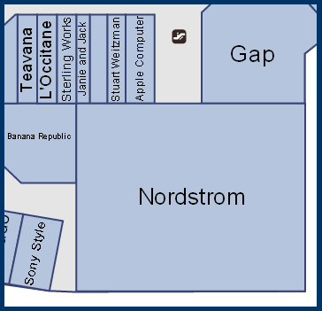
POIs
Entities - Micello DB name for POIs
NOT a part of the map
Matched to Geometry using an Internal Address
Map
Map with Entities Matched
Dave Sutter
sutter@micello.com
10

Slide 11
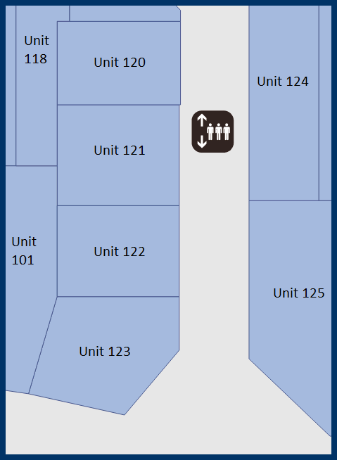
Internal Address
Defined by the Venue
Key-Value Pairs Used to Identify Geometry
Entities matched to Geometry with Internal Address
Key | Value | Entity
Unit | 100 | Macy’s
Level Salon | Yerba Buena 9 | “How Do You…”
Building Room | McCullough 126 | Phil 11N
Aisle Bin Shelf | 8 E 4 | Colgate Total
$id | 24440 | Old Navy
Map
Dave Sutter
sutter@micello.com
11

Slide 12
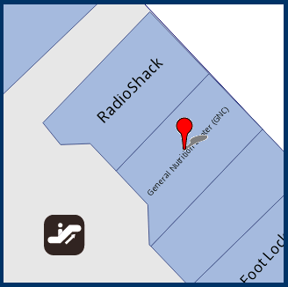
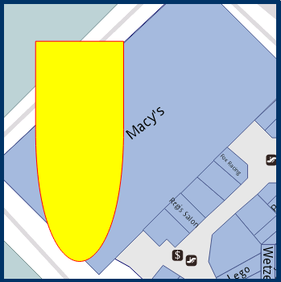
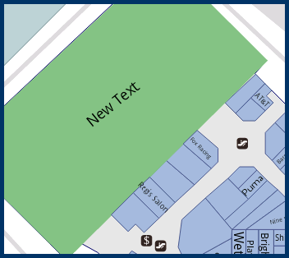
Map Annotations
Marker Overlay - An image placed on the map
Geometry Inlay - A change to an existing piece of geometry
Highlight
Add/Change Text
...
Geometry Overlay - A new piece of geometry added to the map
Dave Sutter
sutter@micello.com
12

Slide 13
Examples
Dave Sutter
sutter@micello.com
13

Slide 14
What Else?
That’s Up to Developers…
Until Recently: Location was at a resolution appropriate for Cars
Street Maps
Outdoor GPS
Today: Location is at a resolution appropriate for People
Smart Phones
More Detailed Outdoor Maps + Indoor Maps
Indoor GPS
This opens a whole new area for location applications
Dave Sutter
sutter@micello.com
14

