Slide 1
Harnessing Video for Realtime Merchandising and Customer Engagement
Prism Skylabs
Matt Kovinsky

Slide 2
Notes:
Prism Skylabs logo animation

Slide 3
Notes:
Video screens flying clip

Slide 4
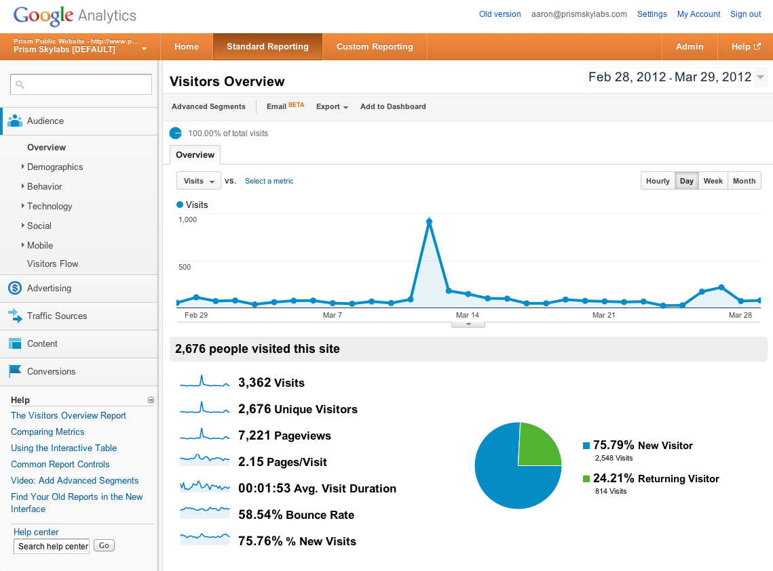
The Internet Era: More, Better Data

Slide 5
Online Metrics: Now Offline
Online analytics
Offline analytics
Visits
Page Views
Average Visit Duration
Bounce Rate
Cart Abandonment
People In Store
Product Interactions
Dwell Time
In Store, Quick Exit
Exit from Register Line

Slide 6
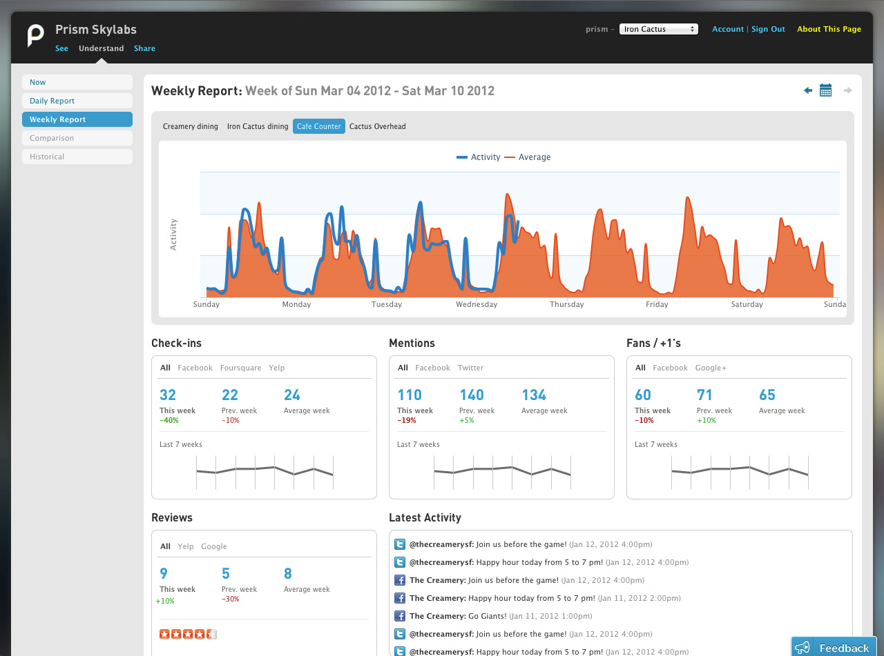
Analytics for the Real World

Slide 7
Notes:
Set up animation (see timing)

Slide 8
Chris Whitmore, The Creamery
Notes:
Chris soundbite 1

Slide 9
Notes:
Video of traffic at Creamery

Slide 10
Notes:
Chris soundbites 2

Slide 11
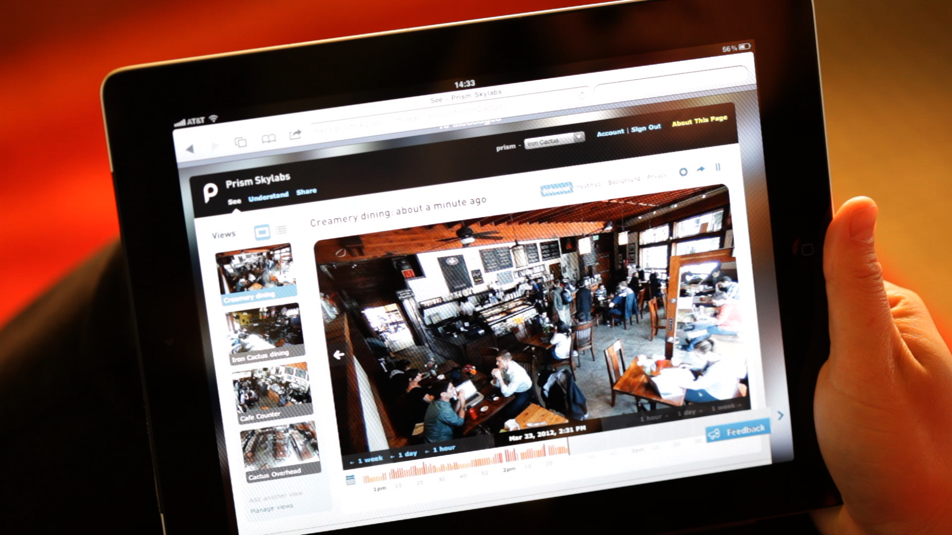
Unlock video beyond the backroom….

Slide 12
Notes:
Chris 3

Slide 13
Notes:
Map animation

Slide 14
Why Prism Skylabs?
Increase Revenues and Reduce Costs:
Optimize merchandising
Optimize staffing, hours, locations
Reduce theft
Greater Engagement
Dynamic content to share with colleagues, partners and customers

Slide 15
Notes:
Contact slide

