Slide 1
Analytics from 330 million smartphones
Sean Byrnes
CTO & Co-founder

Slide 2
Flurry Overview
Flurry Analytics
Better apps on iOS, Android, BB, WP, HTML5
App Developers:
60,000
Live Applications:
160,000
Devices per month:
480M
Sessions per month:
33B
Events per month:
300B
AppCircle Network
Acquisition & Monetization: iOS, Android
6,200
App Developers:
Devices per month:
200M
Daily Completed Views
3M

Slide 3
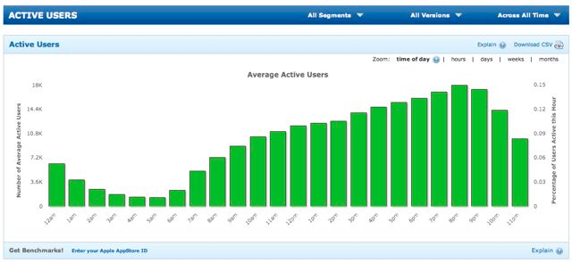
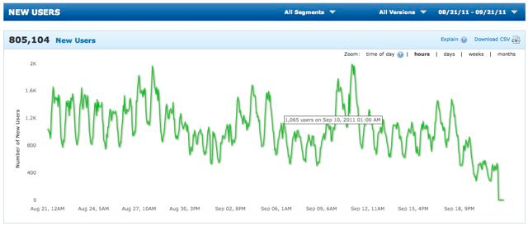
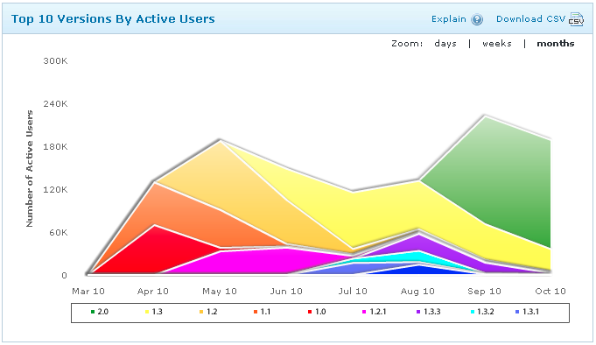
How Flurry Works

Slide 4
Flurry’s Scale
1.2 Billions Sessions / Day
900 Servers
1.56 PB

Slide 5
Topics
Big Data Collection
(HDFS)
Big Data Processing
(Hadoop)
Data Mining at Scale
(Hbase)

Slide 6
Big data collection

Slide 7
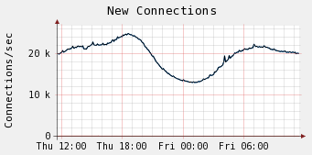
Incoming Data
Peak Connections per Second: 25,000
Data per day: 1.5 TB

Slide 8
Data Collection
Reports
Load Balancer
Load Balancer
Data Collector
Data Collector
Data Collector
Load Balancer
Load Balancer
Load Balancer
File
File
File
HDFS

Slide 9
Data Collection
Reports
Reports
HDFS
HDFS
Location A
Location B

Slide 10
Big data processing

Slide 11
Analytics Processing
Agent Report
Bad Phone Clocks
Partial Session Reports
Data Correction
Identify Device, Country,
Carrier, etc.
Normalization
Handle duplicate reports
De-duplication
Flexible calculation
Configurable Dimensions
Metrics Computation
Portfolio Analysis
Data mining and analysis
Benchmarking
Clustering
Analytics
Industry Trends
Application Analytics
Merchandising
Audience Segmentation

Slide 12
Large-scale Data Processing
Input Data
Collectors
Consumer/ Producer
Systems
MapReduce
(jobs)
Real-Time
NoSQL DataStore
Batch
External Action
External Action

Slide 13
Map/Reduce Management
Challenge: Task Starvation
Challenge: Task Roadblocking
Challenge: Network Connection Waiting
Notes:
Task Starvation: A cluster has a finite number of tasks. The default scheduler will give a job as many tasks as possible. HIGH priority jobs can occupy all the tasks in a cluster.
Task Roadblocking: All the tasks for a given job have to complete for the job to finish. If all tasks complete in 2 min except for one that takes 60 min, the job takes 60 minutes.
Network Connection Waiting: Your cluster has the potential to generate N(odes) X T(asks) X C(onnections) to a given service.

Slide 14
Network Topology: Chained
Switch 1
Switch 2
Switch 3
Rack 1
Rack 2
Rack 3

Slide 15
Network Topology: Star
Rack 1
Rack 2
Switch 1
Switch 2
Trunk
Switch 3
Switch 4
Rack 3
Rack 2

Slide 16
Data mining at scale

Slide 17
Stages of Data
Raw Data
Normalized
OLAP Cube
500 Billion Records
160 Billion Rows
80 Billion Rows

Slide 18
NoSQL Tables
Index
Column Family A
Column Family B
111111111
Data
Data
222222222
Data
Data
333333333
Data
Data

Slide 19
NoSQL OLAP
Index
Column Family A
metric.dimension
#
metric.dimensionA
metric.dimensionB
metric.dimensionC
metric.dimensionA.dimensionB
metric.dimensionA.dimensionC
...
metric.dimensionA.dimensionB.dimensionC

Slide 20
Lexicographical Ordering
metric.dimensionA.dimensionB
metric | dimensionA | dimensionB | index
3 | 1 | 1 | 311
3 | 1 | 11 | 3111
3 | 11 | 1 | 3111

Slide 21
Lexicographical Ordering
metric.dimensionA.dimensionB
metric | dimensionA | dimensionB | index
3 | 001 | 001 | 3001001
3 | 001 | 011 | 3001011
3 | 011 | 001 | 3011001

Slide 22
NoSQL OLAP
Index
metric.dimension.date
metric
1/1/12
Row Scan
metric.dimension.1_1_12
metric.dimension.3_1_12
3/1/12

Slide 23
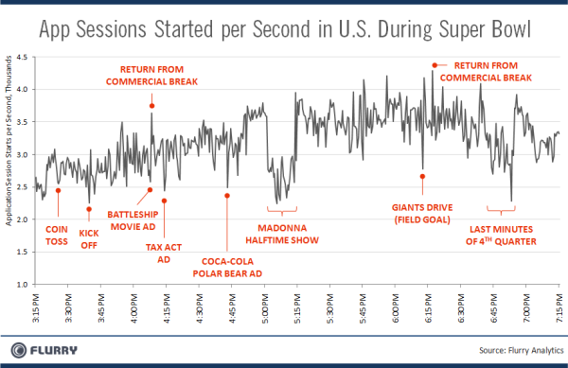
blog.flurry.com

Slide 24
Sean Byrnes sean@flurry.com
Flurry, Inc.
282 2nd St. Suite 202
San Francisco, CA 94105
http://www.flurry.com

