Slide 2
Tapping into the global library market in today’s digital world for creating a right and successful strategy
Gary Rodrigues
Executive Vice President Sales - Impelsys

Slide 3
Summary
eTextbooks: Some Statistics
Adoption of eBooks by Academic Libraries
Formats
Student Use of eBooks
School Adoption – Key Drivers
What Schools want
Licensing Models – present and future
The changing environment for the publisher
Fuelling adoption
The value of partnerships
Your digital infrastructure
Content Syndication and International markets
A Winning Strategy
www.ipublishcentral.com

Slide 4
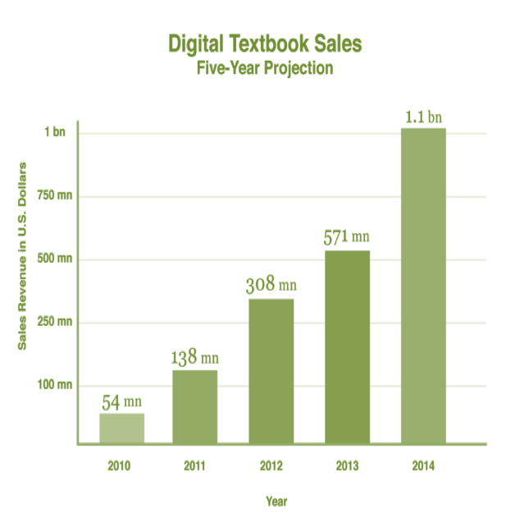
eTextbooks: Some Statistics
The largest library market is Schools Library (K-12)
90,000+ school libraries in the USA
15,500 school districts
99,000 public schools and
55m students
The textbook market is worth annually $8bn
0.4% or $300m is derived from eBook sales
Overall growth is 2% year on year. Ebook
growth in excess of 150% year on year.
Source: blog.xplana.com

Slide 7
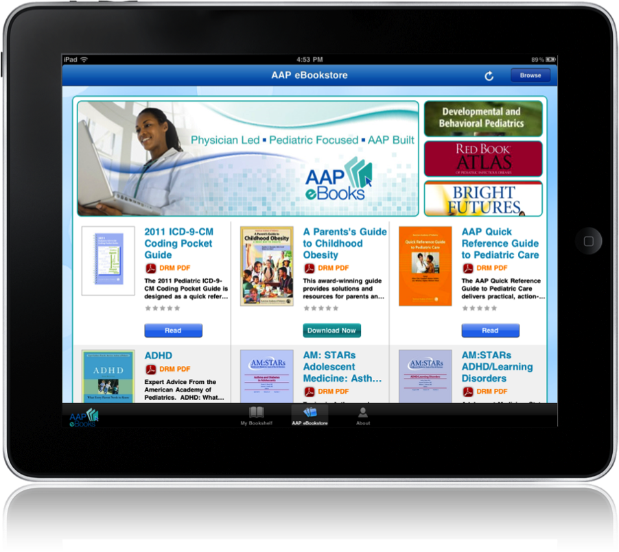
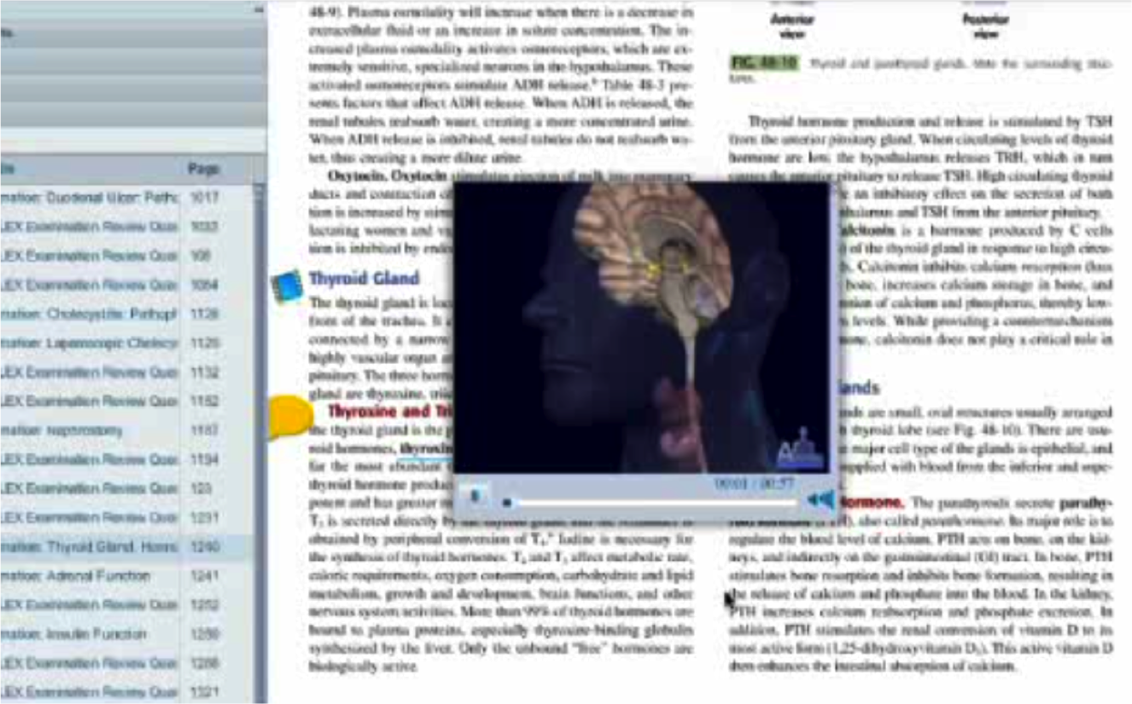
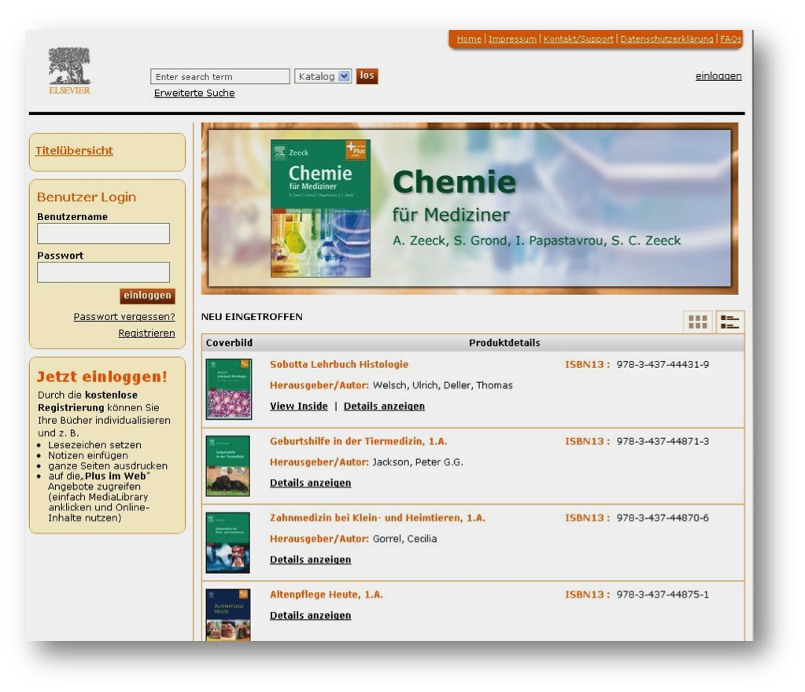
Adoption of Academic eBooks
Usable Interface
Quality Content, Multimedia
High resolution illustrations
Chapter level access
Search and Discovery

Slide 8
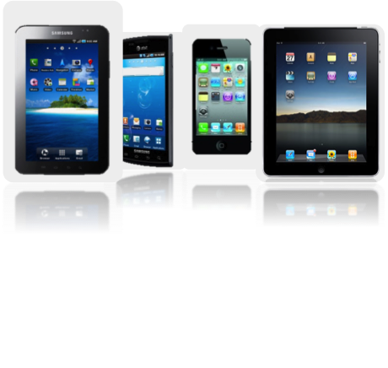
Format Portability
ePub 2
Fluid layout
Supported by web browsers and devices
No enhanced content support
ePub3/HTML5
Very good support for rich media e.g. audio with word highlight, animation
Fixed layout through which the look and feel of the print version can be achieved
Complex multimedia activity can be achieved through HTML 5 with JavaScript
Support for pop-ups
Not widely supported as yet

Slide 9
Student Use
Two-thirds of academic libraries (67%) are confident that eBook circulation will continue increasing over the 2012-2013 academic year.
The top barrier remains “unaware of eBook availability.”
Print preferred due to poor usability of eTextbooks.
(Excerpts from 2011 Survey of Ebook Penetration & Use in U.S. Academic Libraries)

Slide 10
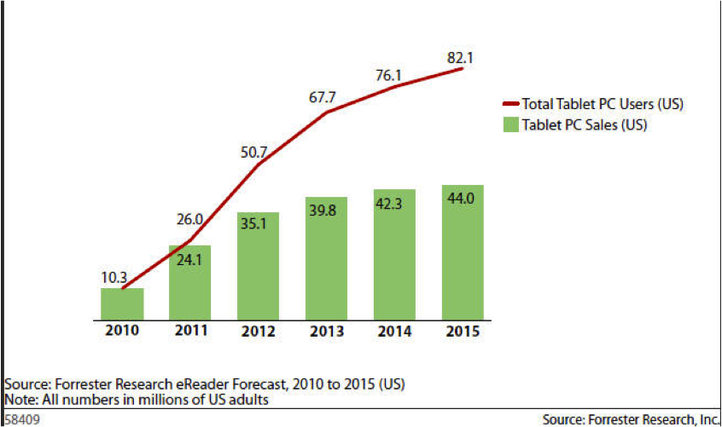
School Libraries – Key Drivers
“…..states modify the textbook adoption process, allowing K-12 schools to use taxpayer funding once reserved for the acquisition of printed books on tablet and other eReading devices and software”
Federal Communications Commission Chairman – Julius Genachowski
Education Secretary – Arne Duncan.
eReader adoption will now accelerate
Schools have more discretionary spend
600 school districts adopting 1:1 policy
Lower priced eTextbooks from Apple

Slide 11
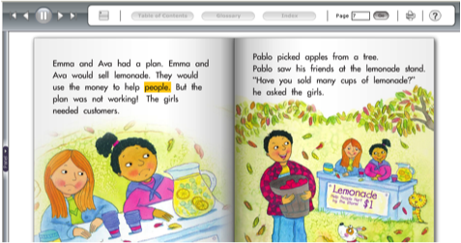
What Schools want
Media Rich Content – audio / animated / interactive eBooks
Customized feature-rich end-user portal
LMS and Assessments – Quizzes, question banks ,etc
Content delivery in multiple formats for multiple devices
Individual & Institutional access
Electronic Sampling
Flexible business models – eBook rentals, part / whole collections, subscriptions
Teacher – Student interface

Slide 12
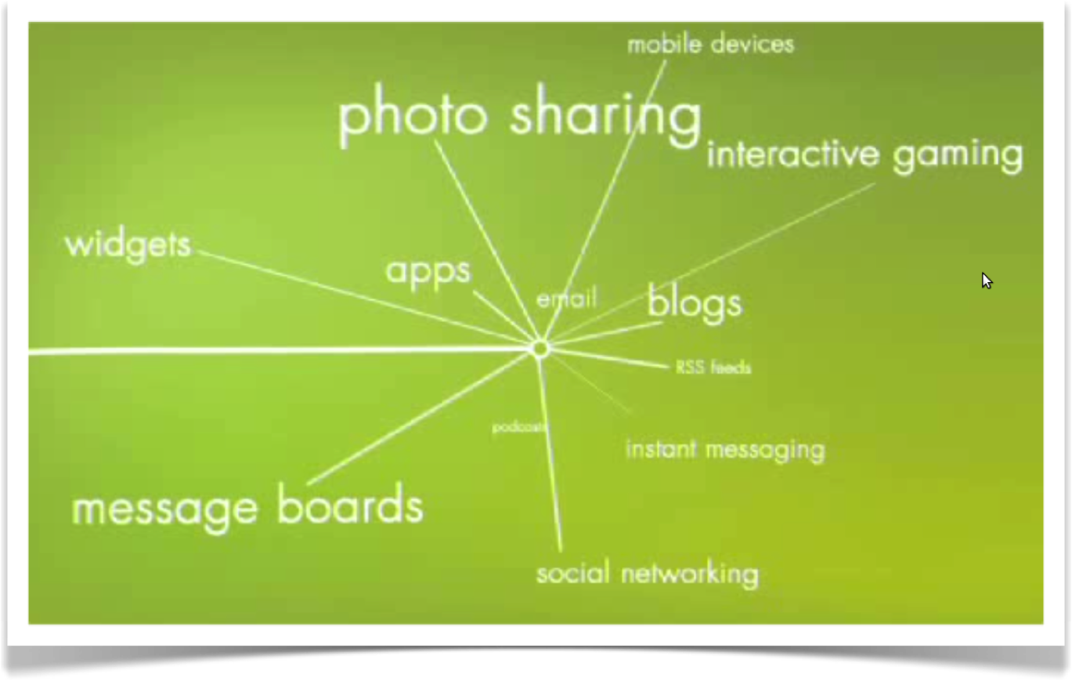
Personalisation

Slide 13
Licensing Models
Subscription based.
Purchase (Perpetual Archive)
Patron Driven Acquisition
Rental
Freemium
Collaborative

Slide 14
Changing environment for the Publisher

Slide 15
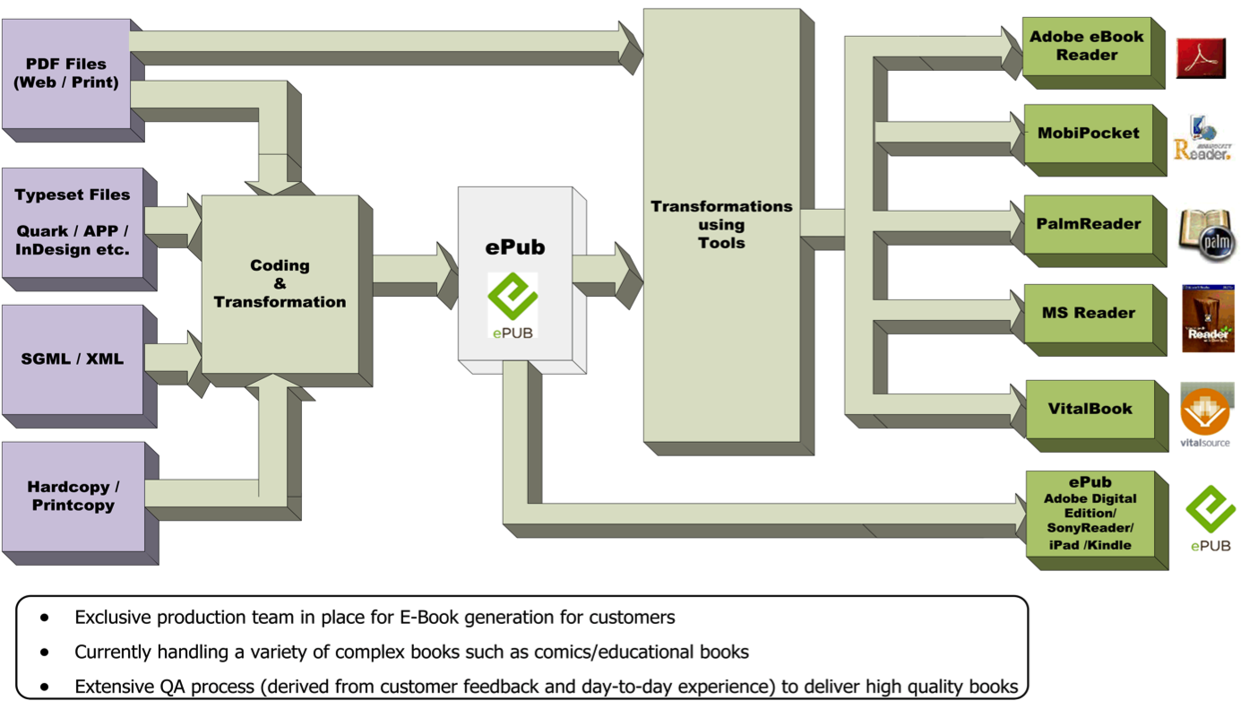

Slide 16
Fuelling adoption - summary

Slide 17
The Value of Partnerships

Slide 18
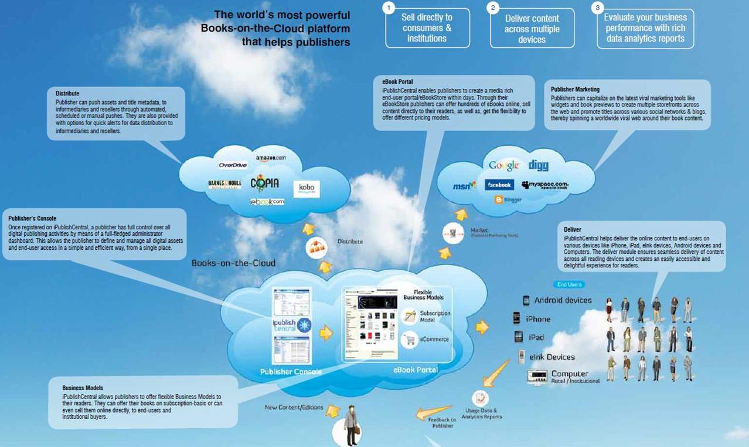

Slide 19
Quarterly Upgrades : iPublishCentral 3.2
New! iPublishCentral 3.2
Support for Multiple Formats
Bookshelf-as-an-App for Smartphones iPhone & Android phones and devices
Subscription and Lending features
Improved Offline/Online Reader
…and more exciting features to be added in the coming quarters
(Excerpts from 2011 Survey of Ebook Penetration & Use in U.S. Academic Libraries)

Slide 20
International Distribution

Slide 21
Some Final Thoughts ….
Strategic partners, not vendors or alone
Partner with companies that understand publishing and technology
Companies that can help plan and implement comprehensive e-strategies
Focus on your core competence – content
Connect directly to your readers
Your users are your sales team
Develop lasting customer relationships

Slide 22
Thank You
www.ipublishcentral.com

