Slide 1
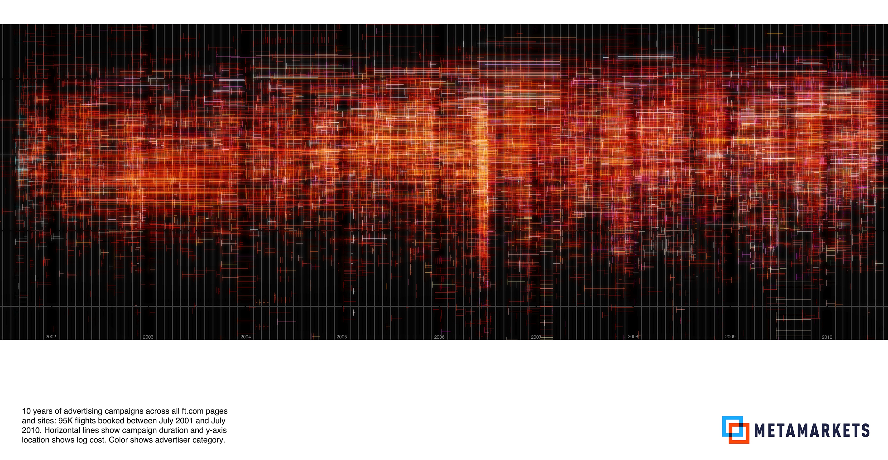
One Billion Rows Per Second:
Analytics for the Digital Media Markets
STRATA SUMMIT NYC
September 21, 2011
MICHAEL DRISCOLL
CO-FOUNDER & CTO
@medriscoll

Slide 2
Taming the Inferno of the Online Ad Markets
billions of microtransactions per day
dozens of publisher, advertiser, & audience attributes
Notes:
Across traditional desktop, mobile, and now gaming platforms, there are billions of advertising events occurring ever day.
Many of these are priced and bought in real-time.
Willie Sutton was once asked, why do you rob banks? That’s where the money is.
For me, the reason I was enticed by this vertical is similar: that’s where the data is.

Slide 3
Goal: Fast Dashboards
Over Big Data
Notes:
Strategic implications:

Slide 4
Goal: Fast Dashboards
Over Big Data
dashboard
queries in
seconds
database
data
crunched in minutes
ingestion
Notes:
Practically speaking, we define this as:
data freshness on the order of minutes
but queries over the data, made through our dashboard, return in seconds
Hadoop isn’t enough.

Slide 5
Solution 1:
Relational
Database
dashboard
queries in
minutes
database
MPP relational DB
data
crunched in minutes
ingestion
Hadoop
Notes:
Practically speaking, we define this as:
data freshness on the order of minutes
but queries over the data, made through our dashboard, return in seconds

Slide 6
Solution 2:
HBase
dashboard
queries
in seconds
database
HBase
data
crunched
in hours
ingestion
Hadoop
Notes:
Hadoop summarizes and precomputes a ton.

Slide 7
Solution 3:
Do It Ourselves: Druid
dashboard
queries
in seconds
database
Druid
data
crunched
in minutes
ingestion
Hadoop
Notes:
Hadoop summarizes and precomputes a ton.

Slide 8
Four Principles of Performance at Scale
SUMMARIZE
100x smaller
vs raw data
DISTRIBUTE
100x throughput
vs a single node
PARALLELIZE
STORE IN-MEMORY
100x faster
vs reading disk
10^6
Druid can filter and aggregate over 1 billion rows per second on a 50-core cluster,
or 20m rows per core per second
factor increase
Notes:
Hadoop summarizes and precomputes a ton.

Slide 9

Consequences of Speed: Data Freshness
photo credit: Lars P. http://www.flickr.com/photos/lars_p/4911238308/sizes/o/in/photostream/
Notes:
We all know that things taste better when they’re fresh.
Data is no different.
Jeff Jonas says, no value is knowing where the traffic was five minutes ago.

Slide 10

Consequences of Speed: Blue Sky Exploration
photo credit: MonkeyAt Large http://www.flickr.com/photos/monkeyatlarge/16645379/sizes/l/in/photostream/
Notes:
We all know that things taste better when they’re fresh.
Data is no different.
Jeff Jonas says, no value is knowing where the traffic was five minutes ago.

Slide 11
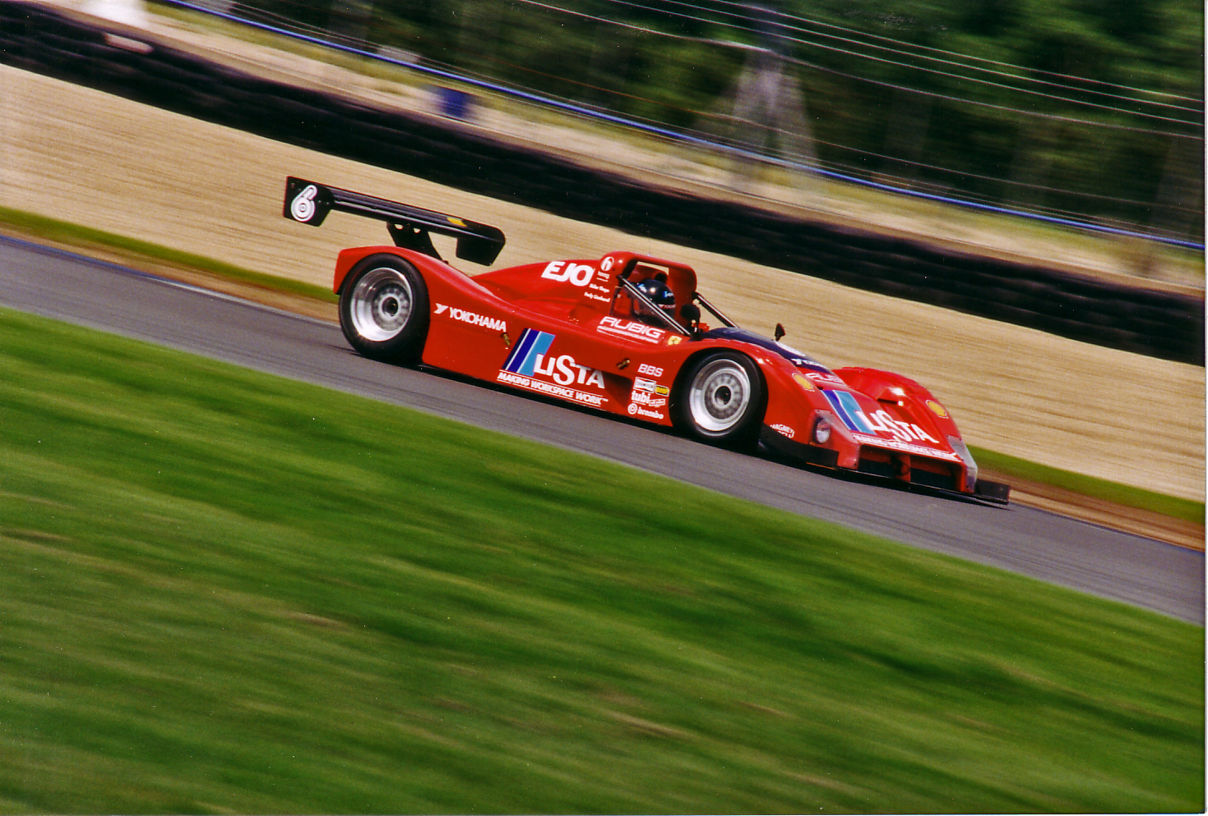
Consequences of Speed: Interactivity
photo credit tonylanciabeta http://www.flickr.com/photos/tonysphotos/3305157904/sizes/o/in/photostream/
Notes:
Dialogue with the data.
Eliminate the chain of data bureaucrats and put the data in the hand of the decision maker.
Get in the car & drive yourself.

Slide 12
One Billion Rows Per Second:
Analytics for the Digital Media Markets
QUESTIONS? CONTACT ME AT MIKE@METAMARKETSGROUP.COM
MICHAEL DRISCOLL
CO-FOUNDER & CTO
@medriscoll

