Slide 1

Deploying Apache Traffic Server
Leif Hedstrom
@zwoop
+lhedstrom

Slide 2
Who am I?
Principal Architect at Akamai Technologies
Spending much of my time on Apache Traffic Server, and how it can best integrate with our Ghost infrastructure and services
Several projects at Akamai are made possible with Traffic Server
lhedstro@akamai.com

Slide 3

Who am I?
One of the principals behind open sourcing Traffic Server
Committer for Apache Traffic Server
VP of Apache Traffic Server PMC
ASF member
zwoop@apache.org

Slide 4
Agenda
    Types of proxies
    Building and installation
    Configuration files – or – OMFG, why so many configurations?!?
    Detailed configurations
      Static Content (forward proxying)
      Forward and transparent proxy
    Advanced features
      Cache, clustering, monitoring etc.

Slide 5
Brief history and introduction

Slide 6
Mandatory useless benchmark …
Notes:
The point here is that performance of modern proxy servers is already ridiculous. Other things are more important, such as latency, or features.

Slide 7
Mandatory less useless benchmark …
Notes:
The point here is that performance of modern proxy servers is already ridiculous. Other things are more important, such as latency, or features.

Slide 8
Intermediaries – Forward Proxy

Slide 9
Intermediaries – Reverse Proxy

Slide 10
Intermediaries – Intercepting (transparent) Proxy

Slide 11
Small deployment

Slide 12
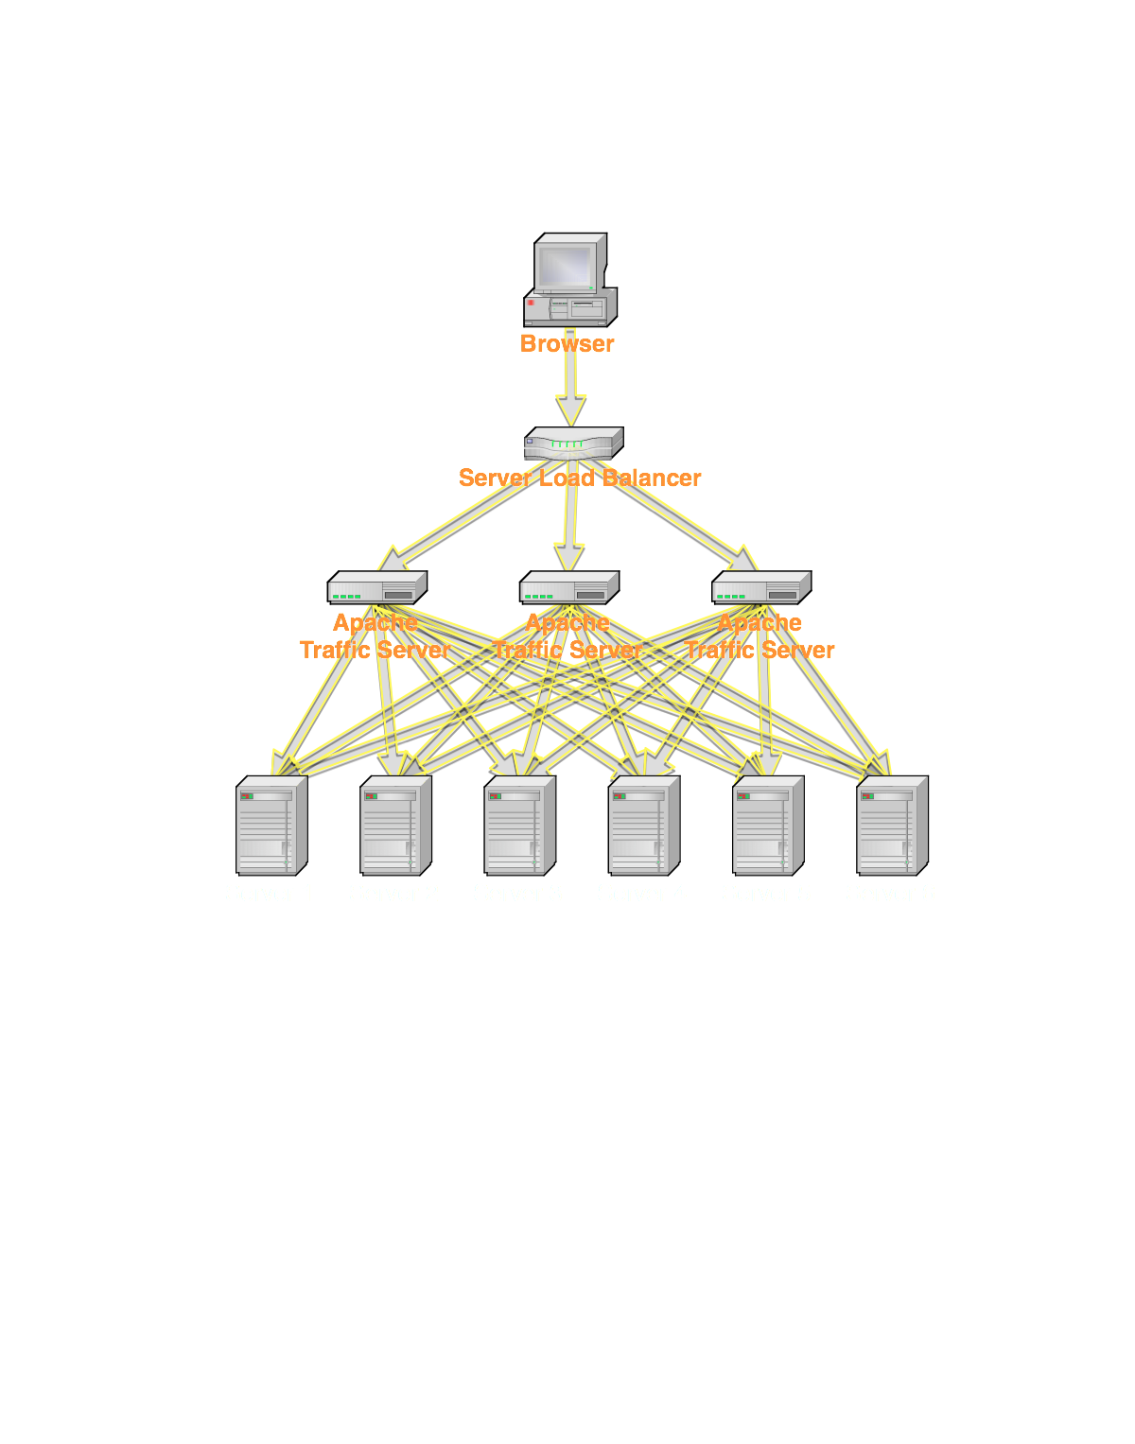
Large deployments
Notes:
Could use DNS, or UCARP, or other router logic at the SLB layer – heck, even ATS on top of ATS is useful

Slide 13

Installation or Building
Notes:
Binary packages preferred
Fetch source from trafficserver.apache.org
Standard gnu configure build process (./configure && make && sudo make install)
Default configuration is as a reverse proxy, with no remap rules. This renders it completely useless, and that’s intentional.

Slide 14
Running it
Recommended way
    $ sudo trafficserver start
    $ sudo trafficserver stop
“Manual” way
    $ sudo traffic_cop
For testing purposes
    $ sudo traffic_server [-T http.*]
For debugging
    $ sudo gdb traffic_server
    (gdb) handle SIGPIPE nopass nostop noprint
    (gdb) run
  (or attach to running traffic_server process)

Slide 15
Running it
Recommended way
    $ sudo trafficserver start
    $ sudo trafficserver stop
“Manual” way
    $ sudo traffic_cop
For testing purposes
    $ sudo traffic_server [-T http.*]
For debugging
    $ sudo gdb traffic_server
    (gdb) handle SIGPIPE nopass nostop noprint
    (gdb) run
  (or attach to running traffic_server process)

Slide 16
Running it
Recommended way
    $ sudo trafficserver start
    $ sudo trafficserver stop
“Manual” way
    $ sudo traffic_cop
For testing purposes
    $ sudo traffic_server [-T http.*]
For debugging
    $ sudo gdb traffic_server
    (gdb) handle SIGPIPE nopass nostop noprint
    (gdb) run
  (or attach to running traffic_server process)

Slide 17
Running it
Recommended way
    $ sudo trafficserver start
    $ sudo trafficserver stop
“Manual” way
    $ sudo traffic_cop
For testing purposes
    $ sudo traffic_server [-T http.*]
For debugging
    $ sudo gdb traffic_server
    (gdb) handle SIGPIPE nopass nostop noprint
    (gdb) run
  (or attach to running traffic_server process)

Slide 18
Running it
Recommended way
    $ sudo trafficserver start
    $ sudo trafficserver stop
“Manual” way
    $ sudo traffic_cop
For testing purposes
    $ sudo traffic_server [-T http.*]
For debugging
    $ sudo gdb traffic_server
    (gdb) handle SIGPIPE nopass nostop noprint
    (gdb) run
  (or attach to running traffic_server process)

Slide 19
plugin.config
records.config
partition.config
hosting.config
cache.config
update.config
ip_allow.config
storage.config
logs_xml.config
parent.config
remap.config
icp.config
Notes:
Traffic Server comes with a fairly large number of configuration files.
Most of the configurations have reasonable “defaults”.
Most applications wouldn’t use even a fraction of the available configuration options and features.

Slide 20



records.config
storage.config
remap.config
Notes:
Getting started, only two or maybe three configuration files are necessary to tweak.
records.config is a key-value configuration format, holding most global application configuration settings
storage.config is used to specify disk storage configurations
remap.config is used to specify mapping rules for rewriting requests, typically in a reverse proxy setup

Slide 21
remap.config
This is the primary tool to “rewrite” URLs
Typically used with reverse proxying, but can be used in forward proxy as well.
    E.g. remap all traffic for http://twitter.com to https://twitter.com
Change can almost always be reloaded without server restart, except when a plugin changes.
    $ sudo traffic_line –x
Order matters! First match wins.
Notes:
Note that order matters in remap.config, and it’s currently (and unfortunately) not particularly logical.
Caveat: different mapping types have different priorities
“map” happens before “redirect” for example, which is rather unfortunate (and we’ll take patches to fix this)

Slide 22
remap.config examples
map http://www.example.com/css http://css.example.com
map http://www.example.com http://real.example.com
reverse_map http://real.example.com http://www.example.com
redirect http://example.com http://www.example.com
regex_map http://(.*)\.example.com http://other.example.com/$1
map / http://kitchensink.example.com

Slide 23
remap.config examples
map http://www.example.com/css http://css.example.com
map http://www.example.com http://real.example.com
reverse_map http://real.example.com http://www.example.com
redirect http://example.com http://www.example.com
regex_map http://(.*)\.example.com http://other.example.com/$1
map / http://kitchensink.example.com

Slide 24
remap.config examples
map http://www.example.com/css http://css.example.com
map http://www.example.com http://real.example.com
reverse_map http://real.example.com http://www.example.com
redirect http://example.com http://www.example.com
regex_map http://(.*)\.example.com http://other.example.com/$1
map / http://kitchensink.example.com

Slide 25
remap.config examples
map http://www.example.com/css http://css.example.com
map http://www.example.com http://real.example.com
reverse_map http://real.example.com http://www.example.com
redirect http://example.com http://www.example.com
regex_map http://(.*)\.example.com http://other.example.com/$1
map / http://kitchensink.example.com

Slide 26
remap.config examples
map http://www.example.com/css http://css.example.com
map http://www.example.com http://real.example.com
reverse_map http://real.example.com http://www.example.com
redirect http://example.com http://www.example.com
regex_map http://(.*)\.example.com http://other.example.com/$1
map / http://kitchensink.example.com

Slide 27
storage.config
Configures disk storage.
    At least one disk (or “file”) required for any caching to happen
Recommended usage is to use the raw devices
        /dev/sde1
        /dev/sdf
Can also create a cache file on file system, but not as efficient
        /some/path/ts-cache 1GB
RAM cache is configured separately, using records.config
Tiered caches coming (e.g. SSD disks on top of rotational disks)

Slide 28
records.config
Key-value configurations
Common configurations are in default config file
    There are many more configurations available
The defaults are generally “good”
Default configurations are for a reverse proxy, aka “accelerator”. This requires at a minimum configuration changes to remap.config
Many configurations (but not all) can be reloaded without restart
    $ sudo traffic_line -x

Slide 29
records.config for reverse proxy
CONFIG proxy.config.http.server_port INT 80
CONFIG proxy.config.cache.ram_cache.size INT 1G
CONFIG proxy.config.cache.ram_cache_cutoff INT 1M
CONFIG proxy.config.reverse_proxy.enabled INT 1
CONFIG proxy.config.url_remap.remap_required INT 1
CONFIG proxy.config.url_remap.pristine_host_hdr INT 0
CONFIG proxy.config.http.negative_caching_enabled INT 1
CONFIG proxy.config.http.negative_caching_lifetime INT 120
CONFIG proxy.config.http.cache.ignore_client_cc_max_age INT 1
CONFIG proxy.config.http.normalize_ae_gzip INT 1

Slide 30
records.config for reverse proxy
CONFIG proxy.config.http.server_port INT 80
CONFIG proxy.config.cache.ram_cache.size INT 1G
CONFIG proxy.config.cache.ram_cache_cutoff INT 1M
CONFIG proxy.config.reverse_proxy.enabled INT 1
CONFIG proxy.config.url_remap.remap_required INT 1
CONFIG proxy.config.url_remap.pristine_host_hdr INT 0
CONFIG proxy.config.http.negative_caching_enabled INT 1
CONFIG proxy.config.http.negative_caching_lifetime INT 120
CONFIG proxy.config.http.cache.ignore_client_cc_max_age INT 1
CONFIG proxy.config.http.normalize_ae_gzip INT 1

Slide 31
records.config for reverse proxy
CONFIG proxy.config.http.server_port INT 80
CONFIG proxy.config.cache.ram_cache.size INT 1G
CONFIG proxy.config.cache.ram_cache_cutoff INT 1M
CONFIG proxy.config.reverse_proxy.enabled INT 1
CONFIG proxy.config.url_remap.remap_required INT 1
CONFIG proxy.config.url_remap.pristine_host_hdr INT 0
CONFIG proxy.config.http.negative_caching_enabled INT 1
CONFIG proxy.config.http.negative_caching_lifetime INT 120
CONFIG proxy.config.http.cache.ignore_client_cc_max_age INT 1
CONFIG proxy.config.http.normalize_ae_gzip INT 1

Slide 32
records.config for forward proxy
CONFIG proxy.config.cache.ram_cache.size INT 16G
CONFIG proxy.config.url_remap.remap_required INT 0
CONFIG proxy.config.reverse_proxy.enabled INT 0
CONFIG proxy.config.http.transaction_active_timeout_in INT 1800
CONFIG proxy.config.http.normalize_ae_gzip INT 1
CONFIG proxy.config.dns.dedicated_thread INT 1
(transparent proxy would be very similar)

Slide 33
records.config for forward proxy
CONFIG proxy.config.cache.ram_cache.size INT 16G
CONFIG proxy.config.url_remap.remap_required INT 0
CONFIG proxy.config.reverse_proxy.enabled INT 0
CONFIG proxy.config.http.transaction_active_timeout_in INT 1800
CONFIG proxy.config.http.normalize_ae_gzip INT 1
CONFIG proxy.config.dns.dedicated_thread INT 1
(transparent proxy would be very similar)

Slide 34
Testing and debugging configurations
Headers
    proxy.config.http.insert_request_via_str
    proxy.config.http.insert_response_via_str
    proxy.config.http.verbose_via_str
Tracers (very, very slow)
    proxy.config.diags.debug.enabled
    proxy.config.diags.debug.tags (e.g. http.*|dns)
Other
    proxy.config.dump_mem_info_frequency
    proxy.config.http.slow.log.threshold

Slide 35
Testing and debugging configurations
Headers
    proxy.config.http.insert_request_via_str
    proxy.config.http.insert_response_via_str
    proxy.config.http.verbose_via_str
Tracers (very, very slow)
    proxy.config.diags.debug.enabled
    proxy.config.diags.debug.tags (e.g. http.*|dns)
Other
    proxy.config.dump_mem_info_frequency
    proxy.config.http.slow.log.threshold

Slide 36
Testing and debugging configurations
Headers
    proxy.config.http.insert_request_via_str
    proxy.config.http.insert_response_via_str
    proxy.config.http.verbose_via_str
Tracers (very, very slow)
    proxy.config.diags.debug.enabled
    proxy.config.diags.debug.tags (e.g. http.*|dns)
Other
    proxy.config.dump_mem_info_frequency
    proxy.config.http.slow.log.threshold

Slide 37
Testing and debugging configurations
Headers
    proxy.config.http.insert_request_via_str
    proxy.config.http.insert_response_via_str
    proxy.config.http.verbose_via_str
Tracers (very, very slow)
    proxy.config.diags.debug.enabled
    proxy.config.diags.debug.tags (e.g. http.*|dns)
Other
    proxy.config.dump_mem_info_frequency
    proxy.config.http.slow.log.threshold

Slide 38
Power user tip
Debugging a request the “easy” way
    First, make sure ATS is down (trafficserver stop)
    Now start it from command line, using
      $ sudo traffic_server –T http.*
    Send a request through the server
    Watch the output
    The argument to –T is a regular expression, telling the server which debug tracers you are interested in
    This needs much better documentation
      Volunteer!

Slide 39
[Jul 27 09:28:47.132] Server {140541802645248} DEBUG: (http) NEXTDUP: 0x0, RAW: 1, RAWLEN: 13, F: 1]
[Jul 27 09:28:47.132] Server {140541802645248} DEBUG: (http)
+++++++++ Incoming Request +++++++++
-- State Machine Id: 0
GET http://l.yimg.com/a/lib/ycs/bench/500.bmp HTTP/1.1
User-Agent: curl/7.21.0 (x86_64-redhat-linux-gnu) libcurl/7.21.0 NSS/3.12.10.0 zlib/1.2.5 libidn/1.18 libssh2/1.2.4
Host: l.yimg.com
Accept: */*
[Jul 27 09:28:47.132] Server {140541802645248} DEBUG: (http_trans) [DecideCacheLookup] Will do cache lookup.
[Jul 27 09:28:47.132] Server {140541802645248} DEBUG: (http_seq) [DecideCacheLookup] Will do cache lookup
[Jul 27 09:28:47.132] Server {140541802645248} DEBUG: (http_trans) Next action CACHE_LOOKUP; NULL
[Jul 27 09:28:47.132] Server {140541802645248} DEBUG: (http) [0] State Transition: HTTP_API_POST_REMAP -> CACHE_LOOKUP
[Jul 27 09:28:47.132] Server {140541802645248} DEBUG: (http_seq) [HttpSM::do_cache_lookup_and_read] [0] Issuing cache lookup for URL http://l.yimg.com/a/lib/ycs/bench/500.bmp
[Jul 27 09:28:47.145] Server {140541802645248} DEBUG: (http_match) [SelectFromAlternates] # alternates = 1
[Jul 27 09:28:47.145] Server {140541802645248} DEBUG: (http_seq) [SelectFromAlternates] 1 alternates for this cached doc
[alts] There are 1 alternates for this request header.
[Jul 27 09:28:47.145] Server {140541802645248} DEBUG: (http_alternate) Exact match for ACCEPT CHARSET
[Jul 27 09:28:47.145] Server {140541802645248} DEBUG: (http_alternate) Exact match for ACCEPT ENCODING
[Jul 27 09:28:47.145] Server {140541802645248} DEBUG: (http_alternate) Exact match for ACCEPT LANGUAGE
[Jul 27 09:28:47.145] Server {140541802645248} DEBUG: (http_match) CalcQualityOfMatch: Accept match = 1
[Jul 27 09:28:47.145] Server {140541802645248} DEBUG: (http_seq) CalcQualityOfMatch: Accept match = 1
[Jul 27 09:28:47.145] Server {140541802645248} DEBUG: (http_alternate) Content-Type and Accept 1.000000
[Jul 27 09:28:47.145] Server {140541802645248} DEBUG: (http_match) CalcQualityOfMatch: AcceptCharset match = 1.0

Slide 40

Advanced logging in many systems
http://www.flickr.com/photos/osucommons/3329879294/

Slide 41

Advanced logging in Apache Traffic Server
http://www.newlaunches.com/archives/insectesque_machine_prototype_helps_logging.php

Slide 42
Advanced logging example
<LogFormat>
<Name = "some_squid"/>
<Format = "%<cqts> %<ttms> %<chi> %<psql> %<cqhm> %<cquc>"/>
</LogFormat>
<LogObject>
<Format = "some_squid"/>
<Filename = "ssquid"/>
<Mode = "ascii_pipe"/>
</LogObject>
Notes:
Many, many configuration options for custom log formats, we’ll discuss a few

Slide 43
Advanced logging example
<LogFormat>
<Name = "some_squid"/>
<Format = "%<cqts> %<ttms> %<chi> %<psql> %<cqhm> %<cquc>"/>
</LogFormat>
<LogObject>
<Format = "some_squid"/>
<Filename = "ssquid"/>
<Mode = "ascii_pipe"/>
</LogObject>
Notes:
Many, many configuration options for custom log formats, we’ll discuss a few

Slide 44
Advanced logging example
<LogFormat>
<Name = "some_squid"/>
<Format = "%<cqts> %<ttms> %<chi> %<psql> %<cqhm> %<cquc>"/>
</LogFormat>
<LogObject>
<Format = "some_squid"/>
<Filename = "ssquid"/>
<Mode = "ascii_pipe"/>
</LogObject>
Notes:
Many, many configuration options for custom log formats, we’ll discuss a few

Slide 45

Clustering

Slide 46
Advanced caching
Used to override / force cache behavior
Highly flexible, with many configuration options
    And still evolving and worked on
In general, you are better off using Cache-Control on the origin

Slide 47
cache.config example
dest_domain=example.com scheme=http revalidate=2h
dest_host=server suffix=.html method=PUT action=never-cache
url_regex=/static/ ttl-in-cache=86400

Slide 48
cache.config example
dest_domain=example.com scheme=http revalidate=2h
dest_host=server suffix=.html method=PUT action=never-cache
url_regex=/static/ ttl-in-cache=86400

Slide 49
cache.config example
dest_domain=example.com scheme=http revalidate=2h
dest_host=server suffix=.xml method=PUT action=never-cache
url_regex=/static/ ttl-in-cache=86400

Slide 50
cache.config example
dest_domain=example.com scheme=http revalidate=2h
dest_host=server suffix=.html method=PUT action=never-cache
url_regex=/static/ ttl-in-cache=86400

Slide 51
Monitoring tools
traffic_line [-h]
traffic_shell
Management APIs (C, but easily used from e.g. Python using ctype)
Perl APIs to read stats
Useful for monitoring, statistics etc.
Stats via HTTP (plugin producing JSON, or “text” via built-in URL)
Health checks supported (and used by traffic_cop)
    curl -0 –x localhost:80 http://127.0.0.1:8084/synthetic.txt

Slide 52
Akamai is hiring
- on both coasts! http://www.akamai.com/careers

Slide 53
Plugin examples
Header filtering
JSON stats via HTTP
Geo-location request ACLs (filter out requests by e.g. country)
Rewrite rules using mySQL or memcached “data”
Hopefully soon:
    ATS plugins written in LUA

Slide 54
Other useful records.config settings
Control threads (performance)
    proxy.config.exec_thread.autoconfig
    proxy.config.exec_thread.limit
    proxy.config.accept_threads
Buffers
    proxy.config.net.sock_send_buffer_size_in
    proxy.config.net.sock_recv_buffer_size_in
    proxy.config.net.sock_send_buffer_size_out
    proxy.config.net.sock_recv_buffer_size_out

Slide 55
Other useful records.config settings
Bind specific IP / interface
    proxy.local.incoming_ip_to_bind
Ports to bind
    proxy.config.http.server_port
    proxy.config.http.server_port_attr
    proxy.config.http.server_other_ports
    proxy.config.http.connect_ports

