Slide 1
The Impact of Ads on Performance and Improving Perceived Performance
Julia Lee, Sr. Dir. of Engineering, Yahoo! Mail
Stevan Vlaovic, PhD, Ads Architect
Yahoo!, Inc.
June 2011

Slide 2
Fast facts
Yahoo! Mail #1 in US
284MM unique users
1.9B pageviews/day
Yahoo! Mail just went GA with new product
  2x faster
  New ad implementation
My goal today
Tell you about our ads journey
Share some broad strategies to try

Slide 3
Definitions
Display Advertising – Not Search Advertising
Ad creative – Markup, images, assets, JS/CSS to show the ad
Ad decisioning time – Time to decide which ad to show the user
Ad serving time – Time to send the ad creatives/assets over the network to the user
Ad rendering time – Time to render the ad, including animation

Slide 4
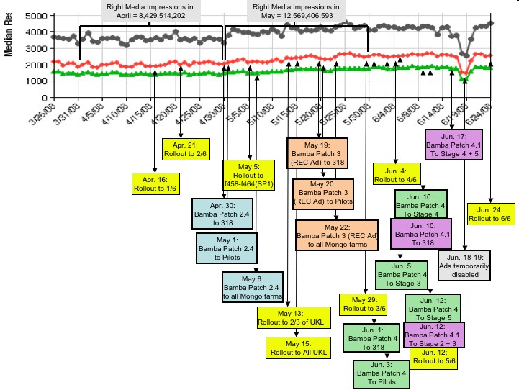
Timeline

Slide 5
Text vs. Graphical Impact

Slide 6
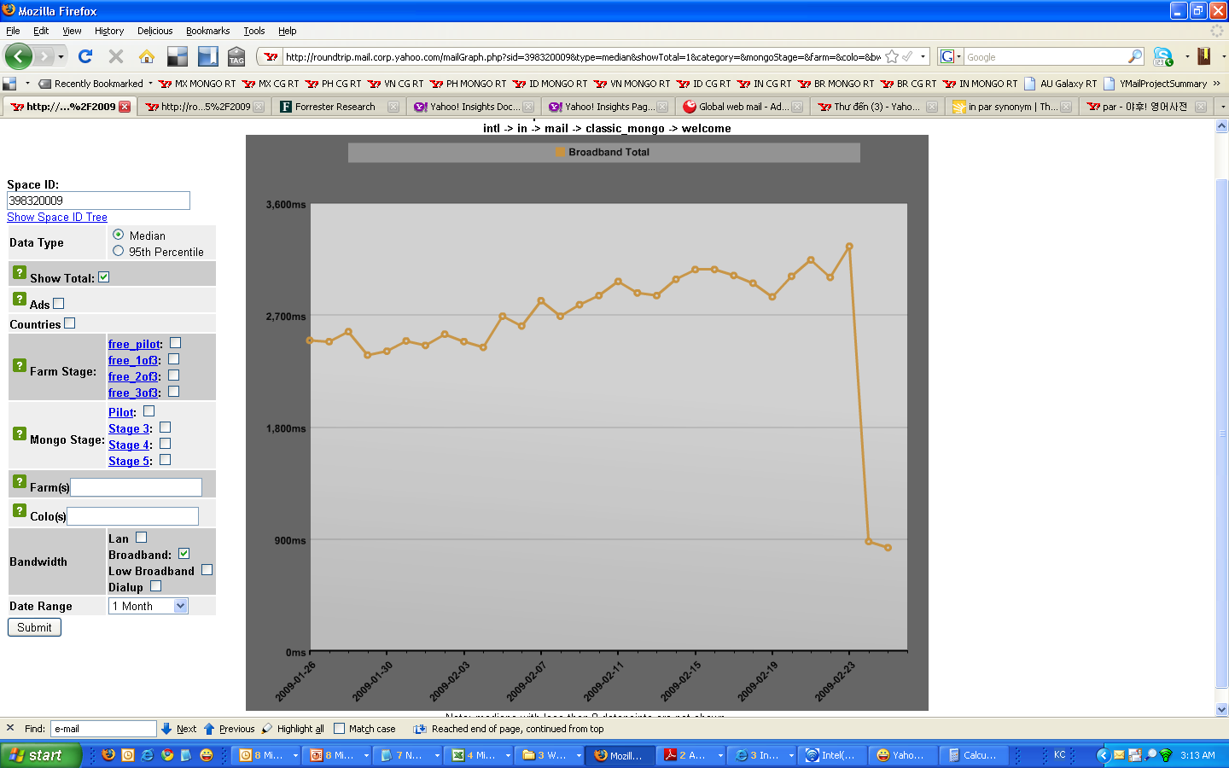
Overall latency breakdown
73% latency
Due to ads
27% latency
Application

Slide 7
What changed?
Display
Advertising
Landscape

Slide 8
Ad Marketplace + Ecosystem (~2006)
Demand
(advertisers)
Ad
Ad
Ad
Ad
Ad
Ad
Ad
Ad
Ad Networks
Ad
Net
Supply
(publishers)
Y! O&O
Ad Server

Slide 9
Ad Marketplace + Ecosystem (~2009)
Demand
(advertisers)
Ad
Ad
Ad
Ad
Ad
Ad
Ad
Ad Networks
Y!
Network
Ad
Net
Ad
Net
Ad
Net
Ad
Net
Ad
Net
Exchanges
Right Media
DCLK
Supply
(publishers)
Y! O&O
NPC
Comcast
eBay
Ad Server

Slide 10
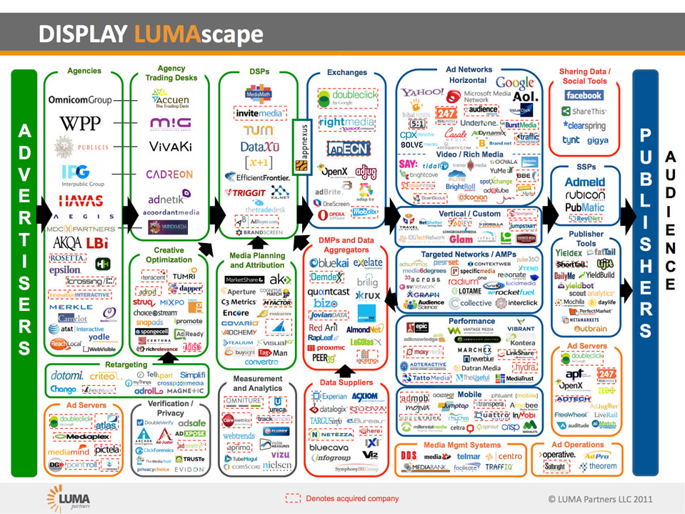
It’s complicated
Richer targeting: relevant is fast!
Better yield management
Real time bidding
Local deals

Slide 11



Old ad flow
No redirection
Premium ads
100 ms
100 ms
100 ms
100 ms
2 ms
Latency Total:
~464 ms
2 ms
CDN
Ad Server
Application Server
50 ms
10 ms

Slide 12
New ad flow
Multiple ad redirection
Highest bidder
Most relevance
300 ms
300 ms
CDN
50 ms
100 ms
100 ms
100 ms
300 ms
300 ms
100 ms
300 ms
Ad Exchange 2
2 ms
2 ms
Latency Total:
~2714 ms
Ad Exchange 1
Ad Server
Application Server
650 ms
10 ms

Slide 13


Ad call sequence
Client
Application
Ad server
Ad network
Ad exchange
Ad content hosting
HTTP request for page
Asynchronous ad call
Ad creative/tags
Server side
Page content with ads (tags)
Ad request to ad network
Ad creative/tags
Ad request to 3rd party
Ad creative/tags
Client side
Ad infinitum…
Ad infinitum…
Ad creative request
Ad creative

Slide 14
What next?
Measure and monitor

Slide 15
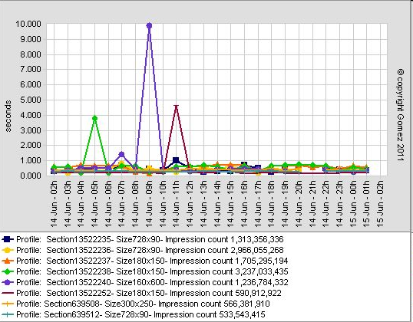
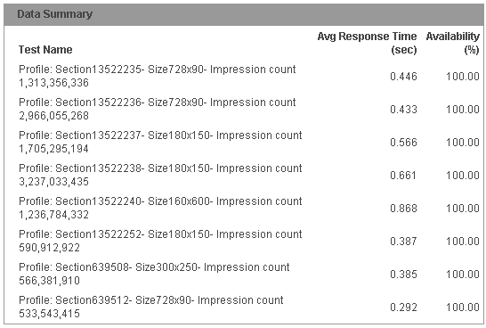
Monitoring ad positions
Many different profiles/positions
Profiles change when campaigns change
Latency transient
What should alert threshold be?
What triggered the alert?

Slide 16
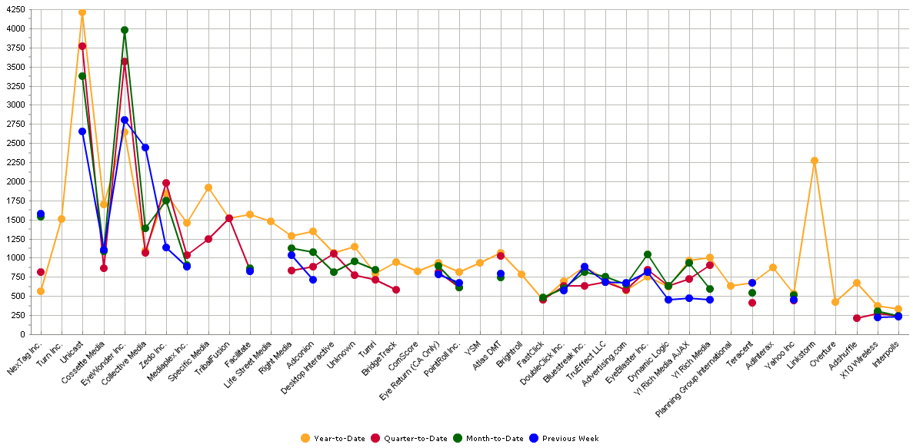
Vendor Ad Latency Monitoring
X Axis: Vendors Y Axis: Avg P95 Time(in ms), sorted on Avg Median Time
Time periods below are rolling windows (e.g. Year-to-Date = 2/24/09 through 2/23/10)

Slide 17
Monitoring Challenges
What is representative?
Is it repeatable?
What is actually slow? Decisioning? Serving? Network?
Identifying ads == finding needle in a haystack
Is this the right level of granularity?

Slide 18
Ad defensive strategies

Slide 19
Strategy #1: Ad handling library
AD content (HTML, JavaScript, etc) is rendered in an IFRAME tag
IFRAME has a cross-domain URL / not specific to property / publisher
IFRAME is controlled by publisher / property
Implements an API that publishers/vendors can use for rich functionality
Uses cross-domain messaging to communicate between application and ad
Better security
Better stability
More control
Faster performance
Allows metrics gathering

Slide 20
Strategy #2: Double buffering
Requires ad handling library to hook into events
Requires same ad position in same web2.0 “page view” to work
Load first ad into iframe
Load second ad into iframe underneath first iframe
When second ad is loaded, destroy the first iframe
Ad underneath gets shown, promote the second iframe z-index

Slide 21
Strategy #3: Fine grained ad loading
Server side vs. client side
Combine ad requests with application requests
Leverage Web2.0 techniques
Delay ad loading to avoid browser contention

Slide 22
Web1.0 Ad Flow
Web Browser
Application server inserts AD markup
Synchronous/blocked loading
Direct DOM access
Cannot differentiate ad content from main content
Best perceived user experience for premium ads in prominent positions
Application Server fetches application
and Ad content
HTML processed
Page rendered
User may now interact with page

Slide 23
Web1.0/2.0 Client-side Ad Flow
Client
Fetch ad after application has loaded
Fine grained ad-rotation in Web2.0/AJAX pages
Prioritizes user actions first
Requires extra roundtrip
Application Server generates content
HTML processed
Page rendered
User may now interact with page
Client fetches and inserts ad content

Slide 24
Web2.0 Ad Flow
Web Browser
Web server fetches AD HTML
Client runtime ad strategy
AD content is simply data
AD content render occurs after initial page load/render
Prioritizes user actions first
Saves one roundtrip for client side ad fetch
AD HTML transformed into data,
emits with page content
Page HTML processed
(ADs not rendered)
Page rendered
JS process AD DATA,
and emits sandbox
User may interact with page
ADs rendered

Slide 25
Example – Message Read Flow Attempt #1
Mail Inbox
*Old AD still visible until new one arrives
Message Read
Fetch Message
Process Message
Fetch AD Content
Message Rendered
Process AD Content
AD Rendered

Slide 26
Example – Message Read Flow Attempt #2
Mail Inbox
*Old AD still visible until new one arrives
Message Read
Fetch Message
Process Message
Fetch AD Content
Message Rendered
Process AD Content
AD Rendered

Slide 27
Example – Message Read Flow Attempt #3
Mail Inbox
*Old AD still visible until new one arrives
Message Read
Fetch Message
Process Message
Fetch AD Content
Message Rendered
Process AD Content
AD Rendered

Slide 28
Demo

Slide 29
Summary
Display advertising landscape is complex
Measuring and monitoring ad performance is subtle
Exercise defensive strategies to mitigate ad impact
End user experience is qualitative

Slide 30
Appendix

Slide 31
Aren’t many ADs already rendered this way?
Web page
IFRAME
ad.yieldmanager.com
(RightMedia)
HTML/CSS/JS
ad content
Many ADs already use their own IFRAME
  However, in this case the IFRAME is part of the AD itself
  This is both GOOD and BAD

Slide 32
Sandbox library resources
2 ms or less of server time added to transform AD into DATA
Adds 2 client-side HTTP requests at most
1 JavaScript file to build sandbox and receive calls from vendors
1 HTML file for the sandbox
Typically makes 0 HTTP requests, as both JavaScript, and
HTML files are cacheable
Typically less than 50 ms of run time, client side impact in browser,
due to best practices in JavaScript

Slide 33
AD HTML as DATA
Original AD HTML is transformed into new HTML
Is a “data-island”
  Not executed / rendered by browser
<SCRIPT type="text/plain" _pos="LREC" _en="ISO-8859-1">
<!-- Other meta-data attributes may be added -->
"<IFRAME SRC=\"http://ad.doubleclick.net/adi/N4912.153730.YAHOO.COM/B5177000.11; . . . \“ />”
<!-- Original AD HTML above, JS safe string -->
</SCRIPT>

Slide 34
Metrics gathering
Ad library can be configured with a variety of “callback” functions
DARLA_CONFIG =
{
/* . . . Other config options here . . . */
onStartPosRender: function()
{
/* Log the time of an AD starting render process */
},
onFinishPosRender: function()
{
/* Log when an AD has finished rendering */
}
}
This level of detail was not available without library
Allows properties like Yahoo! Mail to decide what info is important

Slide 35
Metrics gathering
Properties like Yahoo! Mail implement these callbacks
to collect their own statistics
AD Request Time
AD Render Time
Other data relevant to rendering
  Was JavaScript used
  Were IFRAMEs used
  Was the EAS used
  etc
Or to track and report “bad” ADs
Such as an AD taking too long to be rendered
JavaScript Errors found in ADs

Slide 36
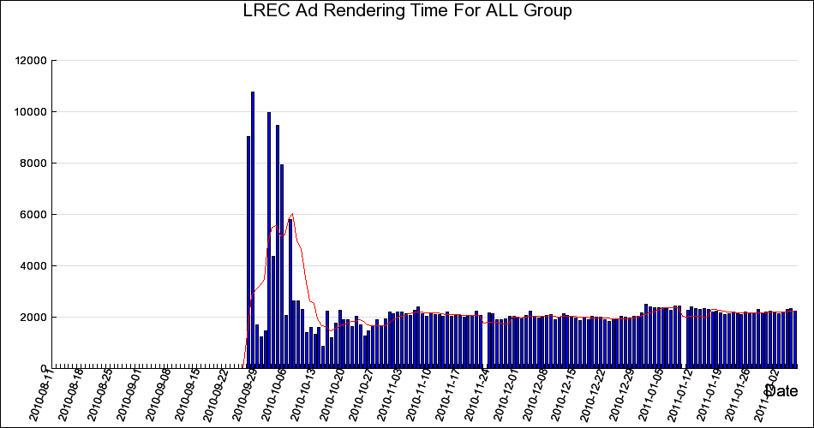
Yahoo! Mail Usage of SecureDARLA – Business Rules
Render time of LREC AD in Minty / Neo
http://twiki.corp.yahoo.com/view/Devel/CGDynamicReportGen?report=5972&cat=All&days=180

Slide 37
Server side ad integration

Slide 38
Ad Call Flow – Server side
6: Ad calls invoked from Client
Client
Ad call should be called asynchronously
Ad call must return before content needs to be flushed
Ad call should batch multiple ads
Ad decision time increasing to better target ads
~30s to 600ms
1
5
Application Server
8
2
4
Ad Server
Ad network
3
7

Slide 39

Acceptable Server-side Ad Latency
Client Request
Make ad call asynchronous
Ad call must return before content needs to be flushed
Ad call should batch multiple ads
Ad decisioning time increasing to better target ads
~30s to 600ms
Impacts server capacity
Ad Call
Ad Response
Client Response
Ad Response
Client Response

Slide 40
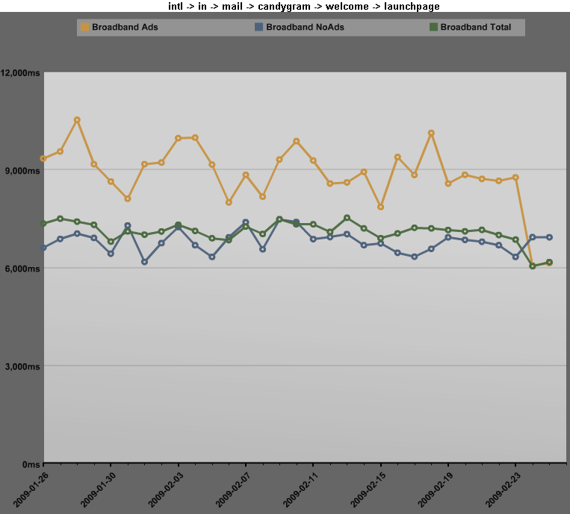
Web1.0 vs. Web2.0 Ad Impact
With Ads
With Ads
37% faster
Without Ads
73% faster
Without Ads

Slide 41
Global challenges
Are ads locally decided?
Are ads geo-targeted?
What type of account is this?
What is the right user experience?
Are ad creatives served globally?

