Slide 1
Building Apps for BlackBerry PlayBook and Smartphones using the WebWorks SDK
Adam Stanley (@n_adam_stanley)
Research In Motion

Slide 2
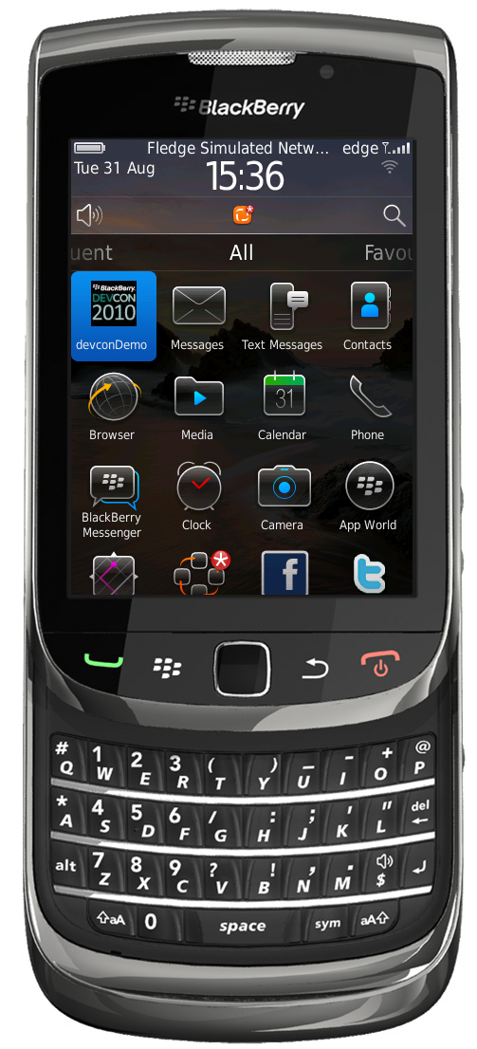
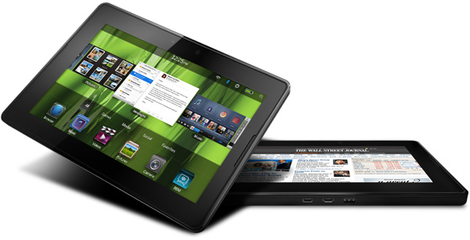
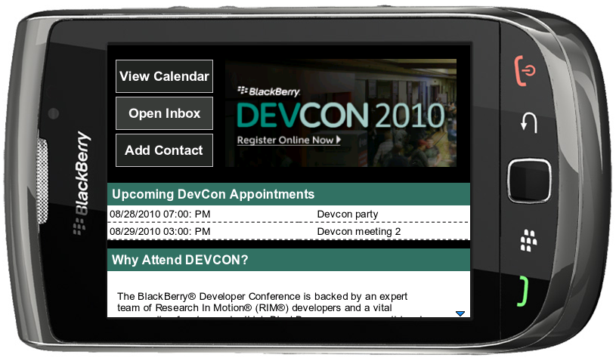
What is BlackBerry WebWorks?
BlackBerry WebWorks is an application platform that enables developers to create standalone applications using modern and standardized web technologies.
WebWorks applications can be fully-featured “Super Apps” through their ability to integrate with native BlackBerry and PlayBook features.

Slide 3
BlackBerry Programming Models
Runtime
Java / AIR
Hybrid
Application
power
Browser
Simplicity of development
and maintenance
Hitting the sweet spot means
The richness of device access and reuse of assets
The simplicity of the browser programming model

Slide 4
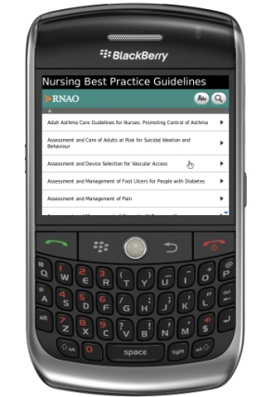
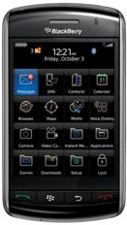
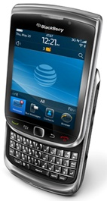
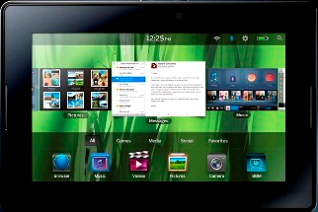
Web = Platform Plurality
BlackBerry Smartphone
BlackBerry PlayBook
It’s a diverse world out there for developers!
Strong Web standards offer support across multiple platforms
Reuse Web assets and developer skills to create BlackBerry apps
Each platform seeing growth in access to native functionality
Access the richness and differentiators of each platform

Slide 5
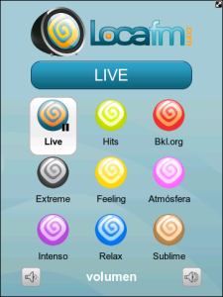
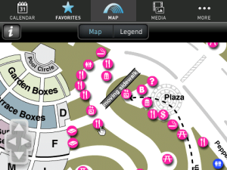
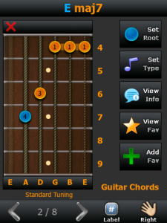
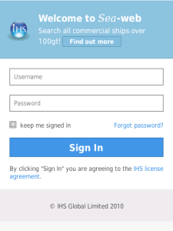
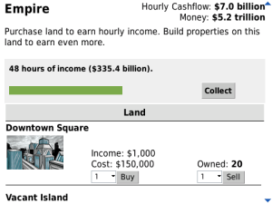
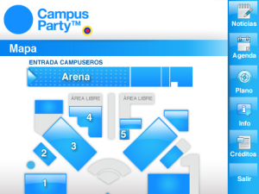
Real World Examples
Hollywood Bowl
(LA Philharmonic)
Loca FM
(Vanatur World Mobile)
Guitar Chords
(My App Catalog)
Superheroes Alliance
(Uken Games)
Campus Party
(Contento Media)
Sea-Web
(Nitobi/PhoneGap)

Slide 6
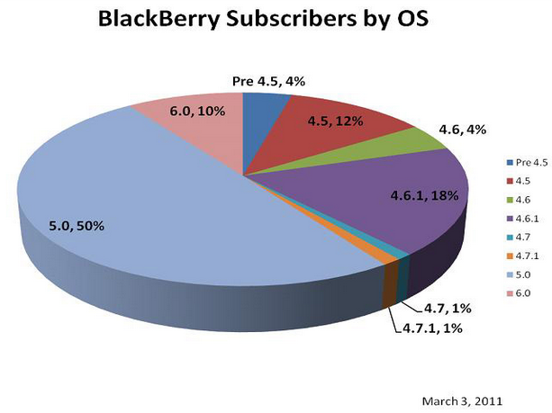
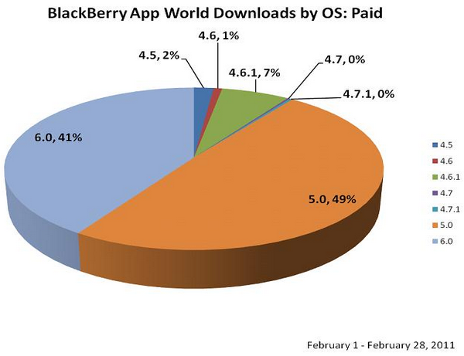
Market for WebWorks Applications
BlackBerry WebWorks applications are supported on
BlackBerry Device Software version 5.0
BlackBerry 6
BlackBerry PlayBook

Slide 7
Features and Capabilities

Slide 8
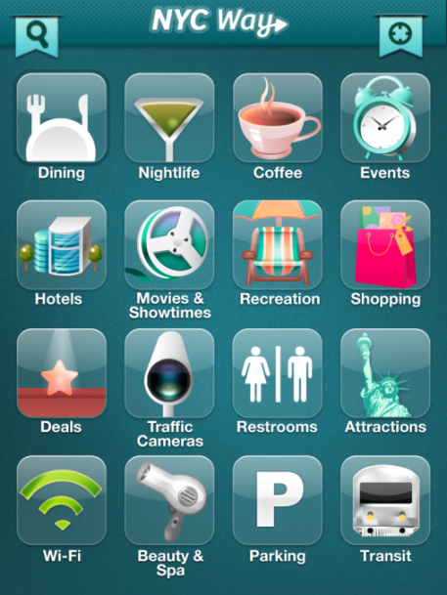
Architecture: How Does it Work?
User interface
Powered by Web
HTML and CSS
Application logic
JavaScript®
WebWorks APIs
Access to Platform OS
Your app
WebKit Engine
WebWorks Platform
BlackBerry Platform
BBM
Security
Push
Monetization
PIM
Background
Media
Storage
Multi-Tasking
Hardware
Compression
…

Slide 9
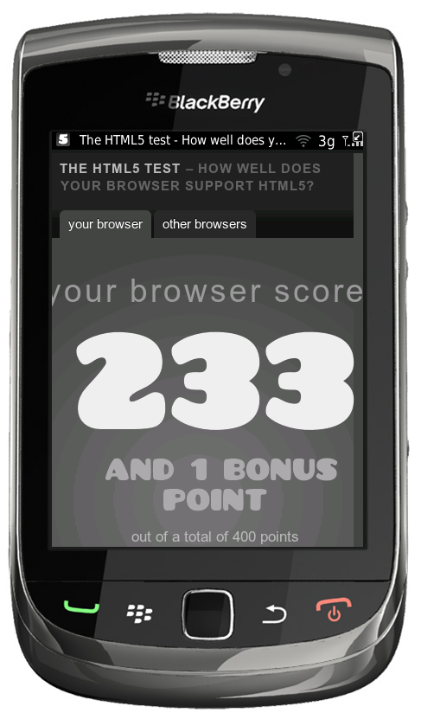
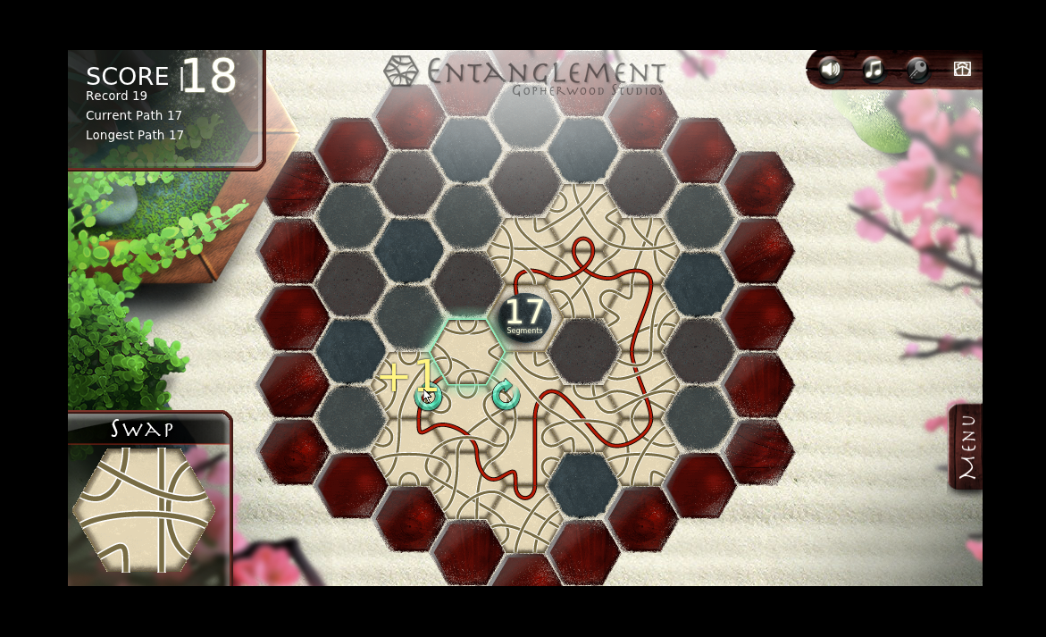
Web Platform Powered by WebKit
WebKit rendering engine added to BlackBerry® 6 and BlackBerry Tablet OS
Industry leading mobile browser experience
High quality Web fidelity and JavaScript performance
Combine the power of HTML5 and CSS3 with JavaScript APIs
http://entanglement.gopherwoodstudios.com/light

Slide 10
Tablet OS: Web Development
Improved high fidelity WebKit browser engine
Very strong support for HTML5 and CSS3 Web standard
Full support of Adobe Flash 10.1
Transform existing Flash content into standalone PlayBook applications
Develop Tablet OS Applications using Adobe Flash Builder
Faster hardware
1Ghz dual core processor
1Gb Ram

Slide 11
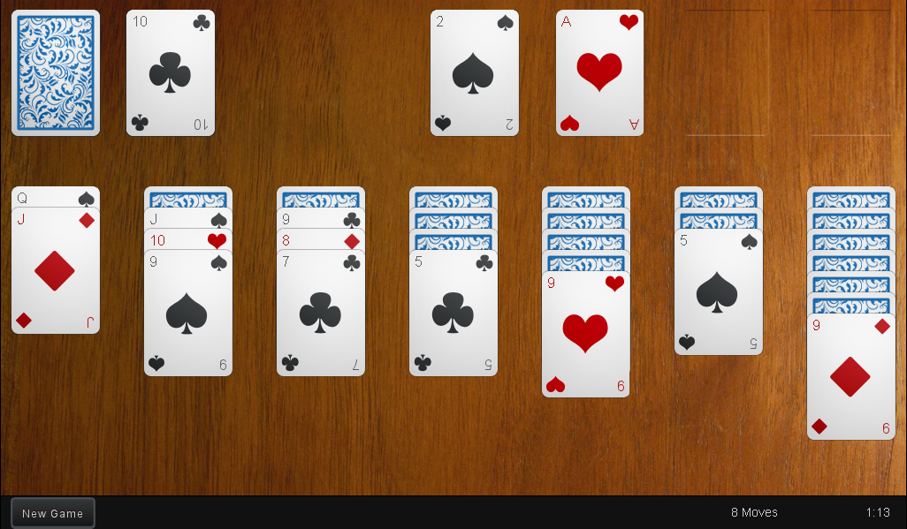
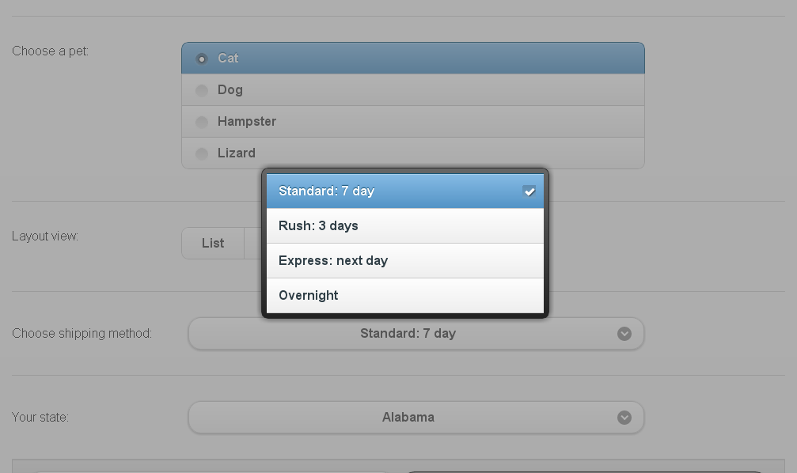
3rd Party Frameworks
Touch optimized Web frameworks support multiple platforms
Examples: jQuery Mobile/UI, Sencha Touch, Dojo, AlphaSoftware
Improve the UI and functionality of your application
Save time and money by using existing code!
Sencha Touch
jQuery Mobile
http://touchsolitaire.mobi/app/
http://jquerymobile.com/demos/

Slide 12
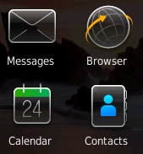
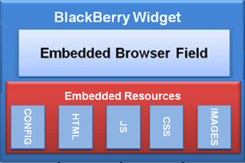
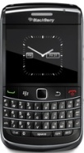
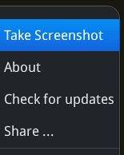
What Can a WebWorks App Do?
Services &
Content
BROWSER ENGINE
WEB
SERVICES
APPLICATION
INTEGRATION
PUSH
SYSTEM
EVENTS
File
System
MENUS
GPS
STORAGE
SQLite

Slide 13
Development Tools

Slide 14
How do you build BlackBerry WebWorks Applications?
Setup Development Environment
Write application content (HTML, CSS, JavaScript files)
Create a ZIP archive containing these Web assets
Package your application using the WebWorks SDK

Slide 15
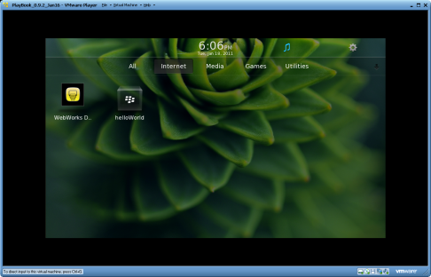
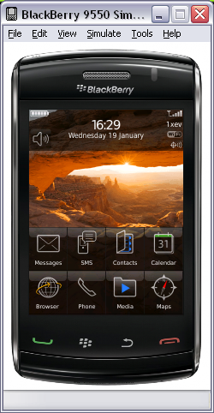
BlackBerry WebWorks SDK
Development Tools
BlackBerry PlayBook
PlayBook Development
Adobe AIR SDK
*.bar
Packaging Process
BlackBerry WebWorks SDK for PlayBook
WebWorks
Application
Archive (ZIP)
Packaging Process
*.cod
Java SDK
Smartphone Development
BlackBerry WebWorks SDK
BlackBerry Smartphone

Slide 16
Required Development Tools: Smartphone SDK
Compile Application:
Java SDK
http://www.oracle.com/technetwork/java/javase/downloads/index.html
BlackBerry WebWorks SDK
http://us.blackberry.com/developers/browserdev/widgetsdk.jsp
Device Simulator:
BlackBerry Smartphone Simulators
http://us.blackberry.com/developers/resources/simulators.jsp

Slide 17
Required Development Tools: PlayBook SDK
Compile Application:
Adobe AIR SDK
http://www.adobe.com/products/air/sdk/
BlackBerry WebWorks SDK for Tablet OS
http://us.blackberry.com/developers/tablet/webworks.jsp
Device Simulator:
VMware Player
http://www.vmware.com/products/player/
BlackBerry PlayBook Simulator
http://us.blackberry.com/developers/tablet/webworks.jsp

Slide 18
Writing An App: “Hello World”

Slide 19
Start Writing Code: Landing page
Open your favorite text editor
Create a new file named index.html
Add the following HTML content:
<html>
<head>
<style type="text/css">
body { font-size: 5em; }
</style>
</head>
<body>
<p> Hello World </p>
</body>
</html>

Slide 20
Start Writing Code: Config
Create a second file named config.xml
Add the following XML content to this file:
<?xml version="1.0" encoding="UTF-8"?>
<widget xmlns="http://www.w3.org/ns/widgets"
xmlns:rim="http://www.blackberry.com/ns/widgets"
version="1.0.0.0">
<name>helloWorld</name>
<content src="index.html"/>
</widget>

Slide 21
Configuration Document (config.xml)
XML document based on W3C spec
http://www.w3.org/TR/widgets/#configuration-document0
Used to define system properties and application permissions
Application name, description, version and icon
Maintains a list of domain and feature permissions
See “Code sample: Creating a BlackBerry WebWorks configuration document” for full details
http://bit.ly/fdOiO6

Slide 22
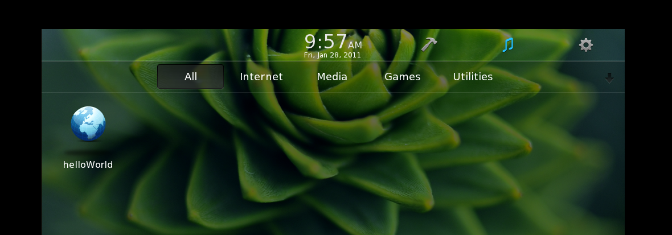
Configuration Document (config.xml)
Define visual characteristics for your application
<?xml version="1.0" encoding="UTF-8"?>
<widget xmlns="http://www.w3.org/ns/widgets" version="1.0.0.0">
<name>helloWorld</name>
<icon src="icon.png"/>
<content src="index.html"/>
</widget>

Slide 23
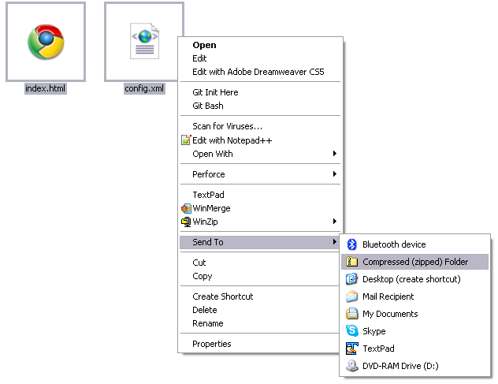
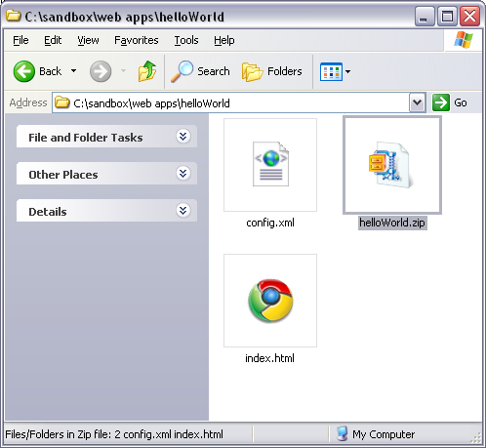
Start Writing Code: Create Archive
Create an archive (ZIP) named helloWorld.zip containing the index.html and config.xml files

Slide 24
Start Writing Code: Compile
Run the BlackBerry WebWorks Packager (bbwp.exe)
Packages the helloWorld.zip file into a helloWorld.bar PlayBook application
C:\Program Files\Research In Motion\BlackBerry WebWorks Pack
ager for PlayBook\bbwp>bbwp "c:\sandbox\web apps\helloWorld\
helloWorld.zip"
[INFO] Parsing command line options
[INFO] Parsing bbwp.properties
[INFO] Validating WebWorks archive
[INFO] Parsing config.xml
[WARNING] Failed to find a <feature> element
[WARNING] Failed to find the <author> element
[INFO] Populating application source
[INFO] Compiling WebWorks application
[INFO] Packaging the bar file
[INFO] Bar packaging complete
[INFO] WebWorks application packaging complete

Slide 25
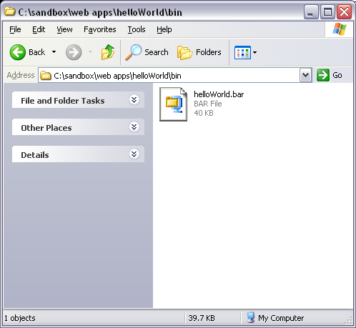
Start Writing Code: Complete

Slide 26
Deploying Your Application
Use “blackberry-deploy” from the BlackBerry Tablet OS SDK
Installed as part of the BlackBerry WebWorks SDK for PlayBook
C:\Program Files\Research In Motion\BlackBerry WebWorks Pack
ager for PlayBook\bbwp\blackberry-tablet-sdk>blackberry-deploy -installApp -device 192.168.198.134 -package "c:\sandbox\
web apps\helloWorld\bin\helloWorld.bar" -password pass
Sending Install request...
Info: Action: Install
Info: File size: 40731
Info: Installing ...
actual_dname::helloWorld1a833da63a6b7e2098dae6d0662e1.MjA5OG
RhZTZkMDY2MmUxICAgICA
actual_id::MjA5OGRhZTZkMDY2MmUxICAgICA
actual_version::1.0.0.0
result::success

Slide 27
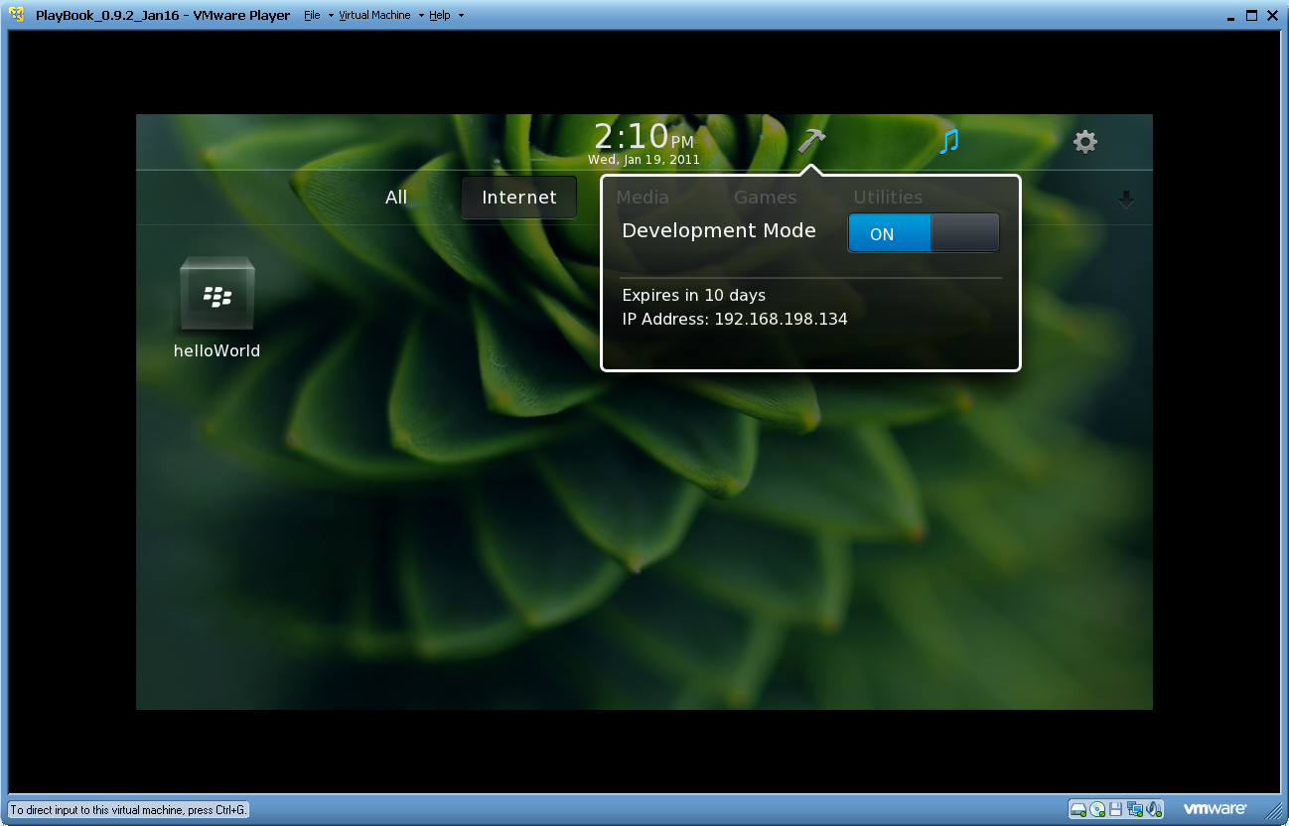
Deploying Your Application

Slide 28
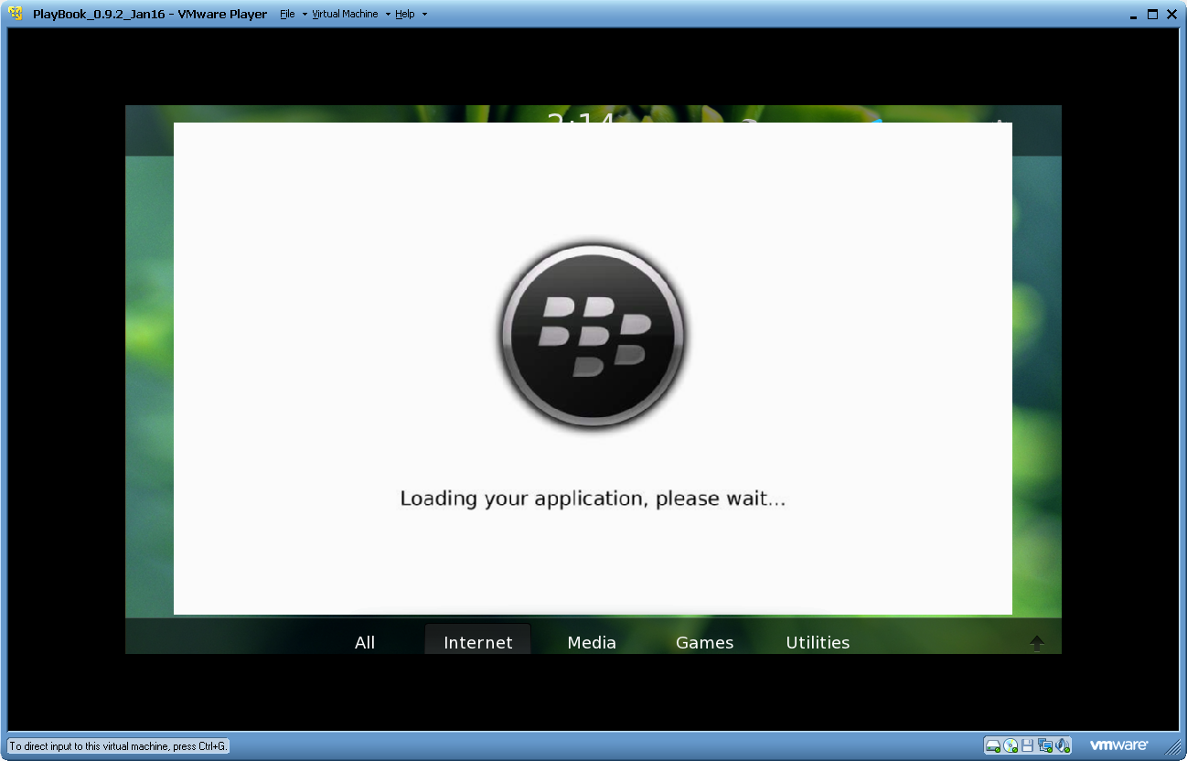
Deploying Your Application

Slide 29
Exercise: Migrating content to the BlackBerry PlayBook Platform

Slide 30
Re-Using Your Existing Web Assets
Step 1: Create a Web Launcher application
Configure your app to directly load your Website
<?xml version="1.0" encoding="UTF-8"?>
<widget xmlns="http://www.w3.org/ns/widgets" version="1.0.0.0">
<name>DevBlog</name>
<icon src="icon.png"/>
<content src="http://devblog.blackberry.com"/>
<access uri="http://devblog.blackberry.com" subdomains="true"/>
</widget>

Slide 31
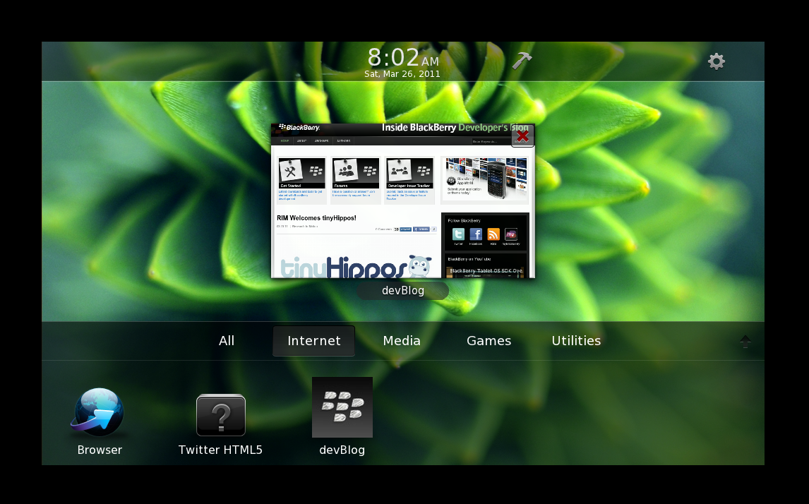
Re-Using Your Existing Web Assets
Step 2: Move remote Web content into standalone application
<?xml version="1.0" encoding="UTF-8"?>
<widget xmlns="http://www.w3.org/ns/widgets" version="1.0.0.0">
<name>DevBlog</name>
<icon src="icon.png"/>
<content src="http://devblog.blackberry.com"/>
<content src="index.html"/>
</widget>
Web Server
devBlog.bar

Slide 32
Re-Using Your Existing Web Assets
Step 3: Start taking advantage of local features
Support platform-specific capabilities using JavaScript WebWorks APIs
if (blackberry.system.hasDataCoverage())
{
if (confirm("Network unavailable. Would you like to try again later?"))
{
blackberry.app.exit();
}
}
Explore other WebWorks API features
Integrate platform capabilities into your Web content
http://www.blackberry.com/developers/docs/widgetapi

Slide 33
Re-Using Your Existing Web Assets
Step 4: Publish your content in BlackBerry App World
http://us.blackberry.com/developers/appworld/distribution.jsp
BlackBerry App World
Free to register and submit apps
70 Countries, 21 Currencies, 6 Languages
PayPal, Credit Card, Carrier Billing
Over 35 million App World users (2+ million app downloads per day)
Over 75% of app downloads are OS 5.0+

Slide 34
BlackBerry PlayBook Integration

Slide 35
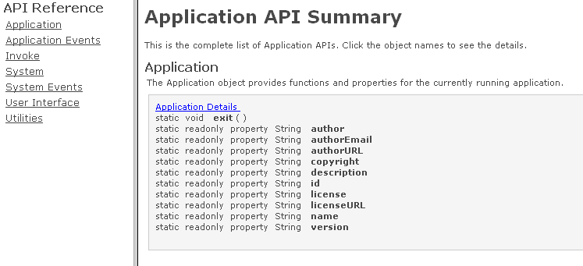
Web Works JavaScript APIs
Custom objects that can connect browser engine with underlying platform
BlackBerry WebWorks apps can be more than just web content
Enables “Super App” functionality
http://www.blackberry.com/developers/docs/webworks/api/playbook/

Slide 36
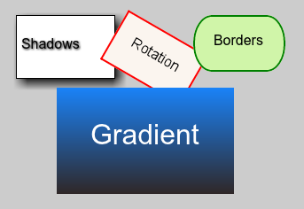
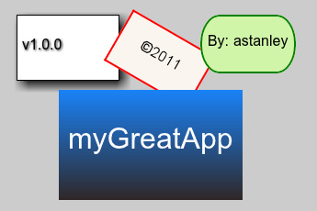
JavaScript API: Application Info
Use blackberry.app to read data from config.xml file
Example: Styling an ‘About’ feature in your app with CSS3
function setValue(id, message) {
document.getElementById(id).innerHTML = message;
}
function showAbout()
{
setValue("version", "v" + blackberry.app.version);
setValue("copyright", "&copy; " + blackberry.app.copyright);
setValue("author", "By: " + blackberry.app.author);
setValue("name", blackberry.app.name);
}

Slide 37
Web Works JavaScript APIs
Grant API permission in config.xml file
Create an <feature> element for any required APIs
Missing <feature> definitions may result in runtime ‘undefined’ errors
<?xml version="1.0" encoding="UTF-8"?>
<widget xmlns="http://www.w3.org/ns/widgets" version="1.0.0.0">
<name>helloWorld</name>
<icon src="icon.png"/>
<content src="index.html"/>
<feature id="blackberry.app" required="true" version="1.0.0.0"/>
</widget>

Slide 38
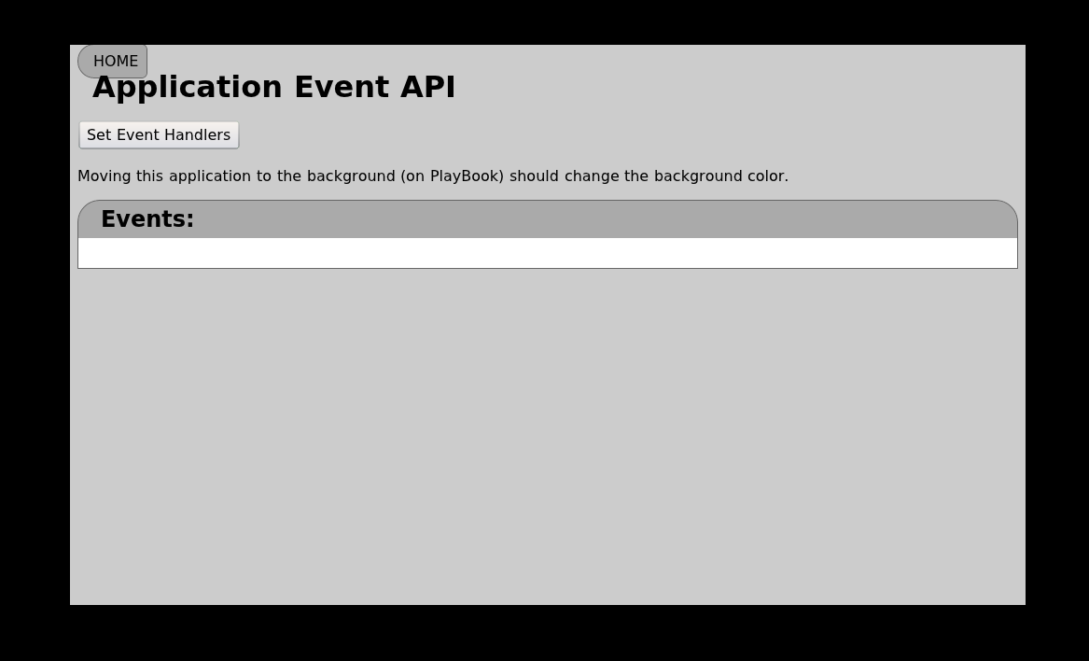
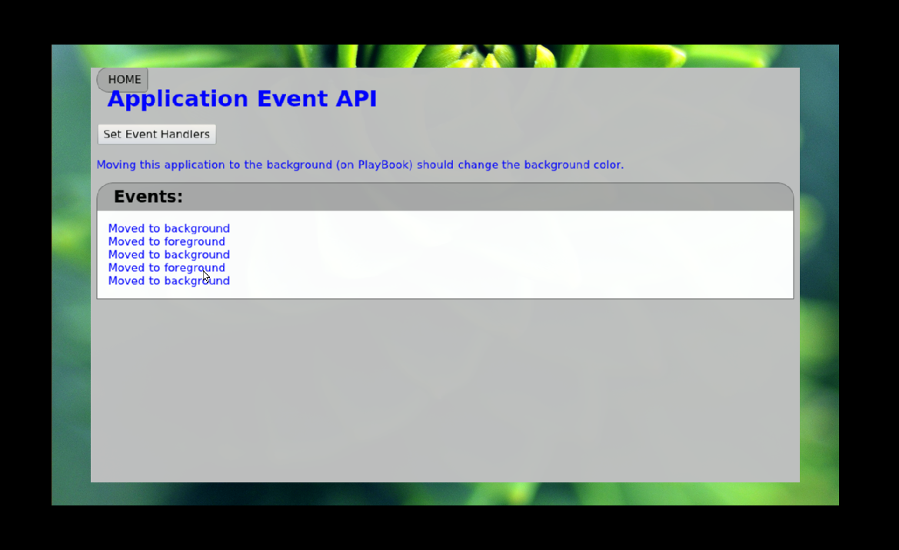
JavaScript API: Application Events
Detect when user has moved the application to the background and/or foreground
function handleBackground() {
document.getElementById("mainElement").className = "background";
}
function handleForeground() {
document.getElementById("mainElement").className = "normal";
}
blackberry.app.event.onBackground(handleBackground);
blackberry.app.event.onForeground(handleForeground);

Slide 39
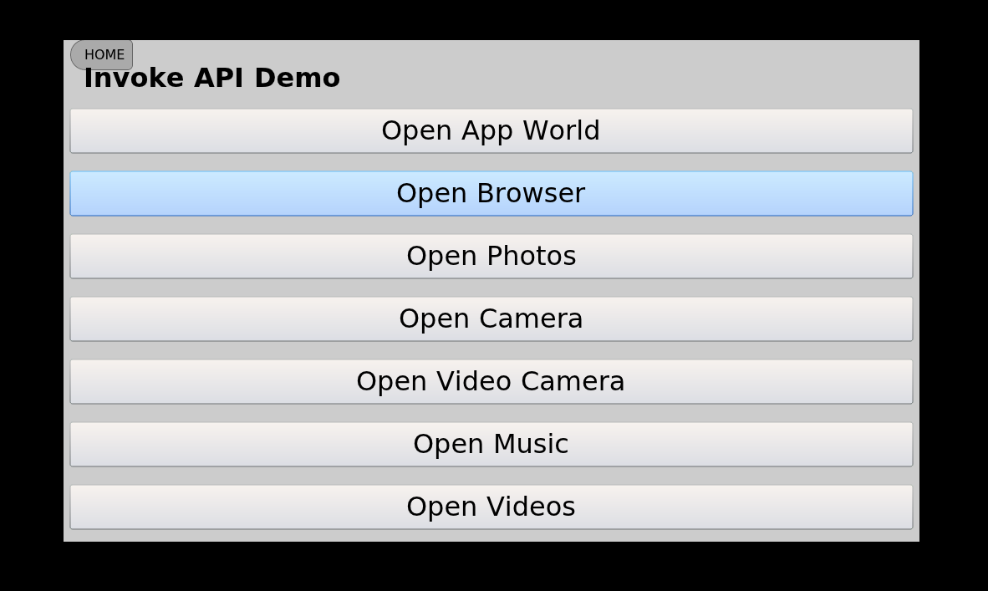
JavaScript API: Invoke Applications
Launch other Tablet OS applications
function openVideoCamera()
{
var args = new blackberry.invoke.CameraArguments();
args.view = blackberry.invoke.CameraArguments.VIEW_RECORDER;
blackberry.invoke.invoke(id, args);
}
...
<button onclick="openVideoCamera()">Open Video Camera</button>

Slide 40
JavaScript API: System Info
Retrieve information about the current state of the Tablet OS
function getNHLscores() {
var data;
//Get live data when network connection is available
// Otherwise, use last saved values.
// hasDataCoverage() is similar to "navigator.onLine"
if (blackberry.system.hasDataCoverage())
{
data = callWebService("http://test.sports.com/ws?t=NHL");
saveToDB("NHL", data);
}
else {
data = getFromDB("NHL");
}
displayScores(data);
}

Slide 41
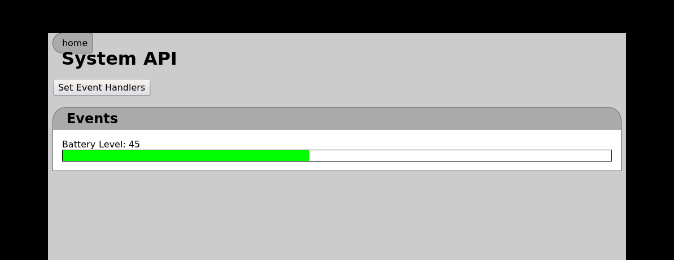
JavaScript API: System Events
Read information about battery level and state
function handleBatteryLevel(level)
{
document.getElementById("level").style.width = level + "%";
}
...
blackberry.system.event.deviceBatteryLevelChange(handleBatteryLevel);
...
<div class="batteryLevelBar">
<div id="level" class="batteryLevel">&nbsp;</div>
</div>

Slide 42
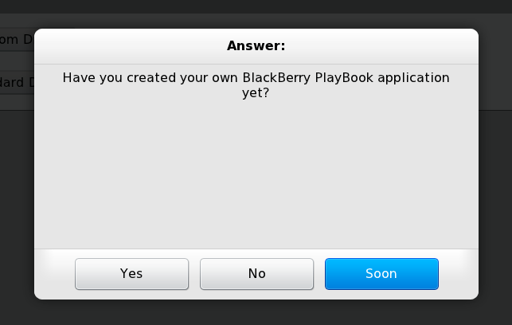
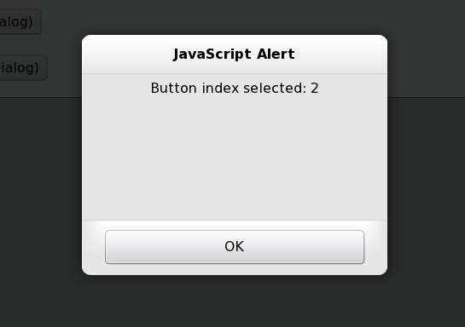
JavaScript API: Tablet OS UI
Display custom and standard Tablet OS Dialog windows
function dialogCallBack(index) {
alert("Button index selected: " + index);
}
function customDialog() {
var question = "Have you created a BlackBerry PlayBook application?";
var buttons = new Array("Yes", "No", "Soon");
var ops = { title : "Answer:", size : blackberry.ui.dialog.SIZE_MEDIUM,
position : blackberry.ui.dialog.LOC_CENTER };
blackberry.ui.dialog.customAsk(question, buttons, dialogCallBack, ops);
}
...
<button onclick="customDialog()">Ask Question (Custom Dialog)</button>

Slide 43
Offline Storage: HTML5 LocalStorage
Save name-value pairs (String) for offline use
Session data persists while application remains open
Local data persists even after restarting application
http://dev.w3.org/html5/webstorage/
function saveSession()
{
window.sessionStorage.clear();
window.sessionStorage.setItem("Greeting", "Hello World");
var key = window.sessionStorage.key(0); //"Greeting"
var value = window.sessionStorage.getItem(key); //"Hello World"
key = key + "_FR"; //"Greeting_FR"
value = "Bonjour Monde";
window.sessionStorage.setItem(key, value);
var num = window.sessionStorage.length; //2 entries
}

Slide 44
Offline Storage: HTML5 Web DB
Relational database powered by SQLite
http://www.w3.org/TR/webdatabase/
function initDBSchema(database)
{
if (database)
{
database.transaction(function(tx) {
var SQL = "CREATE TABLE IF NOT EXISTS Messages (id INTEGER " +
" PRIMARY KEY, message TEXT, created TIMESTAMP)";
//The following method occurs asynchronously. Requires callback
// methods to correctly perform next actions (e.g. INSERT statements)
tx.executeSql(SQL, [], firstCreateComplete, handleSQLError);
}, handleTransactionError);
}
}
function createDB()
{
var dbSize = 2 * 1024 * 1024;
db = window.openDatabase("WebDB", "1.0", "Example", dbSize, initDBSchema);
}

Slide 45
Media: Flash 10.1
Take advantage of Flash 10.1 support on PlayBook
Embed local or remote content directly your Web application
<!-- Remote URI: -->
<object width="640" height="385">
<param name="movie"
value="http://www.youtube.com/v/eAaez_4m9mQ?fs=1&amp;hl=en_US">
</param>
<embed src="http://www.youtube.com/v/eAaez_4m9mQ?fs=1&amp;hl=en_US"
width="640" height="385">
</embed>
</object>
<!– Embedded SWF: -->
<object width="500" height="300">
<param name="movie" value="5-snowflakes.swf"></param>
<embed src="5-snowflakes.swf" width="500" height="300"></embed>
</object>
Sample courtesy of
http://www.swfspot.com/swfspot/samples/flash8/Falling_Snowflakes

Slide 46
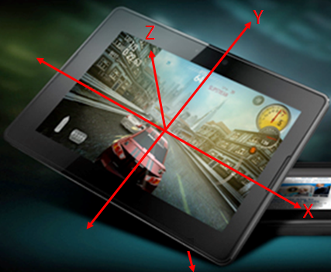
Hardware Feature: Accelerometer
Additional mechanism for user interaction besides screen
http://dev.w3.org/geo/api/spec-source-orientation.html#motion_event
window.addEventListener("devicemotion", function(event)
{
//Acceleration measured in m/s^2
var x = event.accelerationIncludingGravity.x;
var y = event.accelerationIncludingGravity.y;
var z = event.accelerationIncludingGravity.z;
// A BlackBerry PlayBook lying flat on the Earth’s surface
// (facing up) should have an acceleration of:
// { x : 0, y : 0, z : 9.81 }
}, true);

Slide 47
Hardware Feature: Orientation
Event raised when user turns PlayBook left or right
UI can be changed to switch between Landscape and Portrait layout
window.onorientationchange = function()
{
switch(window.orientation)
{
case 0:
alert("Top side up :" + window.orientation);
break;
case 90:
alert("Left side up :" + window.orientation);
break;
case -90:
alert("Right side up :" + window.orientation);
break;
}
}

Slide 48
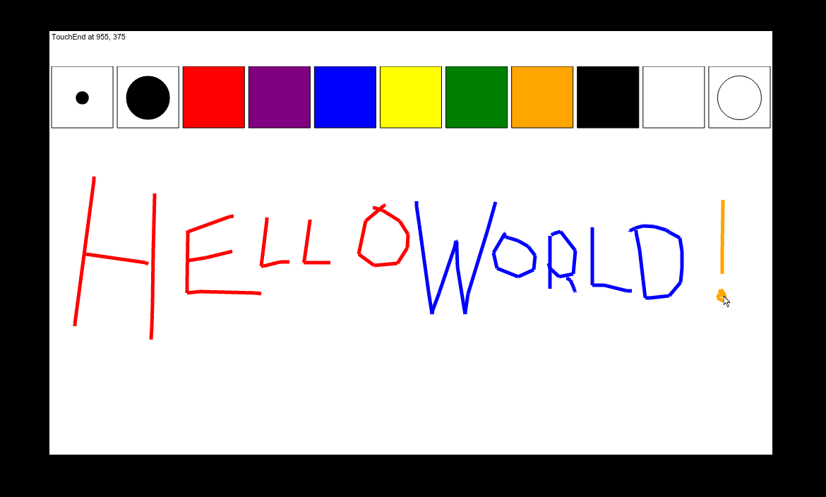
Hardware Feature: Touch Screen
Override default behavior with custom events handlers
See “Sample Code – SketchPad Application” http://bit.ly/hz67JX
document.ontouchstart = function(event)
{
//Tell browser engine not to scroll/span/zoom when user touches screen:
event.preventDefault();
//Get first in collection of all active TouchStart events:
var touchEvent = event.changedTouches[0];
//Process the event
alert("TouchStart: " + touchEvent.pageX + "," + touchEvent.pageY);
}

Slide 49
Getting Help

Slide 50
For More Information
BlackBerry Developer Zone:
http://www.blackberry.com/developers
Download BlackBerry development tools & simulators
Tutorial knowledge base & samples resource center
Developer issue tracker
Community
Web community forum http://bit.ly/8o5EMp
Developers blog http://devblog.blackberry.com
Twitter http://twitter.com/BlackBerryDev
Open source project http://www.github.com/blackberry

Slide 51
Webcast Series
Developing using BlackBerry WebWorks SDK for BlackBerry Tablets
February 1, 2011: Getting Started
February 3, 2011: My First App
February 8, 2011: BlackBerry PlayBook Integration
February 10, 2011: User Interface Guidelines and Best Practices
http://webcast.streamlogics.com/audience/index.asp?eventid=49950807

Slide 52
http://www.blackberrydevcon.com
DevCon 2011

