Slide 1
MAD Skills
New Analysis Practices for Big Data
Brian Dolan | Discovix
Joe Hellerstein | UC Berkeley

Slide 2
MADgenda
Warehousing and the New Practitioners
Getting MAD
A Taste of Some Data-Parallel Statistics
Ecosystem Example
MAD Community

Slide 3
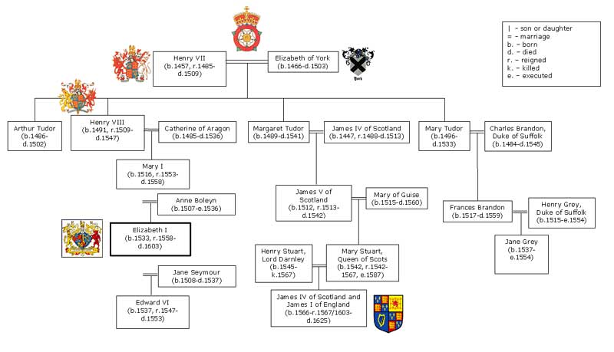

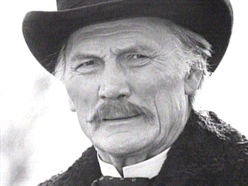
Data Lineage
Enterprise
Research
Managed
Protected
Fluid
Innovative
Scalability
Notes:
You have the same data beliefs as your ‘parents’
Tool stack is driven by your domain. There is a whole continent of people who have never heard of ESRI shape files
Acknowledge a complicated data economy
Now, data is money. You want it to be reliable and protected.
NO NAME CALLING!
The fundamental difference between left and right? The guys on the left have been in business longer.

Slide 4
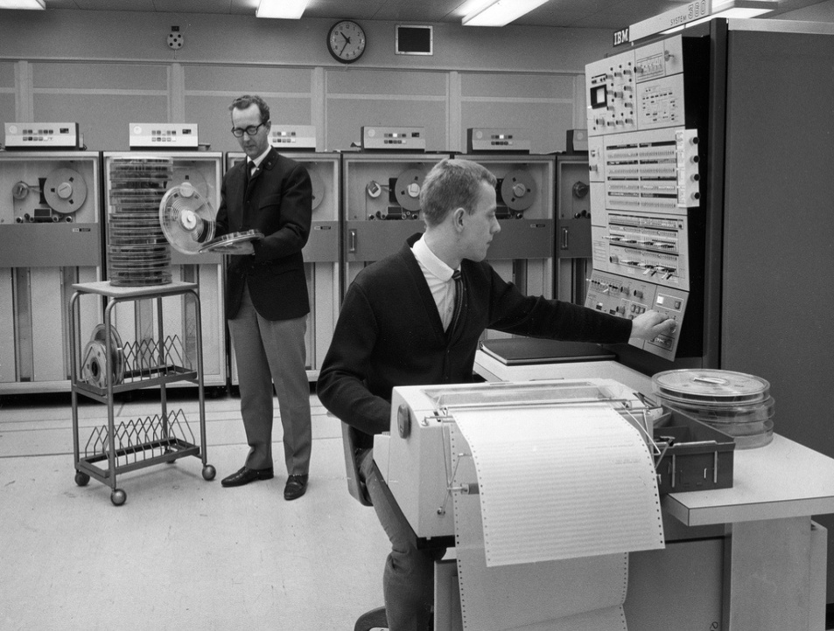

In the Days of
Kings and Priests
Computers and Data: Crown Jewels
Executives depend on computers
  But cannot work with
  them directly
The DBA “Priesthood”
  And their Acronymia
    EDW, BI, OLAP
Notes:
These are not principles, but realities for the ‘Old Guard’

Slide 5
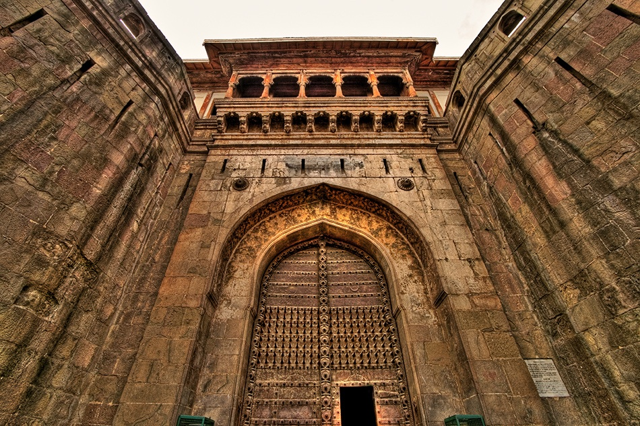
The Architected EDW
Rational behavior … for a bygone era
  “There is no point in bringing data … into the data warehouse environment without integrating it.”
  — Bill Inmon, Building the Data Warehouse, 2005

Slide 6


Where Things Move Fast
Data obtained, tortured then discarded
Researchers consider data their property
  But don’t have the time or inclination to manage it fully
The Research “Gunslingers”
  And their Arsenal
    Hadoop, Java, Python

Slide 7
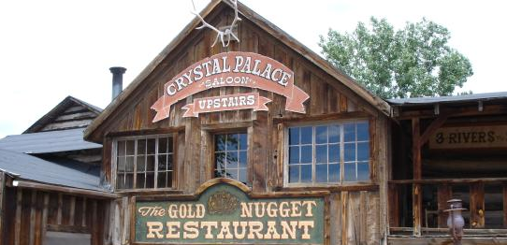
Line-Level Data
Not just detailed, but part of the revenue stream
Notes:
Academics live in a feudal world.
No data integration
No consistency from data set to data set
Hard to share information/knowledge
Flat files and Hadoop rule here: Unstructured worlds

Slide 8

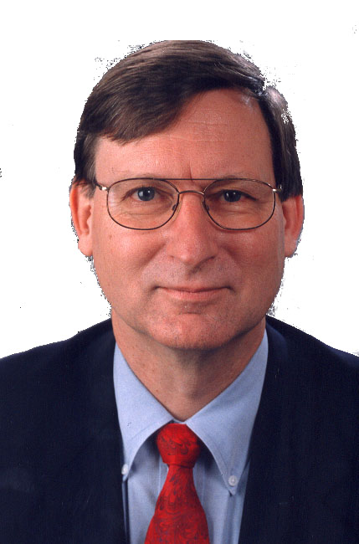
The New Practitioners
the sexy job in the next ten years will be statisticians
Innovate Constantly
Monetize Data
Hal Varian, UC Berkeley, Chief Economist @ Google

Slide 9
MADgenda
Warehousing and the New Practitioners
Getting MAD
A Taste of Some Data-Parallel Statistics
Ecosystem Example
MAD Community

Slide 10
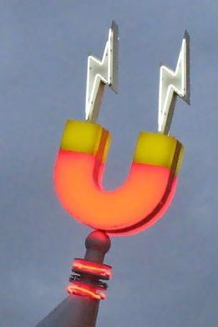


MAD SKILLS
Magnetic
  attract data and practitioners
Agile
  rapid iteration: ingest, analyze,
  productionalize
Deep
  sophisticated analytics in Big Data

Slide 11
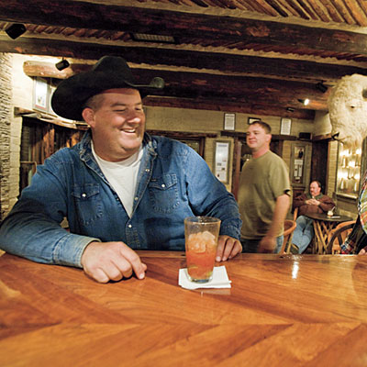
Magnetic
Magnetic warehouses attract users and data.
  Share ideas at the watering hole
  There’s always room in the back for your stuff
Sustain the local data economy
  Meta-data management
  Data supply-chain management

Slide 12

Agile
run analytics to improve performance
The new economy means mathematical products
change practices to suit
Agile product design is a must
acquire new data to be analyzed
Notes:
On the frontier, new methods and sources need to be explored
Taking the time to pave the streets could get you killed.
Any repository is better than none.

Slide 13
Deep
The Vocabulary Of Statistics
Data Mining focused on individual items
  Statistical analysis needs more
  Focus on density methods!
Need to be able to utter statistical sentences
  And run massively parallel, on Big Data!
  (Scalar) Arithmetic
  Vector Arithmetic
    I.e. Linear Algebra
  Functions
    E.g. probability densities
  Functionals
    i.e. functions on functions
    E.g., A/B testing:
    a functional over densities
[MAD Skills, VLDB 2009]
Notes:
Linear algebra (vectors/matrices)
Ordinary Least Squares (multiple linear regression)
Conjugate Gradiant (iterative optimization, e.g. for SVM classifiers)
Functionals including Mann-Whitney U test, Log-likelihood ratios
Resampling techniques, e.g. bootstrapping

Slide 14
MADgenda
Warehousing and the New Practitioners
Getting MAD
A Taste of Some Data-Parallel Statistics
Ecosystem Example
MAD Community

Slide 15
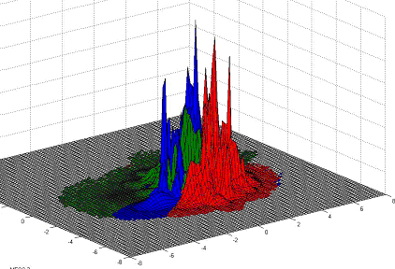
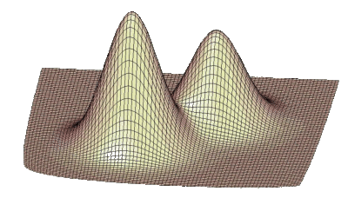
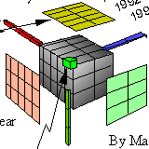



A Scenario from FAN
How many female WWF fans under the age of 30 visited the Toyota community over the last 4 days and saw a Class A ad?
How are these people similar to those that visited Nissan?
  Open-ended question about statistical densities (distributions)

Slide 16
MADgenda
Warehousing and the New Practitioners
Getting MAD
A Taste of Some Data-Parallel Statistics
Ecosystem Example
MAD Community

Slide 17


Multilingual development
SE HABLA MAPREDUCE
SQL SPOKEN HERE
QUI SI PARLA PYTHON
HIER JAVA GESPROCKEN
R PARLÉ ICI

Slide 18

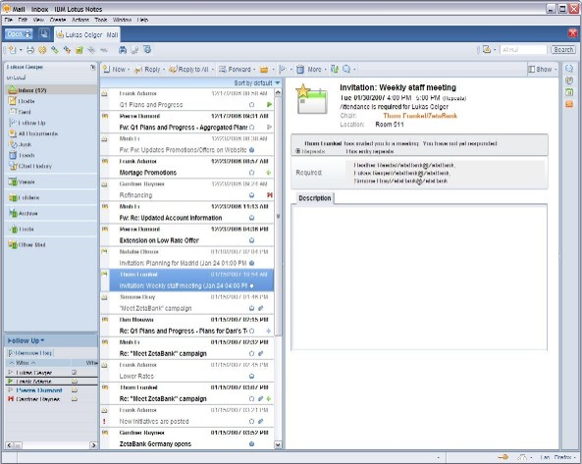


Text Mining
Native Files
This is where you get things
Unstructured Text
Complicated Natural Language and Statistical processes examine the content for relevant features.
dear john i never thought i would writing be to you like this but i think the time has come to move on…
Go get new things.
Structured Features
Advanced in-database statistical processes and machine learning algorithms.
To | John
Date | Feb 14, 2010
Tense | Past
Topic | Yesterday’s News
The analysis reveals new demands on the feature extractors.

Slide 19
MADgenda
Warehousing and the New Practitioners
Getting MAD
A Taste of Some Data-Parallel Statistics
Ecosystem Example
MAD Community

Slide 20



RESEARCH &
OPEN SOURCE
MADlib
the unnamed

Slide 21

“MADlib is an open-source library for scalable in-database analytics.
It provides data-parallel implementations of mathematics, statistical and machine-learning methods for structured and unstructured data.”
http://www.madlib.net

Slide 22
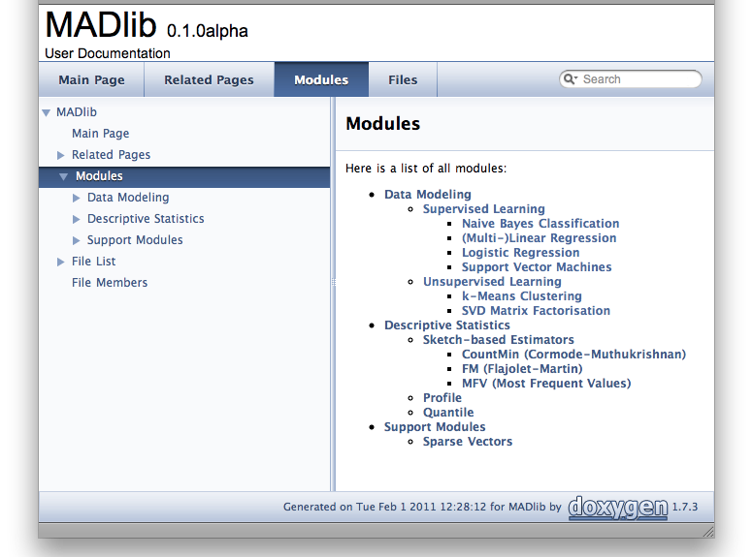

Slide 23
02.03.11
  “friends and family” alpha release
  BSD license
  initial ports: PostgreSQL, Greenplum
  initial contributors: Berkeley, EMC/Greenplum
spring 2011
  beta release
  new contributor pipeline for ports and methods

Slide 24
the unnamed
“facilitating interactions between people and data throughout the analytic lifecycle”
with thanks to research sponsors:
National Science Foundation
Lightspeed Venture Partners
Yahoo! Research
EMC/Greenplum
SurveyMonkey
http://on.fb.me/helpnameus

Slide 25





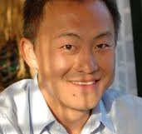


the unnamed
Jeff Heer
Stanford
Maneesh Agrawala
Berkeley
Joe Hellerstein
Berkeley
Tapan Parikh
Berkeley
Sean Diana Ravi
Kandel MacLean Parikh
Kuang Nicholas Wesley
Chen Kong Willett

Slide 26
the unnamed
datawrangler intelligent data xformation
commentspace social data analysis
usher/shreddr first-mile data entry

Slide 27
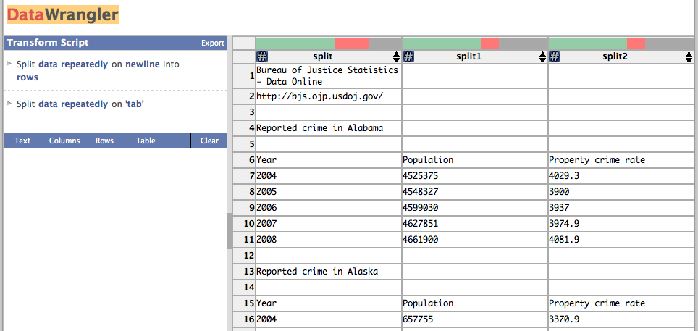
DATAWrangler
http://vis.stanford.edu/wrangler
Kandel, et al. SIGCHI 2011

Slide 28
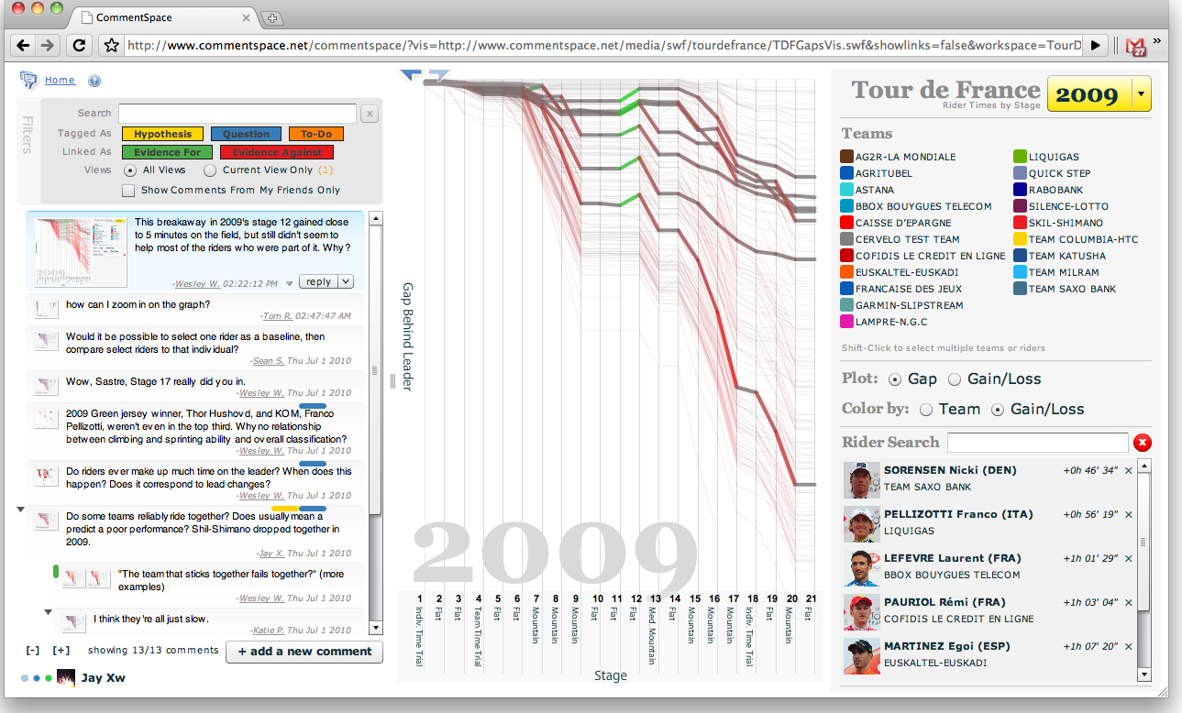
COMMENTSPACE
http://www.commentspace.net
Willett, et al. SIGCHI 2011

Slide 29
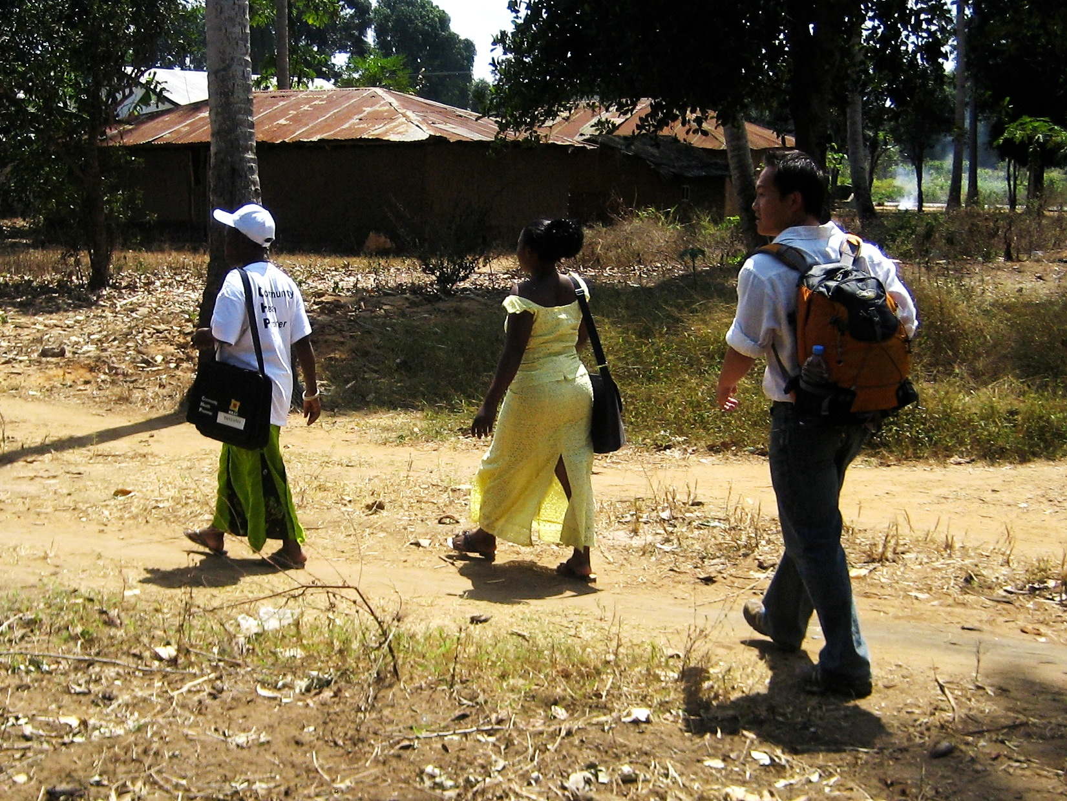
Notes:
The next summer, I volunteered as a data analyst for an HIV/AIDS program in Tanzania
Here I am shadowing CHWs
There I found that, of all things, data entry is a huge challenge.

Slide 30
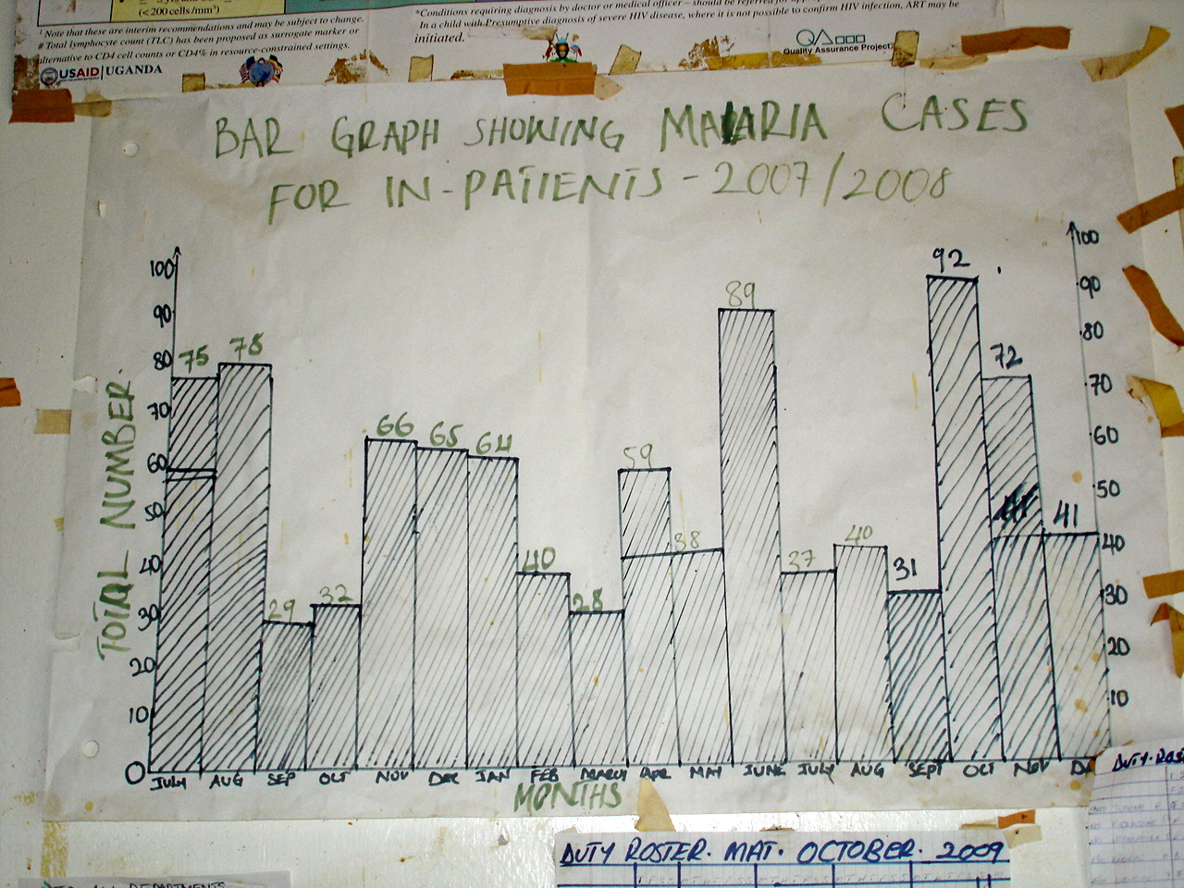
Database

Slide 31


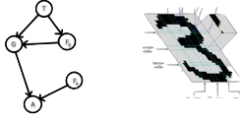

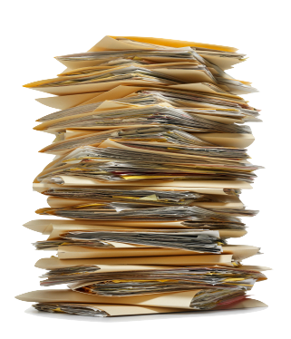


http://shreddr.org

Slide 32
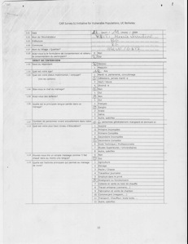
SHREDDING

Slide 33
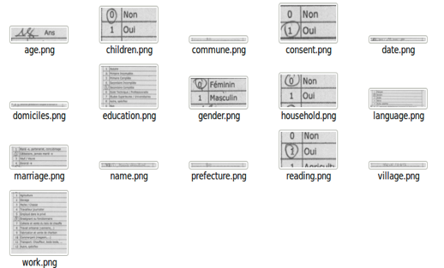
SHREDDING

Slide 34
Column-oriented
Data Entry

Slide 35
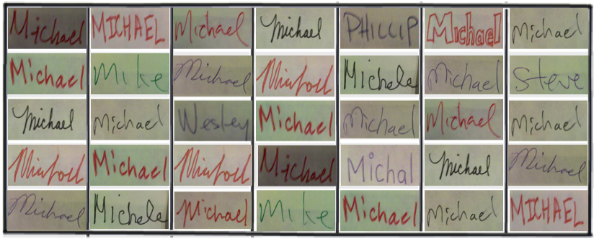
Column-oriented
Data Entry
select the snips that are not ‘MICHAEL’

Slide 36

IN Σ…
^{IF YOU’RE NOT MAD,}
^{YOU’RE NOT} ^{PAYING}
^{ATTENTION!!}
GET MAD!
  Magnetic core for analytic life-cycle
  Agile processes for innovation
  Deep analysis, parallel, close to data
  http://madlib.net
  http://on.fb.me/helpnameus

Slide 37
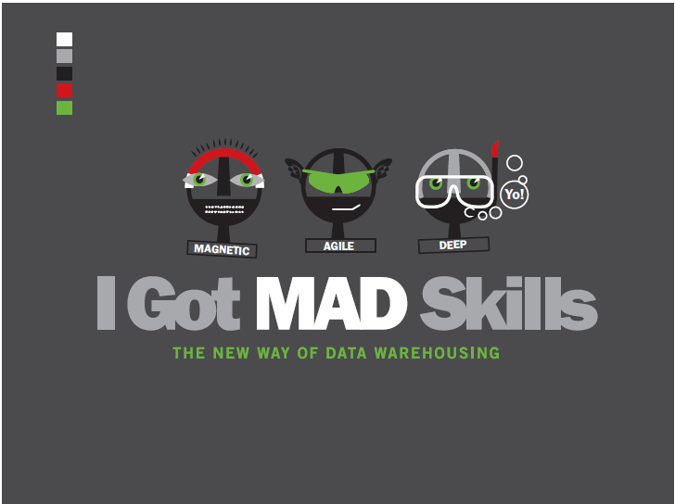

Slide 38
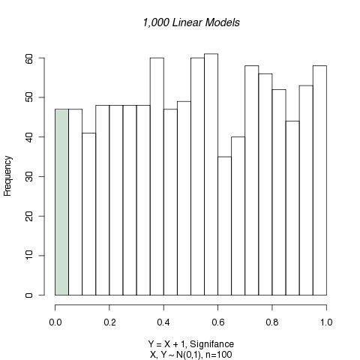

Tea Cup

Slide 39
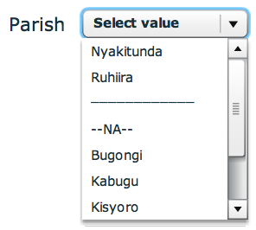
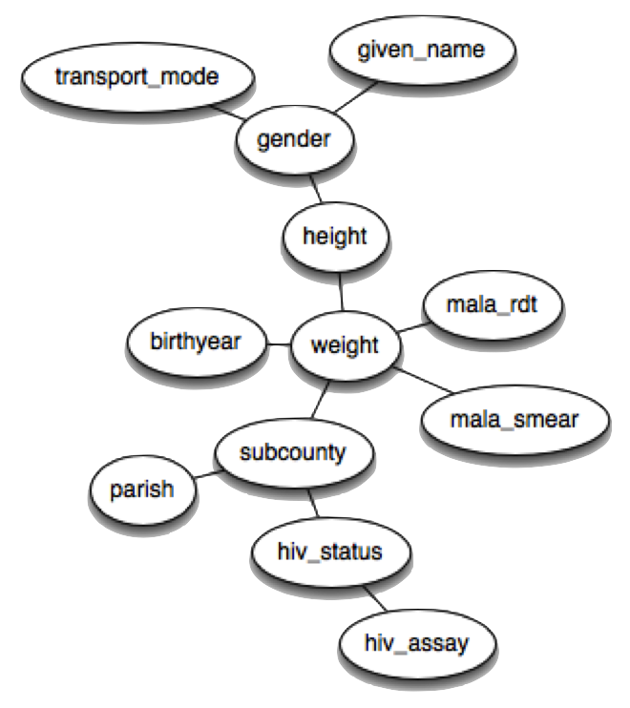
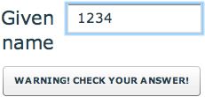
Usher
http://bit.ly/usherforms
K. Chen, et al. ICDE 2010, UIST 2010

Slide 40
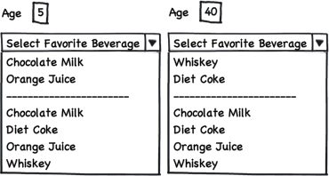


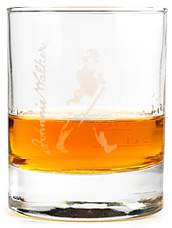
Intuition
Hard constraint
Soft constraint friction
Correlations between questions
“Friction”
  Entry effort should be proportional to value likelihood

Slide 41
Conclusion
Forget:
Your database is a delicate piece of proprietary hardware
Storage is expensive
Math is too hard for you
You're done once the report is in the tool
Remember:
Your database is a parallel computation engine
Your database was purchased to make your business stronger
SQL is a flexible and highly extensible language

Slide 42
Time for ONE? Bootstrapping
A Resampling technique:
  sample k out of N items with replacement
  compute an aggregate statistic θ₀
  resample another k items (with replacement)
  compute an aggregate statistic θ₁
  … repeat for t trials
The resulting set of θ_{i}’s is normally distributed
  The mean θ∗ is a good approximation of θ
  Avoids overfitting:
    Good for small groups of data, or for masking outliers

Slide 43
Bootstrap in
Parallel SQL
Tricks:
  Given: dense row_IDs on the table to be sampled
  Identify all data to be sampled during bootstrapping:
    The view Design(trial_id, row_id) easy to construct using SQL functions
  Join Design to the table to be sampled
    Group by trial_id and compute estimate
    All resampling steps performed in one parallel query!
  Estimator is an aggregation query over the join
A dozen lines of SQL, parallelizes beautifully

Slide 44
SQL Bootstrap:
Here You Go!
CREATE VIEW design AS
SELECT a.trial_id, floor (N * random()) AS row_id
FROM generate_series(1,t) AS a (trial_id),
generate_series(1,k) AS b (subsample_id);
CREATE VIEW trials AS
SELECT d.trial_id, theta(a.values) AS avg_value
FROM design d, T
WHERE d.row_id = T.row_id GROUP BY d.trial_id;
SELECT AVG(avg_value), STDDEV(avg_value)
FROM trials;

Slide 45
The Vocabulary of Statistics
Data Mining focused on individual items
  Statistical analysis needs more
  Focus on density methods!
Need to be able to utter statistical sentences
  And run massively parallel, on Big Data!
  (Scalar) Arithmetic
  Vector Arithmetic
    I.e. Linear Algebra
  Functions
    E.g. probability densities
  Functionals
    i.e. functions on functions
    E.g., A/B testing:
    a functional over densities
  Misc Statistical methods
    E.g. resampling

Slide 46
SHIFTS IN OPEN SOURCE
70’s – 90’s: campus innovation
  e.g. Ingres, Postgres, Mach, etc.
90’s – now: corporate professionalism
  e.g. Linux, Hadoop, Cassandra, etc.
can’t we have both?

Slide 47
ONE IDEA:
◷ is $ (MAYBE BETTER)
in addition to $$…
donate open-source engineering!
  early, substantive research access
  practical grounding for research
  piggyback on SW processes
  shared code = personal trust

Slide 48
MAD SKILLS: VLDB ‘09
Paper includes parallelizable, statistical SQL for
  Linear algebra (vectors/matrices)
  Ordinary Least Squares (multiple linear regression)
  Conjugate Gradiant (iterative optimization, e.g. for SVM classifiers)
  Functionals including Mann-Whitney U test, Log-likelihood ratios
  Resampling techniques, e.g. bootstrapping
Encapsulated as stored procedures or UDFs
  Significantly enhance the vocabulary of the DBMS!
These are examples.
  Related stuff in NIPS ’06, using MapReduce syntax
Plenty of research to do here!!

