Slide 1
Data Everywhere There Ought to be a Marketplace for it
Zane Adam
General Manager
Windows Azure Platform
Microsoft Corp

Slide 2
Windows Azure DataMarket
Driving Innovation by Democratizing Data…
Notes:
Reducing Friction

Slide 3
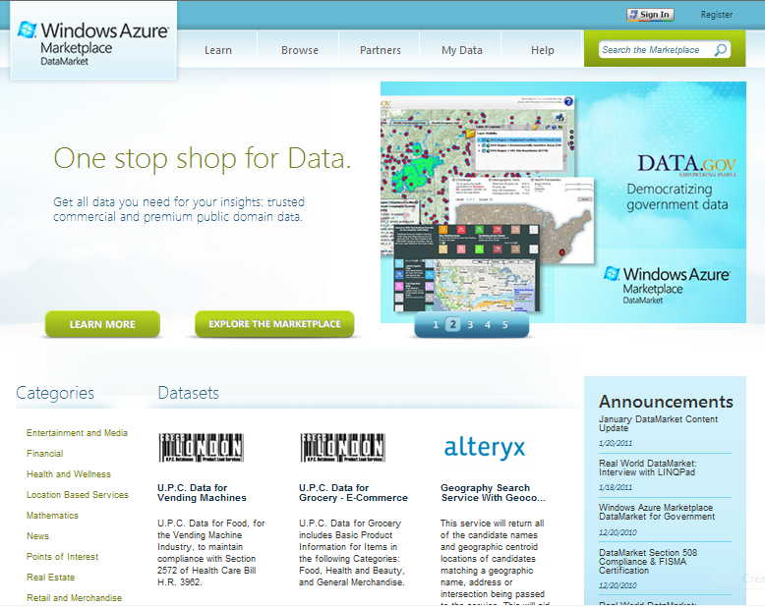
One Stop Shop for Data Commercial and Public Domain…
Notes:
Curated, Trusted Commercial and public domain
Billing on behalf
Global reach
Real-time and static
Our cloud Your cloud – Storage…

Slide 4
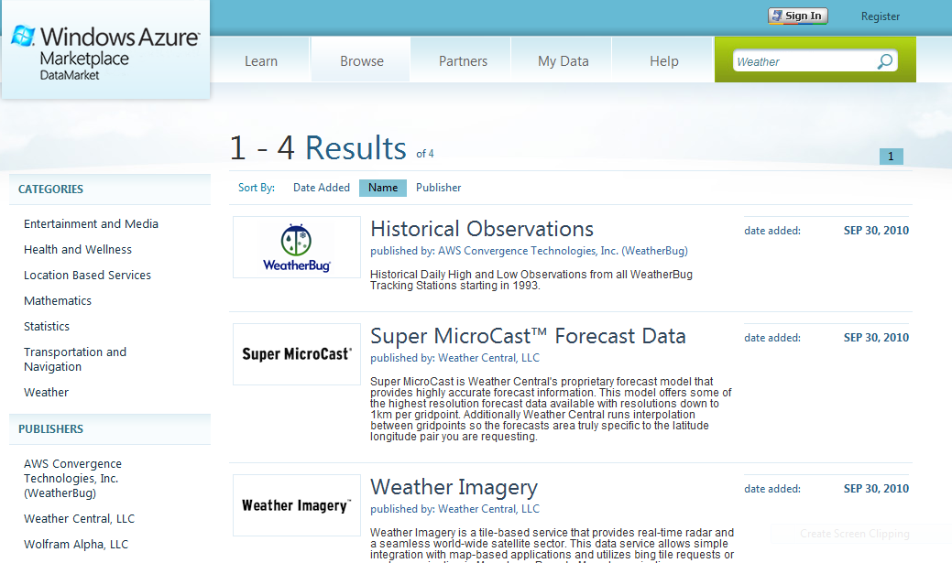
Unified Data Discovery…
Notes:
Discover Data, Media, Web-services
By Category, by providers

Slide 5
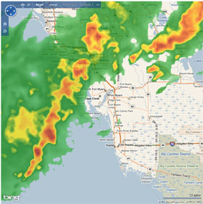
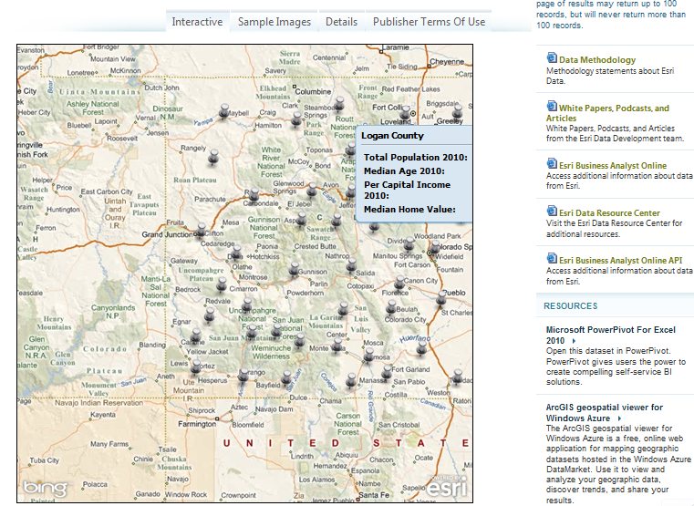
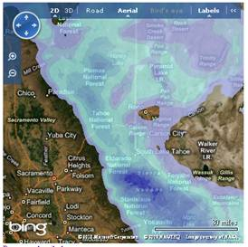
Visualize Before You Subscribe…
Notes:
Rich Visualizations to understand data/meta data
Opportunity for partners to market and sell solution

Slide 6
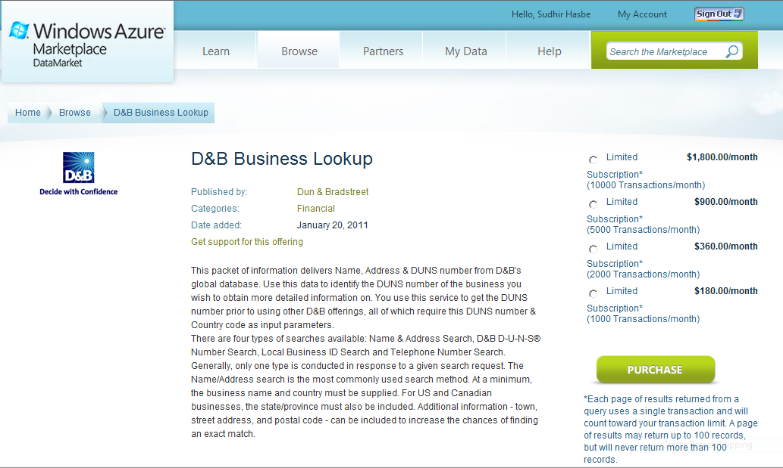
Subscribe With a Click…
Notes:
Subscribe by transactions
Pay as you grow
Data guarantees – SLAs
Availability
Performance
No breaking changes

Slide 7
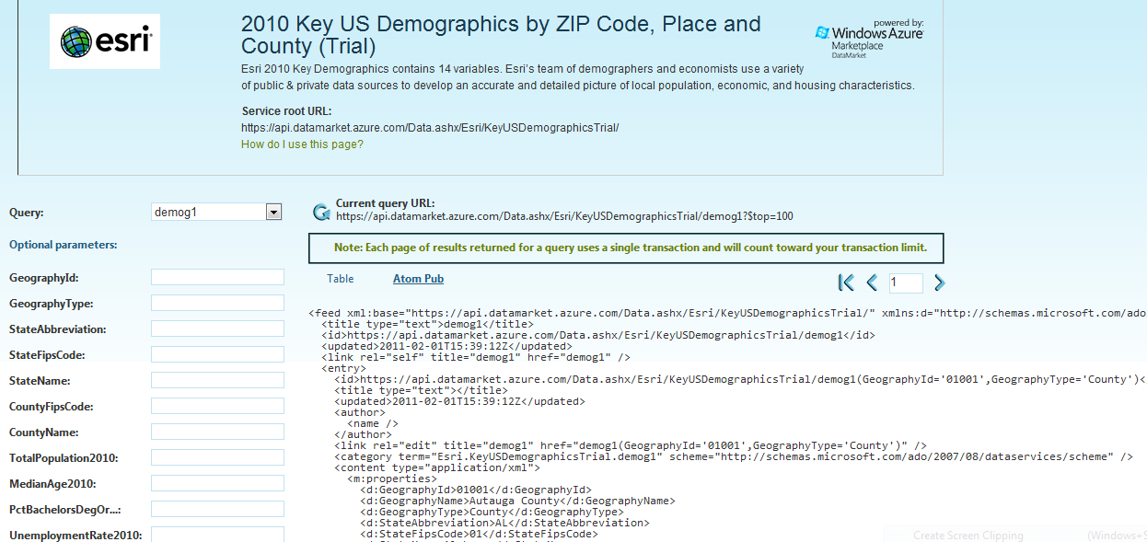
Consistent Open Data API’s…
Notes:
Single REST based secure API to access any dataset
Integrated into developer tools like Visual studio
Integrate into various mobile applications targeted at Iphone, IPAD, Windows Phone

Slide 8
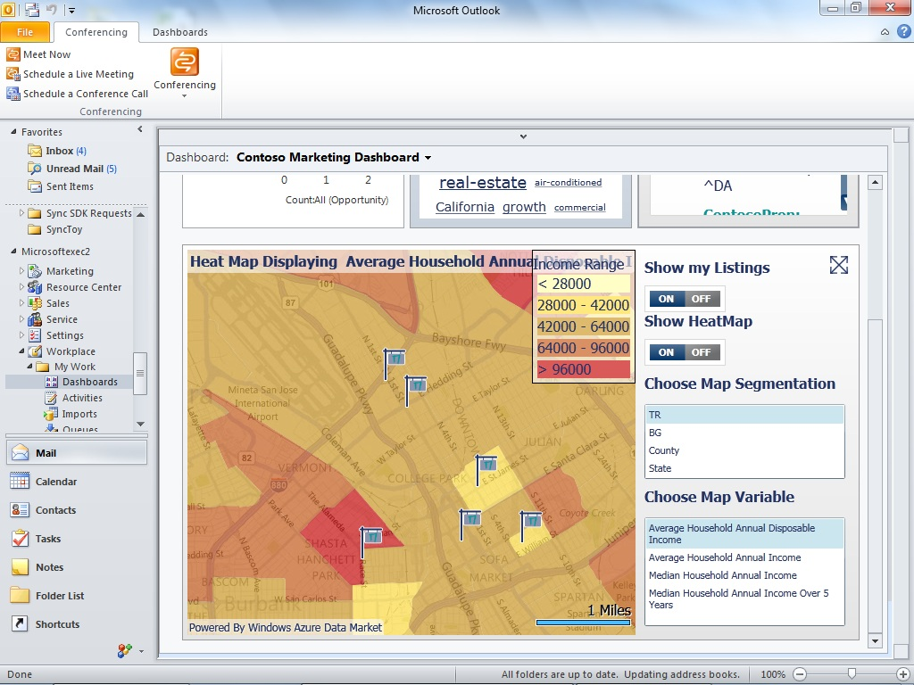
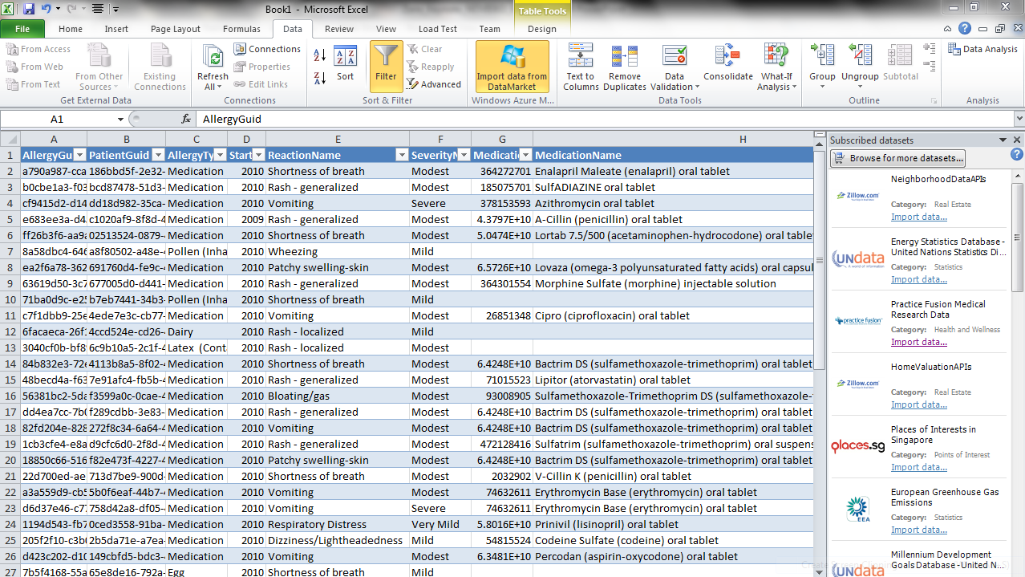
Integrated in Everyday Tools from Microsoft like Excel, PowerPivot , CRM Online…
Notes:
We are investing in integrating Datamarket in various Microsoft products
Like Excel, PowerPivot, Bing and SharePoint
CRM Online 2011 released last week has integrated DataMarket for Demographic data

Slide 9
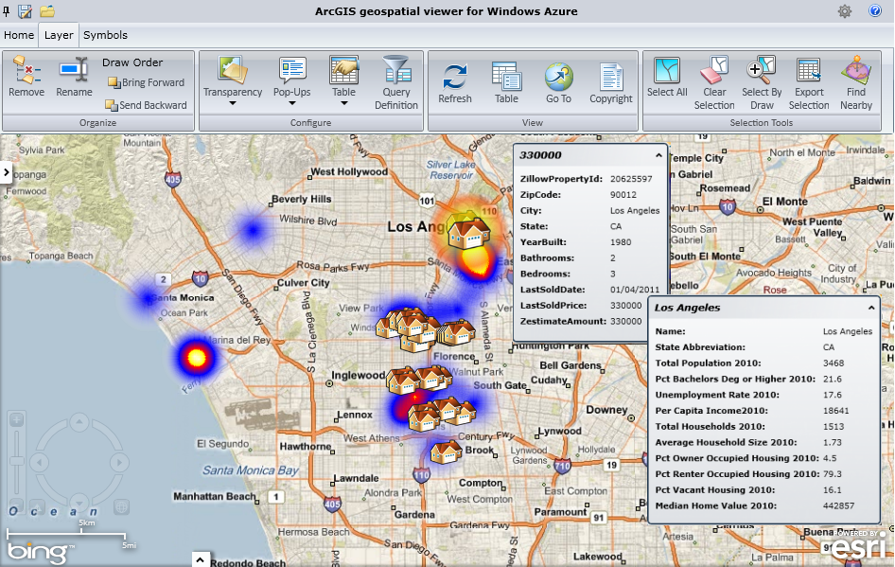
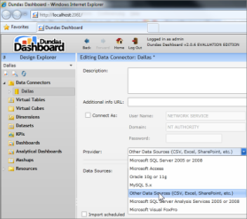
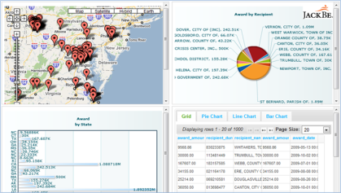
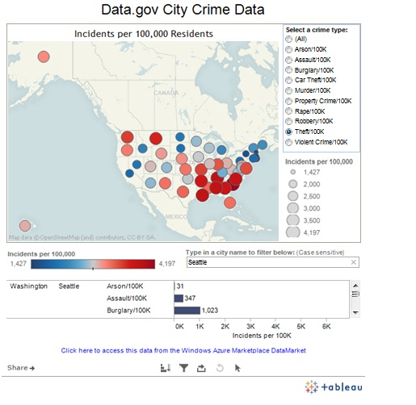
… and Partner Solutions
ESRI
Dundas Dashboard
JackBE
Tableau
Notes:
Have 100s of partners building applications that consume datasets from DataMarket…
Integrating into
BI solutions
mobile apps
Web apps

Slide 10
Momentum is Growing…
90 days…
5000+ subscriptions…
3 Million transactions…

Slide 11
Video

Slide 13
Content Partners
Premium
Public Domain

Slide 14
Get Involved
Visit http://datamarket.azure.com to learn more
Download Excel add-in(https://datamarket.azure.com/about)
Partner with us to sell/share your datasets (datamarketbd@microsoft.com)
Learn more at Strata Conference
Wednesday 2nd Feb 4:10pm
Microsoft DataMarket: Leveraging cloud to deliver public domain and commercial data to millions Sudhir Hasbe (Microsoft), Bruno Aziza (Microsoft)
Thursday 3rd Feb 10:40am
Open Data: Designing Data-centric Web APIs Pablo Castro (Microsoft)
Thursday 3rd Feb 4:10pm
Data Marketplaces Julie Steele (O'Reilly Media, Inc.), Ian White (Urban Mapping, Inc), Peter Marney (Thomson Reuters), Moe Khosravy (Microsoft), Dennis Yang (Infochimps)

Slide 15
© 2011 Microsoft Corporation. All rights reserved. Microsoft, Windows, Windows Vista and other product names are or may be registered trademarks and/or trademarks in the U.S. and/or other countries.
The information herein is for informational purposes only and represents the current view of Microsoft Corporation as of the date of this presentation. Because Microsoft must respond to changing market conditions, it should not be interpreted to be a commitment on the part of Microsoft, and Microsoft cannot guarantee the accuracy of any information provided after the date of this presentation. MICROSOFT MAKES NO WARRANTIES, EXPRESS, IMPLIED OR STATUTORY, AS TO THE INFORMATION IN THIS PRESENTATION.

