Slide 1
No Callbacks, No Threads & Ruby 1.9
async & co-operative web-servers
Ilya Grigorik
@igrigorik

Slide 2
Review:
State of the art
Reactor Pattern
Callbacks & Fibers
Async Primitives
Async Rails?

Slide 3
require "active_record”
ActiveRecord::Base.establish_connection(
:adapter => "mysql",
:username => "root",
:database => "database",
:pool => 5
)
threads = []
10.times do |n|
threads << Thread.new {
ActiveRecord::Base.connection_pool.with_connection do |conn|
res = conn.execute("select sleep(1)")
end
}
end
threads.each { |t| t.join }
The “Experiment”
vanilla everything…

Slide 4
require "active_record”
ActiveRecord::Base.establish_connection(
:adapter => "mysql",
:username => "root",
:database => "database",
:pool => 5
)
threads = []
10.times do |n|
threads << Thread.new {
ActiveRecord::Base.connection_pool.with_connection do |conn|
res = conn.execute("select sleep(1)")
end
}
end
threads.each { |t| t.join }
5 shared connections
# time ruby activerecord-pool.rb
#
# real 0m10.663s
# user 0m0.405s
# sys 0m0.201s

Slide 6
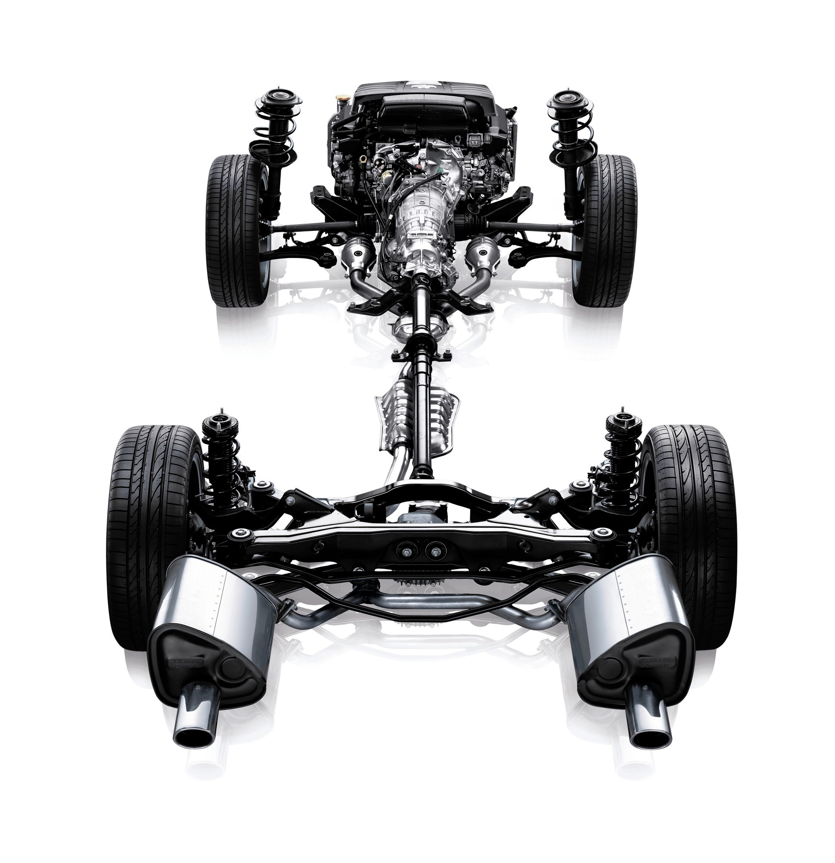
BHP
% power
loss
WHP

Slide 7
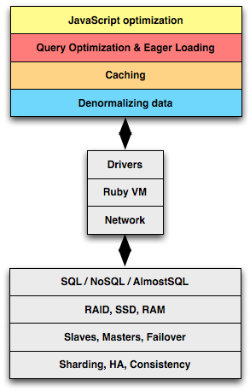

Slide 8
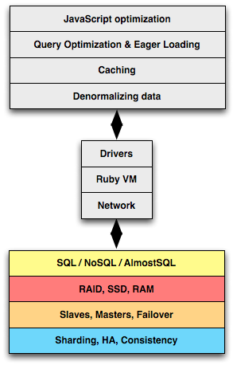

Slide 9
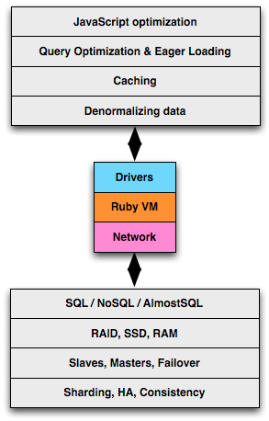

Slide 10
Mongo
Couch
MySQL
PSQL
…
Drivers
Threads
Ruby VM
GIL
Fibers
…
Network
Mongrel
Unicorn
Passenger
…

Slide 11
Global Interpreter Lock is a mutual exclusion lock held by a programming language interpreter thread to avoid sharing code that is not thread-safe with other threads.
There is always one GIL for one interpreter process.
Concurrency is a myth in Ruby
(with a few caveats, of course)
http://bit.ly/ruby-gil

Slide 12
N-M thread pool in Ruby 1.9…
Better but still the same problem!
Concurrency is a myth in Ruby
still no concurrency in Ruby 1.9
http://bit.ly/ruby-gil

Slide 13
Concurrency is a myth in Ruby
still no parallelism in Ruby 1.9
http://bit.ly/ruby-gil

Slide 14
Blocks entire
Ruby VM
Not as bad, but
avoid it still..
Avoid locking interpreter threads at all costs
let’s say you’re writing an extension…

Slide 15
Drivers
Ruby VM
Network
WEBRick
Mongrel made Rails viable
still powers a lot of Rails apps today

Slide 16
Rails rediscovers Apache
the worker/forker model…

Slide 17
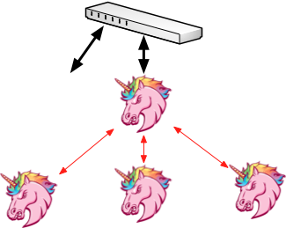
*nix IPC is fast!
…
Full Ruby VM
An exclusive Ruby VM for EACH request
am I the only one who thinks this is terrible?

Slide 18
“Does not care if your application is thread-safe or not, workers all run within their own isolated address space and only serve one client at a time for maximum robustness.”
Robustness? That sounds like a bug.
An exclusive Ruby VM for EACH request
am I the only one who thinks this is terrible?

Slide 19
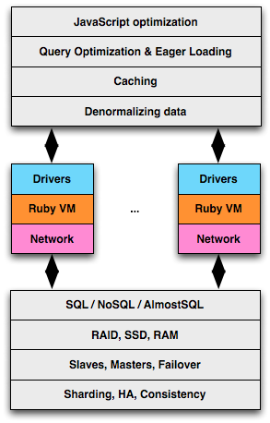

Slide 20
…?

Slide 21
Node imposes the full-stack requirements
Node imposes async drivers
Node imposes async frameworks
*Surprise*: Node is “fast”

Slide 22
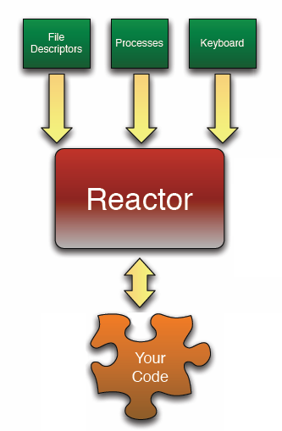
=
I’ll take Ruby over JS
gem install eventmachine

Slide 23
p "Starting" EM.run do p "Running in EM reactor" end p ”won’t get here"
while true do
timers network_io other_io
end
EventMachine Reactor
concurrency without thread

Slide 24
gem install em-mysqlplus
EventMachine.run do
conn = EventMachine::MySQL.new(:host => 'localhost')
query = conn.query("select sleep(1)")
query.callback { |res| p res.all_hashes }
query.errback { |res| p res.all_hashes }
puts ”executing…”
end
callback fired 1s after “executing”
# > ruby em-mysql-test.rb
#
# executing…
# [{"sleep(1)"=>"0"}]
em-mysqlplus: example
async MySQL driver

Slide 25
Non-blocking IO requires non-blocking drivers:
AMQP http://github.com/tmm1/amqp
MySQLPlus http://github.com/igrigorik/em-mysqlplus
Memcached http://github.com/astro/remcached
DNS http://github.com/astro/em-dns
Redis http://github.com/madsimian/em-redis
MongoDB http://github.com/tmm1/rmongo
HTTPRequest http://github.com/igrigorik/em-http-request
WebSocket http://github.com/igrigorik/em-websocket
Amazon S3 http://github.com/peritor/happening
And many others:
http://wiki.github.com/eventmachine/eventmachine/protocol-implementations

Slide 26
httpA = EventMachine::HttpRequest.new(URL).get
httpA.errback {
# retry logic?
}
httpA.callback {
Memcached.set(:key => URL, :value => httpA.response) { |response|
case response[:status]
when Memcached::Errors::NO_ERROR
# That's good
when Memcached::Errors::DISCONNECTED
# Maybe stop filling the cache for now?
else
# What could've gone wrong?
end
}
}
http = get(url)
memc = save(url, http.response)
if memc.error?
# That's good
else
# Err?
end
accidental complexity
async is harder to manage

Slide 27
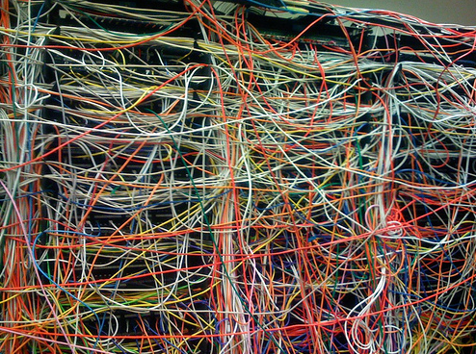
and this callback goes to…

Slide 28
We can do better than node.js
all the benefits of evented code without the drawbacks

Slide 29
Ruby 1.9 Fibers are a means of creating code blocks which can be paused and resumed by our application (think lightweight threads, minus the thread scheduler and less overhead).
f = Fiber.new {
while true do
Fiber.yield "Hi”
end
}
p f.resume # => Hi
p f.resume # => Hi
p f.resume # => Hi
Manual / cooperative scheduling!
Ruby 1.9 Fibers
and cooperative scheduling
http://bit.ly/d2hYw0

Slide 30
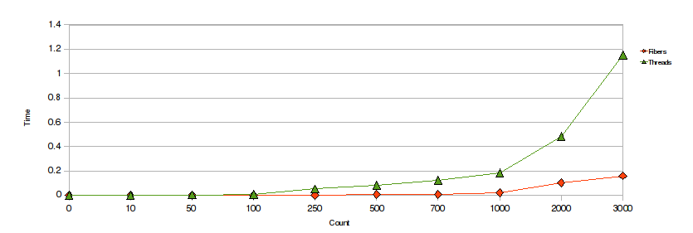
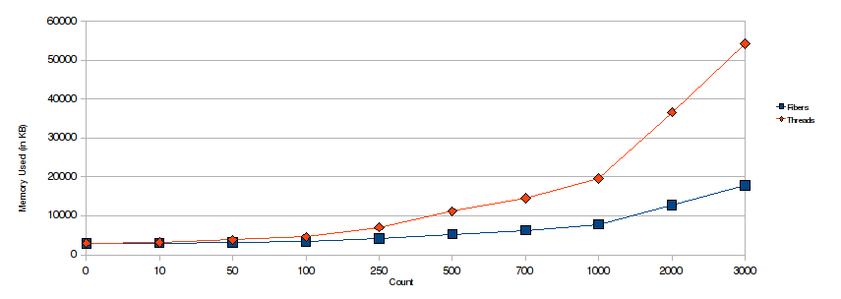
Fibers vs Threads: creation time much lower
Fibers vs Threads: memory usage is much lower
Ruby 1.9 Fibers
and cooperative scheduling
http://bit.ly/aesXy5

Slide 31
def query(sql)
f = Fiber.current
conn = EventMachine::MySQL.new(:host => 'localhost')
q = conn.query(sql)
c.callback { f.resume(conn) }
c.errback { f.resume(conn) }
return Fiber.yield
end
EventMachine.run do
Fiber.new {
res = query('select sleep(1)')
puts "Results: #{res.fetch_row.first}"
}.resume
end
Exception, async!
Untangling Evented Code with Fibers
http://bit.ly/d2hYw0

Slide 32
def query(sql)
f = Fiber.current
conn = EventMachine::MySQL.new(:host => 'localhost')
q = conn.query(sql)
c.callback { f.resume(conn) }
c.errback { f.resume(conn) }
return Fiber.yield
end
EventMachine.run do
Fiber.new {
res = query('select sleep(1)')
puts "Results: #{res.fetch_row.first}"
}.resume
end
1. Wrap into a continuation
Untangling Evented Code with Fibers
http://bit.ly/d2hYw0

Slide 33
def query(sql)
f = Fiber.current
conn = EventMachine::MySQL.new(:host => 'localhost')
q = conn.query(sql)
c.callback { f.resume(conn) }
c.errback { f.resume(conn) }
return Fiber.yield
end
EventMachine.run do
Fiber.new {
res = query('select sleep(1)')
puts "Results: #{res.fetch_row.first}"
}.resume
end
2. Pause the continuation
Untangling Evented Code with Fibers
http://bit.ly/d2hYw0

Slide 34
def query(sql)
f = Fiber.current
conn = EventMachine::MySQL.new(:host => 'localhost')
q = conn.query(sql)
c.callback { f.resume(conn) }
c.errback { f.resume(conn) }
return Fiber.yield
end
EventMachine.run do
Fiber.new {
res = query('select sleep(1)')
puts "Results: #{res.fetch_row.first}"
}.resume
end
3. Resume the continuation
Untangling Evented Code with Fibers
http://bit.ly/d2hYw0

Slide 35
Good news, you don’t even have to muck around with Fibers!
gem install em-synchrony
http://github.com/igrigorik/em-synchrony
Fiber aware connection pool with sync/async query support
Multi request interface which accepts any callback enabled client
Fibered iterator to allow concurrency control & mixing of sync / async
em-http-request: .get, etc are synchronous, while .aget, etc are async
em-mysqlplus: .query is synchronous, while .aquery is async
remcached: .get, etc, and .multi_* methods are synchronous
em-synchrony: simple evented programming
best of both worlds…

Slide 36
EventMachine.synchrony do
multi = EventMachine::Synchrony::Multi.new
multi.add :a, EventMachine::HttpRequest.new(url1).aget
multi.add :b, EventMachine::HttpRequest.new(url2).apost
res = multi.perform
p “No callbacks, and parallel HTTP requests!"
p res
EventMachine.stop
end
Parallel IO with Fibers
multi interface example

Slide 37
Persistent connections
EventMachine.synchrony do
db = EventMachine::Synchrony::ConnectionPool.new(size: 2) do
EventMachine::MySQL.new(host: "localhost")
end
multi = EventMachine::Synchrony::Multi.new
multi.add :a, db.aquery("select sleep(1)")
multi.add :b, db.aquery("select sleep(1)")
res = multi.perform
EventMachine.stop
end
Fiber Pools
accessing shared services

Slide 38
EM.synchrony do
concurrency = 2
urls = ['http://url.1.com', 'http://url2.com']
results = EM::Synchrony::Iterator.new(urls, concurrency).map do |url, iter|
http = EventMachine::HttpRequest.new(url).aget
http.callback { iter.return(http) }
end
p results # all completed requests
EventMachine.stop
end
Explicit iterators
.each, .map, .inject, …
asynchronous iterators

Slide 39
EM.synchrony do
result = EM::Synchrony.sync EventMachine::HttpRequest.new(URL).get
p result
EM.stop
end
Inline synchronization
Inline synchronization
ad-hoc synchronization

Slide 40
require "em-synchrony/em-mysqlplus"
EventMachine.synchrony do
db = EventMachine::MySQL.new(host: "localhost")
res = db.query("select sleep(1)")
puts res
EventMachine.stop
end
Async under the hood
Untangling Evented Code with Fibers
http://bit.ly/d2hYw0

Slide 41
require "em-synchrony/em-mysqlplus"
EventMachine.synchrony do
db = EventMachine::MySQL.new(host: "localhost")
res = db.query("select sleep(1)")
puts res
EventMachine.stop
end
Untangling Evented Code with Fibers
http://bit.ly/d2hYw0

Slide 42
Async web-stack in Ruby?

Slide 43
em-synchrony, connection pool, iterators…
async-rack
Drivers
Ruby VM
Fibers
Network
Thin
http://code.macournoyer.com/thin/
One VM, full concurrency, network-bound
Ruby 1.9, Fibers, Thin: in production!

Slide 44
git clone git://github.com/igrigorik/async-rails.git
database.yml
development:
adapter: em_mysqlplus
database: widgets
pool: 5
timeout: 5000
environment.rb
require 'em-activerecord’
require 'rack/fiber_pool'
# Run each request in a Fiber
config.middleware.use Rack::FiberPool
config.threadsafe!
Async Rails 3
with EventMachine & MySQL
thin –D start

Slide 45
class WidgetsController < ApplicationController
def index
Widget.find_by_sql("select sleep(1)")
render :text => "Oh hai”
end
end
ab –c 5 –n 10 http://127.0.0.1:3000/widgets
Server Software: thin
Server Hostname: 127.0.0.1
Server Port: 3000
Document Path: /widgets/
Document Length: 6 bytes
Concurrency Level: 5
Time taken for tests: 2.210 seconds
Complete requests: 10
Failed requests: 0
Requests per second: 4.53 [#/sec] (mean)
Async DB!
Async Rails
with EventMachine & MySQL

Slide 46
http://gist.github.com/445603
concurrency time
75 73.426
60 66.411
50 65.502
40 78.105
30 106.624
Async Rails
with EventMachine & MySQL

Slide 47
Async Rails 3 demo:
http://github.com/igrigorik/async-rails/
Fibers & Cooperative Scheduling in Ruby:
http://www.igvita.com/2009/05/13/fibers-cooperative-scheduling-in-ruby/
Untangling Evented Code with Ruby Fibers:
http://www.igvita.com/2010/03/22/untangling-evented-code-with-ruby-fibers/
EM-Synchrony:
http://github.com/igrigorik/em-synchrony
What do you think?

