Slide 1
Doing a 24/7 Job in a 9-to-5 Culture: A Balancing Act for Government Workers on the Web
Melissa Jordan, BART Senior Web Producer
Gov 2.0 Expo, May 25, 2010
Photo by Thomas Hawk

Slide 2
What I’ll Cover
-Evolution of Gov 2.0 at BART.gov
-Personality in government (and why we need it)
-Top 10 tips for the balancing act of being a government worker on the web

Slide 3
A Brief History of Gov 2.0 at BART
2008
-BART.gov website redesign
-Twitter
-Facebook
-Blog
-Growth of rider-shared content
-Developer outreach (Google Transit data released to third-party developers in 2007)
Notes:
Talkover: Actually, we released Google transit data to third-party developers in 2007; the second agency in the nation to do so. Within days of the launch of the first iPhone in 2007 there were already BART apps in the iTunes Store.

Slide 5
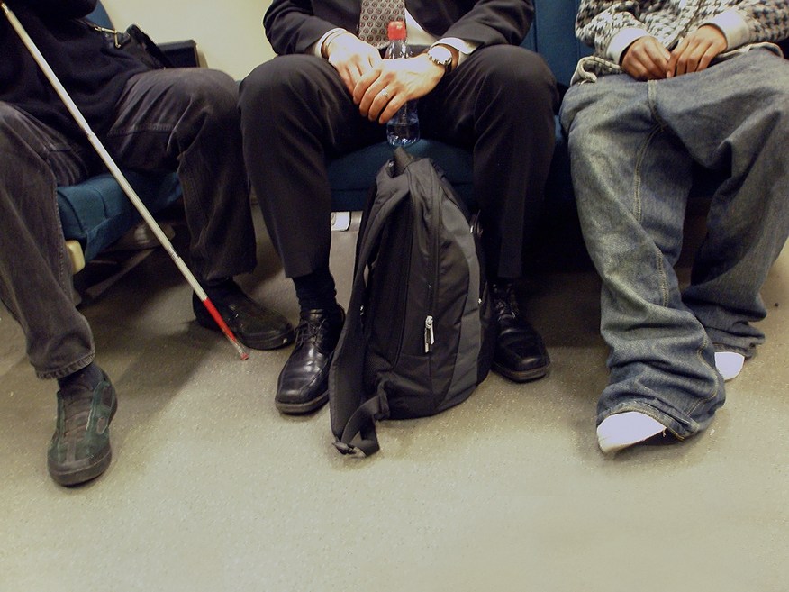
Riders love
to share their
stories
Photo by Daniela Nikolaeva
Notes:
Rider Daniela Nikolaeva thought this shot captured the sense of diversity and community on a BART train – she shared her photo and wrote that the “business man, baggy-pants guy and blind man were all engulfed in a friendly conversation” when she snapped their photo.

Slide 6
A Brief History of Gov 2.0 at BART
2009
-Media and Public Affairs blogger outreach
-Draft guidelines submitted to Human Resources
-Foursquare partnership
-On-demand SMS
Notes:
In our 2nd year we realized that we couldn’t be an island of innovation apart from the rest of the organization so we began to spread our efforts to others. We helped MPA organize a “blogger breakfast” that recognized we had to shift our communications focus from mainstream media only to these new media.

Slide 7
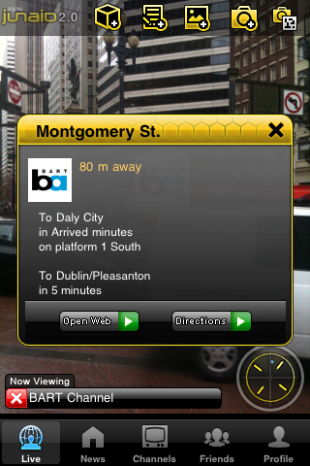
A Brief History of Gov 2.0 at BART
2010
-Integrating with Customer Services
-Expanded public API
-Developer meet-ups
-Augmented reality app
-Growth of mobile
-Webcasts of board meetings

Slide 8
Notes:
Example of customer service issue at SF stations

Slide 9
Can government have personality?
“Wow, BART has a Twitter account AND it’s funny. I like to imagine that it’s actually the train talking like Thomas the Tank Engine.”
Photo by Thomas Merton
Notes:
Photo by Thomas.Mertonhttp://www.flickr.com/photos/thomas-merton/2786373208/

Slide 10
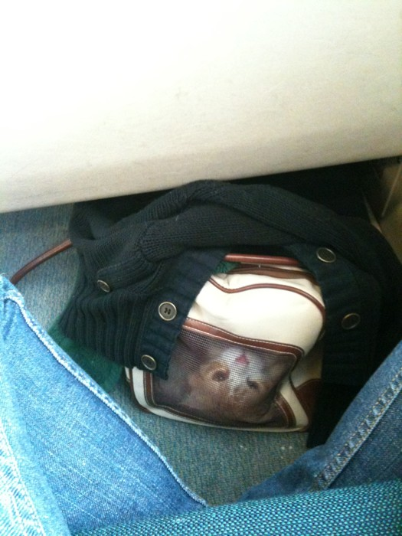
The human touch
We write about things that matter to people
Photo by @live4amoment
Notes:
A rider shared this photo -- giving us the perfect opportunity to write about the rules for pets on trains. Photo by @live4amoment

Slide 11
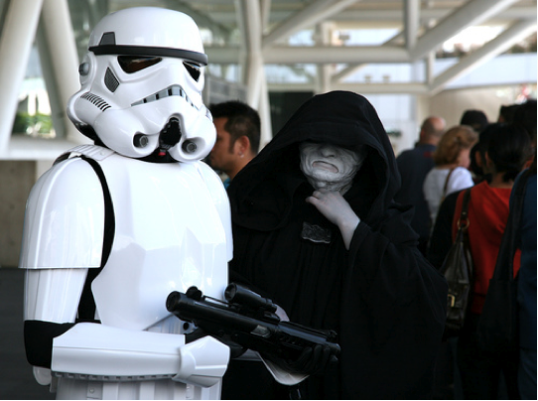
TOP TEN TIPS FOR YOUR BALANCING ACT
1. Know your audience
Photo by Laughing Squid
Notes:
Photo by laughing squid of wondercon –comic book sci/fi conference. Many BART riders like sci-fi, technology, and the environment.

Slide 12
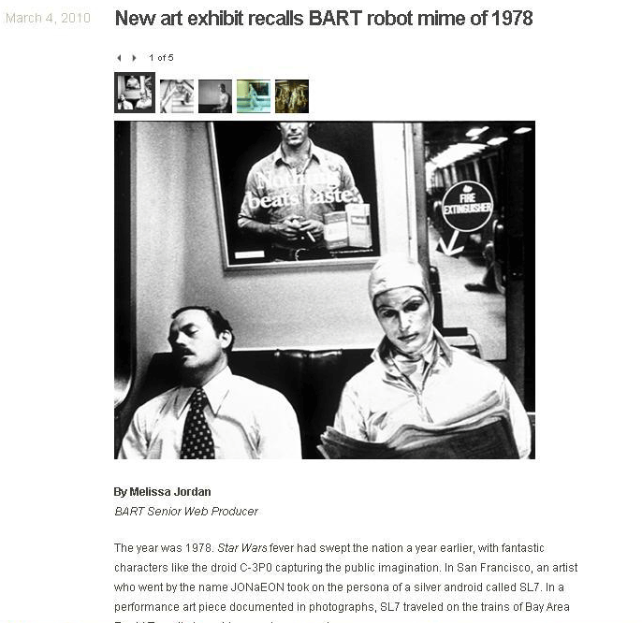
TOP TEN TIPS FOR YOUR BALANCING ACT
2. Adopt the voice of your brand
Photo by JON aEON
Notes:
Your social web voice must be that of your brand not of yourself as an individual

Slide 13
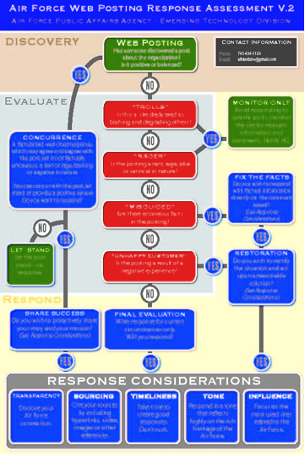
TOP TEN TIPS FOR YOUR BALANCING ACT
3. Learn from what’s out there already
Graphic by U.S. Air Force

Slide 14
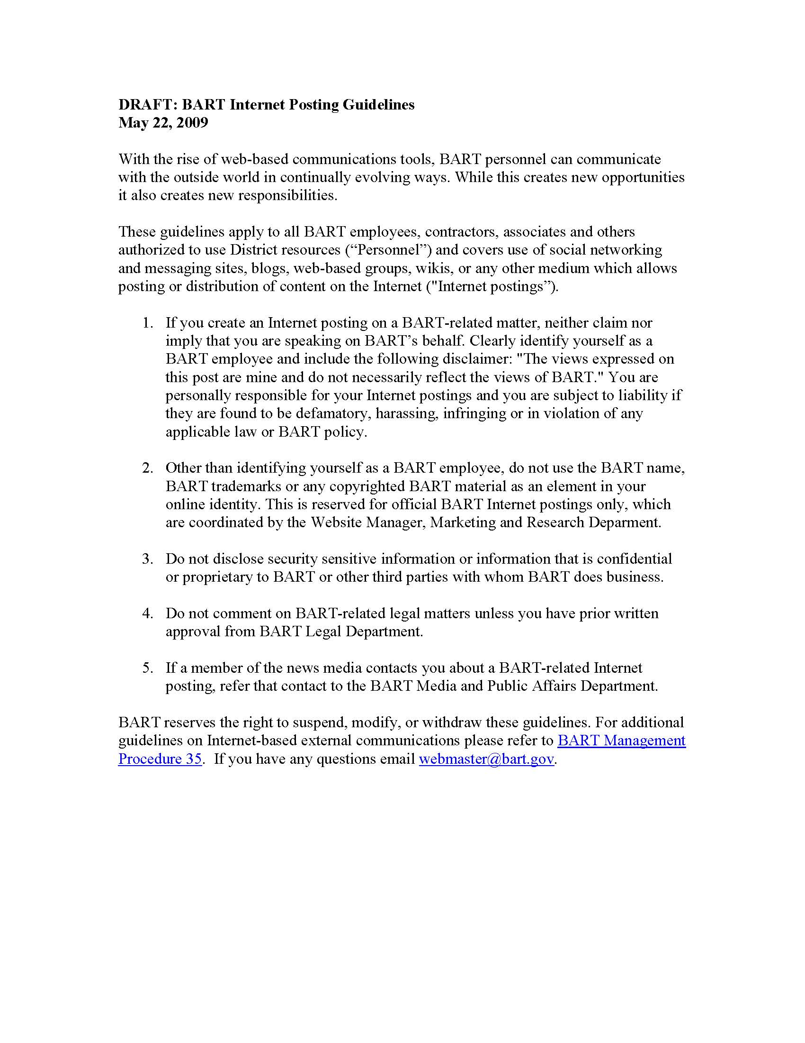
TOP TEN TIPS FOR YOUR BALANCING ACT
4. Teach others in your organization

Slide 15
TOP TEN TIPS FOR YOUR BALANCING ACT
5. Own up to your mistakes

Slide 16
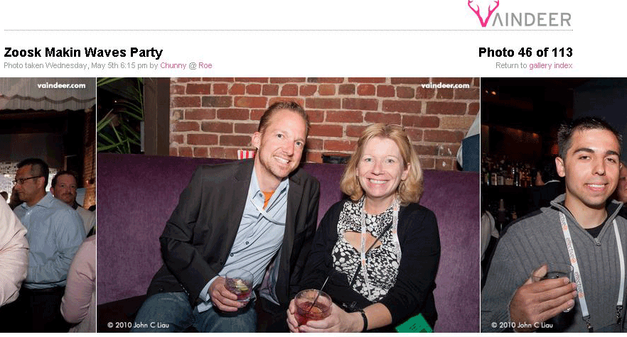
TOP TEN TIPS FOR YOUR BALANCING ACT
6. Be aware of how personal/professional boundaries blur in social spaces
Notes:
Be conscious of how much of your personal life you want to share

Slide 17
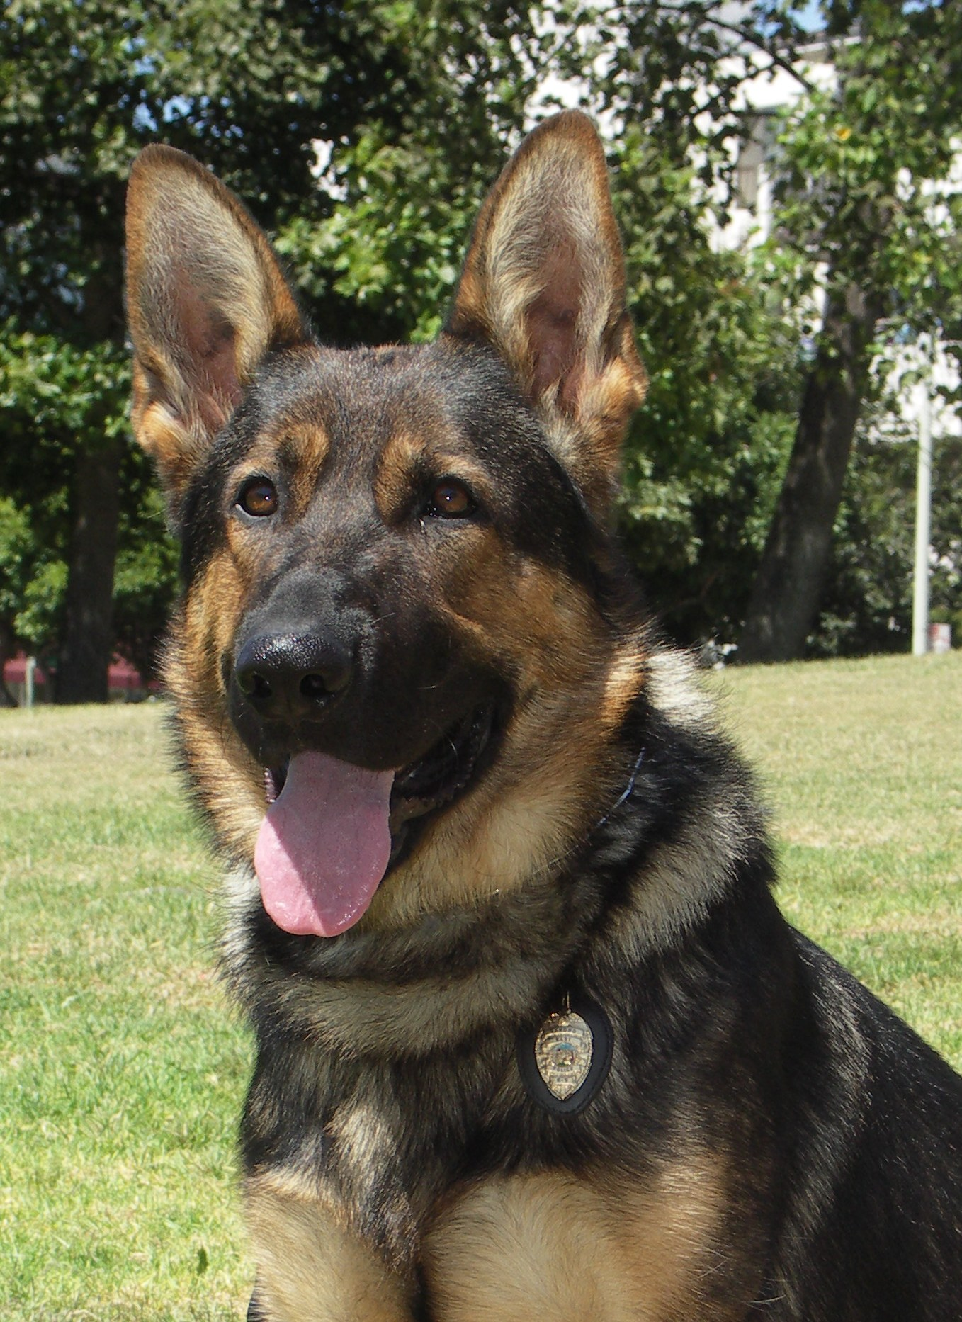
TOP TEN TIPS FOR YOUR BALANCING ACT
7. Create authentic content. Real > spin.
Another rider, Pam Glassoff, said she did not appreciate the use of police dogs on BART. Rather than reducing the threat, "it makes me feel more threatened," she said.
Notes:
This was from a story on the BART K-9 unit. We are working on convincing our colleagues that “all positive,” effusive, jargony, “spin” doesn’t work anymore. HONEST communication that acknowledges different viewpoints is more effective and believable.

Slide 18
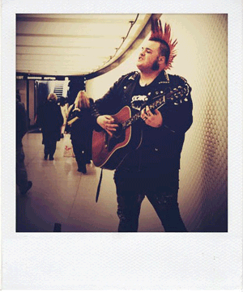
TOP TEN TIPS FOR YOUR BALANCING ACT
8. Remember that you serve a broad and diverse community
Photo by fiveinch pixie
Notes:
This is a busker who plays in stations known as “Punk Rock Johnny Cash.” We did a video story on him that was nominated for an Emmy. But in telling his story we had to be aware of how much “edge” it could have – because, if you go TOO far pushing the envelope, you can alienate customers. So for example: We edited out his swear words in the interview. We chose the tamer clips from his songs – leaving out, for example, the opening line of “Cocaine Blues”: “Early one mornin' while makin' the rounds I took a shot of cocaine and I shot my woman down. “

Slide 19
TOP TEN TIPS FOR YOUR BALANCING ACT
9. You’re a model– don’t goof off
Note time of the "Like” - after work hours!

Slide 20
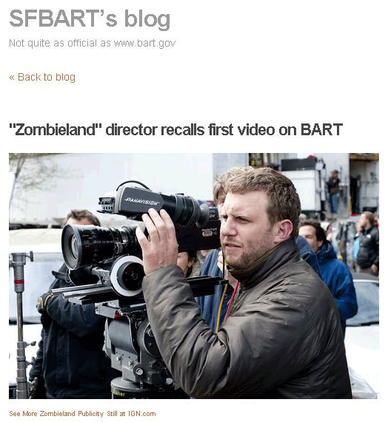
TOP TEN TIPS FOR YOUR BALANCING ACT
10. Have a life outside work.
Notes:
It will make your work more interesting. For example I love movies. I noticed when the film “Zombieland” came out last year that the director, Ruben Fleischer, said the first video he ever made was on a BART train when he was working as a busboy in San Francisco. I tracked him down to interview him for a website story.

Slide 21
Questions?
Melissa Jordan
BART Senior Web Producer
mjordan@bart.gov
510.464.7292
Twitter: @sfbart

