Slide 1
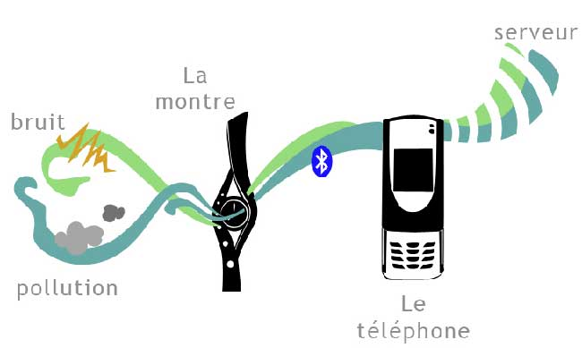
Citizen sensor

Slide 2
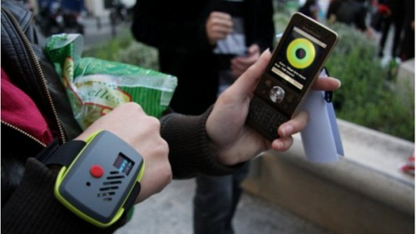
Augmented Reality as a conversation between multiple parties and the sensors on their devices

Slide 4
Chat Room:
Dalila: I need Thomassin Apo please
Apo: Kenscoff Route: Lat: 18.495746829274168, Long:-72.31849193572998
Apo: This Area after Petion-Ville and Pelerin 5 is not on Google Map. We have no streets name
Apo: I know this place like my pocket
Dalila: thank God u was here
Responder:
“just got emergency SMS, child delivery, USCG are acting, and the GPS coordinates of the location we got from the translators were 100% accurate!”

Slide 5
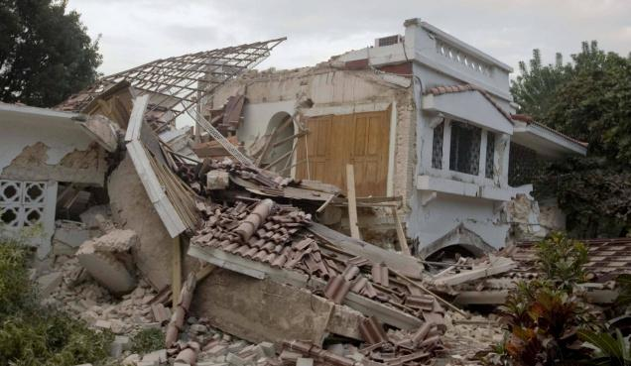
SMS: yo landan kay kraze en Kenscoff, besoin
mange, dlo potab, gen du ti moun avek blese
Volunteer: I’m in a house in Kenscoff, we need food,
potable water, I have 2 injured children
Responder: Does this look familiar?
Volunteer: Yes, the house with a tiled roof

Slide 6
