Slide 1

DoDTechipedia
Collaborate and Support the Warfighter
DoDTechipedia
Collaborate and Support the Warfighter
Noel Dickover (ctr)
DoD CIO, Social Software & Emerging Technologies
Commercial Technologies & Systems Directorate
Noel.dickover.ctr@osd.mil
703-601-4729x152
@NoelDickover - Twitter

Slide 2

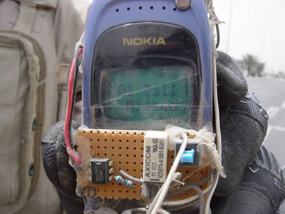
Awareness In A World of Constant Change
How Will Our Adversaries
Exploit Technology?

Slide 3

Bringing Emerging Technologies to the DoD
Current state
Technologies
Enter the Acquisition
Process
Delayed Technologies
Delivered to Warfighter
The DoD Acquisition Process looks like a
Black Hole from the outside
Notes:
Latest technologies not always pursued
Up-front market research required does not always find best set of options
Key Stakeholders lack the information needed to make good business decisions
DoD needs inaccessible
DoD potential buyers do not always know the best options
Key innovations made by non-traditional defense companies are rarely discovered

Slide 4












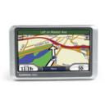










The Procurement Process in DoD Can Take 15 Years!
How Well Are We Incorporating
Emerging Technologies?
1993
1994
1995
1996
1997
1998
1999
2000
2001
2002
2003
2004
2005
2006
2007
2008
Potential Timeline for a Major Defense Acquisition Program

Slide 5


We Are Not Keeping Pace With Innovation

Slide 6

“We need a new capability!
Round up the Usual Suspects…”

Slide 7
Why Emerging Tech Companies Don’t Come to Us
They do not know what they want
The application/bid process takes too long
Our products are not needed by DoD
We do not want to work with DoD
To hard for new firms to break in
I can do fine without them
National Defense University Report to Congress:
Information Technology Program, January 2006

Slide 8

Connecting Problems with Solutions

Slide 9
DoD Key Enabling Technologies
Biometrics
Nanotechnology
Information Technologies
Surveillance Technologies
Networks & Communications
Software Research
Cognitive Enhancements
Casualty Care
Advanced Materials
Advanced Electronics
Human, Social, Cultural & Behavioral Modeling
Robotics
Energetic Materials & Explosives
Directed Energy Technologies
Hyperspectral Sensors
Radar
Autonomous Systems Technologies
Manufacturing Technologies
Combat WMD Technologies
Large Data Set Analysis Tools
Alternative Fuels and Energy
Organization, fusion, & Mining Data
Director of Defense Research & Engineering (DDR&E) 2007 Strategic Plan

Slide 10

What do we Have in the Cupboard
What Technology Have We
Already Invested In?

Slide 11

How Would You Find it?

Slide 12







Innovation & Awareness
Through Collaboration
innovation
S&T
Community
Requirements
Community
Intel
Community
Industry
Continuous engagement between those with challenges and those charged to provide solutions
awareness
.
improvement
DoD Primes
Acquisition
Community
IT Community
response
  Foster communication between those with needs and those with solutions

Slide 13
DoD Techipedia
Family of Services
DoD Techipedia Limited
https://www.dodtechipedia.mil
Defense Solutions
Portal
http://www.defensesolutions.gov/
Semi-permeable wall
DoD Techipedia Classified
DoD Techipedia External

Slide 14
DoDTechipedia Limited
Fulfills Capability Needs
“What capabilities have
we already invested in?”
Combatant
Commands
Science & Technology
Community
Requirements
Community
Acquisition
Community

Slide 15
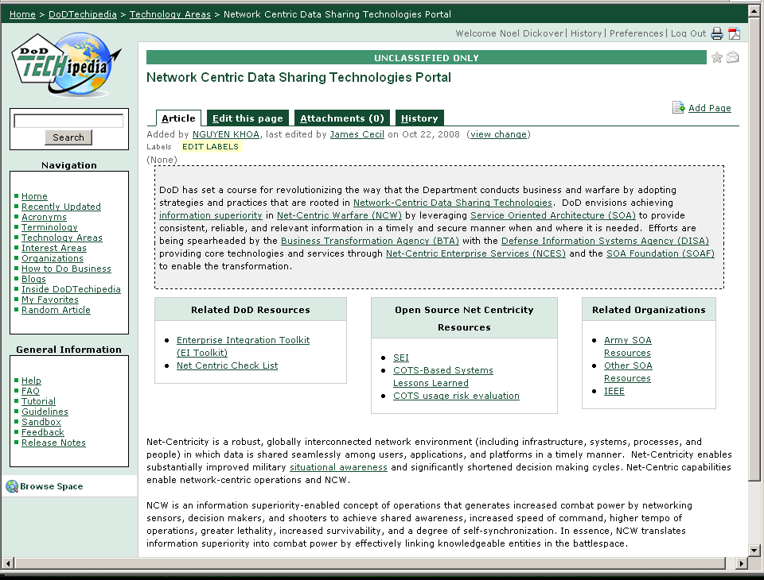
Key Features
Offers roadmap to implement COTS
Software Engineering Institute service to help Programs assess risks
Prioritizes the risks and offers mitigation strategies

Slide 16
DoDTechipedia Limited
Progress to Date
240,000+ page views since going live on October 1, 2008
8,000+ new registered users
1000+ Technology pages
800+ Blog Entries
.

Slide 17

DefenseSolutions.gov
Crowd Sourcing In Action

Slide 18

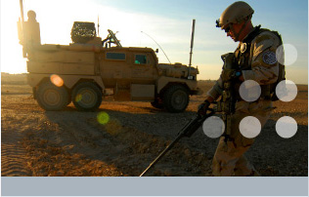
DefenseSolutions.Gov
Results
Battlefield Forensics
  37 Responses in the first offering
  Over 50% had never done work with the DoD before
  6 Responses selected to fund
  Dramatically faster than FAR process
.

Slide 19
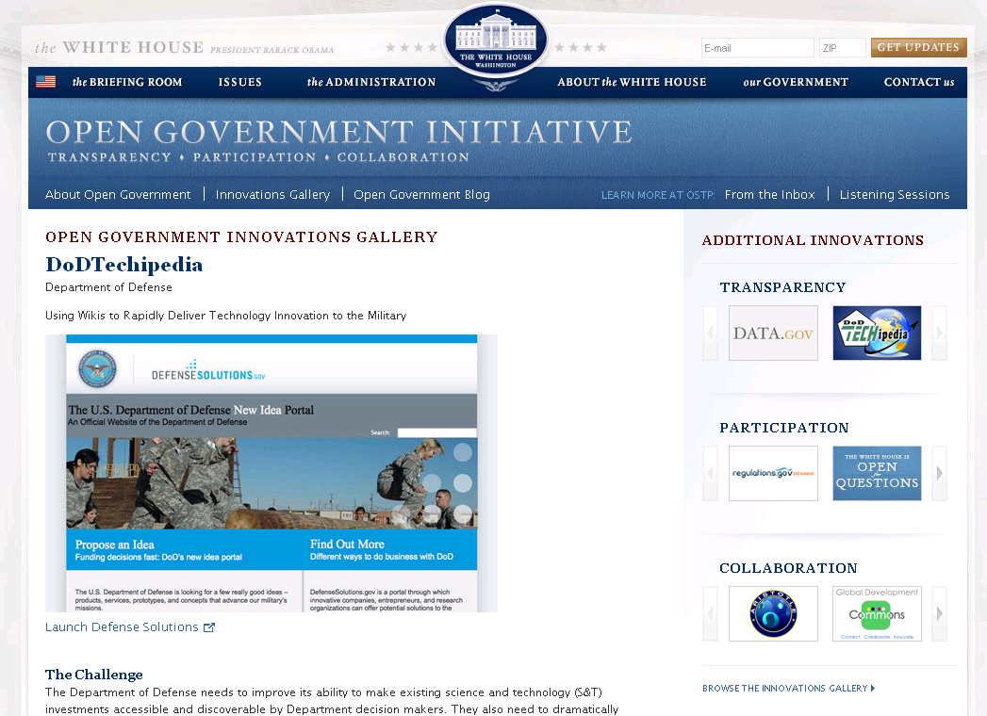

Slide 20
DoDTechipedia Public
Collaboration w/Industry
Enterprise POCs
Requirements Personnel
Early Program Personnel
S&T Personnel
Non-traditional
Emerging Tech Researchers
Emerging Tech Vendors
Technology
Needs, Use
Ongoing
Research
Govt ET, S&T
Projects
Emerging Tech
Products
Roles-based Access
Roles-based Access
DoDTechipedia, Organized by
Wiki-based Technology Taxonomies
Doing Business
With DoD
Lessons Learned
Options
For Each Technology Area, Pilot shows:
State of the practice
DoD needs
Current DoD uses
Near-term ongoing ET research (public info)
Associated emerging technology products
Defense
Solutions.gov
Idea Requests

