Slide 1
A modern dilemma: When to use to a Rules Engine vs. Machine Learning
Andy Bonham, Distinguished Engineer & Architect, Capital One

Slide 2

Andrew Bonham
Application Architecture interests & research include:
Workflow & Case Management
Microservices
Event Storming
Reactive Architecture
Rules Engines
Machine Learning
Special thanks to the folks that contributed to this presentation:
Thiaga Manian
Raja Chattopadhyay
Srini Karlekar
Michael Kubiske
Will Franklin
Frank Showalter

Slide 3
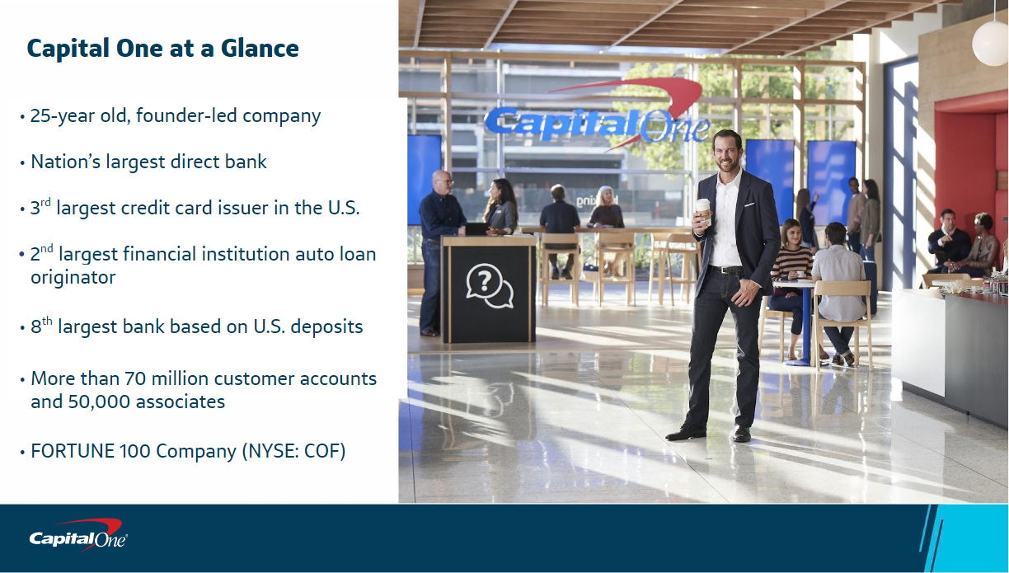

Slide 4



We have transformed the company into a top 10 bank
2018 Acquires Confyrm, a digital identity firm
2017 Acquires Notch
2016 Acquires Critical Stack and Paribus
2015 Acquires GE Capital’s Healthcare Financial Services, Level Money
and Monsoon
2014 Acquires Adaptive Path, a digital design leader and AmeriCommerce,
an online e-commerce company
2013 Acquires Beech Street Capital, an originator, underwriter and servicer of multifamily commercial real estate loans
2012 Acquires ING DIRECT, HSBC US Card portfolio
2010 Enters into card partnerships with Kohl's and Sony in the US and
Hudson's Bay Company and Delta in Canada
2009 Acquires Chevy Chase Bank in the Washington, DC area
2006 Acquires North Fork Bank, one of the largest banks in the New York metro area
2005 Acquires Hibernia National Bank, #1 bank in Louisiana
2002 Launches its Small Business credit card
2000 Introduces slogan, “What’s in your wallet?”
1998 Enters Auto Finance Market
1996 Expands into Canada and the U.K.
1995 Spins off from Signet Bank
1994 Initial Public Offering (IPO)
Notes:
4

Slide 5
Agenda
Intro to Rules
General capabilities of a Business Rules Management System
Overview of Drools
Intro to Machine Learning
General capabilities of a ML Platform
Overview of H2O
Guidance on when to use Rules vs ML
Different patterns for integrating Rules and ML
Using a Microservice & Reactive Architecture Style with Rules & ML
Demo

Slide 6

Business logic contains decisions that govern a business process
Tend to be variable with the market and change often
Rely on the evaluation of conditions before taking an action
Focuses on the when, why

Slide 7
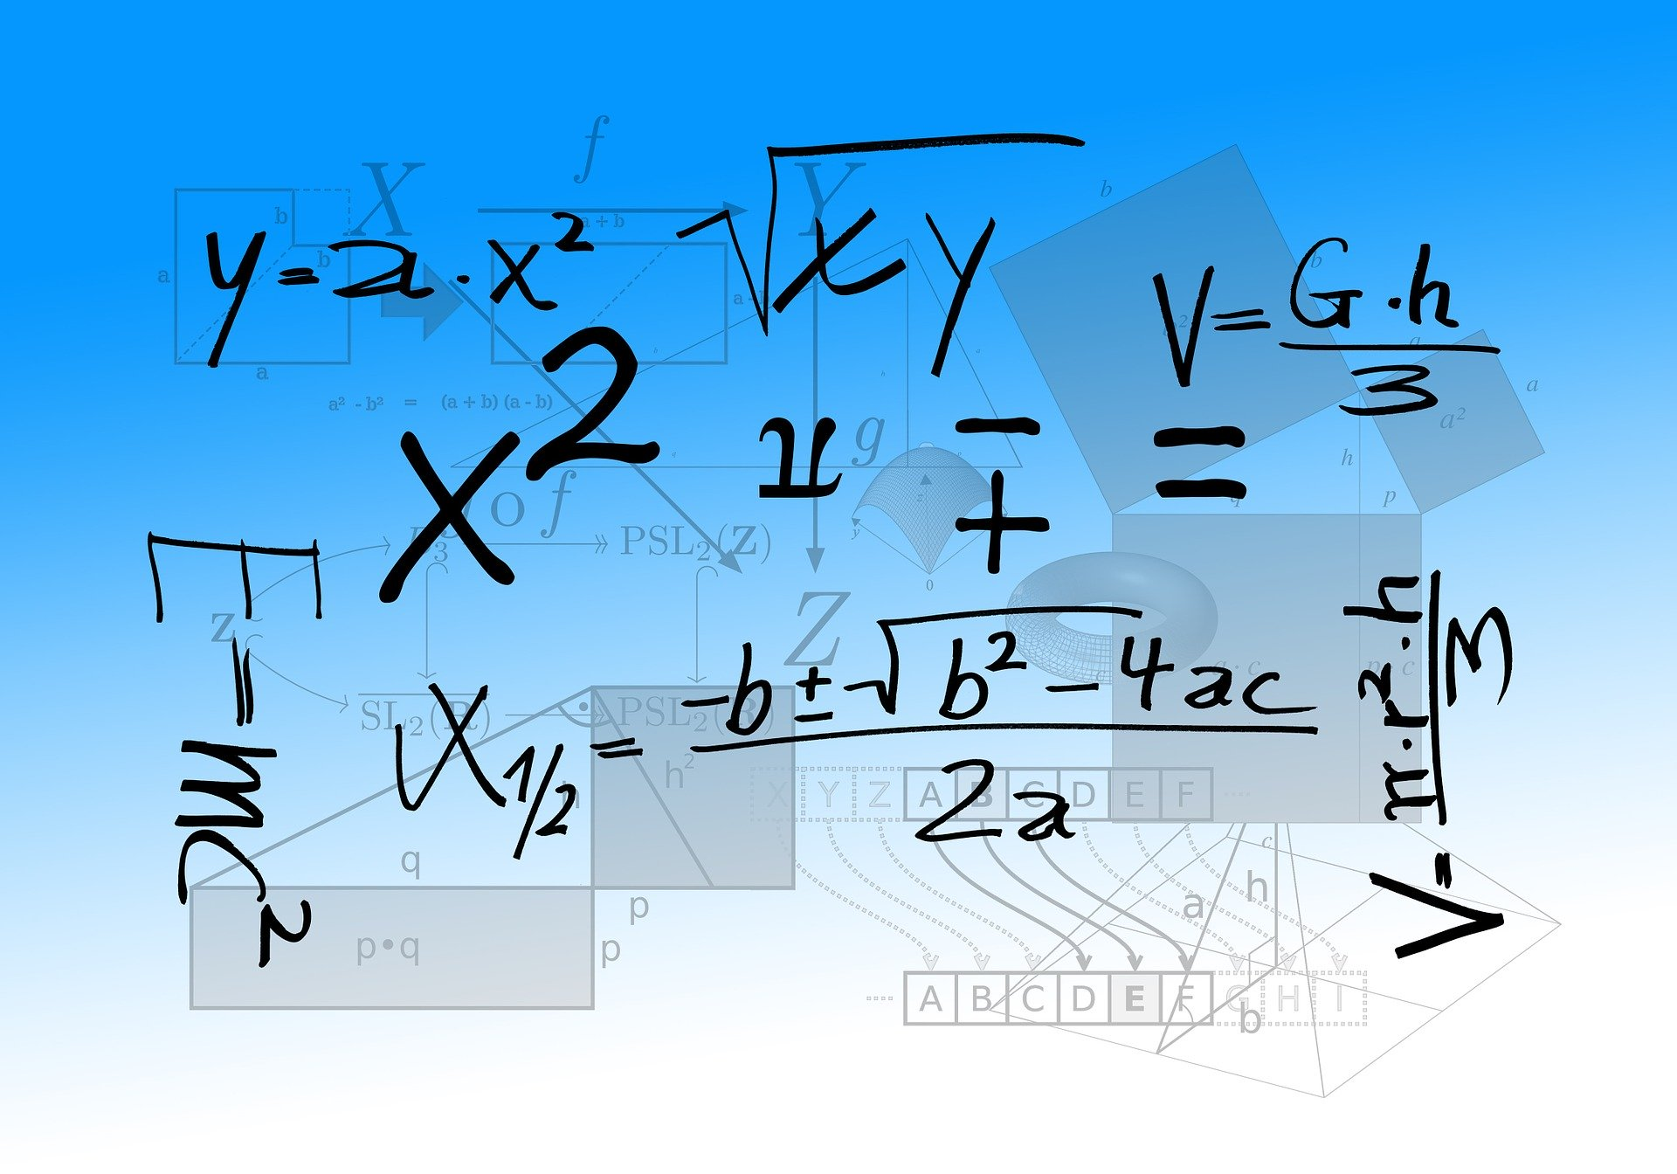
Calculations are typically used by business logic
Tend to stay the same
Should be decoupled from business logic
Focuses on the what, how

Slide 8
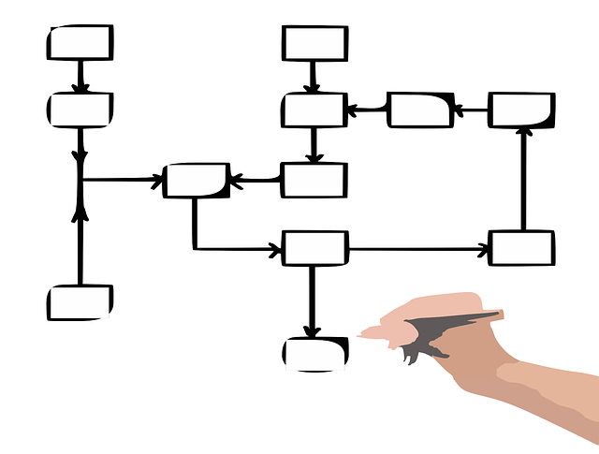
Workflows connect separate business logic steps to create a business process
Workflow is the structured flow or sequencing of work tasks in a business process
Workflows can be human focused or system only focused (e.g. Orchestration) or contain a mix of both

Slide 9
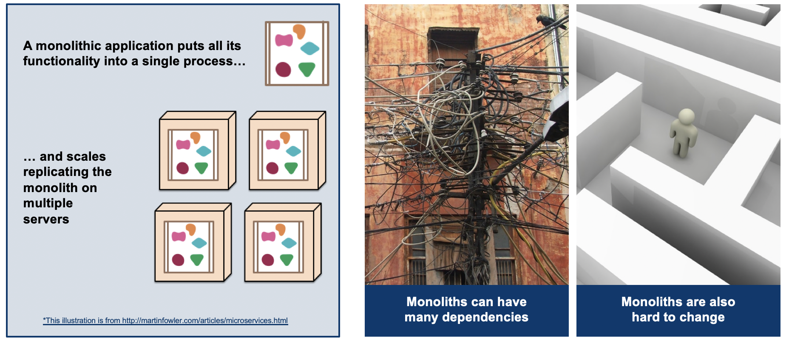
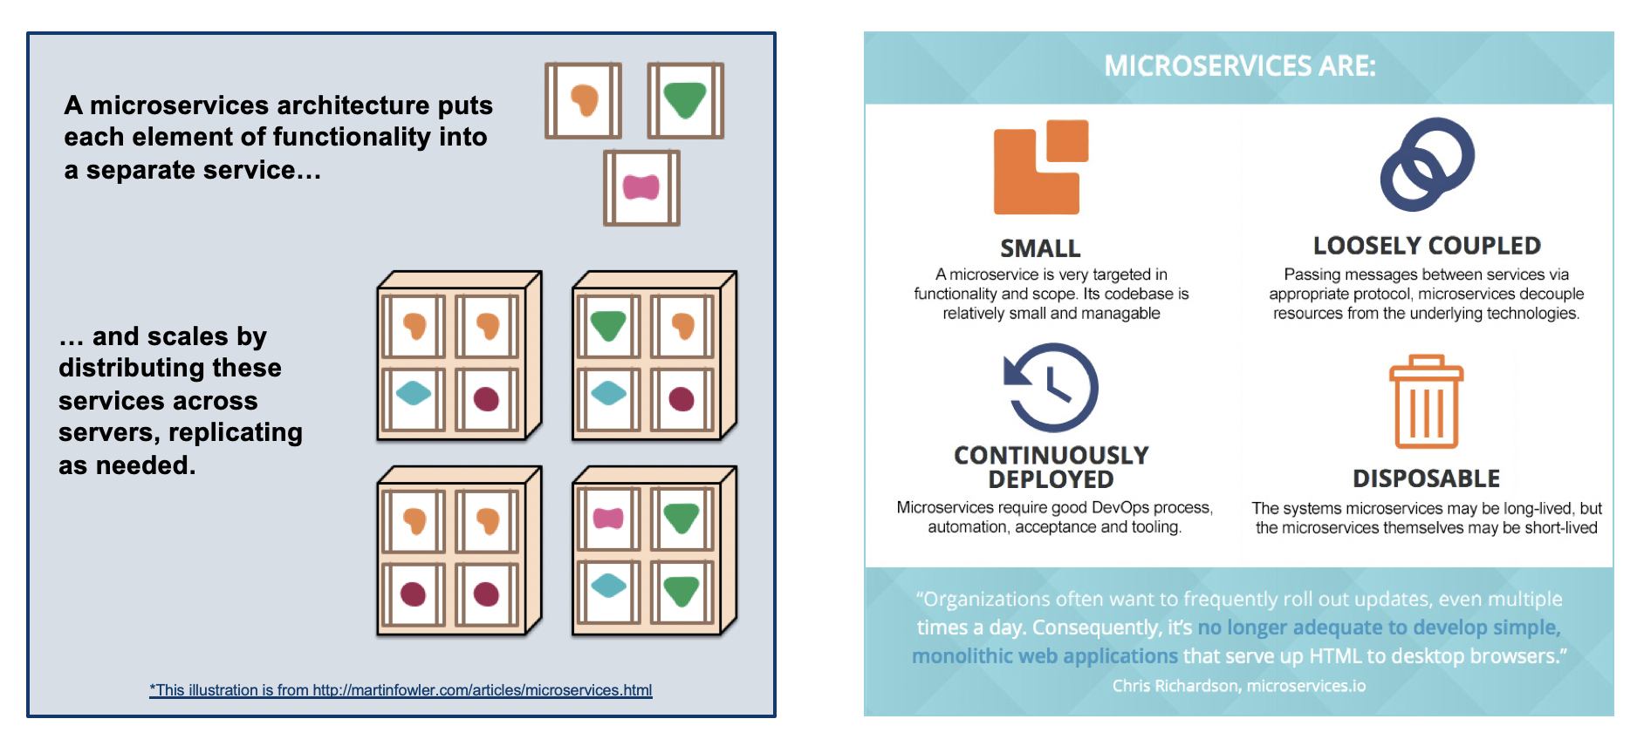

As a general rule, reusable logic should be independently deployable

Slide 10
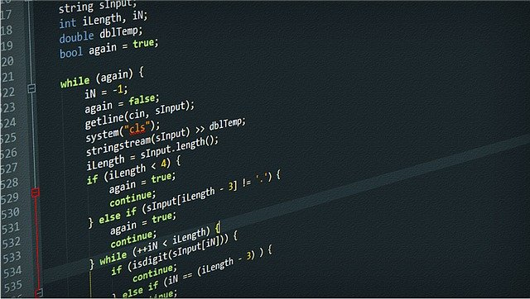
There are different ways to implement business logic
Condition 1 HadSpeeding Ticket | Condition 2 HadAccident | Action Set Discount
False | False | 20
True | False | 10
False | True | 5
True | True | 0
result
rule
Application Code
result
rule
result
rule
Decision Table
result
Rules Engine

Slide 11
Each business logic approach is a fit for a certain rate of change and complexity
Business Rules Management System
Use rules
Decision Complexity
Application Code
Decision Table
Rate of Change in Decisions

Slide 12

What are some of the things you can do with a Business Rules Management System?

Slide 13
Rule Authoring
Rule Management
Code Verification & Validation
Out of the box 4th generation rule language
Build a Domain Specific Language
Auto-syntax completion
Case statements
Dynamic and Static Decision Tables
Decision Tree
Excel based rule authoring
Expression Builder
For each loops
Functions
If Then Else Statements
Integrated Development Environment
Metadata Type Declaration
Neural Networks
Object Model Builder and Imports
Override/exclude rules
Pattern Based Rule
Rule effective and expiration dates
Rule Premise Inheritance
Rule priority/sequencing
Rule Set
Rule Templates
Scorecards
Technical Rule or Guided Rule
Type Declaration
Variables
Visual Decision Tree Navigation
Visual Decision Path View
Visual Rule Flow
Web Service Wizard
While / Until loops
Audit Collection
Business User UI
Cross Reference Browser
Detailed Component Search
Lifecycle Management
Rule Repository
Parallel Development
Performance Profiling
Performance Reporting
Revision Locking
Rule Project Report
Built-in support for GIT
Version Control System Integration
Visual Compare
Visual Execution Path
Breakpoints
Complex Rule Identification
Duplicate rules
Logical loops
Malformed constructs
Missing rules
Real-time Syntax Checker
Rule Collision
Traces
Unreachable rules
Watches
Rule Testing & Security
Deployment
Rule Execution & Integration
Event Processing
Ability to secure rule elements
Active Directory integration
Automated Test Case Execution
Automated Test Case Reporting
Regression Testing
Role based security
Test Case Creation and Repository
Application Container Support
Cloud Offering
Hot Deployments
In-Process Deployment
Standalone deployment via REST
Multi-Platform Deployment
Workflow Suite
Caching
Inferencing
PMML / PFA
Rule Engine API
Run-time monitoring
Sequential Execution
Stateful / Stateless
Compiled Sequential Execution
Event Based Rules
Event Detection
Memory Management
Processing Modes
Session Clock
Siding Windows and Streams Support
Temporal Reasoning and Operators

Slide 14

Drools is an Open Source Business Rules Management System
Originally developed in 2005
Apache license, written in Java
Has multiple projects:
  Drools Workbench: Web UI for Authoring
  Drools Expert: Business Rules Engine
  Drools Fusion: Complex Event Processing
  jBPM: Integrate Rules into workflows
Provides guided rules, technical rule DRL syntax, and support for Domain Specific Language (DSL)
Uses a forward and backward chaining inference engine that leverages the PHREAK algorithm
Supports in-process and standalone deployments
Notes:
CEP include support for sliding windows, streams, temporal reasoning

Slide 15
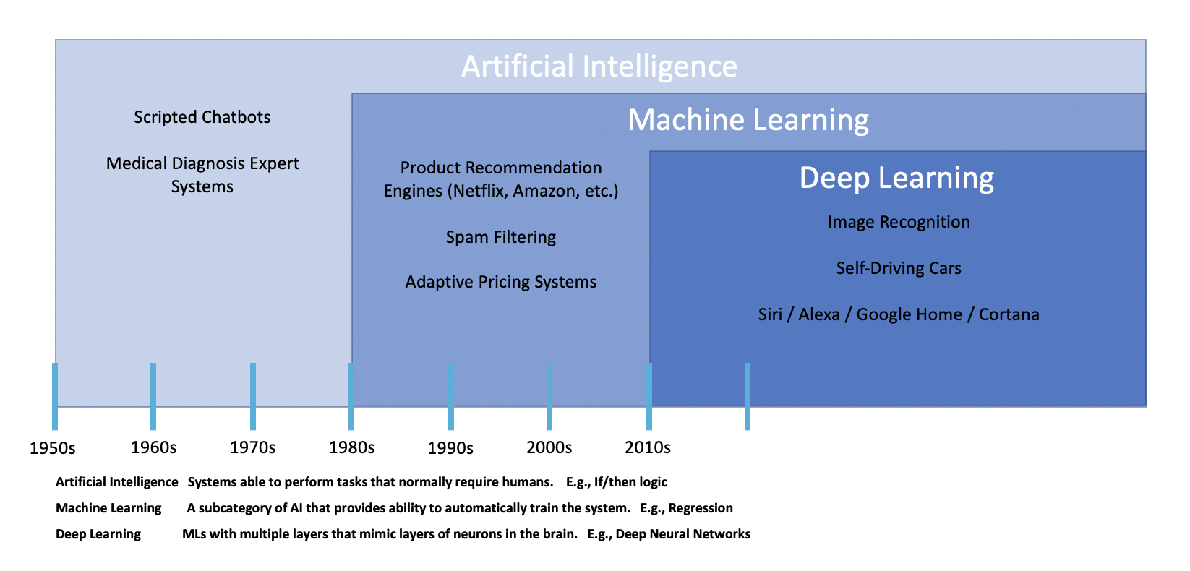
Machine Learning is a type of Artificial Intelligence

Slide 16
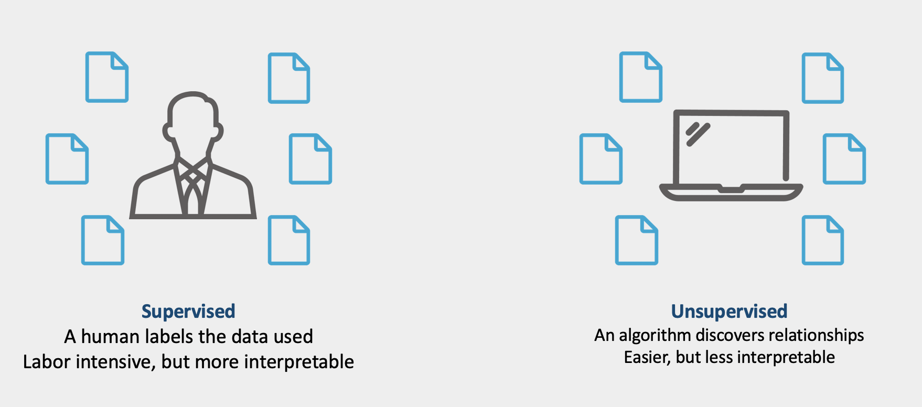

There are three major classes of Machine Learning
Reinforcement
Policy based processing on environmental observations to determine an action to get a reward
Notes:
Reinforcement learning (RL) is an area of machine learning concerned with how software agents ought to take actions in an environment in order to maximize some notion of cumulative reward. In the absence of training dataset, it is bound to learn from its experience
Reinforcement learning differs from supervised learning in not needing labelled input/output pairs be presented, and in not needing sub-optimal actions to be explicitly corrected. Instead the focus is on finding a balance between exploration (of uncharted territory) and exploitation (of current knowledge).^{[1]}
Policy means what to do under certain circumstances

Slide 17
What are some of the things you can do with a Machine Learning Platform?

Slide 18
Modeling Paradigms
Data Ingestion
Feature Engineering
Classic
Neural Networks
Bayesian
Batch
Real-time
Internal business data
3rd Partner Data
Sensor Data
Mobile & Social Media Data
Exploratory analysis
Feature Discovery & Creation
Automatic Feature Engineering
Dimensionality Reduction (e.g. PCA)
Boosting (e.g. XGBoost)
Ensemble Learning (e.g. GBM, BMC, BMA)
Instance Based (e.g. Self-Organizing Maps)
Regression Analysis (e.g. Linear, GLM, CoxPH)
Classifiers (e.g. Naive Bayes)
Clustering (e.g. K-means, Isolation Forest)
Deep Networks + Classic Modeling
Convolutional Neural Networks
Recurrent Neural Networks
Auto-Encoders
Adversarial Networks
Transfer Learning
Neural Networks + Novel Data Stores
Standard Methodologies (e.g. Bayesian networks)
Probabilistic Programming
Model Selection
Model Workflow, Training & Validation
Deployment & Execution
Management / Horizontal
Multiple Language support
Variable Importance
Feature Interactions
Batch Execution Workflow
ML Workflow
Create arbitrary data objects and sets
AutoML
Training Data Set
Validation Data Set
Test Data Set
Java POJO
Binary Formats
CI/CD
PMML
Containerization
REST API
In-Process
Distributed In-Memory
Built-in Notebook UI
GPU model support
Governance
Lineage
Monitoring
Metadata Management
Notes:
The ML workflow is really about getting data from a system, making sure you have the data right, creating a prototype model system, testing your assumptions and 2nd line challenge, and then translating that as quickly as possible into a production system.
AutoML covers the complete pipeline from the raw dataset to the deployable machine learning model.
A Bayesian model is a statistical model where you use probability to represent all uncertainty within the model, both the uncertainty regarding the output but also the uncertainty regarding the input (aka parameters) to the model.
Artificial Neural Networks try to learn tasks (to solve problems) mimicking the behavior of brain. Artificial Neural Networks are computational methods that use a large set of elementary computational units, called themselves (artificial) neurons. And Artificial Neural Networks due their power to the numerous interconnections between neurons.

Slide 19
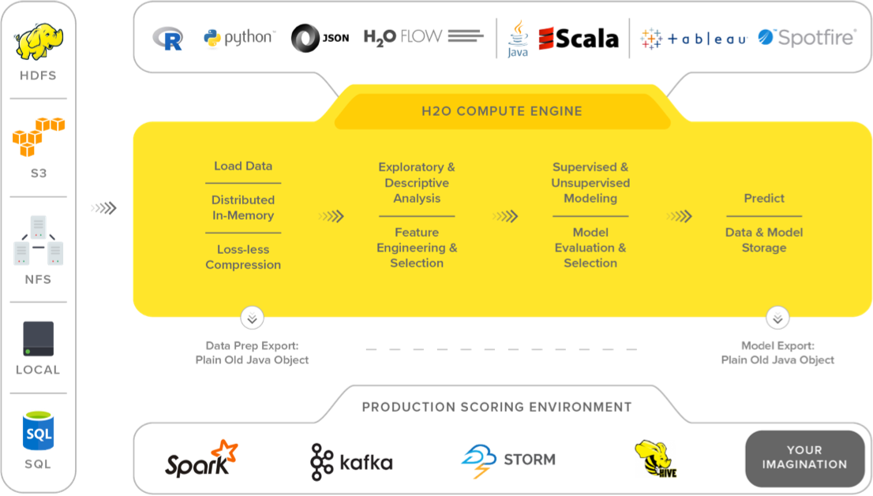
H2O Overview
Open source (Apache license) in-memory big data machine learning platform
Created in 2011 and the core code is written in Java
Can be used with Python, R, H2O Flow, Scala, Tableau, Spotfire
Uses parallelized and distributed algorithms like GLM, Random Forest, GBM, PCA, deep learning neural networks
Also supports supervised and unsupervised learning
Deploy model as a Java POJO or MOJO (Model ObJect, Optimized)

Slide 20
Long-term will we see tighter integration between BRMS and ML platforms?
RULES
ML
Rule Authoring
Modeling Paradigms
Rule Management
Model Training
Runtime Data Ingestion
Rule Execution & Integration
Model Validation
Deployment & Execution
Model Selection
Event Processing
Workflow
Feature Engineering
Code Verification & Validation
Testing
Model Management
Security
Notes:
Similar to how we saw case management and workflow applications come together, is it possible we will see the same happen with BRMS and ML Platforms?

Slide 21
When to use Rules vs. Machine Learning? Or both?
Characteristic | Rules | Machine Learning
Logic | Exact logic is known | Exact logic is not known, but may know the inputs that help predict the output
Logic Type | If then precision based | Prediction based using algorithms
Data | Don’t need to derive the logic from the data | Have lots of data that an algorithm can use to define logic
What creates it | A human | ML software generates the code using algorithms via training

Slide 22
Rule & Machine Learning Integration Patterns
Pattern 1: Leverage ML outputs as an input into rules
Pattern 2: Leverage rule outputs as feature input into ML models
Pattern 3: Leverage both rule and ML outputs as inputs
Probability of house selling in 10 days?
Probability of sellers dropping price?
Needs Repairs?
Is OffSeason?
Sellers want to sell now?
Sellers want to sell now?
Needs Repairs?
Is OffSeason?
ML1
ML2
rule1
rule2
rule3
rule3
rule1
rule2
ML1
ML2
ML1
Probability of sellers dropping price
rule1
Probability of sellers dropping price
Probability of house selling in 10 days
e.g. If ML1 output > 0.50 && ML2 < 0.50 then
Recommend buy now
ML2
Probability of house selling in 10 days
Example: Imagine that you are a realtor wanting to inform your client how quickly they should act on a property they are interested in…

Slide 23
How can we apply Microservices and Reactive Architecture styles to Rules and Machine Learning?

Slide 24
Microservices to the rescue! But are they a silver bullet?

Slide 25
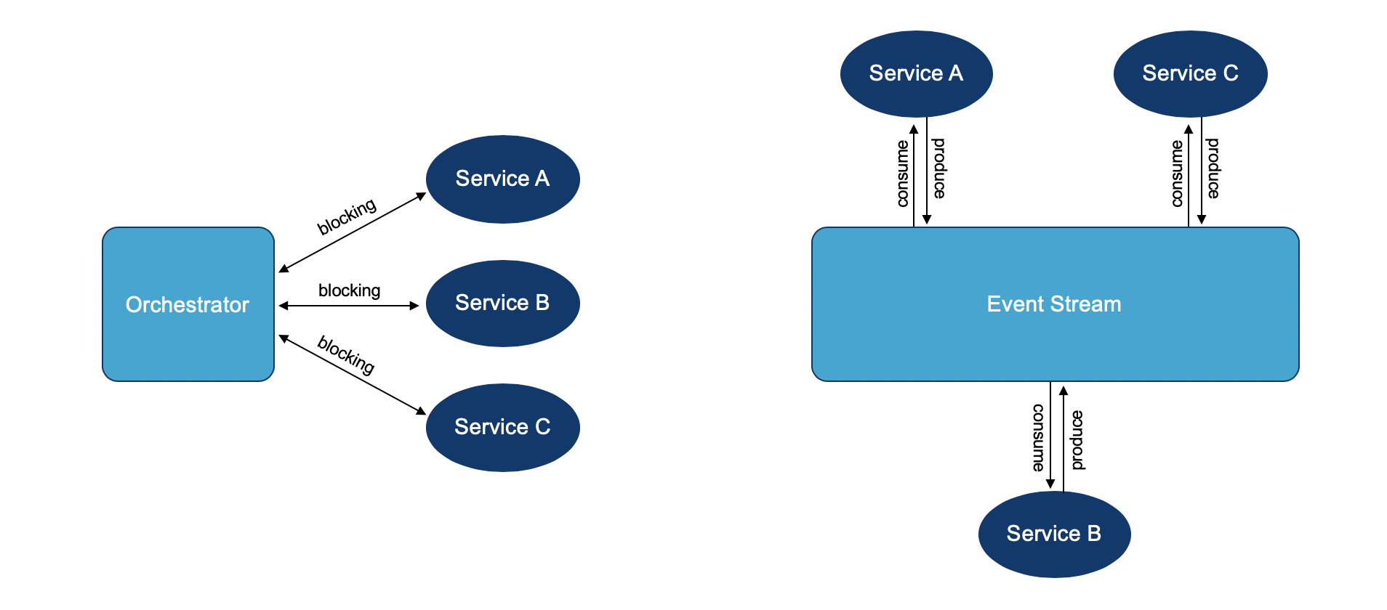
Using a reactive architecture with microservices can add additional value

Slide 26
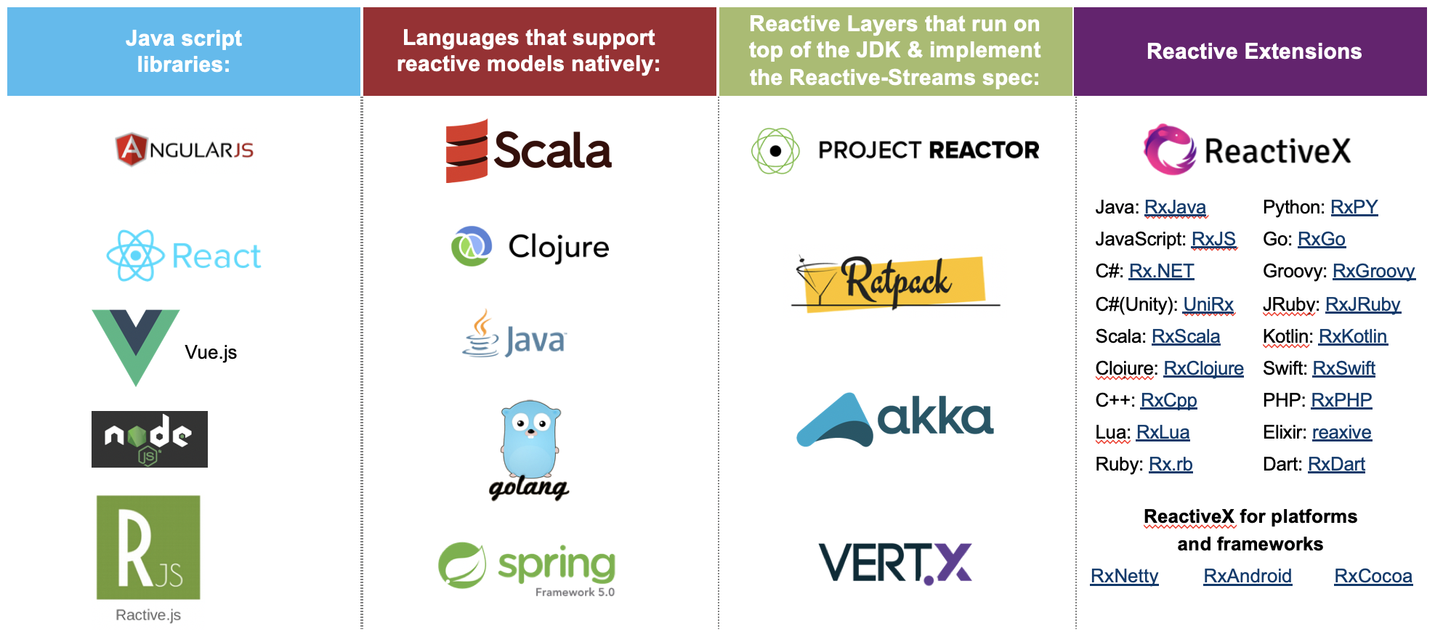
Four categories of technologies you can use to build reactive apps

Slide 27
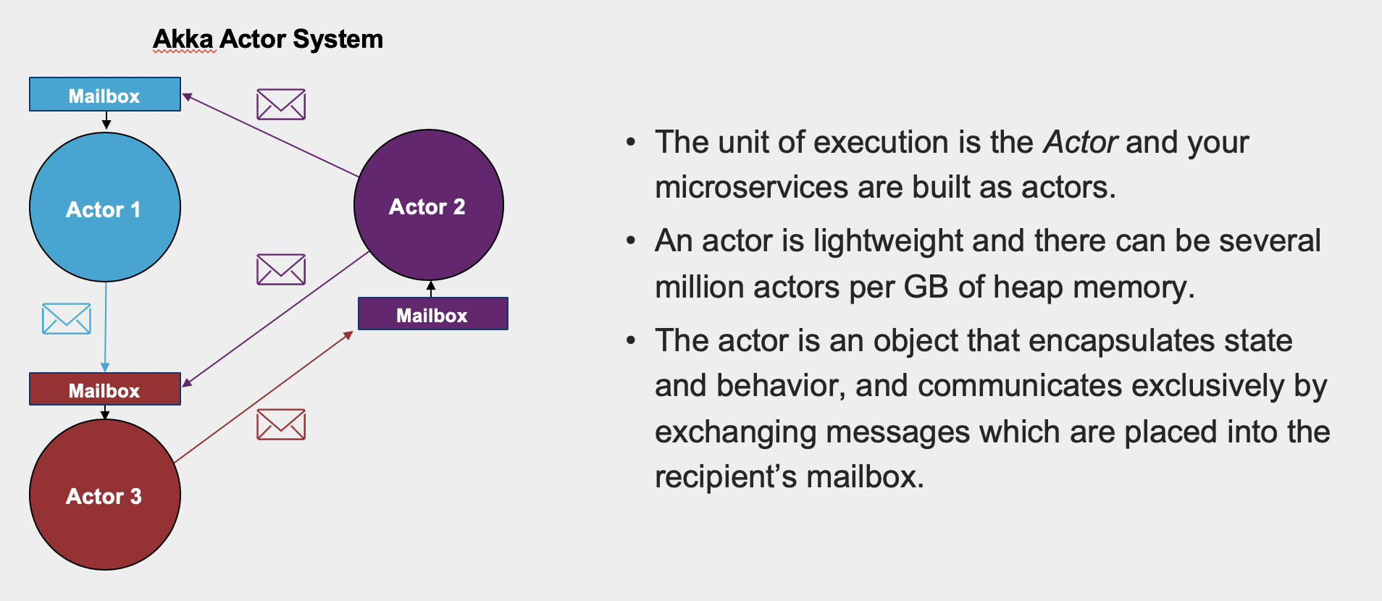
Akka is built off the actor model, which originated in 1973 per Carl Hewitt)

Slide 28
Demo Overview

Slide 29




Combining all of these technologies & patterns together can create a powerful solution
Saga Akka Actor for coordinating a reactive workflow
Leverage Kafka as the messaging mechanism between the microservices
Leverage Lagom to bootstrap Kafka
H2O for machine learning
Drools for rules
Leverage Java for non Akka microservices
Actor System
Saga Actor
Run Model MS Actor
3
2
4
Kafka
1
5
Calc FeaturesMS
Rules MS

Slide 30
Fraudulent Transaction Use Case
Kafka Producer
Akka Saga Actor
Kafka
card.transaction topic
Java Calc Features MS
Akka Run Model MS Actor
Java Rules MS (Drools)
Calc Features
Calc Features
Features Calculated
Features Calculated
Features Calculated
Transaction OK or Fraudulent Transaction
Evaluate Model Output + Additional Criteria
Transaction OK or Fraudulent Transaction
Notes:
For Transactions that the ML model indicates are OK, the rules will perform additional checks on the name and the address if the probability of the ML model is <50%.
If either the name or address checks fails, the rules will indicate that the transaction is now Fraudulent

Slide 31
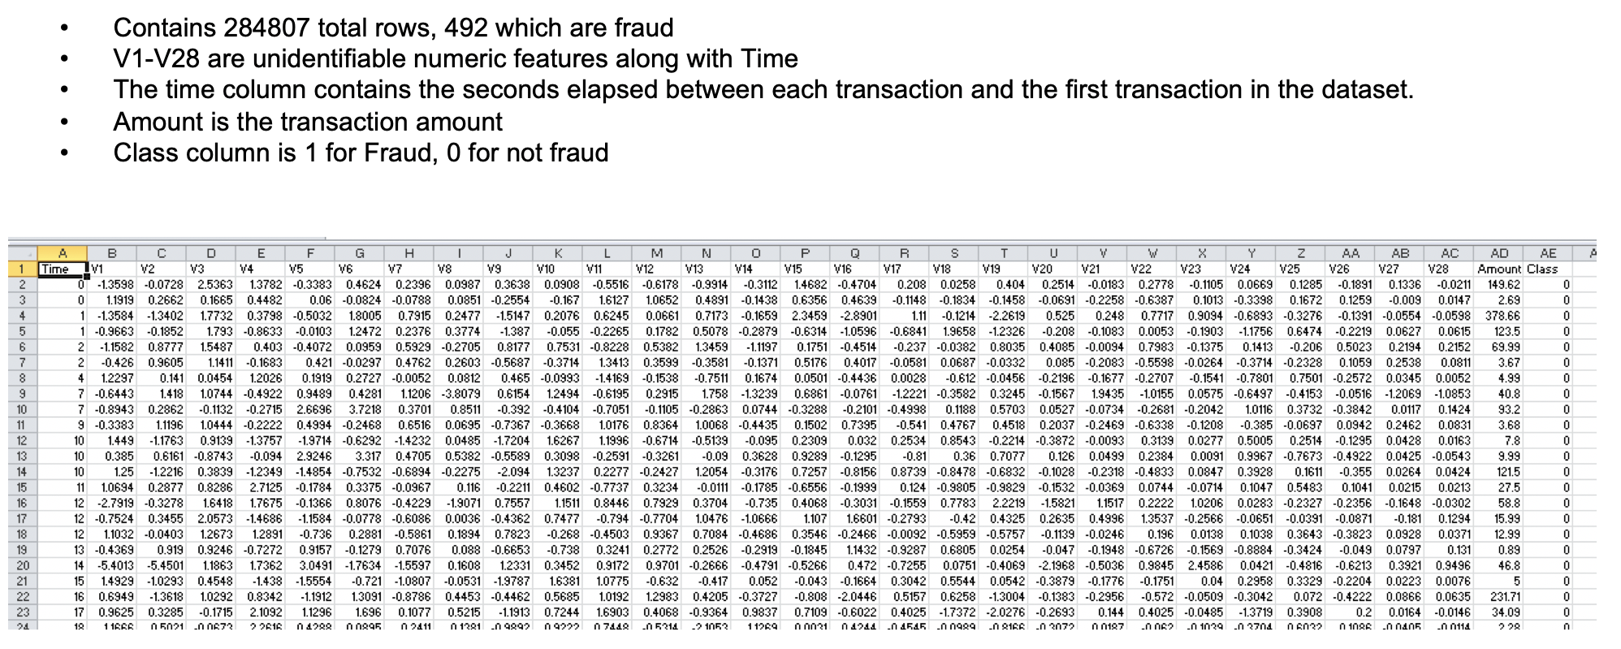
For the machine learning components, we are using a Credit Card Fraud Detection dataset from kaggle.com

Slide 32
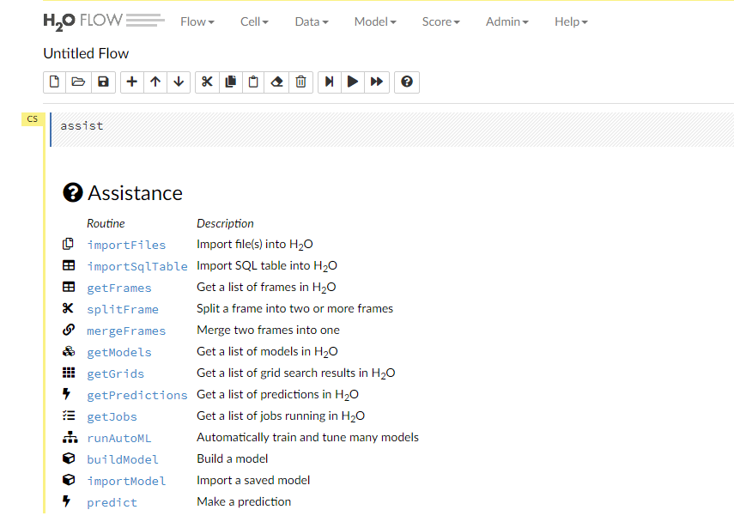
To build the model we used H2O Flow
H2O Flow is an open-source user interface for building H2O models
Very easy to get up and running. Download the zip file and run the jar file
  unzip h2o-3.24.0.4.zip
  cd h2o-3.24.0.4
  java -jar h2o.jar
Navigate to http://localhost:54321

Slide 33
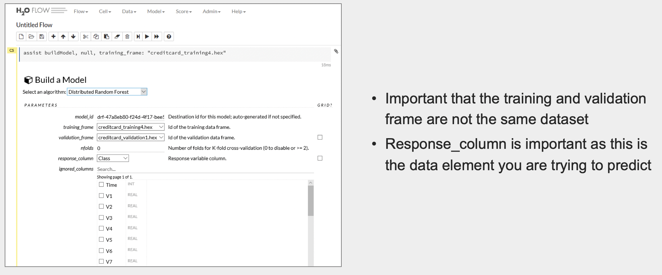
H2O Flow enables you to do multiple trial runs with various algorithms

Slide 34
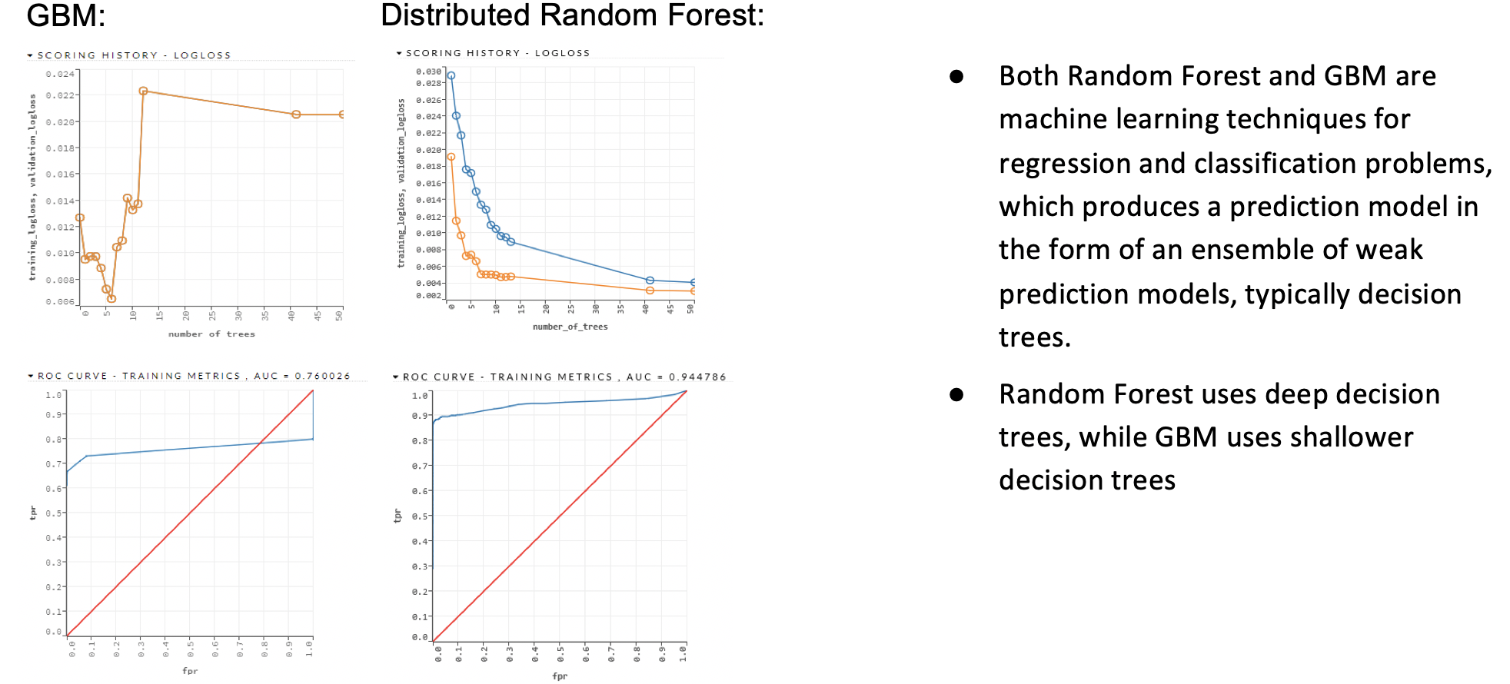
Distributed Random Forest performed better than Gradient Boosting Machine (GBM)
Notes:
Logarithmic loss (related to cross-entropy) measures the performance of a classification model where the prediction input is a probability value between 0 and 1. The goal of our machine learning models is to minimize this value.

Slide 35
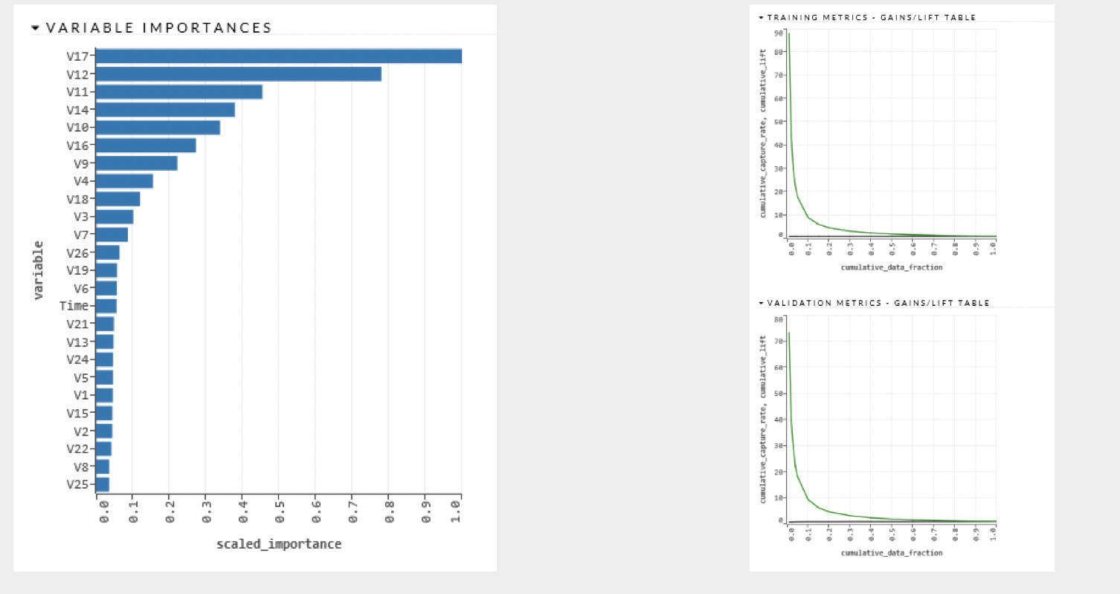
H2O identified which of the features were most important and revised the model until it was accurate

Slide 36
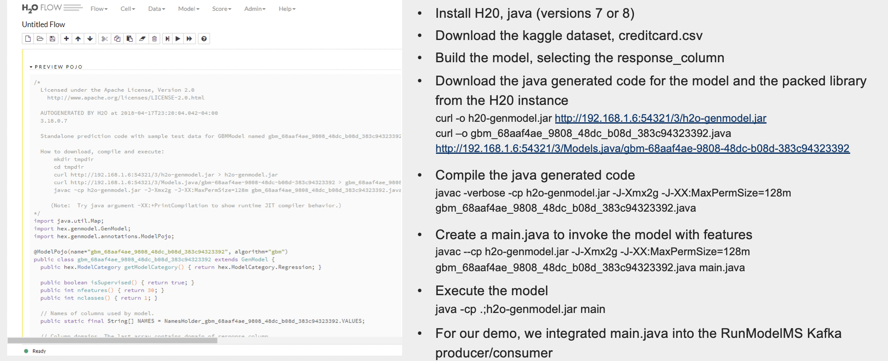
We deployed H2O model as POJO

Slide 37
For rules, we leveraged Drools and deployed them in-process inside a POJO
General Steps:
Create a class for the data elements used by drools (includes getters & setters)
Create your rules
Create your KieSession & insert the data into the KieSession
FireAllRules()
Destroy() for cleanup
Example Rules
rule "Trans OK and Prob < 0.50 and name check fail"
when
m : RulesData( modelProb <= 0.50, mymodelProb : modelProb)
RulesData( status == "Transaction OK" )
RulesData( nameCheck <= 0 )
then
m.setStatus("Fraudulent Transaction from Rules, name check failed");
end
rule "Trans OK and Prob < 0.50 and address check fail"
when
m : RulesData( modelProb <= 0.50, mymodelProb : modelProb)
RulesData( status == "Transaction OK" )
RulesData( addressCheck <= 0 )
then
m.setStatus("Fraudulent Transaction from Rules, address check failed");
end

Slide 38
Live Demo!!

Slide 39
Additional Resources
Leveraging Akka and Machine Learning in a Reactive Microservices Architecture
https://medium.com/capital-one-tech/leveraging-akka-and-machine-learning-in-a-reactive-microservices-architecture-57b2da0c949e
Microservices: When to react vs. orchestrate
https://medium.com/capital-one-developers/microservices-when-to-react-vs-orchestrate-c6b18308a14c
A Reactive Framework Comparison
https://medium.com/capital-one-developers/building-microservices-a-reactive-framework-comparison-fb49d8f3c8f4
Comparing and Contrasting Open Source BPM Products
https://medium.com/capital-one-developers/comparing-and-contrasting-open-source-bpm-projects-196833f23391
Using Machine Learning and Open Source BPM in a Reactive Microservices Architecture
https://medium.com/capital-one-tech/using-machine-learning-and-open-source-bpm-in-a-reactive-microservices-architecture-96bb8dc9e962
https://github.com/andy9876/MachineLearningReactiveBPM
Decomposing the Monolith with Event Storming
https://medium.com/capital-one-tech/event-storming-decomposing-the-monolith-to-kick-start-your-microservice-architecture-acb8695a6e61

Slide 40
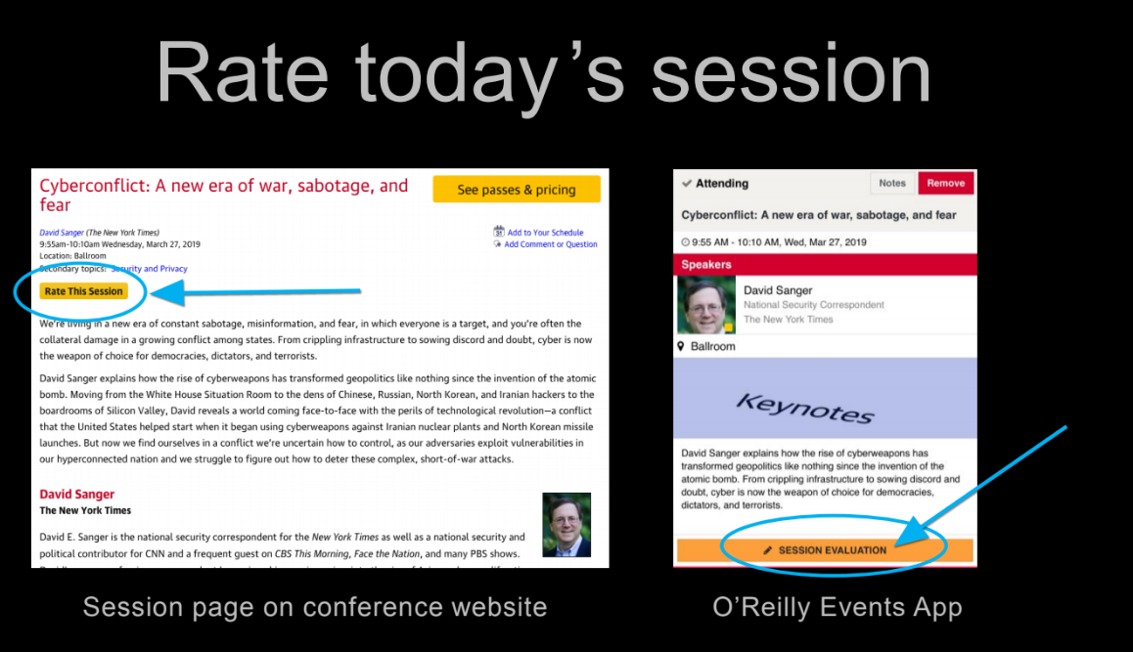

Slide 41
Appendix

Slide 42
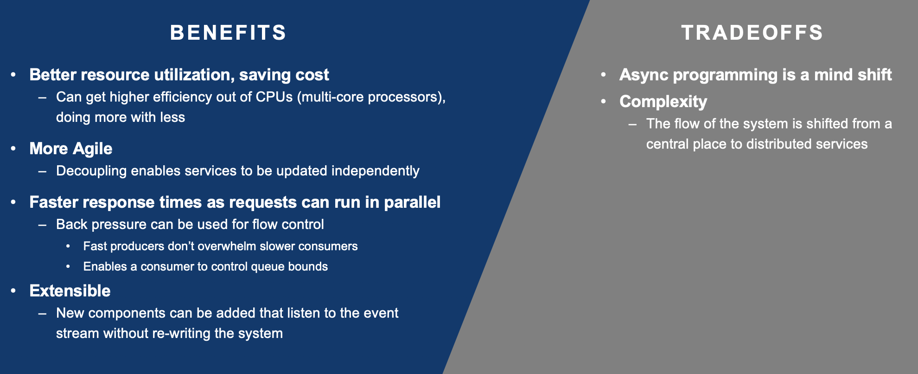
A reactive architecture has both benefits and tradeoffs

Slide 43
A monolithic application can be challenging …

Slide 44

Kafka is a distributed streaming platform
Used in conjunction with Zookeeper
Runs as a cluster
Records are stored in categories called topics
Provides 4 core APIs: Producer, Consumer, Streams and Connector
Supports both publish-subscribe and queuing through a consumer group concept
Very Fast and has very high throughput – many use it for backpressure
Can be used for message replay as the messages do not have destructive reads like traditional messaging technologies
Guarantees order of messages within a partition, but not across partitions
Very easy to get up and running

Slide 45
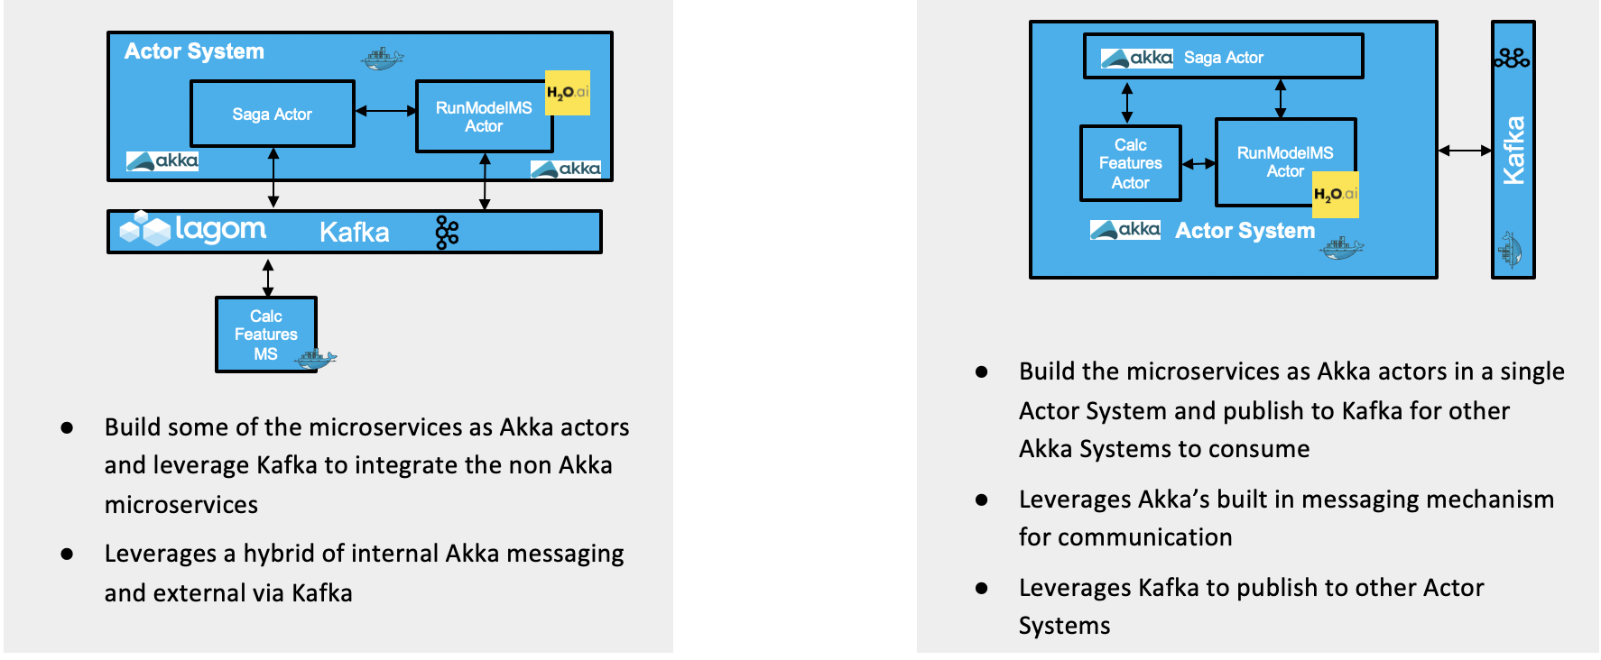
Reactive Machine Learning Integration Patterns with Kafka
Polyglot Approach
All Akka Approach

Slide 46
Lessons learned of this approach
Need a Unique ID (correlation ID ) that goes across all microservices
For the machine learning dataset, use big data and unbiased data
Leverage Chaos testing to validate resiliency
Apply the Saga pattern where:
  there are synchronous blocks of asynchronous processing
  there is a need to decouple as much as possible to eliminate dependencies

