Slide 1
Safe and smarter driving powered by AI
September 12, 2019

Slide 3
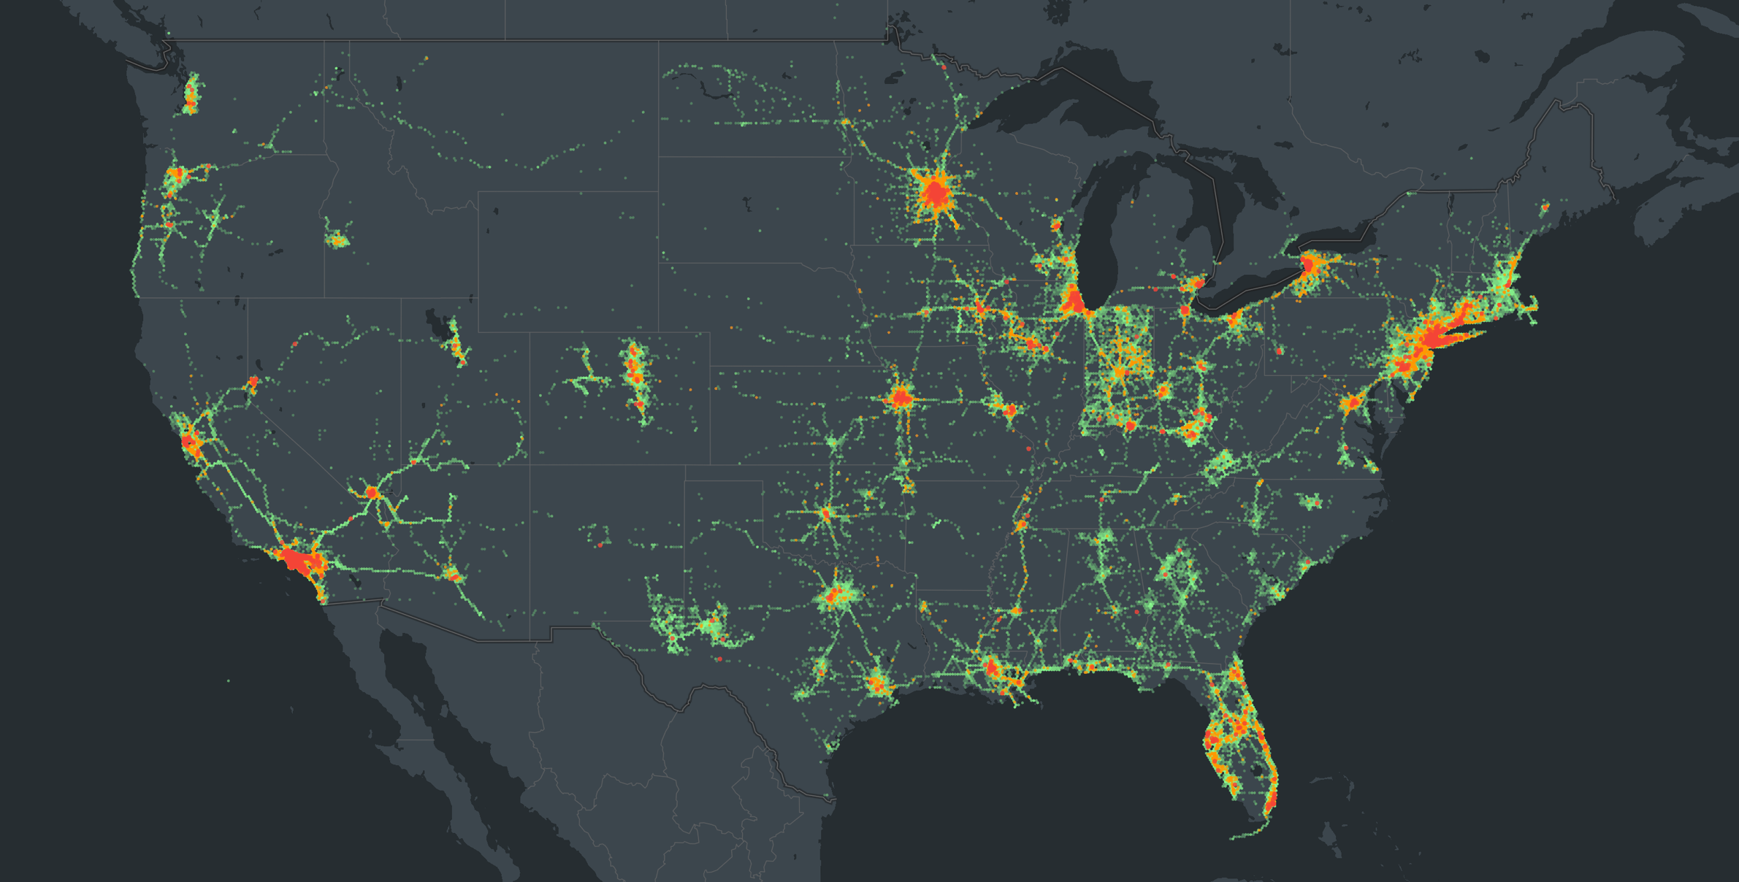
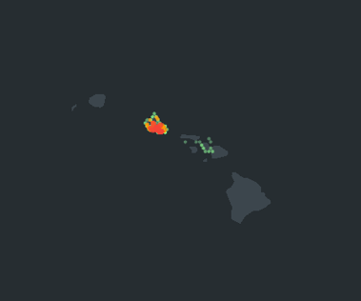
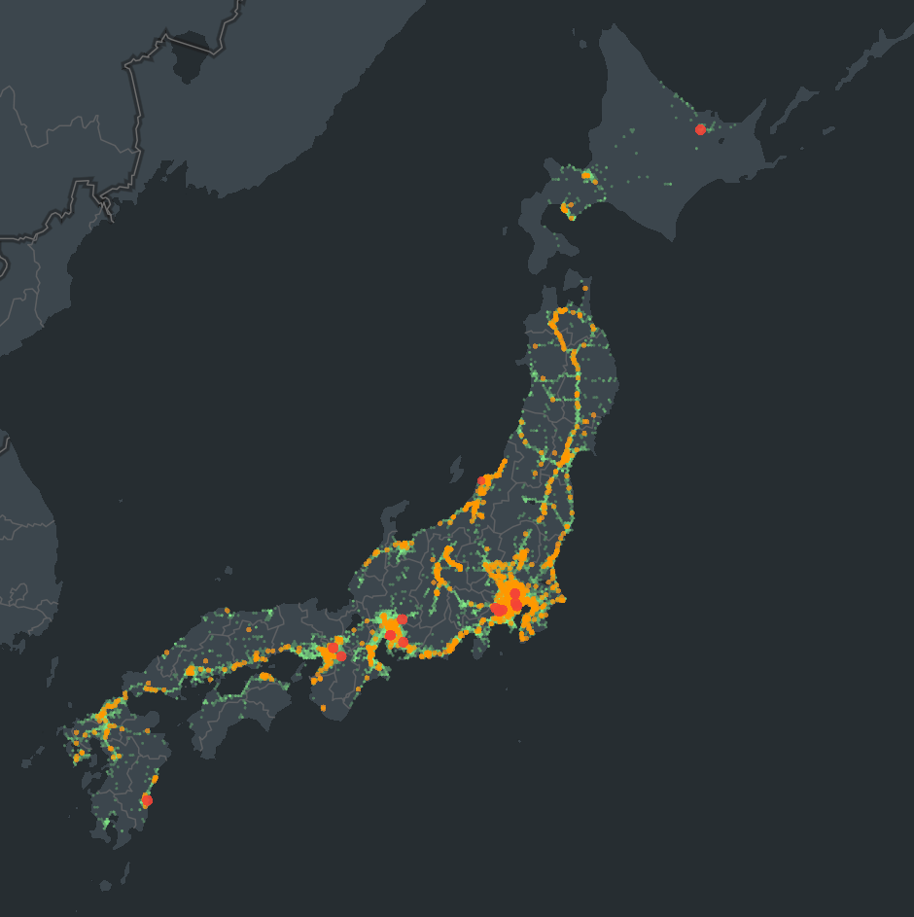
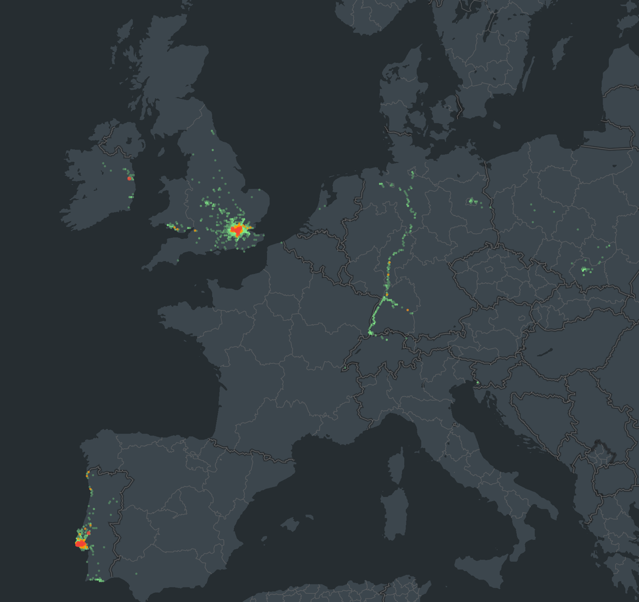
350+
fleets
16
industries
350M+
AI-processed video miles

Slide 4
What does Nauto’s AI enable?
Driving Event Detection
In-Cabin Alerts
Fleet Management Support
Distracted driving
Tailgating
Policy violations (cell phone use, smoking)
Collisions
Distracted driving
Tailgating
Driver identification
Depersonalization (blurring)
Blocked devices

Slide 5
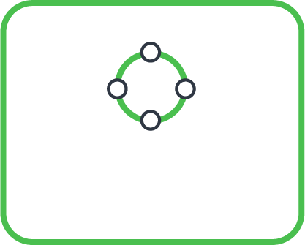
Active learning with closed-loop AI - cloud and edge
EDGE ML/DL MODELS
ML/DL MODELS
DATA STORAGE
Data Collection, Model Testing, Detection & Inference
Model Dev/Testing, Training, Data Review, Augmentation

Slide 6
How it works: our architecture
INPUTS
PROPRIETARY SYSTEMS/TOOLS
OUR FOCUS TODAY
STEP 1
Prep Groundtruth Dataset
Device data
Events
Event Package +
Data Reviewer Tool
Events / Labeling DB
Streaming events
Human reviewers
Labels
3rd party labeling service
Labels
STEP 2
Model Training with Amazon SageMaker
Labels
Cloud models
STEP 3
Model Serving with ECS

Slide 7
Step 1: Prepare Ground Truth Dataset
Immutable
Expressed data for each epoch is immutable
Powers reproducibility of experiments
Full & Delta
Delta for efficient lookup of new data or what is different
Powers continuous training and evaluation in a reproducible way
Staging
Staging
Staging
Staging
Epoch 1
Epoch 2
Epoch 3
Epoch 4
Truth
Truth
Truth
Truth
Notes:
Goal: Build a versioned golden dataset from the growing labeled events reported by our devices, which enables scalable and reproducible models training in the cloud.
Data pre-processing and cleansing, sensor fusion
Collect all media files for each event, handle missing cases
Adjust timestamp, fix time sync issue, etc.
Data export pipeline
Package labeled data on S3 by dates, event type, and labels
Runs daily, organize data by dated folder
Scientists can easily pick a range of dataset for training/test
Provide tools and python lib to filter and read dataset
Based on Open Source - Airflow, PySpark

Slide 8
Step 2: model training infrastructure with Amazon SageMaker
What Amazon SageMaker provides for Nauto's training infrastructure:
Scalable
train many models in parallel, grid search hyper-parameters
Organized
model artifacts are properly archived
Reproducible
code and dataset are versioned
Continuous
continuous train/update models for each region/fleet/device

Slide 9
Step 3: model serving infrastructure with ECS
model files
Model conf
Cloud model (git repo)
CircleCI
scientists
auto deploy
testing/staging/prod env
Priority Queue
human reviewers
Devices
Data reviewer
Cloud models
…
Quoble dashboard / customized scripts
DB
Nauto Cloud

Slide 10
Roadmap
Platform
Algorithms
Products
Drowsiness Detection
Model Playground
Amazon Elastic Inference
Traffic Light / Stop Sign Detection
Live Maps and Routing
Forward Collision Warning
Amazon SageMaker

