Slide 1
Container orchestrator for general applications: FrameworkLauncher

Slide 2

Container orchestrator for general applications: FrameworkLauncher
Kai Liu | Senior Program Manager
Yuqi Wang | Software Engineer
Bin Wang | Principal Software Engineering Manager
Bing MagneTar Team
Sep 12th, 2019
Artificial Intelligence Conference, San Jose, CA

Slide 3
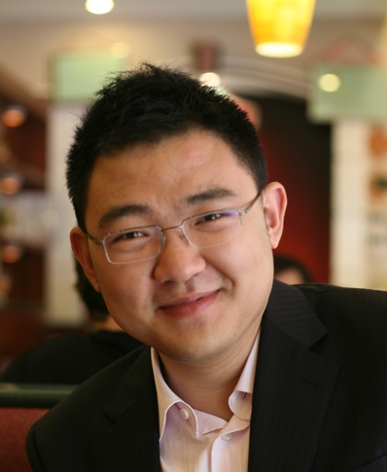
Self-Introduction
10-year experience in Big Data and AI platform
PMP, MBA, MCSE (Data Mgmt and Analytics)
Now:
Large-scale (100K-server) offline processing platform for Bing
OSS stack evangelization and adoption
Past:
Curated Data Sets for Office 365
Compliant DL training platform Office 365
Data-Driven Engineering Culture Building
Kai Liu
Senior Program Manager
Bing | Microsoft
kailiu@microsoft.com
WeChat: zjumad

Slide 4
Session goals
Overview of Bing MagneTar Platform
Challenges in long running services and batch jobs
in Big Data and Deep Learning
How does FrameworkLauncher optimize for AI

Slide 5



What is Bing MagneTar Platform

Slide 6

Imagine you have 1 million machines
Not all of them are fully utilized
I can reuse underutilized capacity…
To host DL and Open Source pipelines
100%
Utilization curve
Big Data and Deep Learning
(Hadoop, Spark, Kafka
TensorFlow, ONNX, etc.)
1 million machines

Slide 7
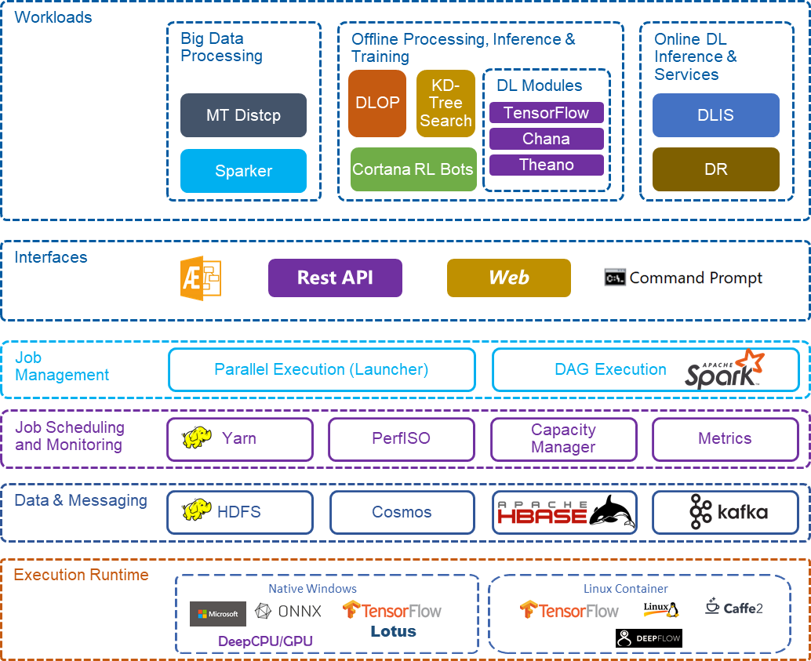
Bing MagneTar
Bing’s Next Generation Offline Processing Platform with DL/OSS Capability and Cost-Efficiency
It supports OSS and DL offline processing
It has a massive scale
~100K machines
~2 million cores, 10 million GB RAM
~200PB storage
It supports various kinds of Big Data/DL workloads
Orchestrated by FrameworkLauncher:
MaltaStreaming, DynamicRendering, DeepLearningInferenceService, etc.
HBase, Kafka, etc.
ChaNa, FastDNN, Cortana Bot Training, Passage Injection, KDTree Building and Serving, etc.
TensorFlow/PyTorch/CNTK, etc.
Orchestrated by Spark:
MaltaGen, Flick, DeepLearningOfflineProcessing, ObjectStore Ingestion, etc.

Slide 8

Challenges of harvesting underutilized capacity

Slide 9
 | Yet-to-Retire Machines | Maintenance Buffer Machines | Online Serving Machines
Key Characteristics | Relatively stable, but subject to return any time; | Large amount, but churning quickly | Running production critical services May have spare cycles time to time
Key Challenges | Maintain data availability at bulk machine moves | Predict machine return and smart task allocation | Isolate data tasks from production services

Slide 10
PerfISO
Advanced YARN NodeLabels
HDFS Block Placement Policy

Slide 11
Performance Isolation: Leveraging Windows APIs
CPU Soft-Cap
Primary
Idle
Secondary
Total memory for primary + secondary
Buffer
Memory Soft-Cap
Primary memory usage
Secondary memory usage

Slide 12
Node Labels and Feature Tags
spark-submit.cmd --conf "spark.yarn.executor.nodeLabelExpression=*besteffort*|*persistent*"
spark-submit.cmd --conf "spark.yarn.executor.nodeLabelExpression=*persistent*#multivm,!IsCtrlEnv"

Slide 13

HDFS Replica Placement Policy
Default HDFS replica placement policy
Local/Start Rack
A Remote Rack
Across 3 environments
(logical cluster for machine ownership)
Our HDFS replica placement policy
Across 3 spines
(physical topology)

Slide 14

How does FrameworkLauncher optimize for AI

Slide 15
Challenges to support various kinds of applications (1)
Batch vs. Long running service, different requirements
Batch/Training
  Run for Completion
    When to complete (cleanup) the whole app attempt? Early Success/Early Failure
    When to retry the whole app and a single instance?
      Always Retry for Transient Failure
      Not Retry for Permanent Failure and Success
      Max Retry Count for Unknown Failure
    Downtime Acceptable
    -> Retry from CKPT
  More differences within Batch scope
    Stateless or Stateful
    Monolithic or Multiple Components
    Single Instance Interruptible or Not
    Serializable or Gang Execution
Service/Serving
  Run for Serving
    No Downtime (Retry the whole app is not acceptable)
    Service Discovery (External Access)
    Service HealthCheck
    Serializable Execution/Antiaffinity Execution
    Single Instance Interruptible
  Long-Running
    Always Retry (even success exit)
    Capacity Guarantee in face of Machine Maintenance
    Update on the fly
      Rescaling/Adding Components/Restart an instance/Rolling Upgrade, etc
    Versioned Deployment
  More differences within Service scope
    Stateless or Stateful
    Monolithic or Multiple Components

Slide 16
Challenges to support various kinds of applications (2)
Support all features into one unified orchestrator
OSS has no mature solution
  YARN
    LinkedIn TonY/Yahoo TensorFlowOnSpark
  Kubernetes
    StatefulSet/Job Controller/Kubeflow
  YARN Service
    Alpha state
    Lacks many features we need
We build FrameworkLauncher
  All In One
  High Scalability/Availability/Usability
  Optimized for AI apps
  Partially Open Sourced
  Support YARN (Prod)
  Support Kubernetes (Alpha)

Slide 17
TF Training/Serving Benefits
Benefits from general Batch features
  AttemptCompletionPolicy, supports both
    Early Success -> All Workers Success
    Early Failure -> One Instance Failure
  FancyRetryPolicy (Always Retry/Not Retry/Max Retry)
Benefits from general Service features
  No Downtime/Service Discovery/Rescale on the fly
Benefits from shared features
  Single Instance Is Not Interruptible/Stateful
Benefits from one unified orchestrator
Same experience across training and serving
Only different in feature settings

Slide 18
TF Training Spec
"taskRoles": {
"ps_server": {
"taskNumber": 2,
"taskRetryPolicy": {
"fancyRetryPolicy": false,
"maxRetryCount": 0
},
"applicationCompletionPolicy": {
"minFailedTaskCount": 1,
"minSucceededTaskCount": null
},
"taskService": {
"entryPoint": "source YarnContainerScripts/0.sh",
"sourceLocations": [
"/Container/yuqian/tensorflow-distributed-cifar10-11/YarnContainerScripts"
],
"resource": {
"cpuNumber": 2,
"memoryMB": 8192,
"portDefinitions": {
"http": {
"start": 0,
"count": 1
},
"ssh": {
"start": 0,
"count": 1
}
},
"gpuNumber": 0,
"gpuAttribute": 0
}
},
"platformSpecificParameters": {
"taskNodeLabel": null,
"taskNodeGpuType": null,
}
},
"worker": {
"taskNumber": 2,
"taskRetryPolicy": {
"fancyRetryPolicy": false,
"maxRetryCount": 0
},
"applicationCompletionPolicy": {
"minFailedTaskCount": 1,
"minSucceededTaskCount": 2
},
"taskService": {
"version": 0,
"entryPoint": "source YarnContainerScripts/1.sh",
"sourceLocations": [
"/Container/yuqian/tensorflow-distributed-cifar10-11/YarnContainerScripts"
],
"resource": {
"cpuNumber": 2,
"memoryMB": 16384,
"portDefinitions": {
"http": {
"start": 0,
"count": 1
},
"ssh": {
"start": 0,
"count": 1
}
},
"gpuNumber": 4,
"gpuAttribute": 0
}
},
"platformSpecificParameters": {
"taskNodeLabel": null,
"taskNodeGpuType": teslak80,
}
}
}
{
"description": null,
"version": 10,
"executionType": "START",
"retryPolicy": {
"fancyRetryPolicy": true,
"maxRetryCount": 0
},
"parentFramework": null,
"platformSpecificParameters": {
"taskNodeLabel": null,
"taskNodeGpuType": null,
"queue": "default",
"antiaffinityAllocation": false,
"gangAllocation": true,
"skipLocalTriedResource": true,
"amType": "DEFAULT",
"agentUseHeartbeat": false,
"agentHeartbeatIntervalSec": 30,
"agentExpiryIntervalSec": 180,
"agentUseHealthCheck": false,
"taskServiceHealthCheck": null
}

Slide 19
TF Serving Spec
"taskRoles": {
"model_server": {
"taskNumber": 10,
"taskRetryPolicy": {
"fancyRetryPolicy": false,
"maxRetryCount": -2
},
"applicationCompletionPolicy": {
"minFailedTaskCount": 1,
"minSucceededTaskCount": null
},
"taskService": {
"entryPoint": "source YarnContainerScripts/0.sh",
"sourceLocations": [
"/Container/yuqian/tensorflow_serving_mnist_
20180913091517.753/YarnContainerScripts"
],
"resource": {
"cpuNumber": 2,
"memoryMB": 8192,
"portDefinitions": {
"model_server": {
"start": 0,
"count": 1
},
"ssh": {
"start": 0,
"count": 1
}
},
"gpuNumber": 1,
"gpuAttribute": 0
}
},
"platformSpecificParameters": {
"taskNodeLabel": null,
"taskNodeGpuType": null,
}
},
{
"description": null,
"version": 10,
"executionType": "START",
"retryPolicy": {
"fancyRetryPolicy": false,
"maxRetryCount": -2
},
"parentFramework": null,
"platformSpecificParameters": {
"taskNodeLabel": null,
"taskNodeGpuType": null,
"queue": "default",
"antiaffinityAllocation": true,
"gangAllocation": false,
"skipLocalTriedResource": true,
"amType": "DEFAULT",
"agentUseHeartbeat": false,
"agentHeartbeatIntervalSec": 30,
"agentExpiryIntervalSec": 180,
"agentUseHealthCheck": false,
"taskServiceHealthCheck": null
}

Slide 20
Gang Scheduling
Start instances in an all-or-nothing fashion -> No Resource Deadlock
Job A
5 Instances
1 GPU/Per Instance
2 GPUs
3 GPUs
Job B
5 Instances
1 GPU/Per Instance

Slide 21
GPU Scheduling: Job Packing
High training speed and cluster GPU utilization
Best Fit Packing
Select the node which is
sufficient for the job request and
has the smallest free GPUs
Benefits
Leave big hole for big job
Reduce fragmentation
Increase cluster utilization
Rack0
Rack1
Rack2
Node 2
Node 2
Node 2
Node 1
Node 1
Node 1
Node 0
Node 0
Node 0
1-GPU job
2-GPU job

Slide 22
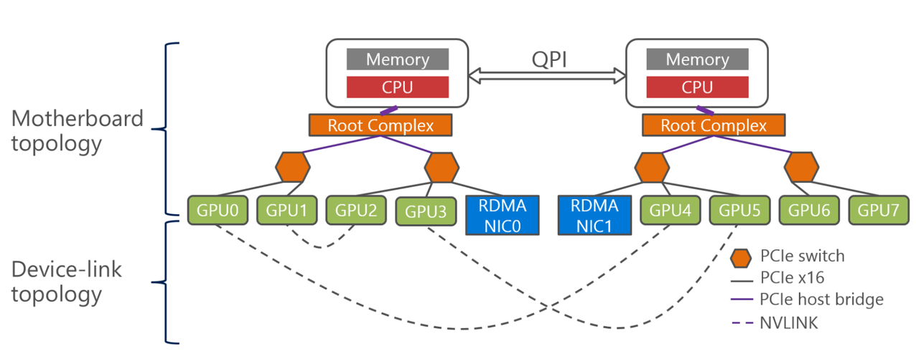
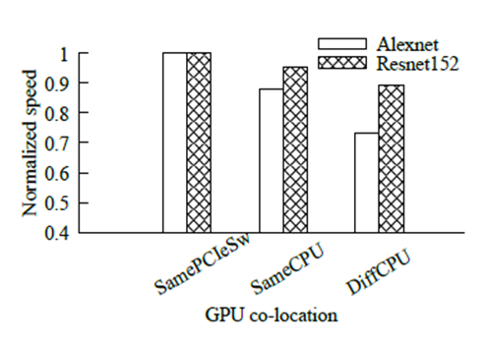
GPU Scheduling: Topology Awareness
High training speed and cluster GPU utilization
Training speed and GPU locality
  Selection Principle
  For a 2-GPU job,
Within the same PCI-E switch
>
Within the same root-complex
>
>
Within the same
Host machine
Within the same CPU core
better
better
better

Slide 23
GPU Scheduling: Topology Awareness
High training speed and cluster GPU utilization
Scheduling a 2-GPU job into a 32-GPU machine node like below: which 2 GPUs?
GPU_0
16
GPU_31
8
4
4
2
2
2
2
1
1
1
1
1
1
1
1
Far
√ Perfect
Reserved for 4-GPU job
Reserved for 8-GPU job
CostTable = {1, 2, 1, 4 ,1, 2, 1, 8, 1, 2, 1, 4, 1, 2, 1, 16, 1, 2, 1, 4, 1, 2, 1, 8, 1, 2, 1, 4, 1, 2, 1}
Cost(i, j) = MAX (CostTable[i…j-1]); Cost(1, 2) = MAX (CostTable[1…1]) = 2; Cost(4, 5) = MAX (CostTable[4…4]) = 1;
Cost(0, 3, 4, 5, 6, 12, 13, 14, 17, 19, 20, 23) < Cost(0, 3, 6, 8, 9, 12, 13, 14, 17, 19, 20, 23)
Selection Rule For 2-GPU Job
Step 1. Select two GPUs, which has minimum current cost
Step 2. If multi candidates in step 1, select the one with minimum future cost to avoid waste big hole

Slide 24
FrameworkLauncher Adoptions
  [Batch]: TensorFlow/ChaNa/FastDNN Training Pipeline (Bing Ads: Woodblocks)
Generation | Model Type | Algo | Framework | Language | Maximum Features Size
1 | LR | LBFGS | ScopeML | Scope | 200 millions
2 | LR | LBFGS | Spark | Jave, Scala | 1 billion
3 | LR | LBFGS | ChaNa | C++ | 3 billions
4 | LR | FTRL | ChaNa | C++ | 10 billions
 | DNN | FTRL | FastDNN | C++ | 10 billions
5 | LR & DNN | FTRL | Customized TensorFlow | C++, Python | 100+ billions
  [Serving]: Dynamic Rendering
  (Bing Web Data: VDOM and Semantic Layout v1)
    MT is their primary way for VDOM generation
    Output 3.5B VDOMs per day, with a peak at 4B/day
  Now 1/3 applications on MT use FL

Slide 25
Resources
  GitHub
  https://github.com/Microsoft/pai/tree/master/subprojects/frameworklauncher
  Contact
    PM: kailiu@microsoft.com

Slide 26

Thank You!

