Slide 1
How China’s search company Baidu adopt InnerSource
Jerry Tan
2019/7
Notes:
Hello，Everyone， welcome to this session, the topic is “How China’s search company Baidu adopt InnerSource”
Before the session, let me do a quick survey, have you heard of InnerSource, please raise your hand.

Slide 2
About Me：Jerry Tan
Senior Engineer of Baidu
Nearly 20 years Experience with OSS
Committer of Mozilla/Gnome/Apache Foundation
TodoGroup member
Notes:
Let me introduce myself a little bit:
My name is Tanzhongyi, you can call me Jerry.
I am a senior engineer of Baidu.Inc, I have nearly 20 years experience with Open Source Software.
And I am an committer of Mozilla.org/gnome.org/Apache foundation/OpenChain Projects.
and I am also an member of todogroup

Slide 3
What is InnerSource?
InnerSource is the use of Open Source Software development best practices and the establishment of an open source like culture within organization. (from Wikipedia)
In a short, InnerSource means open your codes inside your company, and accept the contributions from other departments.
Notes:
In about 2000, Mr Tim O'Reilly found one company to provide opensource consultant services for
organzitions. he called it as "gated open source", one customer is HP, who reduced their printer drivers software from over 100 to less than 10 with Tim's help

Slide 4
History of InnerSource
Tim O’Reilly
2000
Image are from facesofopensource.come
Notes:
In about 2000, Mr Tim O'Reilly founded one company to provide opensource consultant services for
big company. he called it as "gated open source", one customer was HP, who reduced their printer drivers software from over 100 to less than 10 with Tim's help

Slide 5
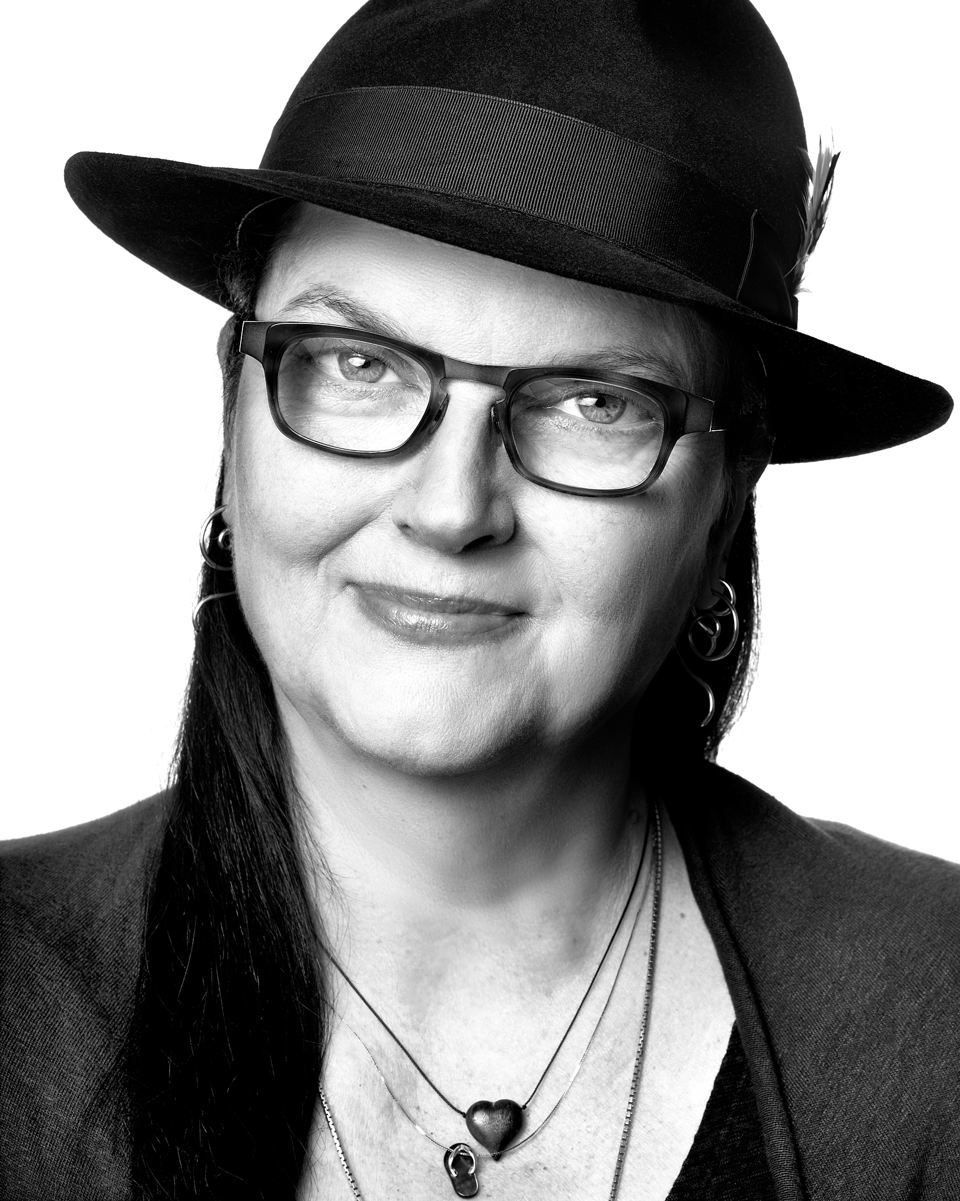
History of InnerSource
Danese Copper
2015 In PayPal
Image are from facesofopensource.come
Notes:
When she acted as the leader of opensource in Paypal, she drived both opensource and innersource within paypal

Slide 6
InnerSourceCommons
2015 InnerSourceCommons.org setup
OSCON InnerSource Day
InnerSource Summit

Slide 7
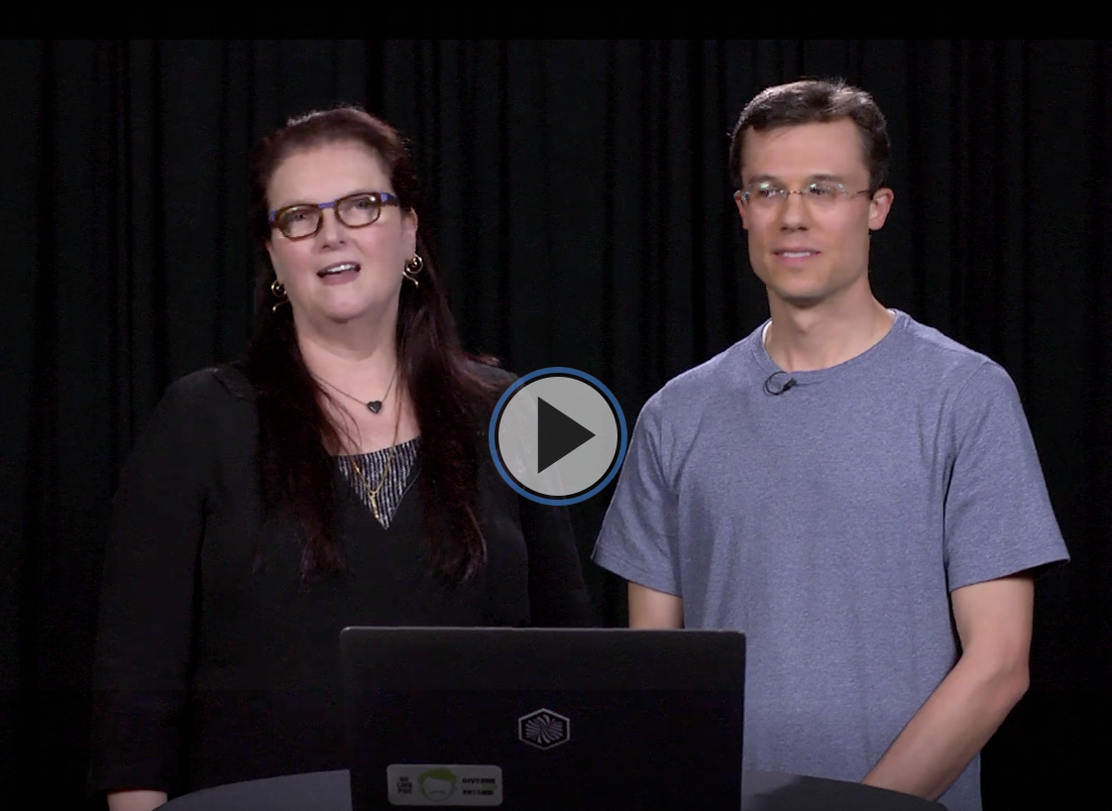
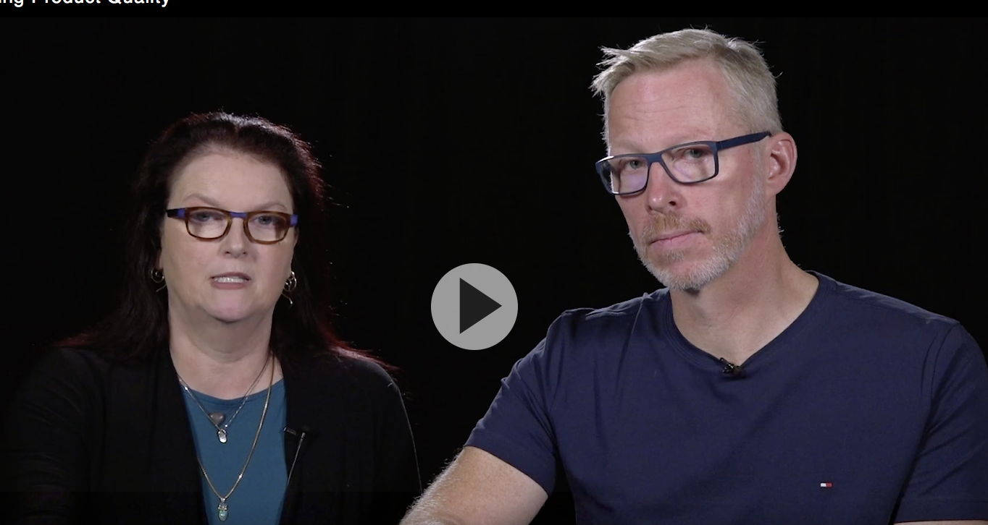
Learning Path (from innersourcecommons)
https://innersourcecommons.org/learningpath/
Introduction
Trusted Committer
Product Owner

Slide 8
Apache Way: Community over Code
Three important fundamentals:
Meritocracy
Transparency
Community

Slide 9
Why InnerSource？ Benefits of InnerSource
To Contributor：
Get features they want
Don’t need to maintain
To Projects：
More Resources
Better Products
Better relationship
To Company：
More collaboration
Improving employee

Slide 10
And more
Break Silos and Improve collaboration
Promote Software Reuse
Fasten Knowledge Sharing
Enable Innovation

Slide 11
But InnerSource is not easy
“not invented here”
Not willing to be a mentor or lacking the knowledge of how to be a mentor
The conflict with Middle management
Change the culture is always hard

Slide 12
InnerSource In China
It is still a new thing.
Several companies have adopted it already
X Company
Tencent
Baidu

Slide 13
X Company
60,000+ Engineers
2014 began InnerSource top-down
Origin: to make debug easier for projects intertwined with each other if their codes are open
Till Now 50% Projects got InnerSourced
Valuable Practices
Total Top down
Very strict code security process
Notes:
sorry it is not convenient to write down its name here, it is an very successful company.

Slide 14
Tencent
20,000+ Engineers
2012 began to adopt InnerSource bottom up
Origin: to promote engineer culture inside company
Till Now 34% projects get InnerSourced
Valuable Practices
Strong Operational activities(Code Culture Prize）
Incubator of open source ，InnerSource first then contribute to open source community

Slide 15
Baidu
The largest search company in China
More than 10,000 engineers
Has several open source projects
Apollo
PaddlePaddle

Slide 16
Apollo
Apollo project is an open autonomous driving platform
https://github.com/apolloauto/apollo
14.3K stars, No.1 in GitHub autonomous-driving category
More than 1000 cars run every day with apollo inside

Slide 17
PaddlePaddle
An open source PArallel Distributed Deep LEarning Platform
Just Like TensorFlow and Pytorch
https://github.com/paddlepaddle/paddle
Very popular in China
Heavy used inside baidu
search
Ad
Image/Video/NLP

Slide 18
The Journey of InnerSource in Baidu
2016 first pilot project
2017 first department
2018 company wide

Slide 19
Pilot Project：ODP
A php framework used widely inside Baidu
2016 began to adopt InnerSource
Origin : Limited Engineer Resource ，can not handle too many feature request
InnerSourced after one year
More than 200 engineers join the project
More than 100 patches

Slide 20
Some good practices
Organized Many Forums to attract developers
Set simple tasks for beginners
The leader is a community guy
The project is layer designed, easy to extend

Slide 21
First department：INF
Responsible for Baidu’s Infrastructure services including storage and computing
About 200 engineers
Got Support from Director, Managers, Developer Leaders
Origin :
Limited Engineer Resource ，Can not handle too many feature request
to build stronger connections with the inside customers

Slide 22
First department：INF （cont）
All products of INF are required to InnerSourced
Also With strict requirements for documentation
Readme
How to contribute
How to test
Results: Within one year
several projects received active contributions

Slide 23
Company Wide
COO promoted InnerSource several times to break down silos
CTO requested all platforms that serve for company wide should be InnerSourced
OSPO Request that all projects need to be InnerSourced first before Open sourced to external

Slide 24
Within one year
50% projects got InnerSourced
1.4% cross department contribution

Slide 25
But InnerSource is a long journey
When scale to company wide,
It became much harder.
We need more manager, more tech leader to support ,and more active contributors

Slide 26
Here is some my thoughts
Top Down vs Bottom Up
Well Begun is half done
Open source culture is the key
Tools is also important

Slide 27
Top Down vs Bottom up
Only Top Down Does not work well
Only Bottom Up Does not work well
Top Down and Bottom Up should be combined together

Slide 28
Well begun is half done
Pilot project must be selected very carefully.
Project Type
Project Tech Leader

Slide 29
Open Source Culture is crucial
Building an active Internal Engineer Community is very important, especially for Chinese companies.
Open Source evangelism for engineers & managers
Policy & process to Incentive Contributions
Continue success and Role models

Slide 30
Tools is also important
Support open and secret mode
Support code-review & merge
Support CI/CD
Support issue & doc

Slide 31
The biggest difference of China
China’s opensource history is not long
Need More patience
Need more evangelism

Slide 32
InnerSource Guidelines
No simple recipe

Slide 33
InnerSource Framework
Air Cover
Policy
Process
Tools
Step1: Pilot
Step2: One BU/BG
Step3: The whole
Groud Support

Slide 34
Any Questions？

