Slide 1
How I failed to build a runbook automation system
And what I learned
Tim Bonci, 2019-06-13
tim at bonci dot net
Notes:
Thank the audience and the organizers

Slide 2
Agenda
Quest
1
Adversary – runbooks
2
Battle
3
Denouement
4
Epilogue and questions
5

Slide 3
The who, what, why, and how
The call to … adventure?
There I was: a relatable, family-friendly, and generic engineer, toiling away in the IT mines.

Slide 4
The who, what, why, and how
The call to … adventure?
There I was: a relatable, family-friendly, and generic engineer, toiling away in the IT mines.
The work to be done was “Sustaining Engineering and Support”

Slide 5
The who, what, why, and how
The call to … adventure?
Dev
SES
Marketing

Slide 6
The who, what, why, and how
The call to … adventure?
CARE
Dev
SES
Marketing

Slide 7
The who, what, why, and how
The call to … adventure?
CARE
Dev
SES
Marketing
Incident Management

Slide 8
So many chores on this web farm
Yes, I switched metaphors

Slide 9
So many chores on this web farm
Yes, I switched metaphors
So many chores

Slide 10
Reduce this toil, they said
See the full stack, they said

Slide 11
Reduce this toil, they said
You try drawing a sword and shield in PowerPoint Freeform
Expertise
Automation

Slide 12
Agenda
Quest
1
Adversary – runbooks
2
Battle
3
Denouement
4
Epilogue and questions
5

Slide 13
My mental model of alerting
Turns out, it’s not that complicated
Data Alert Runbook
Measurements Thresholds Actions
& context & Targets or Procedure

Slide 14
The runbook
Don’t panic, but it appears you are experiencing a problem.
The Forward Aperture Reverse Timing System is responsible for optimizing the size of the…
Things you can try:
Check the database to make sure the foos are all barred.
Log onto prdflxcapctr001 and restart the mr_fusion service.
If all the badness is coming from a single IP, geolocate it and call in a tactical air strike.
If that doesn’t work, look for exceptions in the logs here.

Slide 15
Agenda
Quest
1
Adversary – runbooks
2
Battle
3
Denouement
4
Epilogue and questions
5

Slide 16
Create a system to orchestrate these actions
DevOps!
Most of the actions were either
Get more information
Interact with a system

Slide 17
Create a system to orchestrate these actions
DevOps!
Kicked off a project
Hired an intern
Started a thorough review of our alerts, runbooks, and alert handling procedures

Slide 18
The audit
Here there be dragons
Inaccurate runbooks
Incomplete steps
Inconsistent use
Bad alerts
Ignored alerts
Notes:
Bad alerts – false positives

Slide 19
Defeat
No engineers were harmed in the making of this project

Slide 20
Agenda
Quest
1
Adversary – runbooks
2
Battle
3
Denouement
4
Epilogue and questions
5

Slide 21
What went wrong
All is made clear
Keeping accurate runbooks up-to-date is hard

Slide 22
The runbook
Don’t panic, but it appears you are experiencing a problem.
The Forward Aperture Reverse Timing System is responsible for optimizing the size of the…
Things you can try:
Check the database to make sure the foos are all barred.
Log onto prdflxcapctr001 and restart the mr_fusion service.
If all the badness is coming from a single IP, geolocate it and call in a tactical air strike.
If that doesn’t work, look for exceptions in the logs here.

Slide 23
Bad iterations
Don’t panic, but it appears you are experiencing a problem.
(last updated 3 years ago by [Err: user not found])
The Forward Aperture Reverse Timing System is responsible for optimizing the size of the…
Things you can try:
Check the database to make sure the foos are all barred.
Log onto prdflxcapctr001 and restart the mr_fusion service.
If all the badness is coming from a single IP, geolocate it and call in a tactical air strike.
If that doesn’t work, look for exceptions in the logs here.

Slide 24
“Good” iterations
Don’t Sometimes* panic, but it appears you are experiencing a problem.
The Forward Aperture Reverse Timing System is responsible for optimizing the size of the…
Architectural diagram here.
Things you can try:
Check the database (db183) to make sure the foos are all barred.
Select * from kng.foo where bar = ‘none’
Log onto prdflxcapctr0013 and restart the mr_fusion service.
If all the badness is coming from a single IP, geolocate it and call in a wet work team.
If that doesn’t work, look for exceptions in the logs here.
* If no foos are barred for 61 minutes, the fiddleheads rise up and attempt to fubar the windows and eat all the apples

Slide 25
What went wrong
All is made clear
Keeping accurate runbooks up-to-date is hard
Alert fatigue

Slide 26
What went wrong
All is made clear
Keeping accurate runbooks up-to-date is hard
Alert fatigue
Asking computers to do the things we ask humans to do based on what a computer does is bad praxis.
Notes:
I was going to automate a bad process. Instead of reducing toil, I was going to create it.

Slide 27
Agenda
Quest
1
Adversary – runbooks
2
Battle
3
Denouement
4
Epilogue and questions
5

Slide 28
Computers vs Humans
The right tool for the job

Slide 29
Computers vs Humans
The right tool for the job
Computers
Automatically provide more information

Slide 30
Computers vs Humans
The right tool for the job
Computers
Automatically provide more information
Infrastructure changes

Slide 31
Computers vs Humans
The right tool for the job
Computers
Automatically provide more information
Infrastructure changes
Make trivial decisions

Slide 32
Computers vs Humans
The right tool for the job
Computers
Automatically provide more information
Infrastructure changes
Make trivial decisions
Humans
Make complex decisions
Notes:
Complex decision: do nothing, roll back, use degraded failover, manually adjust infrastructure

Slide 33
Computers vs Humans
The right tool for the job
Computers
Automatically provide more information
Infrastructure changes
Make trivial decisions
Humans
Make complex decisions
Pattern matching

Slide 34
Computers vs Humans
The right tool for the job
Computers
Automatically provide more information
Infrastructure changes
Make trivial decisions
Humans
Make complex decisions
Pattern matching
Correlation and deduction

Slide 35
Takeaways
If you’re going to take a photo of any slide, it should be this one
Do not use alerts to tell a human to do something a computer can do better
Move these triggers and responses as far left as possible
Use alerts to catch
Novel failures
SLO breaches
Humans should spend our time
Correlating events
Making complex decisions
Alerts (and runbooks) as code

Slide 36
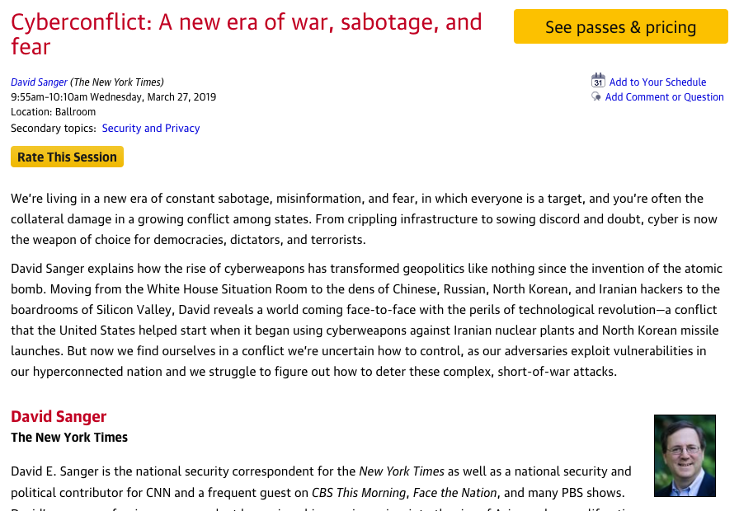
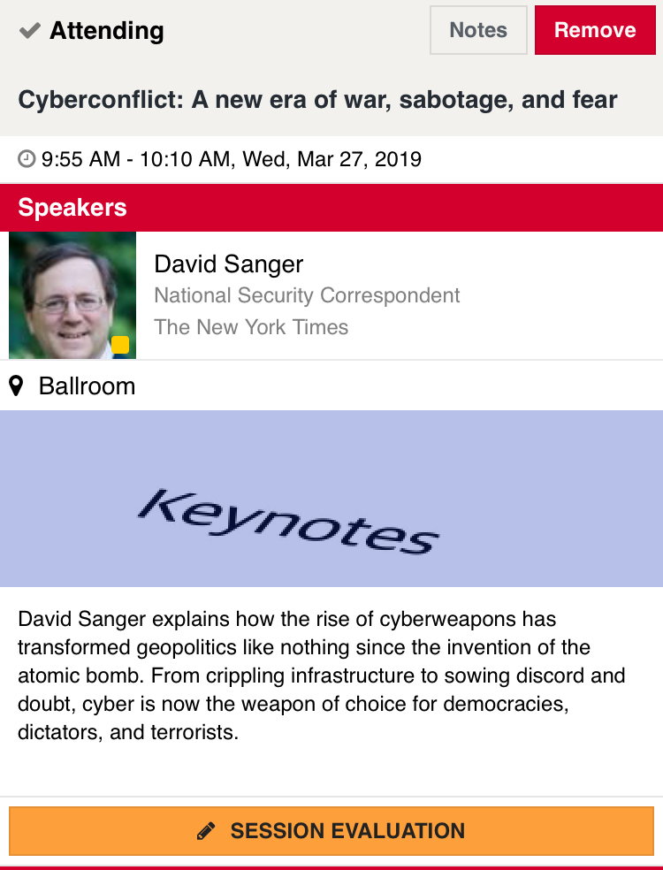
Rate today ’s session
Session page on conference website
O’Reilly Events App

