Slide 1
Executive briefing: what you must know to build ai systems that understand natural language
Dr. David Talby

Slide 2
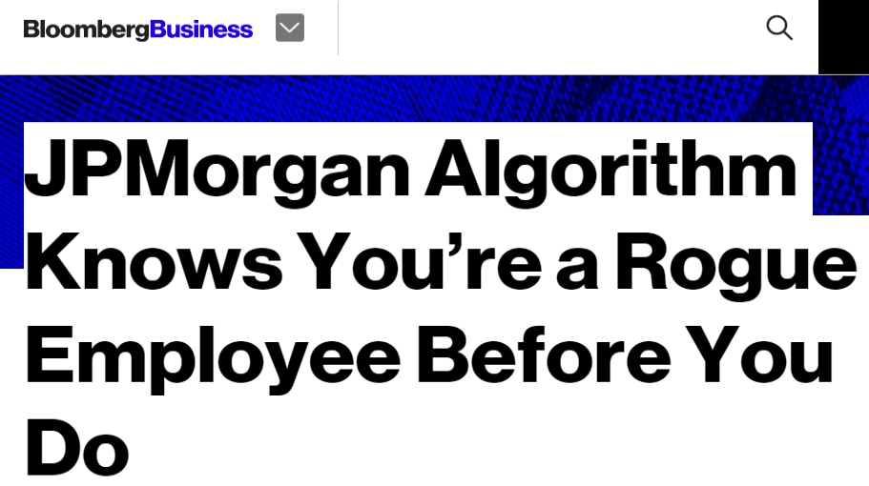
Radiology
Mental Health
Diagnostic
Safety Events
Pre-Auth
Inpatient
Know-ledge Graphs
Meta Analysis
Research
Clinical Coding
Anti-Fraud
Adverse Events
Recruit for Trials
Financial
Drug Development
Notes:
NLP use cases are rising – just like image use cases are – and becoming mainstream across many industries.

Slide 3
Looks easy?
Natural Language Understanding is an AI-Complete problem.
Notes:
However, it’s important to know that can still only deliver accurate results on very specific tasks.

Slide 4
Therefore…
Today we can only match or exceed human performance for very specific tasks.
This talk is about lessons learned from building systems that do.
Notes:
Set the goal of this talk.

Slide 5
1.
We all speak many languages.

Slide 6
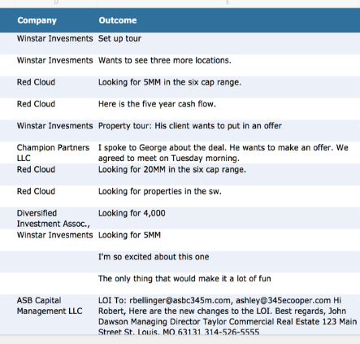
SALES (CRM) LANGUAGE
Features
Budget Authority Need Timeframe
Likelihood of a sale? Time to a sale? Need executive intervention?
Notes:
There is not one “language” – every vertical and communication channel has its own jargon that includes vocabulary, grammar, assumptions and semantics.
For example – in these ED triage notes, none of the sentences is in valid English, and the words “patient” and “pain” do not appear.

Slide 7
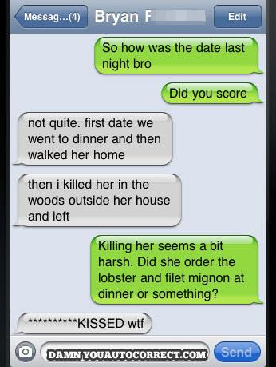
SMS LANGUAGE
Features
Who did What? When and Where? How do they feel about it?
Meaning split across many snippets
Most Snippets aren’t grammatically correct
Slang, profanity & inside jokes
Emojis for sentiment analysis
Auto-Correct Issues
Also a challenge with OCR & ASR
Notes:
There is not one “language” – every vertical and communication channel has its own jargon that includes vocabulary, grammar, assumptions and semantics.
For example – in these ED triage notes, none of the sentences is in valid English, and the words “patient” and “pain” do not appear.

Slide 8
ACADEMIC LANGUAGE
Features
Summarize Main Result Theory or Experiment? Benchmark Used | Double Blind? Sample Size? All Results Published?
Title: Keyword Heavy, common word plays
Authors, affiliations & contact details
Abstract: Best Summary of Work & Results
Introduction, related work, experiment, …
Professional language, correct grammar
Notes:
There is not one “language” – every vertical and communication channel has its own jargon that includes vocabulary, grammar, assumptions and semantics.
For example – in these ED triage notes, none of the sentences is in valid English, and the words “patient” and “pain” do not appear.

Slide 9
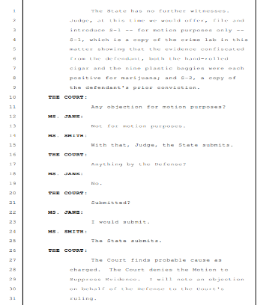
LEGAL TRANSCRIPTIONS LANGUAGE
Features
Kind of hearing Kind of motion Who filed it | Evidence presented Witnesses presented Decision
Verbatim conversation
Procedural step-by-step process
Jargon is specific to kind of procedure
Dashes indicate pauses or talkovers
Notes:
There is not one “language” – every vertical and communication channel has its own jargon that includes vocabulary, grammar, assumptions and semantics.
For example – in these ED triage notes, none of the sentences is in valid English, and the words “patient” and “pain” do not appear.

Slide 10
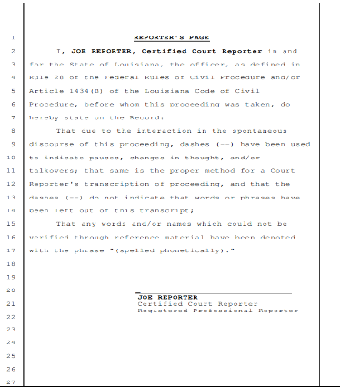
LEGAL LANGUAGE
Plus a lot of boilerplate text
This also applies to financial documents See: SEC Filings Tutorial by the National Center for Business Journalism
Notes:
There is not one “language” – every vertical and communication channel has its own jargon that includes vocabulary, grammar, assumptions and semantics.
For example – in these ED triage notes, none of the sentences is in valid English, and the words “patient” and “pain” do not appear.

Slide 11
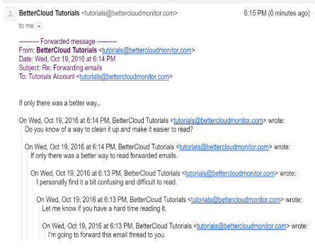
EMAIL LANGUAGE
Features
Schedule Meeting Assign a Task Approve or Deny a Request
Structured from, to, date, subject fields
Reply & Forward text in emails
Conversation: Timeline is important
Grammar of written language (not spoken)
Spam, promotions and calls to action
Notes:
There is not one “language” – every vertical and communication channel has its own jargon that includes vocabulary, grammar, assumptions and semantics.
For example – in these ED triage notes, none of the sentences is in valid English, and the words “patient” and “pain” do not appear.

Slide 12
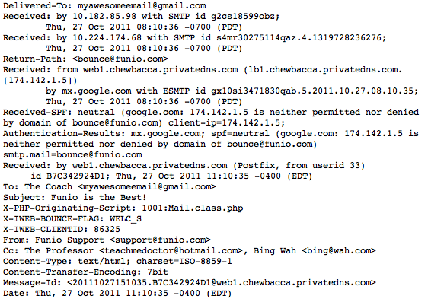
EMAIL LANGUAGE
That’s the string you actually get as input
Notes:
There is not one “language” – every vertical and communication channel has its own jargon that includes vocabulary, grammar, assumptions and semantics.
For example – in these ED triage notes, none of the sentences is in valid English, and the words “patient” and “pain” do not appear.

Slide 13
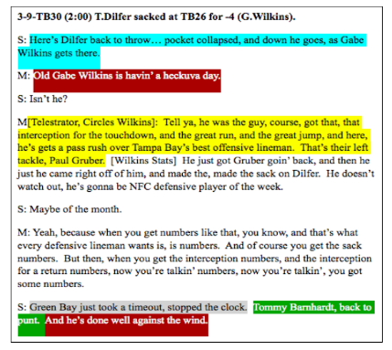
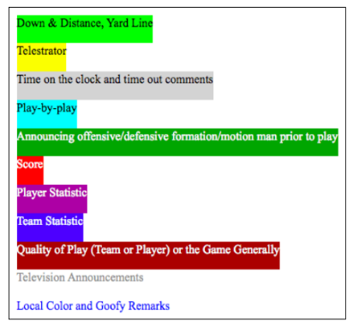
SPORTS (NFL) LANGUAGE
Notes:
There is not one “language” – every vertical and communication channel has its own jargon that includes vocabulary, grammar, assumptions and semantics.
For example – in these ED triage notes, none of the sentences is in valid English, and the words “patient” and “pain” do not appear.

Slide 14
Different Vocabulary
Tokenizer Normalizer
Lemmatizer Fact Extraction
Part of Speech Tagger Spell Checker
Coreference Resolution Dependency Parser
Sentence Splitting Negation Detection
Different Grammar
Different Context
Named Entity Recognition Sentiment Analysis
Intent Classification Summarization
Word Embeddings Emotion Detection
Different Meaning
Question Answering Relevance Ranking
Best Next Action Translation
Different Language Models

Slide 15
2.
Get a domain expert, a data scientist, and a lot of data.

Slide 16
Why can’t I reuse an off-the-shelf nlp model?
Because it won’t work for you.
Try it!
Google Cloud Natural Language | IBM Watson NLU
Azure Text Analytics | spaCy Named Entity Visualizer
Amazon Comprehend (offline) | Stanford Core NLP
Notes:
Most of the popular NLP providers have pre-trained models and make online demos available. That’s often a good ‘Pepsi Test’ but often fails for real use cases.

Slide 17
Example 1: EMERGENCY ROOM LANGUAGE
Triage Notes
states started last night, upper abd, took alka seltzer approx 0500, no relief. nausea no vomiting
Since yeatreday 10/10 "constant Tylenol 1 hr ago. +nausea. diaphoretic. Mid abd radiates to back
Generalized abd radiating to lower x 3 days accompanied by dark stools. Now with bloody stool this am. Denies dizzy, sob, fatigue.
Features
Type of Pain Intensity of Pain Body part of region | Symptoms Onset of symptoms Attempted home remedy
Of the 6 engines from the previous slide, the only medical term that only 2 of them recognized was Tylenol as a product.
Notes:
Explain the use case, and the results on the 6 public NLP engines. Explain that the problem is not with the engines – which are among the best we have – but the assumption that pre-trained models can work for domain-specific use cases.

Slide 18
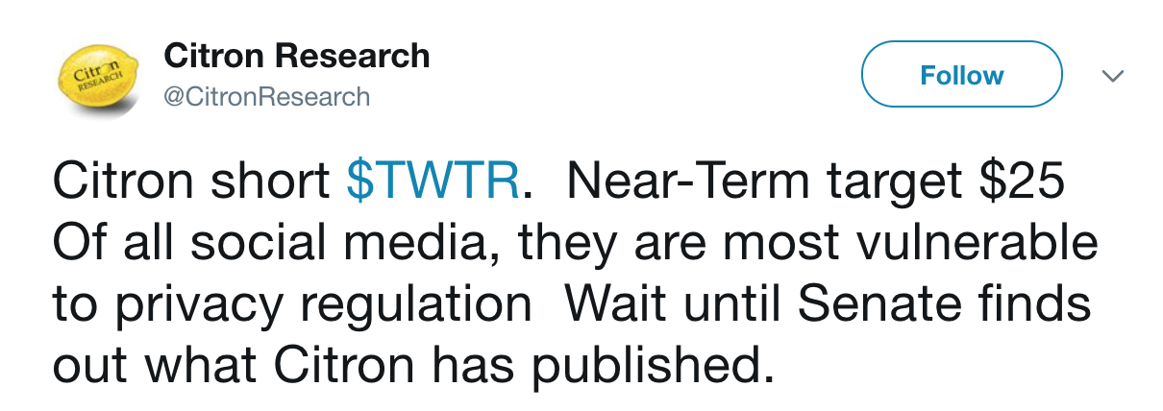
Example 2: Sentiment analysis
News surveillance for traders
Can you trade quickly based on sentiment of breaking news?
Started with Watson Sentiment Analyzer & got zero lift
… because sentiment analysis models are based on emotions
Instead of reputation & change
Notes:
This is an example where even if we don’t need a highly accurate model, often an off-the-shelf model would just provide no lift. One needs to understand the language being analyzed and how the model was trained to know if and what would work. This is similar for any machine learning problem, but is often missed for NLP problems.

Slide 19
So, train your own domain-specific models
Next, pair your NLP data scientist with a domain expert who is a master of the language the model will understand.
How good is this review, from 1 to 5?
If you come for the ambiance, you’ll be disappointed. But if you go for good, inexpensive and authentic Mexican food, then you’re in the right place.
Notes:
Having strong annotators & labelers with real domain expertise is critical. If there’s a team of them, they need to agree on the exact definitions (like 1 to 5 review rankings).

Slide 20
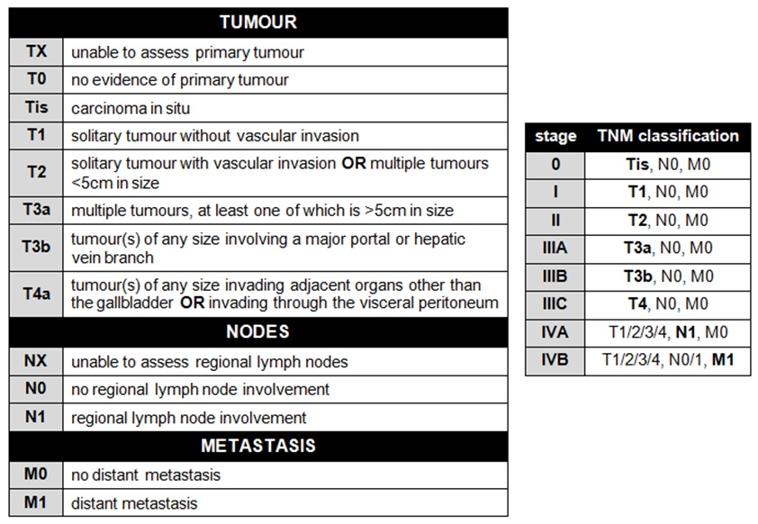
Example 3: understanding pathology reports
Data scientist + Medical doctor + Half of the project
Labeling requires clinical knowledge:
Size
cm or mm?
(x,y,z) axes
Only label size for primary tumor
Location
Primary vs. secondary tumors
Which tumor was first?
Distance between tumor & resection margin
specific per cancer, i.e. left/right lung,
left/right upper/middle/lower lobe
Grading & staging
Specific to the type of cancer
depends of the staging for tumor (T), lymph nodes (N) and if there’s metastasis (M). When T or N or M cannot be assessed it is used Tx or Nx or Mx
Notes:
An example of a project where agreeing on the correct annotations required half the time & effort of the entire project.

Slide 21
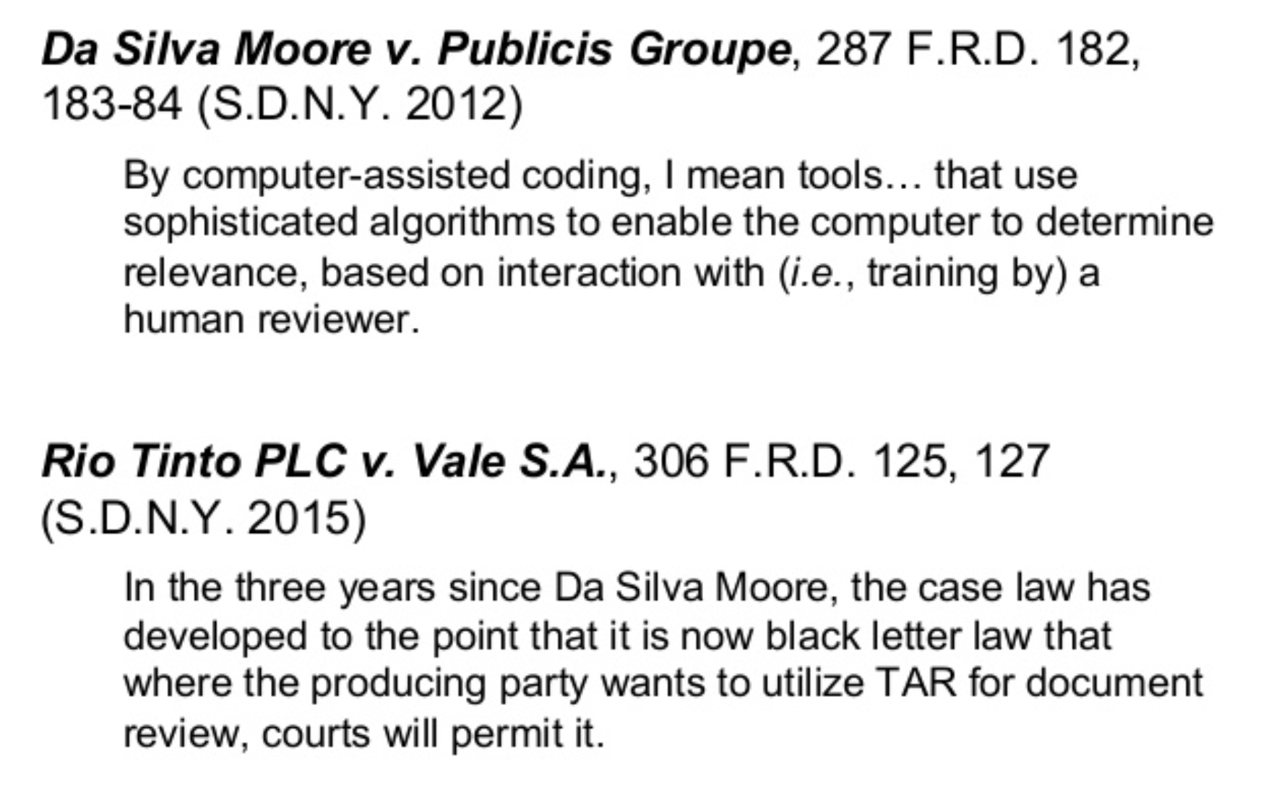
Example 4: E-discovery
Notes:
These are two of the key precedents for using software for e-discovery. It highlights the fact that these are not technical questions but critical domain-specific product questions. Experts must go through many examples and argue the right thing to do, before AI models can be built.

Slide 22
How much labeled data do I need?
1. Get representative data | 2. Get consistent labels | 3. Get pretrained datasets & embeddings
“Inception v3 was trained on 1.28 million images” | “In the study, the algorithm went head-to-head against 21 board-certified dermatologists” | Facebook open sourced pre-trained word vectors for 294 languages, trained on Wikipedia using fastText
“used over 120,000 retinal images to train a neural network to detect diabetic retinopathy” | “All images were graded by 3 to 7 different ophthalmologists, from a panel of 54 US-licensed senior residents & ophthalmologists” | UMLS has over 1 million biomedical concepts and 5 million concept names, from over 100 controlled vocabularies
Notes:
High-quality, fresh, and comprehensive labeling is often where a lot of IP is built.

Slide 23
3.
It’s not a “structured data” or “unstructured data” problem.
Use both.

Slide 24
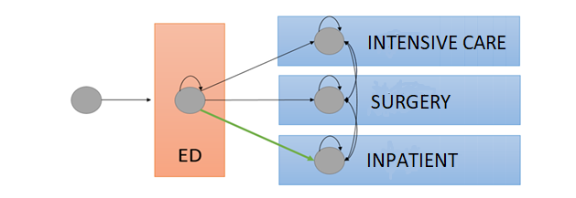
Example 1: hospital demand forecasting
Features from Structured Data
How many patients will be admitted today?
Data Source: EPIC Clarity data
Reason for visit Age Gender Vital signs | Current wait time Number of orders Admit in past 30 days Type of insurance

Slide 25
Adding signals from clinical notes
Features from Natural Language Text
A majority of the rich relevant content lies in unstructured notes that are contributed by doctors and nurses from patient interactions.
Data Source: Emergency Department Triage notes and other ED notes
Type of Pain Intensity of Pain Body part of region | Symptoms Onset of symptoms Attempted home remedy
ML with NLP
ML with structured data
Accuracy Baseline: Human manual prediction

Slide 26
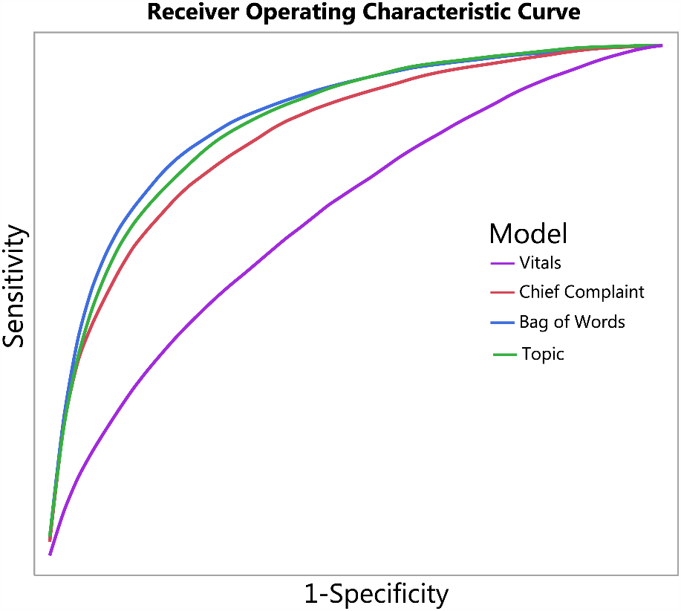
Example 2: detecting sepsis
“Compared to previous work that only used structured data such as vital signs and demographic information, utilizing free text drastically improves the discriminatory ability (increase in AUC from 0.67 to 0.86) of identifying infection.”

Slide 27
best practice: unify your nlp and ml pipeline
pipeline = pyspark.ml.Pipeline(stages=[ document_assembler, tokenizer, stemmer, normalizer, stopword_remover, tf, idf, lda])
topic_model = pipeline.fit(df)
Spark NLP annotators
Spark ML featurizers
Spark ML LDA implementation
Single execution plan for the given data frame
Notes:
NLP algorithms are usually used to generate features for an ML pipeline - so for better experimentation, performance and reproducibility you should aim to unify them into one pipeline.

Slide 28
What’s a good first nlp project?
Start with an existing model based on structured data
That human domain experts usually solve with free text data
Notes:
Look for business critical use cases, where it’s obvious to domain experts that many relevant signals are in free text (examples: medical records, CRM notes, court transcripts).

Slide 29
what expectations should I set?
State of the art deep learning and reinforcement learning NLP models generally match or beat human experts.
However, that’s often not that accurate.
Notes:
Look for business critical use cases, where it’s obvious to domain experts that many relevant signals are in free text (examples: medical records, CRM notes, court transcripts).

Slide 30
Summary
We all speak many languages.
Get real domain experts, real data scientists and a lot of domain-specific data.
Use both structured & unstructured data.
david@pacific.ai
@davidtalby
in/davidtalby

