Slide 1
Applied Machine Learning For Quant Finance
Strata Data Conference
March 27, 2019
Chakri Cherukuri
Senior Researcher
Quantitative Financial Research Group

Slide 2
Outline
ML use cases in finance
Case studies promoting reproducible research
Jupyter notebooks
Interactive plots
Conclusion

Slide 3
Quantitative Finance
 | Sell Side | Buy Side
Institutions | Banks (Goldman, JPM, etc.) | Hedge funds, asset managers
Tasks | Market Making Derivatives pricing/risk management | Asset Allocation Portfolio Management
Mathematical tools | Stochastic Calculus, Monte Carlo, PDEs | Multi variate stats, regression models, convex optimization

Slide 4
ML In Finance: Structured Datasets
Tasks | Machine Learning Techniques
Time series prediction | LSTM
Illiquid asset pricing | Boosted Trees/Random Forests
Trading Strategies | Boosted Trees/Random Forests
Dimensionality Reduction | PCA/Autoencoder
Exotic option pricing | Neural Nets

Slide 5
ML In Finance: Unstructured Datasets
Tasks | Deep Learning Techniques
Object detection from satellite images | Conv nets
Summarization of news articles | RNN, attention based models
News/Twitter sentiment | NLP models (Word embeddings + Nets)
Named Entity Recognition | LSTM

Slide 6
ML In Finance: Challenges
 | Structured data sets | Unstructured/Alt data sets
Obtaining labeled datasets | Cheap | Expensive
Labeled dataset QA | Minimal | High
Predictive power | Low/Moderate | Moderate/High

Slide 7
Yield Curve Dimensionality Reduction

Slide 8
Yield Curve Primer
Bonds have a fixed maturity (1M, 3M, 10Y) and pay coupons
Examples of bonds – treasury bonds, corporates, munis, etc.
Yield Curve: Plot of bond yields against maturities
Adjacent points on the yield curve move together (correlated)

Slide 9
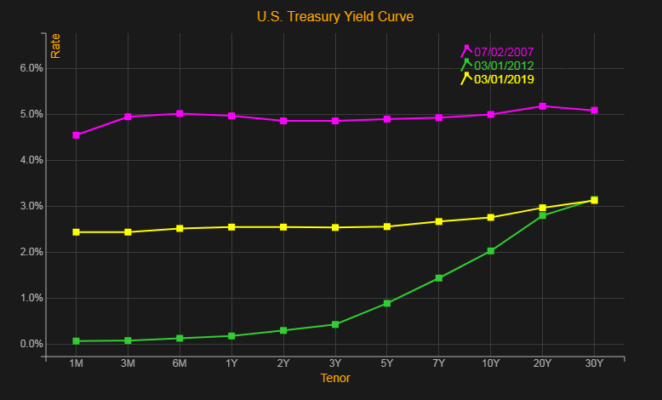
U.S. Treasury Yield Curve
11 tenors/maturities
Different shapes
Pre-crisis
Post-crisis
Current

Slide 10
Yield Curve Dynamics
Yield for each tenor (point on the yield curve) changes every day
Problem:
How to model the changes in the yield curve driven by 11 correlated variables?
Any parsimonious representation possible?

Slide 11
Principal Component Analysis (PCA)
PCA can be used to:
Reduce dimensionality
Retain as much variance in the dataset as possible
PCA Factors: Linear combinations of features
Typically 3-5 PCA factors enough to explain almost all the variance

Slide 12
PCA Over Different Time Periods
PCA factors vary with time periods
“Interval Selector” can be used to:
Quickly select different time periods
Perform statistical analysis on the selected time interval

Slide 13
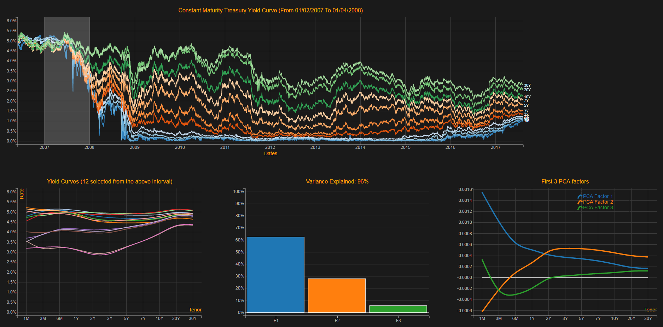
Yield curve PCA: Crisis

Slide 14
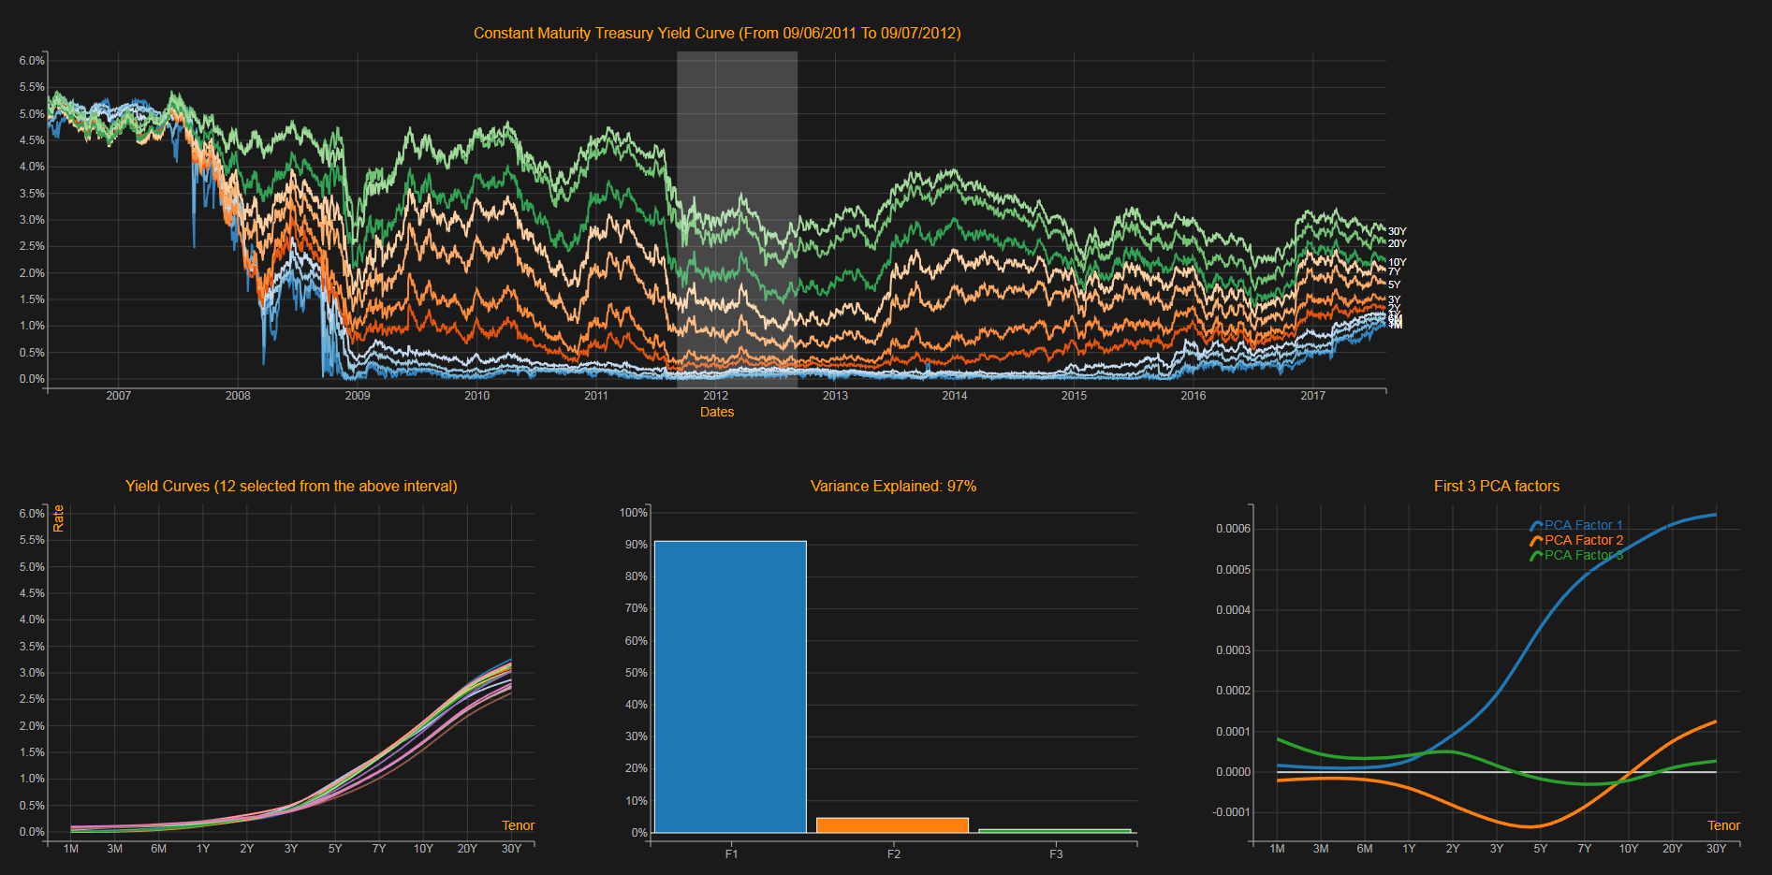
Yield curve PCA: After Crisis

Slide 15
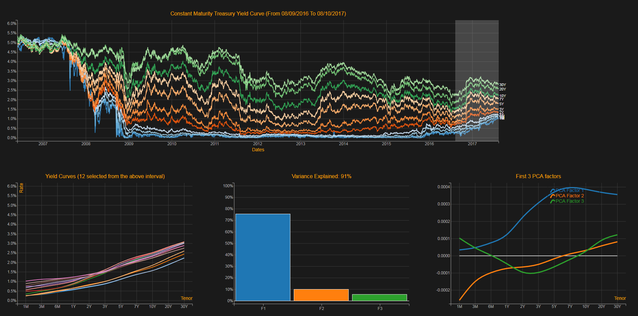
Yield curve PCA: Current

Slide 16
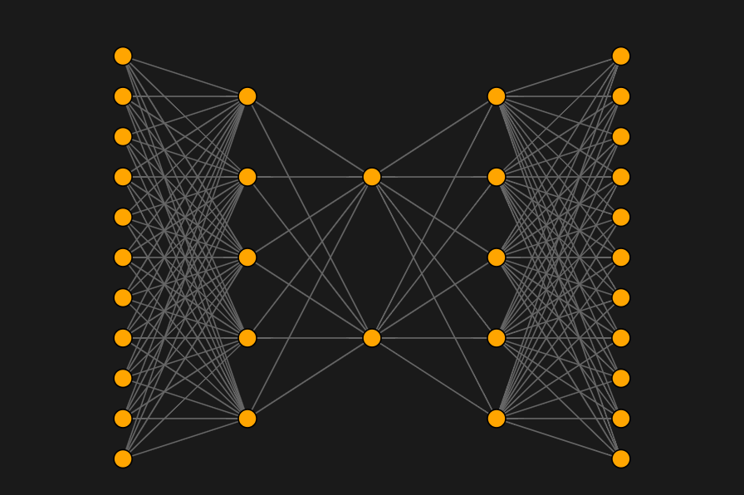
Dimensionality Reduction: Autoencoder
relu
relu
linear
Compressed feature vector

Slide 17
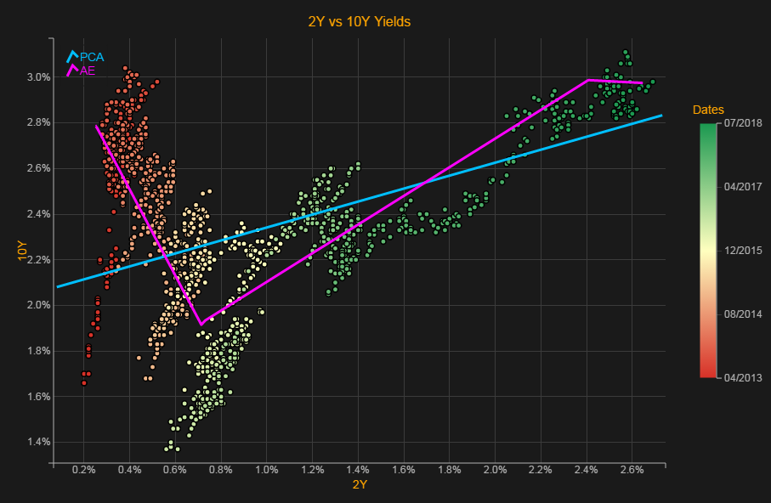
PCA vs. Autoencoder

Slide 18
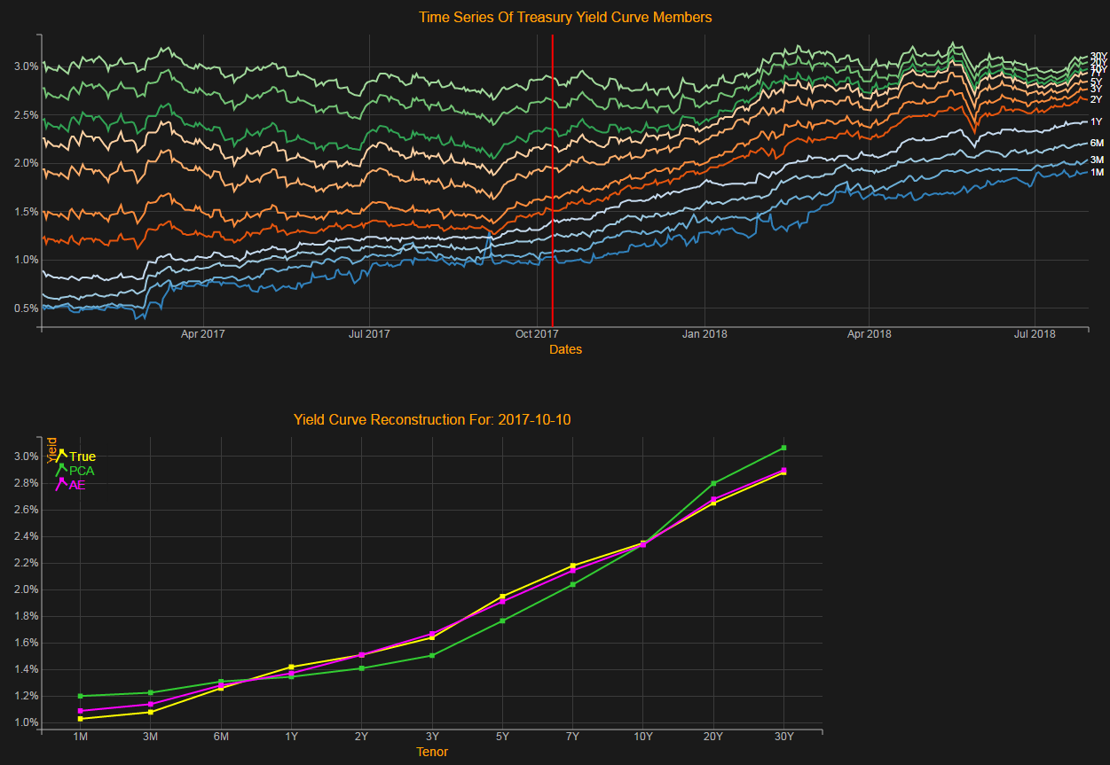
Dimension Reduction: AE vs. PCA

Slide 19
Twitter Sentiment Analysis

Slide 20
News/Twitter Sentiment
News & social sentiment from raw news stories or tweets
Unstructured
Highly time-sensitive
Story-level sentiment
Company-level sentiment
Sentiment score can be used as a trading signal
Buy stocks with positive sentiment
Short stocks with negative sentiment

Slide 21
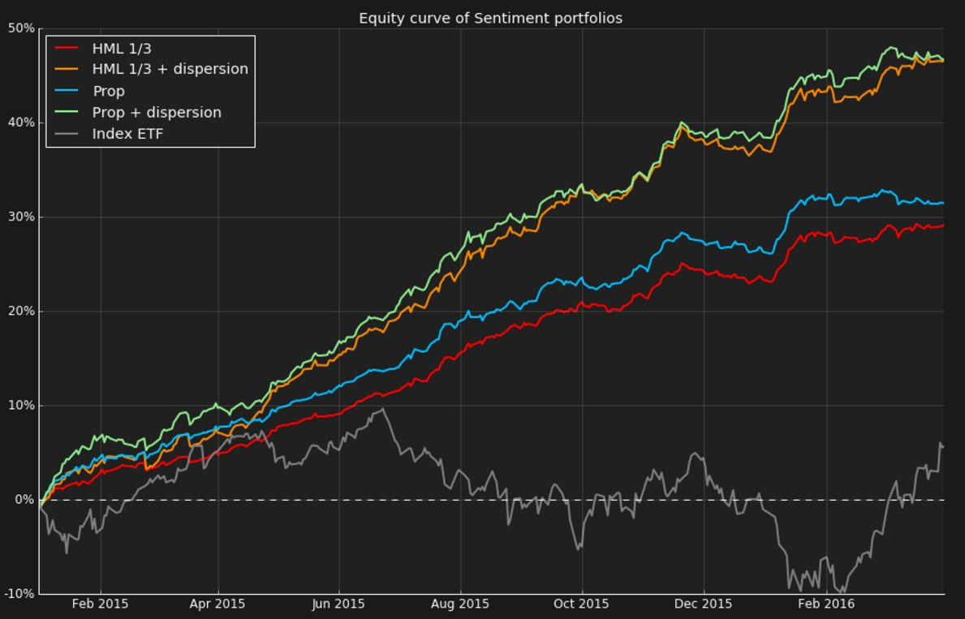
Russell 2000 Stocks

Slide 22
Twitter Sentiment Classification
Task: Predict the sentiment (negative, neutral, positive) of a tweet for a company
Ex: “$CTIC Rated strong buy by three WS analysts. Increased target from $5 to $8.” = Positive
Three way classification problem
Input: raw tweets
Output: sentiment label $∑${negative, neutral, positive}

Slide 23
Methodology
We are given labeled training and test data sets
Train classifier on training data set
Predict labels on test data and evaluate performance

Slide 24
One vs. Rest Logistic Regression
Features: Bag of words (uni/bi grams) + custom features
Train three binary classifiers for each label
Model 1: Negative vs. Not Negative
Model 2: Positive vs. Not Positive
Model 3: Neutral vs. Not Neutral
Get probabilities (measures of confidence) for each label
Output the label associated with the highest probability

Slide 25
Classifier Performance Analysis
Look at misclassifications
Confusion Matrix
Understand model predicted probabilities
Triangle visualization
Fix data issues

Slide 26
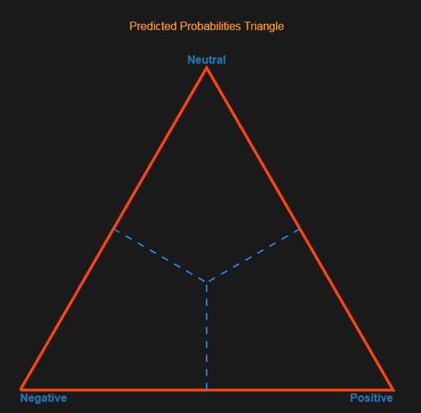
Triangle Visualization
Model returns 3 probabilities (which sum to 1)
How can we visualize these 3 numbers?
Points inside an equilateral triangle
Negative / Neutral
Not sure
Very positive

Slide 27
Performance Analysis Dashboard
Use the dashboard to:
Analyze misclassifications (using confusion matrix)
Improve model by adding more features (by looking at model coefficients)
Fix data issues (using triangle and lasso)

Slide 28
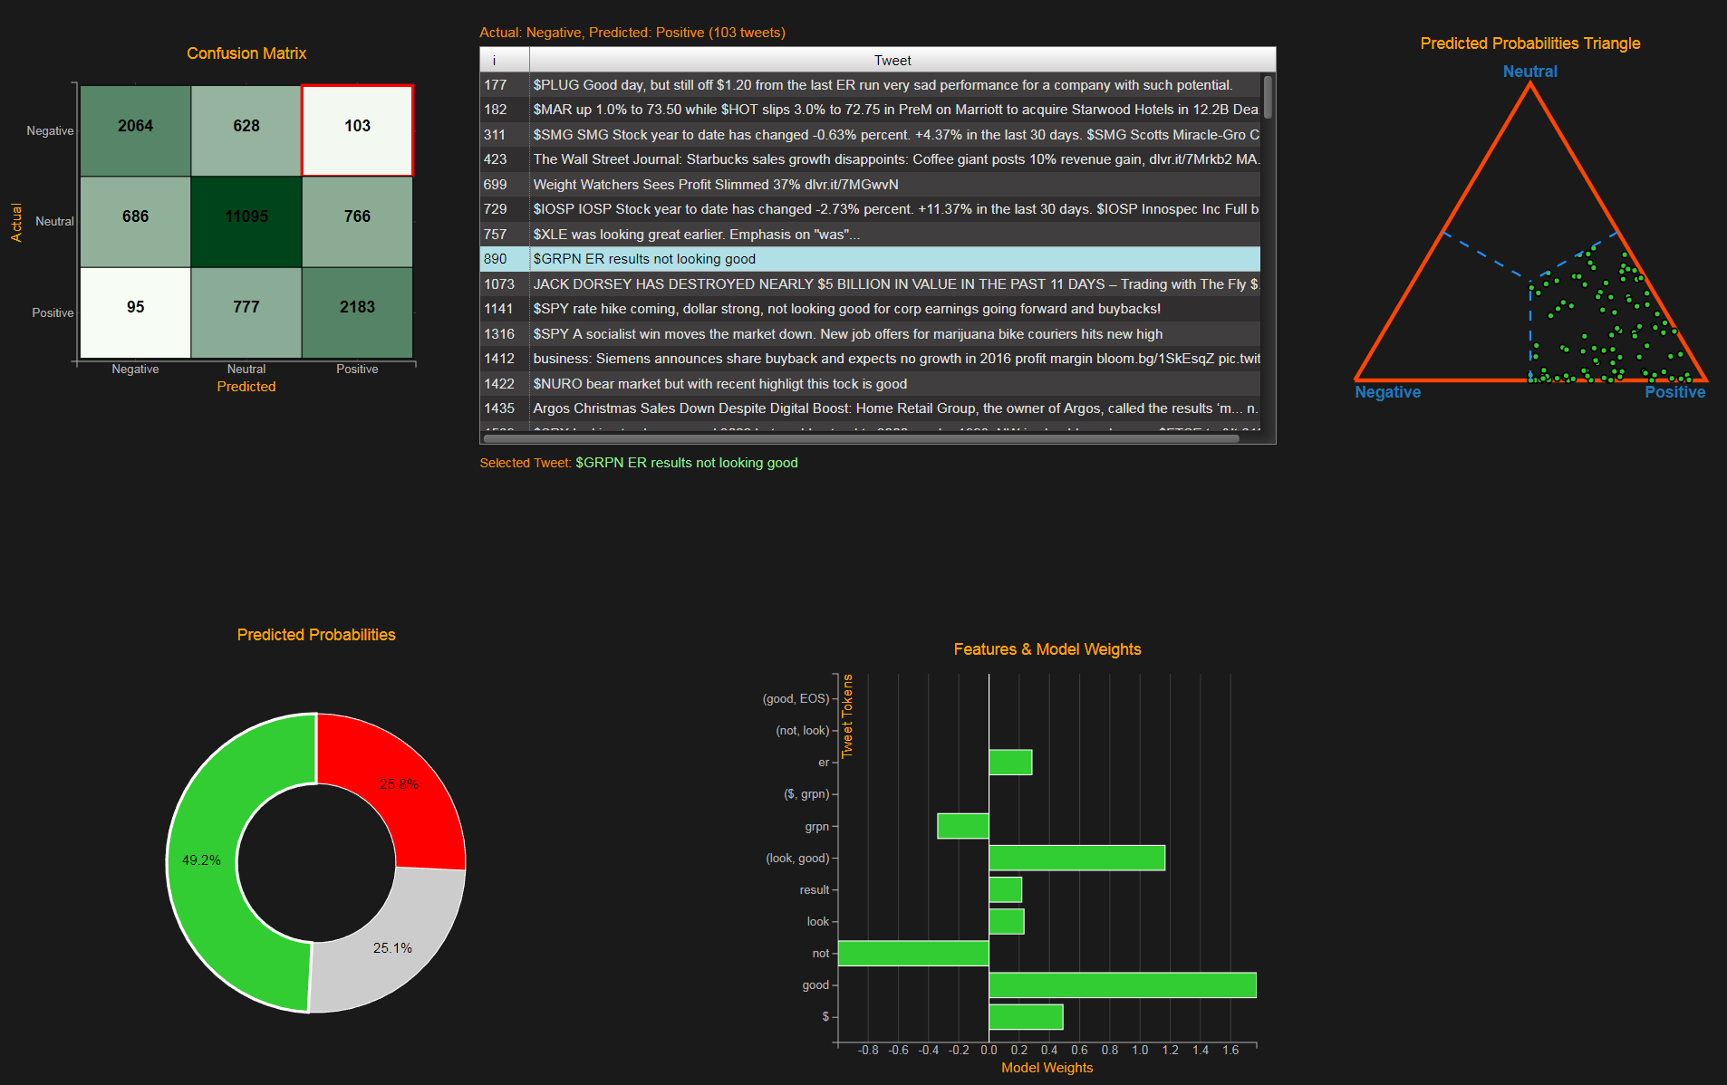
Analyze Misclassifications

Slide 29
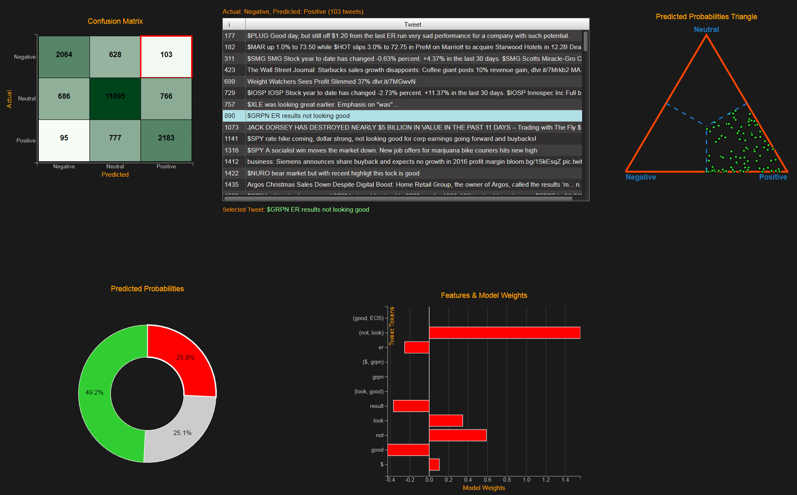
Analyze Misclassifications

Slide 30
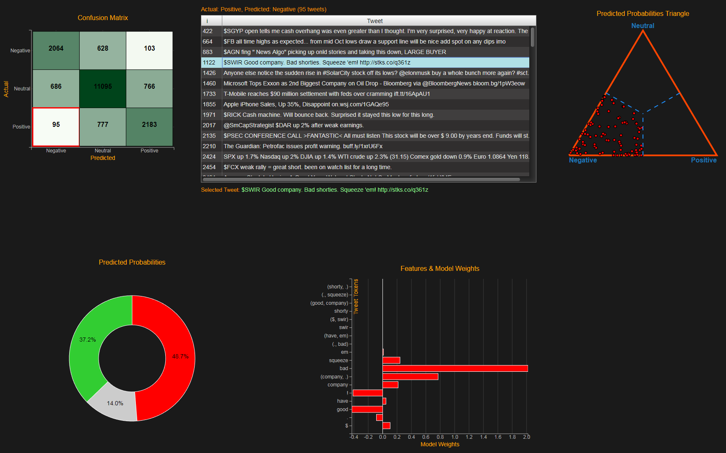
Analyze Misclassifications

Slide 31
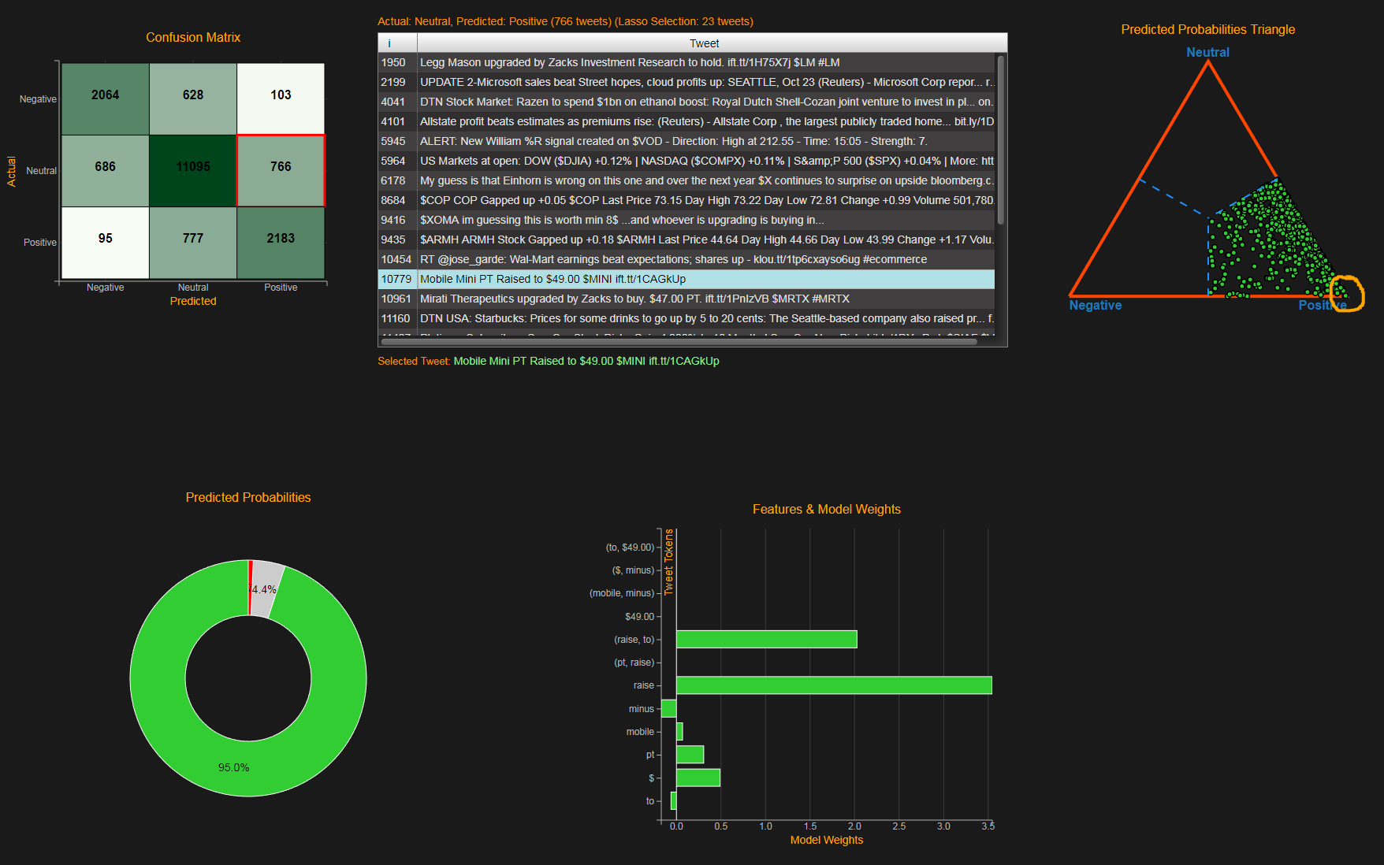
Use Lasso To Find Data Issues

Slide 32
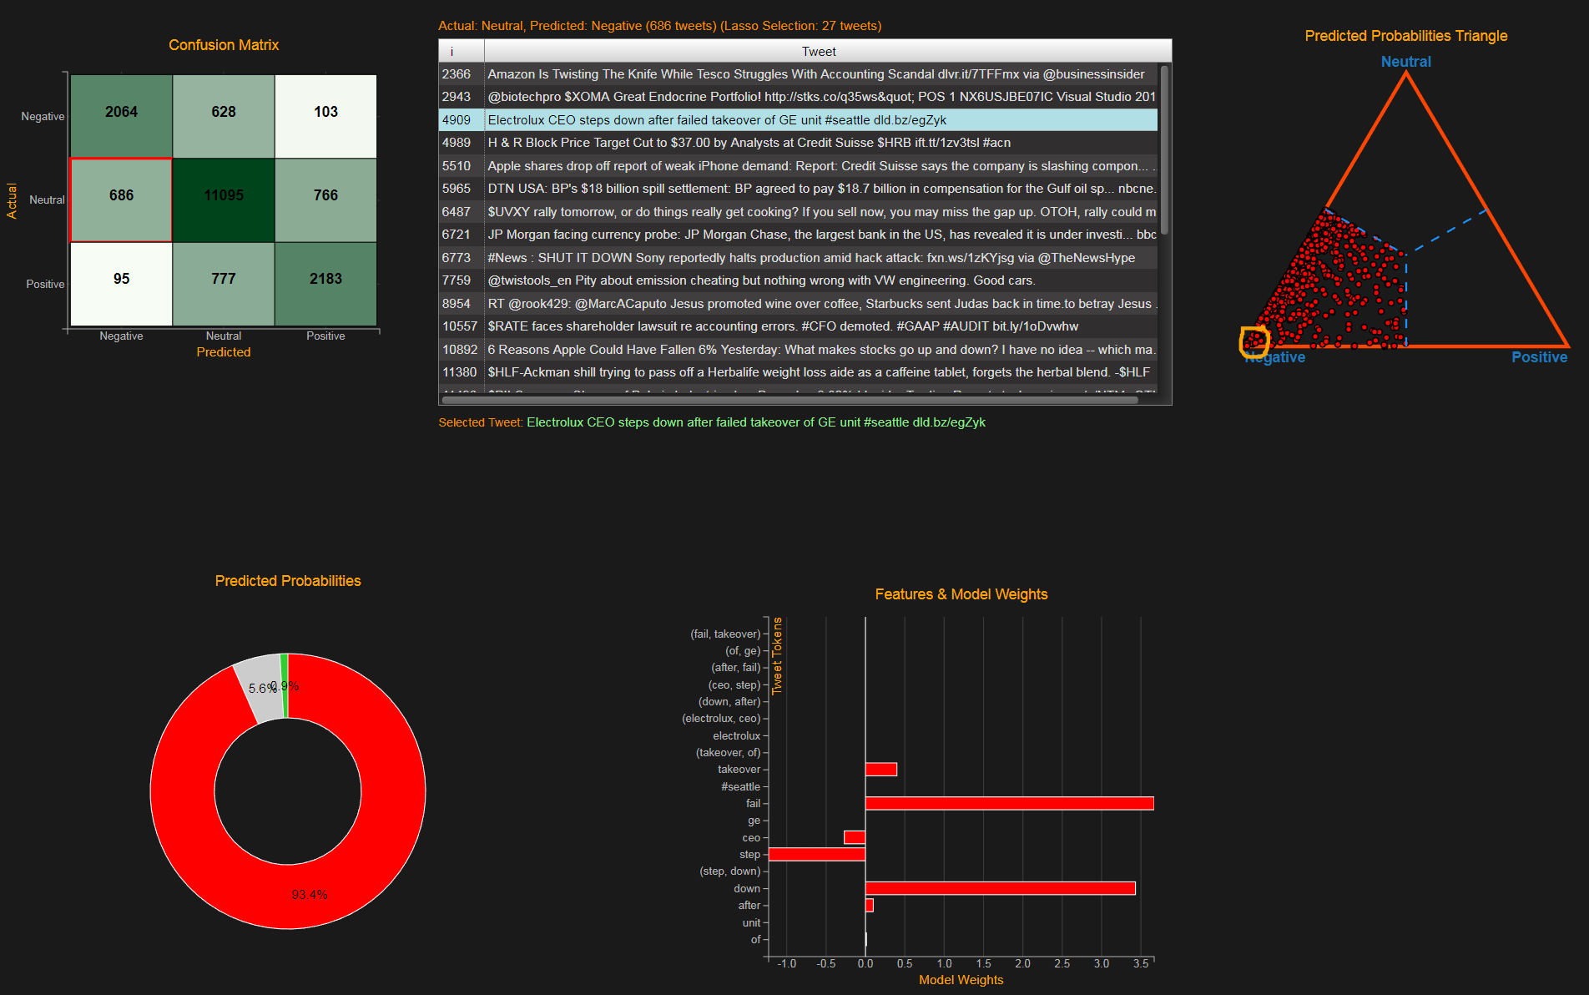
Use Lasso To Find Data Issues

Slide 33
Conclusion
Abundance of financial data
Abundance of already existing quant models
ML techniques can supplement existing models
Deep learning techniques useful for ‘alternative’ datasets
Interactive plots/diagnostic tools promote reproducible research

