Slide 1
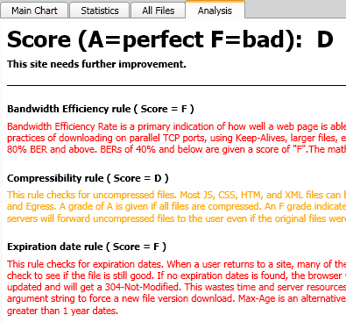
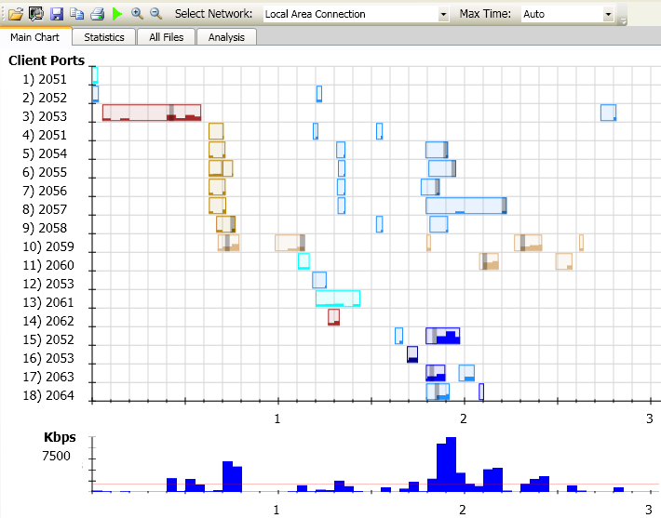
Jim Pierson Microsoft Principal Performance Test Engineer JimPier@microsoft.com
Visual Round Trip Analyzer (VRTA)
Velocity 2009
Performance Tools
Free download.microsoft.com

Slide 2
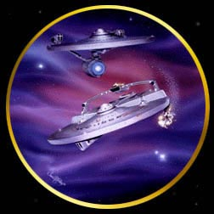
Tool Philosophy
Wrath of Kahn
“His pattern indicates 2 dimensional thinking”
Don't get stuck in the 20th century!

Slide 3
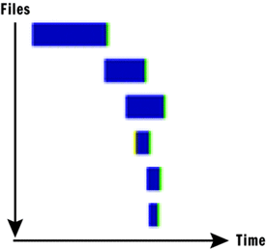
The Waterfall view
2D thinking
Misses the importance of
TCP connection Round-Trip
TCP slow-start ramping

Slide 4
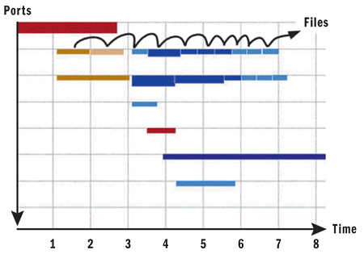
multi-dimensional
Each row is a TCP port
Show reuse of ports
Colors per file
Red html, Gold CSS, Tan JS, Blues images
VRTA2

Slide 5
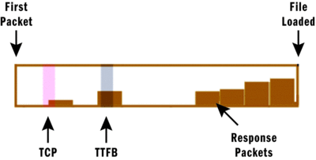
View inside each File
VRTA3 – free download
Red bar = TCP connect, round-trip time
Grey bar = Time To First Byte
Stairs = Bytes downloaded per 100ms

Slide 6
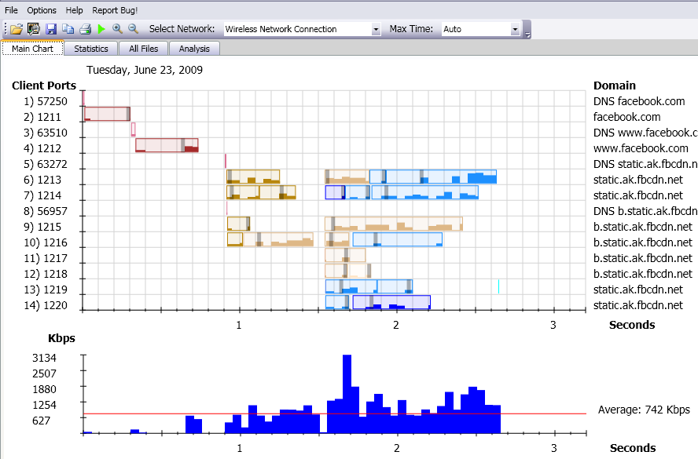
Visual Round Trip Analyzer (VRTA)
Browser independent
Starts/Stops NetMon
Results are based upon NetMon analysis

Slide 7
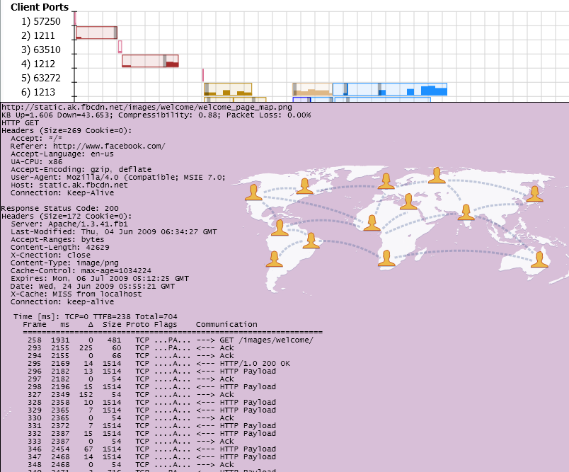
Hover over
Summary:
Request:
Response: images
Packet timing

Slide 8
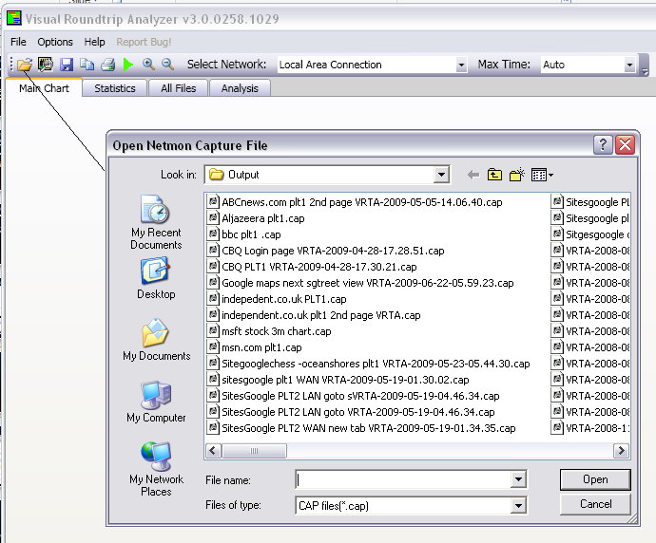
Saving files
Saves cap files automatically
Use folder icon to Open and rename files

Slide 9
Some of the common patterns seen
Slow Server TTFB
Ramped up TCP
XP, IE7, single domain
Default 2 TCP ports
WAN = 125ms RTT, 1 Mbps

Slide 10
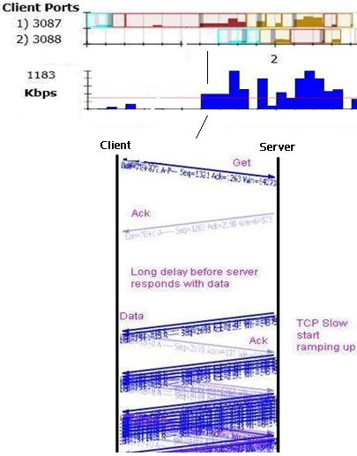
Slow server
Ack from Server/TCP
Long delay from server
TCP Ramping used by subsequent files on same port.

Slide 11
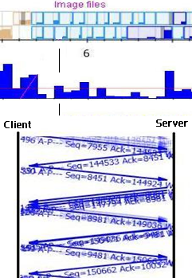
Low bandwidth usage on small files
Most time taken traversing the network round-trip
Low bandwidth usage
Small files should be clustered

Slide 12
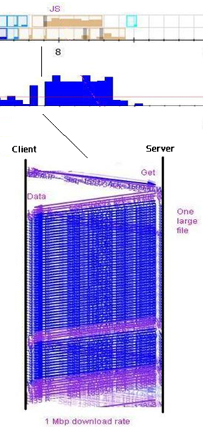
Large files load faster
TCP ramps up on previous files
Server sends at max window size for client (usually 32KB)

Slide 13
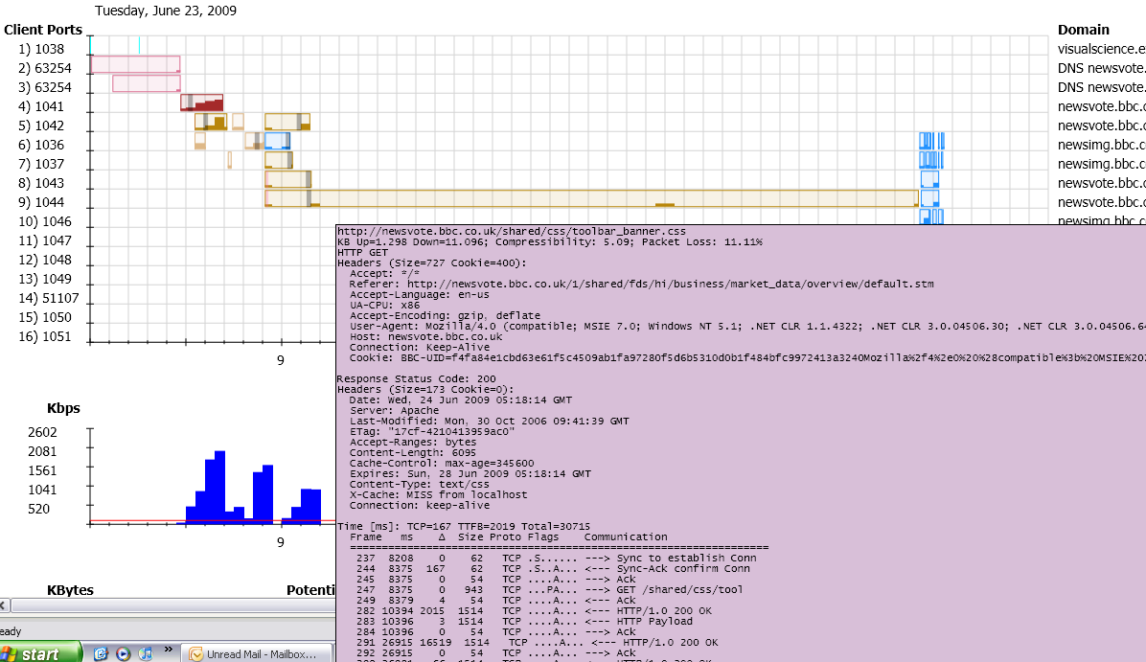
BBC.com example

Slide 14
All files summary
Each file rolled up with statistics
Also has hover over feature, including images of the files

Slide 15
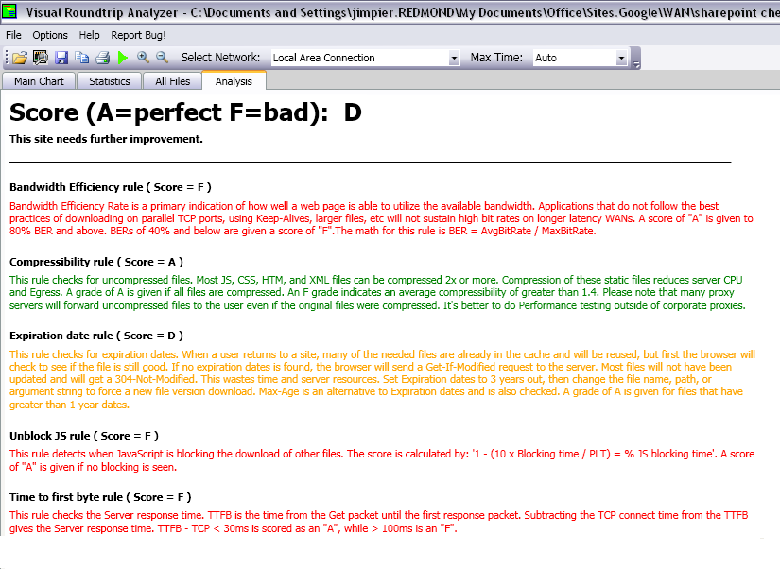
Best Practices Analysis
15 rules today
Bandwidth Efficiency
Compressibility
Expiration
Blocking JS
Slow TTFB
…more

Slide 16
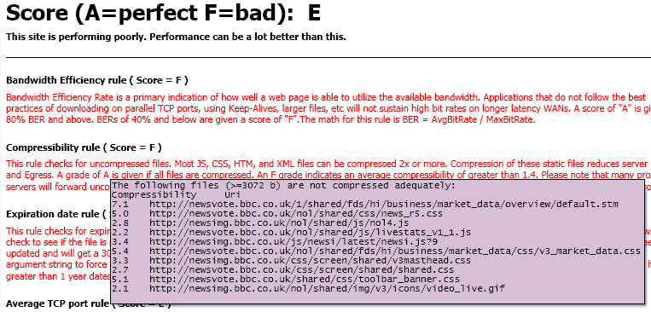
Exceptions
Lists each file breaking BP rule
Text output file

Slide 17
Coming this summer
More rules,
Most of Steve’s list
Some he didn’t mention ;-)
Command line Integration into BVT automation
Scan across many URLs
Catch Dev errors before checking in code.

Slide 18
Resources
http://download.microsoft.com
http://msdn.com
This slide deck is posted on the Velocity site
Jim Pierson, Jimpier@microsoft.com
Thank You
Notes:
<Insert your notes here>
Tips for resources
Name the resource and explain how and why it is useful.
Potential resources include: aliases, articles, books, contacts, online courses, Web sites, and white papers.
Include Web site URLs so that attendees can access resources from printed version of slides.
Example:
Microsoft Manual of Style for Technical Publications (MSTP): The Microsoft corporate style guide http://mstp/
MSTP online course: An introduction to using the MSTP http://mylearning/CourseDetails.aspx?COURSENO=COUR2006070612343804010100
Microsoft Editors Discussion and Information alias (stet): A forum of over 550 content publishers around the company

