Slide 1
www.aol.com
Migrating a Flagship Product from a Proprietary Web Platform to Open Source
Mandi Walls
Velocity 2009

Slide 2
Agenda
Evolution of a flagship site
The old platform: “AOL Dynamic Platform”
The new platform: “Dynapub”
Growing pains
Knowledge migration

Slide 3
Evolution of www.aol.com
You might have seen it before.
AOL’s main home page
Links to various internal and partner sites
Runs Netscape, Latino, Mexico portals, as well as partner co-brands
Also the in-client “Welcome Screen” with a slightly different look and feel
It’s the same page, 55M times a day!
Notes:
Few products reflect the direction of a company the way AOL.com has been changed to reflect the evolution of AOL’s core business. Early examples of www.aol.com available in the Internet Archive are examples of how the site was used to attract customers to AOL’s ISP business. For a number of years, the portal was also “AOL Anywhere”, a companion to the client-based ISP system. In the past several years it has been refocused as a web portal and the push to advertise the ISP products has all but completely disappeared from the main site.

Slide 4
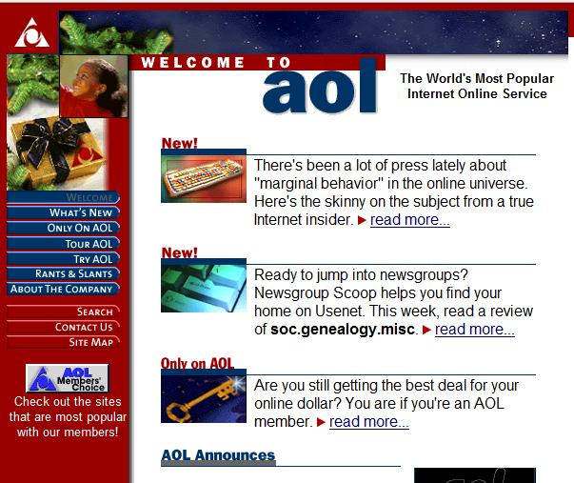
AOL.com - 1996
Notes:
Courtesy of the Wayback Machine, aol.com in 1996. Focused on selling the original access products, getting people interested in AOL’s walled garden experience. The portal went through several years of being “AOL Anywhere”, secondary to the AOL client experience and dialup connectivity.

Slide 5
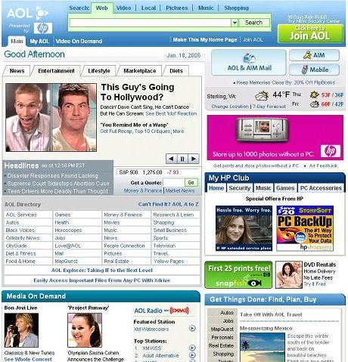
AOL.com 2.0 - 2005
Notes:
The first release on ADP, July 2005. Migrated from another internally developed publishing platform, Shark, with AOLserver frontends. Introduction of the Video Portal. This version almost ended up on another proprietary platform based on a “web” server that didn’t implement most of HTTP. Frontends on Linux, and eventually the middleware was migrated as well.

Slide 6
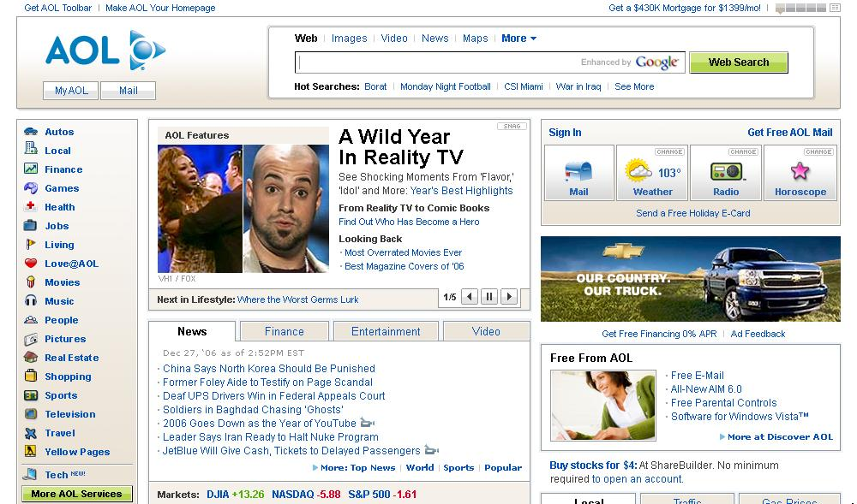
AOL.com 3.0 - 2007
Notes:
The design of the site for the last version to run on ADP, Welcome Screen version. The version famous for looking like Yahoo! at that time. The second major release on the ADP platform, there’s no banner or large invitation on the site to download the AOL dial client, but links to AOL software are still above the fold. Much of the page is configurable to the publishers. Content is a mix of programming and ingested feeds. Still some deadended components in the infrastructure – pieces that no one knows how to work on anymore, though nearly all components now run on Linux.

Slide 7
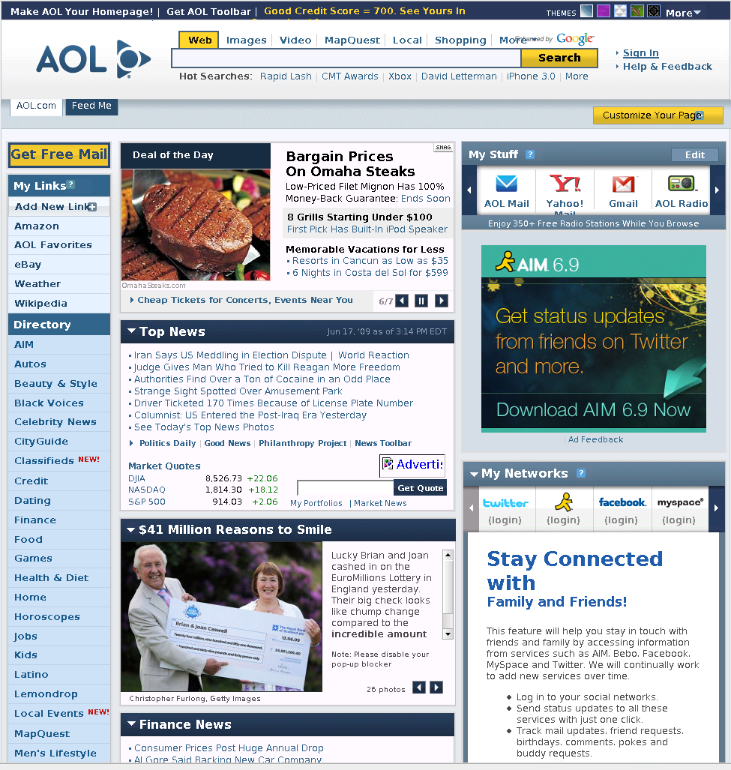
AOL.com 4.0 – 2008
AOL gets to Web 2.0
Notes:
The redesign that came along with the migration. Totally devoted to a web experience, includes various non-AOL web partners, runs real media ads. 100% of the page can change through publishing. The only mention of the AOL Client is at the bottom of the page, under “Services”. The whole environment is based on standard Open Source components and runs on Linux.

Slide 8
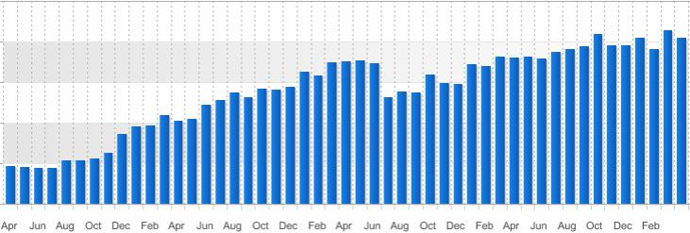
Monthly Pageviews – From April 2005
Notes:
A growth in pageviews during the same era. In addition to contending with the limitations of the platforms, we were working on how to accommodate the hits.

Slide 9
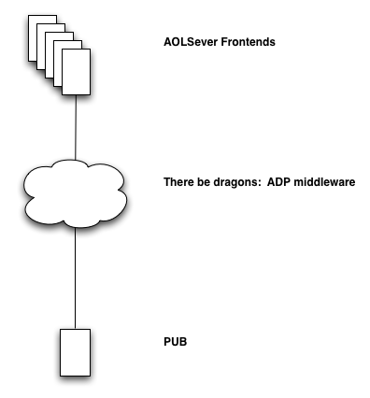
The Old Platform - ADP
The AOL Dynamic Platform
Notes:
Single origin for published data, including much of the objects coming from feeds and partners. The middleware includes index and search, small objects publishing stores, art and static objects, click tracking for metrics and reporting, mail spools for “send to a friend” functionality, databases for music, movies, news. The AOLserver frontends are broken up into farms that serve specific products – AOL.com, the AOL Channels, News, Feeds for Travel and Syndication, Moviefone, Video, etc.

Slide 10
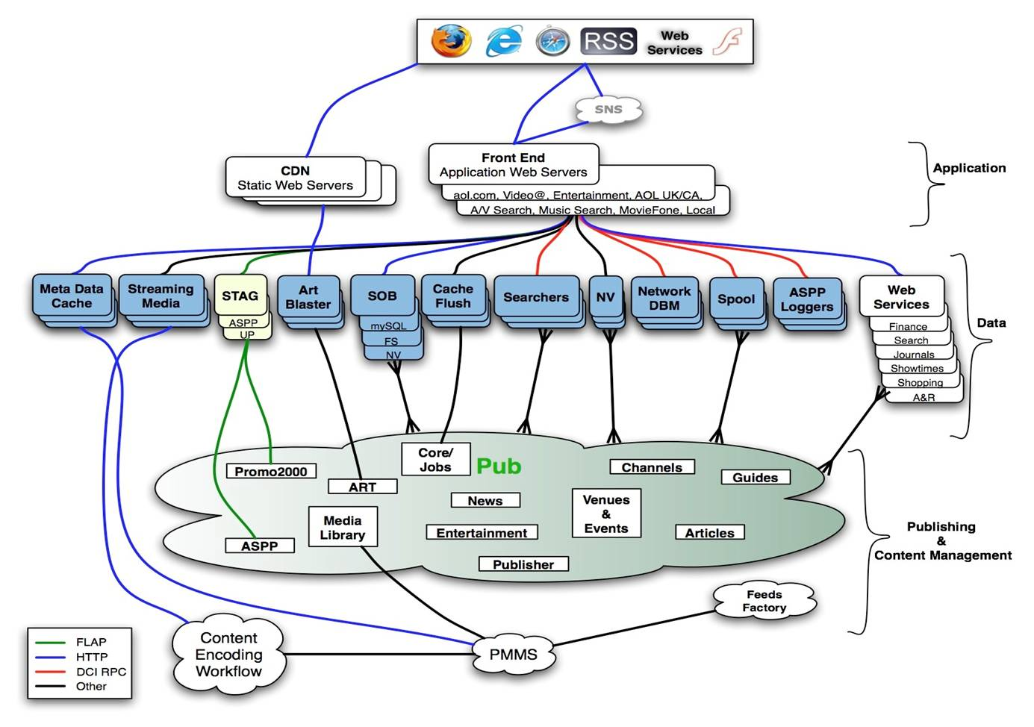
AOL.com ADP Architecture
Notes:
What the architecture really looked like. This diagram was created in 2005.
“Other” connectivity can be database replication, rsync, rsync-over-dci, etc. The amount of proprietary and non-portable connections and components made the option of migrating the architecture piecemeal unmanageable. There is little here that could have been used directly without porting core connectivity components to the new platform.
The “pub” cloud is one very large and very unhappy V880.

Slide 11

ADP
AOLserver on every layer
Internally developed and maintained
Historically related to DigitalCity, 10 years of continuous new development
Proprietary point to point, permanently connected communications
90% of the data transient in RAM
N-tier
Configuration in TCL!
Multiple frontend farms shared all infrastructure
Optimized for real time publishing with caching
Still handling millions of hits a day after large migration efforts
Scaled at 45hps per server instance
Notes:
The baseline AOLserver software is C with a TCL interface. The original bits were purchased and then extended over a number of years internally. Of the more idiosyncratic characteristics of the ADP infrastructure, the connectivity was the most single-use piece, developed to completely adhere to AOL’s network standards and creating headaches and topology nightmares.
All RPC connections originated with the publishing master, and the master held a complete view of all hosts in the network – as many as 2000 single-function applications at a time, with complex interconnectivity to manage caching and flushing and real-time updates to data and search indexes. The size of the topology and geographical distribution required a multi-tiered connectivity plan, with repeaters localized to the frontend servers to keep the master from being overburdened.
Adding insult to this injury, all the configuration was written in TCL. A single misplaced bracket could crash an entire farm of hosts, and if was particularly well-placed, the entire infrastructure.
At one point, nearly all of AOL’s web presence was somehow attached to or dependent on this system except for search and the primary components of the webmail system (though webmail used a header that relied on a piece in this).
For all the nightmares, the system was fairly fast for what it was doing. 100% of hits to these farms demanded dynamically generated content, so most of the data was held in RAM on the frontends, with very little on disk permanently. The request-on-demand nature of most of the data meant that a cold cache was populated with data as it was needed to create pages. The cache-hit rate on a quiesced server could be anywhere from 90% to 99.9% depending on the farm and types of requests it serviced, even with very little memory devoted to cache (<40MB).
However, this memory-intensive storage system meant that on a 32bit system, the servers start to flake out when they reach 2GB of RAM used, and without engineers to build and verify a 64bit build, the system basically obsoleted itself.

Slide 12
Proprietary Systems: Pros / Cons
Good stuff
Shoot me
The person who wrote it might sit down the hall
I can write my own extensions
No licensing
The person who wrote it left the company years ago
I have to write my own extensions
Google can’t help me with this problem…
Hard to apply new ideas evolved in the industry.
Notes:
Continuing to maintain a proprietary infrastructure for a number of years requires careful management of the people who know all the bits of the system. Losing the primary developer on any component or subsystem can (and often does) mean a slow painful death for that system, regardless of how many products rely on it. Letting politics get in the way of the product lifecycle is particularly fun.
Building your infrastructure components from the ground up means building everything yourself. A product needs click-through tracking? Gotta build a system for it. Someone else wants Captcha? Build it yourself. The amount of time and resources necessary to create everything you need from the ground up will put you years behind everyone else (hmm…). While the ADP system eventually had enough basic reusable components to build basic systems, by the time it reached that point most of the original engineers had left and new components or ports of old components were nearly impossible to accomplish.
In a proprietary environment, no one on the Internet can hear you scream.

Slide 13


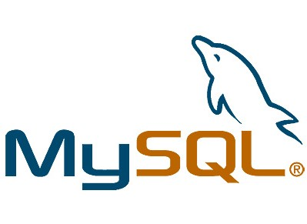


Dynapub
The New Environment
Notes:
The new environment, called “Dynapub” is based on common Open Source components, including Apache, Tomcat, and MySQL. The basic components of the Dynapub stack can be arranged in any number of ways to provide services as needed by the product, so while any given Dynapub environment contains the same basic building blocks, any two environments aren’t necessarily all that similar.

Slide 14
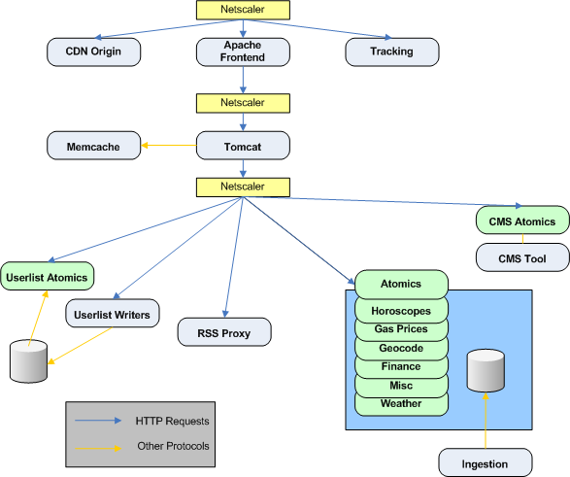
Dynapub Architecture for AOL.com
Notes:
As opposed to the old architecture, the new systems are largely based on HTTP, and the services run on farms behind load balancers.
The databases are all MySQL versus the old flat file PLS databases that supported the ADP architecture.

Slide 15
Features of AOL.com’s New Architecture
Standalone environment
Fewer internally developed systems
Standard connectivity over HTTP
Hides fewer flaws
Requires more technical how-to from development
Notes:
AOL.com no longer shares components with any of our other sites. The combination of a standalone environment and the open architecture requires more knowledge of how to connect components and make use of resources. In the old environment, all the connectivity was already defined as part of the platform itself and no one really had to fully understand how it worked or how to use it – the abstraction was good, but over time weakened the maintainability and robustness of the whole system.
The new system is not without standard practices, but instead of being built on 10 year old assumptions they are based on our actual performance and use of resources.

Slide 16
Growing pains
Re-learning How to Scale

Slide 17
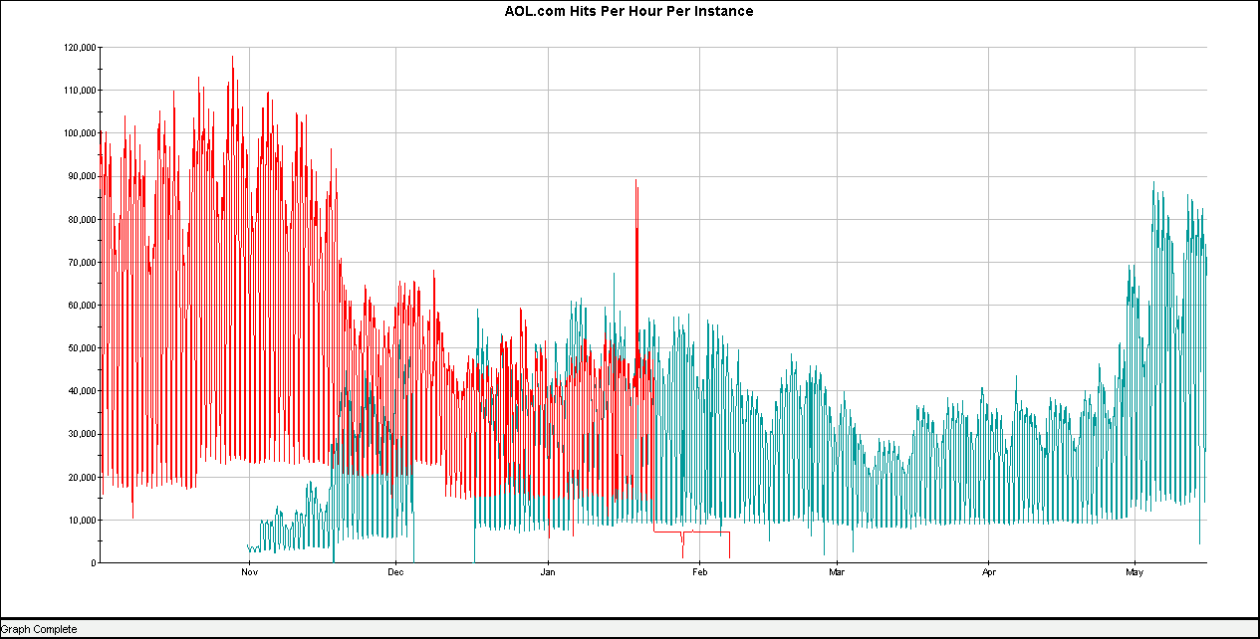
Scaling the Application Layer
Notes:
This graph illustrates the long process of getting to optimum scaling. AOL.com has the opposite problem from a start up project – we had the ability to overbuy hosts to accommodate a worst-case performance level that was well below what we would normally want to have. The slow process of getting to where the apps can actually run reflects the business role the site has. It’s incredibly important to have the site up as much as possible, even if we aren’t trying for five nines anymore. This graph doesn’t show the other metrics we were using to make the scaling decisions, such as memory and CPU utilization, but reflects the effects of decisions based on those metrics.
The old code was well understood by not only the operations team but also the dev team. There is more collaborative code in this new environment that has the potential to have significant effects on the overall performance.

Slide 18
Lessons Learned – Migration Process
One size fits most
Proprietary platforms hide many sins
Learning curve on new tech is frustrating
The customers aren’t always going to like it
Easy to get in a hurry and lose time
Notes:
At the end of life for the old system, there was little that could be added in the way of modern features. The new system is much more extensible, but still isn’t completely prescriptive for every site that might use it. All the applications will perform differently, and fortunately Operations is now able to scale resources to meet the needs of all the products much more easily.
The old system allowed us (Ops) to gloss over what was really going on simply because certain things were “always done that way”. Coming back into an open platform means making sure that anything being redesigned takes into account that there was a reason we use a CDN the way we do, that there are certain benefits and limitations to our networking equipment, and other such things that we were able to handwave on the old platform because it was so ingrained.

Slide 19
Managing Architectural Complexity
Some things did get more complicated than they needed to be
Just because you *can* do something, doesn’t mean you should
There are a lot more things to look at, and for our team to be responsible for than on the old platform
Notes:
Scaling all the individual layers is challenging to keep up with while keeping the site running and working on the number of installations we did during the rollout. Knowing which combinations of threads, children, connections, applications, hosts, etc are required to best serve the traffic without wasting resources takes a concentrated effort.
Using the old system as a complexity baseline, the new system is much simpler to understand. The old system was mostly divided between a couple of teams, another trick to hide the overall complexity.

Slide 20
Knowledge Migration
Learning the New Environment

Slide 21
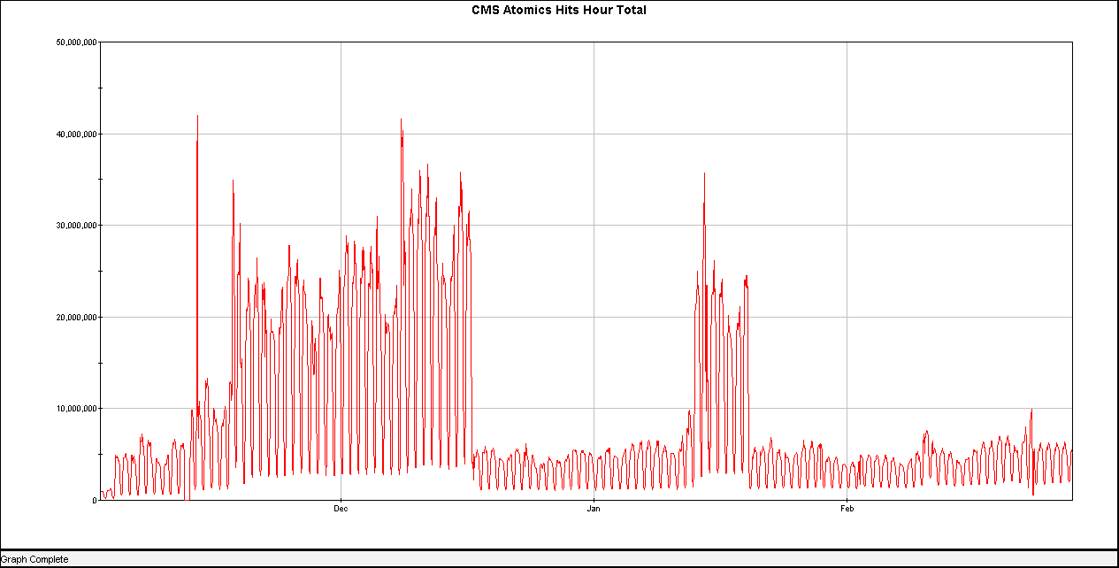
Bringing Knowledge Forward
Notes:
It’s important to keep in mind *why* a particular characteristic was built into the old platform.
This graph is an example of one of the main features of the old infrastructure that we added to AOL.com on the new platform. For every page served by Tomcat, there is a series of calls to the publishing system.
Originally, there was no caching policy for all Dynapub sites. ADP had a greedy caching system that caught 99.4% of all requests for publishing data for AOL.com pages. During the migration of AOL.com to Dynapub, caching was not originally included, and we started to look at widening the datastore layer.
A caching model was launched into the production farm in mid-December when the publishing layer was having trouble dealing with the requests from Tomcat. The frontend was only taking about 20-30% of total traffic at this time. In mid-January some new features were launched without the caching enhancement enabled, and that was fixed.

Slide 22
Metrics and Monitoring
Metrics collection through access logs – we have tools for that
Standard formats, universal meaning
All-HTTP communications simplifies monitoring
Techs at every level can tell when a component has failed
Notes:
One of the side-effects of having a totally proprietary environment is needing to come up with some way to monitor everything. AOLserver has a complex set of application monitoring components, not all of which were terribly helpful, but our monitoring system isn’t sophisticated enough to make smart decisions about them. Limited support for AOLserver meant that our new metrics environment never received an AOLserver monitoring module.
The cut over to all HTTP communications is a huge win for operations in this migration. HTTP is easy to monitor and easy to collect metrics from. The log formats are well defined and meaningful. Additionally, it’s easier to create alerts and for the NOC to determine if the system is broken.

Slide 23
Managing the People Resources
Important to not leave anyone behind on the old stuff
Everyone wants to work on the new cool thing
Applies to development, QA, operations
Challenge is to create a broad range of knowledge about the new platform without wiping everyone’s brain of the old platform

Slide 24
What’s Next

Slide 25
Future of AOL.com
Continues to be a key part of AOL’s web strategy
International components
Refreshing the page design
Business focus on revenue and UVs
Closer integration with other core AOL products means more opportunities for developers to get large scale experience

Slide 26
Conclusion
Positive and negative aspects of a platform migration
Retraining is key, but so is remembering the characteristics of the product
Huge cultural shift at AOL
Notes:
Finally, this entire experience represents a huge cultural change for AOL, away from creating and maintaining proprietary systems. Unchaining resources from low value-added positions leaves more time for working on innovative projects. While the old infrastructure had many innovative qualities when it was new, continuing to support a comprehensive platform holds people back from new innovative opportunities when externally available components surpass what is available internally.

Slide 27
Q&A

