Slide 1
Design and Analysis of the World’s Most Advanced Microprocessors Jupyter and our transformational journey
Kerim Kalafala (i) and Nicholai L’Esperance (ii) on behalf of IBM Systems
(i) Member IBM Academy of Technology, Master Inventor, STSM
(ii) Processor Diagnostics Team

Slide 2
Agenda
IBM Systems
Electronic Design Automation Use Case for Jupyter
Product Engineering Use Case for Jupyter
Reflections on Jupyter (so far…)

Slide 3
System Overview
System Performance
Each node has
The system includes
Peak performance of 200 petaflops for modeling & simulation
Peak of 3.3 ExaOps for data analytics and artificial intelligence
2 IBM POWER9 processors
6 NVIDIA Tesla V100 GPUs
608 GB of fast memory
1.6 TB of NVMe memory
4608 nodes
Dual-rail Mellanox EDR InfiniBand network
250 PB IBM Spectrum Scale file system transferring data at 2.5 TB/s
New 200-Petaflops System is World’s Most Powerful and World’s Smartest Supercomputer for Science

Slide 4
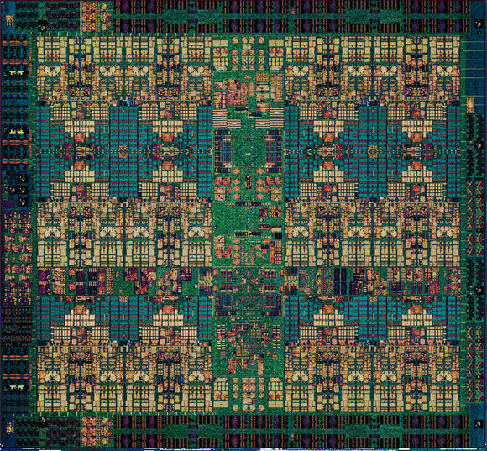
IBM Power9 Processor
Up to 24 cores
Summit’s P9s have 22 cores for yield optimization on first processors
PCI-Express 4.0
Twice as fast as PCIe 3.0
NVLink 2.0
Coherent, high-bandwidth links to GPUs
14nm FinFET SOI technology
8 billion transistors
Cache
L1I: 32 KiB per core, 8-way set associative
L1D: 32KiB per core, 8-way
L2: 258 KiB per core
L3: 120 MiB eDRAM, 20-way

Slide 5
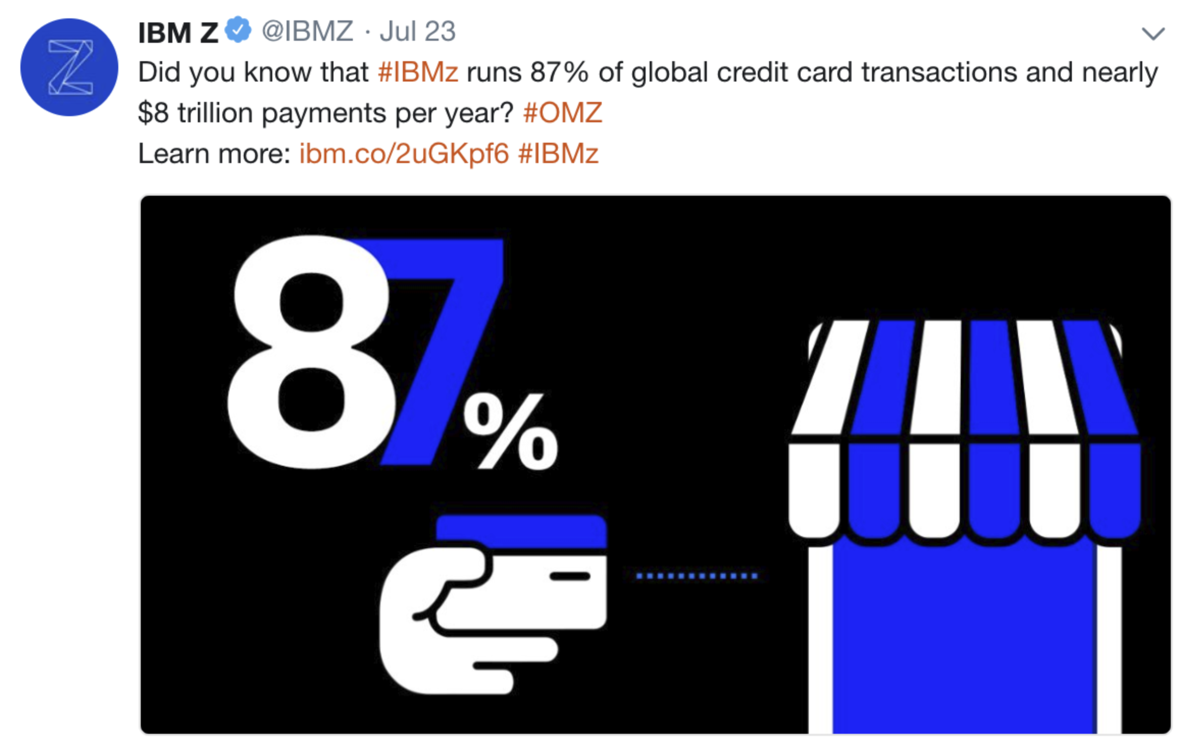
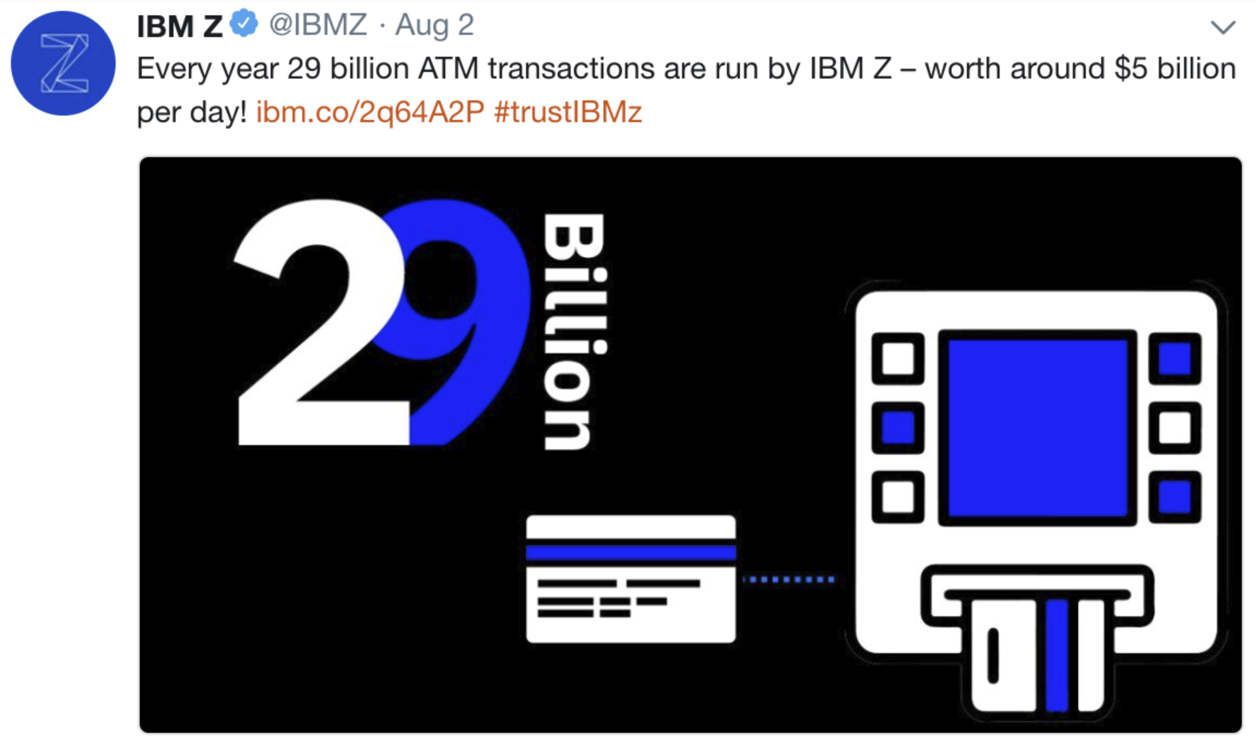
IBM’s Flagship Mainframe
Z- “Zero Downtime”
Hardware accelerated, pervasive encryption.
“The new IBM z14 single frame model can process 850 million encrypted transactions per day in the space of two floor tiles”

Slide 6
Agenda
IBM Systems
Electronic Design Automation Use Case for Jupyter
Product Engineering Use Case for Jupyter
Reflections on Jupyter (so far…)

Slide 7
Electronic Design Automation (EDA)
Millions of lines of logic design (VHDL)
Detailed circuit implementation ready for manufacture
Logic Design
EDA
Verification
Compile in to circuits

Slide 8
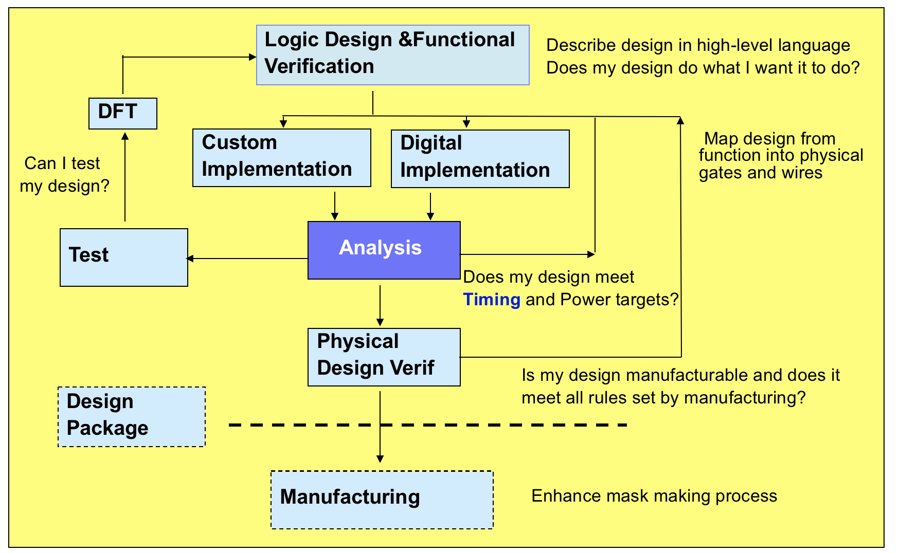
Processor Design Flow
Will our design operate at the right frequency ?
I work here !
Will our chips overheat ?
Are there transient/noise issues that could cause problems ?

Slide 9
A day in the life of an analysis engineer
6PM the day before..
Latest version of a design is available
Kick off analysis tools
Minutes → Several hours runtime
8AM the next day
My analysis runs have completed
100MB – 1GB report data available
8AM-onwards
What needs to be fixed to improve my timing, power, noise ?
Who needs to fix this ?
Assign tasks
Hours → Days of work
The faster engineers can complete the above, the more design iterations we can perform, which leads to shorter time to market, better performance, lower power, etc.

Slide 10
Vision for a smarter chip design driven by a smarter EDA
Provide EDA Data as a Service on the Cloud
Any engineer should have access to data relevant to do their job at any time on the web
No more chasing data, parsing reports
Provide EDA Analytics as a Service
API interface for power-users
Web-interface for common tasks
Learn & evolve through designer interaction
What are the most popular queries ?
How are particular classes of design problems most frequently addressed ?
How has this design progressed over time ?

Slide 11
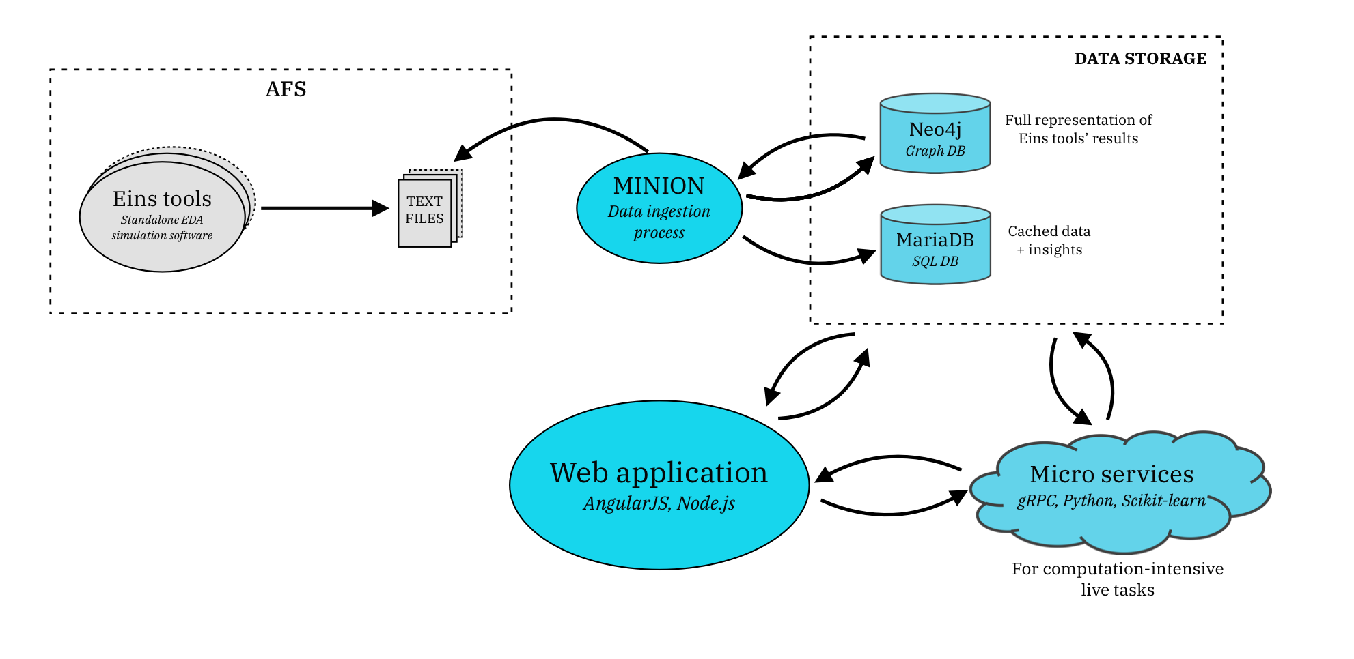
Overall Architecture
Traditional tool environment which produces data
New DAaaS environment which analyzes and serves data
Chart courtesy IBM ExtremeBlue

Slide 12
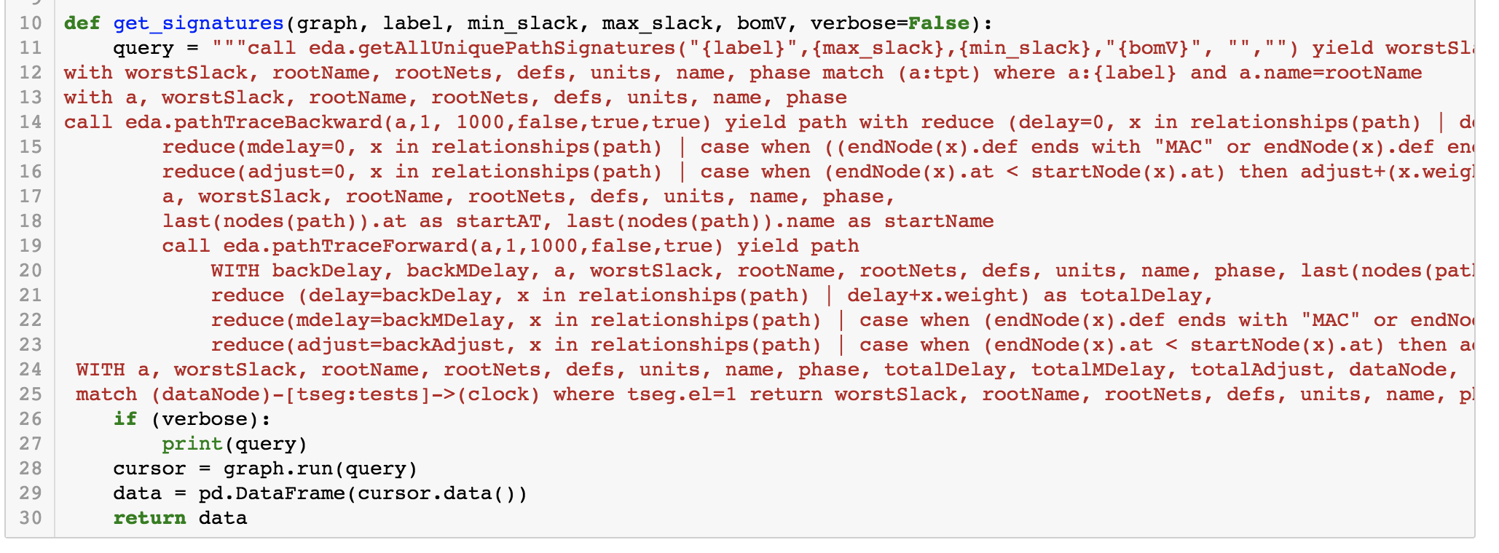
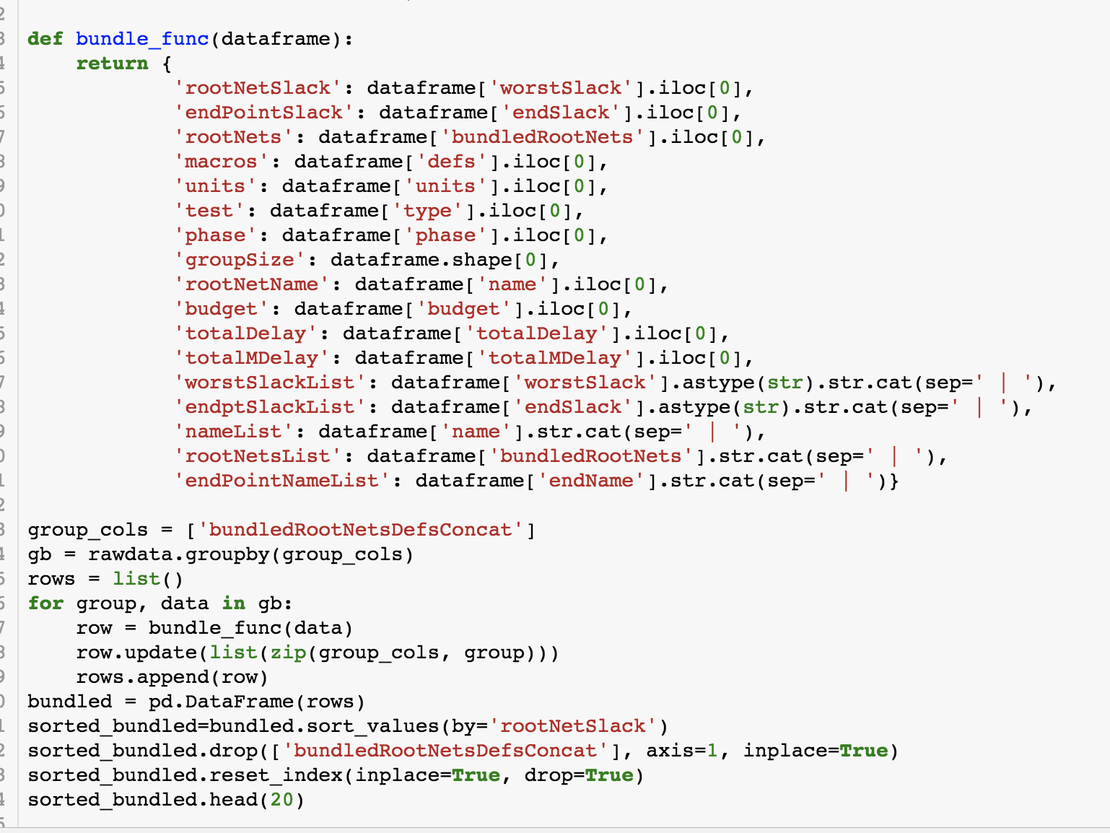
Jupyter Notebooks for Prototyping (Python)
4. Examine results
1. Tune complex database query
Extremely fast iteration
2. Collect output
3. Perform analysis using in-core DF

Slide 13
DAaaS Built with Jupyter
Publish ”verified” code in to DaaS framework

Slide 14
Future: JupyterHub
GitHub Enterprise repo
Verified notebooks
Raw python
(Future)
Enable more “power-users”
(Now)

Slide 15
Agenda
IBM Systems
Electronic Design Automation Use Case for Jupyter
Product Engineering Use Case for Jupyter
Reflections on Jupyter (so far…)

Slide 16
Product Engineering
From product inception to market.
Design
Develop
Test
Analyze
Kerim works here!
Design Develop Test Analyze
Nicholai works here!

Slide 17
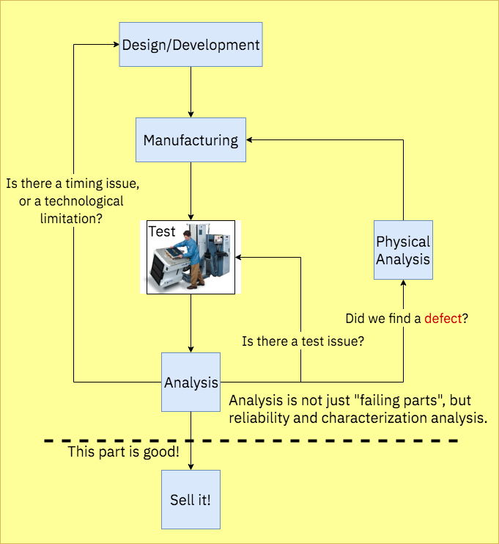
Building a Chip that Works
Is there a pattern to these fails?
Is there a specific circuit that is causing these failures?
I work here !
Why are parts X running faster than parts Y?

Slide 18
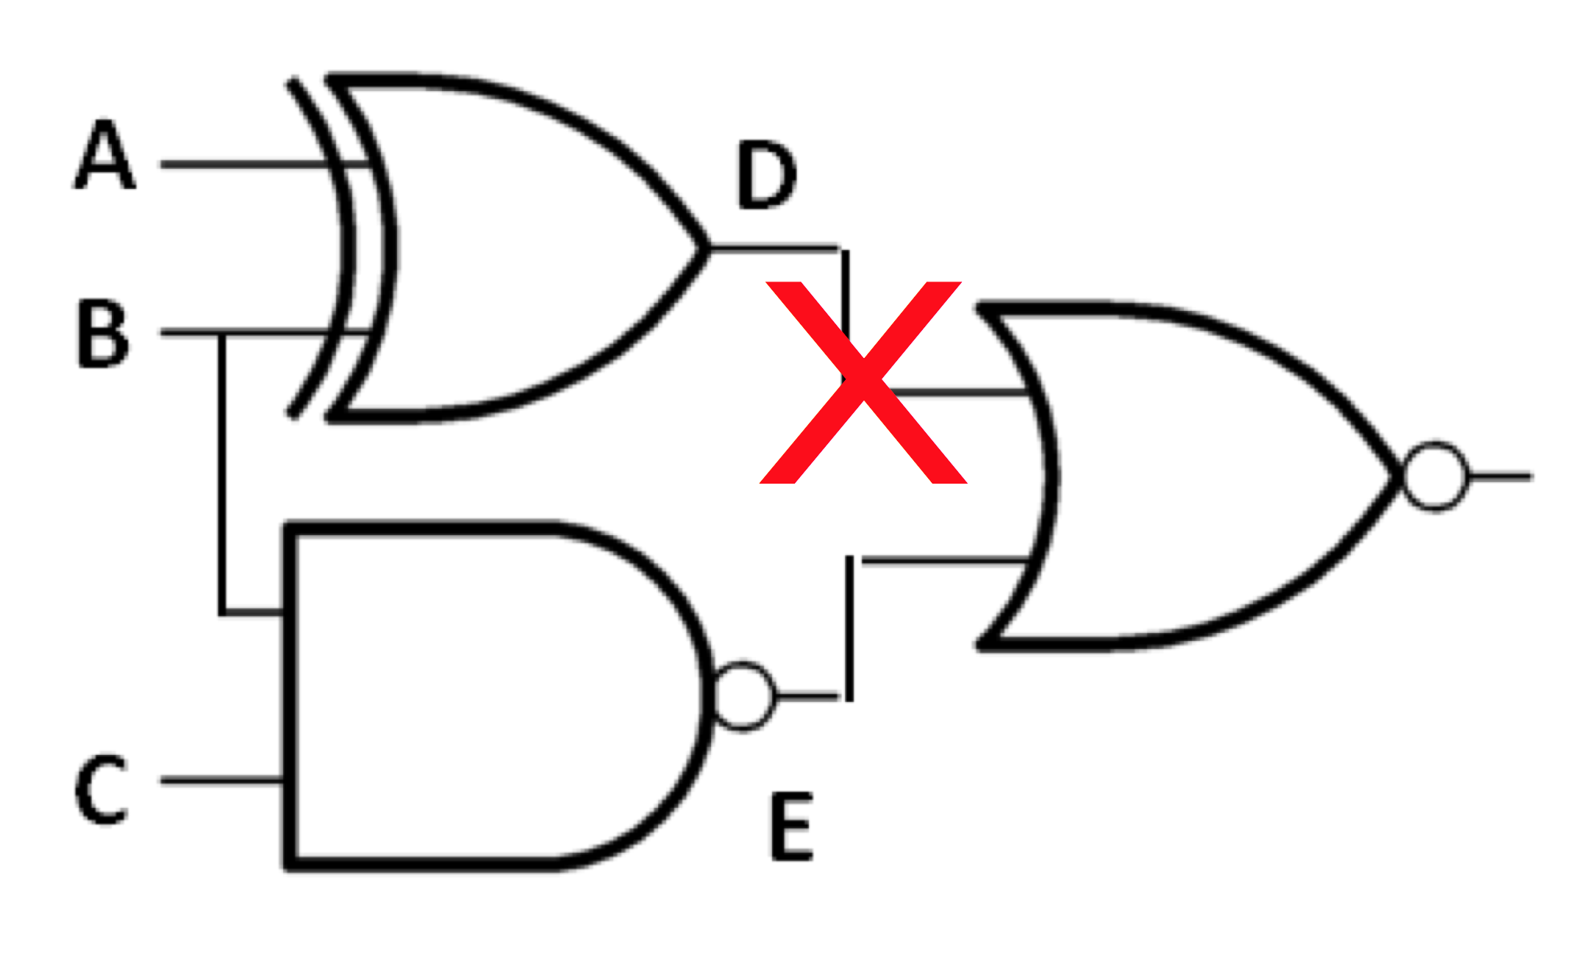
Product Engineering: Diagnostics
Binary Test Data
001111010111101110100101111010100110100101010001001101010101001000010100001010101010110111010110101010100
Decode
Analyze
Simulate
Out of trillions, one.

Slide 19
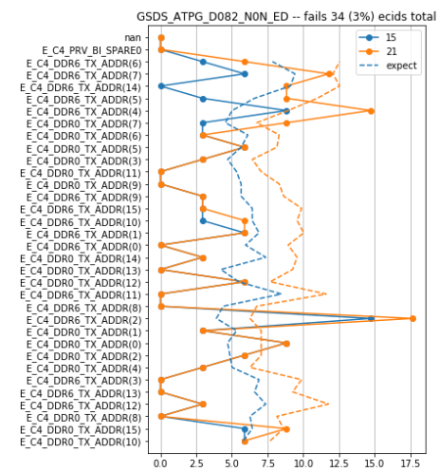
Diagnosing Processors in Jupyter
Why Python + Jupyter?
Python’s versatility allows integrating disparate data sources into a single analysis.
Jupyter workflows give engineers easy, inline sanity checks.
Visualization is vital to narrowing the search for systematics.
Quick resolution saves massive resources—real dollars as well as engineering hours.
Test Data
Rate of Failure by Pin
Circuit Model
Configuration Data
Physical Data

Slide 20
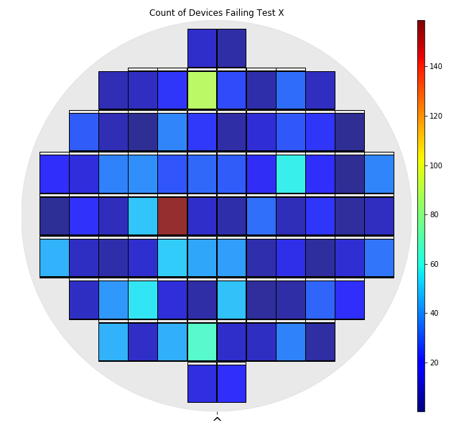
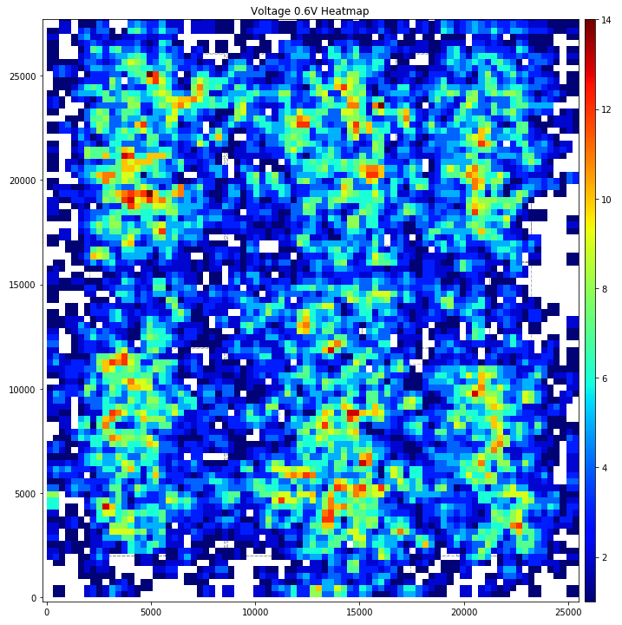
Diagnosing Processors in Jupyter
Count of Devices Failing Test X
Every problem is different.
Clever plotting and tabulation to help identify root cause.
All aspects of the data must be examined:
Logical: circuit names, circuit types
Physical: circuit layout, circuit structure
Geographical: wafer location, die location
Temporal: manufacturing date
Logistical: manufacturing events, test version
Heatmap Of Failing Circuits
4) Check for outliers,
trends
1) Gather data
3) Plot, tabulate
2) Pivot, summarize,
transform

Slide 21
Agenda
IBM Systems
Electronic Design Automation Use Case for Jupyter
Product Engineering Use Case for Jupyter
Reflections on Jupyter (so far…)

Slide 22
Making Jupyter ”Enterprise” Ready
JupyterHub is the next step in an enterprise environment; “roadbumps” have slowed widespread adoption.
Setup Complexity
No good solution without root access (required for process forking).
Requires fairly in-depth knowledge of sub-components to implement.
Documentation is essential—analysts are not implementing JupyterHub, sys-admins are (in an enterprise environment).
“How to Setup” decision tree

Slide 23
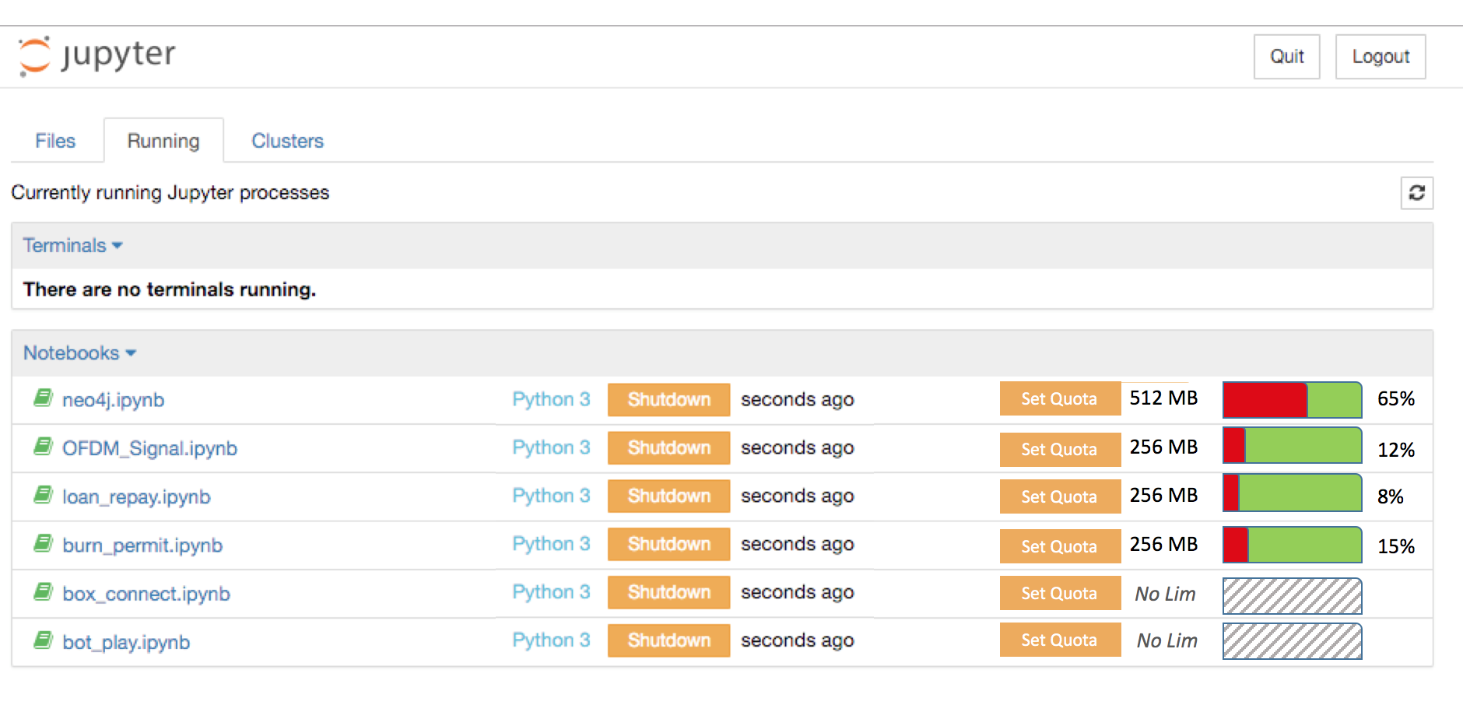
Making Jupyter ”Enterprise” Ready
Resource control
Notebook memory usage monitoring, quota.
Useful even on the single user level.
External solutions/containers leave users blind to resource usage.

Slide 24
JupyterCon Revelations
JupyterHub projects are very exciting.
The Littlest JupyterHub is a promising stepping stone in enterprise.

Slide 25
Questions?

