Slide 1


What’s the Hadoop-la
about
Strata Data 2018, New York, CA

Slide 2



Today’s Speakers
Anant Chintamaneni
Nanda Vijaydev
Vice President of Products
BlueData Software
Sr. Director of Solutions
BlueData Software
@AnantCman
@NandaVijaydev
Notes:
Jason: introduce speakers
We have two highly regarded experts in the field of Big Data as our speakers for today’s webcast…

Slide 3
Agenda
Market Dynamics
What is Kubernetes – Why should you care?
Key gaps in Kubernetes for running Hadoop
What will it take to go from here to there
Introducing KubeDirector
Q & A
Notes:
Jason to briefly cover agenda

Slide 4

Unified Platform
= Oz
Stateless
(Web front-ends, servers)
Stateful
(Databases, queues, Big Data / AI apps)
Daemons
(Log collection, monitoring)
Others?
All Workloads
Single “container” orchestration platform for all application patterns …
Common infrastructure
Notes:
Consistent and cloud/infra agnostic container platform for uniform resource allocation, storage..
Web apps, operational databases, and big data analytics, real time use cases, ..
Automation, scaling, efficient resource utilization
Ability to run multiple applications and versions seamlessly

Slide 5
What is Kubernetes (K8s?)
Open source “platform” for container orchestration
Platform building blocks vs. turnkey platform
  https://kubernetes.io/docs/concepts/overview/what-is-kubernetes/#what-kubernetes-is-not
Top use case is stateless / microservices deployments
Evolving for stateful applications
Notes:
What is Container Orchestration
Deploy and Configure
Fault Isolation & Healing
Secure
Upgrades
Scaling Up and Down
Does not provide app level services (e.g. middleware, databases, caches, cluster storage, networking as built in services)
Does not dictate logging, monitoring or alerting solutions.
Does not provide a configuration language/system. Provides API and leaves it to user for declarative specifications

Slide 6
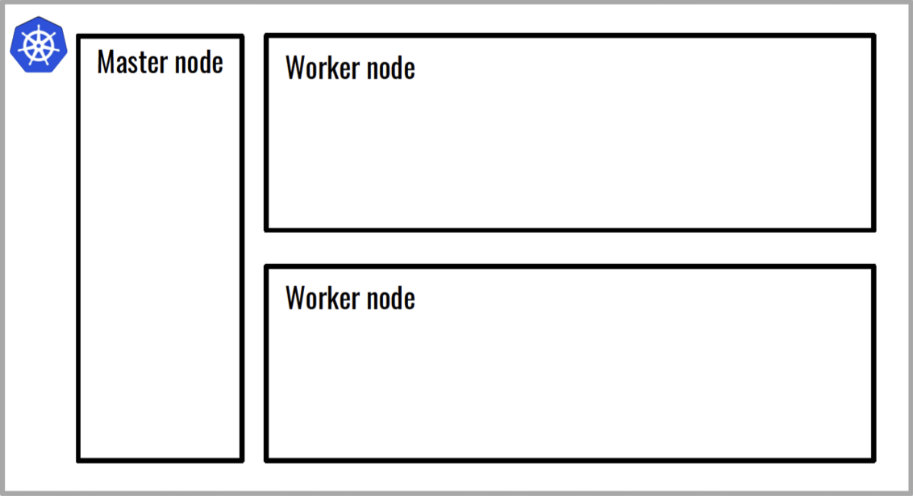
Kubernetes (K8s) – Master/Worker

Slide 7
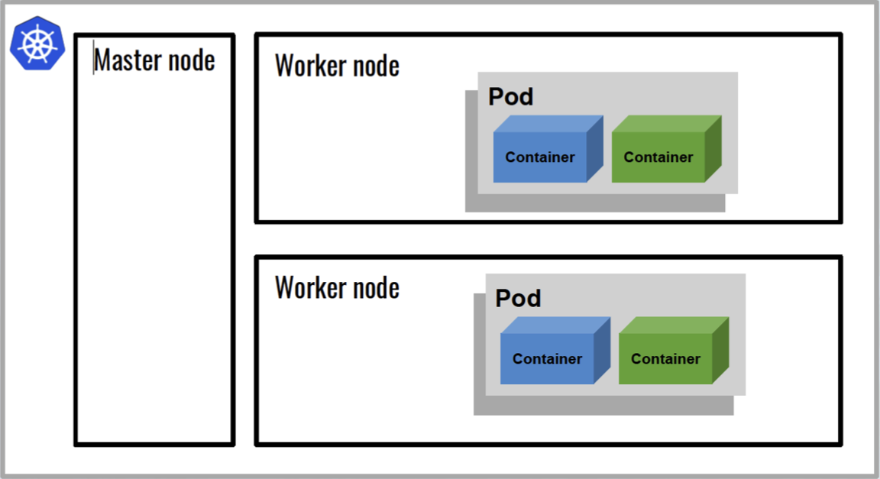
Kubernetes (K8s) – Pods
Notes:
A Pod is a group of one or more containers with shared storage and networking context
In other words, a Pod is comprised of a group of containers scheduled together on the same physical host

Slide 8
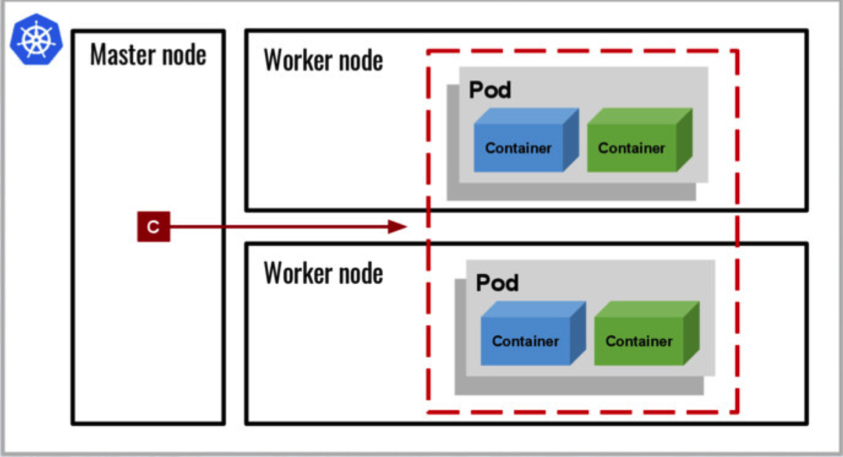
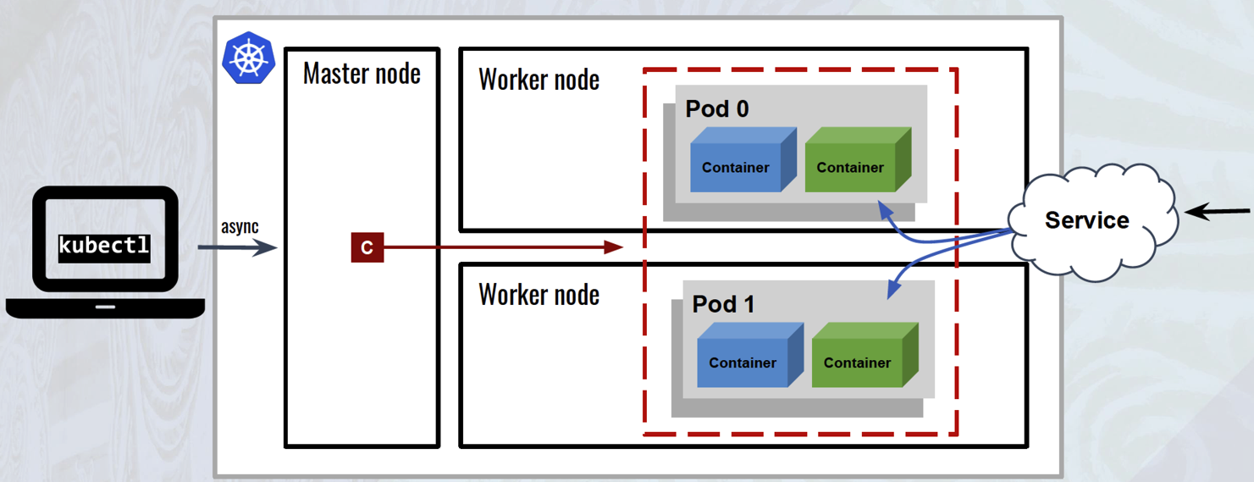
Kubernetes (K8s) – Controller
Notes:
At the simplest level, there is an important concept of a controller. The controller not only schedules the pods but also acts on these pods to ensure they are in the desired end state by the app developer. You can use the Kubectl CLI

Slide 9
Kubernetes (K8s) – Service

Slide 10
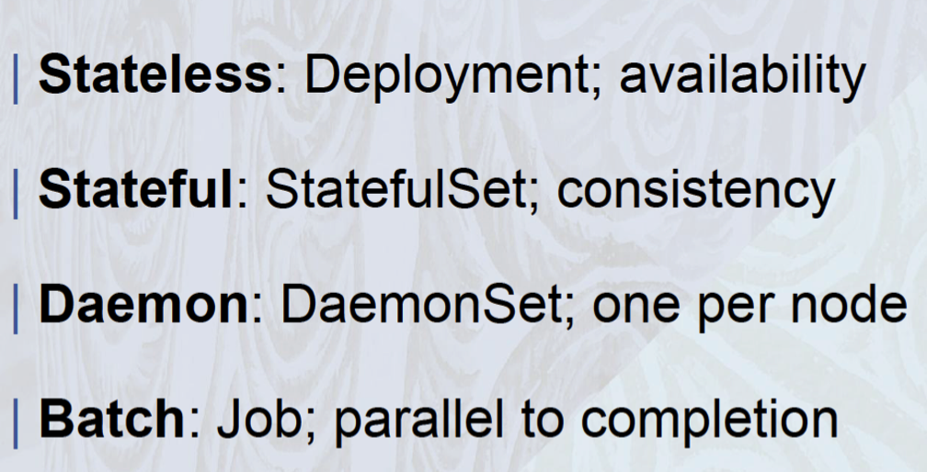


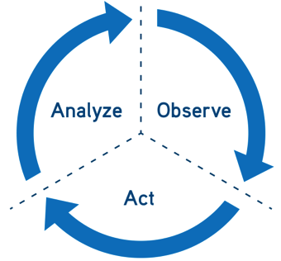
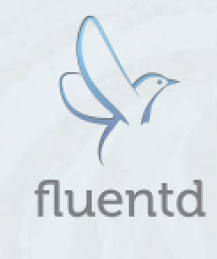
Kubernetes (K8s) - Controller Patterns
K8s is extensible and allows for definition of new controller patterns (custom controller)
Notes:
Persistent Volumes
Feature rich and complex system
The life span of the storage persists beyond the life time of the Pod
Bottom line
The ability to mount an external file system into a container file system namespace
Stateful Set
A set of Pods with special behavior
Each Pod is based on an identical container spec, but the Pod instances are not interchangeable:
Persistent identity info (host and Pod names)
Support for persistent storage claims
Pod ordering
The Pods of the set are deployed and terminated in a fixed sequential order

Slide 11
Reality Check!

Slide 12

Slam dunk for K8s
Stateless
  Each application service instance is configured identically
  All information stored remotely
  “Remotely” refers to some persistent storage that has a life span different from that of the container
  Frequently referred to as “cattle”

Slide 13

High chance of air ball…
Stateful
  Each application service instance is configured differently
  Critical information stored locally
  “Locally” means that the application running in the container accesses the information via file system reads/writes rather than some remote access protocol
  Frequently referred to as “pets”

Slide 14
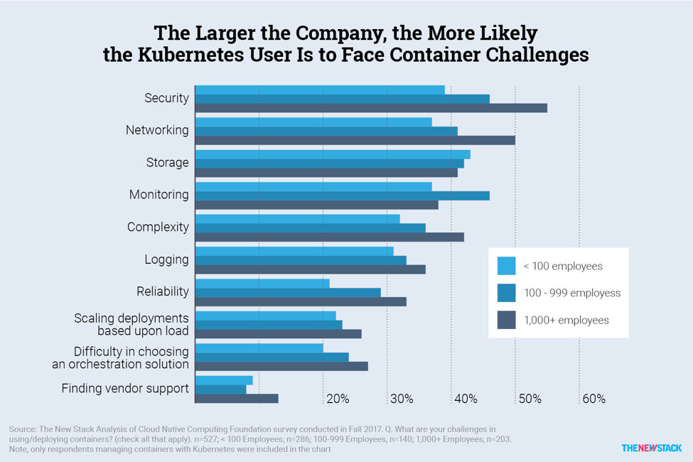
K8s challenges….
source: https://www.cncf.io/blog/2017/06/28/survey-shows-kubernetes-leading-orchestration-platform/

Slide 15
Hadoop & Ecosystem on Containers

Slide 16
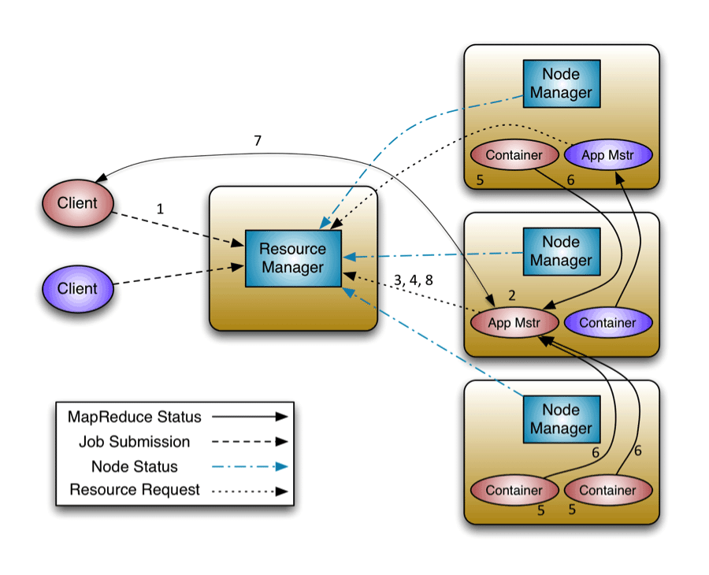
Not to be confused with……..
This is not about using containers to run Hadoop/Spark tasks on YARN:
Source: https://hortonworks.com/blog/apache-hadoop-yarn-concepts-and-applications

Slide 17
Hadoop in Docker Containers
This is about running Hadoop clusters in containers (on K8s):
containers
cluster

Slide 18
Why Hadoop/Spark on Containers
Infrastructure
Standardized environments
(dev, test, prod)
Applications
Fool-proof packaging (configs, libraries, driver versions, etc.)
Repeatable builds and orchestration
Portability
(on-premises and cloud)
Higher resource utilization
Faster app dev cycles
Agility and elasticity

Slide 19



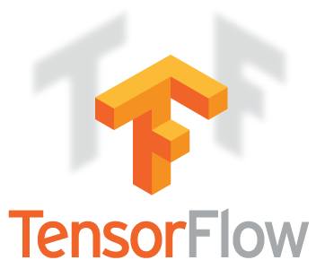
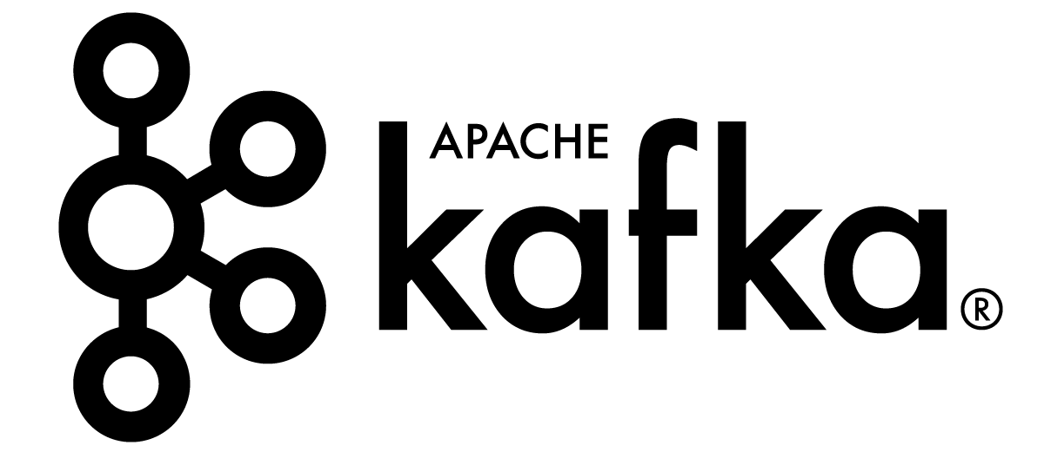
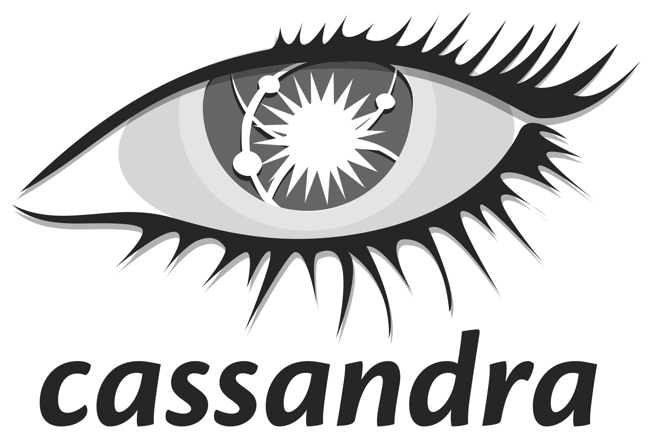

Complex Stateful Applications
Big Data / AI / Machine Learning / Deep Learning
What do all these applications have in common?
  Require large amounts of data
  Use distributed processing, multiple tools / services
  When on-prem, typically deployed on bare-metal
  Do not have a cloud native architecture
    No microservices
    Application instance-specific state

Slide 20

So is it possible to run complex stateful apps (e.g. Hadoop) on Kubernetes (K8s)?

Slide 21

Complex Stateful Apps on Kubernetes
Pods, StatefulSets, and PersistentVolumes are necessary
Helm Charts and Operators provide some promise
But are they sufficient in order to run complex stateful applications in an enterprise environment?

Slide 22
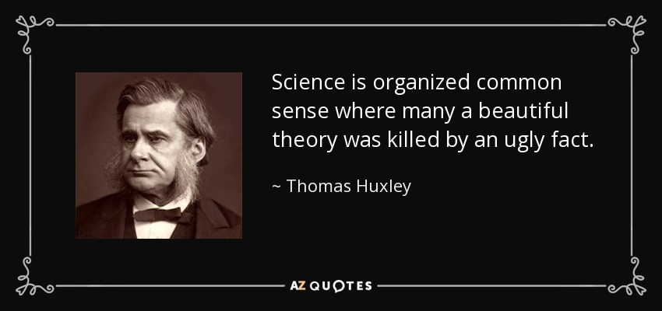
Kubernetes – Specific Challenges
Complex Stateful Applications
Source: http://astrorhysy.blogspot.com/2016/04/perfectly-wrong-or-necessary-but-not.html

Slide 23
Kubernetes – Pod
Ideally: Each application service could be deployed in its own container running in a Pod (microservices architecture)
Current reality: All services of each node for a complex stateful application must run in the same container
  The Pod ordering feature does not help in the ordering of services (which is key for complex stateful apps)
Notes:
Too many interdependencies in current monolithic design
In this deployment model, the Pod is equivalent to a single container

Slide 24
Kubernetes
Stateful Set & Persistent Volume
Hey! If I can mount an external file system at “/” (root) in my container, I can save its full storage state. Right?
  Not so fast.
    Docker containers do not allow remount of “/” (root)
    Many configuration files of stateful apps are typically stored in “/etc” and “/usr”
      The remounting of these directories may cause the loss of other essential container artifacts

Slide 25

Kubernetes – Helm
Helm is designed for managing dependencies between services
  Post configuration changes (e.g. injecting security certs) are a challenge
  Authentication and Authorization of individual apps/services may not be native*
  * Tiller does the authorization; Scheduled to be dropped in next release of Helm.
Notes:
Client (Helm) / Server (Tiller)
Functions: package mgmt, app lifecycle mgmt, rendering
Functionality permissions are “all or nothing”
With Tiller, Helm cannot support per function user privileges
Tiller scheduled to be dropped in the next release of Helm
Without Tiller, Helm will have difficulty managing long-running tasks and monitoring

Slide 26

Kubernetes – Helm (cont’d)
Chart.yaml file
  Helm chart.yaml files become complex
  Simple example hadoop-configmap.yaml: 322 lines.
apiVersion: v1
kind: ConfigMap
metadata:
name: {{ template "hadoop.fullname" . }}
labels:
app: {{ template "hadoop.name" . }}
chart: {{ .Chart.Name }}-{{ .Chart.Version | replace "+" "_" }}
release: {{ .Release.Name }}
heritage: {{ .Release.Service }}
data:
bootstrap.sh: |
#!/bin/bash
…
Source: https://github.com/helm/charts/blob/master/stable/hadoop/templates/hadoop-configmap.yaml

Slide 27

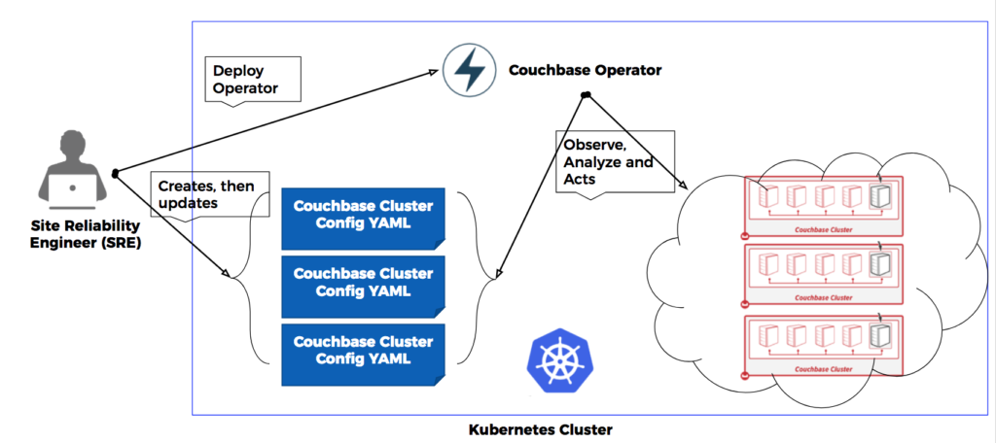

Kubernetes – Operator
Application Specific Operator
(custom controller written in Go)
e.g. Spark, Kafka, Couchbase etc.
Deploy Cluster 1 Config YAML file
Cluster 1
Deploy Cluster 2 Config YAML file
Cluster 2
Deploy Cluster 3 Config YAML file
Cluster 3
Source: https://coreos.com/operators
Notes:
Workflow Steps
Define resource APIs with Custom Resource Definitions
Specify resources to watch
Write Operator code (Golang)
Build and generate the Operator deployment manifest
Deploy Operator
Launch instance of application using newly deployed Operator service

Slide 28
Kubernetes – Operators
Still best suited when application is decomposed into independent services
  Primarily in the realm of the application vendor or OSS community to change/re-architect apps (e.g. Spark)
Reconciliation loop doesn’t work when multiple stateful apps are in a pipeline
  e.g. Kafka + Spark + ML where each
Notes:
Client (Helm) / Server (Tiller)
Functions: package mgmt, app lifecycle mgmt, rendering
Functionality permissions are “all or nothing”
With Tiller, Helm cannot support per function user privileges
Tiller scheduled to be dropped in the next release of Helm
Without Tiller, Helm will have difficulty managing long-running tasks and monitoring

Slide 29

What to Do?
There needs to be an easier way to deploy and manage clusters running complex stateful applications

Slide 30
BlueData EPIC Enterprise – Available Now!

Slide 31





















BlueData EPIC Software Platform
Data Scientists
Developers
Data Engineers
Data Analysts
BlueData EPIC™ Software Platform
Big Data Tools
ML / DL Tools
Data Science Tools
BI/Analytics Tools
Bring-Your-Own
ElasticPlane™ – Self-service, multi-tenant clusters
IOBoost™ – Extreme performance and scalability
DataTap™ – In-place access to data on-prem or in the cloud
Compute
CPUs
GPUs
Storage
NFS
HDFS
On-Premises
Public Cloud
Notes:
The BlueData EPIC software platform leverages Docker container technology – together with patented innovations – to deliver self-service, speed, security, and efficiency for Big Data Analytics, Data Science, and AI / ML / DL environments.
The key components of the BlueData EPIC (which stands for Elastic Private Instant Clusters) platform are:
• ElasticPlane™ enables users to spin up virtual clusters on-demand in a secure, multi-tenant environment.
• IOBoost™ ensures performance on par with bare-metal, with the agility and simplicity of Docker containers.
• DataTap™ accelerates time-to-value for Big Data by eliminating time-consuming data movement.
Our software platform can be deployed on any infrastructure – whether on-premises, in the public cloud (e.g. AWS and now Azure and GCP), or a hybrid architecture

Slide 32
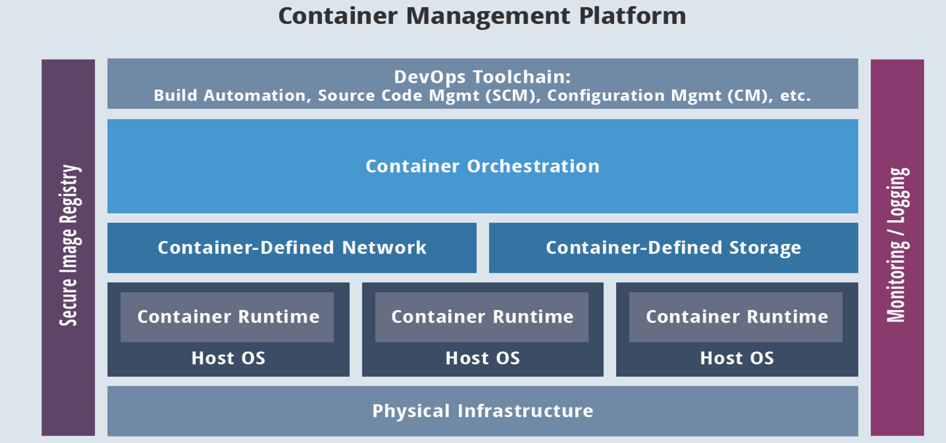

Purpose-Built for Stateful Applications
Out-of-the-box solution with differentiated innovations & optimizations for Big Data / AI
Out-of-the-box solution with differentiated Big Data innovations & optimizations
BlueData EPIC container-based platform for complex stateful apps
Web-based UI and RESTful APIs for automation
Container management for stateful workloads
with pre-built HA and multi-tenancy
App Store with Docker-based
app images & App Workbench
Metricbeat + ELK stack for
container monitoring
Open vSwitch with VXLAN
Dynamic persistent volumes
CentOS / RHEL only
CentOS / RHEL only
CentOS / RHEL only
On-Premises: Physical Servers or VMs
Public Cloud

Slide 33
So what will it take to address these gaps and run complex stateful apps (a’la Hadoop) on K8s?

Slide 34

Here’s How
BlueData is using its expertise in deploying and managing complex stateful applications in containers to drive Kubernetes development
  BlueData recently joined CNCF* and introduced a new “BlueK8s” open source initiative to contribute to Kubernetes
* CNCF = Cloud Native Computing Foundation (i.e. the organization behind Kubernetes) https://www.cncf.io

Slide 35

Application vs Service vs Instance
For example, “Hadoop” is an application
“Collection of Services” - NodeManager, DataNode, ResourceManager are application services
The ResourceManager Service running on node host-1.example.com is an application service instance

Slide 36
Attributes of Hadoop Clusters
Not exactly monolithic applications, but close
Multiple, co-operating services with dynamic APIs
  Service start-up / tear-down ordering requirements
  Different sets of services running on different hosts (nodes)
  Tricky service interdependencies impact scalability
Lots of configuration (aka state)
  Host name, IP address, ports, etc.
  Big meta-data: Hadoop and Spark service-specific configurations

Slide 37
Hadoop itself is clustered….
Master Node
Worker Node
RM
YARN ResourceManager
NN
RM
DN
NM
NM
YARN NodeManager
NN
HDFS NameNode
Worker Node
DN
HDFS DataNode
DN
NM
Data
Hive Server2
Worker Node
Metadata
DN
Hive Server2
NM

Slide 38
Complete list of Hadoop Services?
RM
YARN ResourceManager
SHS
Spark History Server
ISS
Impala State Store
NM
YARN NodeManager
Hue
Hue
ICS
Impala Catalog Server
NN
HDFS NameNode
OZ
Oozie
ID
Impala Daemon
DN
CM
Cloudera Manager
SS
YARN DataNode
Solr Server
JHS
DB
RDBMS
HS
Job History Server
Hive Server
HFS
GW
Gateway
HSS
HttpFS Service
Hive Metastore Service
JN
Journal Node
FA
Flume Agent
…
ZK
ZooKeeper
ACK! Seemingly no end to the Big Data services.
HM
Hbase Master
HRS
Hbase Region Server

Slide 39





Managing and Configuring Hadoop
Use a Hadoop manager
  Cloudera: Cloudera Manager
  MapR: MapR Control System (MCS)
  Hortonworks: Ambari
Follow common deployment pattern
Ensures distro supportability

Slide 40











And we want multiple Hadoop clusters
Multiple distributions, services, tools on shared, cost-effective infrastructure
Data Engineering
SQL Analytics
Machine Learning
Multiple evaluation teams
Evaluate different business use cases (e.g. ETL, machine learning)
Use different services (e.g. Hive, Pig, SparkR), different distributions / versions
Shared ‘containerized’ infrastructure
Petabyte scale data
CDH5.12.2
CDH-Spark
CDH5.14
2.5
2.2
“Containerized” Platform
Data/Storage

Slide 41
Onboarding Complex Stateful Apps to K8s
Key Considerations
Use existing Kubernetes in an enterprise
  Avoid embedding K8s into Apps
  Prevents K8s fragmentation and rehashing installation issues
User authentication and authorization for each request should be done by Kubernetes
  Run your custom controller behind the kube-APIserver
Adding new custom applications, typically non-micro services, should be data driven and use existing deployment recipes
  Avoid writing “GO” language code and building custom controllers for each app separately

Slide 42
Available Approaches
Customizing Kubernetes
Area for simplification & innovation
Approach 1
Approach 2
Change flags,
Local configuration files,
API resources
Extensions
Define New APIs using API extensions
Define a Custom Controller
Approach 2 is the right way to achieve automation, simplification and lifecycle management

Slide 43
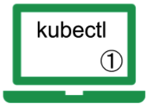

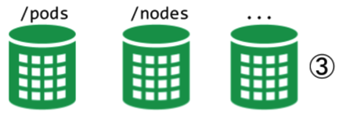
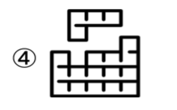
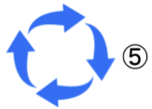
Approach 2: How it should work
Users interact with Kubernetes using kubectl API
API Server handles user requests including custom resources & RBAC
Custom resources are created similar to native resources
Kubernetes will handle the scheduling
Custom Controller will handle application specific lifecycle
https://kubernetes.io/docs/concepts/extend-kubernetes/extend-cluster/
Notes:
Often, when you add a new API, you also add a control loop that reads and/or writes the new APIs. When the combination of a Custom API and a control loop is used to manage a specific, usually stateful, application, this is called the Operator pattern. Custom APIs and control loops can also be used to control other resources, such as storage, policies, and so on.

Slide 44
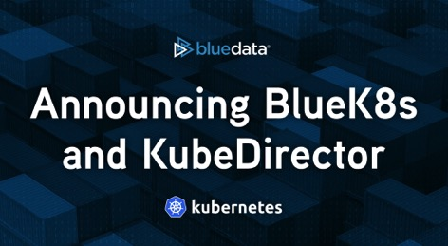
BlueK8s and KubeDirector
An open source initiative focused on bringing enterprise support for complex stateful applications to Kubernetes
A series of Apache open source projects will be rolled out under the BlueK8s umbrella
  The first major project is “KubeDirector”
Source: www.bluedata.com/blog/2018/07/operation-stateful-bluek8s-and-kubernetes-director

Slide 45
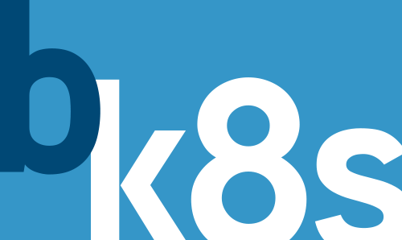
BlueK8s and KubeDirector
KubeDirector is a Kubernetes “custom controller”
  Will address the limitations/complexities found in existing approaches
Watches for custom resources to appear/change
Creates/modifies standard Kubernetes resources (StatefulSets, etc.) in response, to implement specifications from custom resources

Slide 46
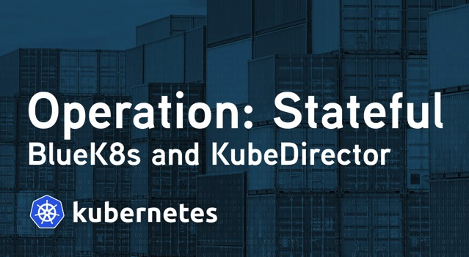
BlueK8s and KubeDirector (cont’d)
Differs from the typical Kubernetes Operator pattern:
  No application-specific logic in KubeDirector code
  App deployment is data-driven from external “catalog”
  Can model interactions between different applications

Slide 47
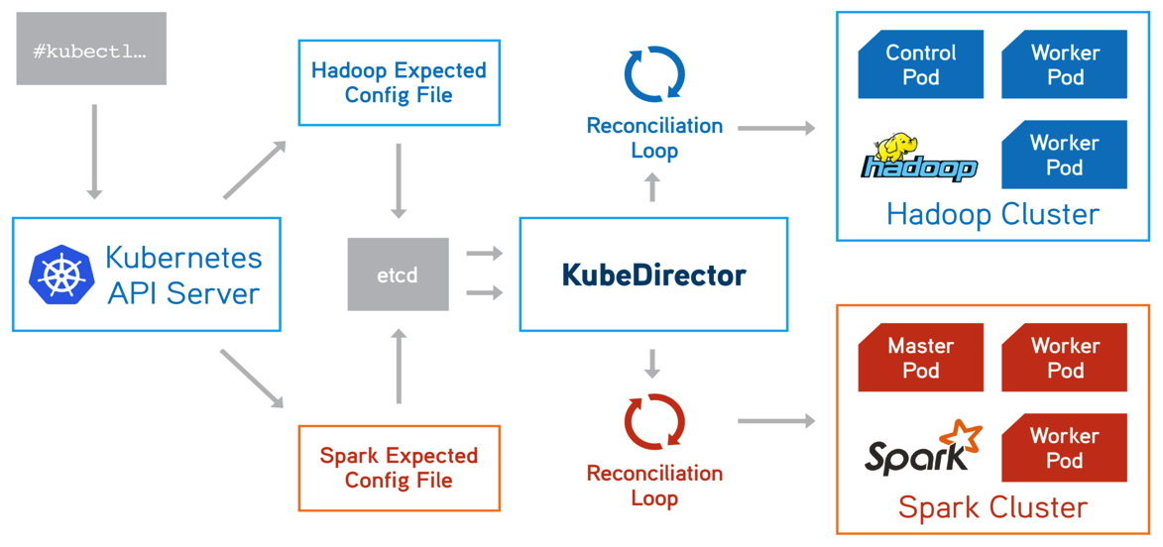
Deploy KubeDirector to K8s
kubectl create -f kubedirector/deployment.yaml
Learn more at: https://github.com/bluek8s/kubedirector/wiki

Slide 48
Our ‘KubeDirector’ Approach..
Launch statefulsets for defined roles
Configure and start services in the right sequence
Make the services available to end users – Network and port mapping
Secure the services with existing enterprise policies (e.g. LDAP / AD)
Maintain Big Data performance goals

Slide 49
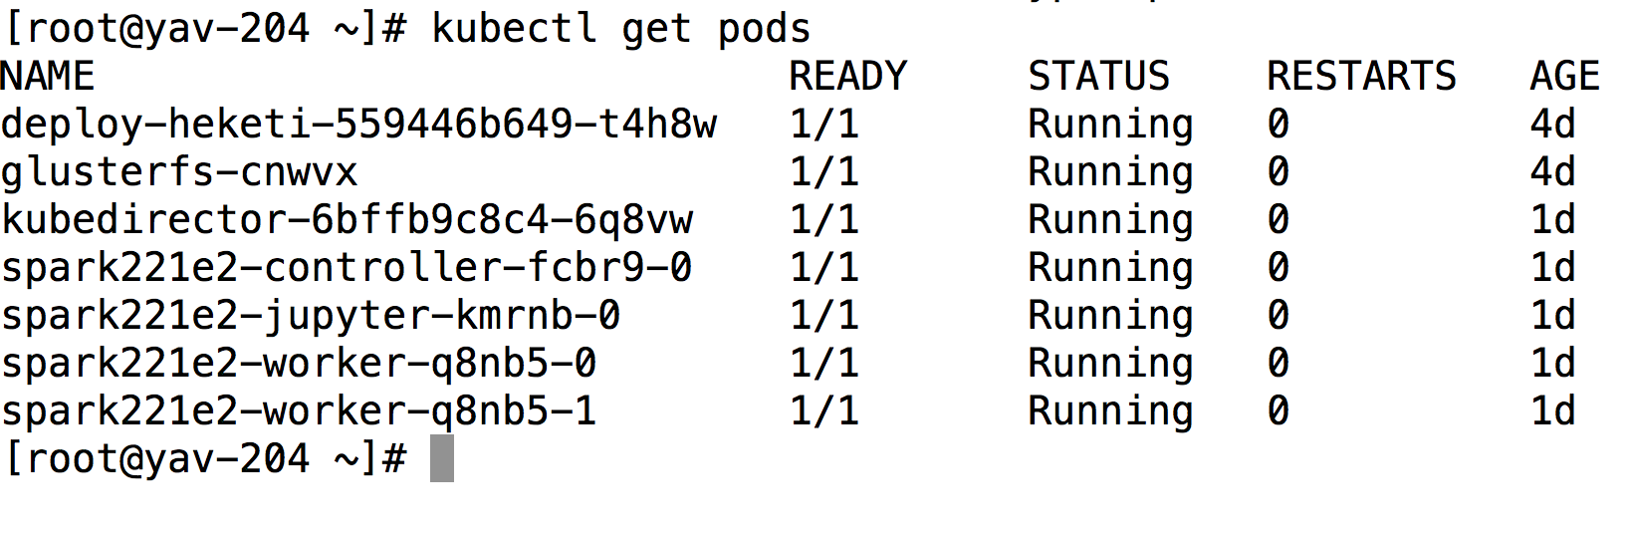
Resources managed using KubeDirector

Slide 50
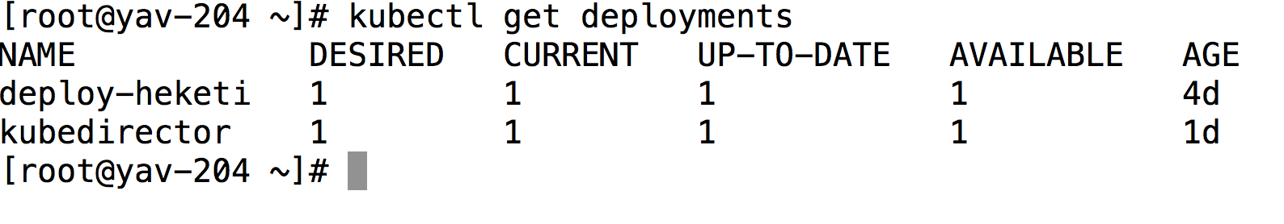
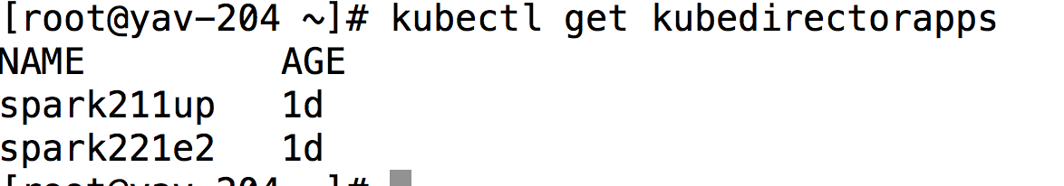
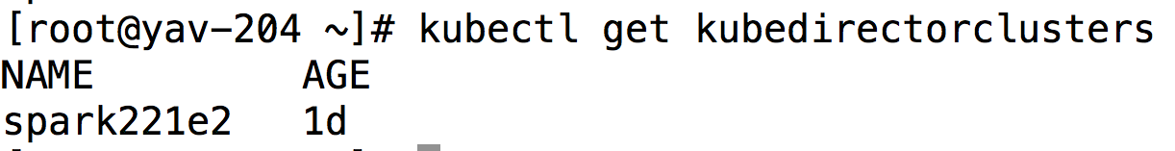
How did we get there?
1. Create a single deployment of KubeDirector
2. Define new Custom Resource App – API Extensions
Available apps that are registered
3.Create new Custom Type Clusters – Custom Resources
Instances of the registered apps (e.g. a spark cluster
Eliminates need for app developers to write app specific controllers

Slide 51
Register a specific app with K8s
JSON file (contd)
"spec" : {
"systemctlMounts": true,
"config": {
"node_services": [
{
"service_ids": [
"cloudera_scm_server",
"cloudera_scm_server_db",
"mysqld",
"cloudera_scm_agent",
"ssh"
],
"role_id": “cmserver"
},
{
"service_ids": [
"ssh",
"cloudera_scm_agent",
"hdfs_nn“,
“resource_manager“,
“hivethrift_server“,
“oozie“
],
"role_id": “controller“
},
JSON file (contd)
{
"service_ids": [
"ssh",
"cloudera_scm_agent“,
“hdfs_dn“,
“node_manager“,
],
"role_id": “worker“
},
"service_ids": [
"ssh",
"cloudera_scm_agent“,
“kafka_broker“,
“zookeeper“
],
"role_id": “broker“
},
.......
In this example, we register a CDH514 app
kubectl create -f example_catalog/cdh-app-cdh514c2.json
root@yav-204 example_catalog]# cat cr-app-cdh514c2.json
{
"apiVersion": "kubedirector.bluedata.com/v1alpha1",
"kind": "KubeDirectorApp",
"metadata": {
"name" : ”cdh514c2"
},

Slide 52
kubectl create -f example_clusters/cr-cluster-cdh514c2.yaml
Create New CDH clusters with CDH App and K8s KD
YAML file
YAML file (contd)
apiVersion: "kubedirector.bluedata.com/v1alpha1"
kind: "KubeDirectorCluster"
metadata:
name: ” cdh514c2"
spec:
app: cdh514c2
roles:
- name: controller
replicas: 1
resources:
requests:
memory: “16Gi"
cpu: “4"
limits:
memory: “16Gi"
cpu: “6"
- name: worker
replicas: 2
resources:
requests:
memory: “12Gi"
cpu: “4"
limits:
memory: “12Gi"
cpu: “4"
- name: cmserver
replicas: 1
resources:
requests:
memory: "4Gi"
cpu: "2"
limits:
memory: "4Gi"
cpu: "2”

Slide 53
KubeDirector Functionality
  Watch on instances of objects with type defined in “CRD”
    Example: Create CDH cluster with Hive, and Oozie
  Runs scripts and services to coordinate activities between different pods for clusters
    Example: Start HDFS, Start HiveServer2
  Any modifications, and scaling logic can be applied using KubeDirector watch events
    Example: Expand and shrink cluster
  Same controller handles requests for multiple instances of custom object
    Example: Create and monitor multiple CDH clusters

Slide 54

Key Takeaways
Kubernetes is still best suited for stateless services
Complex stateful services like Hadoop requires significant work
Statefulsets is a key enabler – necessary, but not sufficient
KubeDirector will simplify onboarding of Hadoop products and complex stateful apps to K8s
https://github.com/bluek8s

Slide 55
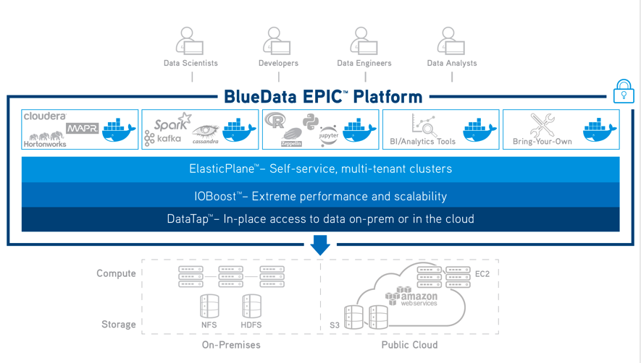
Thank You
For more information:
www.bluedata.com
Booth # 1034
Notes:
Jason: Thank you to everyone for attending this webinar – and a special thanks to Anant for presenting ….
All attendees of this webcast can click on the “Attachments” tab and download a copy of the slides and other information – you’ll also have access to the on-demand replay.
And if you’d like more information about BlueData software, you can visit our website at bluedata.com, contact us directly, or apply for a free trial of BlueData EPIC on AWS at bluedata.com/AWS
Again, thanks and have a great day.

Slide 56

Notes:
Jason to moderate and introduce questions – then field questions with Anant & Tom to answer

