Slide 1


Real-time automated claim processing
The surprising utility of NLP methods on
non-textual data

Slide 2

Who we are
Health Insurance
3 million
40 million
99%
66%
Members
Claims/yr
Electronic
Same-day
Notes:
< Give people real world attachment. This is Health Insurance. Remind people the rea world context

Slide 3
Automation & complexity
100%
Diminishing returns
Rare claims rarely have rules
Claims change, rules follow
Service Line Automation
Static medical rules have been developed, at Daman, to automate service line adjudication
Notes:
< You have not mentioned the actual problem. The : We are processing claims. We have X hundred people employed to solve this task and we want to automate this work.
< ok I get the message, UAE & Daman are cool because they have Electornic Medical reords everywhere AND daman has been working on Automation of the core business which is claims processing for some time. …. My comment : How does this introduce the talk. My Suggestion: “We automate a lot with different techniches and now I am going to show you our latest and greatest ML method for getting up to that 92% AND YOU CAN TOO when you listen to my talk “

Slide 4
Healthcare E-Claim
<Header>
      SenderID
      ReceiverID
      TransactionDate
      RecordCount
      DispositionFlag
<Claim>
      ID
      IDPayer
      MemberID
      PayerID
      ProviderID
      IDNumber
      Gross
      PatientShare
      Net
      <Encounter>
            FacilityID
            Type
            PatientID
            StartDate
            EndDate
            StartType
            EndType
      <Diagnosis>
            Type
            Diagnosis Code
      <Service Line>
            StartDate
            Type
            Service line Code
            Net Claimed amount
            Net
      <Clinician>
Metadata
Member Info
Financial
Network/incident data
Medical Data
Notes:
< Make it visually more clear that we are throwing away most of the data. We are only looking at the medical aspect of the claims
< HERE we should also add a slide which is an actual example of what the input space is. = A series of codes . A bag of codes. A sentence of Codes

Slide 5
Input Space
ICD10 E11.65
ICD10 H53.8
DDC M314223
DDC D529473
DDC M506000
Diabetes Type 2
Blurred Vision
Metformin
Glipizide
Abacavir
International Classification of Diseases Code
Dubai Drug Codes and Procedure Codes
(Service Lines)

Slide 6
Output Space
Accept
Accept
Reject
ICD10 E11.65
ICD10 H53.8
DDC M314223
DDC D529473
DDC M506000
Diabetes Type 2
Blurred Vision
Metformin
Glipizide
Abacavir
Service Line 1
Service Line 2
Service Line 3

Slide 7
A claim is a sentence
Claim 1
ICD10 E11.65
ICD10 H53.8
DDC M314223
DDC D529473
DDC M432150
Claim 2
ICD10 H10.12
ICD10 H93.8
DDC M314223
DDC D529473
DDC M506000
Claim 3
ICD10 E2.05
ICD10 E53.8
DDC M314223
DDC D529473
DDC M506000
Claim 4
ICD10 H8.85
ICD10 E53.8
DDC M314223
DDC D529473
DDC M506000

Slide 8
Using Word2Vec to represent a claim
Words
Service line IDs
Document
Claim
100,000
drug codes
50,000
procedure codes
~ 6 Service lines
Notes:
< slide HealthCare E-Claim & Claims & NLP are kind of together
< I don’t see what is the input space. We have a very well defined input space which is very similar to english lanauge sentences. And that is the key insight which is the title of the presentaiton “NLP Methods utility on non text data” .
< This is the key insight of the talk. Take a lot of time explaing the input space is a series of codes. So anyone listening to this talk that has a dataset which is a series of code can listen up and think wow this talk will be useful to me.

Slide 9
Similarity
Claim vectors
average/concatenate
on its service line words
Find nearby claims
Using cosine distance
and vote on service lines
CLM6
CLAIM
CLAIM
ID2043
ID2007
CLM5
CLM4
ID502
CLM3
CLM1
Word2vec is based on shallow
two-layer neural networks to create word embeddings
Notes:
< Why are we building a similarity space. Why don’t you just try to directly predict Accept/Reject. …. We can leave this open as question which we have a good answer prepared. OR we can create another slide which explains why this is not a simple binary classification problem.

Slide 10
Accepts ≠ Rejects
Gain
$$$
Accepts
Reduce Manual Processing
Wrongly accept Claims
Reduce Manual Processing
Manually process some resubmitted additional Denials
Rejects
+
Deny more
$
Loss

Slide 11
Accepts
Rejects
The model
The model
UP TO
50%
of undecided service lines
UP TO
15%
of undecided service lines
AT
98%
accuracy
AT
95%
accuracy
98%
95%
100
100
80
80
60
50%
60
Coverage (%)
40
40
20
20
15%
0
20
40
60
80
100
0
20
40
60
80
100
Accuracy (%)
Notes:
< Switching between Claims and Service Likes (activities) is really confusing. Maybe we can just delete this slide its too complicated.

Slide 12
Architecture
ML Engine
Rest Module
PRODUCTION
Deployment Module
AUTOMATED
Repository
Validation Module
TRAINING
Create/Refresh Module
REPORTING
Notes:
< Talk about the productive in memory model being 60gb and how we handle the swap when a newly fresh model gets moved to production

Slide 13
ML Engine extends current systems
New
Claim
Claim
Management
System
Auto
Adjudicated
Claim
Enterprise Service Bus
Business Rules
Medical Rules
> 24 mio
ML
Engine
Notes:
< Also move to the end

Slide 14
Journey
Trust
Building
Stand alone implementation Show value on past claims day by day
Validation
Business buy-in
Interpretability
GDPR
DRH AI Guidance
Notes:
< Can you move this slide to the back. You have not given me enough reason to listen to you and now your already telling me some coroporate story. First give people some meat

Slide 15





Reduce
Manual
Processing
By 2/3
Save
Net Cost
Increase
Processing
Speed
Increase
Accuracy
Opportunities
for other AI
systems
Notes:
< I would change the word Accuracy with Precision (or more humanly talk about Increase Decision Consistency )

Slide 16
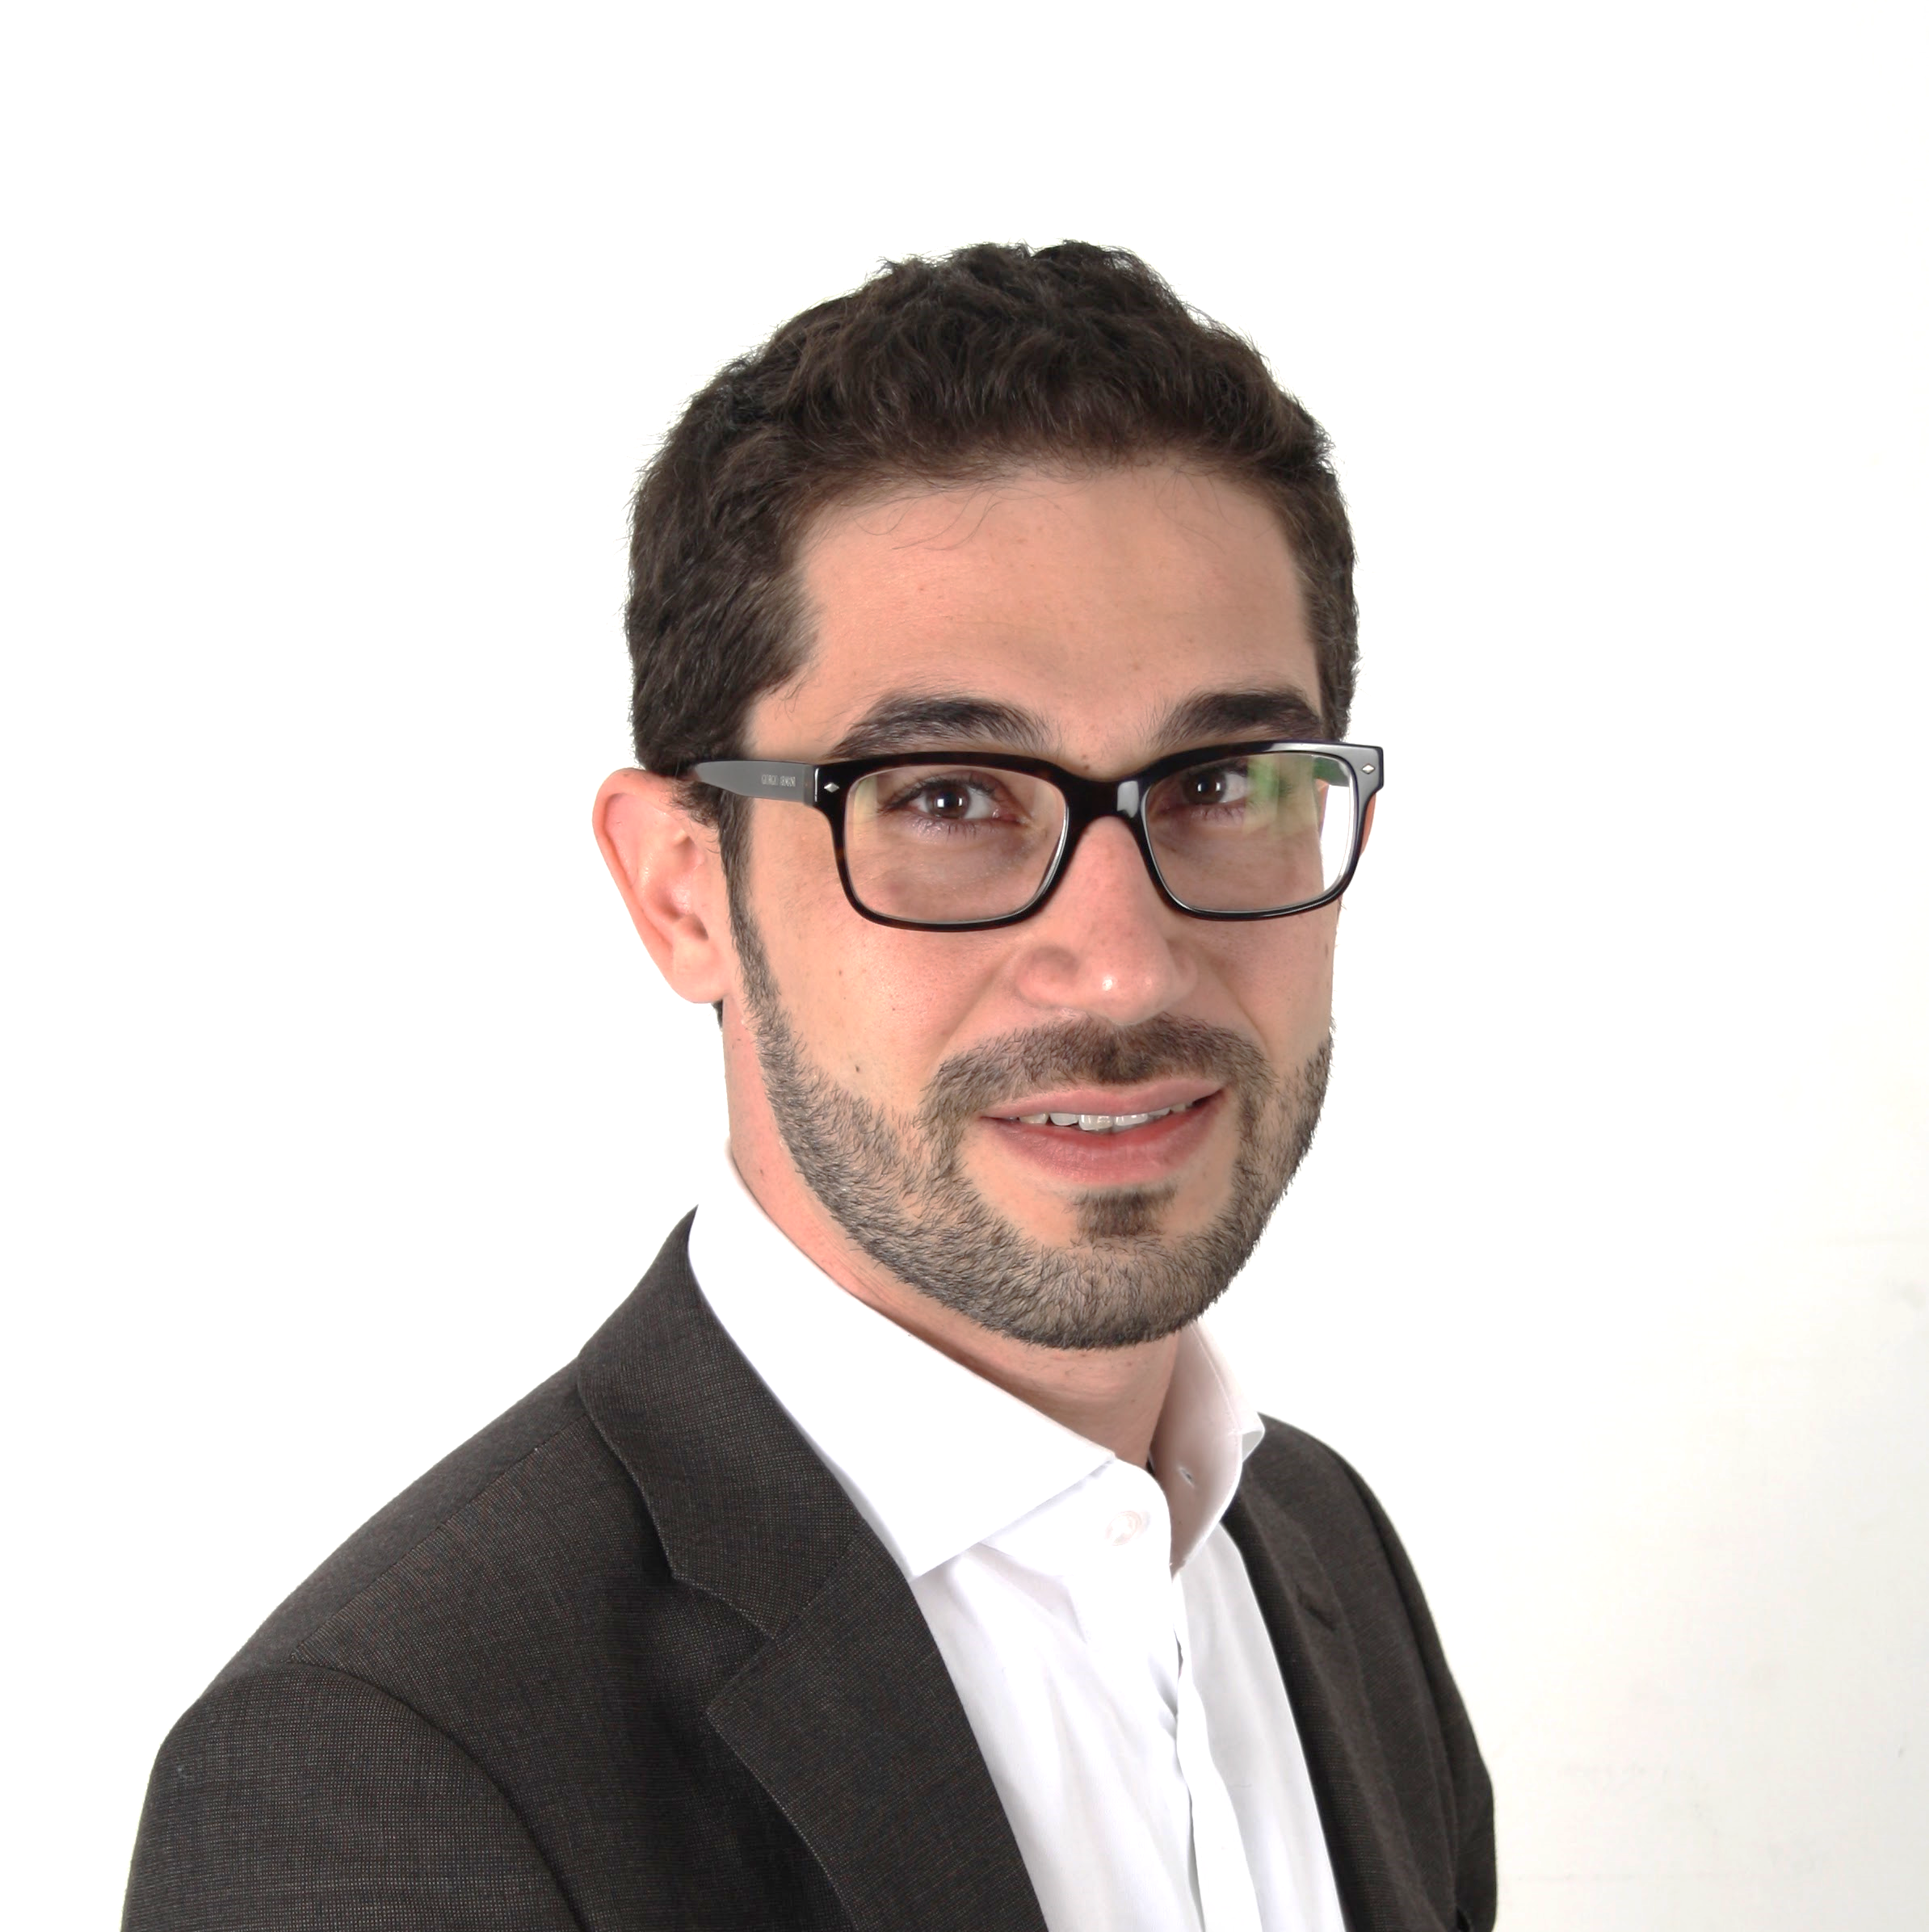
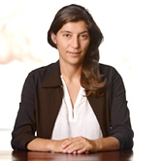
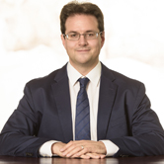

THANK YOU
Amro Alkhatib
Data Scientist
Daman
Asli Yaman
Senior Consultant
D-One
Philipp Thomann
Consultant
D-One
Ruben Wolff
Consultant
D-One

