Slide 1
A Programmer’s Guide to Secure Connections
Liz Rice

Slide 2
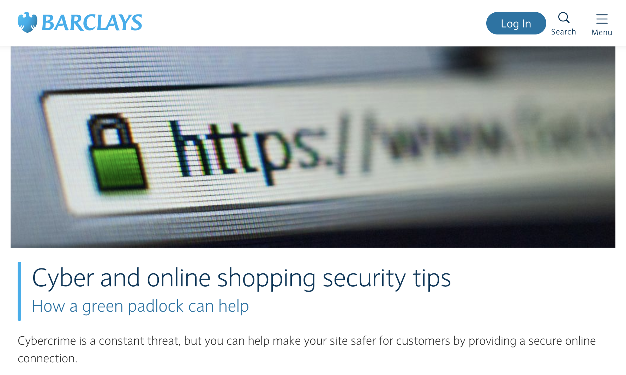

Slide 3
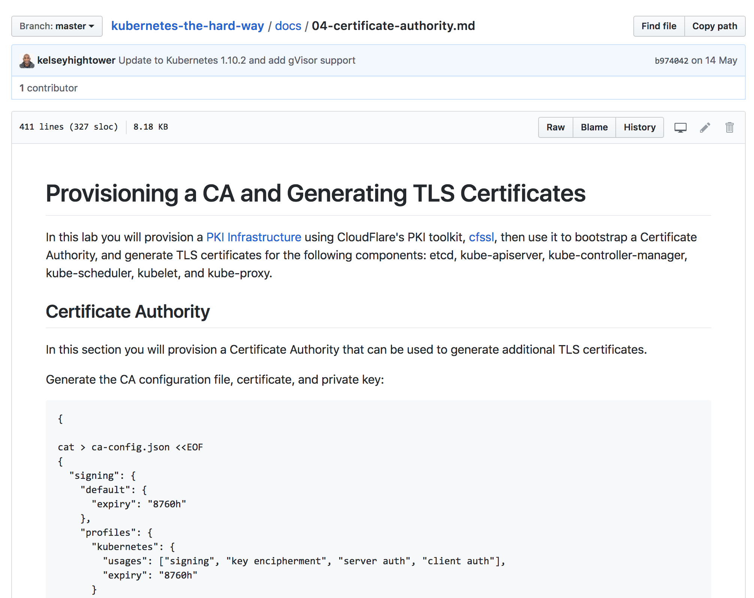

Slide 4
A guide to TLS connections
How do I set up secure connections?
What do these error messages mean?
What the hell are all these .crt, .key, .csr and .pem files?
Notes:
In distributed systems we might be using secure communications between components

Slide 5
Hello, I’m Liz
Hi! I’m your bank
Great! Here’s $500
Establishing identity is critical

Slide 6
Hello, I’m Liz
Hi! I’m your bank
Great! Here’s $500
Encrypted traffic prevents interception

Slide 7
Notes:
TLS is a newer version of SSL. SSL is now deprecated so even though people still talk about SSL

Slide 8
HTTP(S) runs over TCP
“hi”
blah blah blah
“hi”
Create TCP connection
TLS - encrypt TCP connection
Skip if regular HTTP
Send HTTP packets on connection

Slide 9
TCP connection
59.97.3.25:60401
27.193.43.2:8080
“Connection refused” = wrong port
(nearly always)

Slide 10
SYN
Establishing TCP
ACK
HELLO <server name>
HELLO
GetCertificate
(or Certificate)
<Server certificate>
Verify certificate, then call
VerifyPeerCertificate
HELLO DONE
GetClientCertificate
(or Certificate)
<Client certificate>
Verify certificate, then call
VerifyPeerCertificate
TLS Handshake
Generate Pre-Master Secret
<Pre-Master Secret>
(encrypted with server key)
Generate session key from Pre-Master Secret
Generate session key from Pre-Master Secret
Change cipher <session key>
FINISHED
FINISHED
Symmetric encryption with session key
blah blah blah
Symmetric encryption with session key

Slide 11
Keys & certificates

Slide 12
Public / private key encryption
Public key can be freely distributed and is used to encrypt
Private key must be kept private and is used to decrypt
“hello”
<encrypted>
“hello”
Notes:
If I send you my public key, I can send you encrypted messages and you will be able to read them
So will anyone else who has my public key

Slide 13
Public / private key signatures
Private key must be kept private and is used to sign message
Public key is used to verify signature
“hello”
“hello”
+
+
“hello”
signature
+
signature
=
signature
Notes:
If I send you my public key, I can send you encrypted messages and you will be able to read them
So will anyone else who has my public key

Slide 14
Sharing a public key
Hi, I’m Liz. Here’s my public key.
Why should I believe you?
Need a trusted authority in common
“Certificate Authority”

Slide 15
X.509 certificate
Subject name
Subject’s public key
Issuer (CA) name
Validity
Certificate signed by issuer (CA)
This is to certify that
liz-server
has public key
abcdef
CA

Slide 16
X.509 certificate chain
This is to certify that
liz-server
has public key
abcdef
This is to certify that
A
has public key
123456
A
B

Slide 17
Subject Name
Your certs should use Subject alternative names (SAN)
Common Name deprecated in 2000
Chrome browser stopped supporting CN in April 2017
SAN supports multiple DNS names in one certificate

Slide 18
Creating keys & certificates

Slide 19
Trusted Certificate Authorities
Like Let’s Encrypt
Known in system certificate pools
Create a Certificate Signing Request
openssl req -key private-key -new -out csr
For public-facing domains
Not for internal components in a distributed system

Slide 20
CLI tools
openssl
See contents of certificate: openssl x509 -text
Doesn’t easily support SANs (Subject Alternative Names)
cfssl
Comprehensive toolkit
mkcert
Local development
Installs CA into your system & browsers
minica
Easy generation of key & certs

Slide 21
Notes:
DER is an ASN-1 encoding format (TLV)

Slide 22
Mutually-authenticated TLS (mTLS)

Slide 23
Takeaways

Slide 24
To establish your identity
You will need:
A private key
A certificate for your identity
The other end needs to trust the Certificate Authority that signed your certificate. This may require appending the CA’s certificate.

Slide 25
File extensions
Inconsistently used
Information type : .crt for certificate, .key for private key...
Or file format: .pem
PEM files are base64-encoded and tell you what they contain
openssl can tell you about the contents

Slide 26
Common error messages
Connection refused
Check you’re connecting to the right port
Certificate signed by unknown authority
Received a certificate, but it’s not trusted
Examine CA in certificate to see if it should be known to receiver
Remote error
It’s the other end that’s complaining

Slide 27
github.com/lizrice/secure-connections

