Slide 1
Intel Nervana Graph
A Universal Deep learning compiler
Jason knight
Platform Architect

Slide 2
Motivation

Slide 3
Deep learning ecosystem - a many to many problem
Users
Frameworks
Neon
Caffe{2}
MXNet
TensorFlow
…
O(mn)
engineering effort
Hardware
Crest
Xeon
GPU
…

Slide 4
Deep learning hardware - a many to many problem
Users
Frameworks
Neon
Caffe{2}
MXNet
TensorFlow
…
O(m+n)
engineering effort
Nervana Graph
Hardware
Crest
Xeon
GPU
…

Slide 5
The Nervana Graph Project
An intermediate representation (IR) for deep learning
Compiler backends (transformers)
Frontend “connectors”
A reference frontend (neon)

Slide 6
The Nervana Graph Project
An intermediate representation (IR) for deep learning
Compiler backends (transformers)
Frontend “connectors”
A reference frontend (neon)

Slide 7
Nervana Graph – Just one more layer
Neon
MXNet
…
TensorFlow
Nervana Graph
MKL-DNN
MKL
Xeon

Slide 8
Nervana Graph – The Ecosystem
Neon
MXNet
…
TensorFlow
XLA (API)
ONNX
Nervana Graph API
DL Deployment Toolkit
Investigation stage
Crest Backend
CPU Backend
GPU Backend
…
Halide
TVM
Weld
MKL-DNN
OpenCL/CUDA/cuDNN
Crest
Xeon
GPU

Slide 9
Nervana Graph Users
Framework developers
  Create special purpose or new frameworks with high performance across many platforms easily
Hardware and System Software developers
  Commit once and plug into the ecosystem
Optimization experts
  Implement/leverage this optimization technique once and propagate across other platforms
Deployment/Operations
  Take a model and deploy it somewhere; now people can export models from other frameworks

Slide 10
Nervana Graph – IR and Frontends
Intermediate representation and deep learning library “connectors”

Slide 11


Nervana Graph IR
$$b_{0}$$
$$W_{0}$$
X
Dataflow graph
  With support for control dependencies for side-effecting operations
Rectangles are sources
  Trainable (variable)
  External (placeholder)
  Constant
Ellipses are operations
Arrows show data inputs
dot
add
add
neg
exp
1
add
recip

Slide 12
Nervana Graph IR - Currently
Try to strike a balance
  Small enough to avoid ‘op creep’
  Large enough to maintain performance
Tensor math
  Unary/binary element wise, Reductions
Tensor manipulation (slicing, broadcasting)
Control flow (parallel, sequential)
Data mutation (Assignment)

Slide 13
Nervana Graph IR – Where we’re going
More control flow
  Limited looping (while)
  Iterate over selectable axes
Reductions and maps
  With user specified sub computations
With the goal of:
  Enable people to avoid writing x86 assembly, CUDA, etc and still get robust performance for new recurrent kernels and layer types

Slide 14
Nervana Graph Axes
Tensor dimension management (dimshuffles, axis ordering, ...)
  Pain point for end users
  Difficult for device specific layout optimizations
Nervana Graph introduces named Axes
  Give meaningful names to axes for more meaning
  Optional for frontends without support
  Enables compiler to perform more static verification/analysis for the user

Slide 15
Graph construction example
def sigmoid(x):
return ng.reciprocal(ng.exp(-x) + 1)
X = ng.placeholder(axes=[ax.C, ax.N])
Y = ng.placeholder(axes=[ax.N])
W = ng.variable(axes=[ax.C], initial_value=0)
b = ng.variable(axes=ax.C, initial_value=0)
Y_hat = ng.sigmoid(ng.dot(W, X) + b)
L = ng.cross_entropy(Y_hat, Y) / ng.batch_size(Y_hat)

Slide 16
Working with the graph
Find all variables that contribute to an Op
  Y_hat.variables()
Graph traversal and mutation
  op_list = ng.ordered_ops(cost)
Generate graph for the derivative of one Op with respect to another
  grad = ng.deriv(L, W)
  Uses reverse-mode autodiff backprop

Slide 17
Nervana Graph Connectors
Originally: Converters
  Start with graph or layer representation of source framework
    Protobuf output of TensorFlow
    Prototxt of Caffe
  Pattern match operations to one or more ngraph Ops
Now: seamless interop with TensorFlow and MXNet
  By obtaining graph internally to the framework allows for reuse of host framework’s API’s, serialization, etc.

Slide 18
ONNX – Open Neural network exchange
Designed as an interchange format between frameworks
Initial release from Microsoft and Facebook:
  Protocol buffer based definition of dataflow graph
  Initial set of deep learning operators
Inference only for now
No optimizers or compiler ecosystem
Intel is participating in open design process

Slide 19
Nervana Graph Status – Frontend and IR
Currently
    Python API and implementation
    neon on ngraph running with MLP, Convolutional, RNN, GANs, …
    Serialization, visualization (including Tensorboard support), CSS style selectors
    Tensorflow XLA connector POC
In Progress
    C/C++ API and port
    Full TensorFlow XLA backend and MXNet integration
    External Op (FFI) support (support custom user kernels analogous to inline assembly in C/C++)

Slide 20
Nervana Graph – Backends
Graph compilation

Slide 21
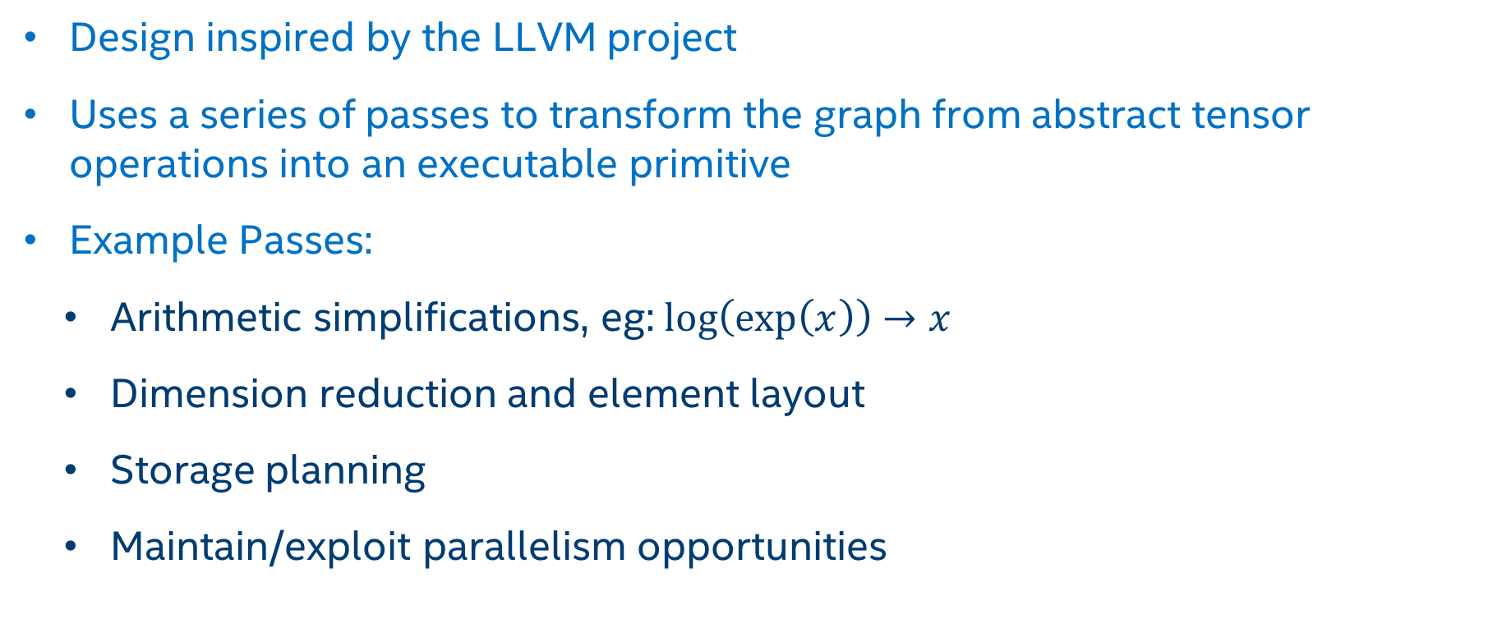
Graph Transformation/Compilation
Design inspired by the LLVM project
Uses a series of passes to transform the graph from abstract tensor operations into an executable primitive
Example Passes:
  Arithmetic simplifications, eg: $\log\left(\exp\left(x\right)\right)→x$
  Dimension reduction and element layout
  Storage planning
  Maintain/exploit parallelism opportunities

Slide 22
Why not use existing compilers? (LLVM, ICC)
Operations are primarily tensor operations
  Tensor == Large multidimensional (often aliased) array
  Fairly regular structure at this level
Many optimizations at the tensor level
  Horizontal fusion
  Memory liveness for large tensors (rather than registers)
Can still leverage these compilers within codegen of transformers
  POC for C++ code gen and JIT using LLVM

Slide 23
How does this compare to CUDA, cuDNN, MKL-DNN?
CUDA, cuDNN, and MKL-DNN offer low levels of abstraction
  ‘Raw’ matrix multiplies and convolutions
Deep learning practitioners usually don’t need this amount of control
Many ways to hurt performance when working at this level
  Memory layout/allocation strategies
  Operation fusion

Slide 24
Why neon vs TensorFlow, Caffe, etc?
We plan for neon to set the bar for performance in the industry
Innovation laboratory for deep learning infrastructure
  Axes
  Containers
  Dynamic networks

Slide 25
Nervana Graph Status – Transformers/Compilation
Transformers
  GPU transformer using Nervana GPU Kernels on CUDA
  CPU transformer using MKL-DNN and Numpy
  Heterogeneous distributed training
  Crest
Common optimization pass API
  Operator fusion
  Pattern matching utilities
  Memory sharing
  Layout

Slide 26
Nervana Graph roadmap - highlights
2017Q4
  Seamless interop with TensorFlow through XLA backend
  Multi-device training support via Heterogeneous Transformer
  Multi-node training for small (~8) number of nodes
  Performance milestones
And Beyond
  More frontends: MXNet, CNTK, Pytorch
  More backends
  Deployment optimizations: quantization and pruning

Slide 27
More information
Github Repository
https://github.com/NervanaSystems/ngraph
Documentation
https://ngraph.nervanasys.com/docs/latest/

Slide 29
Legal Notices & disclaimers
This document contains information on products, services and/or processes in development. All information provided here is subject to change without notice. Contact your Intel representative to obtain the latest forecast, schedule, specifications and roadmaps.
Intel technologies’ features and benefits depend on system configuration and may require enabled hardware, software or service activation. Learn more at intel.com, or from the OEM or retailer. No computer system can be absolutely secure.
Tests document performance of components on a particular test, in specific systems. Differences in hardware, software, or configuration will affect actual performance. Consult other sources of information to evaluate performance as you consider your purchase. For more complete information about performance and benchmark results, visit http://www.intel.com/performance.
Cost reduction scenarios described are intended as examples of how a given Intel-based product, in the specified circumstances and configurations, may affect future costs and provide cost savings. Circumstances will vary. Intel does not guarantee any costs or cost reduction.
Statements in this document that refer to Intel’s plans and expectations for the quarter, the year, and the future, are forward-looking statements that involve a number of risks and uncertainties. A detailed discussion of the factors that could affect Intel’s results and plans is included in Intel’s SEC filings, including the annual report on Form 10-K.
The products described may contain design defects or errors known as errata which may cause the product to deviate from published specifications. Current characterized errata are available on request.
No license (express or implied, by estoppel or otherwise) to any intellectual property rights is granted by this document.
Intel does not control or audit third-party benchmark data or the web sites referenced in this document. You should visit the referenced web site and confirm whether referenced data are accurate.
Intel, the Intel logo, Pentium, Celeron, Atom, Core, Xeon and others are trademarks of Intel Corporation in the U.S. and/or other countries.
*Other names and brands may be claimed as the property of others.
© 2017 Intel Corporation.

Slide 30
 | Intel Nervana Graph | XLA | TVM | Halide | Tensor RT
Framework independence | ✓ |  | ✓ | ✓ | ✓
Framework connectors | ✓ | ✓ (only 1) | ~ | ~ | ✓
Hardware independence | ✓ | ✓ | ✓ | ✓
Leverage existing tensor libraries | ✓ | ✓ |  |  | ~
Inference and training | ✓ | ✓* | ✓ | ✓
Production ready |  |  |  | ✓ | ✓

