Slide 1
Supply chain evolution
from horseless buggies
to driverless cars
Val Bercovici Founder & CEO
@valb00 @Pencil_DATA

Slide 2
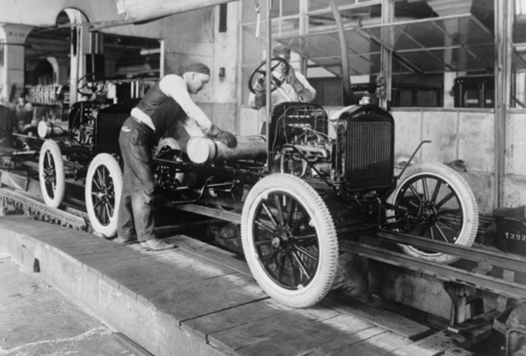
Context
105 years old
Global manufacturing
Broad supply chains
Highly regulated
~ 100M Cars
Will soon never be same
http://www.scotsusa.com/heritage/on-this-day-100-years-ago-henry-t-ford-installed-the-first-moving-assembly-line/

Slide 3
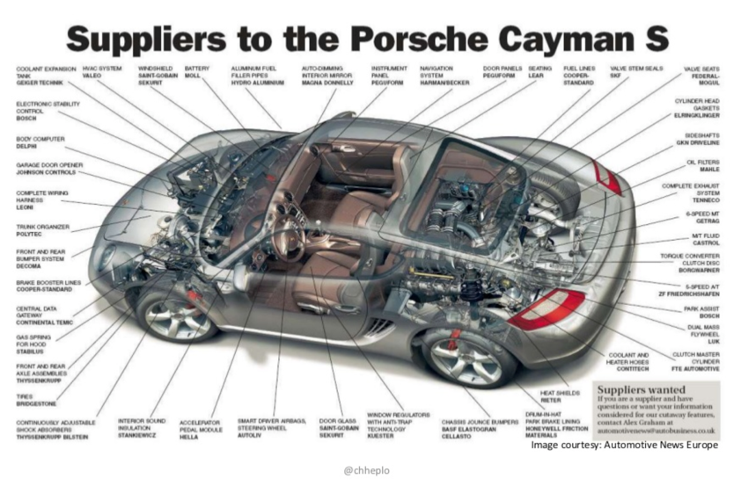
Complexity to Date

Slide 4
IoT Fatigue
https://www.yaabot.com/31856/iot-fatigue-real-thing-happens-avoid/

Slide 5
Tectonic Auto Industry Shifts
Autonomous
DATA, DATA, DATA
From horseless to Driverless
Captive Audience = Unprecedented Marketing
Connected
Electrification
5G enables peer to peer communications at scale
Disrupts massive Oil Industrial Complex

Slide 6
Data Hierarchy of Needs
Teachable
Raw & Filtered
Connected - eventually
Heterogeneous
Compliant
Primal to Enlightened

Slide 7
Tools
Software supply chain:
Aggregation
Verification &
Distribution
Data:
Provenance
Lineage
Immutability as needed
Valuation

Slide 8
Software 2.0 = Teaching Algos with Data

Slide 9
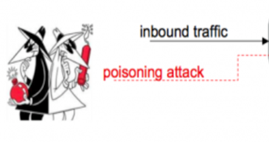
Data Poisoning

Slide 10
One Chain to Bind Them
Blockchain Nodes on fleet of vehicles
Natural deployment model. Secure the genesis block and create distributed set of nodes with mining Proof of Work as:
Miles / Kilometers driven
Regenerative braking energy gained
Roads mapped via LIDAR
Images classified from cameras
Incident / Event info exchange over 5G

Slide 11
Digital Supply Chain
Software
Config
3D Printing
Data ←→

Slide 12
Ecosystem
Service
(incl Preventative)
Rideshare
Loyalty
Security
(Public & Private)
Connectivity
Insurance
Registration

Slide 13
Decentralized Supply Chain

Slide 14
Business Metrics
Loyalty Program$
Hidden Gem – New MRR / ARR
Partner / Ecosystem Heavy
Compliance (Right to Repair)
Optimize for Superset of Legal Jurisdiction
Adapt to evolving L3-L5 Autonomous Regulations
Global Manufacturing
Robotic Assembly Optimizes for Location
Raw Material Supply Chain (Li-on, Cobalt, …)
Recalls & Fines (DieselGate)
Avoidance via Machine Learning Predictions
Efficient Recall Processing via Gaming Theory

Slide 15
Supply chain evolution
from horseless buggies
to driverless cars
Val Bercovici Founder & CEO
@valb00 @Pencil_DATA

