Slide 1
Rendezvous with AI

Slide 2
Contact Information
Ted Dunning, PhD
Chief Application Architect, MapR Technologies
Committer, PMC member, board member, ASF
O’Reilly author
Email tdunning@mapr.com tdunning@apache.org
Twitter @Ted_Dunning

Slide 3
No matter how clever you are, two
things will always hold:

Slide 4
data and deployment logistics will dominate your work

Slide 5
you will need more than two versions of your model

Slide 6
Traditional View

Slide 7
Traditional View: This isn’t the whole story

Slide 8
90% of the effort in successful machine learning isn’t in the training or model dev…
It’s the logistics

Slide 9
What We Want Today
Decision models with limited context
Hard real-time response (10’s of ms)
Provide realistic warmup and QA environment
Roll (back) new models safely and quietly
Monitor champion and challengers
Detect changes in input data distribution
Collect real data for next round of model upgrades

Slide 10
Rendezvous to the Rescue: Better ML Logistics
Stream-1st architecture is a powerful approach with surprisingly widespread advantages
  Innovative technologies emerging to for streaming data
Microservices approach provides flexibility
  Streaming supports microservices (if done right)
Containers remove surprises
  Predictable environment for running models

Slide 11
Rendezvous: Mainly for Decisioning Engines
Decisioning models
  Looking for a “right answer”
  Simpler than reinforcement learning
Examples include:
  Fraud detection
  Predictive analytics / market prediction
  Churn prediction (as in telecommunications)
  Yield optimization
  Deep learning in form of speech or image recognition, in some cases

Slide 12
Stream-1st Architecture: Basis for MicroServices
Stream instead of database as the shared “truth”
Image © 2016 Ted Dunning & Ellen Friedman from Chap 6 of O’Reilly book Streaming Architecture used with permission

Slide 13
Streaming Isolates Services

Slide 14
With MapR, Geo-Distributed Data Appears Local

Slide 15
With MapR, Geo-distributed Data Appears Local
Regional Data Center
Global Data Center

Slide 16
Features of Good Streaming
It is Persistent
  Messages stick around for other consumers
  Consumers don’t affect producers
  Consumer doesn’t have to be online when message arrives
It is Performant
  You don’t have to worry if a stream can keep up
It is Pervasive
  It is there whenever you need it, no need to deploy anything
  How much work is it to create a new file? Why harder for a stream?

Slide 17
Stream transport supports microservices

Slide 18
But we talked about decision engines?!?

Slide 19
What We Ultimately Want

Slide 20
But This Isn’t The Answer

Slide 21
First Try with Streams

Slide 22
First Rendezvous

Slide 23
Some Key Points
Note that all models see identical inputs
All models run in production setting
All models send scores to same stream
The rendezvous server decides which scores to ignore
Roll forward, roll back, correlated comparison are all now trivial

Slide 24
Reality Check, Injecting External State

Slide 25
Recording Raw Data (as it really was)

Slide 26
Quality & Reproducibility of Input Data is Important!
Recording raw-ish data is really a big deal
  Data as seen by a model is worth gold
  Data reconstructed later often has time-machine leaks
  Databases were made for updates, streams are safer
Raw data is useful for non-ML cases as well (think flexibility)
Decoy model records training data as seen by models under development & evaluation

Slide 27
Canary for Comparison

Slide 28
What Does the Canary Do?
The canary is a real model, but is very rarely updated
The canary results are almost never used for decisioning
The virtue of the canary is stability
Comparing to the canary results gives insight into new models

Slide 32
Models in production live in the real world:
Conditions may (will) change

Slide 33
Rendezvous Schedules
The key idea of rendezvous schedules is to define the trade-off of latency versus model priority
  At short delays, we want the best
  At moderate delays we will compromise a bit
  Near the deadline, we will take any answer at all
Normally the same rendezvous schedules apply to all transactions
  Overriding default schedule has bona fide uses

Slide 34
Rendezvous Overrides
Incoming transaction can carry an overriding schedule
  This is great for QA, to see output from a specific model
  Overriding the default schedule is also good for systemic A/B tests
Overrides should be unusual

Slide 35
A Quick Review

Slide 36
The Proxy Talks to the Outside World

Slide 37
The Input Stream Feeds All Models Identically

Slide 38
The Scores Stream Contains All Results

Slide 39
The Rendezvous Picks A Result

Slide 40
Results Return Via A Stream and Return Address

Slide 41
Let’s talk about how the rendezvous architecture makes evaluation easier

Slide 42
Decoy Model in the Rendezvous Architecture
Looks like a server, but it just archives inputs
Safe in a good streaming environment, less safe without good isolation

Slide 43
Other Data Collected in Rendezvous
Request ID + Input data
All output scores
Evaluation latency
Round trip latency
Rendezvous choices

Slide 44
Direct Model Comparison
Don’t need ground truth to compare models at a gross level
For uncalibrated models, score quantiles are useful
For mature models, most results will be very similar
  Large differences from known good models cannot be good
Ultimately, ground truth is important
  But only for cases where scores differ significantly

Slide 45
Direct Model Differencing

Slide 46
Direct Model Differencing
Scales may differ radically

Slide 47
Direct Model Differencing
Scales may differ radically
Quantiles correct scaling

Slide 48
Direct Model Differencing
Perfect match on high scores
Scales may differ radically
Quantiles correct scaling

Slide 49
Reject Inferencing
Today’s model selects tomorrows training data
Safe decisions often prevent data collection
  Fraud flag prevents the transaction
  Recommendation ranking has the same effect
The model winds up confirming what it already knows
Model comparison has same problem
  Champion says reject, challenger says retain

Slide 50
Reject Inferencing Solution
We must balance EXPLORATION
  Calling a bluff to look at ground truth
Versus EXPLOITATION
  Doing what we think is right
Exploration costs us because we make worse decisions
  But it can help make better decisions later
Exploitation costs us because we don’t learn better answers
  But it is the best we know now

Slide 51
Multi-Armed Bandits
Classic formulation for explore/exploit trade-offs
Thompson sampling is very good option
Simple dithering may be good enough
Key intuition is that we don’t need to perfectly characterize losers … once we know they are losers, we don’t care
Variant for ranking also good for model evaluation
  Also used to rank reddit comments

Slide 52
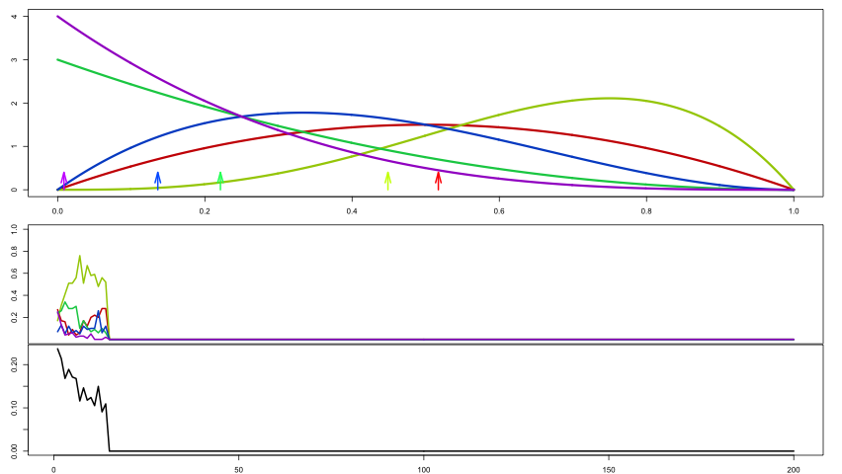

Slide 53
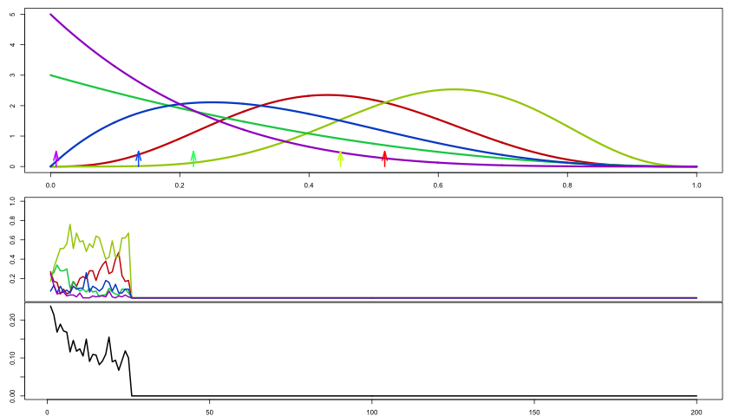

Slide 54
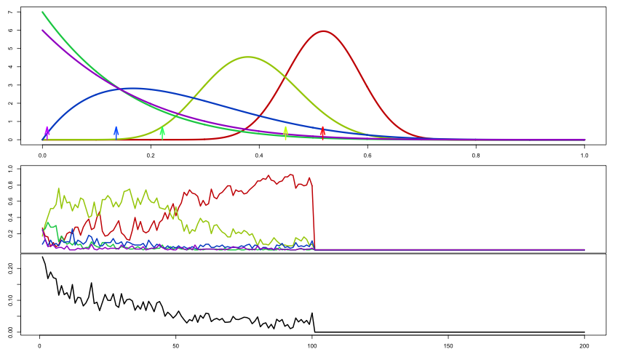

Slide 55
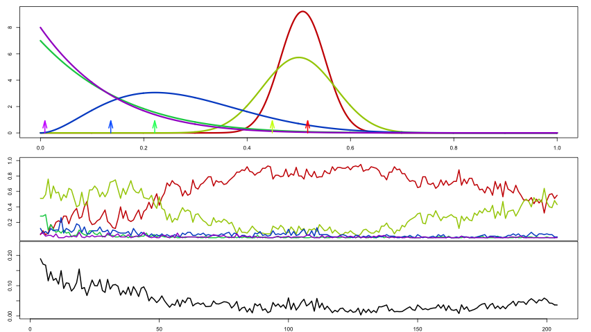

Slide 56
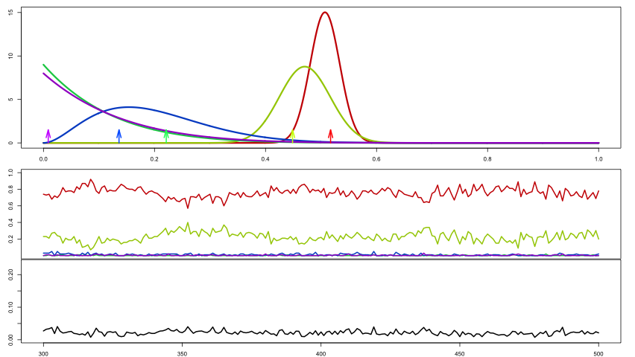

Slide 57
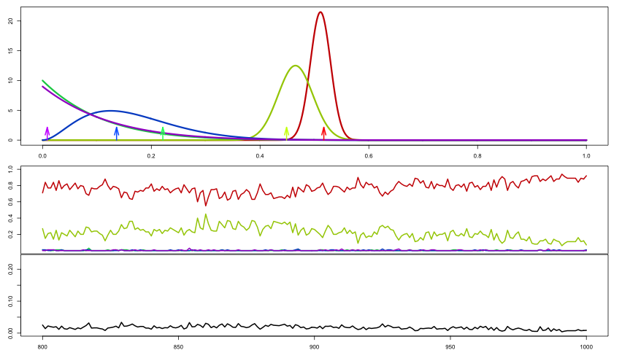

Slide 58
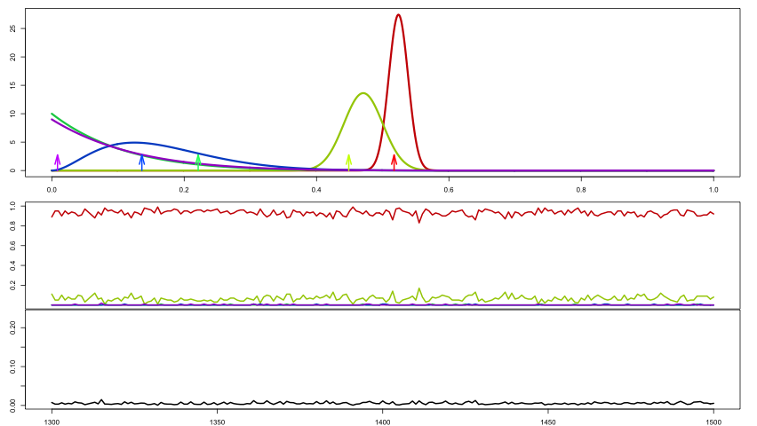

Slide 59
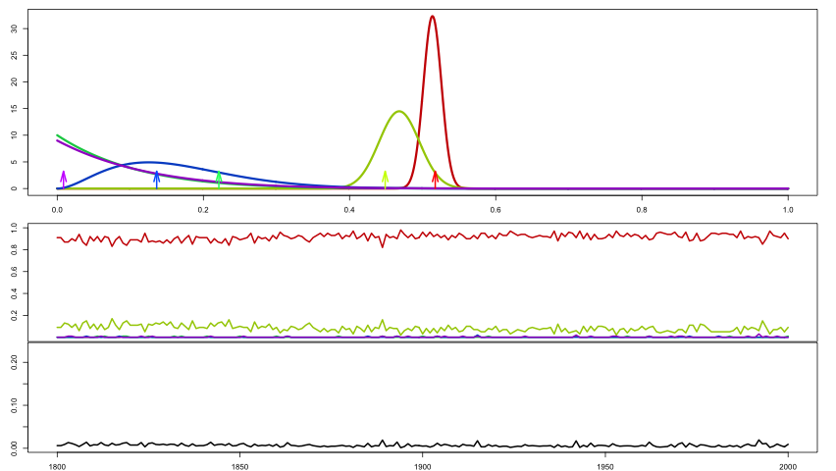

Slide 60
Some Warnings
Bad models can be good explorers
That can make other models look better
Offline evaluation is fine, but you don’t know what would have happened … real innovation has high error bars
Where models all agree, we learning nothing
In the end, it is differences that matter the most

Slide 61
Having complete and precise history is golden for
offline comparisons

Slide 62
Allowing the rendezvous server
to do Thompson sampling is
even better

Slide 63
Change Detection
Model comparison is all fine and good until the world changes
And the world will change
One of the most sensitive indicators is score distribution for a good model
  T-digest is very effective for sketching distributions, especially in tails
  Compare current vs historical distribution using q-q or KS

Slide 64
Rendezvous Schedules
The key idea of rendezvous schedules is to define the trade-off of latency versus model priority
  At short delays, we want the best
  At moderate delays we will compromise a bit
  Near the deadline, we will take any answer at all
Normally the same rendezvous schedules apply to all transactions
  Overriding default schedule has bona fide uses

Slide 65
Rendezvous Overrides
Incoming transaction can carry an overriding schedule
  This is great for QA, to see output from a specific model
  Overriding the default schedule is also good for systemic A/B tests
Overrides should be unusual

Slide 66
Scaling Up
More kinds of model
  multiple rendezvous frameworks for different tasks
More throughput
  Fast default models
  Partition input stream to allow parallel model evaluation
  Input batching
Extreme volumes require extreme measures
  Cannibalize fancy models to run more fast/simple models
  Speed before beauty

Slide 67
Faster Throughput Through Failure
Suppose we have one model that can handle 10,000 t/s @ 2ms
  But this isn’t the most accurate model. Not bad, but not best
And our champion model can handle 1000 t/s @ 10ms
Then imagine a burst of 2000 t/s for several minutes
Champion can only evaluate half of all requests
  Should skip to keep up
  Fast model will cover for champion

Slide 73
Always have a default or
fallback model
Models that fall behind should discard requests to catch up

Slide 74
Limitations of Rendezvous
100% speculative execution can be expensive
  Can be mitigated by partial speculation
  Or it may just be too expensive
Minimum Viable Products should be minimal
  You may not require zero downtime … be realistic
Context may be too large
Latency limits may be too stringent

Slide 75
Ad Targeting Example
User profile and context used
for rough-cut selection of ads
Roughly 1000 ads are scored in
detail for p(click)

Slide 76
Model Batching

Slide 77
Model Batching

Slide 78
Model Batching

Slide 79
Model Batching

Slide 80
Model Batching

Slide 81
Model Batching

Slide 82
Why Not Full Rendezvous?
1000’s of ads / second x 1000 candidates = 1M scores / second
  AKA “a lot”
Scoring a single model is expensive
Sharding and replication provides a form of failure tolerance
Full speculative execution across several options is prohibitive
Latency guarantees can be very short (10 ms)

Slide 83
Rendezvous-lite Options
We have some options
We can allow selective speculation on marked requests
  If only 1% of ads run speculative execution, we can pack 10x more shards per node and use 10x fewer nodes
  Selective speculation doesn’t give redundancy
We can release results if >80% of shards reply
Temporary speculation during hand-offs is useful

Slide 84
Let’s Review

Slide 85
A Quick Review

Slide 86
The Proxy Talks to the Outside World

Slide 87
The Input Stream Feeds All Models Identically

Slide 88
The Scores Stream Contains All Results

Slide 89
The Rendezvous Picks A Result

Slide 90
Results Return Via A Stream and Return Address

Slide 91
Conclusions
Computers are much faster than before
Previously crazy ideas can now be valuable
But, you can’t have it all
  Your mother already told you that

Slide 92


Additional Resources
O’Reilly report by Ted Dunning & Ellen Friedman © March 2017
Read free courtesy of MapR:
https://mapr.com/geo-distribution-big-data-and-analytics/
O’Reilly book by Ted Dunning & Ellen Friedman © March 2016
Read free courtesy of MapR:
https://mapr.com/streaming-architecture-using-apache-kafka-mapr-streams/

Slide 93

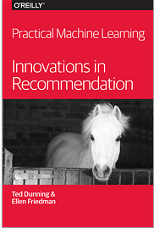
Additional Resources
O’Reilly book by Ted Dunning & Ellen Friedman © June 2014
Read free courtesy of MapR:
https://mapr.com/practical-machine-learning-new-look-anomaly-detection/
O’Reilly book by Ellen Friedman & Ted Dunning © February 2014
Read free courtesy of MapR:
https://mapr.com/practical-machine-learning/

Slide 94
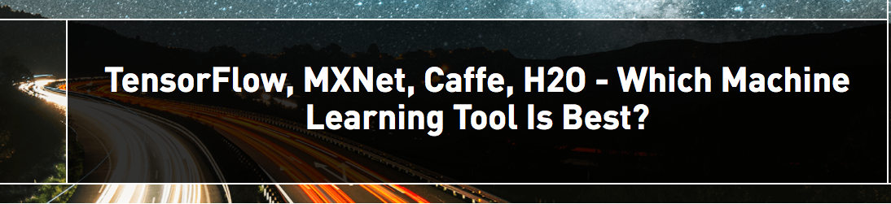
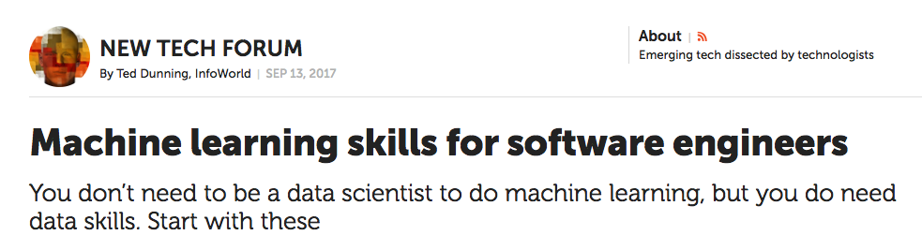
Additional Resources
by Ellen Friedman 8 Aug 2017 on MapR blog:
https://mapr.com/blog/tensorflow-mxnet-caffe-h2o-which-ml-best/
by Ted Dunning 13 Sept 2017 in InfoWorld:
https://www.infoworld.com/article/3223688/machine-learning/machine-learning-skills-for-software-engineers.html

Slide 95
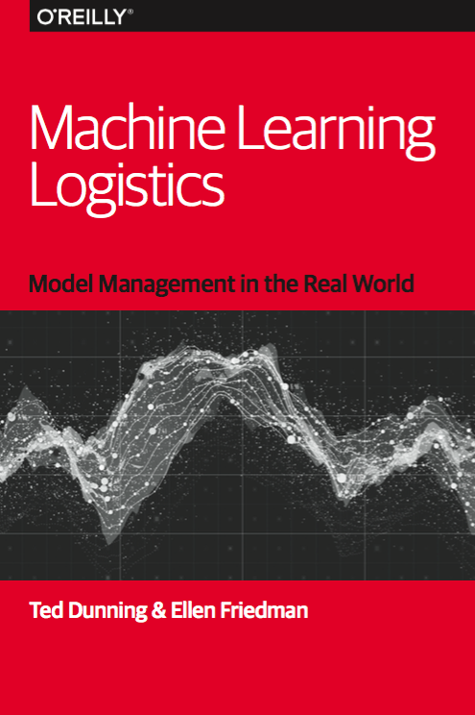
This book: Machine Learning Logistics
Model Management in the Real World
O’Reilly book by Ellen Friedman & Ted Dunning
Download free from MapR
https://mapr.com/ebook/machine-learning-logistics/

Slide 96

Please support women in tech – help build girls’ dreams of what they can accomplish
#womenintech #datawomen
© Ellen Friedman 2015

Slide 97


ENGAGE WITH US
Q&A
@ Ted_Dunning
@mapr
tdunning@mapr.com

