Slide 1
Macroeconomic news sentiment: Enhanced risk assessment for sovereign bond spreads
Christina Erlwein-Sayer

Slide 2
Overview
Eurostars project SENRISK
Aim and Purpose
Partners and Product
Macroeconomic news sentiment
News and sentiment evaluation
Sentiment-enhanced bond modelling
Detecting regime shifts in news
ARIMAX and LSTM

Slide 3
SENRISK - Aim and purpose
Project aim:
Development of an automated credit risk assessment tool
Innovative Decision Support System for risk assessment of Fixed Income products incorporating news sentiments
Purpose:
Valuation of sovereign and corporate bonds incorporating news-based information from the market.
Predictive risk models shall be enhanced through
sentiments from firm-specific or macroeconomic news
social media sentiment

Slide 4
SENRISK - Consortium
Partners

Slide 5
SENRISK - Products
Components of Fixed Income Risk Assessment tool:
News Filters - Detection of important news items relevant for specific region or company, building of daily news figures.
Monitoring – Informative and efficient monitoring of single bonds as well as country- and sector-risks.
Screening – Spotting investment opportunities and risks.
Credit Risk DSS platform
Consulting Services
Products

Slide 6
DSS Platform
Risk assessment tool
 | Business logic
 |  | Data management
 |  |  | Filter & process data and scores |  |  |  |  |  |  |  |  | Create scores
 |  |  | Database (market data & scores (social media, market and macro news, fundamental))
 |  | Valuation
 |  |  | Enhanced risk assessment model
 | Front end
 |  |  | Graphical user interface
 | Inputs
 |  | Sovereign & corporate bond market data |  |  | Social media scores |  |  | Market & macro- economic news scores |  |  | Fundamental reports

Slide 7
Bond Data
Market data
Analysed markets in study: four European mainland countries and UK
Short and long term bonds issued by sovereigns and corporates
Bonds with available prices between 2007 and 2017.
Source: Datascope (Thomson Reuters)
Spread calculated through the Svensson model with (AAA) Eurobond from ECB

Slide 8
News Data
News and sentiment sources:
Market and Macroeconomic news sentiment
Source: RavenPack
Relevance and Event Sentiment Score considered, political and business news items concerning the issuing country or company
Social media sentiment
Source: StockPulse
Daily sentiment for EuroStoxx 50 companies

Slide 9
News and sentiment evaluation: news contents
Ontology definition and Event research: macroeconomic news
Example: Macro news Germany (RavenPack)

Slide 10
News and sentiment evaluation
Aggregation of intra-day sentiment to daily sentiment and impact values
Distinguish between positive and negative news, daily impact scores with decay, volume of news
Daily Volume of News time series: $V\left.\left(t\right.\right)=\sum_{i=1}^{n}{I_{\{TD\left(N_{i}\right)=t\}}}$
Daily Mean News Sentiment value time series:
$\left.MS\left(t\right.\right)=\frac{1}{V(t)}\sum_{j=1}^{V(t)}{{ESS(N_{j})I}_{\{TD\left(N_{i}\right)=t\}}}$
Daily News Impact time series:
$\left.IS\left(t\right.\right)=\frac{1}{V(t)}\sum_{j=1}^{V(t)}{{ESS(N_{j})e^{λ(c−time\left( N_{j}\right))} I}_{\{TD\left(N_{i}\right)=t\}}}$

Slide 11
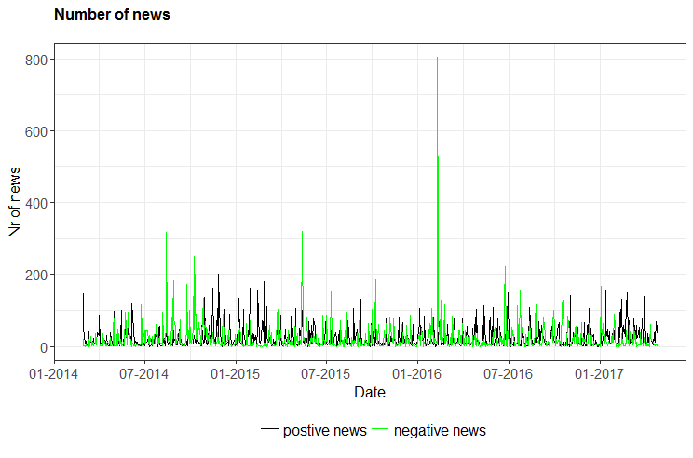
News and sentiment evaluation
Unemployment on record low
Train collision
Slowdown in German economy
Decline in GDP
Daily news volume of entity “Germany” between 2014 and 2017

Slide 12
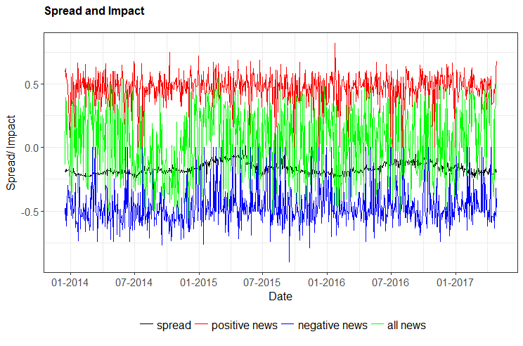
News and sentiment evaluation

Slide 13
Modelling bond closing yields: adding social sentiment
Sentiment classification, trustworthiness and relevance analysis for social media sentiment
Daily social sentiment (buzz and impact) is analysed and a relationship to bonds investigated
Machine Learning: LSTM method is applied to find impact of social media buzz and sentiment
Hit rate can be improved when social sentiment is included into analysis

Slide 14
Modelling bond closing yield: adding macro sentiment
Correlation analysis: correlation between spread series and daily news series.
Correlation is calculated over the whole time horizon as well as in rolling windows with length of 250 days.
Linear regression
ARIMAX(p,i,q) Model is given by
$$d_{t}= φ_{0}+ \sum_{\left\{k=1\right\}}^{p}{φ_{k}}d_{\left\{t−k\right\}}+ a_{t}+\sum_{\left\{k=1\right\}}^{q}{θ_{k}}a_{\left\{t−k\right\}}+ \sum_{\left\{l=1\right\}}^{m}{ψ_{l}}x_{\left\{lt\right\}}$$
where $d_{\left\{t\right\}}$is the i-th difference of a time series$, \left\{a_{t}\right\}$ is white noise and $x_{\left\{lt\right\}}$ is the l-th external variable, l=1,...,m. The external variable is uni- or multivariate.

Slide 15
Correlation analysis
Time series of spreads: Spread $S_{t}, t=1,…,K,$of bond yield, the difference process of spreads $D_{t}=S_{t}−S_{\left\{t−1\right\}}, t=2,…,K,$and a volatility proxy $V_{t}= \left|D_{t}\right|, t=2,…,K.$
Correlation between daily news and sentiment signals and single bond spread series as well as with mean bond spread for each investigated issuing country.
Rolling correlation of news volume and mean country spread is indication of changing market regimes: we can fit a regime-switching model here.
Correlation: 87% of analysed spread time series, at least one news sentiment series showed significant correlation with the spread series

Slide 16
Correlation analysis
Spain bond timeseries Daily news series | Spreads | First spread difference | Volatility
All Sentiment | 66% | 75% | 47%
Volume All News | 97% | 31% | 88%
All Impact | 50% | 78% | 28%
Positive Sentiment | 78% | 0% | 56%
Volume Positive News | 88% | 37% | 91%
Positive Impact | 78% | 0% | 59%
Negative Sentiment | 91% | 3% | 78%
Volume Negative News | 97% | 59% | 84%
Negative impact | 91% | 3% | 78%
Percentage of significant correlations between news time series and long-term bonds issued by Spain between 2007 and 2017.

Slide 17
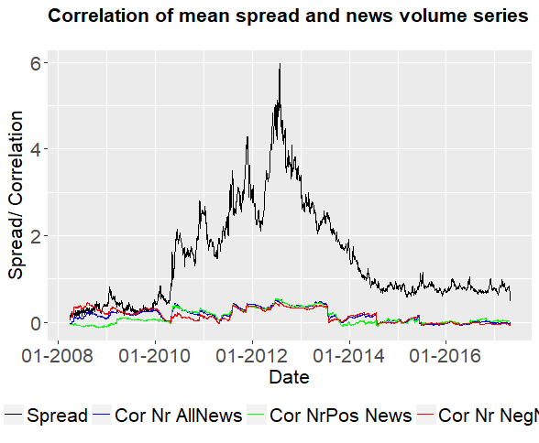
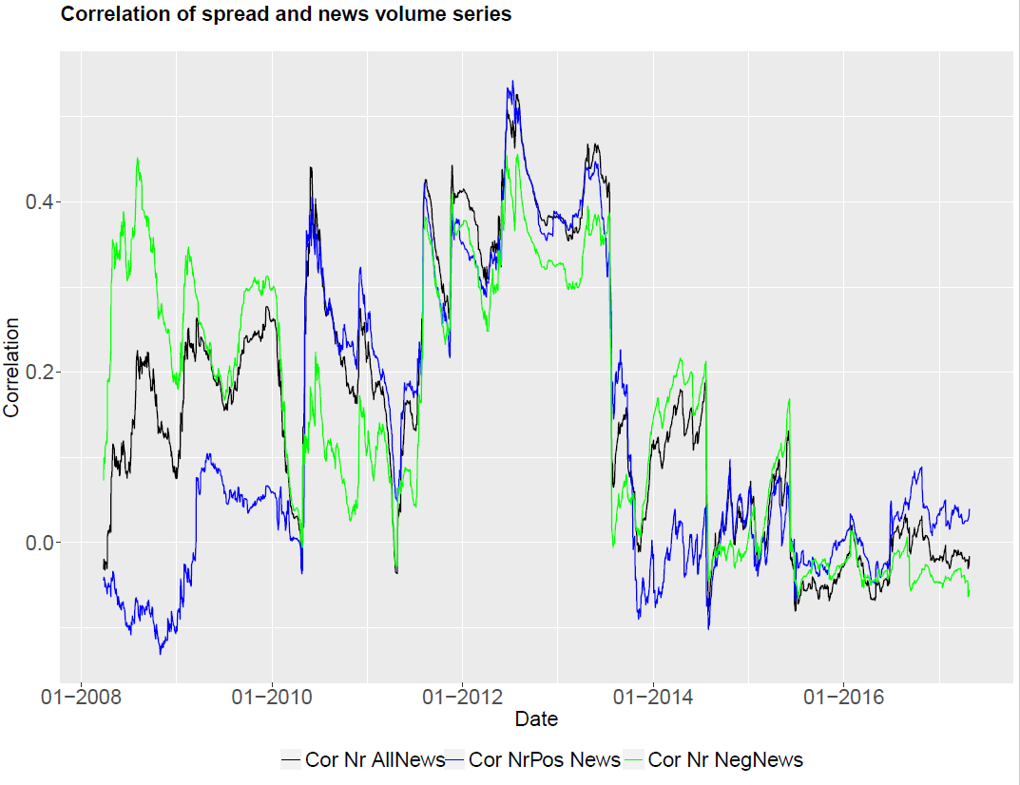
Rolling correlation
Correlation between volume of positive news and mean spread of long-term bonds changes its sign -> point to a change in market regimes

Slide 18
Correlation analysis - regime change
Analysis of correlation series in Hidden markov Model (HMM)
We fit an HMM with three states to the time series, hidden regimes are filtered out through the Forward-Backward and the Viterbi algorithm.
The estimates market regime is in line with the actual observed regime.
Spain: Bond spreads widen between 2011 and 2014, the market is estimated as bullish or neutral before and after this period.

Slide 19
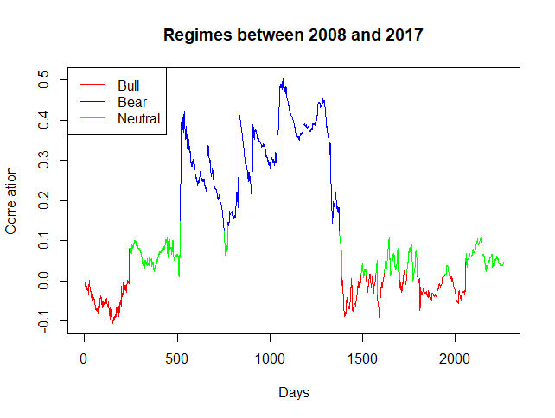
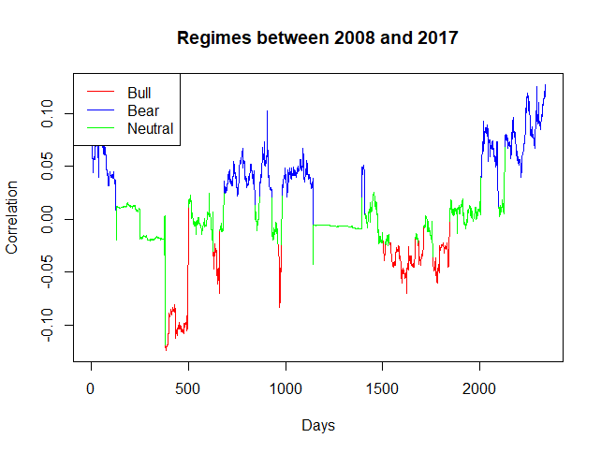
Correlation analysis - regime change
Regime estimation for Spain and Germany based on rolling correlation between news volume and bond spreads

Slide 20
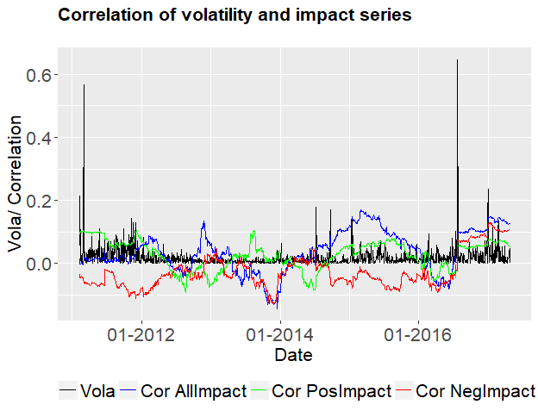
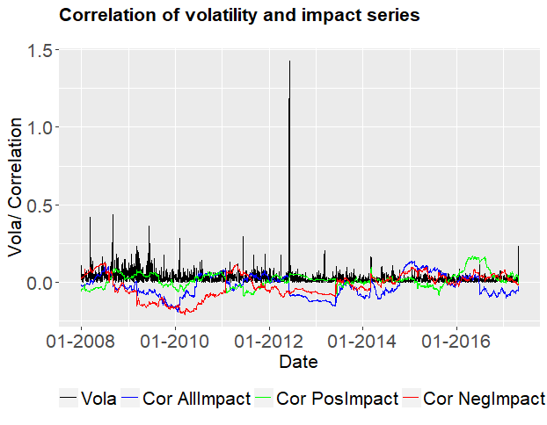
Correlation analysis - volatility
Mean volatility of daily spread change and its correlation with daily news impact series for five European countries.
Correlation decreases, when markets are calm, the correlation fluctuates around 0.2 in turbulent market times.
Significant correlation between sentiment time series of all news and mean spread series.
France: UK:

Slide 21
ARIMAX modelling and prediction of spreads
Results: Best one-step ahead prediction is gained when external variables are included.
Time series “Positive Impact” and “Negative Impact” as well as “Volume of all news” and “All News Impact” reduces the error (RMSE) for single bonds.
Mean spread of countries Germany, Spain, France, Italy and Great Britain is also predicted through an ARIMAX (1,1,1) model.
Smallest error measures are attained when external variables “Volume of all news”, “All News Impact”, “Volume of negative news” and “Negative Impact” are combined.

Slide 22
Conclusion
Bonds and macroeconomic news series are matched, daily news time series created and their influence on bond spreads analysed.
Correlation analysis highlights impulse from positive and negative impact time series to spreads and volatility of bond spreads.
Prediction of spread changes within the ARIMAX model is improved when news series are chosen as external variables.
Analysis of mean bond spreads and news for European countries facilitates calculation of country risks and estimation of market regimes.

Slide 23
News-enhanced risk control decision model
Beta-version: release in July
Let us have your comments!
News Filtering, Monitoring, Screening
SENRISK DSS
Please visit our project page www.senrisk.eu for more information

Slide 24
Thank you very much for your attention! Any questions? Christina@optirisk-systems.com

