Slide 1
Improving DevOps and QA efficiency using machine learning and NLP methods
Omer Sagi
May 2018

Slide 2
Outline
Investigating failed tests
Document similarity
The developed search system
Unsupervised similarity
Supervised similarity learning
Evaluation
Challenges in moving to production

Slide 3
The business domain – Investigating failed tests

Slide 4
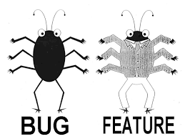
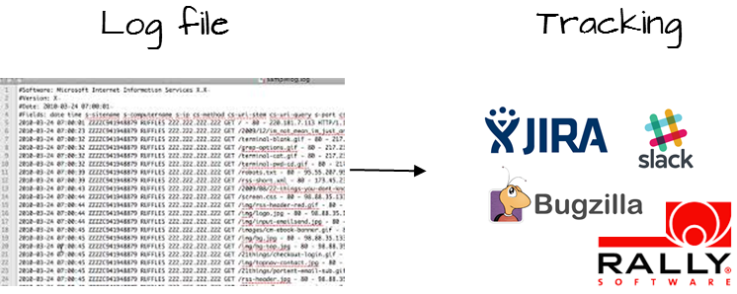
Investigating failed tests - overview
New test design
Failed test
Test investigation
Notes:
The users of our solution are QA and Devops engineers. Let’s take Ben who is a QA engineer…
His work is to think about software tests that would check software’s performance under different scenarios.
If the test that Ben created runs and raises exceptions or errors that means the software doesn’t do what we expect it to do and Ben needs to investigate the failure reason or root cause. And this root cause can be tracked in the log-file that related to the test. Log-files virtually tells the story. They contain millions of messages that describe what happened at every millisecond. It is a very tedious task to go over these log-files searching for the root-cause.

Slide 5
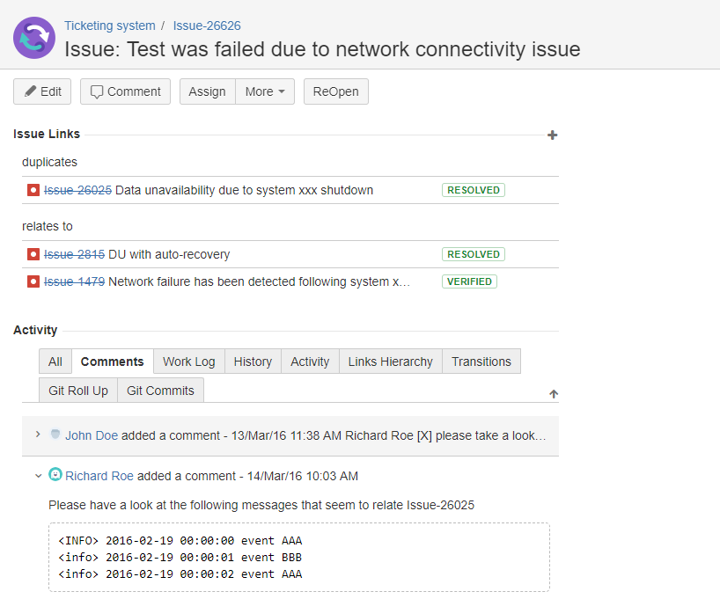
Investigating failed tests – duplicated issues

Slide 6
Investigating failed tests – duplicated issues
Log filesystem
Issue
xxxxx
Issue
xxxxx
Issue
26626
Issue
26025
Issue
1479

Slide 7
Current state problem
Investigators overlook duplicated issues while mistakenly mark other duplications
Log filesystem
AAA
BBB
AAA
Looks like a
network outage
CCC
AAA
CCC
CCC
DDD
FFF
Network outage
GUI issue
AAA
BBB
AAA
CCC
AAA
CCC
Data
unavailability
Data loss

Slide 8
User Interface

Slide 9
Document similarity

Slide 10
Document search system - overview
Query
Text processing
Processed terms
Indexed
knowledge base
Ranked
Document set
Relevant
document set
Retrieved
document set
Ranking
Similarity model

Slide 11
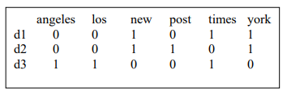
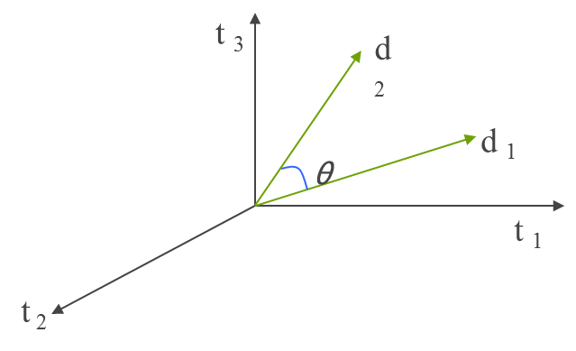
Documents as vectors
The intuition: Since [D] is a vector we can find other nearby vectors (documents)
Distance between vectors d₁ and d₂ can be captured by the cosine of the angle θ between them
d1: new york times
d2: new york post
d3: los angeles times
$$Cosine similarity \left(d_{1},d_{2}\right)=\frac{d_{1}∗d_{2}}{\left|d_{1}\right|∗\left|d_{2}\right|}=0.66$$
$$Cosine similarity \left(d_{2},d_{3}\right)=\frac{d_{2}∗d_{3}}{\left|d_{2}\right|∗\left|d_{3}\right|}=0$$

Slide 12
The developed solution: log-files search system

Slide 13
Solution overview
Query
Log processing
Vector
Indexed
knowledge base
Ranked
issues
Relevant
log set
Retrieved
issues
Ranking
Similarity model

Slide 14
Log file vectorization
Messages are analogous to words, defining the vector dimensionality
In the following example, each ‘word’ is a concatenation of log type and event id
Log
processing
Vector_dim: | info_14 | crit_150 | info_23 | error_25
Value: | 2 | 1 | 1 | 1

Slide 15
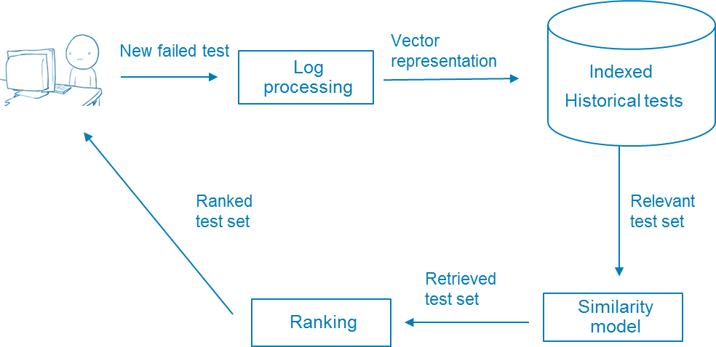
The developed solution – important notes
TF-IDF vectors
Time range filtering
Similarity-driven vs. Diversity-driven ranking

Slide 16
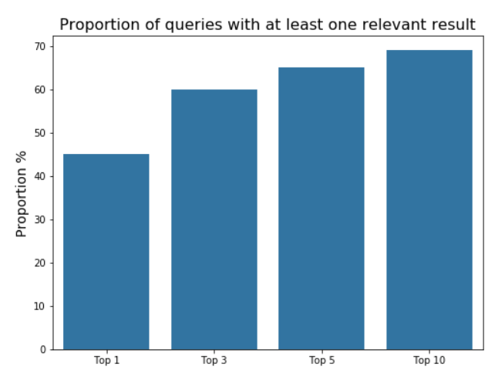
Results

Slide 17
Similarity learning
Issue 1
Issue 2
…
….
Pair vector
Is duplicate?
Machine-learning model

Slide 18
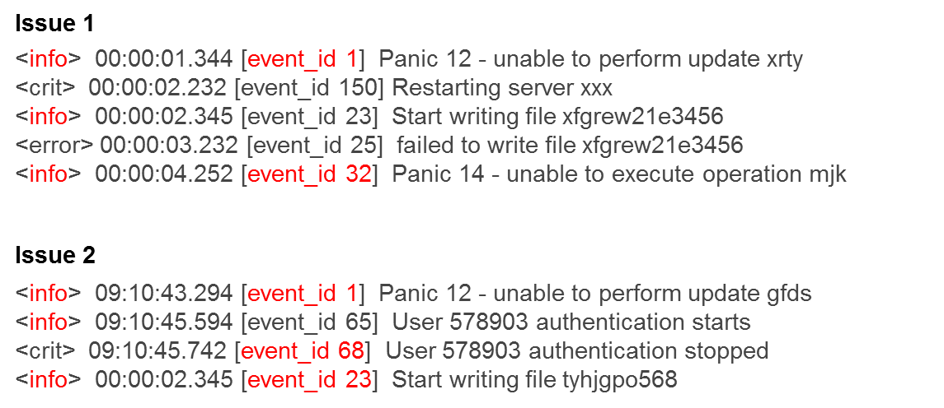
Extracting similarity vector
Info similarity
$$\frac{1}{\sqrt{6}}$$

Slide 19
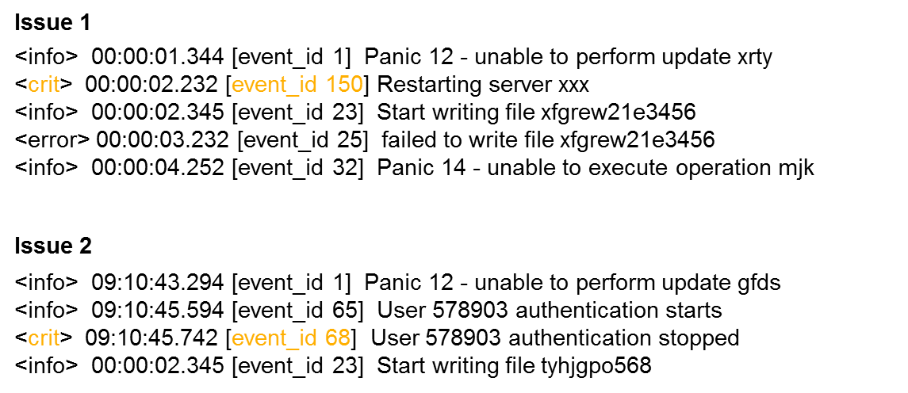
Extracting similarity vector
Info similarity | Crit similarity
$$\frac{1}{\sqrt{6}}$$ | 0

Slide 20
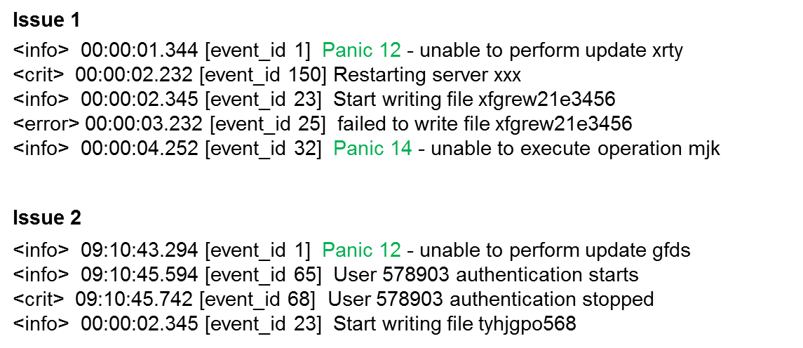
Extracting similarity vector
Info similarity | Crit similarity | Panic
$$\frac{1}{\sqrt{6}}$$ | 0 | $$\frac{1}{\sqrt{2}}$$

Slide 21
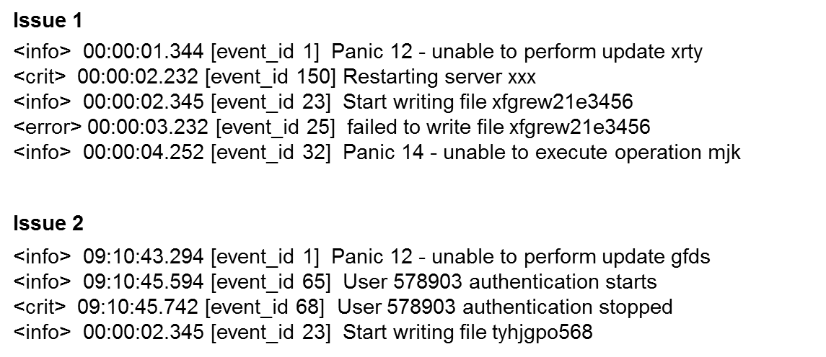
Extracting similarity vector
Configuration properties
Configuration properties
Info similarity | Crit similarity | Panic | Same Operation System | Time difference (days)
$$\frac{1}{\sqrt{6}}$$ | 0 | $$\frac{1}{\sqrt{2}}$$ | True | 12

Slide 22
Extracting similarity vector
Info similarity | Crit similarity | Panic | Same Operation System | Time difference (days) | Label: Is duplication
$$\frac{1}{\sqrt{6}}$$ | 0 | $$\frac{1}{\sqrt{2}}$$ | True | 12 | True

Slide 23
Results

Slide 24
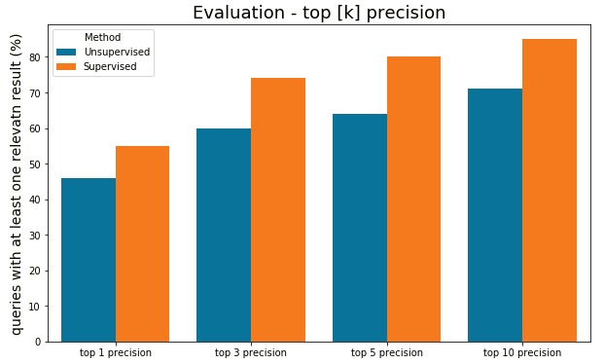
Evaluation – top [k] precision

Slide 25
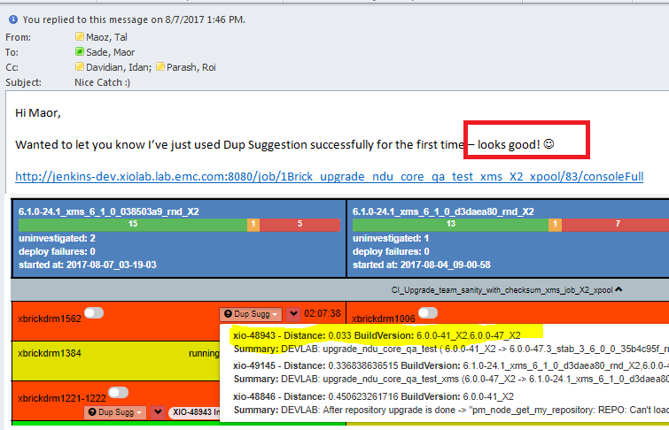
Evaluation – users feedback
Devops team leader:
“Towards the new product release, we ran about 250-300 tests a day.
Having the machine learning suggestions is one of the reasons
we were able to investigate it in time. “

Slide 26
Challenges in moving to production

Slide 27
Real-time performance over time
Production
starting point

Slide 28
Challenges in moving to production
Communicate the feature engineering process
Similarity measures may change over time
Strong features Vs. cheat features
Performance issues

Slide 29
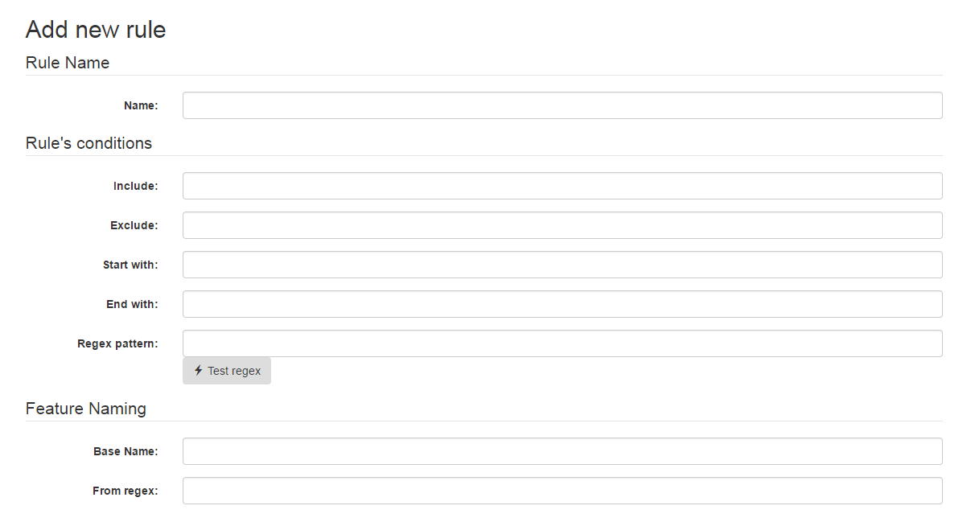
Communicate the feature engineering process

Slide 30
Performance issues
Information retrieval response time
Applying the model automatically during night time and cache the results
Avoid recurring feature extraction
Data reduction

