Slide 1
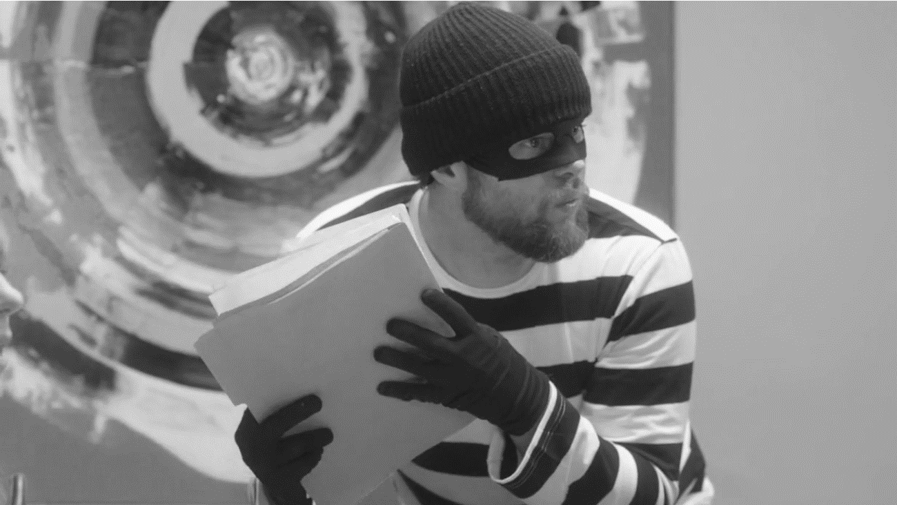
Shifting to Security Awareness 2.0
My adventures in the trenches and what I’ve learned.
Jason Hoenich | Founder & Chief Product Officer

Slide 2
The security awareness industry is BULLSH*T.

Slide 3
How I know:
The Walt Disney Company
Sony Pictures Entertainment (post attack)
Activision | Blizzard

Slide 4
Intranet sites
Annual training
Phishing training
Ambassadors
Videos
NCSAM events
I’ve reviewed all the vendors.

Slide 5
What I learned
Vendors:
No awareness experience
Highly technical
No user focus
Defining awareness

Slide 6
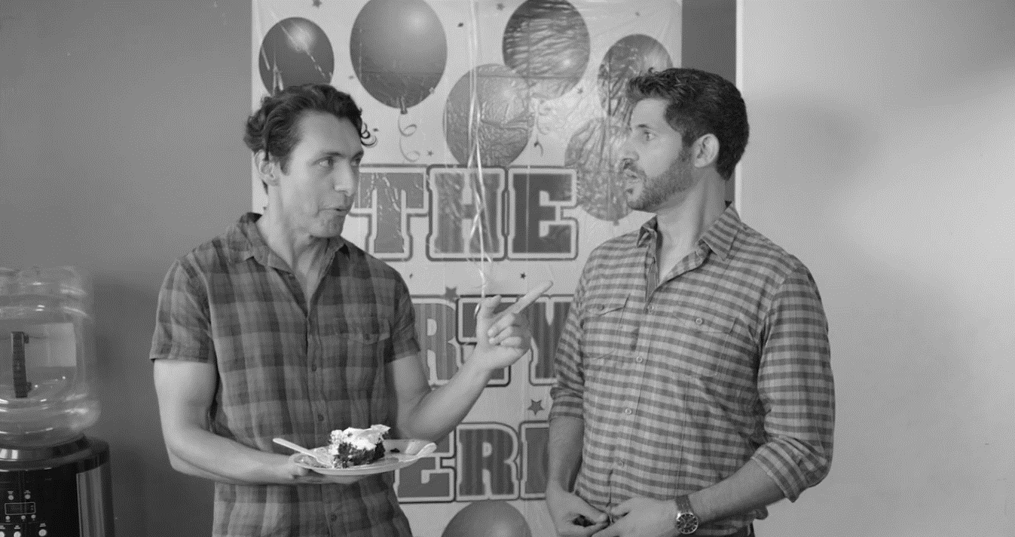
NEURO. STUFF.

Slide 7
It’s a luxury to stay at the top of someone’s mind
Carmen Simon - Impossible to Ignore

Slide 8
COGNITIVE FRICTION

Slide 9
SECURITY FATIGUE

Slide 10
STORIES.

Slide 11
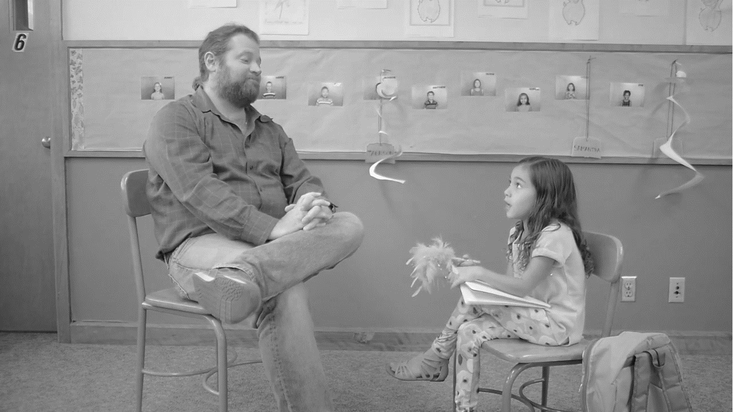
DISNIFICATION OF LEARNING

Slide 12
VENDIFICATION OF LEARNING

Slide 13
THEORY OF EXPECTATIONS

Slide 14
If you want to engage people, violate their expectations.
Ben Parr - Captivology

Slide 15
POSITIVE LANGUAGE

Slide 16
INDUSTRY LANGUAGE

Slide 17
2.0

Slide 18
ADD THE SOAP.

Slide 19
Start with a plan.
Steering committee/advisory board
Who to train
What topics to train on
How to deliver training
Metrics & behaviors
Feedback loop (sustainment)
Key milestones & projects Y1, Y2, & Y3

Slide 20
TA DA!
SECURITY AWARENESS SO GOOD,
ITS NOT TOO BAD.
JASON@HABITU8.IO

