Slide 1
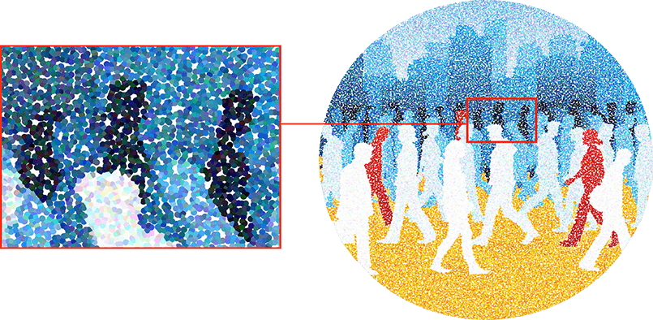
Inside a Bad Actor’s Studio
Julian Wong, Solutions Architect
Oct 31st^{st}, 2017

Slide 2
Agenda
Fraud Landscape
Fraud Attack Techniques
Detection Challenges
Detection Technology

Slide 3
Fraud Landscape

Slide 4

The Increasing Online Fraud Attack Surface
Today
10B
Past
Social
Gaming
Multifaceted
fraud attacks:
1B
Mass registration
Account take over
Transaction fraud
Promotional abuse
Fake review
User acquisition fraud
Individual
transaction attacks
User Growth
Ecommerce
Search
100M
… …
Rich feature platform
10M
Ecommerce
Single function site
1995
2017

Slide 5
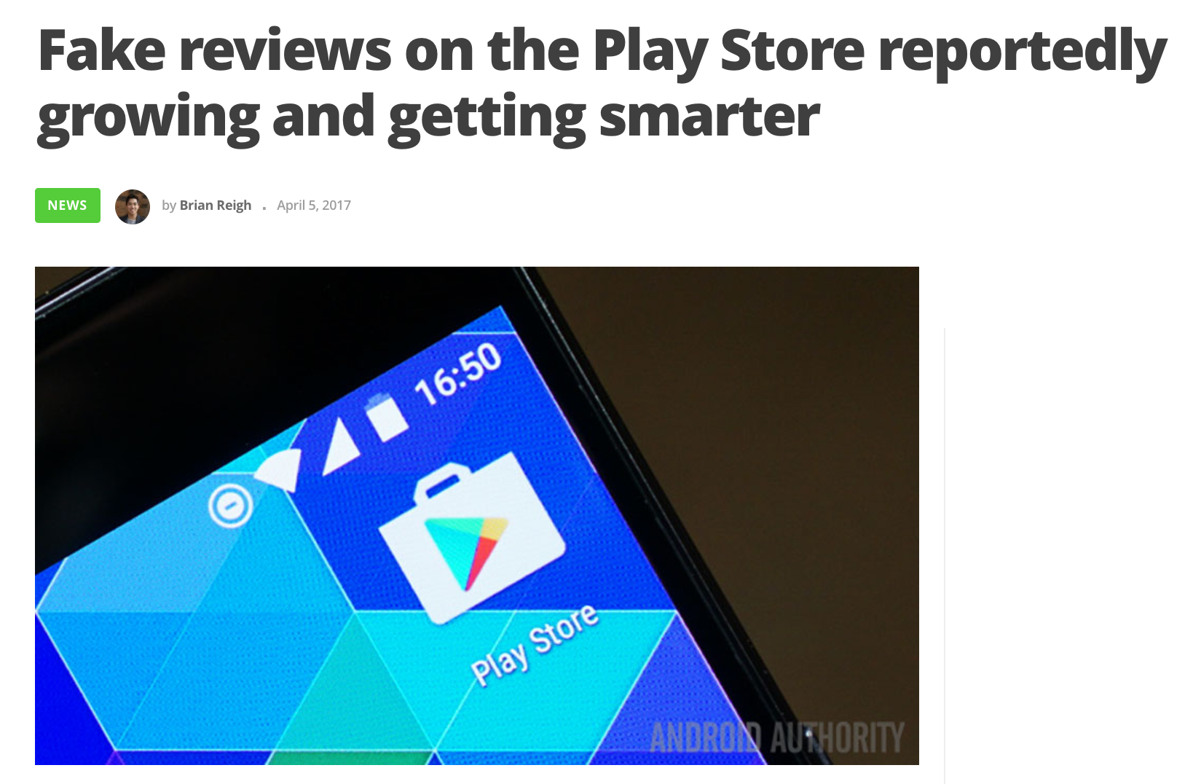
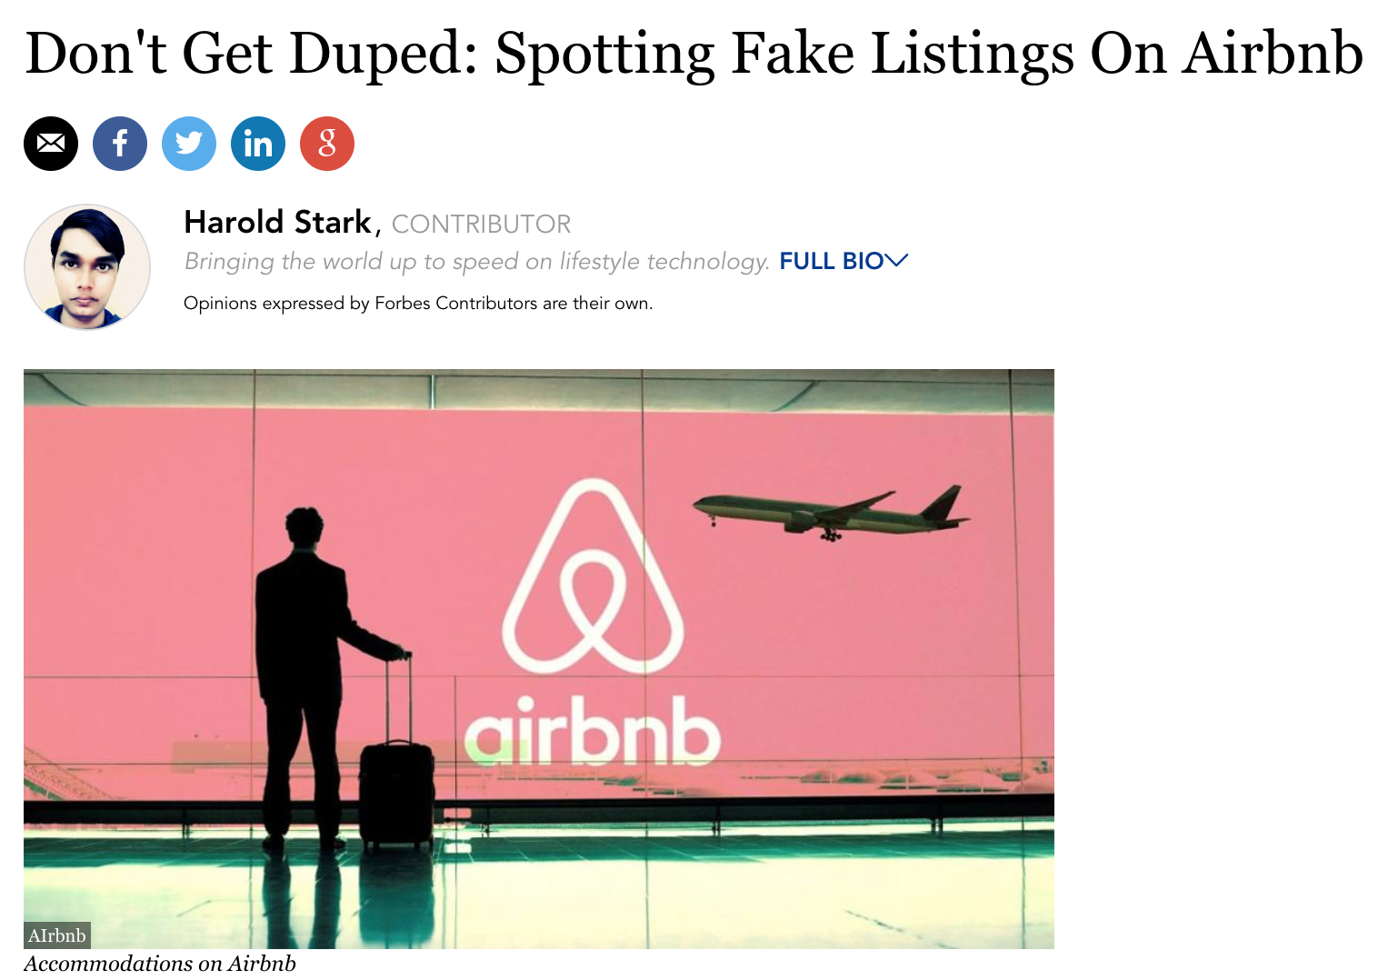
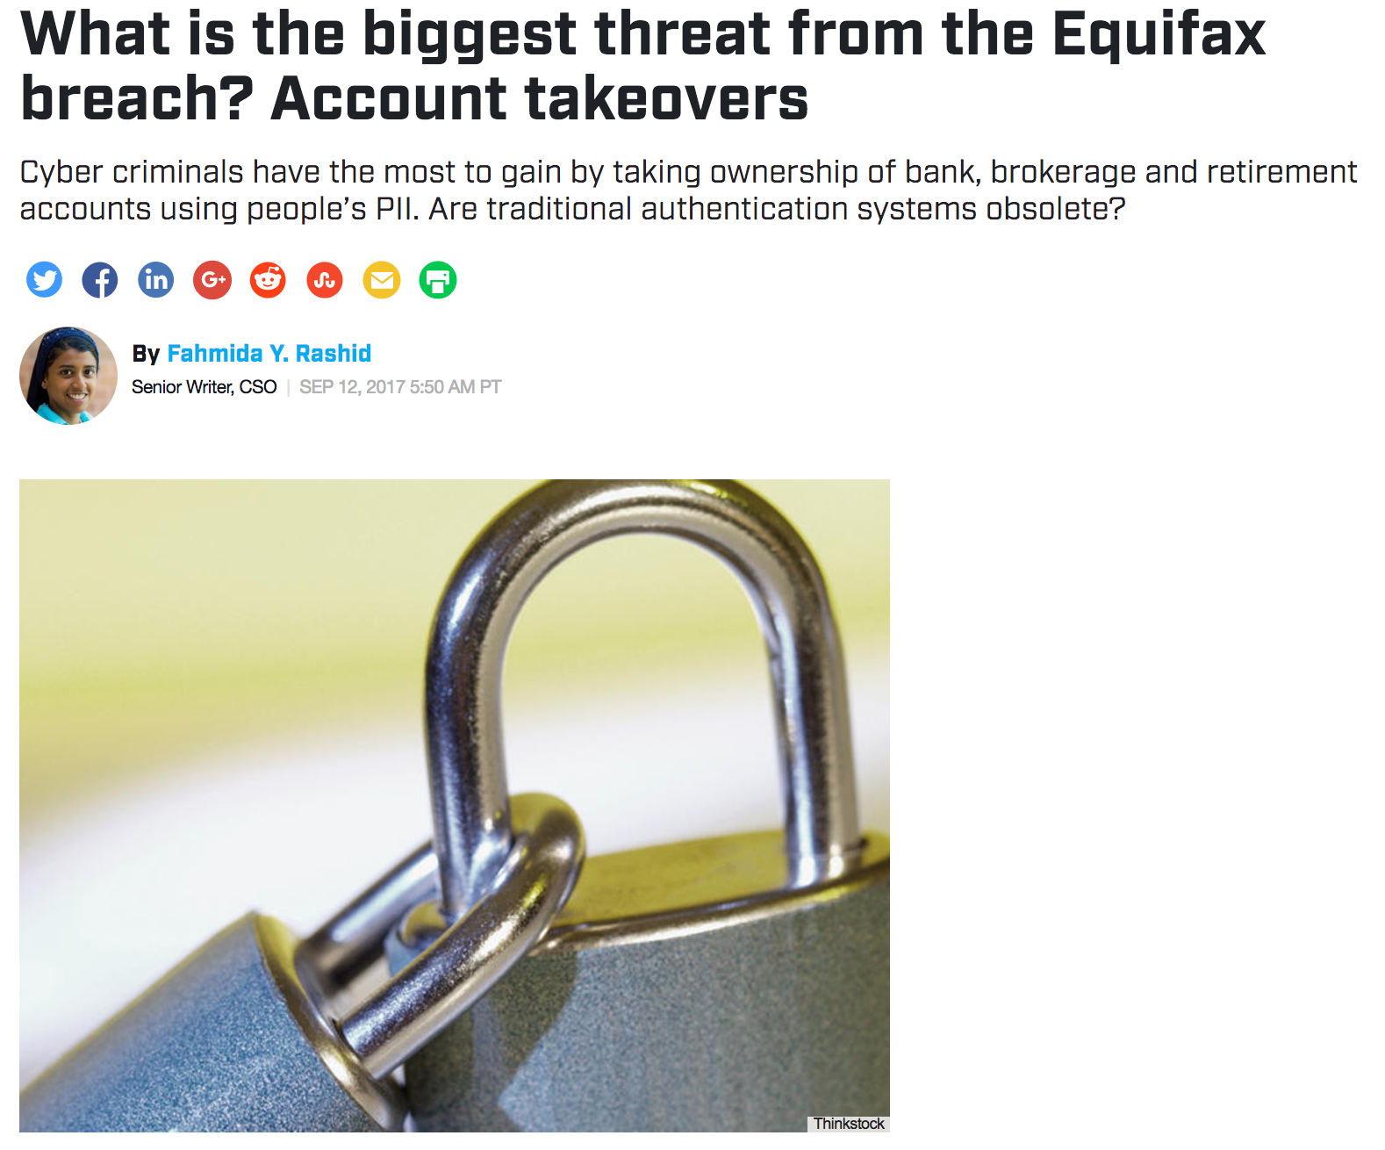
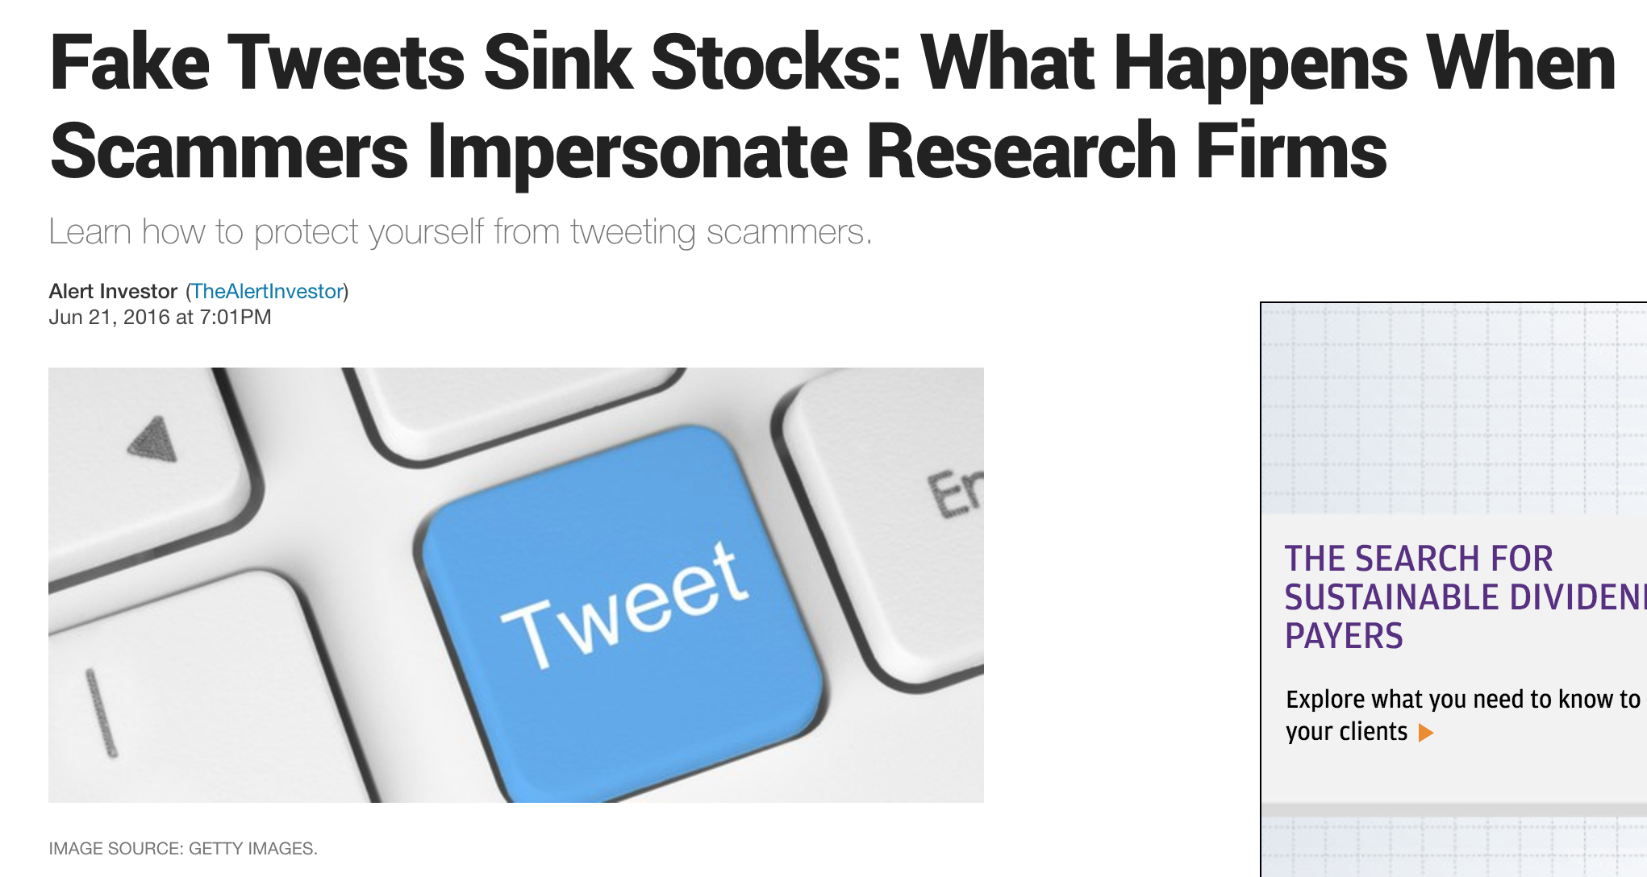
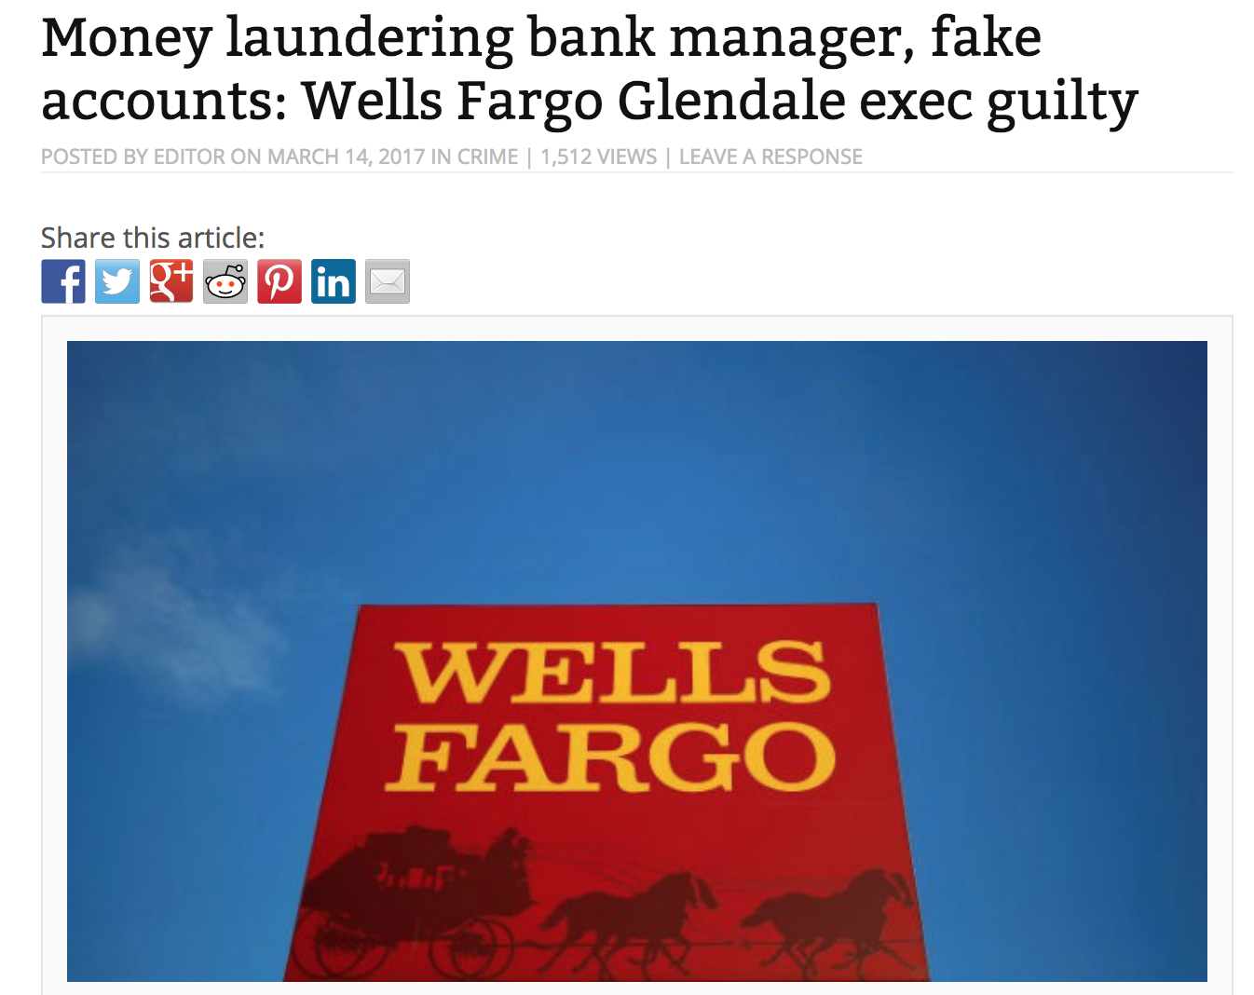
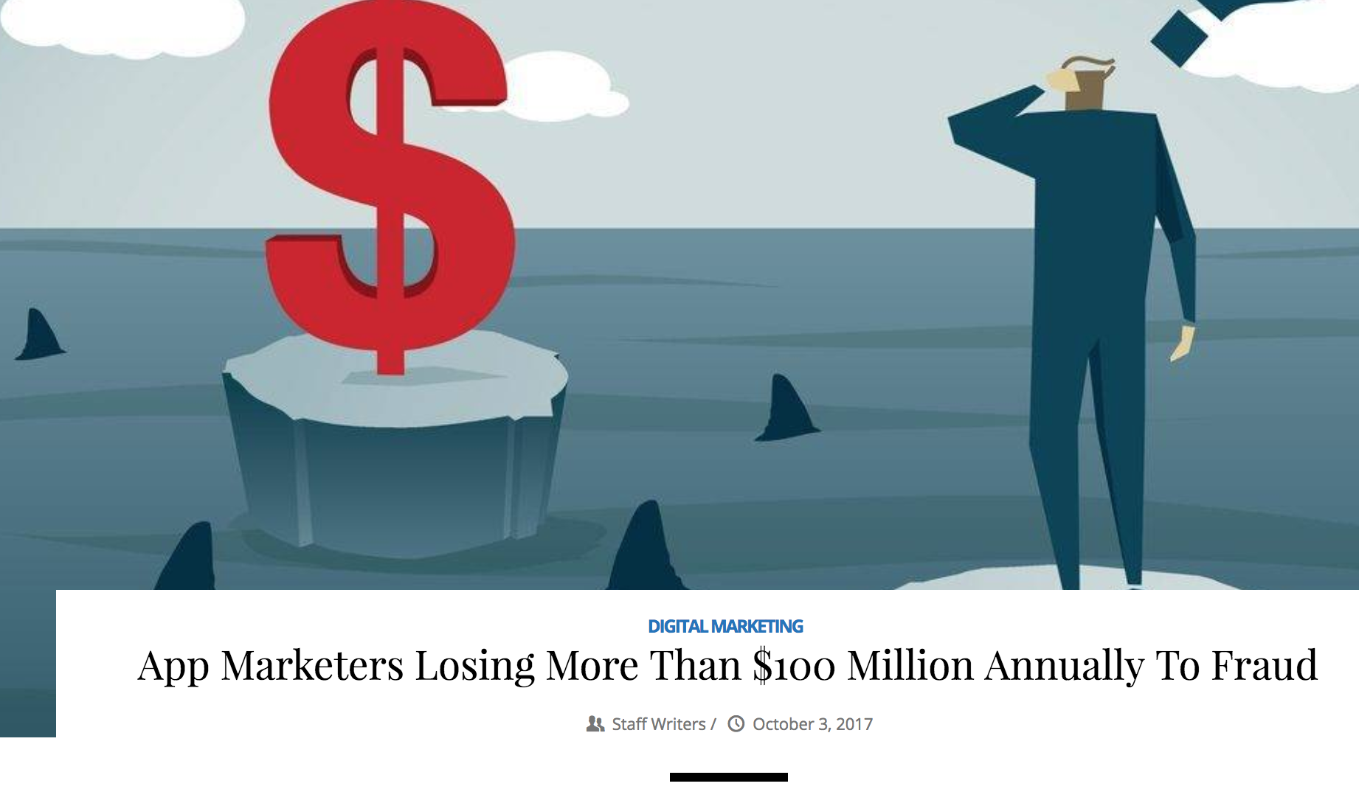
Fraud Attacks Targeting Online Services

Slide 6
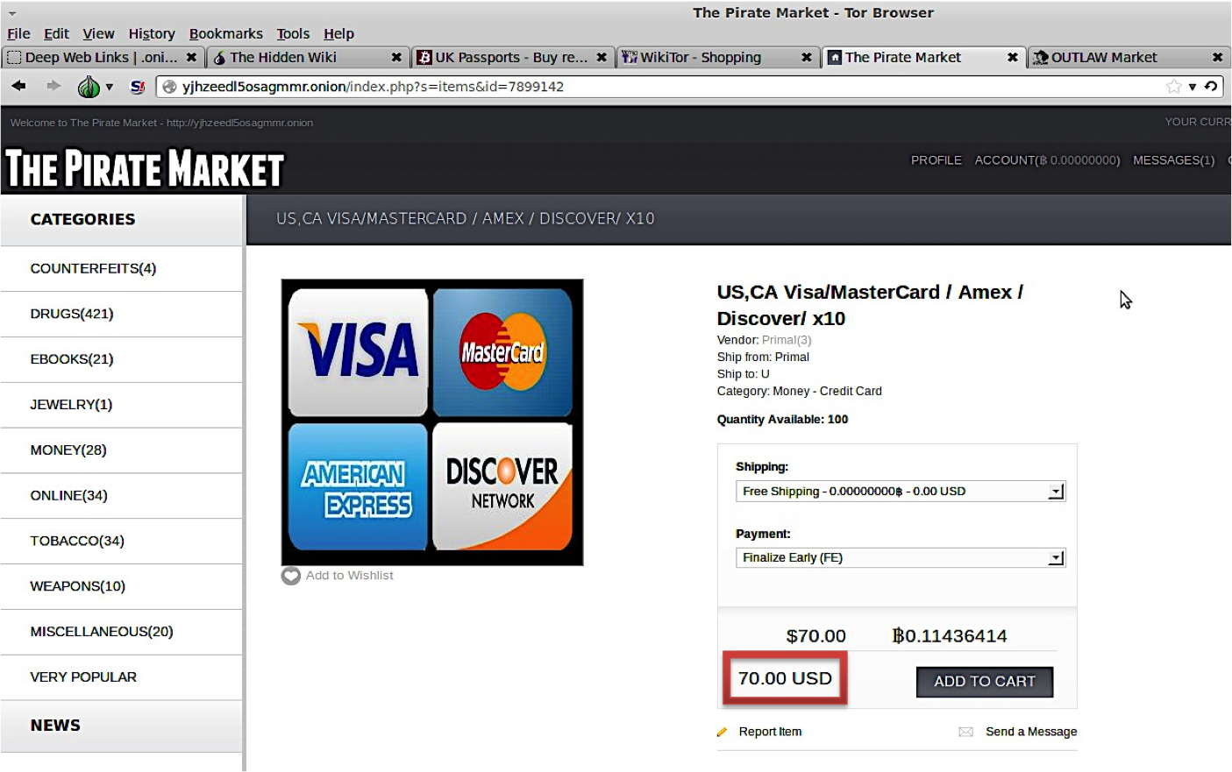
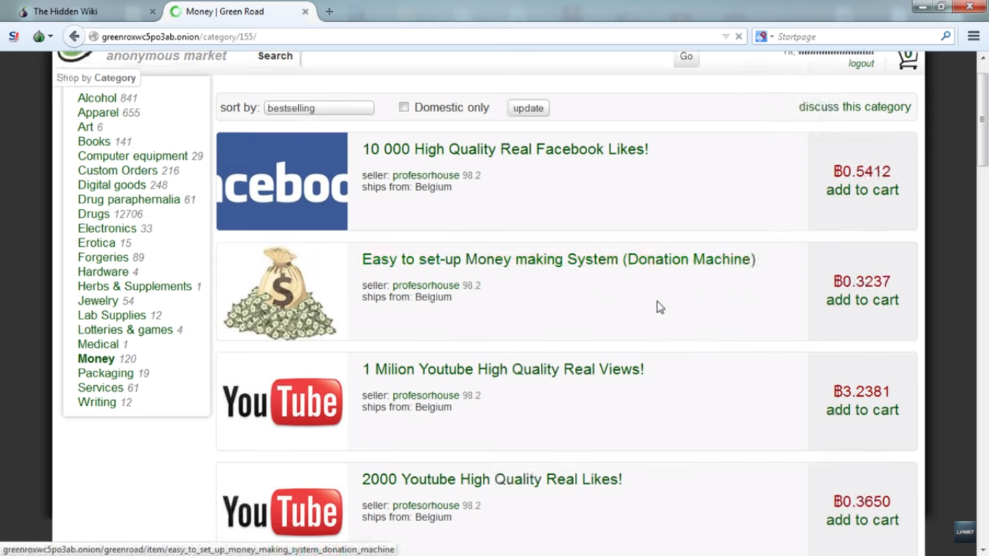
Fraud Services Booming On The Dark Web
Botnets and malware
Stolen identities
Fake and compromised accounts
Financial accounts and credit cards

Slide 7
Fraud Attack Techniques

Slide 8
Attack Techniques
Device flashing
IP obfuscation
Aging "Sleeper Cell” accounts

Slide 9
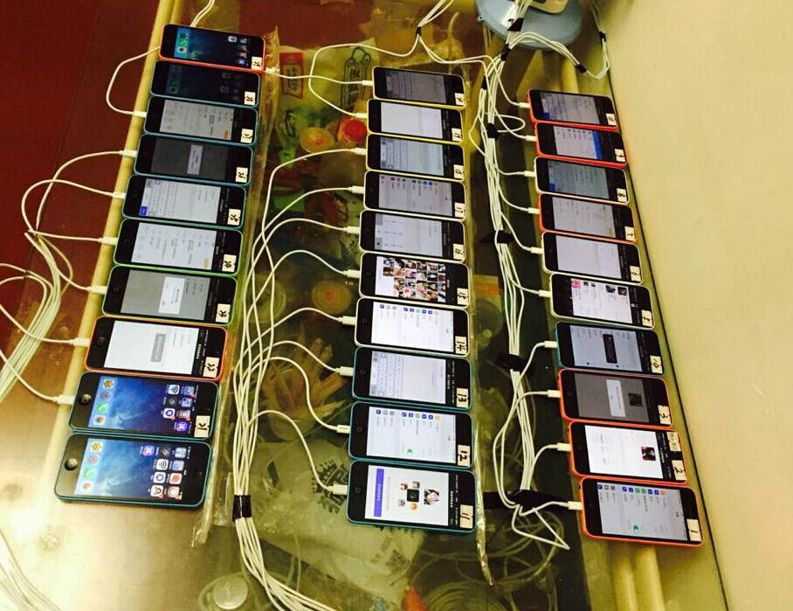
Device Flashing
Force a new device identifier to be created
Simulate appearance of many new devices
Look like random legitimate users
Jailbroken phones being "flashed"

Slide 10
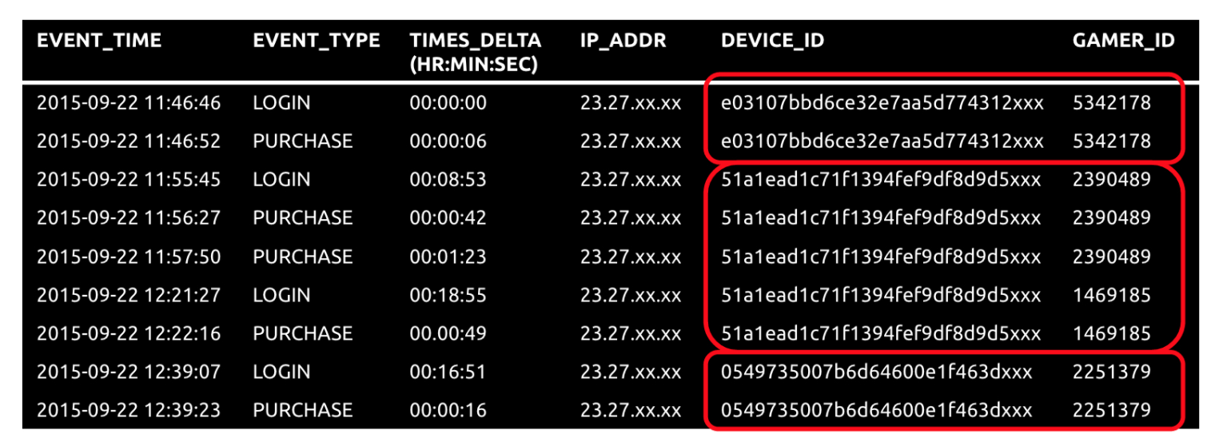
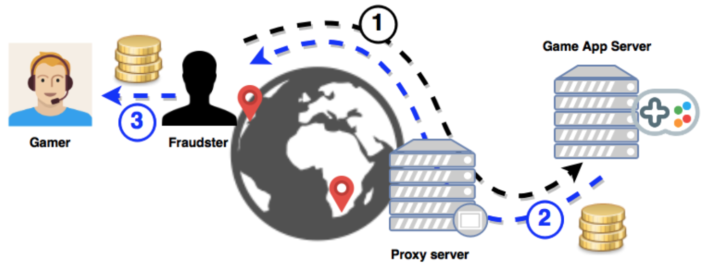
Device Flashing: Fraudulent Purchases in Mobile Game Apps
Flash device and login as a different gamer
Use stolen credit cards to purchase virtual game items
Profit by selling virtual items to players

Slide 11








IP Obfuscation: Cloudhosting Services
Enable massive scale attacks
Evade IP blacklists and rules-based systems
Fake presence in different geographies
Emulate many unique devices

Slide 12
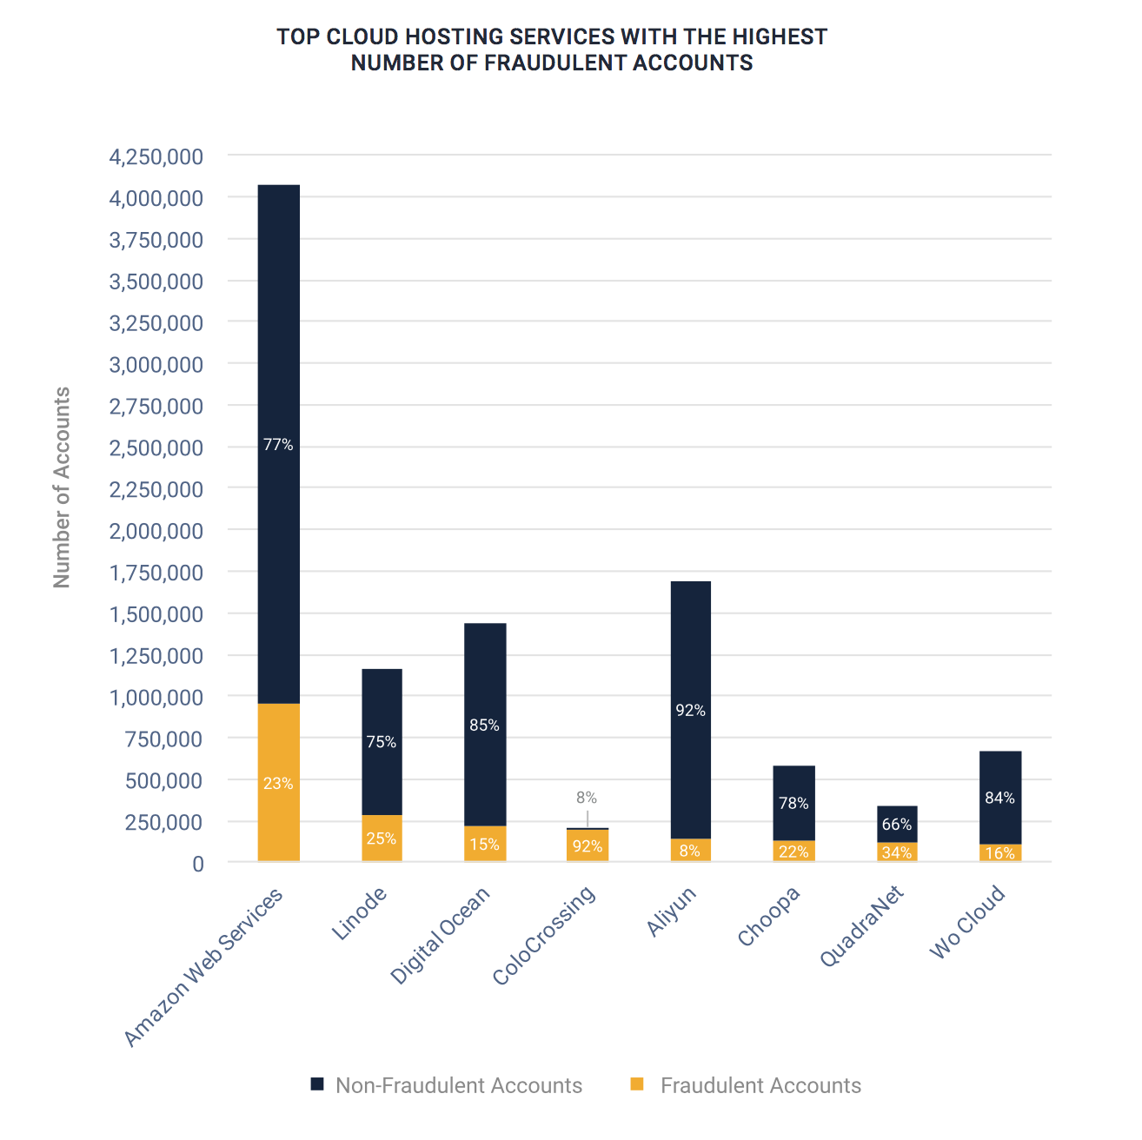
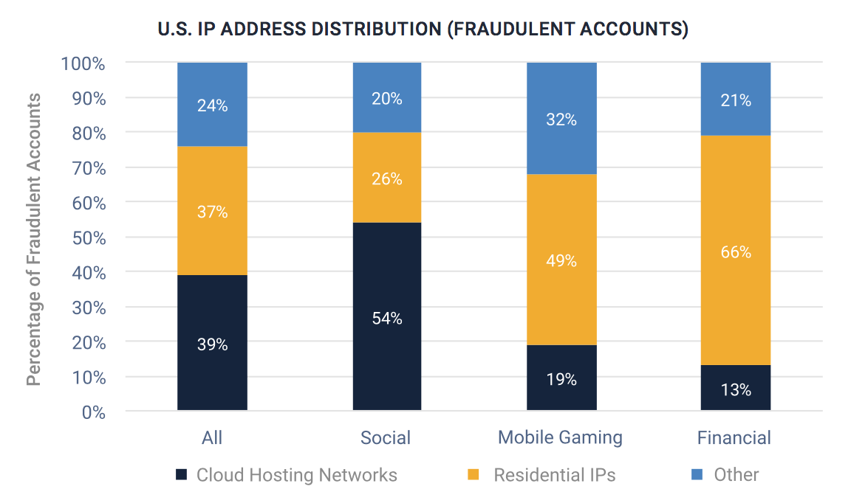
Cloud Services Hosting Fraudulent Accounts
18% of accounts are fraudulent
Fraudsters 7x more likely to use than normal users
54% of fraudulent accounts on social platforms

Slide 13
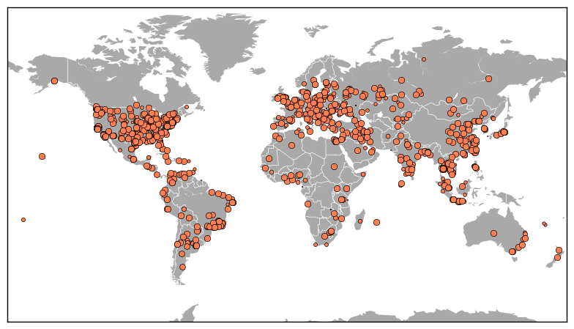
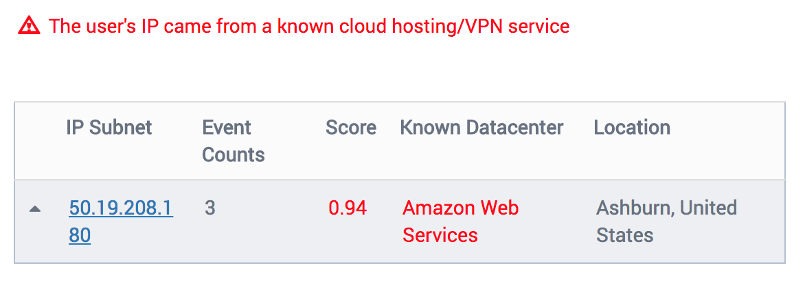

Cloud Attack: Fraudulent Online Purchases
2K accounts on an ecommerce marketplace
Fake presence in same location as hacked users
Leveraged good reputation of the users
Global distribution of attacking IPs

Slide 14
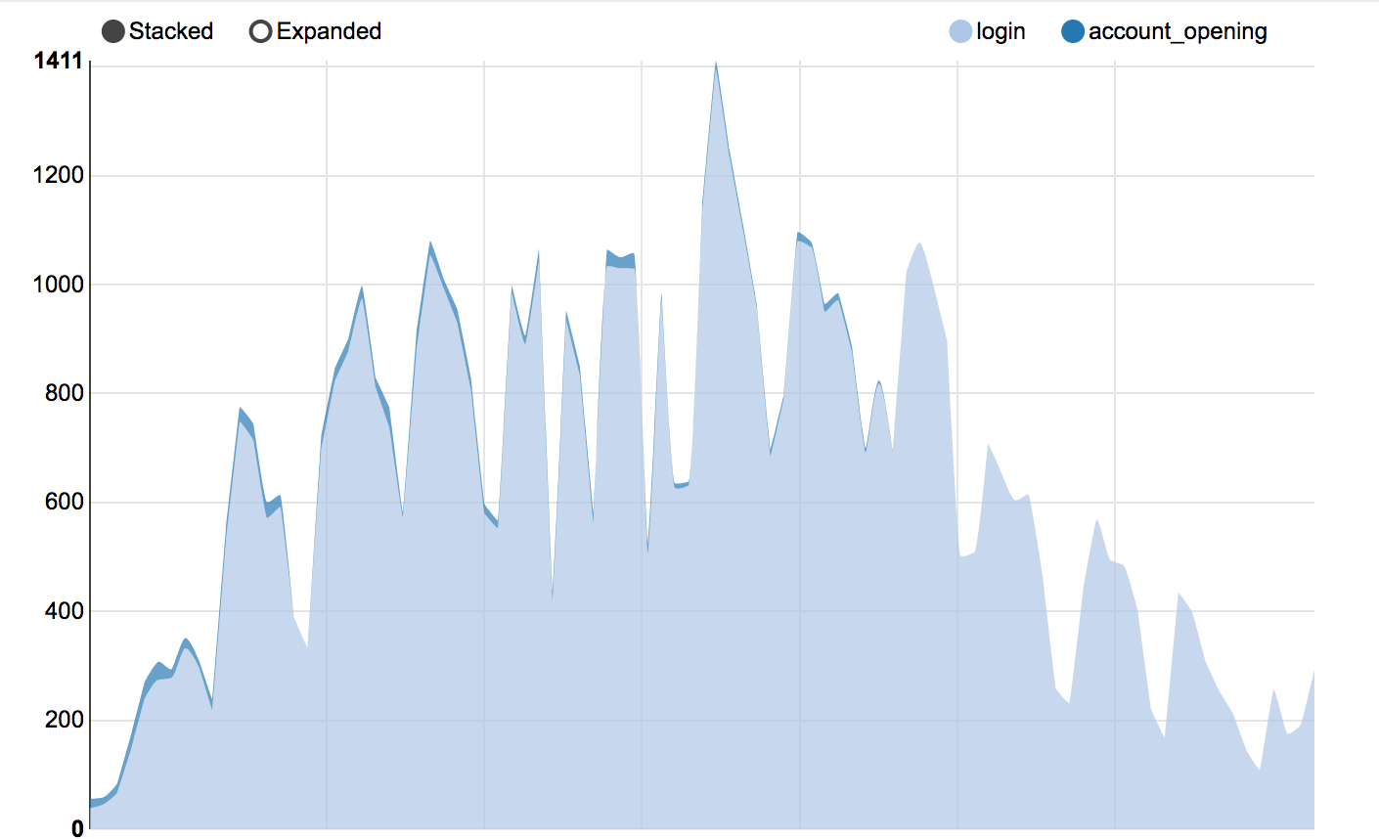
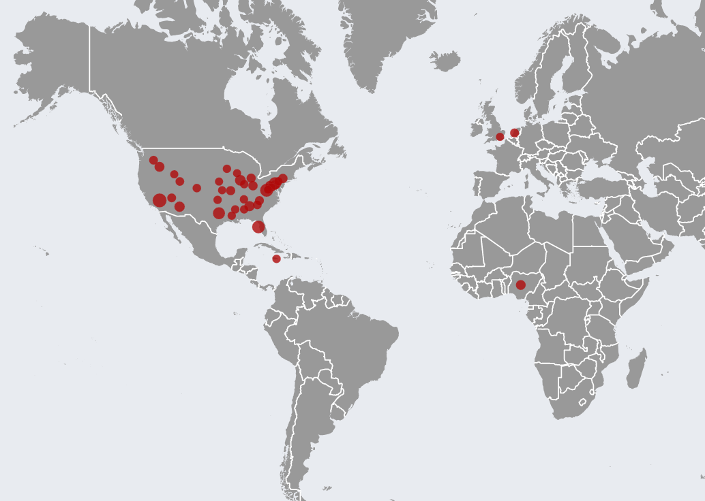
Cloud Attack: Mass Fake Bank Account Openings
Created thousands of bank accounts on a Fortune 500 bank using stolen identities
Faked same geographic location as stolen identities through cloud hosting IPs
Signed up using free email services
Hundreds of accounts opened globally over several weeks

Slide 15
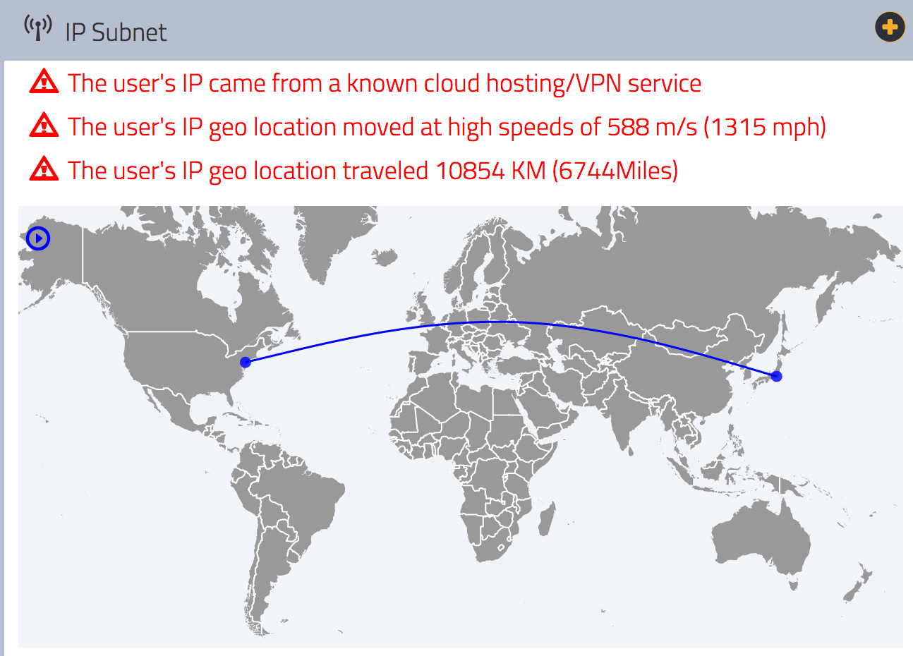
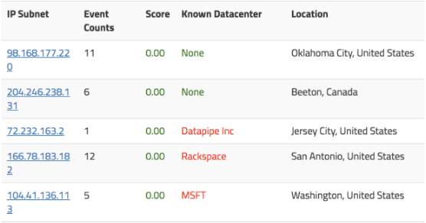

Cloud Attack: Spam in a Classifieds Marketplace
Fraudsters created thousands of fake accounts on a P2P classifieds marketplace
Spammed users through chat messages to phish for info and launch advance fee scams
Switched IPs quickly to message different users in different locations
Using datacenter IPs, VPNs, and cloud hosting services

Slide 16
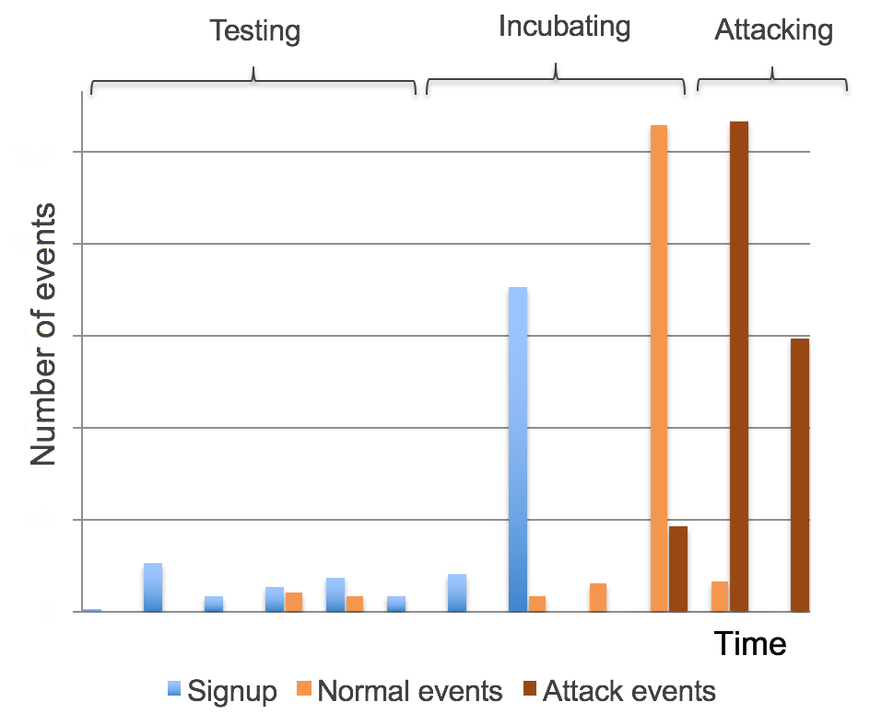
Sleeper Cells: Appear Like Good Users
Older accounts more trusted than new ones
Used for testing or carrying out attacks in stages
Blend in by performing normal looking activities
Can wait months or years before attacking

Slide 17
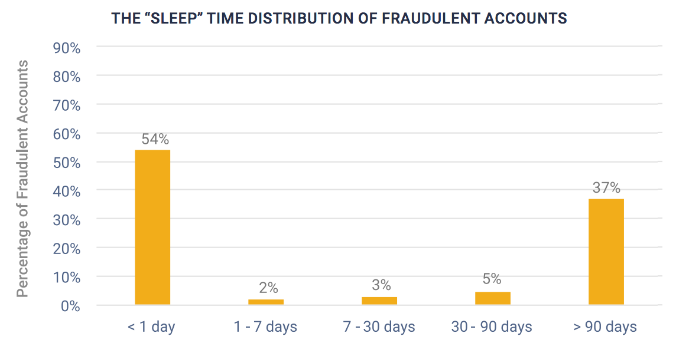
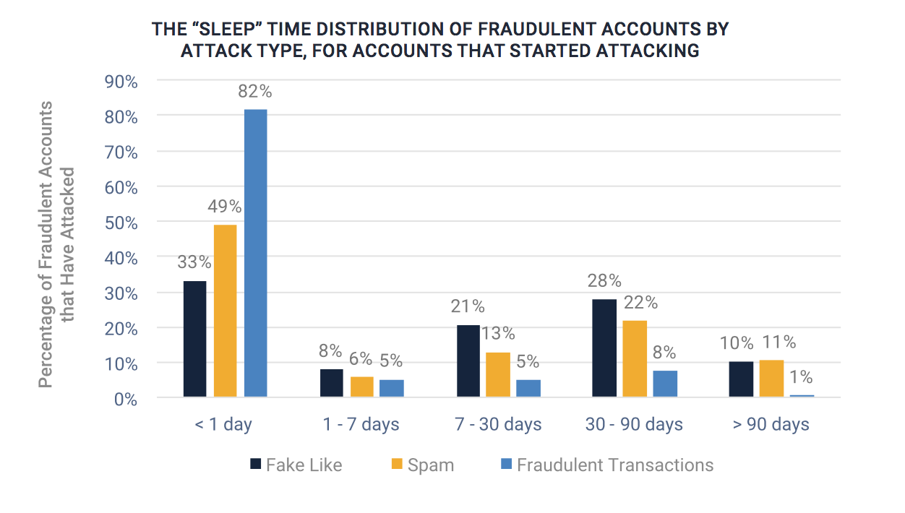
Aging Accounts: Don’t Sleep on Sleeper Cells
44% of fraudulent accounts created remain sleeper cells for seven days or longer
37% don’t act until three months or more
Fraudulent accounts used in social network attacks have longer sleep time

Slide 18
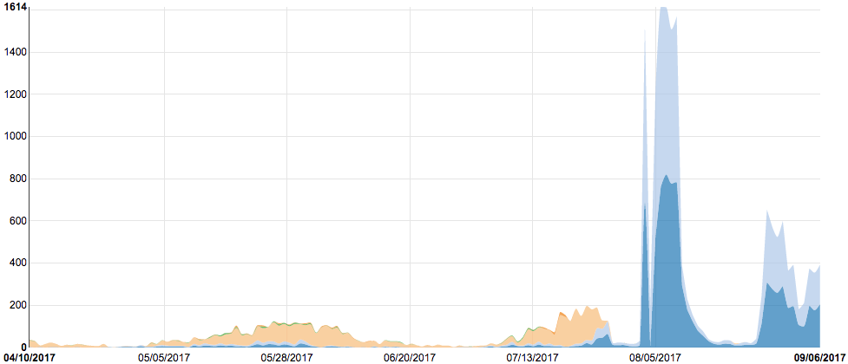
Sleeper Cells: Fake Reviews and Content
Spammers mass sign-up using disposable emails and free email services
Login daily and write test reviews building reputation and trust
Accounts "sleep” 4 months establishing history to appear legitimate to good users
Break out writing fake reviews in mass
Mass fake reviews attack break out after 4 months
Incubation: register accounts, age accounts, and write normal reviews
Social attacks require a certain degree of trust from the victims to be successful

Slide 19
Detection Challenge

Slide 20


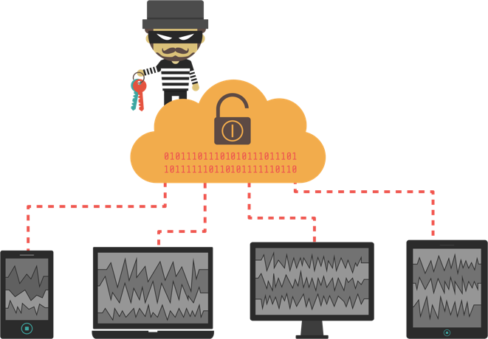






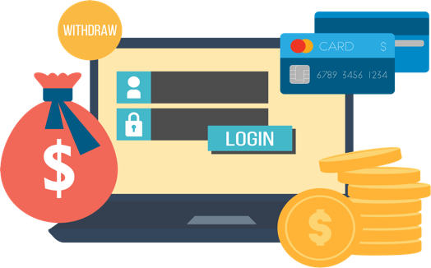

The Hidden Enemy Within Your Service
Fraudulent Account openings
Fake Content
- ‘
Fraudulent Transactions
Support Tools
Fraud Ring
Mass Army of Accounts Using Advanced Techniques
Fraud Loss and Damage

Slide 21
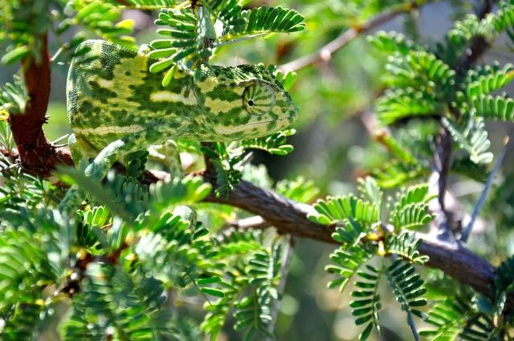
Detection Challenge
Look at anomalies and incidents in isolation
Large attack surface with billions of events
Require known examples of the fraud
Fraudsters blend in with the rest of the crowd

Slide 22
The Next Technology Step

Slide 23
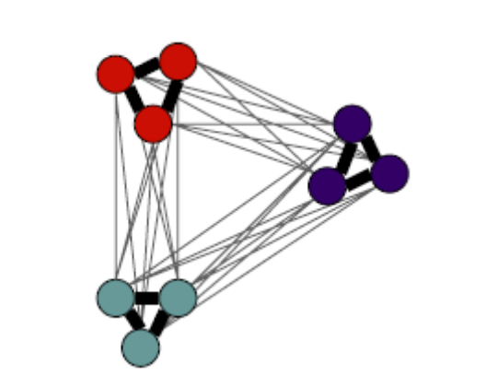
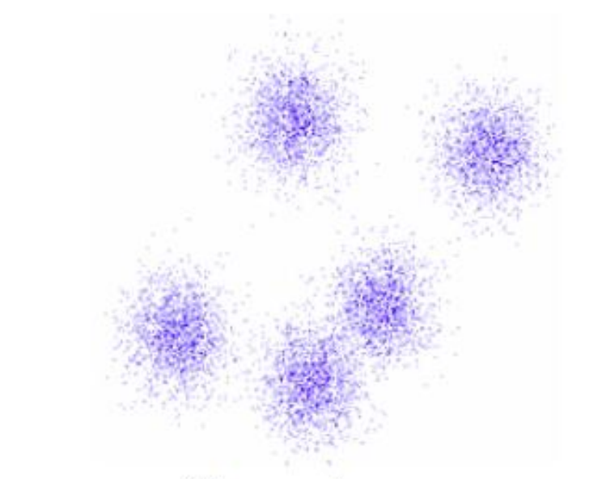
Unsupervised Learning Algorithms
Clustering Analysis
Graph Analysis
Identifies similar fraudulent users or events
Looks at connectivity among users (more closely related to each other)

Slide 24
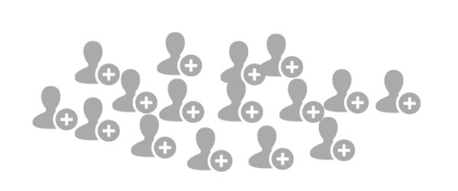

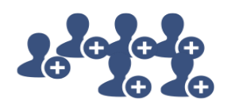
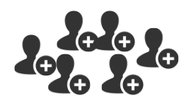
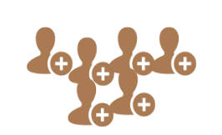
Unsupervised Clustering
User Sign-ups
Sign-up time of day
Name capitalized?
IP address from datacenter?
Browser version
3-4AM, No, Yes, Chrome, Android 5, 10m
OS version
Add card time diff
3AM, Yes, Yes, Chrome 47.0, Windows NT 6, <1m
2-4pm, Yes/No, No, Safari,
iOS 9, 5-8m
10-11AM, Yes/No, No, Chrome 51.0, OS X El Capitan, 5-10m

Slide 25
Unsupervised Graph Analysis
Normal good users
Coordinated attackers
One spammer attacking good users

Slide 26



Leveraging Latest Big Data Technology
Big Data architecture framework
High speed in-memory distributed computing

Slide 27

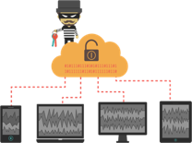




Unsupervised Learning - Credit Card Application
Fraudulent applicants/transactions look legitimate individually
Name
Irma H
Carolyne F
Celina P
Ned A
Hilda G
Buford N
Paulita H
Earnestine G
Age | Addr. | FICO | Bureau Info Match | Email | In Fraud DB | Fraud Score
45 | MA | 790 | Yes | IrmaH512@gmail.com | No | 0.3%
27 | NY | 725 | Yes | CarolyneF119@gmail.com | No | 0.5%
34 | CA | 800 | Yes | CelinaP130@gmail.com | No | 0.1%
30 | NC | 742 | Yes | NedA91@gmail.com | No | 0.2%
55 | FL | 803 | Yes | HildaG823@gmail.com | No | 0.1%
46 | WI | 785 | Yes | BufordN42@gmail.com | No | 0.3%
29 | OR | 780 | Yes | PaulitaH617@gmail.com | No | 0.5%
49 | WA | 777 | Yes | EarnestineG12@gmail.com | No | 0.6%
Fraudster obtains customers’ PII information from a data breach and applies for new credit cards.

Slide 28
Unsupervised Learning – Discovering Hidden Correlations
Subtle, hidden correlation exists in digital traces when viewed in a bigger picture
Name
Irma H
Carolyne F
Celina P
Ned A
Hilda G
Buford N
Paulita H
Earnestine G
Product Applied | Email String | IP | Device | Browser
Premier | IrmaH512 | 67.198.236.72 | iPhone 5 OS 9 | Chrome
Premier | CarolyneF119 | 67.198.236.74 | iPhone 5s OS 9 | Chrome
Premier | CelinaP130 | 108.171.209.68 | iPhone 5s OS 9 | Chrome
Premier | NedA91 | 23.27.13.71 | iPhone 5s OS 9 | Chrome
Premier | HildaG823 | 184.170.253.77 | iPhone 5 OS 9 | Chrome
Premier | BufordN42 | 67.198.236.174 | iPhone 5 OS 9 | Chrome
Premier | PaulitaH617 | 108.171.209.92 | iPhone 5s OS 9 | Chrome
Premier | EarnestineG12 | 23.27.13.71.219 | iPhone 5 OS 9 | Chrome
Same card product | First + Last + Birthday | All IPs come from data centers | Old iPhone device with same system | Same Browser
Fraudster obtains customers’ PII information from a data breach and applies for new credit cards.

Slide 29
Unsupervised Learning – Seeing Bigger Picture
Subtle, hidden correlation exists in digital traces when viewed in a bigger picture
Name
Irma H
Carolyne F
Celina P
Ned A
Hilda G
Buford N
Paulita H
Earnestine G
Product Applied | Email String | IP | Device | Browser
Premier | IrmaH512 | 67.198.236.72 | iPhone 5 OS 9 | Chrome
Premier | CarolyneF119 | 67.198.236.74 | iPhone 5s OS 9 | Chrome
Premier | CelinaP130 | 108.171.209.68 | iPhone 5s OS 9 | Chrome
Premier | NedA91 | 23.27.13.71 | iPhone 5s OS 9 | Chrome
Premier | HildaG823 | 184.170.253.77 | iPhone 5 OS 9 | Chrome
Premier | BufordN42 | 67.198.236.174 | iPhone 5 OS 9 | Chrome
Premier | PaulitaH617 | 108.171.209.92 | iPhone 5s OS 9 | Chrome
Premier | EarnestineG12 | 23.27.13.71.219 | iPhone 5 OS 9 | Chrome
Same card product | First + Last + Birthday | All IPs come from data centers | Old iPhone device with same system | Same Browser
Fraudster obtains customers’ PII information from a data breach and applies for new credit cards.
Part of fraud ring with over 200 applicants

Slide 30
Summary: Key Takeaways
Online fraud attack surface area is increasing
  Billions of online users and millions of apps/services with trillions of events
Fraudsters have sophisticated attack techniques
  Device flashing
  IP obfuscation
  Sleeper cells
Detecting fraud today has many challenges
  Fraudsters are good at blending in with good users
  No training data on new types of fraud
  Large amount of data to process
Unsupervised machine learning is the next step in fighting online fraud
  Clustering and graph analysis

Slide 31
Questions

Slide 32


Thank You!
julian.wong@datavisor.com
www.datavisor.com

