Slide 1
Rumpelstiltskin and the financial markets
Rob Passarella
CEO

Slide 2
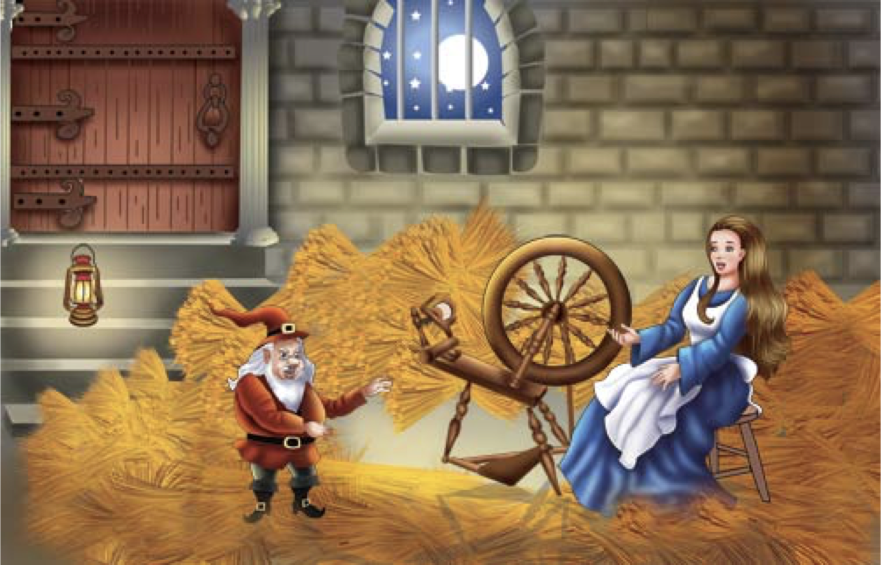
Notes:
Woman in a bind thanks to her dad, the miller… needs to spin straw into gold for the king …
Straw is an agricultural by-product, the dry stalks of cereal plants, after the grain and chaff have been removed. Straw makes up about half of the yield of cereal crops such as barley, oats, rice, rye and wheat. It has many uses, including fuel, livestock bedding and fodder, thatching and basket-making.

Slide 3
Notes:
Alchemy – transformation of matter … base metals into gold … idea of taking something of little value and making it more valuable through a process

Slide 4
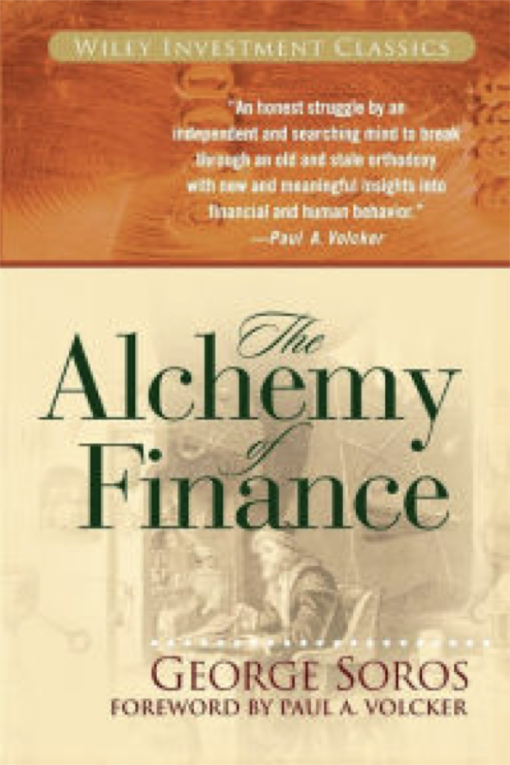
“Investors operate with limited funds and limited intelligence. They do not need to know everything. As long as they understand something better than others, they have an edge.”
Notes:
George Soros and the Alchemy of Finance – The context and comprehension … the edge is better understanding of the data and the catalysts of events

Slide 5
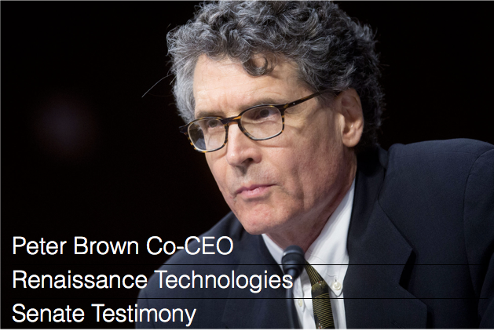
“We collect all the publicly available data we can find that we believe might bear on the movement of the prices of tradable instruments…Our models use this data to make predictions about future price changes.”
Notes:
Renaissance Technlogy with it’s Medallion Fund and greater than 40% returns … Co-CEO’s Bob Mercer & Peter Brown – Machine learning backgrounds IBM research – Language Translation by machine … Pure stat without understanding the language – ubiquitous today (google translate) – The wuant method of translating language

Slide 6
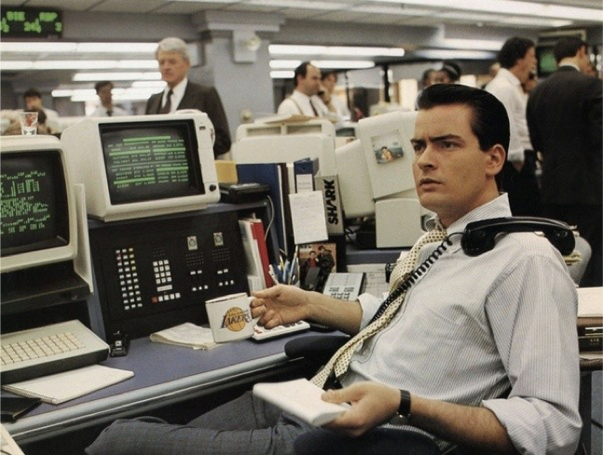
Notes:
The great divide – Quant based Strategies and fundamental based strategies … Predominate style is fundamental in the hedge fund word … known as long short … it is under siege as quant strategies which make up 10 – 13% of the fund managers are finding greater success and asset gathering. The long short world is getting killed…

Slide 7
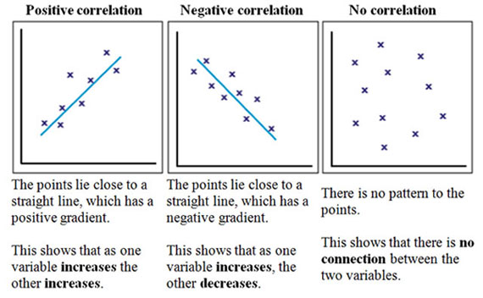
Notes:
What is Quant? Sorry my quant friends in the audience … at it basic level its about large sets of data that can be looked at historically for patterns (read that as yes correlations) Correlations to return measures … it can be deeply complex in finding patterns sure .. But it is about how numbers move.

Slide 8
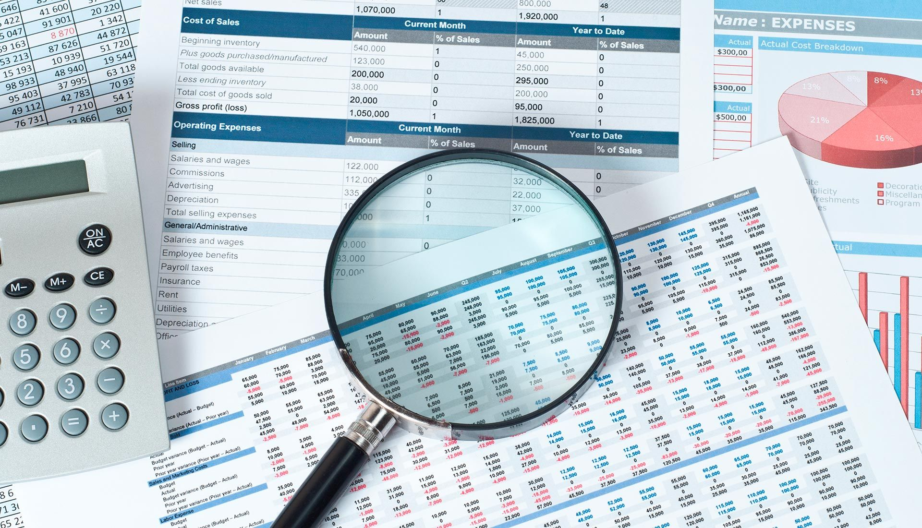
Notes:
Fundamental analysis the driver of the long/short world is concerned with the company and industry in part and whole. This is about key pieces of the company metrics, revenues, incomes, costs, key performance indicators and how they interact in the overall firm’s performance measures in share price. Commonly this is what we think of as investing at it’s ultimate practice we think of Warren Buffet and Value Investing … The data is what the company says and produces and all the context in between … think of this as people reading things

Slide 9
Notes:
What both quant and fundamental are trying to do is predict the future… That is the goal, you can vary the horizon but each is trying to make predictions based on the data available … we would call this modeling (quant) and orecasting (fundamental)

Slide 10
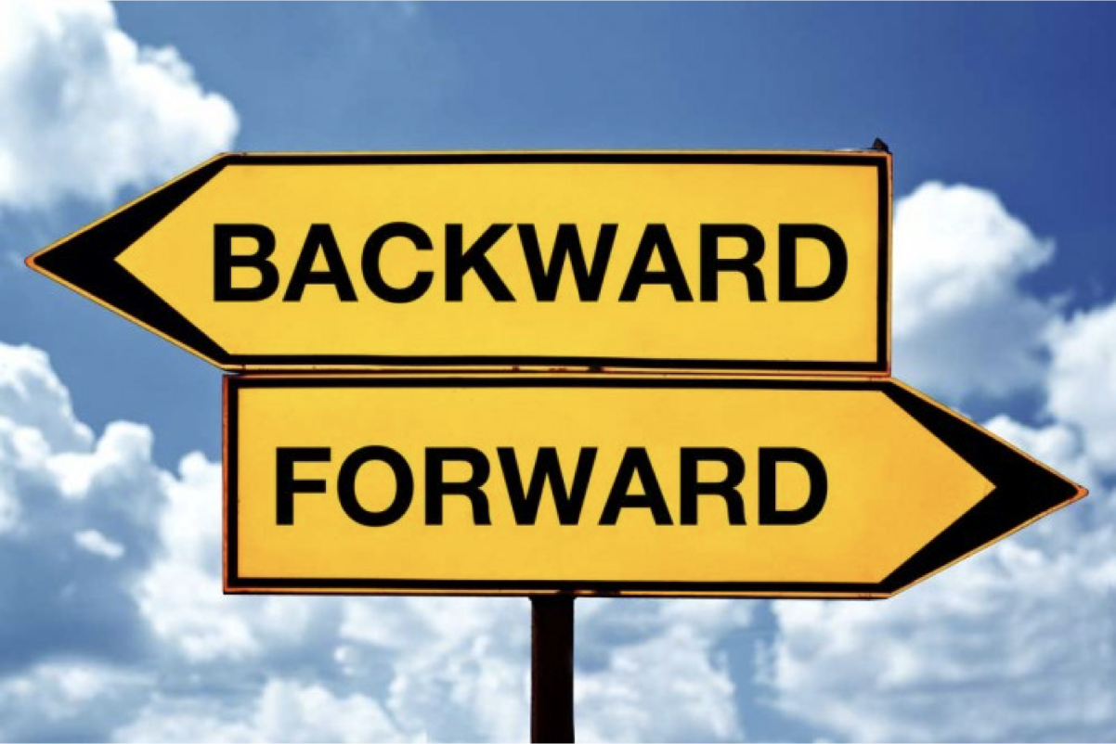
Notes:
But given the established sources of data .. Market data, company releases, industry data we have a problem …we are always looking forward but with backward data (it’s the only way you can) but the problem is with in the data and the cycle of analysis to create forecasts or models

Slide 11
COMPANY REPORTING CYCLE
Quarterly Data
Review
Release
Quarterly Data
Review
Release
Market
Reaction
Last Forecast
Lag
Forecast
FUND RESEARCH CYCLE
Notes:
This all depends on positioning an investment before the market reaction … Once the reaction happens the market is aware of the information. From the beginning of time people have looked for ways to gain insight (the edge) on the real time nature of the firm’s measures to position before the reaction. Insider information is the illegal case … collecting data on your own (analysts taking pictures of parking lots or watching ships unload)

Slide 12
Notes:
That problem is the time between collection and release of data leads to large mismatches and opportunities in investing. WAITING for data to imporve forecasts or models

Slide 13
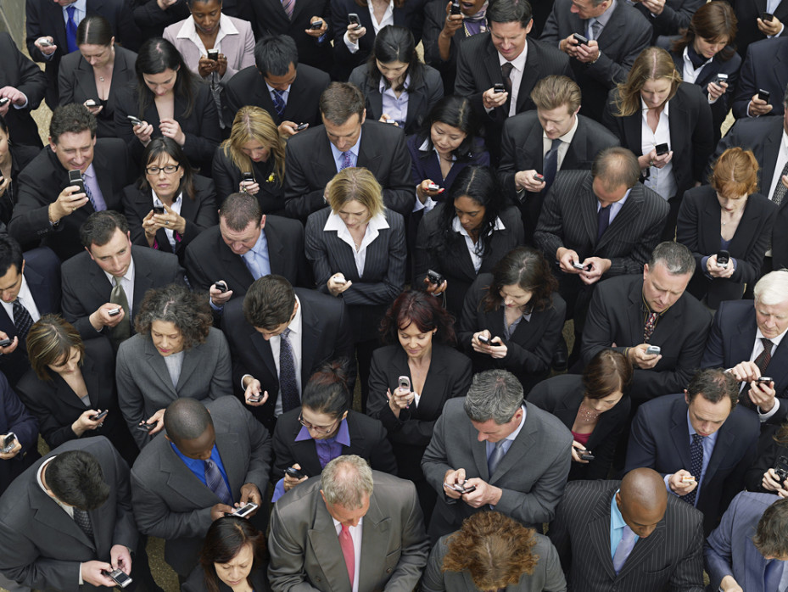
Notes:
WE, PEOPLE …are the engines of economic transactions… our activity shows up on incomes statements of companies .. Tracking us any way we can is the key.. And there are devices and applications that make this possible .. iphone anyone?

Slide 14
Notes:
The straw in our story is what is known as exhaust data… think of this as the data created from & as a byproduct of applications and devices .. Many of theses devices are capturing all types of economic activity.

Slide 15
Unstructured data is growing rapidly
This new “data” is used by many organizations for analytics and to make predictions
It’s quickly becoming the fastest spend within an organization
IDC: Rise in spending as companies expand their unstructured data and analytic activities growing 38.6% (CAGR)
IDG: Unstructured data is growing at the rate of 62% per year.
IDG: By 2022, 93% of all data in the digital universe was unstructured.
Gartner: Data volume is set to grow 800% over the next 5 years and 80% of it will reside as unstructured data.
Notes:
Documents, Video, Satellite, locations, IoT … all of these growing technologies are throwing off data at an incredible rate … it is becoming the raw material for both Quants and Fundamental funds alike. This data is as close to real-time (certainly better than waiting for the company to release it) and can be tested in respect to predictability. It can answer both short-term and depending on history, long-term questions.

Slide 16
COMPANY REPORTING CYCLE
Quarterly Data
Review
Release
Quarterly Data
Review
Release
Market
Reaction
Real-time Proxies
NowCasting
FUND RESEARCH CYCLE
Notes:
The key is to look for data that can proxy for the company measures … for example Netflix revs are based on subscribers – new, cancellations, and renewals along with usage. Data can be found from mobile devices identifying packet traffic, browser extensions and credit card transactions (billing) – That can be tested and tracked on a persistent basis. It is where we are headed … Companies provide the final benchmark … eps, income, revs, etc.. But others are distributing data that has predictive power on those company benchmarks

Slide 17
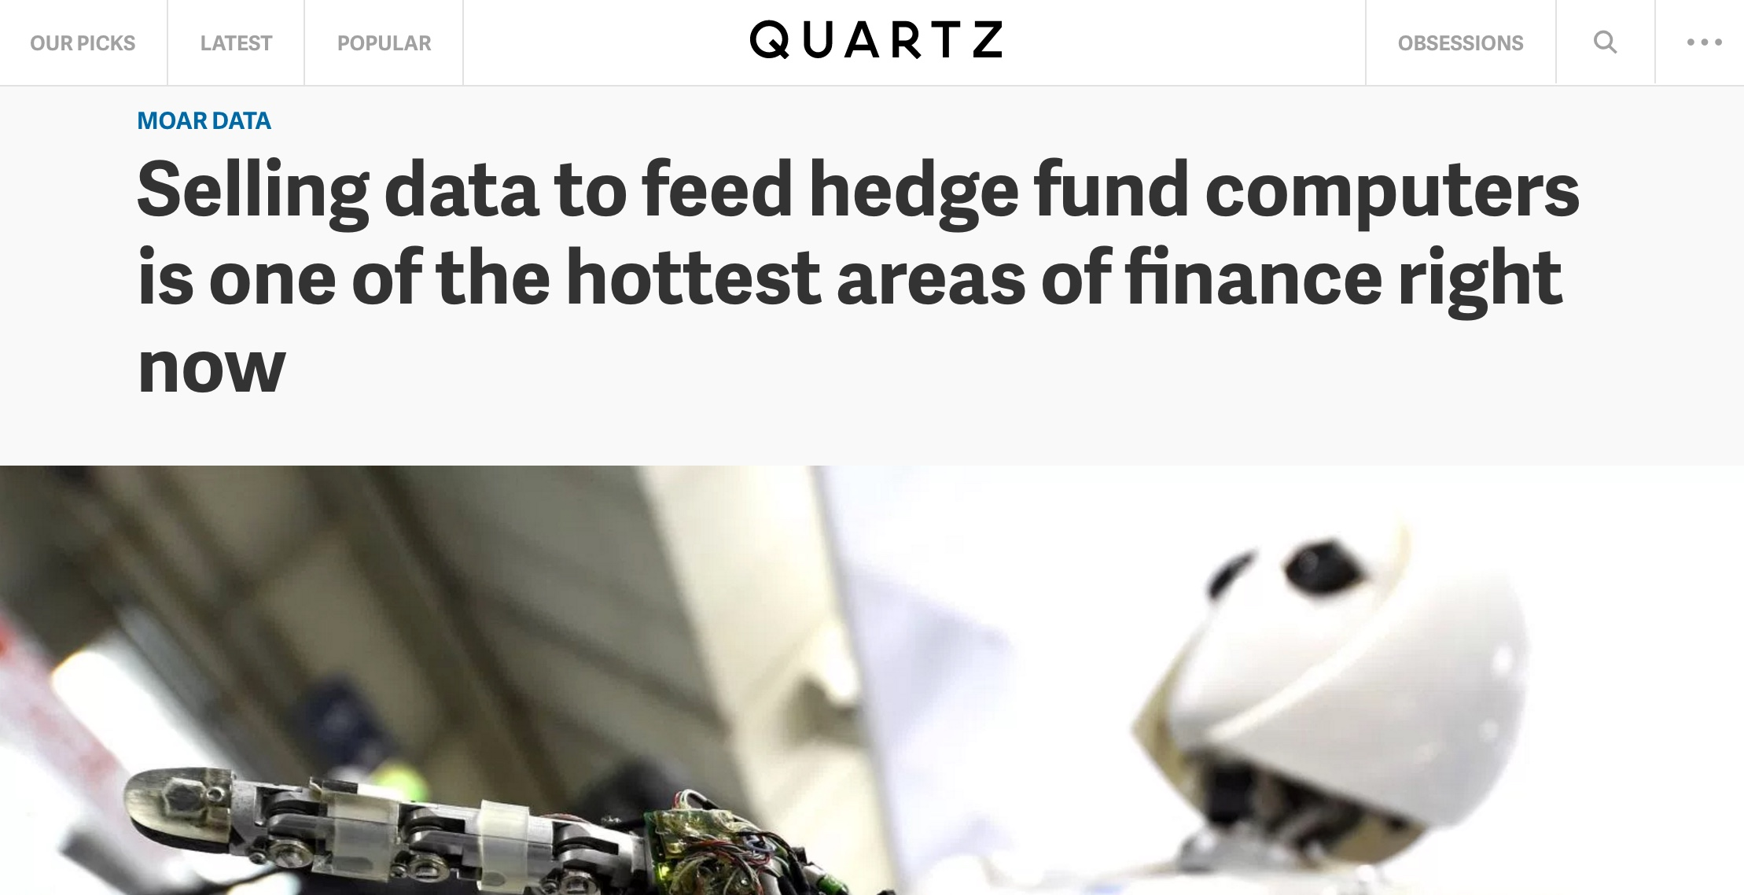
Notes:
Alternative Data … the race in on to find sources to proxy and add to current data and signals … You’ll hear more about this later in the program

Slide 18
Data management is the new pain point in every fund
Third Party Sources
Raw Data
Visualizations
Data Vendors
Reports & Predictions
Data Delivery
Data Analysts
Analytics
Evaluation
On-Board
Acquire
Data Scientists
Interpretive Research
Notes:
Because of this every fund that wants to stay alive is finding, evaluating and and using data from non-traditional sources … managing the data process for either quant or fundamental is a new pain point…

Slide 19
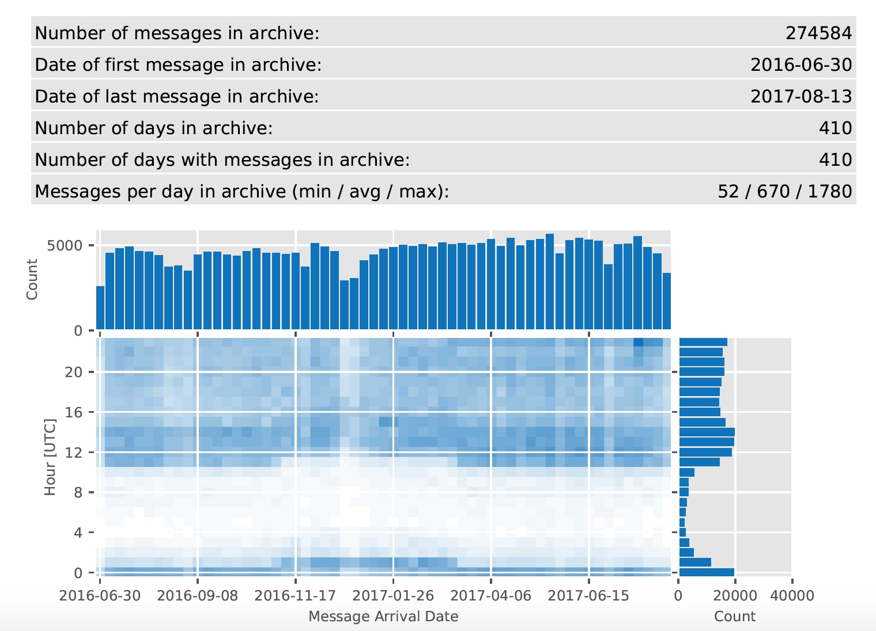
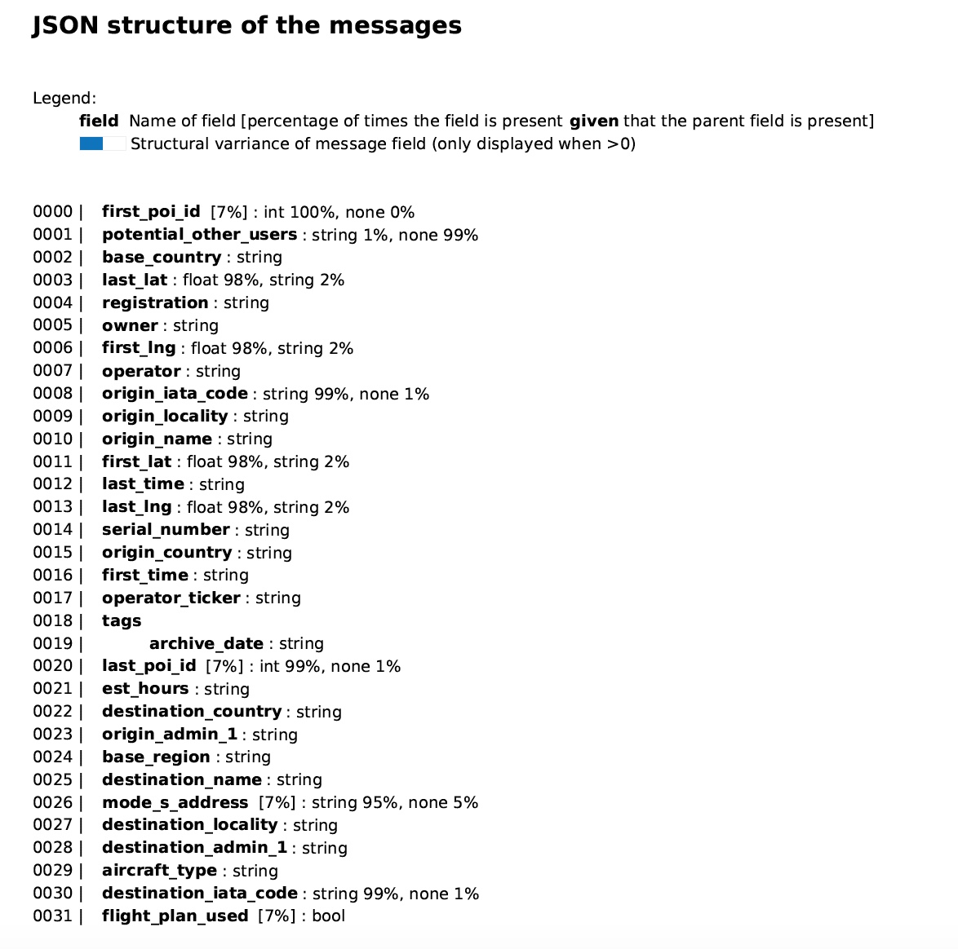
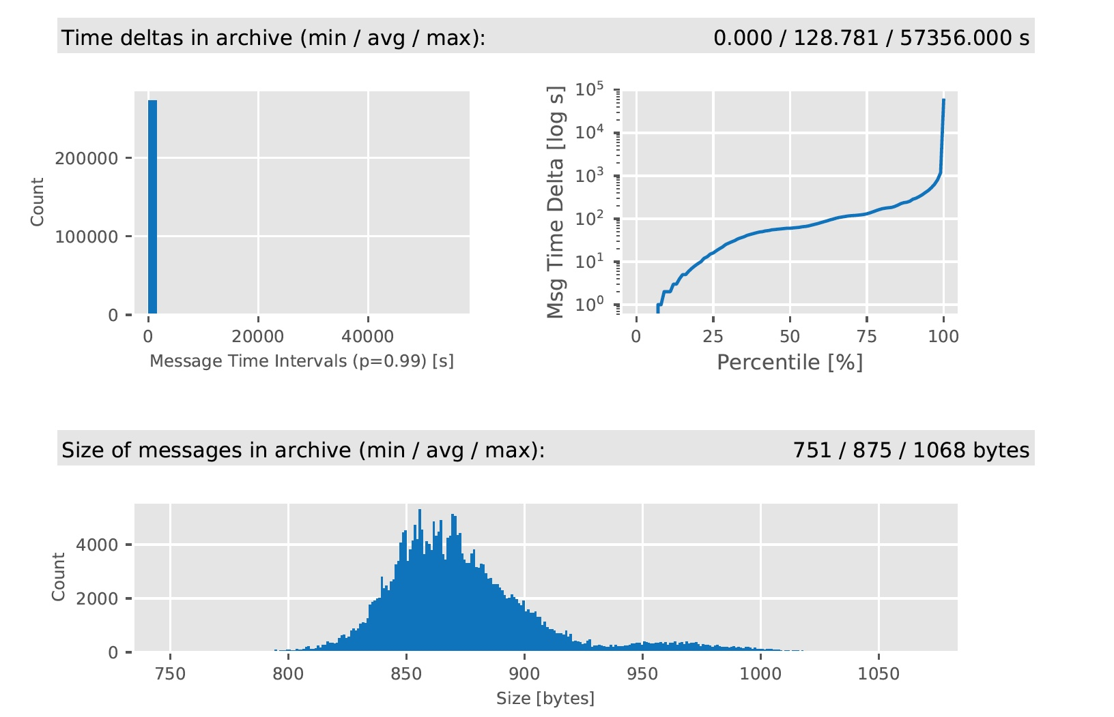
Notes:
Firms are thinking about data in new ways and are looking for ways to analyze it in mass --- to figure out it’s usefulness

Slide 20
“Because of styles people are separated. Research your own experience, absorb what is useful, reject what is useless, add what is essentially your own.”
Notes:
The rigid lines of Quant and fundamental are being blurred ... Bruce Lee as inspiration on the “style of no style” if the goal is winning use what helps you to win … If the goal is better predictions .. Then use what you need to make better predictions eliminate orthodoxy.

Slide 21
QUANTITATIVE
QUANT
AMENTAL
FUNDAMENTAL
DATA IS BRINGING THEM TOGETHER
Notes:
The new Yin & Yang of Investment research

Slide 22
“No man is better than a machine. No machine is better than a man with a machine.”
Data is the equalizer, from many sources and loads of it.
Notes:
Paul Tudor Jones … probably the poster boy of the hedge fund era (1980’s – 2008) embracing quantamental --- which is starting to be defined as Wo(Man) + Plus Machine

